Slide 1

A Voluntary Commitment to Collaborate to Prevent and Relieve Homelessness

Slide 2


Introduction to the Session and Ground Rules
Agenda
Aims
Process
Ground rules
Notes:
Introduce the session giving the aims of the day and letting participants know what will happen following the event:
We aim to discuss how we can collaborate to prevent and relieve homelessness, look at what we do now and what further activity can take place.
We’ll be focussing on what WE can do, not just issues in general.
We will create a number of pledges that we all agree on.
The discussions will be written up, shared and actions will be created and allocated.
Give the context of your own organisation and why the session is taking place.
Set out any ground rules at the start of the session including confidentiality, that all ideas will be considered equally, participation is voluntary and that all viewpoints will be respected.

Slide 3
Agenda
1. | An Introduction to the Positive Pathways Model | 10 Mins
2. | The Case Study | 15 Mins
3. | Session 1 – what is already in place | 30 Mins
4. | Session 2 – what are the gaps in provision? | 30 Mins
5. | Session 3 – what are the opportunities for improvement? | 30 Mins
6. | Session 4 – our pledges | 30 Mins
7. | Next steps – forming actions and feedback | 15 Mins
Notes:
The session is broken down into four clear stages.
1. What is already in place? 2. What gaps are there? 3. What more could we do and how can we fill those gaps? 4. What do we pledge to do following this session?
Incorporate breaks into the session as required

Slide 4
An Introduction to the Positive Pathways Model
Notes:
By working through the practical elements of this toolkit, we will be able to identify what actions can be taken to prevent and relieve homelessness at the earliest opportunity.
There is also an opportunity to consider who else we will need to collaborate with in order to make this happen; taking this as an opportunity to design homelessness prevention into services and systems.
Homelessness can feel like an unsolvable problem, but it isn’t. By working together and focussing on getting help to people before the point of crisis, we can make a real difference. Even small changes can add up, having a substantial and positive impact to prevent and relieve homelessness.
We’ll be basing the session around the Positive Pathways Model.

Slide 5
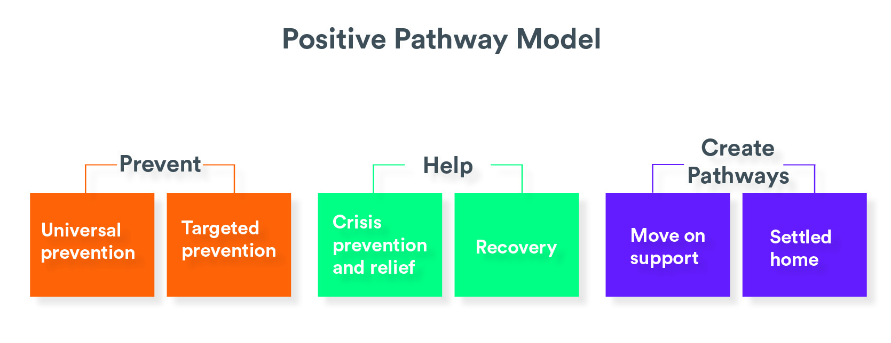
Notes:
The model; adapted for use by the WMCA Homelessness Taskforce and the C2C toolkit, helps to identify what is already being done to prevent homelessness, identify where the gaps are, and what might be done to address those gaps. Thus, underpinning a better understanding to enhance the protective factors within the universal prevention space and target homeless prevention at the earliest possible opportunity.
While it may appear linear, it is recognised that experience of life, especially in the occurrence of something like homelessness, is rarely straightforward. The model could in fact be conveyed as circular, reflecting that it is universal prevention that enables and maintains the status of a settled home.
Today’s discussions will use the six stages of the pathway highlighted here to underpin the session. The next slides will take you through those stages in more detail.

Slide 6
Stages of the Pathway
Heading | Definition
Universal Prevention | This is what prevents homelessness without having any directly perceived relationship to homelessness prevention. Those things in society and life that are protective factors. In health terms universal prevention is having fluoride in water, health advice to eat ‘five a day’, and immunisations; in homelessness terms it is those factors which support and protect – health, income, relationships, secure accommodation, amongst many others.
Targeted Prevention | This is provision or interventions which have a designed purpose in preventing homelessness or related issues. For example, housing advice, leaving care pathway, discretionary housing payments, bond schemes.
Notes:
Take the group through what each of the stages of the Positive Pathways Model mean.
When we’re discussing what we already do, what are the gaps and what more we can do, we’ll be working to these stages.
How can we move activity away from crisis and towards universal and targeted prevention?

Slide 7
Stages of the Pathway
Heading | Definition
Crisis Prevention | This is where homeless crisis is imminent or occurring, requiring emergency accommodation. The objective is for any crisis to be as brief and having as small an impact as possible. For example, the experience of temporary accommodation, hostel accommodation or rough sleeping.
Recovery | This is the work required in re-establishing the protections against homelessness and often dealing with the causes and impact of homelessness. This may include financial, health, relationship, rebuilding.
Notes:
Take the group through what each of the stages of the Positive Pathways Model mean.
Use this slide to focus on crisis and how easy it is to arrive there.
How can we move away from crisis and into the universal prevention space? This is a major aspect of today’s session.

Slide 8
Stages of the Pathway
Heading | Definition
Move-On Support | This is what is required for the physical, emotional and cognitive moving on from a homelessness experience. For example, it may be very practical matters like the logistics of moving, or the emotional support to deal with change and challenges.
Settled Home | This is attaining the desired state of protection against homelessness, the re-established factors being in place, while also clearly requiring the access to affordable, secure accommodation.
Notes:
Take the group through what each of the stages of the Positive Pathways Model mean.
Even after crisis has been alleviated, without the support to move-on and create a settled home, people can easily slip back into crisis.

Slide 9
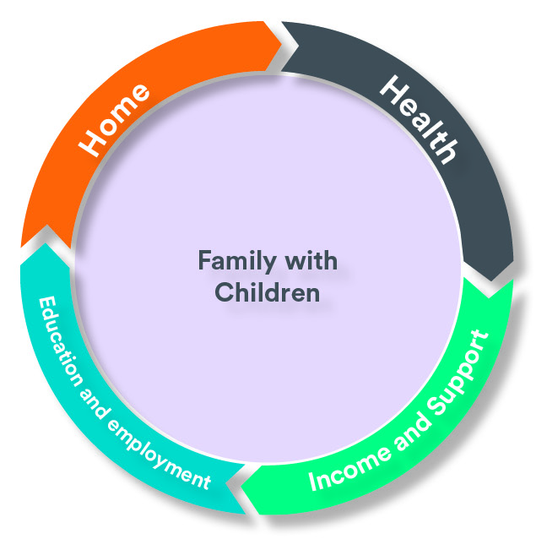
Risk
Protective
Gate-kept services with limited access
Homeless- TA compounds risks; inadequate move on supply; reluctance to let to benefit recipients
Safe, affordable accommodation, appropriate size and location underpins learning, work and community
Generic approaches
Lack of options
Physical and mental ill health; ‘reason to believe’ burden of proof on women; inability to reach thresholds of assistance
Timely access to health services including mental health for all the family; DVA specialist
Increased social and financial cost to all
Re-traumatising experiences
Challenges accessing schools; difficulty sustaining employment; unaffordable childcare
Flexible approach to school enrolment; support structure in schools; pathway to employment
Single gateway to tailored holistic family support, income and accommodation
Prevention and early help
No independent income; delayed UC payments; debt; absolute poverty; inadequate support
Integrated accessible services
Breaking the cycle
Process which serves purpose
Secure accommodation; healthy relationships; specialist DVA support for the whole family
Ending of TA/Assured short hold tenancy; domestic abuse
Reduced social and financial cost to all
Inclusion
Affordable supply
Tackle welfare related poverty
Good employment
Info advice guidance
Integrated Prevention
Notes:
Take the group through the slide, highlighting the impact homelessness has in a number of areas.
Go through the areas of risk and the protective factors in the image.
Pick out where your organisation falls and the need for collaboration.
Introduce the cyclical nature of homelessness.
When in the roundtable discussions, consider how the cycle can be broken – as seen in the lower-right image.

Slide 10
The Case Study
Time to examine the case study
Review how we could impact on this person’s journey
We’ll be going through the case study looking at what support we already provide, what we could be doing more of and our opportunities to improve the support highlighted in this case study.
Notes:
YOUR CASE STUDY HERE
Run through the case study that you are using for the discussion.
Consider breaking the group into pairs to work through the case study.

Slide 11
Session 1 – What do we already do, and is currently in place, to prevent and relieve homelessness?
30 minutes to discuss what we do now to keep people included – focus on the situation highlighted within the case study
Use the suggested questions to prompt discussions
State which category the intervention falls into and mark it on the template (universal, targeted, etc.)
Give thought to how activity can be moved from the crisis prevention & relief space towards the universal prevention space. Are there things that could be put in place to move things upstream, away from crisis, as much as possible?
Notes:
Use the discussion checklist and example questions from the toolkit to prompt questions and discussions.
Use the case study to shape your discussions:
What do we already know is happening? How has our organisation affected the person in this case study?
What support are we already providing that came across in the case study?
Could we be doing MORE of it?
Who could we collaborate with to improve what is already there?
What category does each intervention fall into – Universal Prevention through to Settled Home?
Ensure all of the points are documented.
Allow time to feed back the key points.
Keep to the allocated time.

Slide 12
What are we already doing?
What do we already do, and is currently in place, to prevent and relieve homelessness? | U | T | C | R | M | S

Slide 13
Session 2 – What are the gaps in our provision or service to prevent and relieve homelessness?
30 minutes to discuss what are the gaps highlighted within the case study
Use the suggested questions to start discussions
State which category the intervention falls into and mark it on the template (universal, targeted, etc)
Give thought to how activity can be moved from the crisis prevention & relief space towards the universal prevention space. Are there things that could be put in place to move things upstream, away from crisis, as much as possible?
Notes:
In session 1 we discussed what’s already in place in the case study, and some gaps probably came up during that discussion. Now is the time to go through them in more detail.
Use the discussion checklist and example questions from the toolkit to prompt questions and discussions:
What gaps within our provision are evident in this case study?
What is missing that would have an effect on this person's situation?
Who could we collaborate with to help close those gaps?
What category does each intervention fall into – Universal Prevention through to Settled Home?
Ensure all of the points are documented.
Allow time to feed back the key points.
Keep to the allocated time.

Slide 14
What are our gaps in provision?
What are the gaps in our provision or service to prevent and relieve homelessness? | U | T | C | R | M | S

Slide 15
Session 3 – What are the opportunities for us to do more to prevent and relieve homelessness?
30 minutes to discuss what are our opportunities to improve provision for the person/people highlighted within the case study
Use the suggested questions to start discussions
State which category the intervention falls into and mark it on the template (universal, targeted, etc.)
Give thought to how activity can be moved from the crisis prevention & relief space towards the universal prevention space. Are there things that could be put in place to move things upstream, away from crisis, as much as possible?
Notes:
We’ve now discussed what we already have in place, and the gaps in our provision, so further opportunities for us to do more probably came up during the previous discussion. Now is the time to go through them in more detail.
Use the discussion checklist and example questions from the toolkit to prompt questions and discussions:
What are our opportunities to improve provision for the support of this person?
What more could we be doing that would have an effect on this person’s situation?
Who could we collaborate with to maximise the opportunities for improvement?
What category does each intervention fall into – Universal Prevention through to Settled Home?
Ensure all of the points are documented.
Allow time to feed back the key points.
Keep to the allocated time.

Slide 16
What are the opportunities for us to do more ?
What are the opportunities for us to do more to prevent and relieve homelessness? | U | T | C | R | M | S

Slide 17
Session 4
30 minutes to discuss and finalise our pledges
Use the template to record the pledges
How can today’s discussions become pledges?
What are we going to change? What are we going to do?
These pledges will become actions following the session!
Notes:
From the three sessions we’ve gone through, what do we pledge to do from now on?
What suggestions from Session 1 can we pledge to do more of?
What gaps from Session 2 can we pledge to fill?
What opportunities from Session 3 can we pledge to take forward?
Use the example completed pledges in the toolkit to prompt discussions.

Slide 18
Our commitment to collaborate to prevent and relieve homelessness
Universal prevention | Targeted Prevention | Crisis Prevention and Relief | Recovery | Move On Support | Settled Home

Slide 19

Next steps – Forming Actions and Feedback
The discussion logs and pledges will be used to form actions
The actions will be fed back to all participants
The completed pledges and actions will be submitted to WMCA for award of the C2C logo
Thank you for your participation and pledging to C2C

