Slide 1
COMP 3322-P01
Software Engineering
Chapter 3
Agile Software Development
Fall 2026
Prairie View A&M University
Computer Science
Mohammed Ayyat, Ph. D.

Slide 2
Learning Objectives
3.1 Agile methods
3.2 Agile development techniques
3.3 Agile project management
3.4 Scaling agile methods

Slide 3
Rapid Software Development
Rapid development and delivery is now often the most important requirement for software systems
Plan-driven development is essential for some types of system but does not meet these business needs.
Agile development methods emerged in the late 1990s whose aim was to radically reduce the delivery time for working software systems
Notes:
Plan-driven – heavy-weight, long time of development, geographically dispersed teams,
Government system, aircraft control system…

Slide 4
Agile Development
Program specification, design and implementation are inter-leaved
The system is developed as a series of versions or increments with stakeholders involved in version specification and evaluation
Frequent delivery of new versions for evaluation
Extensive tool support (e.g. automated testing tools) used to support development.
Minimal documentation – focus on working code

Slide 5
Plan-Driven and Agile Development (1 of 2)

Slide 6
Plan-Driven and Agile Development(2 of 2)
Plan-driven development
  Separate development stages with the outputs to be produced at each of these stages planned in advance.
  Iteration occurs within activities.
Agile development
  Specification, design, implementation and testing are inter-leaved and the outputs from the development process are decided through a process of negotiation during the software development process.

Slide 7
Agile Methods
Based on the dissatisfaction with the overheads of software design methods of the 1980s and 1990s
  Focus on the code rather than the design
  Based on an iterative approach to software development
  Intended to deliver working software quickly and evolve this quickly to meet changing requirements.
Aim is to reduce overheads in the software process (e.g. by limiting documentation) and to be able to respond quickly to changing requirements without excessive rework.

Slide 8
Agile Manifesto
Value:
  Individuals and interactions over processes and tools
  Working software over comprehensive documentation
  Customer collaboration over contract negotiation
  Responding to change over following a plan
  Visit -- https://agilemanifesto.org/

Slide 9
The Principles of Agile Methods
Principle | Description
Customer involvement | Customers should be closely involved throughout the development process. Their role is provide and prioritize new system requirements and to evaluate the iterations of the system.
Incremental delivery | The software is developed in increments with the customer specifying the requirements to be included in each increment.
People not process | The skills of the development team should be recognized and exploited. Team members should be left to develop their own ways of working without prescriptive processes.
Embrace change | Expect the system requirements to change and so design the system to accommodate these changes.
Maintain simplicity | Focus on simplicity in both the software being developed and in the development process. Wherever possible, actively work to eliminate complexity from the system.

Slide 10
Agile Method Applicability
Developing a small or medium-sized product for sale
Clear commitment from the customer to become involved in the development process
Few external rules and regulations that affect the software
Notes:
Bridge building vs. mobile app
Use Plan-Driven When:
Requirements are stable and well understood
System is safety-critical (medical, avionics, nuclear)
Strong regulatory and documentation requirements
Use Agile When:
Requirements are uncertain or changing
Product is user-facing
Need fast delivery and feedback

Slide 11
Agile Development Techniques

Slide 12
Extreme Programming (XP)
A very influential agile method, developed in the late 1990s
X P takes an ‘extreme’ approach to iterative development.
  New versions may be built several times per day
  Increments are delivered to customers every 2 weeks
  All tests must be run for every build and the build is only accepted if tests run successfully
Notes:
Kent Beck – 1999 Crysler comprehensive compensation system (C3 system)

Slide 13
The Extreme Programming Release Cycle

Slide 14
Extreme Programming Practices (a)
Principle or practice | Description
Incremental planning | Requirements are recorded on story cards and the stories to be included in a release are determined by the time available and their relative priority. The developers break these stories into development ‘Tasks’.
Small releases | The minimal useful set of functionality that provides business value is developed first. Releases of the system are frequent and incrementally add functionality to the first release.
Simple design | Enough design is carried out to meet the current requirements and no more.
Test-first development | An automated unit test framework is used to write tests for a new piece of functionality before that functionality itself is implemented.
Refactoring | All developers are expected to refactor the code continuously as soon as possible code improvements are found. This keeps the code simple and maintainable.

Slide 15
Extreme Programming Practices (b)
Pair programming | Developers work in pairs, checking each other’s work and providing the support to always do a good job.
Collective ownership | The pairs of developers work on all areas of the system, so that no islands of expertise develop, and all the developers take responsibility for all of the code. Anyone can change anything.
Continuous integration | As soon as the work on a task is complete, it is integrated into the whole system. After any such integration, all the unit tests in the system must pass.
Sustainable pace | Large amounts of overtime are not considered acceptable as the net effect is often to reduce code quality and medium-term productivity
On-site customer | A representative of the system’s end-user (the customer) should be available full-time for the use of the XP team. In an extreme programming process, the customer is a member of the development team and is responsible for bringing system requirements to the team for implementation.

Slide 16
X P and Agile Principles
Incremental development is supported through small, frequent system releases.
Customer involvement means full-time customer engagement with the team.
People, not process through pair programming, collective ownership and a process that avoids long working hours.
Change supported through regular system releases.
Maintaining simplicity through constant refactoring of code.

Slide 17
Influential X P Practices
Extreme programming has a technical focus and is not easy to integrate with management practice in most organizations.
Consequently, while agile development uses practices from XP, the method as originally defined is not widely used.
Key practices
  User stories for specification
  Refactoring
  Test-first development
  Pair programming

Slide 18
Pair Programming (1 of 2)
programmers working in pairs, developing code together.
develops common ownership of code and spread knowledge across the team.
serves as an informal review process as each line of code is looked at by more than 1 person.
encourages refactoring as the whole team can benefit from improving the system code.

Slide 19
Pair Programming (2 of 2)
programmers sit together at the same computer to develop the software.
pairs are created dynamically so that all team members work with each other during the development process.
sharing of knowledge that happens during pair programming is very important. Reduces the overall risks to a project when team members leave.
pair working together is more efficient than 2 programmers working separately.

Slide 20
User Stories for Requirements
In XP, a customer or user is part of the XP team and is responsible for making decisions on requirements.
User requirements are expressed as user stories or scenarios.
Written on cards and the development team breaks them down into implementation tasks. These tasks are the basis of schedule and cost estimates.
The customer chooses the stories for inclusion in the next release based on their priorities and the schedule estimates.
Notes:
Imagine one strong horse pulling a heavy wagon.
Alone, the horse can pull 1,000 pounds.
Now add a second horse of equal strength. Intuitively, you might expect the wagon to carry 2,000 pounds.
But when the two horses are trained to work together, they can often pull 2,500–3,000 pounds.
They coordinate their pace
They balance the load
They reduce wasted effort
They maintain momentum more efficiently

Slide 21
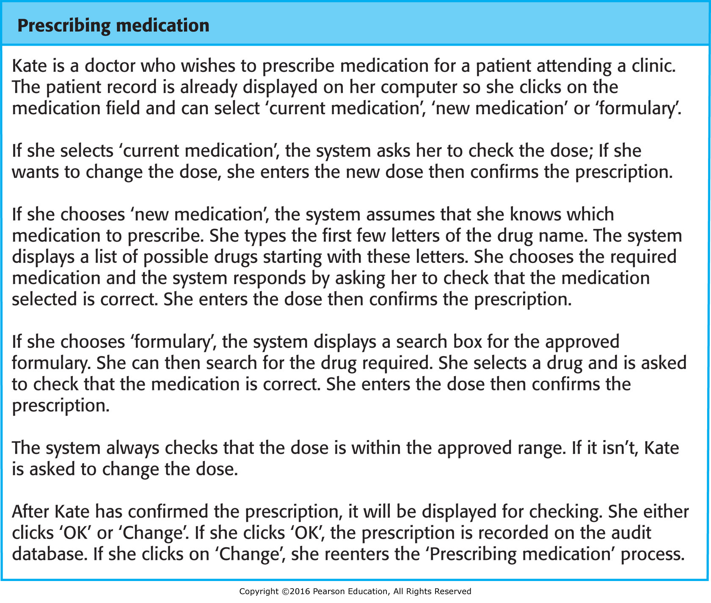
A “Prescribing Medication” Story

Slide 22
Examples of Task Cards for Prescribing Medication

Slide 23
Refactoring (1 of 2)
Conventional wisdom in software engineering is to design for change. It is worth spending time and effort anticipating changes as this reduces costs later in the life cycle.
X P, however, maintains that this is not worthwhile as changes cannot be reliably anticipated.
Rather, it proposes constant code improvement (refactoring) to make changes easier when they have to be implemented.

Slide 24
Refactoring (2 of 2)
Look for possible software improvements and make these improvements even where there is no immediate need for them.
Improve the understandability of the software and reduce the need for documentation.
Changes are easier to make because the code is well-structured and clear.
However, some changes require architecture refactoring and this is much more expensive.

Slide 25
Examples of Refactoring
Re-organization of a class hierarchy to remove duplicate code.
Tidying up and renaming attributes and methods to make them easier to understand.
The replacement of inline code with calls to methods that have been included in a program library.

Slide 26
Refactoring Example
class PizzaDelivery {
// ...
int getRating() {
return moreThanFiveLateDeliveries() ? 2 : 1;
}
boolean moreThanFiveLateDeliveries() {
return numberOfLateDeliveries > 5;
}
}
class PizzaDelivery {
// ...
int getRating() {
return numberOfLateDeliveries > 5 ? 2 : 1;
}
}
When a method body is more obvious than the method itself, use this technique.
Replace calls to the method with the method’s content and delete the method itself.

Slide 27
Test-first Development
Program is tested after every change has been made.
X P testing features:
  Test-first development.
  Incremental test development from scenarios.
  User involvement in test development and validation.
  Run all component tests each time a new release is built.

Slide 28
Test-Driven Development
Writing tests before code clarifies the requirements to be implemented.
Tests are written as programs that can be executed automatically.
Include a check that is executed correctly.
  Usually relies on a testing framework such as Junit.
All previous and new tests are run automatically when new functionality is added, thus checking that the new functionality has not introduced errors.

Slide 29
Customer Involvement
help develop acceptance tests for the stories that are to be implemented in the next release of the system.
writes tests as development proceeds. All new code is therefore validated to ensure that it is what the customer needs.
have limited time available and so cannot work full-time with the development team. Being reluctant to get involved in the testing process.

Slide 30
Test Case Description for Dose Checking

Slide 31
Problems with Test-First Development
Programmers prefer programming to testing and sometimes they take shortcuts when writing tests. They may write incomplete tests that do not check for all possible exceptions that may occur.
Some tests can be very difficult to write incrementally. For example, in a complex user interface, it is often difficult to write unit tests for the code that implements the ‘display logic’ and workflow between screens.
It is difficult to judge the completeness of a set of tests. Although you may have a lot of system tests, your test set may not provide complete coverage.

