Slide 1

Chapter 3::
Names, Scopes, and Bindings
Programming Language Pragmatics, Fourth Edition
Michael L. Scott

Slide 2
Name, Scope, and Binding
A name is exactly what you think it is
  Most names are identifiers
  symbols (like '+') can also be names
A binding is an association between two things, such as a name and the thing it names
The scope of a binding is the part of the program (textually)in which the binding is active

Slide 3
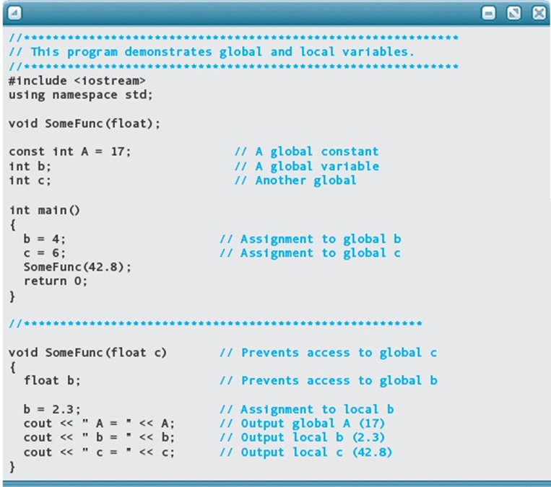
Name, Scope, and Binding

Slide 4
Binding
The terms STATIC and DYNAMIC are generally used to refer to things bound before run time and at run time, respectively

Slide 5
Binding
In general, early binding times are associated with greater efficiency
Later binding times are associated with greater flexibility
Compiled languages tend to have early binding times
Interpreted languages tend to have later binding times

Slide 6
Scope
Scope Rules - control bindings
  Fundamental to all programming languages is the ability to name data, i.e., to refer to data using symbolic identifiers rather than addresses
  Not all data is named! For example, dynamic storage in C or Pascal is referenced by pointers, not names

Slide 7
Lifetime and Storage Management
Key events
  creation of objects
  creation of bindings
  references to variables (which use bindings)
  (temporary) deactivation of bindings
  reactivation of bindings
  destruction of bindings
  destruction of objects

Slide 8
#include <iostream>
using namespace std;
void SampleFunc();
int main() {
// Write C++ code here
int temp;
temp = 10;
cout << "temp before Sampfunc: " << temp << endl;
SampleFunc();
cout << "temp after Sampfunc: " << temp << endl;
return 0;
}
void SampleFunc(){
int temp;
temp = 20;
cout << "temp in Sampfunc: " << temp << endl;
}

Slide 9
Lifetime and Storage Management
The period of time from creation to destruction is called the LIFETIME of a binding
  If object outlives binding it's garbage
  If binding outlives object it's a dangling reference
The textual region of the program in which the binding is active is its scope
The complete set of bindings in effect at a given point in a program is know as the current reference environment.

Slide 10
#include <iostream>
using namespace std;
int main() {
int* ptr;
ptr = new int(20); // Dynamically allocated memory
ptr = new int(40);
cout << *ptr;// Forgot to delete ptr for 20, causing a memory leak
return 0;
}
#include <iostream>
using namespace std;
int main() {
int* ptr = new int(100);
cout << *ptr << std::endl;
delete ptr; // Memory is freed, but ptr is not reset
cout << *ptr << std::endl; // Undefined behavior (dangling pointer)
return 0;
}

Slide 11
Lifetime and Storage Management
Storage Allocation mechanisms
–Static
–Stack
–Heap
Static allocation for
–code
–globals
–static or own variables
–explicit constants (including strings, sets, etc)
Copyright © 2009 Elsevier

Slide 12
Lifetime and Storage Management
Central stack for
–parameters
–local variables
–temporaries
Why a stack?
–allocate space for recursive routines
(not necessary in FORTRAN – no recursion)
–reuse space
(in all programming languages)
Also, each instance of subroutine, has its own frame
Copyright © 2009 Elsevier

Slide 13
Lifetime and Storage Management
Contents of a stack frame (cf., Figure 3.1)
  arguments and returns
  local variables
  temporaries
  bookkeeping (saved registers, line number static link, etc.)

Slide 14
Lifetime and Storage Management
Maintenance of stack is responsibility of calling sequence and subroutine prologue (code executed at the beginning) and epilogue (code executed at the end)

Slide 15
Lifetime and Storage Management
the compiler can arrange (in the calling sequence or prologue) for a particular register, known as the frame pointer to always point to a known location within the frame of the current subroutine.
the stack pointer (sp) points to the first unused location on the stack (or the last used location on some machines).
Local variables and arguments are assigned fixed OFFSETS from the stack pointer or frame pointer at compile time.

Slide 16
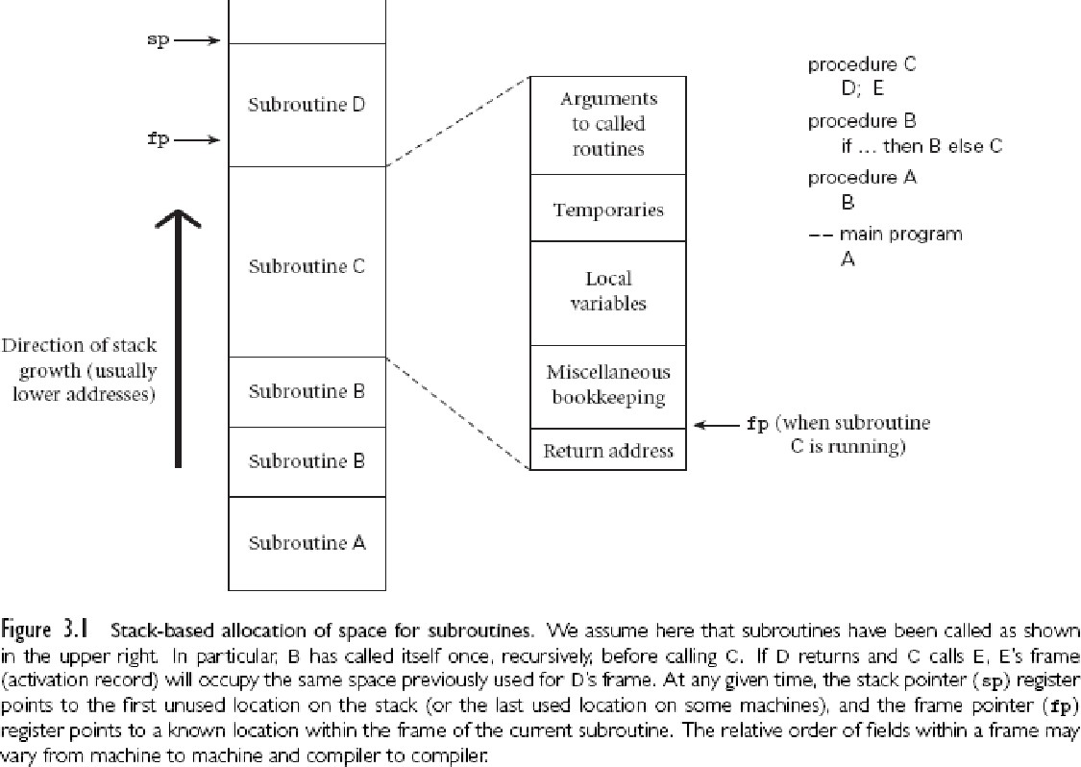
Lifetime and Storage Management
In programming, a subroutine (also known as a function, procedure, method, or routine) is a sequence of program instructions that perform a specific task, packaged as a unit. This unit can then be used in programs wherever that particular task should be performed.

Slide 17
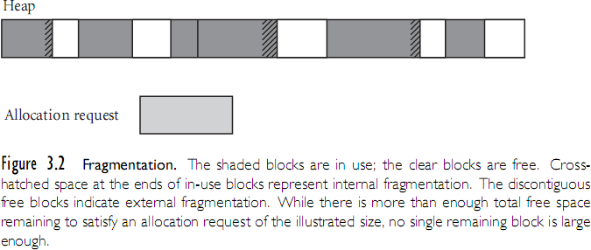
Lifetime and Storage Management
Heap for dynamic allocation
When memory needs to be manually managed for dynamic structures

Slide 18
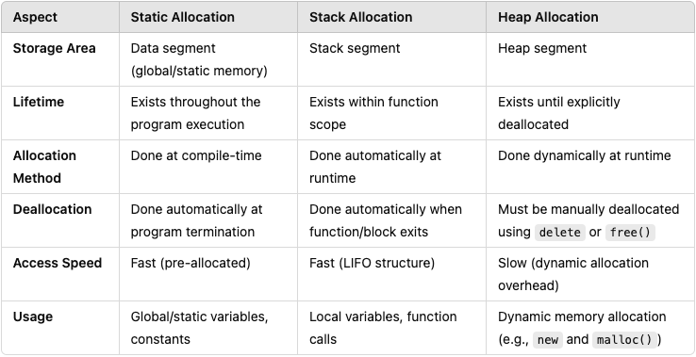
Static, Stack and Heap Allocation

Slide 19
EX1
If each char is 1 byte. How many space required for the following piece of code if we use stack memory allocation?
{char a, b;
{char c, d;
{char a, e;
}
}
{char f, g, h;
}
}

Slide 20
Scope Rules
A scope is a program section of maximal size in which no bindings change, or at least in which no re-declarations are permitted (see below)
In most languages with subroutines, we OPEN a new scope on subroutine entry
  create bindings for new local variables,
  deactivate bindings for global variables that are re- declared (these variable are said to have a "hole" in their scope)
  make references to variables

Slide 21
Scope Rules
On subroutine exit:
  destroy bindings for local variables
  reactivate bindings for global variables that were deactivated

Slide 22
Scope Rules
With STATIC (LEXICAL) SCOPE RULES, a scope is defined in terms of the physical (lexical) structure of the program
  The determination of scopes can be made by the compiler
  All bindings for identifiers can be resolved by examining the program
  Typically, we choose the most recent, active binding made
at compile time
  Most compiled languages, C and Pascal included, employ static scope rules

Slide 23
Scope Rules
The classical example of static scope rules is the most closely nested rule used in block structured languages
  An identifier is known in the scope in which it is declared and in each enclosed scope, unless it is re-declared in an enclosed scope
  To resolve a reference to an identifier, we examine the local scope and statically enclosing scopes until a binding is found

Slide 24
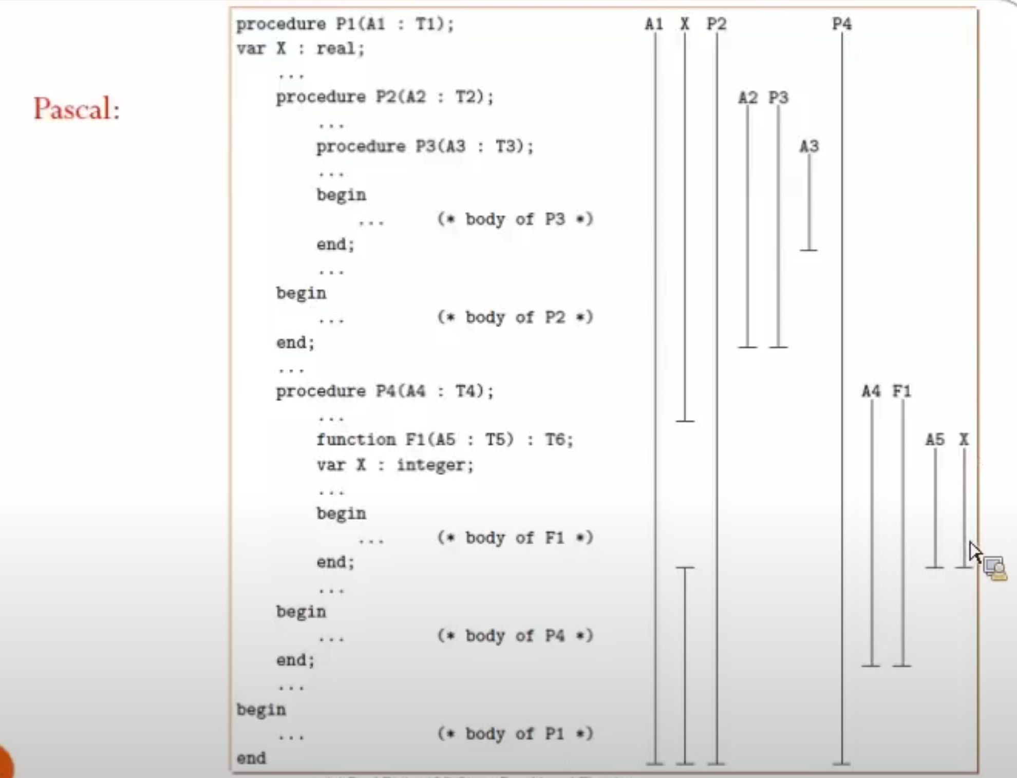

Slide 25
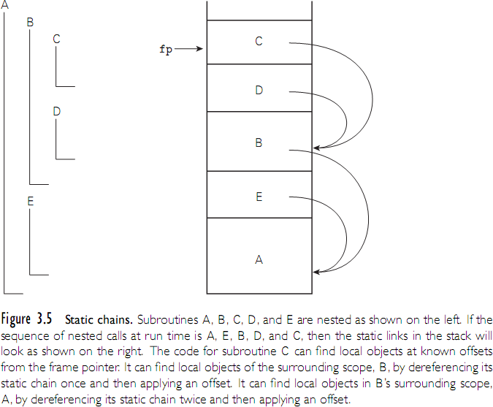
Scope Rules

Slide 26
Example of static scope (Python):
x = 10 # Global variable
def outer():
x = 20 # Outer function variable
def inner():
print(x) # Refers to x in the outer function (lexical scope)
inner()
outer() # Output: 20

Slide 27
Example of static scope (Python):
x = 10 # Global variable
def inner():
print(x) # Refers to x in global (lexical scope)
def outer():
x = 20 # Outer function variable
inner()
inner() # output: 10
outer() # Output: 10

Slide 28
Example of static scope (C++):
#include <iostream>
using namespace std;
int main() {
int a = 1;
int b = 2;
int c = 3;
for (int i = 0; i < 1; i++) {
int a = 11;
cout << "block 1: " << endl;
cout << "a = " << a << endl;
cout << "b = " << b << endl;
cout << "c = " << c << endl;
for (int i = 0; i < 1; i++) {
int b = 21;
cout << "block 2: " << endl;
cout << "a = " << a << endl;
cout << "b = " << b << endl;
cout << "c = " << c << endl;
}
for (int i = 0; i < 1; i++) {
int b = 21;
cout << "block 3: " << endl;
cout << "a = " << a << endl;
cout << "b = " << b << endl;
cout << "c = " << c << endl;
}
}
cout << "block 0: " << endl;
cout << "a = " << a << endl;
cout << "b = " << b << endl;
cout << "c = " << c << endl;
}

Slide 29
Scope Rules
Note that the bindings created in a subroutine are destroyed at subroutine exit
  The modules of Modula, Ada, etc., give you closed scopes without the limited lifetime
  Bindings to variables declared in a module are inactive outside the module, not destroyed
  The same sort of effect can be achieved in many languages with own (Algol term) or static (C term) variables (see Figure 3.5)

Slide 30
Scope Rules
Access to non-local variables STATIC LINKS
  Each frame points to the frame of the (correct instance of) the routine inside which it was declared
  In the absence of formal subroutines, correct means closest to the top of the stack
  You access a variable in a scope k levels out by following k static links and then using the known offset within the frame thus found

Slide 31
EX2
procedure main()
x : integer = 1
B(3)
procedure B(a : integer)
x : integer = 8
A(a+1)
procedure A(n : integer)
x: integer = 5
R(1)
procedure R(m : integer)
write integer(x)
x := m + m
write integer(x)
write integer(x)
What does this program print if using static scope?
Explain how R finds x.

Slide 32
Scope Rules
The key idea in static scope rules is that bindings are defined by the physical (lexical) structure of the program.
With dynamic scope rules, bindings depend on the current state of program execution
  They cannot always be resolved by examining the program because they are dependent on calling sequences
  To resolve a reference, we use the most recent, active binding made at run time

Slide 33
Scope Rules
Dynamic scope rules are usually encountered in interpreted languages
– early LISP dialects assumed dynamic scope rules.
Such languages do not normally have type checking at compile time because type determination isn't always possible when dynamic scope rules are in effect

Slide 34
What if using dynamic scope?
x = 10 # Global variable
def inner():
print(x) # Refers to x in global (lexical scope)
def outer():
x = 20 # Outer function variable
inner()
inner() # output: 10
outer() # Output: 20
This illustrates how dynamic scoping can lead to different outcomes based on the call context, which can increase flexibility but also complexity and potential for bugs.

Slide 35
Scope Rules
Example: Static vs. Dynamic
Dynamic scope is dangerous?
int temp = 0;
void foo(){
void boo () {
int temp = 10;
bvz();
print temp;
}
void goo(){
int temp = 5;
bvz(); //(boo())
}
void bvz() {
temp = 6;
}
goo();
print temp;
}
var = 10 # Global variable
def foo():
print(var) # Variable 'var' is dynamically resolved
def bar():
var = 20 # This 'var' is not local; it affects 'foo'
foo()
foo()
bar()

Slide 36
Shallow Binding VS Deep Binding
In programming languages that use dynamic scoping, the concepts of shallow binding and deep binding relate to how the environment in which variable bindings are resolved is determined at runtime.
These concepts come into play particularly in the context of functions and their use of non-local variables (variables that are not local to the function itself but are accessed from a surrounding scope).

Slide 37
Shallow Binding VS Deep Binding
Shallow binding links a variable reference to the most recent activation of the variable in the dynamic environment.
Deep binding links a variable reference to the environment (activation record) in which the function was defined.

Slide 38
EX3
x: integer := 3
y: integer := 4
procedure add
x:= x+y
write_integer(x)
procedure second (P: procedure)
x: integer := 5
p()
procedure first
y : integer := 6
second(add)
first()
What does this program print if the language uses static scoping?
(b) What does it print if the language uses dynamic scoping with deep binding?
(c) What does it print if the language uses dynamic scoping with shallow binding?

Slide 39
Non-local variables
C:
Global variables
C++ (in a method):
Method
  Enclosing class
  Super class
  Global
Java:
Method in inner class
  Enclosing inner class
  Super class for the inner class
  Outer class
  Super class for the outer class
  globals

Slide 40
The Meaning of Names within a Scope
Aliasing
  Two name point to the same object
  Dangling pointers
  Memory leakage
  Limited Optimization Opportunities

Slide 41
The Meaning of Names within a Scope
Aliasing
  What are aliases good for?
    space saving - modern data allocation methods are better
    multiple representations - unions are better
    linked data structures - legit

Slide 42
The Meaning of Names within a Scope
Overloading -- two different things with the same name
  Function Overloading
    Multiple functions can have the same name but differ in the type or number of parameters. This is common in statically typed languages like C++ and Java.
  Operator Overloading
    operators like +, -, *, etc., can be redefined to work with user-defined types, making expressions involving these types more intuitive.

Slide 43
Function Overloading
The compiler or interpreter distinguishes between the different overloaded functions or methods based on the number, types, and sequence of the parameters passed to the function. This process is known as "static polymorphism" or "compile-time polymorphism" because the decision about which function to invoke is made at compile time.
In function overloading, the return type of the functions is not considered in differentiating between the overloaded functions, although the return type can be different.

Slide 44
Function Overloading
#include <iostream>
using namespace std;
class Print {
public:
void show(int i) {
cout << " Integer: " << i << endl;
}
void show(double f) {
cout << " Double: " << f << endl;
}
void show(string s) {
cout << " String: " << s << endl;
}
};
int main() {
Print obj;
obj.show(10);
obj.show(10.5);
obj.show(“Programming Language");
return 0;
}

Slide 45
The Meaning of Names within a Scope
Operator Overloading
  some overloading happens in almost all languages
    integer + vs. string + vs. float +
Benefits of Overloading
Improved Code Readability: Using the same function name for similar actions on different data types or parameter lists makes the code more readable and intuitive.
Ease of Use: Programmers can use a single function name to perform similar operations on different types, which simplifies the function calling process.
Consistency: It allows for consistent naming conventions, which can make the library or API easier to learn and use.
Considerations
Complexity: Overloading can sometimes increase the complexity of code, making it harder to understand which version of the function will be called.
Ambiguity: In some cases, particularly with implicit type conversions, it might be unclear which overloaded function will be invoked, leading to ambiguity.

Slide 46
Binding of Referencing Environments
Accessing variables with dynamic scope:
  (1) keep a stack (association list) of all active variables
    When you need to find a variable, hunt down from top of stack
    This is equivalent to searching the activation records
on the dynamic chain

Slide 47
Binding of Referencing Environments
Accessing variables with dynamic scope:
  (2) keep a central table with one slot for every variable name
    If names cannot be created at run time, the table layout (and the location of every slot) can be fixed at compile time
    Otherwise, you'll need a hash function or something to do lookup
    Every subroutine changes the table entries for its locals at entry and exit.

Slide 48
Binding of Referencing Environments
(1) gives you slow access but fast calls
(2) gives you slow calls but fast access
In effect, variable lookup in a dynamically- scoped language corresponds to symbol table lookup in a statically-scoped language
Because static scope rules tend to be more complicated, however, the data structure and lookup algorithm also have to be more complicated

Slide 49
Binding of Referencing Environments
REFERENCING ENVIRONMENT of a statement at run time is the set of active bindings
A referencing environment corresponds to a collection of scopes that are examined (in order) to find a binding

Slide 50
Binding of Referencing Environments
SCOPE RULES determine that collection and its order
BINDING RULES determine which instance of a scope should be used to resolve references when calling a procedure that was passed as a parameter
– they govern the binding of referencing environments to formal procedures

Slide 51
Summary of Chapter 3
In programming languages, scope rules determine how names in a program (such as variable names) are associated with corresponding values. Dynamic scope and static scope (also known as lexical scope) are two different sets of scope rules that define how variable names are resolved within a program.
Static Scope (Lexical Scope)
Dynamic Scope

Slide 52
Static Scope
Static Scope (Lexical Scope)
Static scope is the most common scoping rule used by the majority of modern programming languages, including JavaScript, Python, C, Java, etc. Under static scope, the scope of a variable is determined at the time the code is written, based on its position in the code. The scope chain of a function is based on where the function is defined, not where it is called from.
Advantages: High readability and predictability of code because the scope of variables can be determined by reading the code structure.
Example: If a function accesses a non-local variable, that variable will be looked up in the place where the function is defined, not where the function is called from.

Slide 53
Dynamic Scope
Dynamic Scope
Dynamic scope is less common and refers to when the scope of a variable is determined at runtime, based on the call stack. In other words, the scope chain of a function is determined by the state of the call stack at the time the function is called, rather than where it is defined.
Advantages: Adds flexibility for certain types of programs, especially in some specific functional programming and scripting languages.
Disadvantages: Can lead to code that is difficult to understand and maintain, as the behavior of functions can change depending on the context in which they are called, making it harder to predict function behavior.
Example: Dynamic scoping is used in Bash scripting and in early dialects of Lisp.

Slide 54
Comparison
Comparison
Predictability: Static scope makes code behavior more predictable and easier to understand. Dynamic scope allows function behavior to depend on the context in which it is called, which can lead to uncertainty and hard-to-trace errors.
Flexibility: Dynamic scope offers greater flexibility in some cases because it allows the value of variables to be dynamically changed based on the context of the function call at runtime.
Use Cases: Static scope is suitable for most application development due to its clear code structure and predictable behavior. Dynamic scope may have unique uses in certain scripting languages or programs, especially where a lot of dynamic behavior is required.
In summary, static scope is widely adopted due to its predictability and ease of understanding, while dynamic scope offers a different, more dynamic way of resolving variables in specific situations.

Slide 55
Shallow Binding
Shallow binding refers to a method of variable binding in which the environment used to resolve non-local variable references is the environment in which the function was called, not the environment in which it was defined.
This means that when a function is invoked, the values of non-local variables are looked up in the environment that is active at the time of the function call.
Pros: Shallow binding allows for more dynamic use of functions, as the same function can operate on different non-local variables depending on where it is called from. This can be particularly useful in certain programming paradigms like dynamic programming or in languages that heavily utilize first-class functions.
Cons: It can lead to issues where the function's behavior is not only dependent on its inputs but also on the state of the program when it is called, which can lead to bugs that are difficult to track down.

Slide 56
Deep Binding
Deep binding, on the other hand, refers to the method where the environment used to resolve non-local variables is the environment in which the function was defined, not where it was called.
This means that a function 'remembers' the scope of variables as they were when and where the function was defined, regardless of where it is later called.
Pros: Deep binding can make functions more predictable and their behaviors more encapsulated, as their operation is not influenced by the calling environment. This can simplify debugging and reasoning about code, as the scope of variables is determined at the time of function definition.
Cons: This approach can limit the flexibility of functions to operate in different contexts or with different sets of non-local variables, potentially requiring more boilerplate code or redundant definitions for similar operations in different scopes.

