Slide 1

Chapter 4 :: Semantic Analysis
Programming Language Pragmatics, Fourth Edition
Michael L. Scott
Copyright © 2016 Elsevier

Slide 2
Role of Semantic Analysis
Following parsing, the next two phases of the "typical" compiler are
  semantic analysis
  (intermediate) code generation
The principal job of the semantic analyzer is to enforce static semantic rules
  constructs a syntax tree (usually first)
  information gathered is needed by the code generator

Slide 3
Role of Semantic Analysis
There is considerable variety in the extent to which parsing, semantic analysis, and intermediate code generation are interleaved
A common approach interleaves construction of a syntax tree with parsing (no explicit parse tree), and then follows with separate, sequential phases for semantic analysis and code generation

Slide 4
Attribute Grammars
Both semantic analysis and (intermediate) code generation can be described in terms of annotation, or "decoration" of a parse or syntax tree
ATTRIBUTE GRAMMARS provide a formal framework for decorating such a tree
The notes below discuss attribute grammars and their ad-hoc cousins, ACTION ROUTINES

Slide 5
Attribute Grammars
We'll start with decoration of parse trees, then consider syntax trees
Consider the following LR (bottom-up) grammar for arithmetic expressions made of constants:

Slide 6
Attribute Grammars
Attribute grammars are a formal way to define attributes for the productions in a context-free grammar, providing a powerful tool for defining semantics, including static semantics, of programming languages.
Attributes: These are values associated with grammar symbols (non-terminal and terminal). Attributes are divided into two main types:
Synthesized Attributes: These are attributes whose values are determined from the attribute values of their children in the syntax tree. They are used to pass information up the syntax tree.
Inherited Attributes: These are attributes whose values are determined from the context, i.e., from the attributes of their parent and/or siblings in the syntax tree. They are used to pass information down or across the syntax tree.

Slide 7
Attribute Grammars
Production Rules: In addition to the production rules of context-free grammars, attribute grammars include rules for computing the attributes. These rules define how the values of attributes are computed based on the values of other attributes.
Semantic Functions: These are functions or equations associated with the production rules that define how to compute the value of attributes. They specify how the attributes of a symbol are derived from the attributes of its related symbols.
Applications of Attribute Grammars
Attribute grammars are used in compiler construction, especially in the semantic analysis phase where the compiler checks for semantic consistency according to the language's rules.

Slide 8
Attribute Grammars
E | → | E | + | T
E | → | E | – | T
E | → | T
T | → | T | * | F
T | → | T | / | F
T | → | F
F | → | - | F
This says nothing about what the program MEANS

Slide 9
Attribute Grammars
We can turn this into an attribute grammar as follows (similar to Figure 4.1):
E | → | E | + | T | E1.val | = | E2.val | + | T.val
E | → | E | – | T | E1.val | = | E2.val | - | T.val
E → T E.val = T.val
T | → | T | * | F | T1.val | = | T2.val | * | F.val
T | → | T | / | F | T1.val | = | T2.val | / | F.val
T → |  | F |  |  | T.val = F.val
F → |  | - F |  |  | F1.val = - F2.val
F → |  | (E) |  |  | F.val = E.val
F → |  | const |  |  | F.val = C.val

Slide 10
Attribute Grammars
The attribute grammar serves to define the semantics of the input program
Attribute rules are best thought of as definitions, not assignments
They are not necessarily meant to be evaluated at any particular time, or in any particular order, though they do define their left-hand side in terms of the right-hand side

Slide 11
Evaluating Attributes
The process of evaluating attributes is called annotation, or DECORATION, of the parse tree. When a parse tree under this grammar is fully decorated, the value of the expression will be in the val attribute of the root
The code fragments for the rules are called SEMANTIC FUNCTIONS
  Strictly speaking, they should be cast as functions, e.g., E1.val = sum (E2.val, T.val)

Slide 12
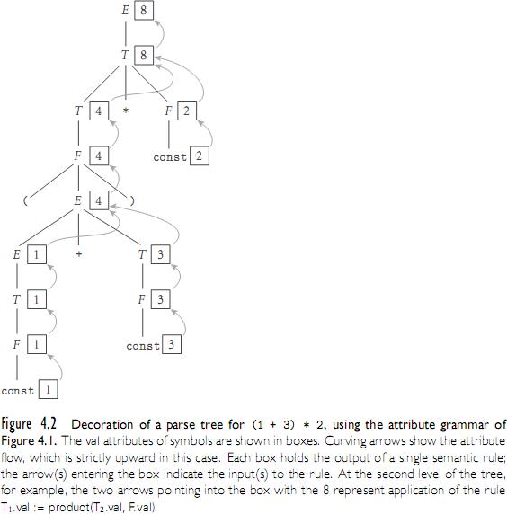
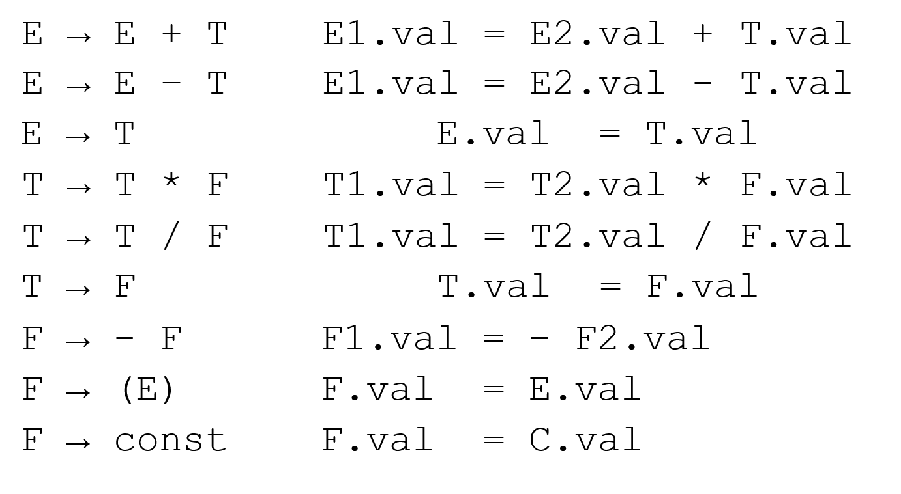
Evaluating Attributes

Slide 13
Evaluating Attributes
This is a very simple attribute grammar:
  Each symbol has at most one attribute
    the punctuation marks have no attributes
These attributes are all so-called SYNTHESIZED attributes:
  They are calculated only from the attributes of things below them in the parse tree

Slide 14
Evaluating Attributes
In general, we are allowed both synthesized and INHERITED attributes:
  Inherited attributes may depend on things above or to the side of them in the parse tree
  Tokens have only synthesized attributes, initialized by the scanner (name of an identifier, value of a constant, etc.).
  Inherited attributes of the start symbol constitute run-time parameters of the compiler

Slide 15
Evaluating Attributes
The grammar above is called S- ATTRIBUTED because it uses only synthesized attributes
Its ATTRIBUTE FLOW (attribute dependence graph) is purely bottom-up
An equivalent LL(1) grammar requires inherited attributes:

Slide 16
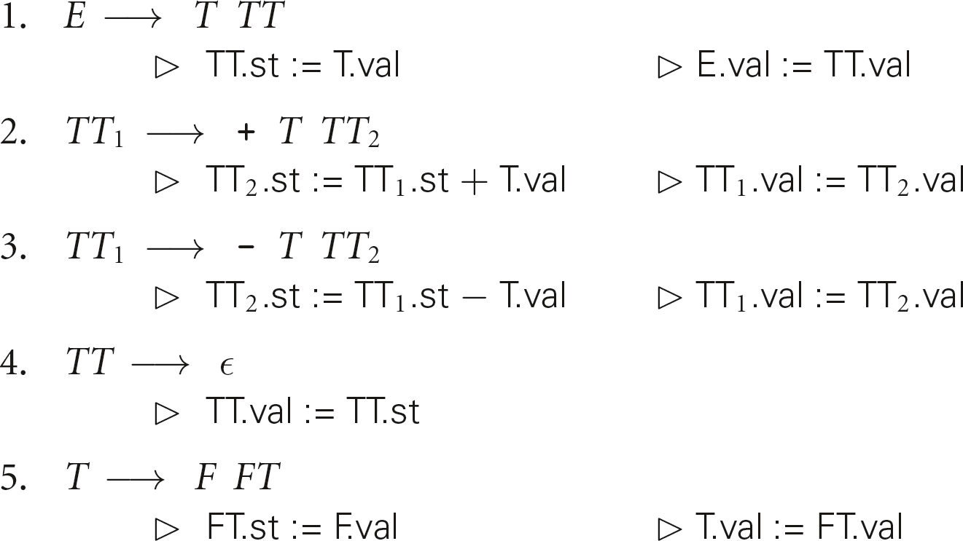
Evaluating Attributes – Example
Attribute grammar in Figure 4.3:
Notes:
St: subtotal

Slide 17
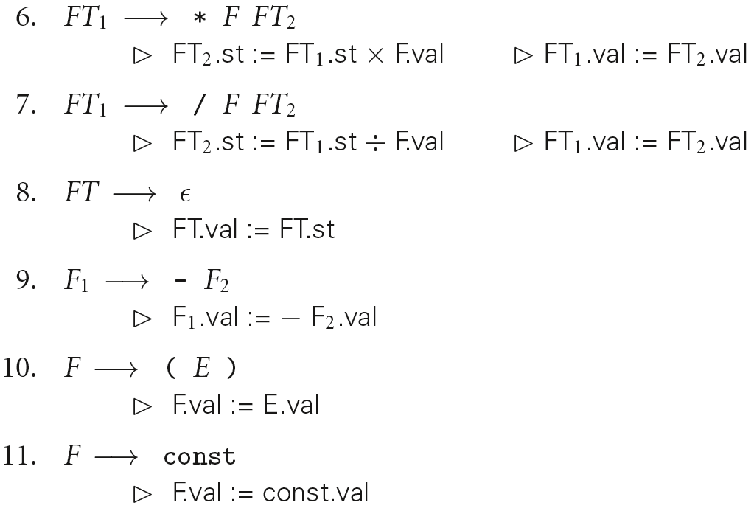
Evaluating Attributes– Example
Attribute grammar in Figure 4.3 (continued):

Slide 18
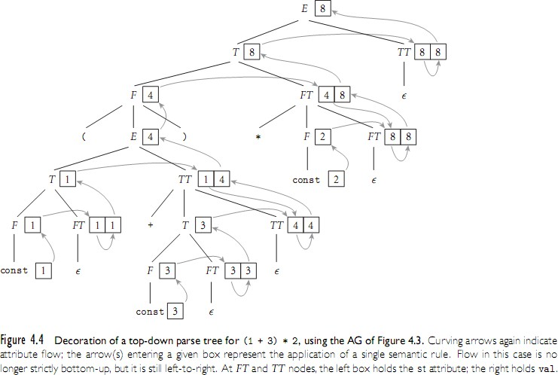
Evaluating Attributes– Example

Slide 19
Evaluating Attributes– Example
Attribute grammar in Figure 4.3:
  This attribute grammar is a good bit messier than the first one, but it is still L-ATTRIBUTED, which means that the attributes can be evaluated in a single left-to-right pass over the input
  In fact, they can be evaluated during an LL parse
  Each synthetic attribute of a LHS symbol (by definition of synthetic) depends only on attributes of its RHS symbols

Slide 20
Evaluating Attributes – Example
Attribute grammar in Figure 4.3:
  Each inherited attribute of a RHS symbol (by definition of L-attributed) depends only on
    inherited attributes of the LHS symbol, or
    synthetic or inherited attributes of symbols to its left in the RHS
  L-attributed grammars are the most general class of attribute grammars that can be evaluated during an LL parse

