Slide 1

Chapter 10 :: Data Abstraction and Object Orientation
Programming Language Pragmatics, Fourth Edition
Michael L. Scott
Copyright © 2016 Elsevier

Slide 2
Object-Oriented Programming
Control or PROCESS abstraction is a very old idea (subroutines!)
Data abstraction is somewhat newer
– An Abstract Data Type is one that is defined in terms of the operations that it supports (i.e., that can be performed upon it) rather than in terms of its structure or implementation

Slide 3
Object-Oriented Programming
Why abstractions?
  easier to think about - hide what doesn't matter to programmer
  protection - prevent access to things you shouldn't see
  plug compatibility
    replacement of pieces, often without recompilation, definitely without rewriting libraries
    division of labor in software projects
Notes:
1. Easier to think about (Simplification)
Abstraction hides unnecessary details.
Programmers focus only on what matters, not how everything works internally.
Example:
When you use a car.drive(), you don’t need to know how the engine works.
2. Protection (Encapsulation)
Prevents access to internal details that should not be modified.
Helps maintain data integrity and security.
Example:
Private variables in a class cannot be accessed directly from outside.
3. Plug Compatibility (Modularity & Flexibility)
✅ Replace components easily
You can swap parts without affecting the whole system.
Often no need to recompile or rewrite code.
✅ Reuse libraries
Abstraction allows using pre-built modules without knowing their internal implementation.
✅ Division of labor
Different developers can work on different parts of a system independently.
Each works with interfaces, not full implementations.
🔹 Simple Analogy
Think of abstraction like using a TV remote:
You press buttons (interface)
You don’t need to understand the electronics inside (implementation)

Slide 4
Object-Oriented Programming
Statics allow a subroutine to retain values from one invocation to the next, while hiding the name in-between
Modules allow a collection of subroutines to share some statics, still with hiding
– If you want to build an abstract data type, though, you have to make the module a manager

Slide 5
Object-Oriented Programming
Module types allow the module to be the abstract data type - you can declare
a bunch of them
  This is generally more intuitive
    It avoids explicit object parameters to many operations
    In C++ you need to make one of the classes (or some of its members) "friends" of the other class

Slide 6
Object
An object is an instance of a class or struct. When a class or struct is defined, no memory is allocated. However, when it is instantiated (an object is created), memory is allocated for the object.
The object encapsulates state and behavior. It holds the data members defined by its class or struct and can perform actions through its member functions.
Each object has its own identity, and multiple objects of the same class can have different states (values of their data members)

Slide 7
Object-Oriented Programming
Objects add inheritance and dynamic method binding
The 3 key factors in OO programming
  Encapsulation (data hiding)
  Inheritance
  Dynamic method binding

Slide 8
Encapsulation and Inheritance
Visibility rules
  Public and Private parts of an object declaration/definition
  2 reasons to put things in the declaration
    so programmers can get at them
    so the compiler can understand them
  At the very least the compiler needs to know the size of an object, even though the programmer isn't allowed to get at many or most of the fields (members) that contribute to that size
    That's why private fields have to be in declaration

Slide 9
Encapsulation and Inheritance Classes (C++)
C++ distinguishes among
–public class members
  accessible to anybody
–protected class members
  accessible to members of this or derived classes
–private
  accessible just to members of this class
A C++ structure (struct) is simply a class whose members are public by default
C++ base classes can also be public, private, or protected

Slide 10
Encapsulation and Inheritance Classes (C++)
Example:
class circle : public shape { ...
anybody can convert (assign) a circle* into a shape*
class circle : protected shape { ... only members and friends of circle or its derived classes can convert (assign) a circle* into a shape*
class circle : private shape { ...
only members and friends of circle can convert (assign) a circle* into a shape*

Slide 11
Encapsulation and Inheritance Classes (C++)
Disadvantage of the module-as-manager approach: must include explicit create/initialize and destroy/finalize routines for every abstraction
  Even w/o dynamic allocation inside module, users don't have necessary knowledge to do initialization
  Object-oriented languages often give you constructors and maybe destructors
    Destructors are important primarily in the absence of garbage collection

Slide 12
Encapsulation and Inheritance Classes (C++)
A few C++ features you may not have learned:
  classes as members
foo::foo (args0) : member1 (args1),
member2 (args2) { ...
args1 and args2 need to be specified in terms of args0
    The reason these things end up in the header of foo is that they get executed before foo's constructor does, and the designers consider it good style to make that clear in the header of foo::foo
Notes:
Class as member of another class

Slide 13
Encapsulation and Inheritance Classes (C++)
A few C++ features (2):
– initialization v. assignment
foo b;
foo f = b;
// calls constructor foo b, f;
// calls no-argument constructor
f = b;
// calls operator=

Slide 14
Encapsulation and Inheritance Classes (C++)
A few C++ features (3):
  virtual functions:
Key question: if child is derived from parent and I have a parent* p (or a parent& p) that points (refers) to an object that's actually a child, what member function do I get when I call p->f (p.f)?
    Normally I get p's f, because p's type is parent*.
    But if f is a virtual function, I get c's f.

Slide 15
Encapsulation and Inheritance Classes (C++)
A few C++ features (4):
–virtual functions (continued)
  If a virtual function has a "0" body in the parent class, then the function is said to be a pure virtual function and the parent class is said to be abstract
  You can't declare objects of an abstract class; you have to
declare them to be of derived classes
  Moreover any derived class must provide a body for the pure virtual function(s)
  multiple inheritance in Standard C++ (see next)
–friends
  functions
  classes

Slide 16
Initialization and Finalization
In Section 3.2, we defined the lifetime of an object to be the interval during which it occupies space and can hold data
  Most object-oriented languages provide some sort of special mechanism to initialize an object automatically at the beginning of its lifetime
    When written in the form of a subroutine, this
mechanism is known as a constructor
    A constructor does not allocate space
  A few languages provide a similar destructor mechanism to finalize an object automatically at the end of its lifetime

Slide 17
Initialization and Finalization
Issues
choosing a constructor
references and values
  If variables are references, then every object must be
created explicitly - appropriate constructor is called
  If variables are values, then object creation can happen implicitly as a result of elaboration
execution order
  When an object of a derived class is created in C++, the constructors for any base classes will be executed before the constructor for the derived class
garbage collection

Slide 18
Dynamic Method Binding
Virtual functions in C++ are an example of
dynamic method binding
– you don't know at compile time what type the object referred to by a variable will be at run time
Simula also has virtual functions (all of which are abstract)
In Smalltalk, Eiffel, and Java all member functions are virtual

Slide 19
Dynamic Method Binding
Data members of classes are implemented just like structures (records)
  With (single) inheritance, derived classes have extra fields at the end
  A pointer to the parent and a pointer to the child contain the same address - the child just knows that the struct goes farther than the parent does

Slide 20
Dynamic Method Binding
Non-virtual functions require no space at run time; the compiler just calls the appropriate version, based on type of variable
  Member functions are passed an extra, hidden, initial parameter: this (called current in Eiffel and self in Smalltalk)
C++ philosophy is to avoid run-time overhead whenever possible(Sort of the legacy from C)

Slide 21
Dynamic Method Binding
Virtual functions are the only thing that requires any trickiness (Figure 10.3)
  They are implemented by creating a dispatch table (vtable) for the class and putting a pointer to that table in the data of the object
  Objects of a derived class have a different dispatch table
    In the dispatch table, functions defined in the parent come first, though some of the pointers point to overridden versions
    You could put the whole dispatch table in the object itself, saving a little time, but potentially wasting a LOT of space

Slide 22
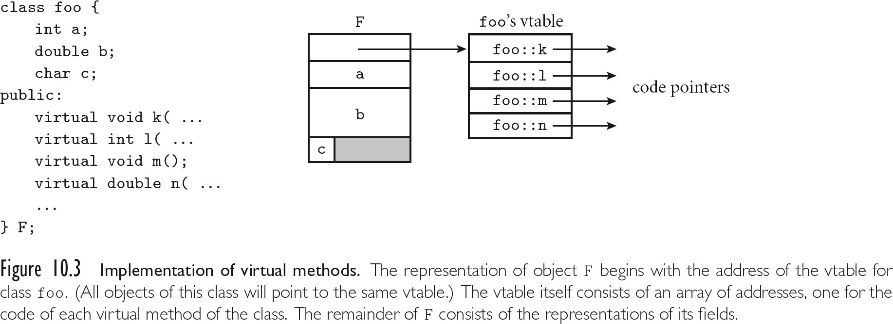
Dynamic Method Binding

Slide 23
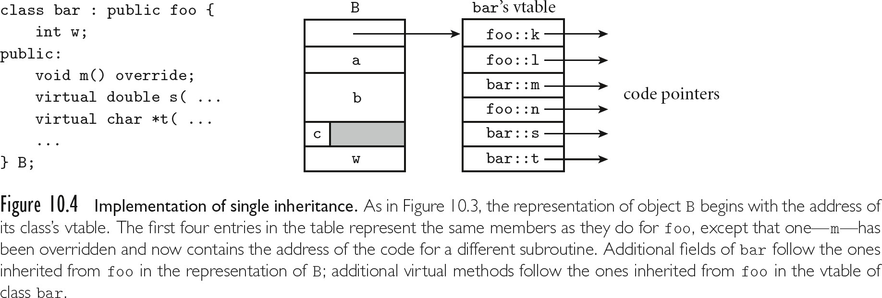
Dynamic Method Binding

Slide 24
Dynamic Method Binding
Note that if you can query the type of an object, then you need to be able to get from the object to run-time type info
  The standard implementation technique is to put a pointer to the type info at the beginning of the vtable
  Of course you only have a vtable in C++ if your class has virtual functions
    That's why you can't do a dynamic_cast on a pointer whose static type doesn't have virtual functions

Slide 25
Mix-In Inheritance
Classes can inherit from only one “real” parent
Can “mix in” any number of interfaces, simulating multiple inheritance
Interfaces appear in Java, C#, Go, Ruby, etc.
– contain only abstract methods, no method bodies or fields
Has become dominant approach, superseding true multiple inheritance

Slide 26
True Multiple Inheritance
In C++, you can say
class professor : public
teacher, public researcher {
...
}
Here you get all the members of teacher
and all the members of researcher
– If there's anything that's in both (same name and argument types), then calls to the member are ambiguous; the compiler disallows them

Slide 27
True Multiple Inheritance
You can of course create your own member in the merged class
professor::print () { teacher::print (); researcher::print (); ...
}
Or you could get both:
professor::tprint () {
teacher::print ();
}
professor::rprint () { researcher::print ();
}

Slide 28
True Multiple Inheritance
Virtual base classes: In the usual case if you inherit from two classes that are both derived from some other class B, your implementation includes two copies of B's data members
That's often fine, but other times you want a
single copy of B
– For that you make B a virtual base class

Slide 29
Object-Oriented Programming
Analogy to the real world is central to the OO paradigm - you think in terms of real-world objects that interact to get things done
Many OO languages are strictly sequential, but the model adapts well to parallelism as well
Strict interpretation of the term
  uniform data abstraction - everything is an object
  inheritance
  dynamic method binding

Slide 30
Object-Oriented Programming
Lots of conflicting uses of the term out there object-oriented style available in many languages
  data abstraction crucial
  inheritance required by most users of the term OO
  centrality of dynamic method binding a matter of dispute

Slide 31
Object-Oriented Programming
SMALLTALK is, historically, the canonical object-oriented language
  It has all three of the characteristics listed above
  It's based on the thesis work of Alan Kay at Utah in the late 1960„s
  It went through 5 generations at Xerox PARC, where Kay worked after graduating
  Smalltalk-80 is the current standard

Slide 32
Object-Oriented Programming
Other languages are described in what follows:
Modula-3
  single inheritance
  all methods virtual
  no constructors or destructors
Java
  interfaces, mix-in inheritance
  all methods virtual

Slide 33
Object-Oriented Programming
Ada 95
–tagged types
–single inheritance
–no constructors or destructors
–class-wide parameters:
  methods static by default
  can define a parameter or pointer that grabs the object-specific version of all methods
–base class doesn't have to decide what will be virtual
–notion of child packages as an alternative to friends

Slide 34
Object-Oriented Programming
Is C++ object-oriented?
  Uses all the right buzzwords
  Has (multiple) inheritance and generics (templates)
  Allows creation of user-defined classes that look just like built-in ones
  Has all the low-level C stuff to escape the paradigm
  Has friends
  Has static type checking

