Slide 1

Chapter 11 :: Functional Languages
Programming Language Pragmatics
Michael L. Scott
Copyright © 2016 Elsevier

Slide 2
Functional Programming Concepts
So how do you get anything done in a functional language?
  Recursion (especially tail recursion) takes the place of iteration
  In general, you can get the effect of a series of assignments
x | := | 0 | ...
x | := | expr1 | ...
x | := | expr2 | ...
from f3(f2(f1(0))), where each f expects the value of x as an argument, f1 returns expr1, and f2 returns expr2

Slide 3
Functional Programming Concepts
Recursion even does a nifty job of replacing looping
x := 0; i := 1; j := 100;
while i < j do
x := x + i*j; i := i + 1; j := j - 1
end while
return x
becomes f(0,1,100), where f(x,i,j) == if i < j then
f (x+i*j, i+1, j-1) else x

Slide 4
Functional Programming Concepts
Thinking about recursion as a direct, mechanical replacement for iteration, however, is the wrong way to look at things
  One has to get used to thinking in a recursive style
Even more important than recursion is the notion of higher-order functions
  Take a function as argument, or return a function as a result
  Great for building things

Slide 5
A Bit of Scheme
Scheme:
  Boolean values #t and #f
  Numbers
  Lambda expressions
  Quoting
(+ 3 4) ⇒ 7
(quote (+ 3 4)) ⇒ (+ 3 4)
'(+ 3 4) ⇒ (+ 3 4)
  Mechanisms for creating new scopes
(let ((square (lambda (x) (* x x)))
(plus +))
(sqrt (plus (square a) (square b))))

Slide 6
A Bit of Scheme
Scheme:
  Conditional expressions (if (< 2 3) 4 5) ⇒ 4 (cond
((< 3 2) 1)
((< 4 3) 2)
(else 3)) ⇒ 3
  Imperative stuff
    assignments
    sequencing (begin)
    iteration
    I/O (read, display)

Slide 7
Functional Programming
Functional programming is a style of programming:
Imperative Programming:
  Program = Data + Algorithms
OO Programming:
      Program = Object. message (object)
Functional Programming:
  Program = Functions Functions
Computation is done by application of functions

Slide 8
Functional Programming Languages
A functional language supports and advocates for the style of FP.
Important Features:
Everything is function (input->function->output)
No variables or assignments ( only constant values, arguments, and returned values. Thus no notion of state, memory location)
No loops (only recursive functions)
No side-effect: the value of a function depends only on the values of its parameters. Evaluating a function with the same parameters gets the same results.
Functions are first-class values: functions are values, can be parameters and return values, can be composed.

Slide 9
functional style and imperative style
Imperative style
  int sumto(int n)
  { int i, sum = 0;
  for(i = 1; i <= n; i++) sum += i;
  return sum;
  }
Functional style:
  int sumto(int n)
  { if (n <= 0) return 0;
  else return sumto(n-1) + n;
  }

Slide 10
Lazy Evaluation: Special Forms
if function (if a b c):
  a is always evaluated
  Either b or c (but not both) is evaluated and returned as result.
  c is optional. (if a is false and c is missing, the value of the expression is undefined.)
e.g., (if (= a 0) 0 (/ 1 a))
cond :
(cond (e1 v1) (e2 v2) ... (else vn))
  The (ei vi) are considered in order
  ei is evaluated. If it is true, vi is then evaluated, and the value is the result of the cond expression.
  If no ei is evaluated to true, vn is then evaluated, and the value is the result of the cond expression.
  If no ei is evaluated to true, and vn is missing, the value of the expression is undefined.
(cond ((= a 0) 0) ((= a 1) 1) (else (/ 1 a)))

Slide 11
Lists
List
  Only data structure
  Used to construct other data structures.
  Thus we must have functions to manipulate lists.
cons: construct a list
(1 2 3) = (cons 1 (cons 2 (cons 3 '())))
(1 2 3) = (cons 1 '(2 3))
car: the first element (head), which is an expression
(car '(1 2 3)) = 1
cdr:the tail, which is a list
(cdr '(1 2 3)) = (2 3)

Slide 12
Box diagrams
a List = (head expression, tail list)
L = ((1 2) 3 (4 (5 6))) looks as follows in memory

Slide 13
Lambda expressions/function values
A function can be created dynamically using a lambda expression, which returns a value that is a function:
(lambda (x) (* x x))
The syntax of a lambda expression:
(lambda list-of-parameters exp1 exp2 …)
Indeed, the "function" form of define is just syntactic sugar for a lambda:
(define (f x) (* x x))
is equivalent to:
(define f (lambda (x) (* x x)))

Slide 14
Higher-order functions
higher-order function:
a function that returns a function as its value
or takes a function as a parameter
or both
E.g.:
  add-x
  (define (make-adder n)
  (lambda (x) (+ x n)))
  (define add5 (make-adder 5))
  (add5 3) ; ⇒ 8

Slide 15
let expressions as lambdas:
A let expression is really just a lambda applied immediately:
(let ((x 2) (y 3)) (+ x y))
is the same as
((lambda (x y) (+ x y)) 2 3)
This is why the following let expression is an error if we want x = 2 throughout:
(let ((x 2) (y (+ x 1))) (+ x y))
Nested let (lexical scoping)
(let ((x 2)) (let ((y (+ x 1))) (+ x y)))

Slide 16
Tuples and Records
Tuples, are immutable, heterogeneous, but fixed-size collections of values of simpler types.
Tuple aggregates are written by separating the component values with commas and surrounding them with parentheses.
In a chemical database, the element Mercury might be represented by the tuple
("Hg", 80, 200.592)
This tuple is said to be of type string * int * float.
Components of tuples are typically extracted via pattern matching. In two-element tuples (often referred to as pairs), the components can also be obtained using the built-in polymorphic functions fst and snd:
fst ("Hg", 80);; =⇒ "Hg"
snd ("Hg", 80);; =⇒ 80

Slide 17
Tuples and Records
Records are much like tuples, but the component values (fields) are named, rather than positional.
type element = {name: string; atomic_number: int; atomic_weight: float};;
Record aggregates are enclosed in braces, with the fields (in any order) separated by semicolons:
let mercury = {atomic_number = 80; name = "Hg"; atomic_weight = 200.592};;
Individual fields of a record are easily accessed by name, using familiar “dot” notation:
mercury.atomic_weight;; =⇒ 200.592

Slide 18
Evaluation Order Revisited
Applicative order
  what you're used to in imperative languages
  usually faster
Normal order
  like call-by-name: don't evaluate arg until you need it
  sometimes faster
  terminates if anything will (Church-Rosser theorem)

Slide 19
Evaluation Order Revisited
(define double (lambda (x) (+ x x)))
Evaluating the expression (double (* 3 4)) in applicative order, we have
(double (* 3 4))
=⇒ (double 12)
=⇒ (+ 12 12)
=⇒ 24
Under normal-order evaluation
(double (* 3 4))
=⇒ (+ (* 3 4) (* 3 4))
=⇒ (+ 12 (* 3 4))
=⇒ (+ 12 12)
=⇒ 24
Here we end up doing extra work: normal order causes us to evaluate (* 3 4)
twice.

Slide 20
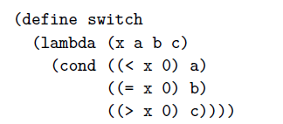
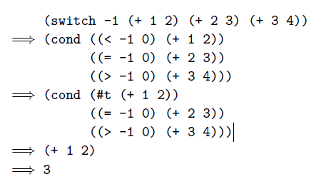
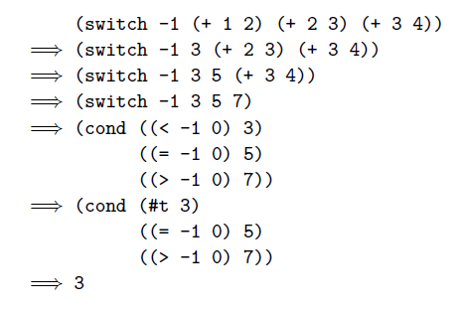
Evaluated Order Revisited
Here normal-order evaluation avoids evaluating (+ 2 3) or (+ 3 4).

Slide 21
Functional Programming in Perspective
Advantages of functional languages
  lack of side effects makes programs easier to understand
  lack of explicit evaluation order (in some languages) offers possibility of parallel evaluation (e.g. MultiLisp)
  lack of side effects and explicit evaluation order simplifies some things for a compiler (provided you don't blow it in other ways)
  programs are often surprisingly short
  language can be extremely small and yet powerful

