Slide 1

Chapter 12 :: Logic Languages
Programming Language Pragmatics, Fourth Edition
Michael L. Scott
Copyright © 2016 Elsevier

Slide 2
Logic Programming
Based on predicate calculus
Predicates - building-blocks P(a₁,a₂,...,a_{K})
  enrolled(you, CS xxx)
  Predicates are fundamental building blocks in logic programming languages like Prolog. They define relationships between entities and represent statements about the world.

Slide 3
Logic Programming Concepts
We insist that all statements be in the form of HORN CLAUSES consisting of
a HEAD and a BODY
  The head is a single term
  The body is a list of terms
  A term can be a constant, variable, or STRUCTURE consisting of a FUNCTOR and a parenthesized list of arguments

Slide 4
Prolog
grandmother(A, C) :- mother(A, B),
mother(B, C).
can be read:
for all A, C [A is the grandmother of C if there exists a B such that A is the mother of B and B is the mother of C].
We probably want another rule that says
grandmother(A, C) :- mother(A, B),
father(B, C).

Slide 5
Prolog
To run a Prolog program, one asks the interpreter a question
  This is done by stating a theorem - asserting a predicate - which the interpreter tries to prove
    If it can, it says yes
    If it can't, it says no
    If your predicate contained variables, the interpreter prints the values it had to give them to make the predicate true.

Slide 6
Prolog – Claus Rules and Facts
A Horn clause consists of a head, or consequent term H, and a body consisting of terms Bi:
  H ← B1, B2, . . . , Bn
A rule: Head :- Body
A Fact: Head

Slide 7
Query
rainy(seattle).
rainy(rochester).
?- rainy(C).
the Prolog interpreter would respond with
C = seattle
If we want to find all possible solutions, we can ask the
interpreter to continue by typing a semicolon:
C = seattle ;
C = rochester.
If there had been another possibility, the interpreter would have left off the final period and given us the opportunity to type another semicolon.

Slide 8
Query
rainy(seattle).
rainy(rochester).
cold(rochester).
snowy(X) :- rainy(X), cold(X).
the query
?- snowy(C).

Slide 9
Prolog -- Terms
In Prolog, all data – including Prolog programs are represented as terms.
Variables: start with an Uppercase letter or _
Atomic term: atom, integer and others
Compound term: F (Arg1, Arg2, … ArgN)
  F: functor name
  ArgK k-th argument
  N arity
  Functor: functor name together with arity
  F/N: Principle Functor

Slide 10
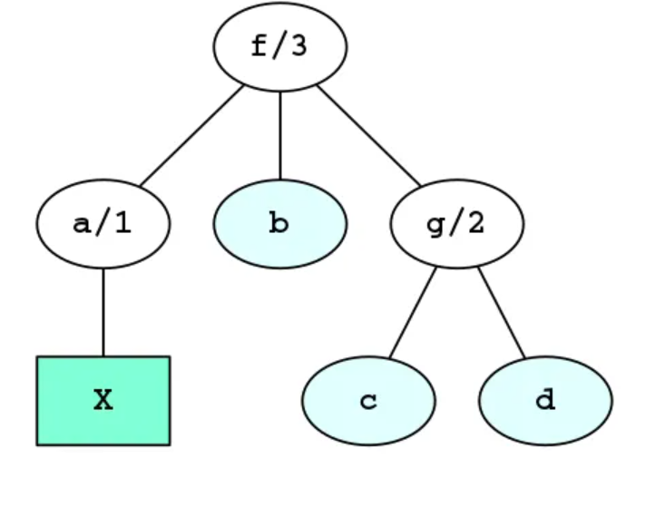
Prolog -- Terms
Examples: V/A can be leaf, PF can be internal node
f(a) -> principal functor: f/1
  f(a)
  f(a,b)
  f(a,b,c)
  f(a,b,g(c))
  f(a,b,g(c,d))
  f(a(X), b, g(c,d))

Slide 11
Prolog -- Lists
A list is a fundamental data structure that represents an ordered collection of elements. Lists in Prolog are typically denoted by square brackets [ ] and can contain zero or more elements, which can be of any data type, including other lists.
The atom [] (nil) is a list, with no element / the empty list.
The compound term .(E, Es) is a list iff Es is a list.
  E: first element or head of the list
  Es: tail of the list
  ‘.’/2 called a list constructor

Slide 12
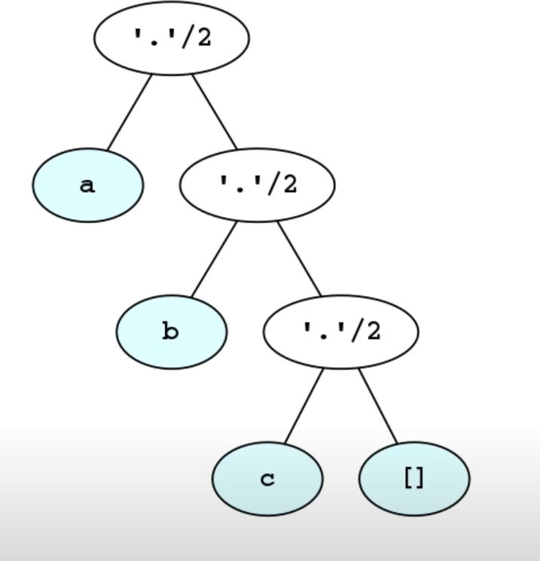
Prolog -- Lists
Functional Notation Examples:
[]
.(a ,[])
.(a, .(b,[]))
.(a, .(b, .(c,[])))
[]
[a]
[a,b]
[a,b,c]
[a,b,c,d]

Slide 13
Prolog
The interpreter works by what is called BACKWARD CHAINING
  It begins with the thing it is trying to prove and works backwards looking for things that
would imply it, until it gets to facts
It is also possible in theory to work forward from the facts trying to see if any of the things you can prove from them are what you were looking for - that can be very time- consuming
  Fancier logic languages use both kinds of chaining, with special smarts or hints from the user to bound the searches

Slide 14
Prolog
The predicate you ask for is the interpreter's original GOAL
  In an attempt to SATISFY that goal, it looks for facts or rules with which the goal can be UNIFIED
    Unification is a process by which compatible statements are merged
  Any variables that do not yet have values but
which correspond to constants or to variables with values in the
other clause get INSTANTIATED with that value
  Anyplace where uninstantiated variables correspond, those variables are identified with each other, but remain without values

Slide 15
Prolog
The interpreter starts at the beginning of your database (this ordering is part of Prolog, NOT of logic programming in general) and looks for something with which to unify the current goal
  If it finds a fact, great; it succeeds
  If it finds a rule, it attempts to satisfy the terms in the body of the
rule depth first
  This process is motivated by the RESOLUTION PRINCIPLE, due to Robinson:
    It says that if C1 and C2 are Horn clauses, where C2 represents a true statement and the head of C2 unifies with one of the terms in the body of C1, then we can replace the term in C1 with the body of C2 to obtain another statement that is true if and only if C1 is true

Slide 16
Prolog
When it attempts resolution, the Prolog interpreter pushes the current goal onto a stack, makes the first term in the body the current goal, and goes back to the beginning of the database and starts looking again
If it gets through the first goal of a body successfully, the interpreter continues with the next one
If it gets all the way through the body, the goal is satisfied and it backs up a level and proceeds

Slide 17
Prolog
If it fails to satisfy the terms in the body of a rule, the interpreter undoes the unification of the left hand side (this includes uninstantiating any variables that were given values as a result of the unification) and keeps looking through the database for something else with which to unify (This process is called BACKTRACKING)
If the interpreter gets to the end of database without succeeding, it backs out a level (that's how it might fail to satisfy something in a body) and continues from there

Slide 18
Prolog
We can visualize backtracking search as a tree in which the top-level goal is the root and the leaves are facts
  The children of the root are all the rules and facts with which the
goal can unify
  The interpreter does an OR across them: one of them must succeed in order for goal to succeed
  The children of a node in the second level of the tree are the terms
in the body of the rule
  The interpreter does an AND across these: all of them must succeed in order for parent to succeed
  The overall search tree then consists of alternating AND and OR
levels

Slide 19
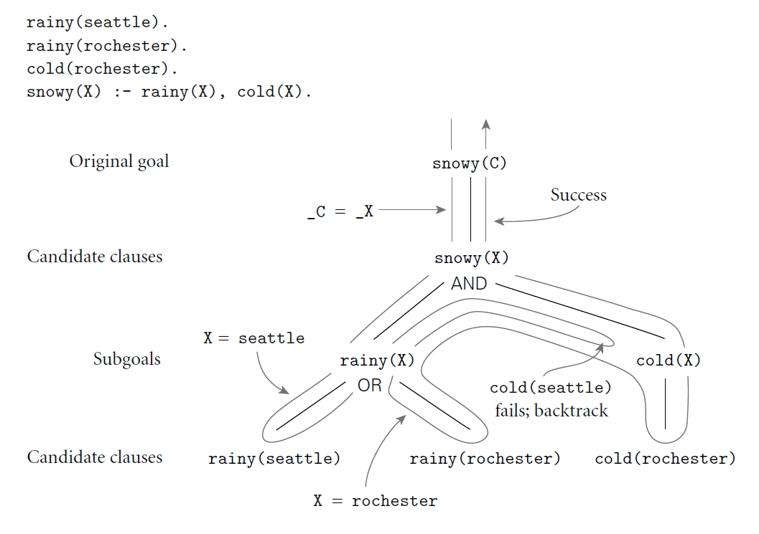
Search/Execution Order

Slide 20
Order of rule evaluation
edge(a, b). edge(b, c). edge(c, d).
edge(d, e). edge(b, e). edge(d, f).
path(X, X). ← base case
path(X, Y) :- edge(Z, Y), path(X, Z).
?- path(a,a)

Slide 21
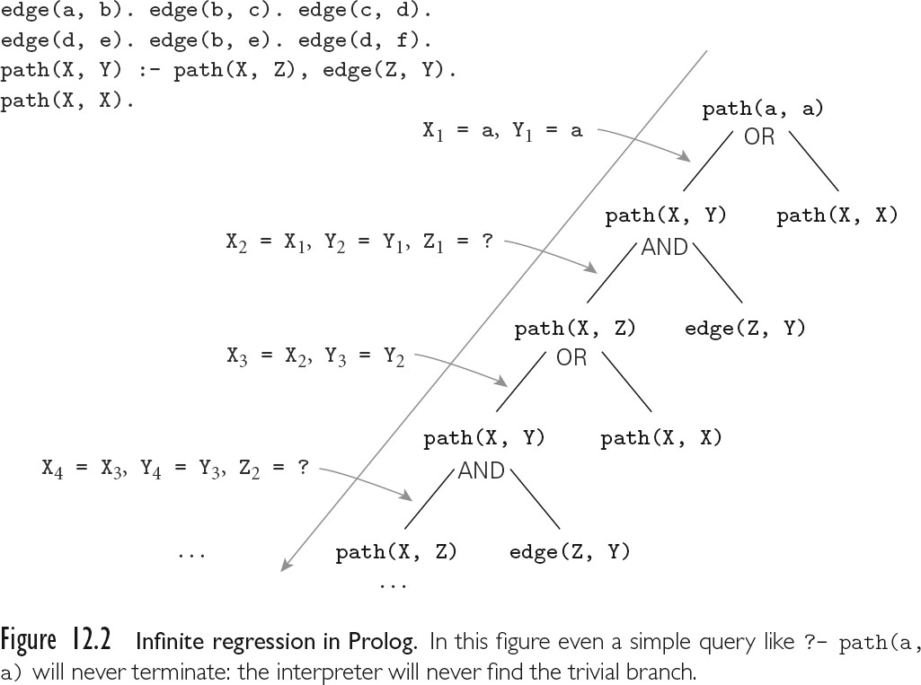
Prolog

Slide 22
Prolog
PROLOG IS NOT PURELY DECLARATIVE
  The ordering of the database and the left-to- right pursuit of sub-goals gives a deterministic imperative semantics to searching and backtracking
  Changing the order of statements in the database can give you different results
    It can lead to infinite loops
    It can certainly result in inefficiency
Tree relationships:

Slide 23
Prolog
parent(a,b).
parent(a,d).
parent(a,k).
parent(k,l).
parent(k,m).
parent(b,e).
parent(b,f).
parent(f,g).
parent(f,h).
parent(f,i).
% a is the parent of b
ancestor(X,Y) :- parent(X,Y).
ancestor(X,Y) :- parent(Z,Y), ancestor(X,Z).

Slide 24
Prolog
Then the question
?- ancestor(U,h).
What is the answers

Slide 25
Prolog
Then the question
?- ancestor(U,h).
generates the answers
U = f; U = b; U = a;
no
The question
generates all nodes in the subtree rooted in b
<< trace >>
?- ancestor(b,U).

Slide 26
Prolog
If we change the order of the two ancestor rules, we get different execution orders:
?- ancestor(U,h).
U = a; U = b; U = f;
no
If we change the order of the subgoals in the compound rule,
ancestor(X,Y) :- ancestor(X,Z),
parent(Z,Y).

Slide 27
Prolog
If we change the order of the two ancestor rules, we get different execution orders:
?- ancestor(U,h).
U = a; U = b; U = f;
no
If we change the order of the subgoals in the compound rule,
ancestor(X,Y) :- ancestor(X,Z),
parent(Z,Y).
?

Slide 28
Prolog
If we change the order of the two ancestor rules, we get different execution orders:
If we change the order of the subgoals in the compound rule,
ancestor(X,Y) :- ancestor(X,Z),
parent(Z,Y).
we run into an infinite loop (see also Figure 12.2)

