Slide 1

Chapter 14 :: Scripting Languages
Programming Language Pragmatics, Fourth Edition
Michael L. Scott
Copyright © 2016 Elsevier

Slide 2
What is a script Language
A scripting language is a type of programming language designed for integrating and communicating with other programming languages. Often, scripting languages are used to automate the execution of tasks that could alternatively be executed one-by-one by a human operator.

Slide 3
Scripting Language vs Programming Language
Key differences across definition, execution, typing, performance, and usage.
https://www.youtube.com/watch?v=g0Q-VWBX5Js
https://www.youtube.com/watch?v=7-0iBZxNq74

Slide 4
Definition
Scripting Language: automates tasks, glues components, usually interpreted.
Programming Language: general-purpose, builds full applications, usually compiled.

Slide 5
Execution Model
Scripting: interpreted line-by-line, no separate compile step.
Programming: compiled into machine code or bytecode.

Slide 6
Usage Purpose
Scripting: automation, system scripts, web scripting, quick prototypes.
Programming: large-scale software, OS, databases, high-performance apps.

Slide 7
Development Speed
Scripting: fast development, concise syntax, no declarations.
Programming: stricter syntax, structured, larger development cycle.

Slide 8
Typing System
Scripting: dynamic typing (type determined at runtime).
Programming: static typing (type checked at compile time).

Slide 9
Performance
Scripting: slower due to interpretation and dynamic typing.
Programming: faster due to compilation and optimizations.

Slide 10
Examples
Scripting: Python, JavaScript, Bash, Perl, Ruby.
Programming: C, C++, Java, Rust, Go.

Slide 11
Applications of Scripting Languages
Web Development: Scripting languages like JavaScript, PHP, and Python are used to build dynamic websites that interact with user input.
Automation: Automating tasks such as file management, system configuration, and software updates.
Data Analysis and Machine Learning: Languages like Python offer powerful libraries and frameworks for data analysis (Pandas, NumPy) and machine learning (scikit-learn, TensorFlow).
Testing: Scripting languages are used to write automated tests for software, ensuring stability and functionality through frameworks.

Slide 12
What Is A Scripting Language
Common Characteristics
  Both batch and interactive use
  Economy of expression
  Lack of declarations; simple scoping rules.
  Flexible dynamic typing
  Easy access to other programs
  Sophisticated pattern matching and string manipulation
  High level data types

Slide 13
Problem Domains
Shell Languages
  They have features designed for interactive use
  Provide a wealth of mechanisms to manipulate file names, arguments, and
commands, and to glue together other programs
    Most of these features are retained by more general scripting languages

Slide 14
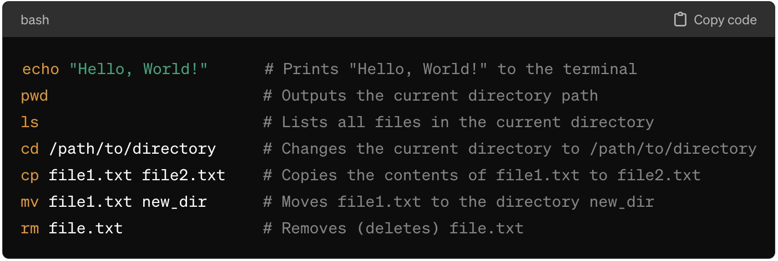
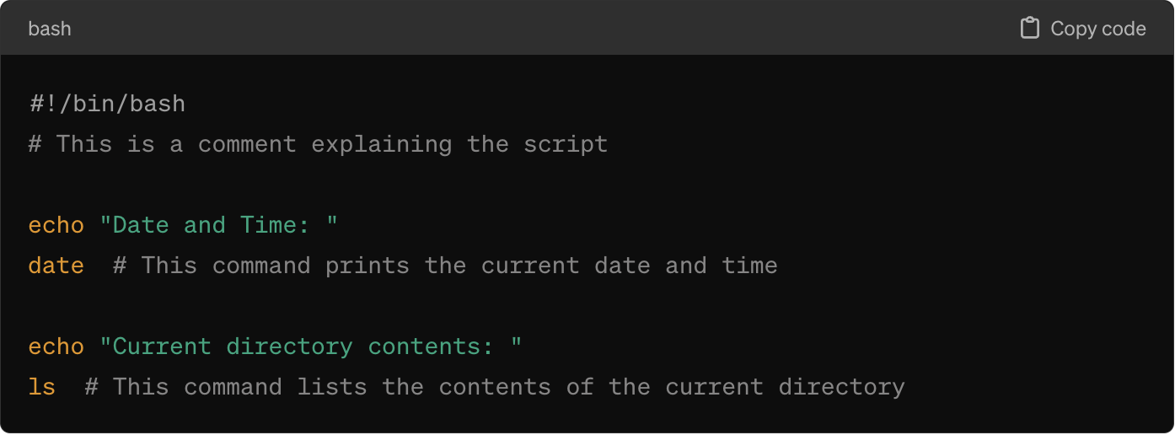
Examples of Shell Scripting
To run this script:
Save it as script.sh
Make it executable: chmod +x script.sh
Execute: ./script.sh

Slide 15
Sed and Awk
Both sed (Stream Editor) and AWK are powerful text processing tools used on Unix-like operating systems (including Linux and macOS). These tools are essential for scripting and data manipulation, allowing users to perform complex pattern matching, editing, and transformation of text data.

Slide 16
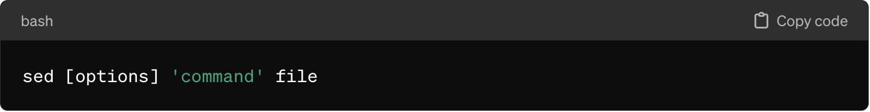
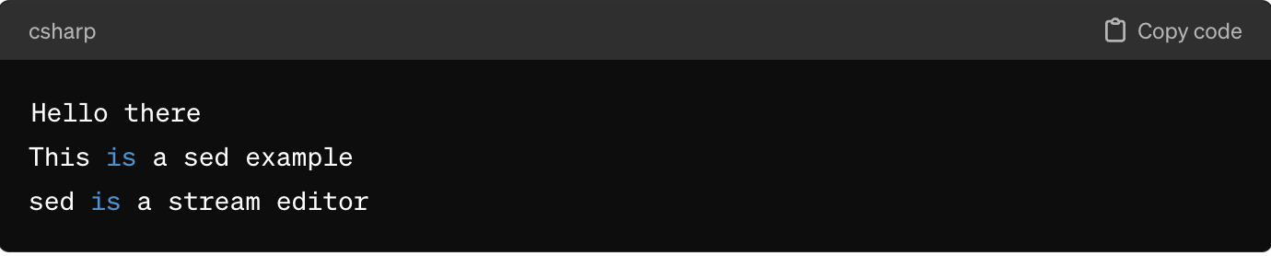
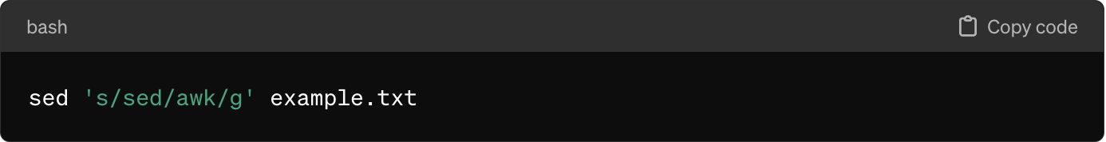
Sed
Sed is a stream editor for filtering and transforming text. It is used primarily for text substitution, selective printing of text files, and more complex transformations.

Slide 17
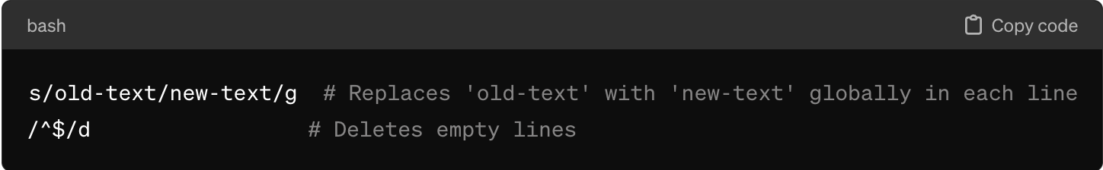
How to run sed from script:
This script file contains two sed commands:
s/old-text/new-text/g - This command substitutes "old-text" with "new-text" across all occurrences in a line (the g at the end signifies a global replacement).
/^$/d - This command deletes empty lines.

Slide 18
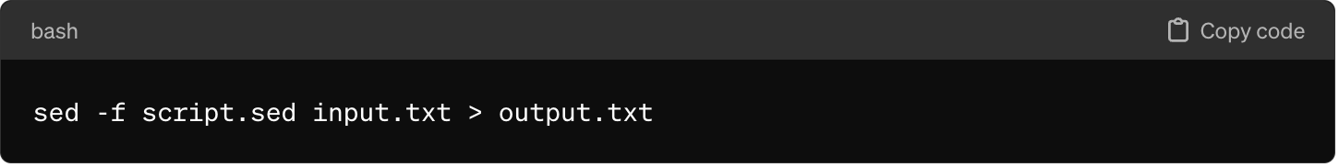
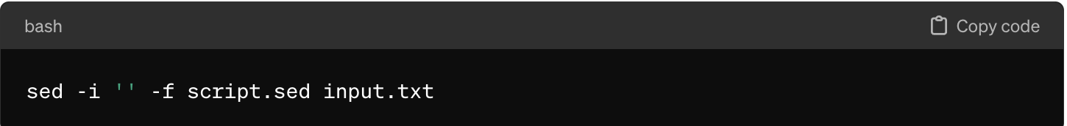
How to run sed from script:
Running the sed Script
sed - Invokes the sed editor.
-f script.sed - Specifies that sed should read commands from the file script.sed.
input.txt - The file on which sed will operate.
> output.txt - Redirects the output to a file named output.txt. Without this, sed would output to the standard output (typically the console).
If you prefer to edit your input file in place, use the -i option

Slide 19
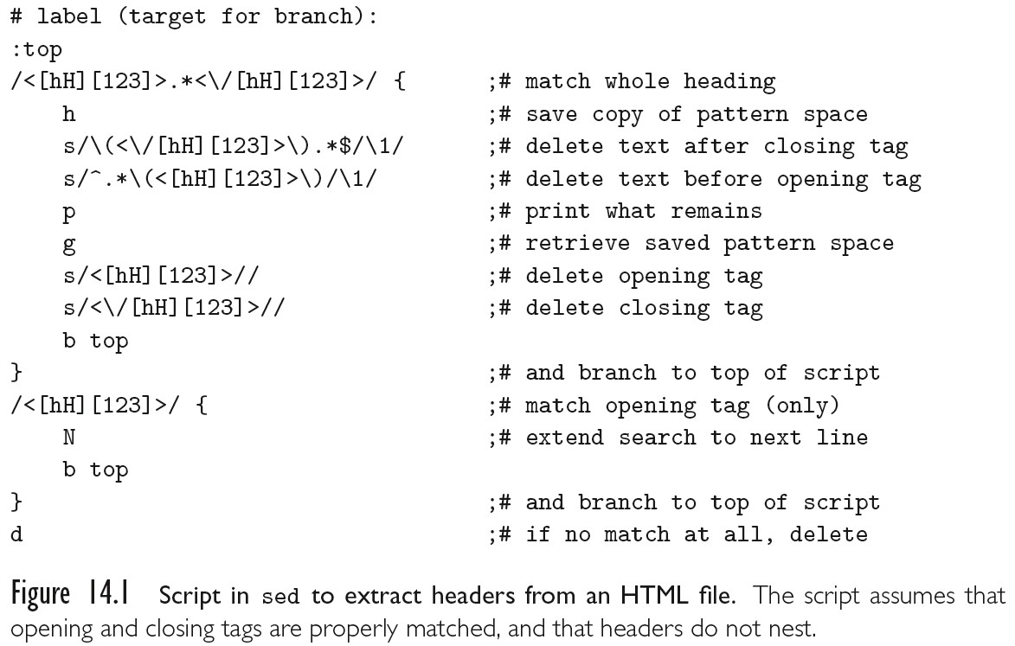
Problem Domains
Text Processing and Report Generation
– Sed

Slide 20
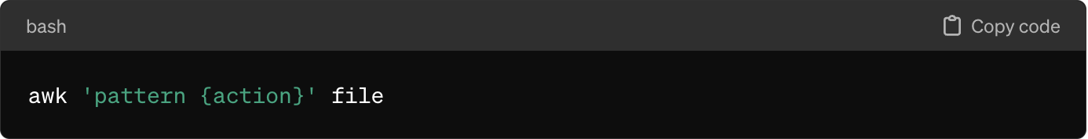
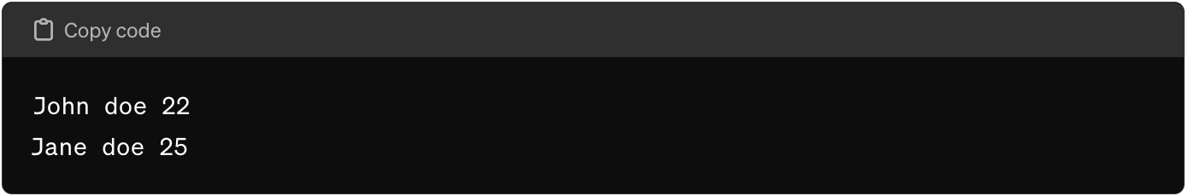
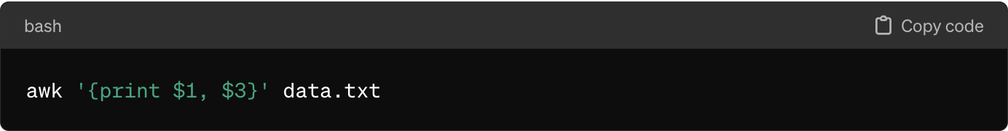
Awk
AWK is a programming language designed for pattern scanning and processing. It excels at field-based data manipulation.

Slide 21
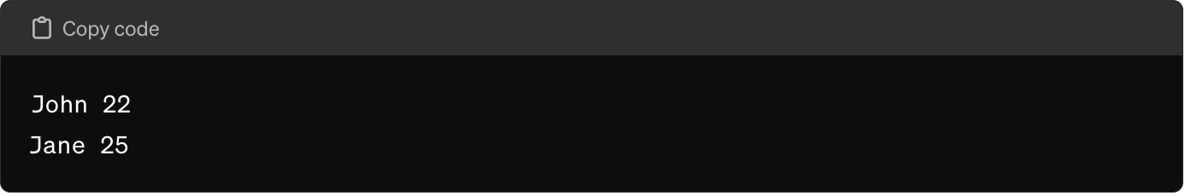
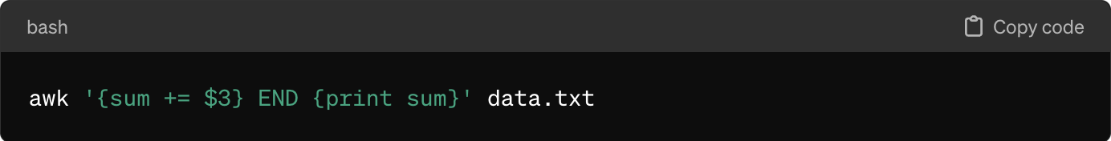
Awk
AWK is a programming language designed for pattern scanning and processing. It excels at field-based data manipulation.

Slide 22
Scripting the World Wide Web
CGI Scripts
  The original mechanism for server-side web scripting is the Common Gateway Interface (CGI)
  A CGI script is an executable program residing in a special directory known
to the web server program
  When a client requests the URI corresponding to such a program, the server executes the program and sends its output back to the client
    this output needs to be something that the browser will understand:
typically HTML.
  CGI scripts may be written in any language available
    Perl is particularly popular:
      its string-handling and ―glue mechanisms are suited to generating
HTML
      it was already widely available during the early years of the web

Slide 23
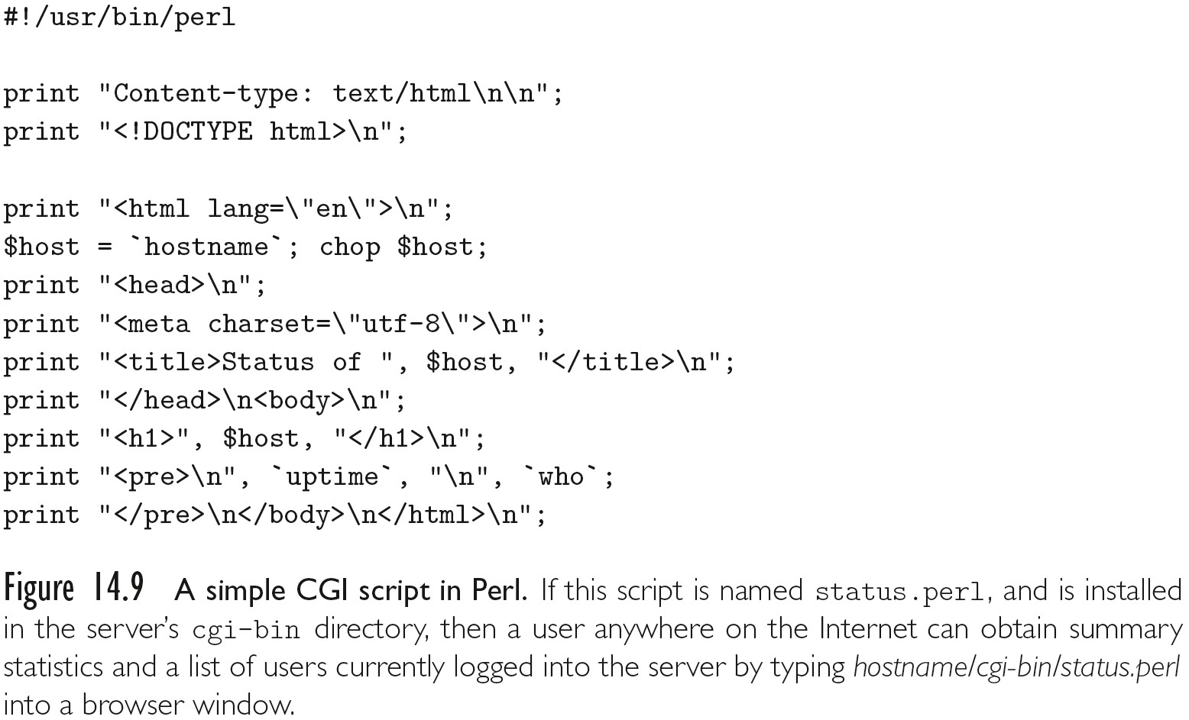
Scripting the World Wide Web

Slide 24
Scripting the World Wide Web
Embedded Server-Side Scripts
  Though widely used, CGI scripts have several disadvantages:
    The web server must launch each script as a separate program, with potentially significant overhead
      Though, CGI script compiled to native code can be very fast once running
    Scripts must generally be installed in a trusted directory by trusted system administrators
      they cannot reside in arbitrary locations as ordinary pages do
    The name of the script appears in the URI, typically prefixed with the name of
the trusted directory, so static and dynamic pages look different to end users
    Each script must generate not only dynamic content, but also the HTML tags that are needed to format and display it
      This extra ―boilerplate makes scripts more difficult to write
  Most web servers now provide a ―module loading mechanism that allows interpreters for one or more scripting languages

Slide 25
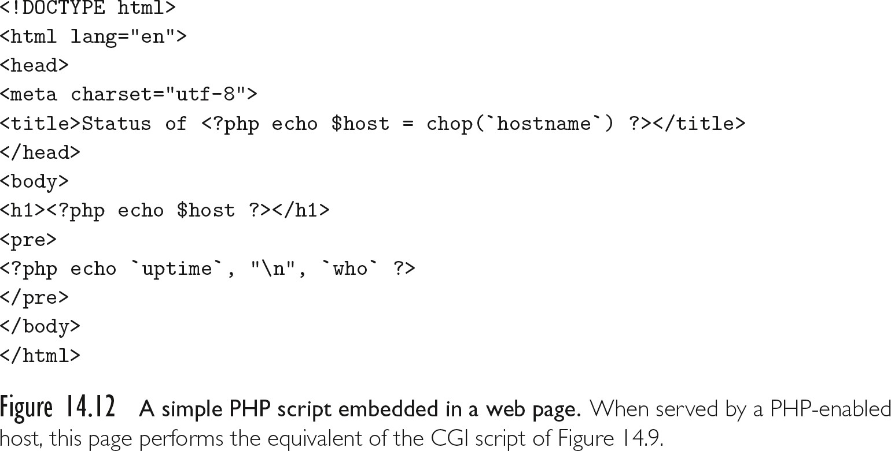
Scripting the World Wide Web

