Slide 1
Programming Language Midterm Review
Time: 2pm, October 14, 2026
Location: Rm 209, SR Collins
Format: Close Book
True / False Questions
Similar Questions from Assignments

Slide 2
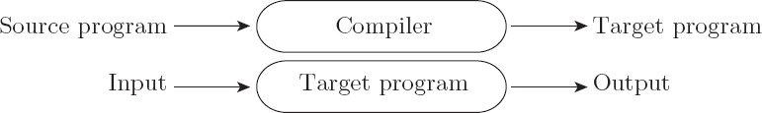
Compilation vs. Interpretation
Compilation vs. interpretation
  not opposites
  not a clear-cut distinction
Pure Compilation
  The compiler translates the high-level source program into an equivalent target program (typically in machine language), and then goes away:

Slide 3
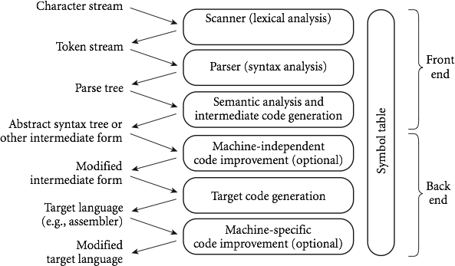

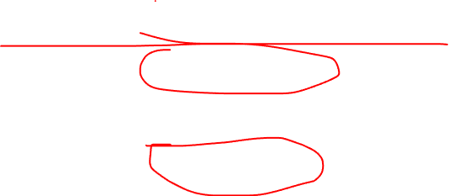
An Overview of Compilation
Phases of Compilation

Slide 4
Tokens and Regular Expressions
Tokens are the basic building blocks of programs—the shortest strings of characters with individual meaning. Tokens come in many kinds, including keywords, identifiers, symbols, and constants of various types.
To specify tokens, we use the notation of regular expressions.

Slide 5
Regular Expressions
A regular expression is one of the following:
  A character
  The empty string, denoted by ε
  Two regular expressions concatenated
  Two regular expressions separated by | (i.e., or)
  A regular expression followed by the Kleene star
* (concatenation of zero or more strings)

Slide 6
Scanning
Recall scanner is responsible for
  tokenizing source
  removing comments
  (often) dealing with pragmas (i.e., significant comments)
  saving text of identifiers, numbers, strings
  saving source locations (file, line, column) for error messages

Slide 7
Scanner vs. Parser: Who Catches Which Error?
A compiler is a translator: source language → target language (e.g., machine code), then it goes away.
Scanner (lexical analysis): groups characters into tokens
  An invalid token (e.g., 2abc$, an unterminated string "hello) → lexical error, reported by the scanner
Parser (syntax analysis): checks the token stream against the context-free grammar
  Valid tokens in an illegal order (e.g., x = + ;) → syntax error, reported by the parser
Semantic analysis: syntax is legal but meaning is wrong
  Type mismatch, undeclared variable, wrong number of arguments → semantic error

Slide 8
How to build the DFA?
RE->NFA->DFA
An NFA, or Non-deterministic Finite Automaton, is a conceptual model used in computer science, particularly in automata theory and formal language theory, to represent and understand the behavior of systems with finite numbers of states.
there may be more than one transition out of a given state labeled by a given character, and
there may be so-called epsilon transitions: arrows labeled by the empty string symbol.
The NFA is said to accept an input string (token) if there exists a path from the
start state to a final state whose non-epsilon transitions are labeled, in order, by the characters of the token.

Slide 9
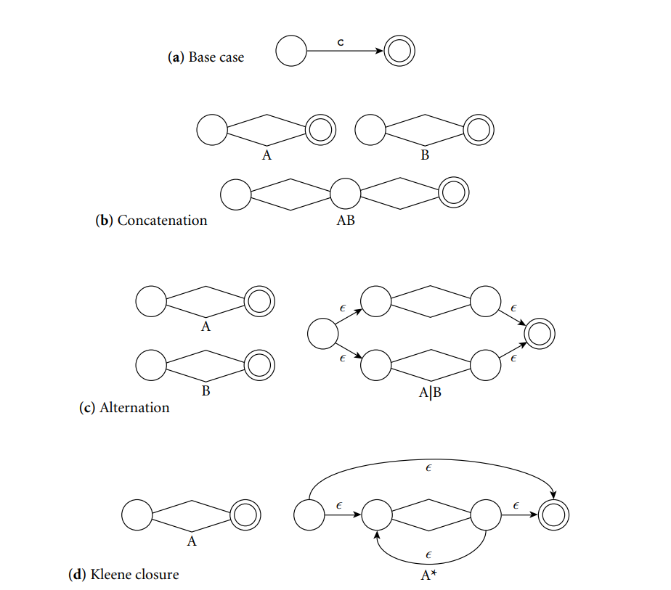
From a Regular Expression to an NFA

Slide 10
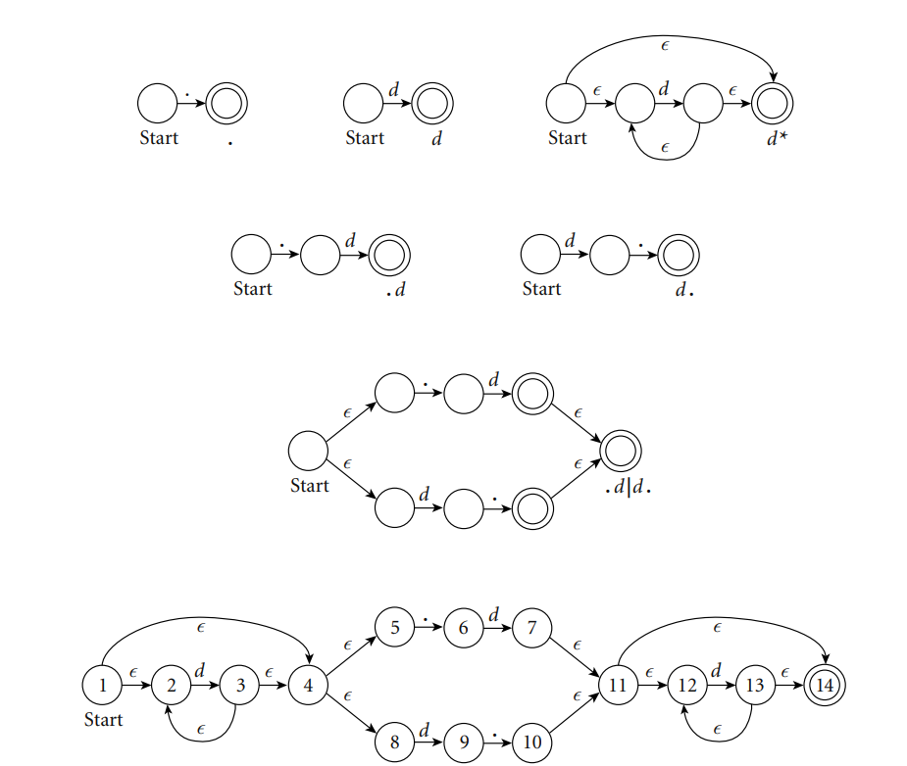
From RE to NFA:
Construction of an NFA equivalent to the regular expression d *( .d | d. ) d *

Slide 11
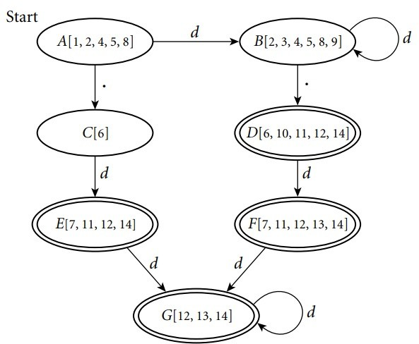
From NFA to DFA:

Slide 12
Practice: RE → NFA → DFA for (a | b)* b
Step 1 – RE → NFA (Thompson): build the small NFAs for a and b, join with | (alternation), wrap in * (Kleene star), then concatenate with b
Step 2 – NFA → DFA (subset construction):
  Start state = ε-closure of the NFA start state
  For each DFA state and each symbol: move, then take the ε-closure
  A DFA state is final if it contains the NFA's final state
Step 3 – merge equivalent states (minimize)
Resulting DFA
State | a | b
→ A (start) | A | B
B (final) | A | B
Accepts every string of a's and b's that ends in b.
Check: abb → A→A→B→B ✓ accept
ba → A→B→A ✗ reject

Slide 13
Lifetime and Storage Management
Storage Allocation mechanisms
–Static
–Stack
–Heap
Static allocation for
–code
–globals
–static or own variables
–explicit constants (including strings, sets, etc)
Copyright © 2009 Elsevier

Slide 14
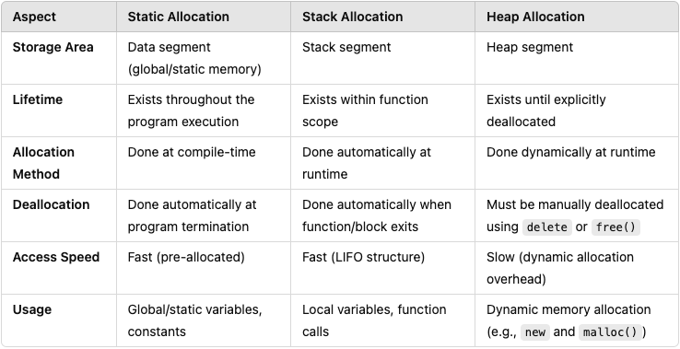
Static, Stack and Heap Allocation

Slide 15
EX1
If each char is 1 byte. How many space required for the following piece of code if we use stack memory allocation?
{char a, b;
{char c, d;
{char a, e;
}
}
{char f, g, h;
}
}

Slide 16
Scope Rules
A scope is a program section of maximal size in which no bindings change, or at least in which no re-declarations are permitted

Slide 17
Scope Rules
With STATIC (LEXICAL) SCOPE RULES, a scope is defined in terms of the physical (lexical) structure of the program
  The determination of scopes can be made by the compiler
  All bindings for identifiers can be resolved by examining the program
  Typically, we choose the most recent, active binding made
at compile time
  Most compiled languages, C and Pascal included, employ static scope rules

Slide 18
EX2
procedure main()
x : integer = 1
B(3)
procedure B(a : integer)
x : integer = 8
A(a+1)
procedure A(n : integer)
x: integer = 5
R(1)
procedure R(m : integer)
write integer(x)
x := m + m
write integer(x)
write integer(x)
What does this program print if using static scope?
Explain how R finds x.

Slide 19
Scope Rules
The key idea in static scope rules is that bindings are defined by the physical (lexical) structure of the program.
With dynamic scope rules, bindings depend on the current state of program execution
  They cannot always be resolved by examining the program because they are dependent on calling sequences
  To resolve a reference, we use the most recent, active binding made at run time

Slide 20
What if using static/dynamic scope?
x = 10 # Global variable
def inner():
print(x) # Refers to x in global (lexical scope)
def outer():
x = 20 # Outer function variable
inner()
inner() # output: 10
outer() # Output: 10/20
This illustrates how dynamic scoping can lead to different outcomes based on the call context, which can increase flexibility but also complexity and potential for bugs.

Slide 21
Shallow Binding VS Deep Binding
Shallow binding links a variable reference to the most recent activation of the variable in the dynamic environment.
Deep binding links a variable reference to the environment (activation record) in which the function was defined.

Slide 22
EX3
x: integer := 3
y: integer := 4
procedure add
x:= x+y
write_integer(x)
procedure second (P: procedure)
x: integer := 5
p()
procedure first
y : integer := 6
second(add)
first()
What does this program print if the language uses static scoping?
(b) What does it print if the language uses dynamic scoping with deep binding?
(c) What does it print if the language uses dynamic scoping with shallow binding?

Slide 23
The Meaning of Names within a Scope
Overloading -- two different things with the same name
  Function Overloading
    Multiple functions can have the same name but differ in the type or number of parameters. This is common in statically typed languages like C++ and Java.
  Operator Overloading
    operators like +, -, *, etc., can be redefined to work with user-defined types, making expressions involving these types more intuitive.

Slide 24
Attribute Grammars
Attribute grammars are a formal way to define attributes for the productions in a context-free grammar, providing a powerful tool for defining semantics, including static semantics, of programming languages.
Attributes: These are values associated with grammar symbols (non-terminal and terminal). Attributes are divided into two main types:
Synthesized Attributes: These are attributes whose values are determined from the attribute values of their children in the syntax tree. They are used to pass information up the syntax tree.
Inherited Attributes: These are attributes whose values are determined from the context, i.e., from the attributes of their parent and/or siblings in the syntax tree. They are used to pass information down or across the syntax tree.

Slide 25
Evaluating Attributes
The process of evaluating attributes is called annotation, or DECORATION, of the parse tree. When a parse tree under this grammar is fully decorated, the value of the expression will be in the val attribute of the root
The code fragments for the rules are called SEMANTIC FUNCTIONS
  Strictly speaking, they should be cast as functions, e.g., E1.val = sum (E2.val, T.val)

Slide 26
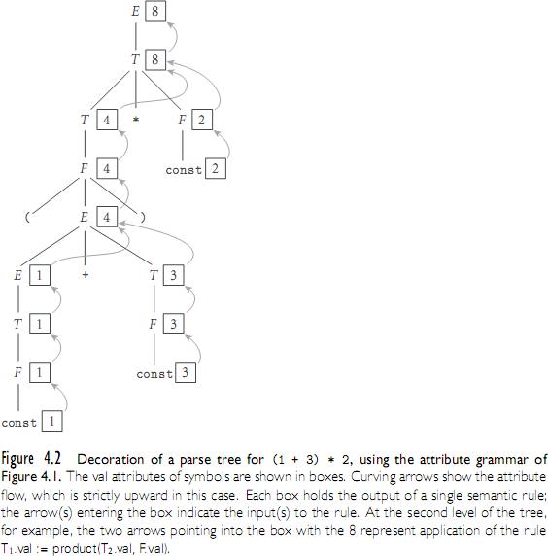
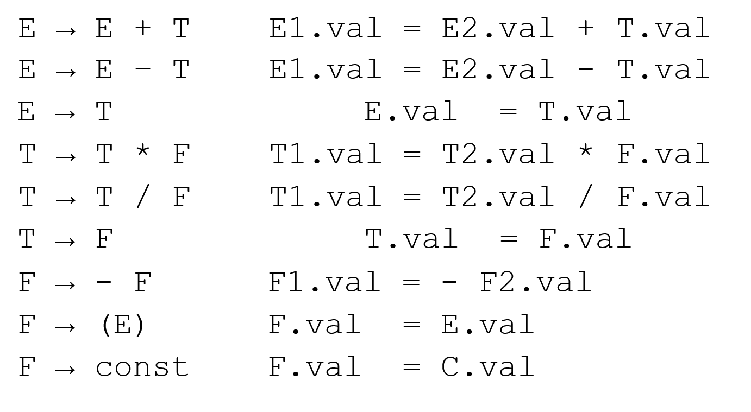
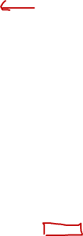
Evaluating Attributes

Slide 27
Evaluating Attributes
This is a very simple attribute grammar:
  Each symbol has at most one attribute
    the punctuation marks have no attributes
These attributes are all so-called SYNTHESIZED attributes:
  They are calculated only from the attributes of things below them in the parse tree

Slide 28
Evaluating Attributes
In general, we are allowed both synthesized and INHERITED attributes:
  Inherited attributes may depend on things above or to the side of them in the parse tree
  Tokens have only synthesized attributes, initialized by the scanner (name of an identifier, value of a constant, etc.).
  Inherited attributes of the start symbol constitute run-time parameters of the compiler

