Slide 1
WEEK 02
Motion in One Dimension
Aug 31-Sep 4 • Giancoli Chapter 2
Muhammad Nauman • PHYS 2325 • Fall 2026
Notes:
Teaching focus: Motion in One Dimension.
[Sources]
- PHYS 2325 University Physics I Fall 2026 syllabus and semester calendar.
[/Sources]

Slide 2
PHYS 2325 | University Physics I
Week 02 • Aug 31-Sep 4 • Giancoli Chapter 2
This week follows one connected learning path
01
02
03
MON AUG 31
Position, Displacement, and Velocity
WED SEP 2
Acceleration and Constant-Acceleration Motion
FRI SEP 4
Problem Solving, Free Fall, and Variable Acceleration
By week's end: Describe one-dimensional motion with graphs, derivatives, constant-acceleration models, and free-fall reasoning.
Notes:
Teaching focus: This week follows one connected learning path.
[Sources]
- PHYS 2325 University Physics I Fall 2026 syllabus and semester calendar.
[/Sources]

Slide 3
LECTURE 01
Position, Displacement, and Velocity
Mon Aug 31 • Giancoli Ch. 2
Muhammad Nauman • PHYS 2325 • Fall 2026
Notes:
Teaching focus: Position, Displacement, and Velocity.
[Sources]
- PHYS 2325 University Physics I Fall 2026 syllabus and semester calendar.
[/Sources]

Slide 4
PHYS 2325 | University Physics I
Lecture 01 • Mon Aug 31 • Giancoli Ch. 2
Learning outcomes
Define and represent reference frames and displacement.
Derive and interpret average velocity.
Apply instantaneous velocity.
Check units, vector directions, assumptions, and limiting behavior in every solution.
Notes:
Teaching focus: Learning outcomes.
[Sources]
- PHYS 2325 University Physics I Fall 2026 syllabus and semester calendar.
[/Sources]

Slide 5
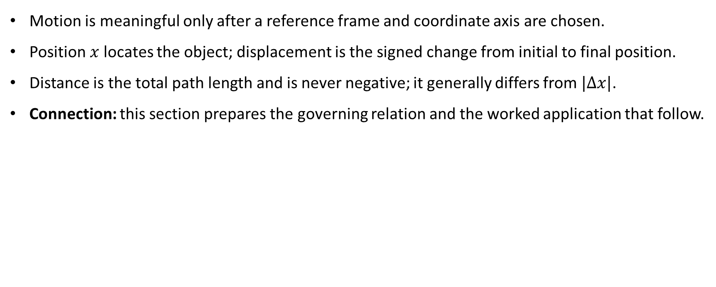
PHYS 2325 | University Physics I
Lecture 01 • Mon Aug 31 • Giancoli Ch. 2
Reference Frames and Displacement
Motion is meaningful only after a reference frame and coordinate axis are chosen.
Position $x$ locates the object; displacement is the signed change from initial to final position.
Distance is the total path length and is never negative; it generally differs from $|Δx|$.
Connection: this section prepares the governing relation and the worked application that follow.
Notes:
Teaching focus: Concept • Reference Frames and Displacement.
[Sources]
- Douglas C. Giancoli, Physics for Scientists and Engineers, 5th ed., Chapter 2, Section 2-1, starting p. 21.
[/Sources]

Slide 6
PHYS 2325 | University Physics I
Lecture 01 • Mon Aug 31 • Giancoli Ch. 2
Describing Motion: What Is Kinematics?
Kinematics describes how an object moves without first asking what forces cause the motion.
In this chapter, we study one-dimensional motion: motion along a straight line.
The object’s position can therefore be described using a single coordinate axis, usually the 𝑥-axis.
Motion along curved paths or in two and three dimensions will be introduced in Chapter 3.
Rotational motion will be studied separately in Chapters 10 and 11.
Notes:
Teaching focus: Concept • Reference Frames and Displacement.
[Sources]
- Douglas C. Giancoli, Physics for Scientists and Engineers, 5th ed., Chapter 2, Section 2-1, starting p. 21.
[/Sources]

Slide 7
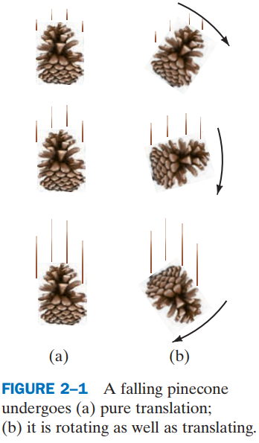
PHYS 2325 | University Physics I
Lecture 01 • Mon Aug 31 • Giancoli Ch. 2
Translational Motion and Rotational Motion
An object undergoes translational motion when it moves from one location to another.
In one-dimensional translation, the object follows a straight-line path.
An object undergoes rotational motion when it turns about an axis.
A real object can translate and rotate simultaneously, but Chapter 2 initially concentrates on translation without rotation.
Separating these types of motion allows us to develop the basic language of kinematics systematically.
Notes:
Teaching focus: Concept • Reference Frames and Displacement.
[Sources]
- Douglas C. Giancoli, Physics for Scientists and Engineers, 5th ed., Chapter 2, Section 2-1, starting p. 21.
[/Sources]

Slide 8
PHYS 2325 | University Physics I
Lecture 01 • Mon Aug 31 • Giancoli Ch. 2
The Particle Model
In many problems, the object’s physical size and shape do not affect the motion being studied.
We can then represent the object as an idealized particle—a mathematical point with position but no spatial dimensions.
A point particle can undergo translational motion, but its internal rotation and shape are ignored.
This does not mean that the real object is physically a point; it is a simplifying model.
The particle model is appropriate when the object’s size is small compared with the distance over which it moves.
Examples include treating a billiard ball moving across a table or a spacecraft traveling toward the Moon as particles.
Notes:
Teaching focus: Concept • Reference Frames and Displacement.
[Sources]
- Douglas C. Giancoli, Physics for Scientists and Engineers, 5th ed., Chapter 2, Section 2-1, starting p. 21.
[/Sources]

Slide 9
PHYS 2325 | University Physics I
Lecture 01 • Mon Aug 31 • Giancoli Ch. 2
From the particle model to a reference frame
The particle model represents the moving object as a point.
However, describing the particle as “moving” is not sufficient.
We must specify:
  Its position relative to what?
  The direction in which it moves.
  The coordinate system used to describe its position.
Motion is always measured relative to a chosen reference frame.
Question: If you are sitting inside a moving train, are you at rest or in motion?
The answer depends on the observer’s reference frame.
Notes:
Teaching focus: Concept • Reference Frames and Displacement.
[Sources]
- Douglas C. Giancoli, Physics for Scientists and Engineers, 5th ed., Chapter 2, Section 2-1, starting p. 21.
[/Sources]

Slide 10
PHYS 2325 | University Physics I
Lecture 01 • Mon Aug 31 • Giancoli Ch. 2
What is a reference frame?
A reference frame is a coordinate system, together with an observer, relative to which position and motion are measured.
Position, distance, velocity, and speed must be stated relative to a reference frame.
The same object can have different velocities in different reference frames.
In everyday situations, “relative to Earth” is normally assumed.
The reference frame must be stated whenever the meaning could be ambiguous.
Key message:
Motion is relative—not absolute.
Notes:
Teaching focus: Concept • Reference Frames and Displacement.
[Sources]
- Douglas C. Giancoli, Physics for Scientists and Engineers, 5th ed., Chapter 2, Section 2-1, starting p. 21.
[/Sources]

Slide 11
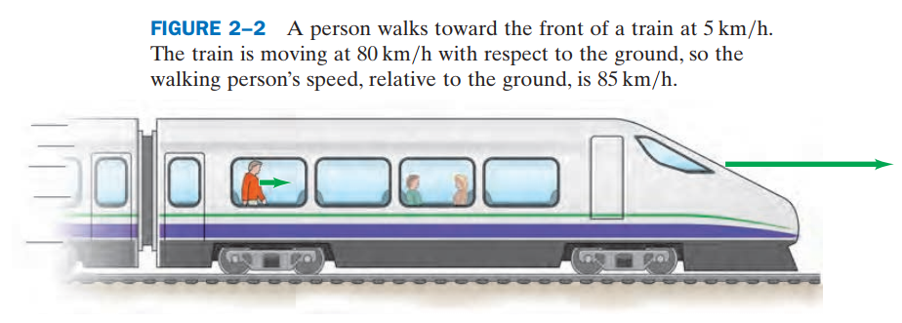
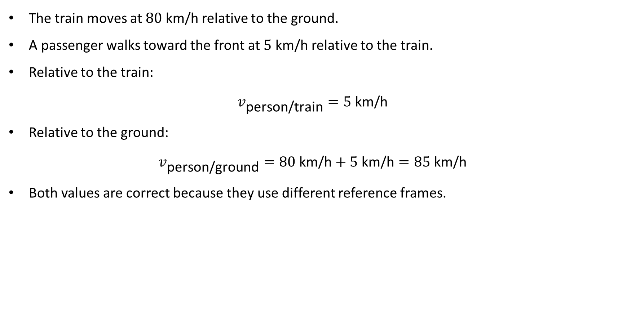
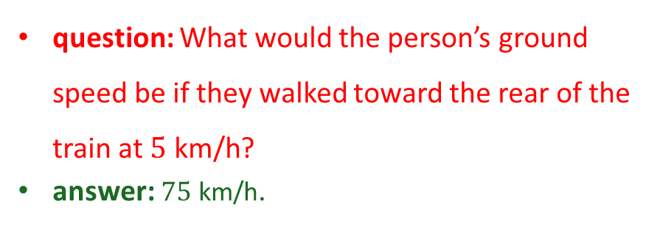
PHYS 2325 | University Physics I
Lecture 01 • Mon Aug 31 • Giancoli Ch. 2
Example: Walking inside a moving train
The train moves at $80\text{ km/h}$ relative to the ground.
A passenger walks toward the front at $5\text{ km/h}$ relative to the train.
Relative to the train:
$$v_{\text{person/train}}=5\text{ km/h}$$
Relative to the ground:
$$v_{\text{person/ground}}=80\text{ km/h}+5\text{ km/h}=85\text{ km/h}$$
Both values are correct because they use different reference frames.
question: What would the person’s ground speed be if they walked toward the rear of the train at $5\text{ km/h}$?
answer: $75\text{ km/h}$.
Notes:
Teaching focus: Concept • Reference Frames and Displacement.
[Sources]
- Douglas C. Giancoli, Physics for Scientists and Engineers, 5th ed., Chapter 2, Section 2-1, starting p. 21.
[/Sources]

Slide 12
PHYS 2325 | University Physics I
Lecture 01 • Mon Aug 31 • Giancoli Ch. 2
Choosing a coordinate system
A reference frame is commonly represented using coordinate axes.
We are free to choose:
  The location of the origin.
  The direction of the 𝑥-axis.
  The direction considered positive.
The origin is the point where the coordinates are zero.
On the conventional 𝑥-axis:
  Positions to the right of the origin are positive.
  Positions to the left are negative.
On the conventional 𝑦-axis:
  Positions above the origin are positive.
  Positions below are negative.
Important: The choice of positive direction is a convention, not a law of nature.
Notes:
Teaching focus: Concept • Reference Frames and Displacement.
[Sources]
- Douglas C. Giancoli, Physics for Scientists and Engineers, 5th ed., Chapter 2, Section 2-1, starting p. 21.
[/Sources]

Slide 13
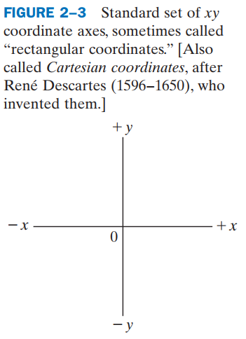
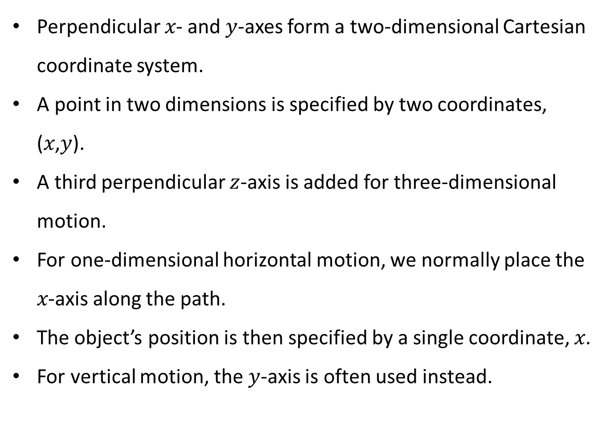
PHYS 2325 | University Physics I
Lecture 01 • Mon Aug 31 • Giancoli Ch. 2
Cartesian coordinates and one-dimensional motion
Perpendicular 𝑥- and 𝑦-axes form a two-dimensional Cartesian coordinate system.
A point in two dimensions is specified by two coordinates, (𝑥,𝑦).
A third perpendicular $z$-axis is added for three-dimensional motion.
For one-dimensional horizontal motion, we normally place the 𝑥-axis along the path.
The object’s position is then specified by a single coordinate, 𝑥.
For vertical motion, the 𝑦-axis is often used instead.
Notes:
Teaching focus: Concept • Reference Frames and Displacement.
[Sources]
- Douglas C. Giancoli, Physics for Scientists and Engineers, 5th ed., Chapter 2, Section 2-1, starting p. 21.
[/Sources]

Slide 14
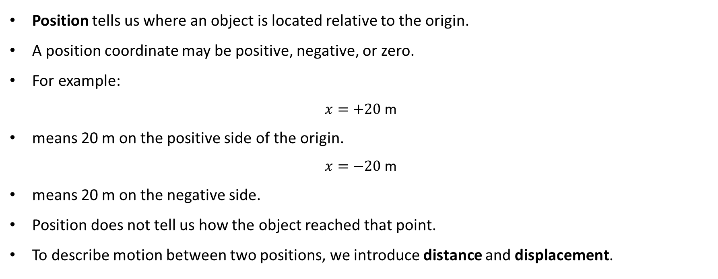
PHYS 2325 | University Physics I
Lecture 01 • Mon Aug 31 • Giancoli Ch. 2
Position is not the same as distance
Position tells us where an object is located relative to the origin.
A position coordinate may be positive, negative, or zero.
For example:
$$x=+20\text{ m}$$
means 20 m on the positive side of the origin.
$$x=−20\text{ m}$$
means 20 m on the negative side.
Position does not tell us how the object reached that point.
To describe motion between two positions, we introduce distance and displacement.
Notes:
Teaching focus: Concept • Reference Frames and Displacement.
[Sources]
- Douglas C. Giancoli, Physics for Scientists and Engineers, 5th ed., Chapter 2, Section 2-1, starting p. 21.
[/Sources]

Slide 15
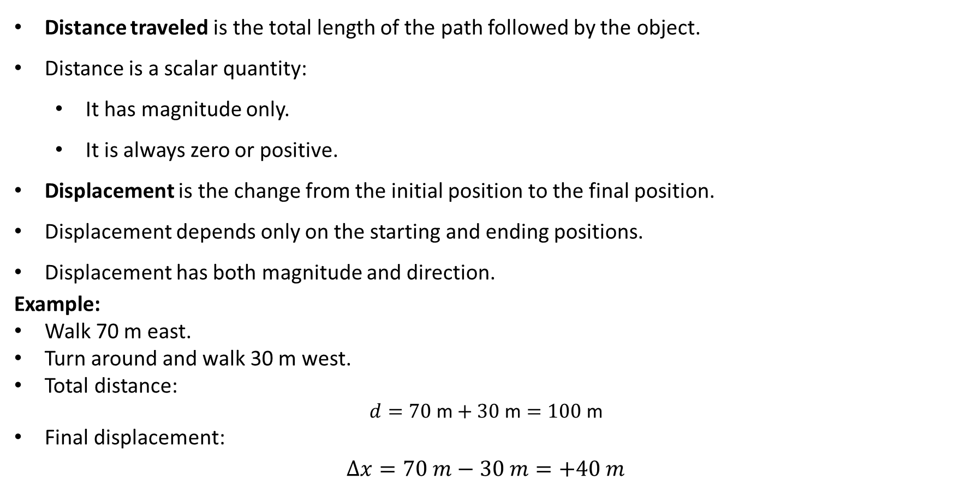
PHYS 2325 | University Physics I
Lecture 01 • Mon Aug 31 • Giancoli Ch. 2
Distance traveled versus displacement
Distance traveled is the total length of the path followed by the object.
Distance is a scalar quantity:
  It has magnitude only.
  It is always zero or positive.
Displacement is the change from the initial position to the final position.
Displacement depends only on the starting and ending positions.
Displacement has both magnitude and direction.
Example:
Walk 70 m east.
Turn around and walk 30 m west.
Total distance:
$$d=70\text{ m}+30\text{ m}=100\text{ m}$$
Final displacement:
$$Δx=70 m−30 m=+40 m$$
N
W
70 m
E
30 m
S
Notes:
Teaching focus: Concept • Reference Frames and Displacement.
[Sources]
- Douglas C. Giancoli, Physics for Scientists and Engineers, 5th ed., Chapter 2, Section 2-1, starting p. 21.
[/Sources]

Slide 16
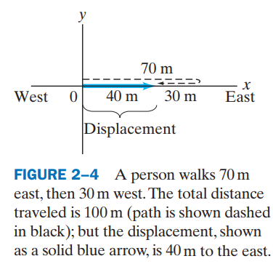
PHYS 2325 | University Physics I
Lecture 01 • Mon Aug 31 • Giancoli Ch. 2
Distance traveled versus displacement
The complete path length is 100 m.
The initial and final positions are separated by only 40 m.
The blue arrow connects the starting position directly to the final position.
That arrow represents the displacement vector.
Distance and displacement are therefore not generally equal.
Question: If the person returns completely to the starting point, what are the distance and displacement?
Answer: Distance is nonzero; displacement is zero.
Notes:
Teaching focus: Concept • Reference Frames and Displacement.
[Sources]
- Douglas C. Giancoli, Physics for Scientists and Engineers, 5th ed., Chapter 2, Section 2-1, starting p. 21.
[/Sources]

Slide 17
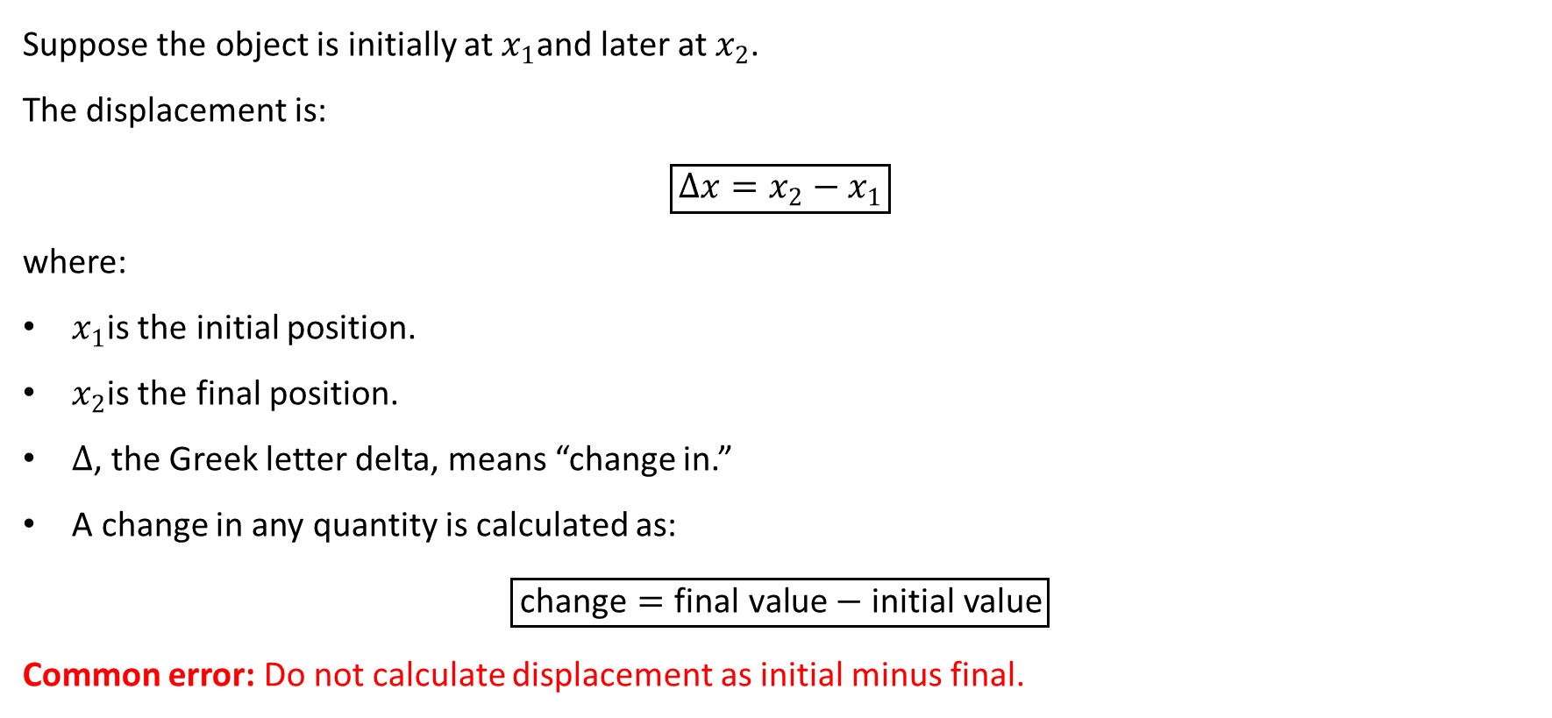
PHYS 2325 | University Physics I
Lecture 01 • Mon Aug 31 • Giancoli Ch. 2
Displacement: the governing relation
Suppose the object is initially at $x_{1}$and later at $x_{2}$.
The displacement is:
$$\boxed{Δx=x_{2}−x_{1}}$$
where:
$x_{1}$is the initial position.
$x_{2}$is the final position.
$Δ$, the Greek letter delta, means “change in.”
A change in any quantity is calculated as:
$$\boxed{\text{change}=\text{final value}−\text{initial value}}$$
Common error: Do not calculate displacement as initial minus final.
Notes:
Teaching focus: Concept • Reference Frames and Displacement.
[Sources]
- Douglas C. Giancoli, Physics for Scientists and Engineers, 5th ed., Chapter 2, Section 2-1, starting p. 21.
[/Sources]

Slide 18
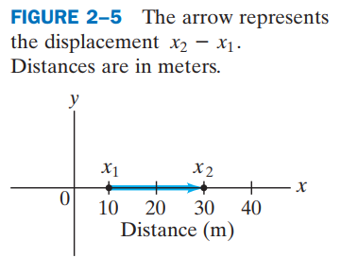
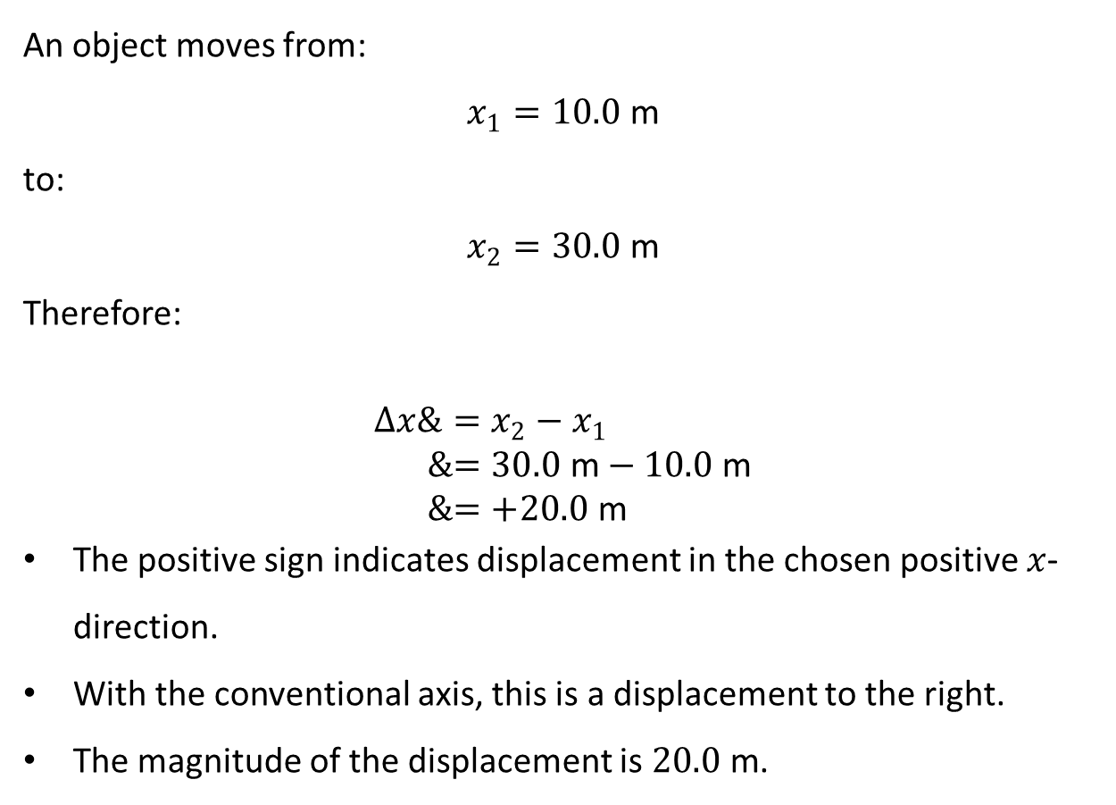
PHYS 2325 | University Physics I
Lecture 01 • Mon Aug 31 • Giancoli Ch. 2
Example: Positive displacement
An object moves from:
$$x_{1}=10.0\text{ m}$$
to:
$$x_{2}=30.0\text{ m}$$
Therefore:
$$\begin{aligned}Δx&=x_{2}−x_{1} \\ &=30.0\text{ m}−10.0\text{ m} \\ &=+20.0\text{ m}\end{aligned}$$
The positive sign indicates displacement in the chosen positive $x$-direction.
With the conventional axis, this is a displacement to the right.
The magnitude of the displacement is $20.0\text{ m}$.
Notes:
Teaching focus: Concept • Reference Frames and Displacement.
[Sources]
- Douglas C. Giancoli, Physics for Scientists and Engineers, 5th ed., Chapter 2, Section 2-1, starting p. 21.
[/Sources]

Slide 19
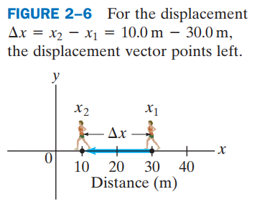
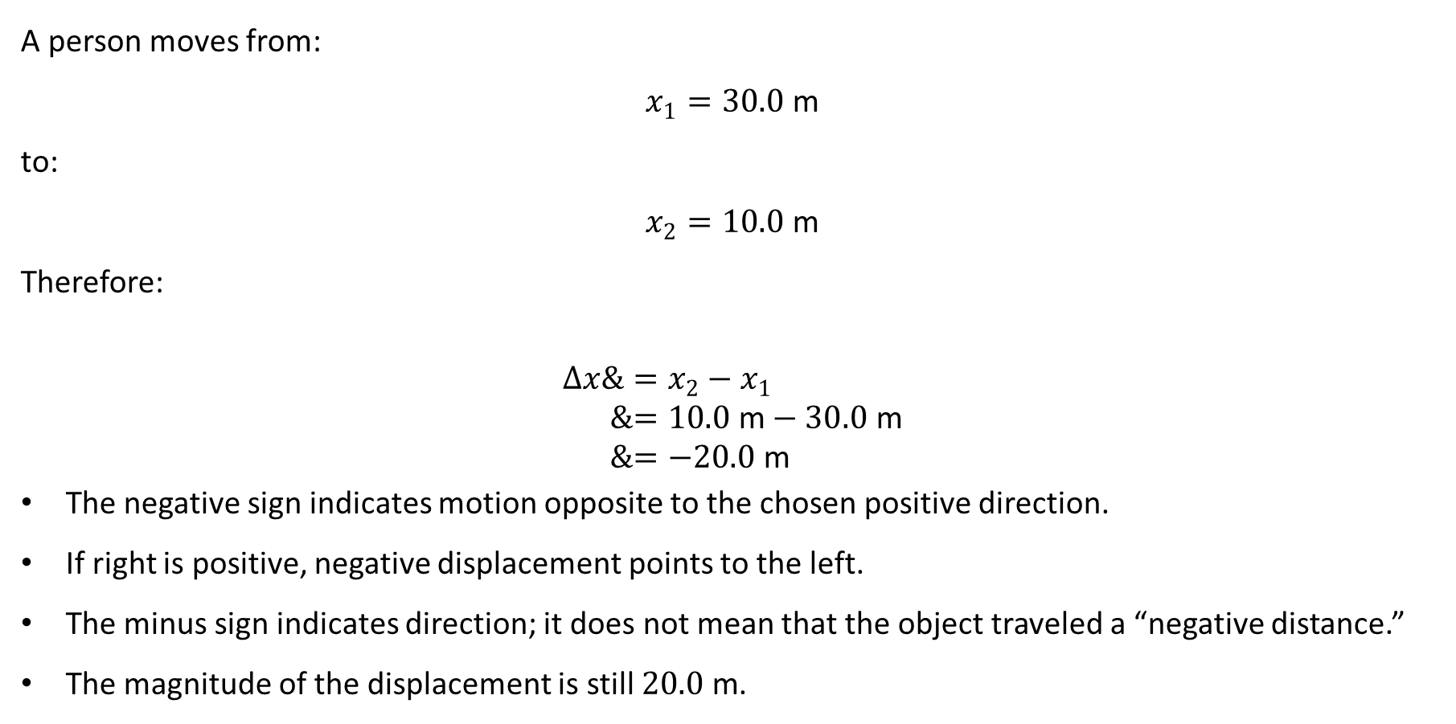
PHYS 2325 | University Physics I
Lecture 01 • Mon Aug 31 • Giancoli Ch. 2
Example: Negative displacement
A person moves from:
$$x_{1}=30.0\text{ m}$$
to:
$$x_{2}=10.0\text{ m}$$
Therefore:
$$\begin{aligned}Δx&=x_{2}−x_{1} \\ &=10.0\text{ m}−30.0\text{ m} \\ &=−20.0\text{ m}\end{aligned}$$
The negative sign indicates motion opposite to the chosen positive direction.
If right is positive, negative displacement points to the left.
The minus sign indicates direction; it does not mean that the object traveled a “negative distance.”
The magnitude of the displacement is still $20.0\text{ m}$.
Notes:
Teaching focus: Concept • Reference Frames and Displacement.
[Sources]
- Douglas C. Giancoli, Physics for Scientists and Engineers, 5th ed., Chapter 2, Section 2-1, starting p. 21.
[/Sources]

Slide 20
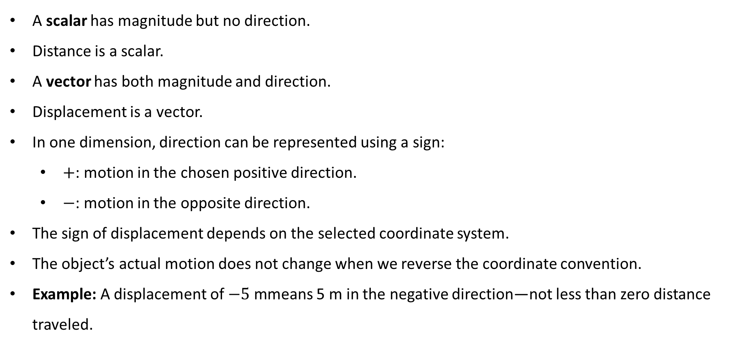
PHYS 2325 | University Physics I
Lecture 01 • Mon Aug 31 • Giancoli Ch. 2
Why displacement is a vector
A scalar has magnitude but no direction.
Distance is a scalar.
A vector has both magnitude and direction.
Displacement is a vector.
In one dimension, direction can be represented using a sign:
  $+$: motion in the chosen positive direction.
  $−$: motion in the opposite direction.
The sign of displacement depends on the selected coordinate system.
The object’s actual motion does not change when we reverse the coordinate convention.
Example: A displacement of $−5\text{ m}$means 5 m in the negative direction—not less than zero distance traveled.
Notes:
Teaching focus: Concept • Reference Frames and Displacement.
[Sources]
- Douglas C. Giancoli, Physics for Scientists and Engineers, 5th ed., Chapter 2, Section 2-1, starting p. 21.
[/Sources]

Slide 21
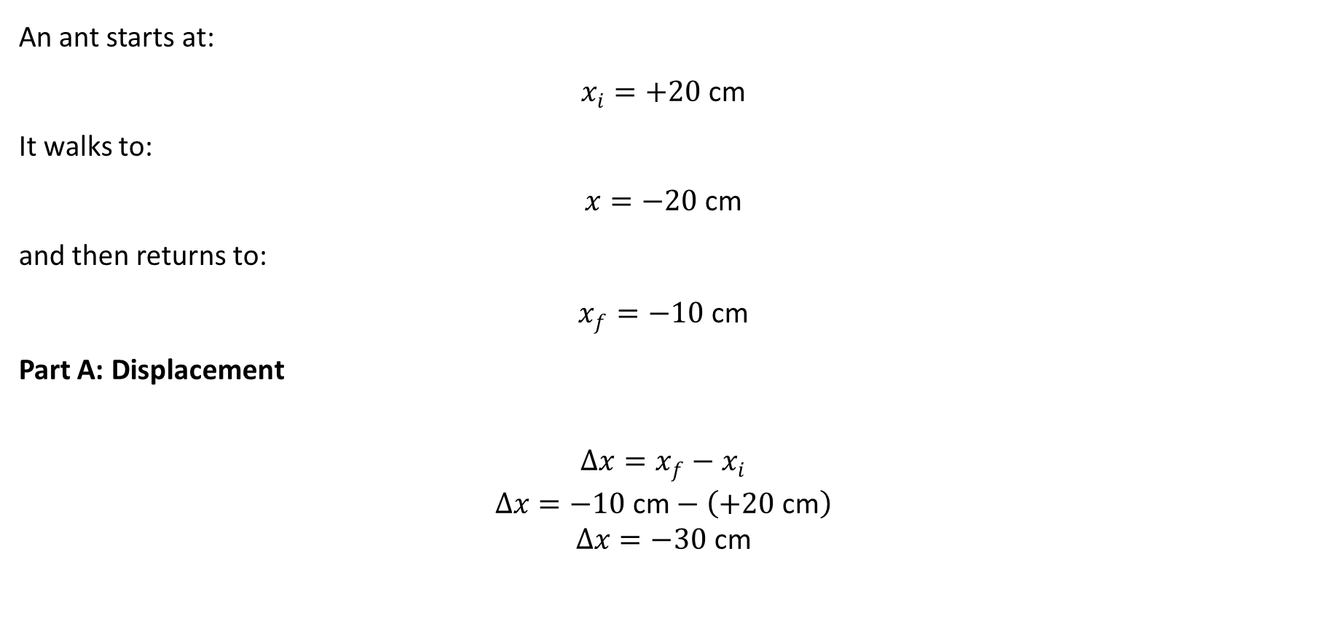
PHYS 2325 | University Physics I
Lecture 01 • Mon Aug 31 • Giancoli Ch. 2
Guided practice: The ant’s journey
An ant starts at:
$$x_{i}=+20\text{ cm}$$
It walks to:
$$x=−20\text{ cm}$$
and then returns to:
$$x_{f}=−10\text{ cm}$$
Part A: Displacement
$$\begin{aligned}Δx=x_{f}−x_{i} \\ Δx=−10\text{ cm}−\left(+20\text{ cm}\right) \\ Δx=−30\text{ cm}\end{aligned}$$
Notes:
Teaching focus: Concept • Reference Frames and Displacement.
[Sources]
- Douglas C. Giancoli, Physics for Scientists and Engineers, 5th ed., Chapter 2, Section 2-1, starting p. 21.
[/Sources]

Slide 22
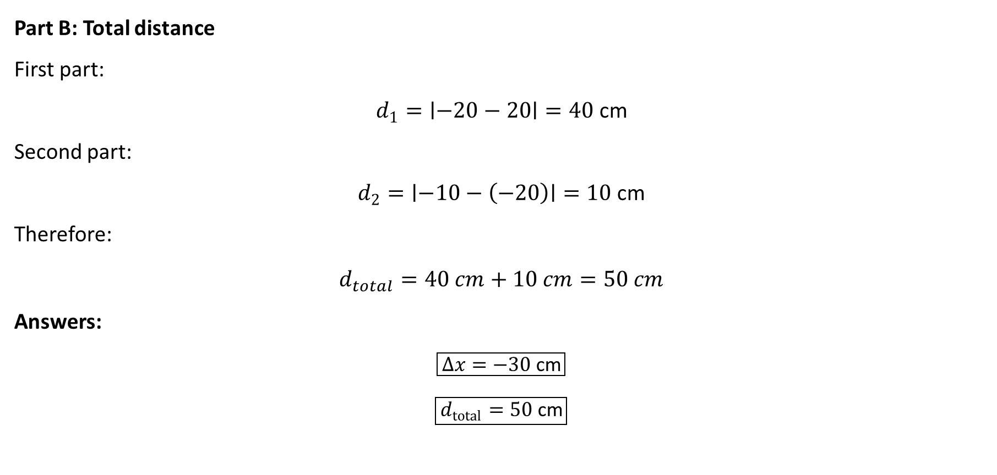
PHYS 2325 | University Physics I
Lecture 01 • Mon Aug 31 • Giancoli Ch. 2
Guided practice: The ant’s journey…..
Part B: Total distance
First part:
$$d_{1}=∣−20−20∣=40\text{ cm}$$
Second part:
$$d_{2}=∣−10−\left(−20\right)∣=10\text{ cm}$$
Therefore:
$$d_{total}​=40 cm+10 cm=50 cm$$
Answers:
$$\boxed{Δx=−30\text{ cm}}$$
$$\boxed{d_{total}=50\text{ cm}}$$
Notes:
Teaching focus: Concept • Reference Frames and Displacement.
[Sources]
- Douglas C. Giancoli, Physics for Scientists and Engineers, 5th ed., Chapter 2, Section 2-1, starting p. 21.
[/Sources]

Slide 23
PHYS 2325 | University Physics I
Lecture 01 • Mon Aug 31 • Giancoli Ch. 2
From displacement to velocity
Displacement tells us how much an object’s position changes.
It does not tell us how rapidly that change occurs.
To describe how fast motion occurs, we must include the elapsed time.
This leads to two related but distinct quantities:
  Average speed
  Average velocity
Distance leads to average speed, whereas displacement leads to average velocity.
Notes:
Teaching focus: Concept • Reference Frames and Displacement.
[Sources]
- Douglas C. Giancoli, Physics for Scientists and Engineers, 5th ed., Chapter 2, Section 2-1, starting p. 21.
[/Sources]

Slide 24
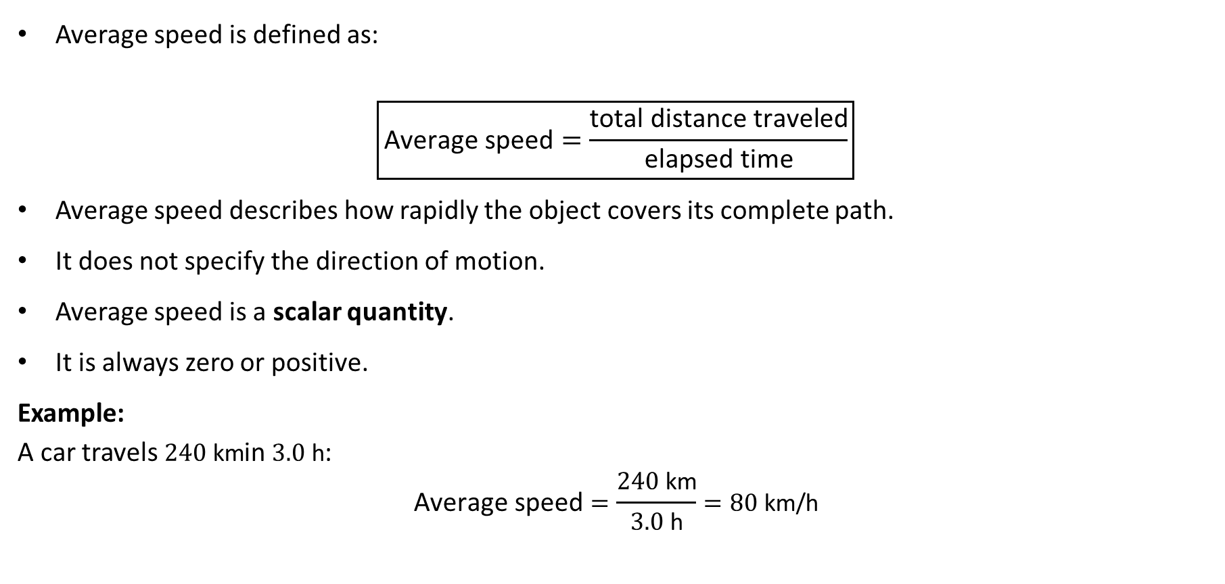
PHYS 2325 | University Physics I
Lecture 01 • Mon Aug 31 • Giancoli Ch. 2
Average speed
Average speed is defined as:
$$\boxed{\text{Average speed}=\frac{\text{total distance traveled}}{\text{elapsed time}}}$$
Average speed describes how rapidly the object covers its complete path.
It does not specify the direction of motion.
Average speed is a scalar quantity.
It is always zero or positive.
Example:
A car travels $240\text{ km}$in $3.0\text{ h}$:
$$\text{Average speed}=\frac{240\text{ km}}{3.0\text{ h}}=80\text{ km/h}$$
Notes:
Teaching focus: Concept • Reference Frames and Displacement.
[Sources]
- Douglas C. Giancoli, Physics for Scientists and Engineers, 5th ed., Chapter 2, Section 2-1, starting p. 21.
[/Sources]

Slide 25
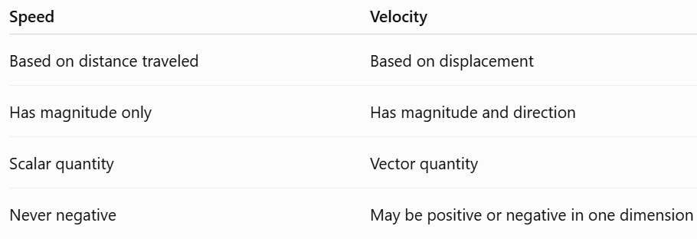
PHYS 2325 | University Physics I
Lecture 01 • Mon Aug 31 • Giancoli Ch. 2
Speed and velocity are different
In everyday language, “speed” and “velocity” are often used interchangeably.
In physics, they have different definitions.
A negative velocity does not mean the object is moving slowly.
It means the object is moving in the selected negative direction.
Concept check: Can two objects have the same speed but different velocities?
Answer: Yes. They may move equally fast in opposite directions.
Notes:
Teaching focus: Concept • Reference Frames and Displacement.
[Sources]
- Douglas C. Giancoli, Physics for Scientists and Engineers, 5th ed., Chapter 2, Section 2-1, starting p. 21.
[/Sources]

Slide 26
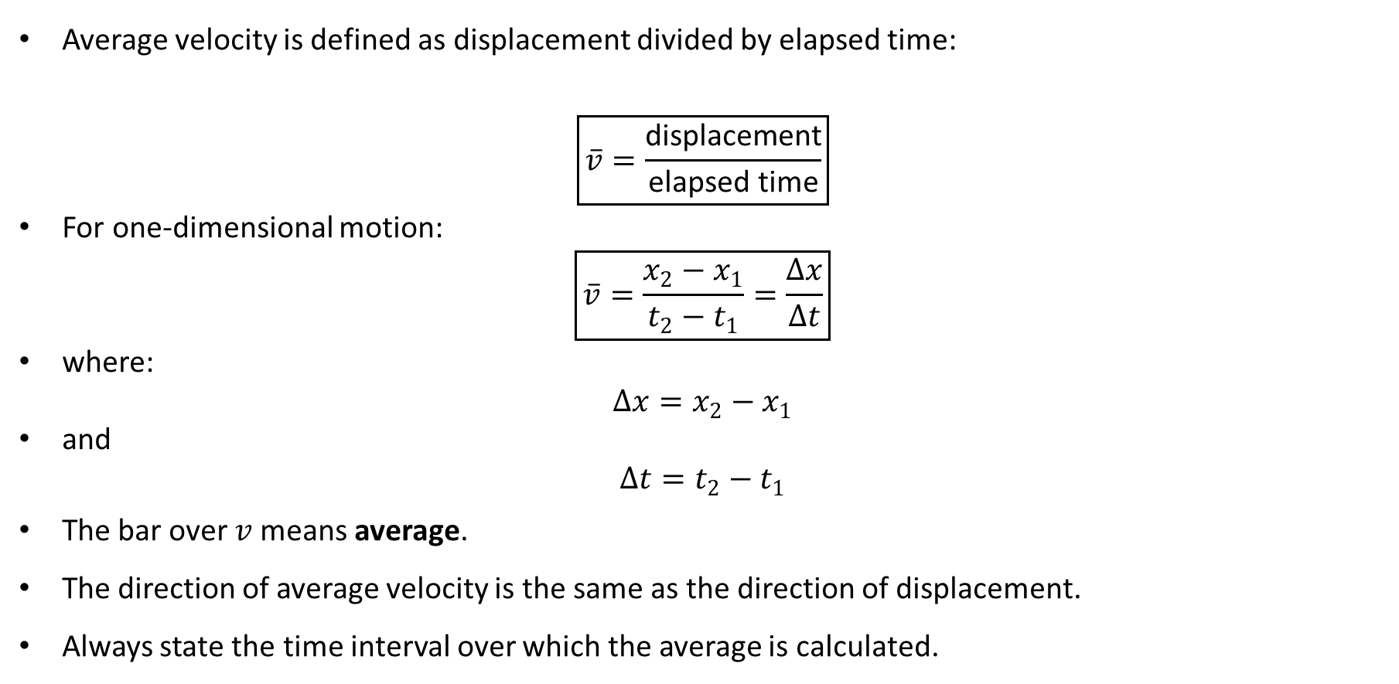
PHYS 2325 | University Physics I
Lecture 01 • Mon Aug 31 • Giancoli Ch. 2
Average velocity
Average velocity is defined as displacement divided by elapsed time:
$$\boxed{\overline{v}=\frac{\text{displacement}}{\text{elapsed time}}}$$
For one-dimensional motion:
$$\boxed{\overline{v}=\frac{x_{2}−x_{1}}{t_{2}−t_{1}}=\frac{Δx}{Δt}}$$
where:
$$Δx=x_{2}−x_{1}$$
and
$$Δt=t_{2}−t_{1}$$
The bar over $v$means average.
The direction of average velocity is the same as the direction of displacement.
Always state the time interval over which the average is calculated.
Notes:
Teaching focus: Concept • Reference Frames and Displacement.
[Sources]
- Douglas C. Giancoli, Physics for Scientists and Engineers, 5th ed., Chapter 2, Section 2-1, starting p. 21.
[/Sources]

Slide 27
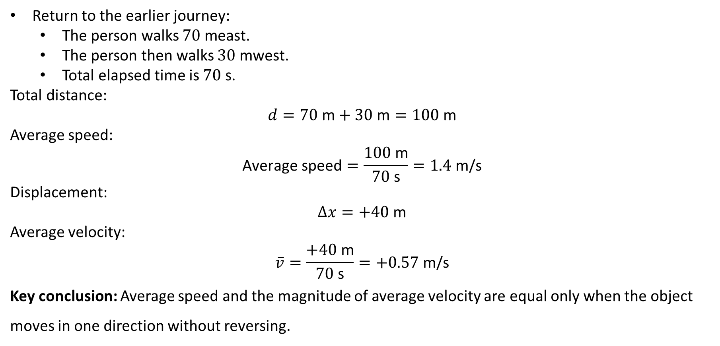
PHYS 2325 | University Physics I
Lecture 01 • Mon Aug 31 • Giancoli Ch. 2
Average speed and average velocity can differ
Return to the earlier journey:
  The person walks $70\text{ m}$east.
  The person then walks $30\text{ m}$west.
  Total elapsed time is $70\text{ s}$.
Total distance:
$$d=70\text{ m}+30\text{ m}=100\text{ m}$$
Average speed:
$$\text{Average speed}=\frac{100\text{ m}}{70\text{ s}}=1.4\text{ m/s}$$
Displacement:
$$Δx=+40\text{ m}$$
Average velocity:
$$\overline{v}=\frac{+40\text{ m}}{70\text{ s}}=+0.57\text{ m/s}$$
Key conclusion: Average speed and the magnitude of average velocity are equal only when the object moves in one direction without reversing.
Notes:
Teaching focus: Concept • Reference Frames and Displacement.
[Sources]
- Douglas C. Giancoli, Physics for Scientists and Engineers, 5th ed., Chapter 2, Section 2-1, starting p. 21.
[/Sources]

Slide 28
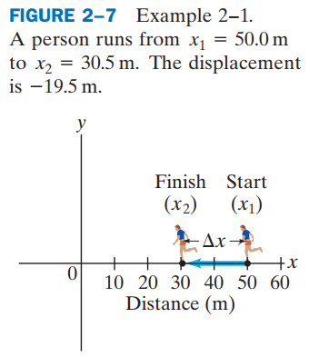
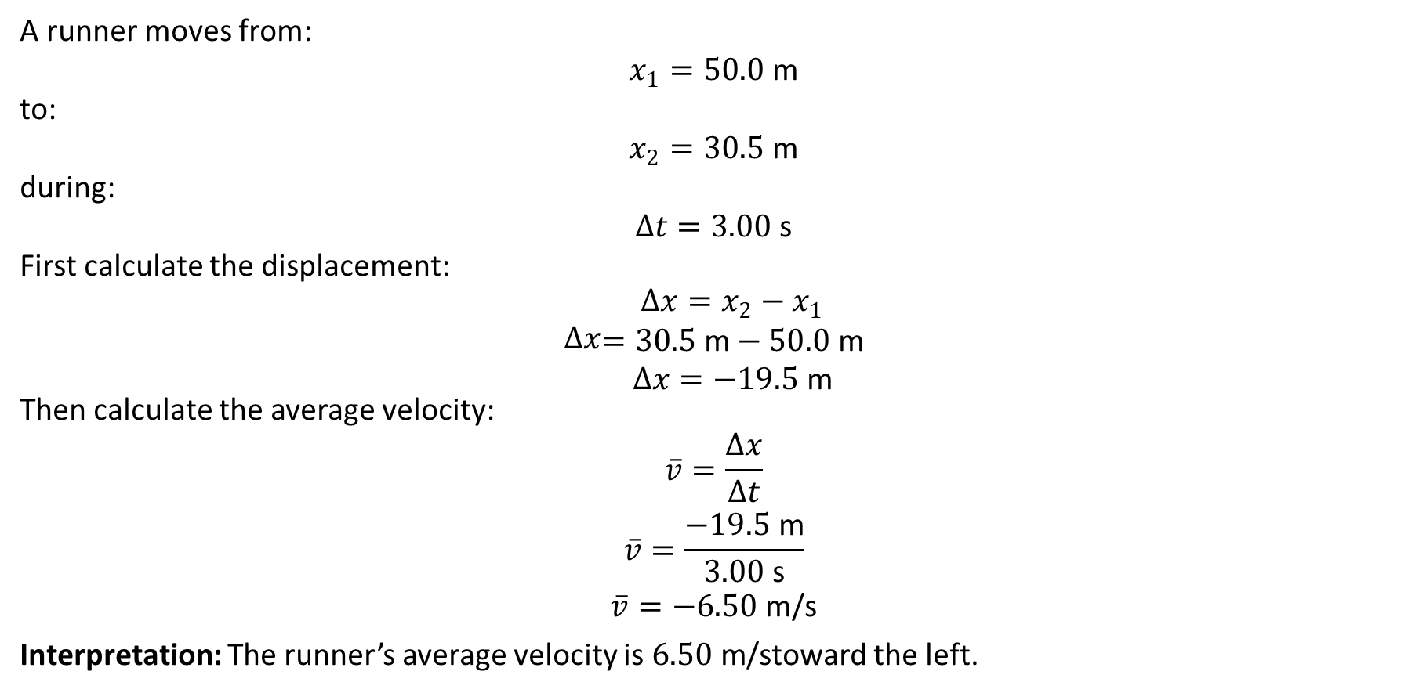
PHYS 2325 | University Physics I
Lecture 01 • Mon Aug 31 • Giancoli Ch. 2
Worked example: Runner’s average velocity
A runner moves from:
$$x_{1}=50.0\text{ m}$$
to:
$$x_{2}=30.5\text{ m}$$
during:
$$Δt=3.00\text{ s}$$
First calculate the displacement:
$$Δx\begin{aligned}Δx=x_{2}−x_{1} \\ =30.5\text{ m}−50.0\text{ m} \\ Δx=−19.5\text{ m}\end{aligned}$$
Then calculate the average velocity:
$$\begin{aligned}\overline{v}=\frac{Δx}{Δt} \\ \overline{v}=\frac{−19.5\text{ m}}{3.00\text{ s}} \\ \overline{v}=−6.50\text{ m/s}\end{aligned}$$
Interpretation: The runner’s average velocity is $6.50\text{ m/s}$toward the left.
Notes:
Teaching focus: Concept • Reference Frames and Displacement.
[Sources]
- Douglas C. Giancoli, Physics for Scientists and Engineers, 5th ed., Chapter 2, Section 2-1, starting p. 21.
[/Sources]

Slide 29
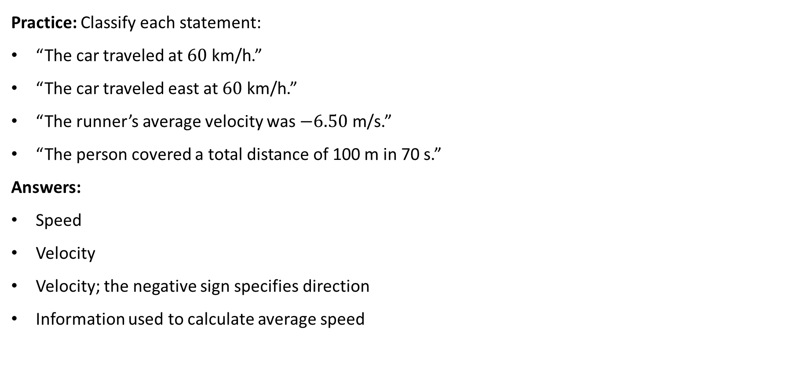
PHYS 2325 | University Physics I
Lecture 01 • Mon Aug 31 • Giancoli Ch. 2
Concept check: Speed or velocity?
Practice: Classify each statement:
“The car traveled at $60\text{ km/h}$.”
“The car traveled east at $60\text{ km/h}$.”
“The runner’s average velocity was $−6.50\text{ m/s}$.”
“The person covered a total distance of 100 m in 70 s.”
Answers:
Speed
Velocity
Velocity; the negative sign specifies direction
Information used to calculate average speed
Notes:
Teaching focus: Concept • Reference Frames and Displacement.
[Sources]
- Douglas C. Giancoli, Physics for Scientists and Engineers, 5th ed., Chapter 2, Section 2-1, starting p. 21.
[/Sources]

Slide 30
LECTURE 02
Acceleration and Constant-Acceleration Motion
Wed Sep 2 • Giancoli Ch. 2
Muhammad Nauman • PHYS 2325 • Fall 2026
Notes:
Teaching focus: Acceleration and Constant-Acceleration Motion.
[Sources]
- PHYS 2325 University Physics I Fall 2026 syllabus and semester calendar.
[/Sources]

Slide 31
PHYS 2325 | University Physics I
Lecture 02 • Wed Sep 2 • Giancoli Ch. 2
Learning outcomes
By the end of this lecture, students should be able to:
Distinguish average velocity from instantaneous velocity.
Interpret velocity as the slope of a position–time graph.
Calculate velocity from a position function.
Define average and instantaneous acceleration.
Interpret acceleration as the slope of a velocity–time graph.
Determine whether an object is speeding up or slowing down from the signs of 𝑣and 𝑎.
Distinguish velocity from acceleration.
Notes:
Teaching focus: Learning outcomes.
[Sources]
- PHYS 2325 University Physics I Fall 2026 syllabus and semester calendar.
[/Sources]

Slide 32
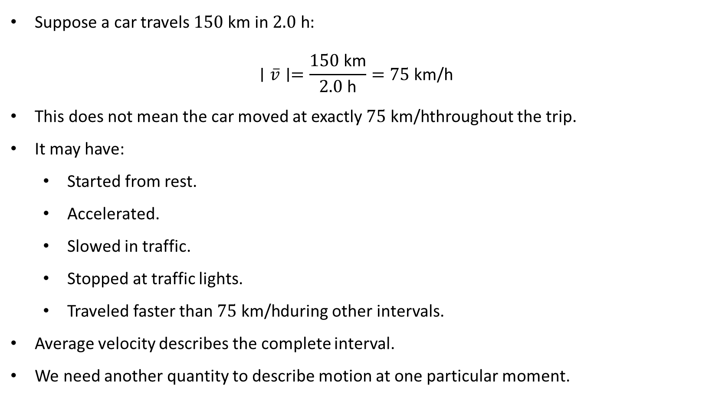
PHYS 2325 | University Physics I
Lecture 02 • Wed Sep 2 • Giancoli Ch. 2
Why average velocity is not enough
Suppose a car travels $150\text{ km}$in $2.0\text{ h}$:
$$∣\overline{v}∣=\frac{150\text{ km}}{2.0\text{ h}}=75\text{ km/h}$$
This does not mean the car moved at exactly $75\text{ km/h}$throughout the trip.
It may have:
  Started from rest.
  Accelerated.
  Slowed in traffic.
  Stopped at traffic lights.
  Traveled faster than $75\text{ km/h}$during other intervals.
Average velocity describes the complete interval.
We need another quantity to describe motion at one particular moment.
Notes:
Teaching focus: Learning outcomes.
[Sources]
- PHYS 2325 University Physics I Fall 2026 syllabus and semester calendar.
[/Sources]

Slide 33
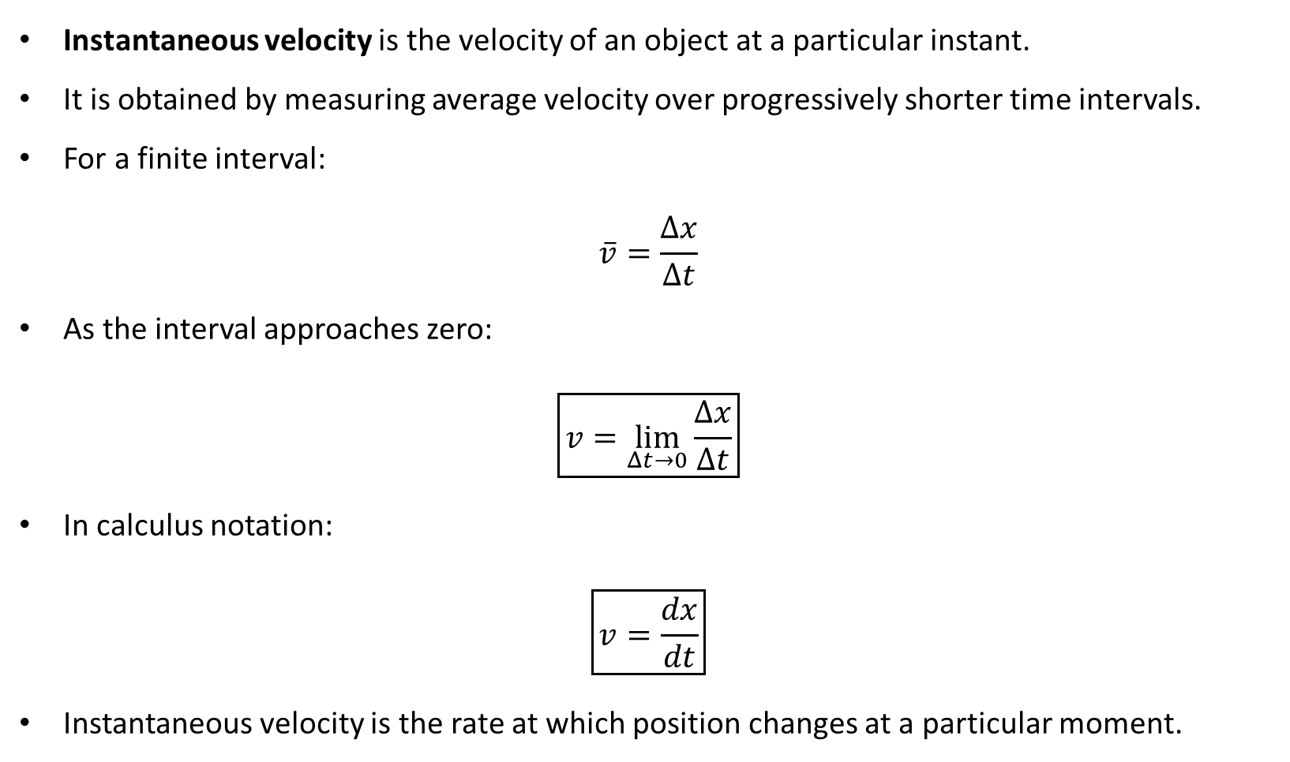
PHYS 2325 | University Physics I
Lecture 02 • Wed Sep 2 • Giancoli Ch. 2
Instantaneous velocity
Instantaneous velocity is the velocity of an object at a particular instant.
It is obtained by measuring average velocity over progressively shorter time intervals.
For a finite interval:
$$\overline{v}=\frac{Δx}{Δt}$$
As the interval approaches zero:
$$\boxed{v=\lim_{Δt→0}\frac{Δx}{Δt}}$$
In calculus notation:
$$\boxed{v=\frac{dx}{dt}}$$
Instantaneous velocity is the rate at which position changes at a particular moment.
Notes:
Teaching focus: Learning outcomes.
[Sources]
- PHYS 2325 University Physics I Fall 2026 syllabus and semester calendar.
[/Sources]

Slide 34
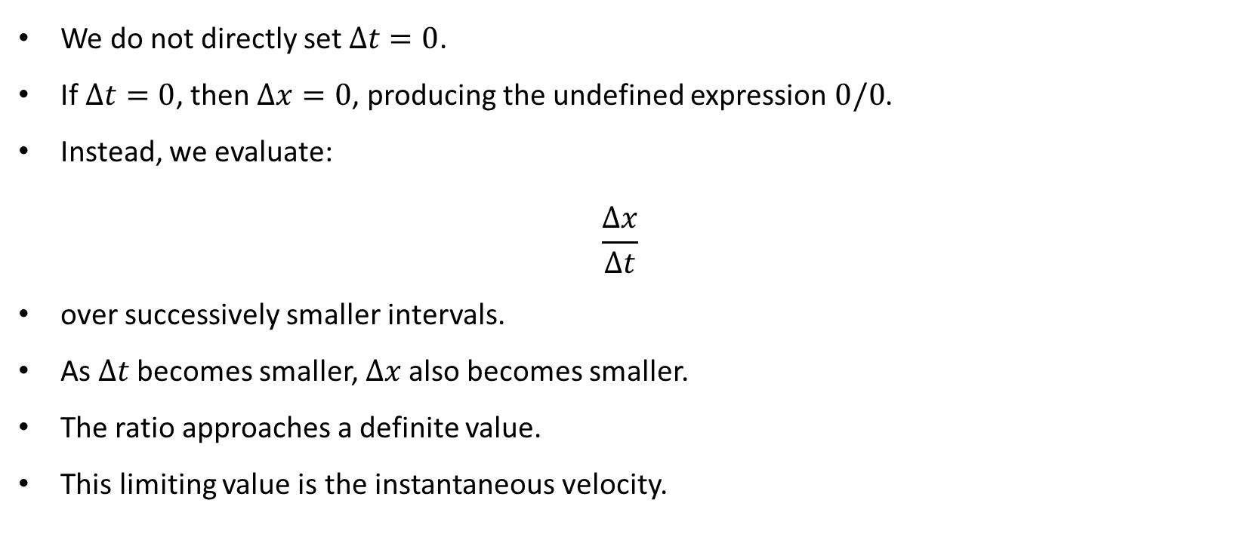
PHYS 2325 | University Physics I
Lecture 02 • Wed Sep 2 • Giancoli Ch. 2
What does the limit mean?
We do not directly set $Δt=0$.
If $Δt=0$, then $Δx=0$, producing the undefined expression $0/0$.
Instead, we evaluate:
$$\frac{Δx}{Δt}$$
over successively smaller intervals.
As $Δt$ becomes smaller, $Δx$also becomes smaller.
The ratio approaches a definite value.
This limiting value is the instantaneous velocity.
Notes:
Teaching focus: Learning outcomes.
[Sources]
- PHYS 2325 University Physics I Fall 2026 syllabus and semester calendar.
[/Sources]

Slide 35
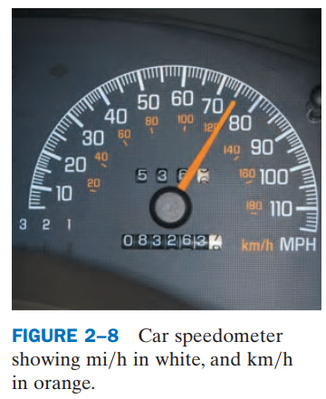
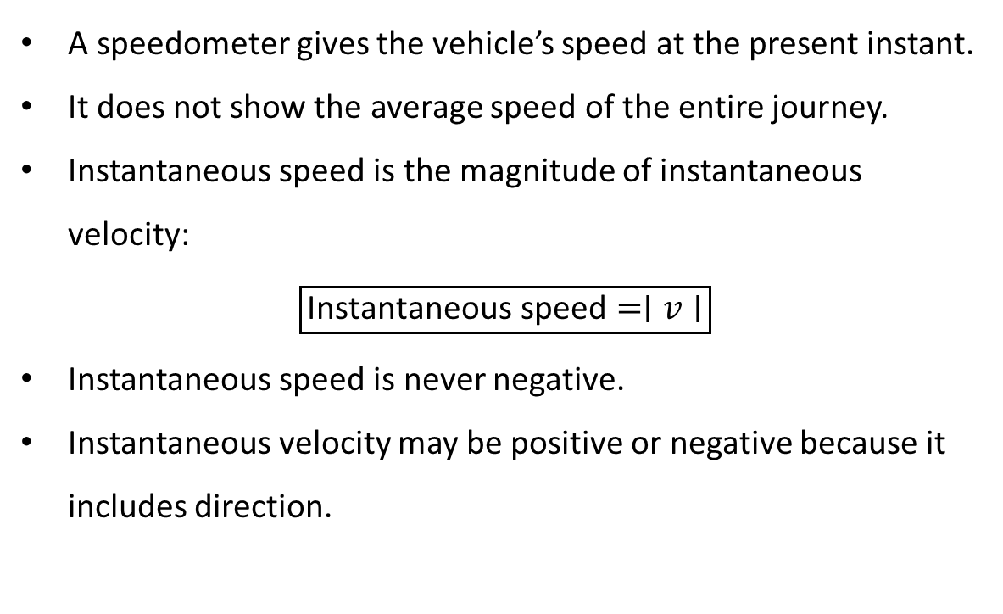
PHYS 2325 | University Physics I
Lecture 02 • Wed Sep 2 • Giancoli Ch. 2
What does a speedometer measure?
A speedometer gives the vehicle’s speed at the present instant.
It does not show the average speed of the entire journey.
Instantaneous speed is the magnitude of instantaneous velocity:
$$\boxed{\text{Instantaneous speed}=∣v∣}$$
Instantaneous speed is never negative.
Instantaneous velocity may be positive or negative because it includes direction.
Notes:
Teaching focus: Learning outcomes.
[Sources]
- PHYS 2325 University Physics I Fall 2026 syllabus and semester calendar.
[/Sources]

Slide 36
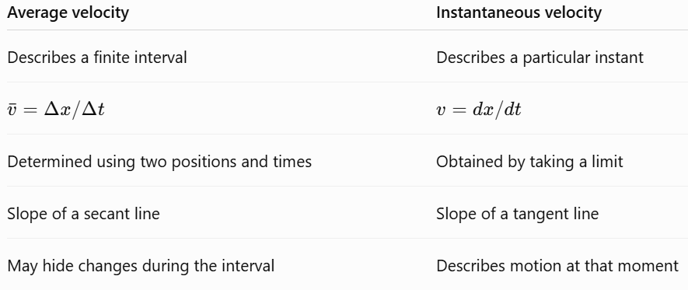
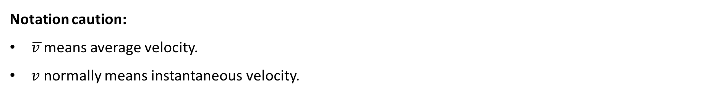
PHYS 2325 | University Physics I
Lecture 02 • Wed Sep 2 • Giancoli Ch. 2
Average versus instantaneous velocity
Notation caution:
$\overline{v }$means average velocity.
$v$ normally means instantaneous velocity.
Notes:
Teaching focus: Learning outcomes.
[Sources]
- PHYS 2325 University Physics I Fall 2026 syllabus and semester calendar.
[/Sources]

Slide 37
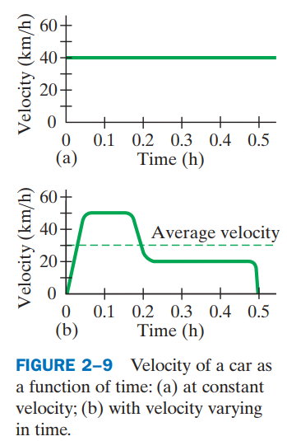
PHYS 2325 | University Physics I
Lecture 02 • Wed Sep 2 • Giancoli Ch. 2
Constant and changing velocity
If an object has constant velocity, its instantaneous velocity equals its average velocity over every interval.
A horizontal line on a 𝑣-versus-𝑡 graph represents constant velocity.
If velocity changes during the journey, the instantaneous velocity generally differs from the average velocity.
A single average value cannot show speeding up, slowing down, or stopping.
Notes:
Teaching focus: Learning outcomes.
[Sources]
- PHYS 2325 University Physics I Fall 2026 syllabus and semester calendar.
[/Sources]

Slide 38
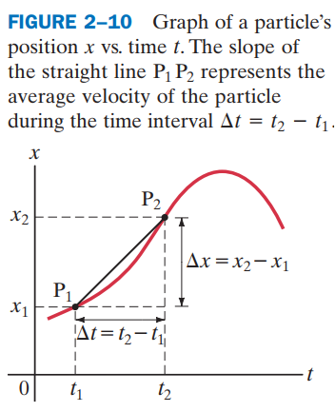
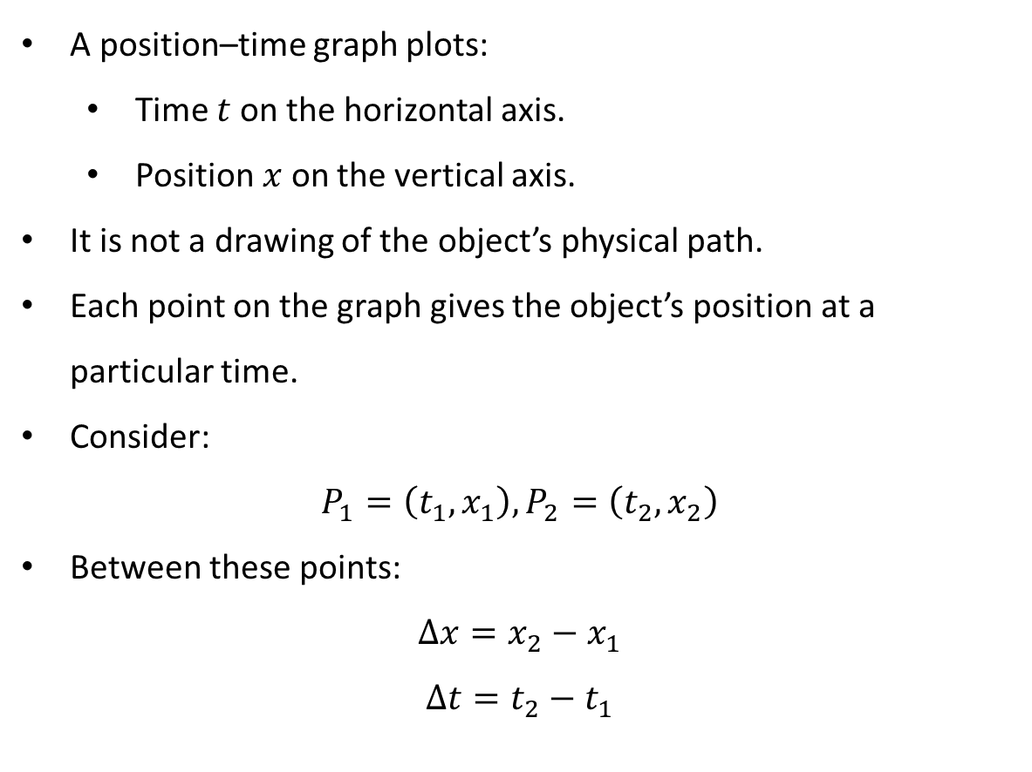
PHYS 2325 | University Physics I
Lecture 02 • Wed Sep 2 • Giancoli Ch. 2
Position–time graphs
A position–time graph plots:
  Time $t$ on the horizontal axis.
  Position $x$ on the vertical axis.
It is not a drawing of the object’s physical path.
Each point on the graph gives the object’s position at a particular time.
Consider:
$$P_{1}=\left(t_{1} , x_{1}\right), P_{2}=\left(t_{2} , x_{2}\right)$$
Between these points:
$$Δx=x_{2}−x_{1}$$
$Δt=t_{2}−t_{1}$
Notes:
Teaching focus: Learning outcomes.
[Sources]
- PHYS 2325 University Physics I Fall 2026 syllabus and semester calendar.
[/Sources]

Slide 39
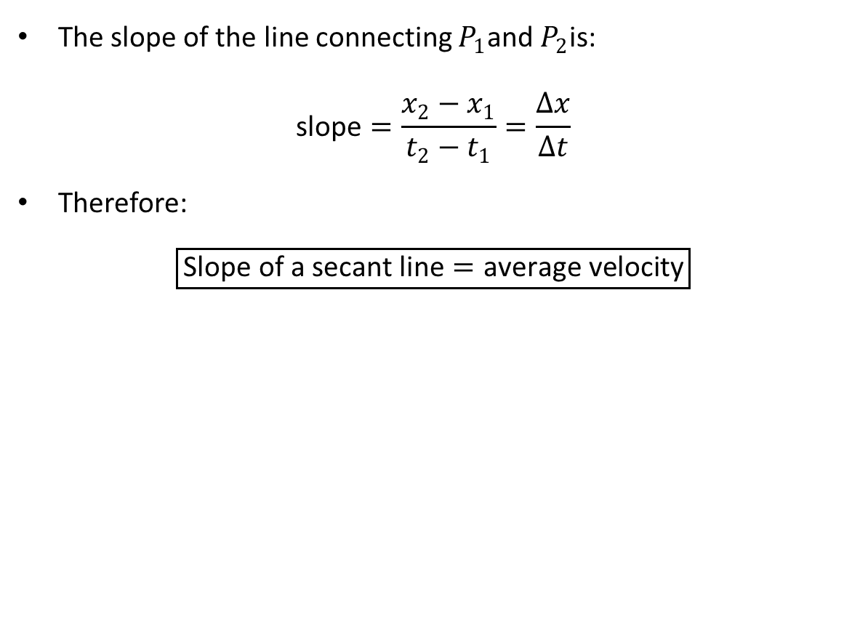
PHYS 2325 | University Physics I
Lecture 02 • Wed Sep 2 • Giancoli Ch. 2
Average velocity is a secant-line slope
The slope of the line connecting $P_{1}$and $P_{2}$is:
$$\text{slope}=\frac{x_{2}−x_{1}}{t_{2}−t_{1}}=\frac{Δx}{Δt}$$
Therefore:
$$\boxed{\text{Slope of a secant line}=\text{average velocity}}$$
Notes:
Teaching focus: Learning outcomes.
[Sources]
- PHYS 2325 University Physics I Fall 2026 syllabus and semester calendar.
[/Sources]

Slide 40
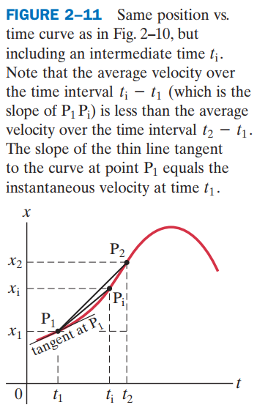
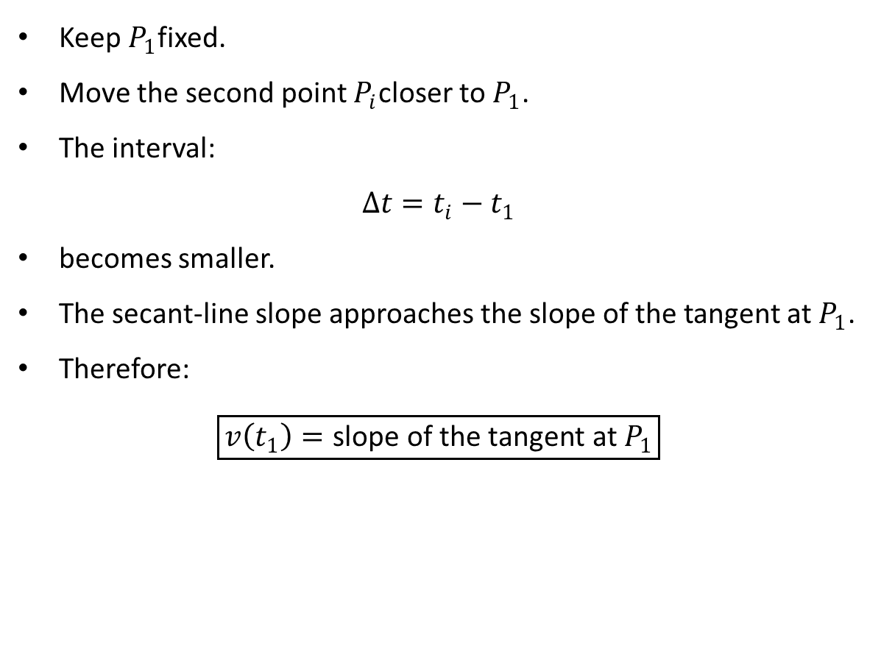
PHYS 2325 | University Physics I
Lecture 02 • Wed Sep 2 • Giancoli Ch. 2
From average to instantaneous velocity
Keep $P_{1}$fixed.
Move the second point $P_{i}$closer to $P_{1}$.
The interval:
$$Δt=t_{i}−t_{1}$$
becomes smaller.
The secant-line slope approaches the slope of the tangent at $P_{1}$.
Therefore:
$$\boxed{v\left(t_{1}\right)=\text{slope of the tangent at }P_{1}}$$
Notes:
Teaching focus: Learning outcomes.
[Sources]
- PHYS 2325 University Physics I Fall 2026 syllabus and semester calendar.
[/Sources]

Slide 41
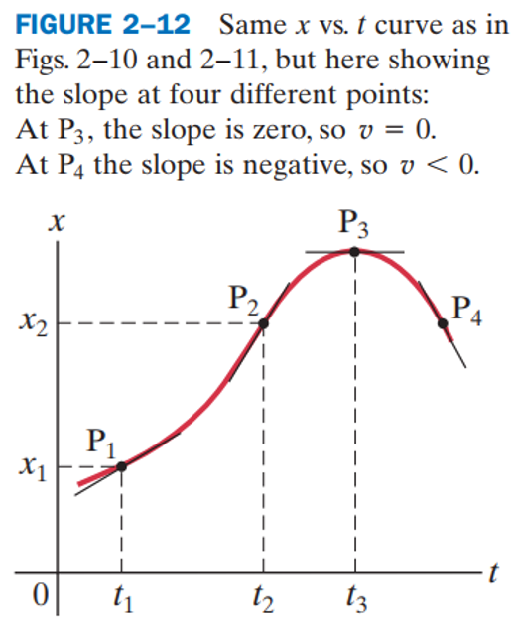
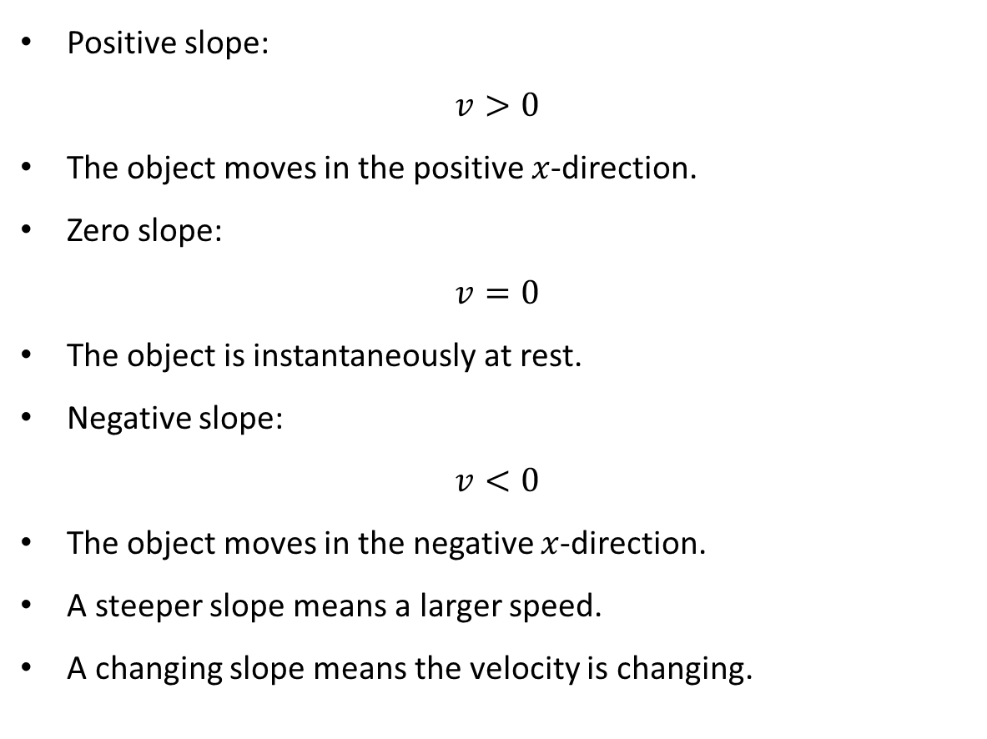
PHYS 2325 | University Physics I
Lecture 02 • Wed Sep 2 • Giancoli Ch. 2
Reading motion from an $x$-versus-$t$ graph
Positive slope:
$$v>0$$
The object moves in the positive $x$-direction.
Zero slope:
$$v=0$$
The object is instantaneously at rest.
Negative slope:
$$v<0$$
The object moves in the negative $x$-direction.
A steeper slope means a larger speed.
A changing slope means the velocity is changing.
Notes:
Teaching focus: Learning outcomes.
[Sources]
- PHYS 2325 University Physics I Fall 2026 syllabus and semester calendar.
[/Sources]

Slide 42
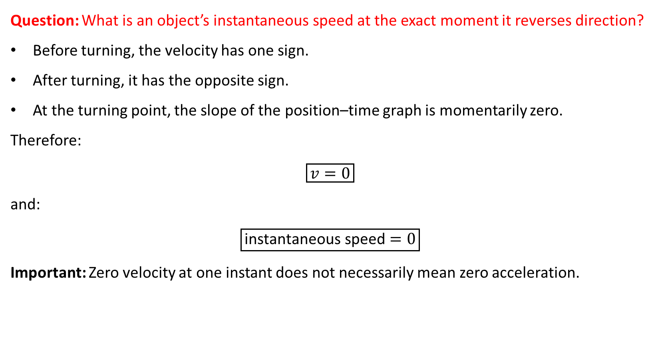
PHYS 2325 | University Physics I
Lecture 02 • Wed Sep 2 • Giancoli Ch. 2
Concept check: Turning around
Question: What is an object’s instantaneous speed at the exact moment it reverses direction?
Before turning, the velocity has one sign.
After turning, it has the opposite sign.
At the turning point, the slope of the position–time graph is momentarily zero.
Therefore:
$$\boxed{v=0}$$
and:
$$\boxed{\text{instantaneous speed}=0}$$
Important: Zero velocity at one instant does not necessarily mean zero acceleration.
Notes:
Teaching focus: Learning outcomes.
[Sources]
- PHYS 2325 University Physics I Fall 2026 syllabus and semester calendar.
[/Sources]

Slide 43
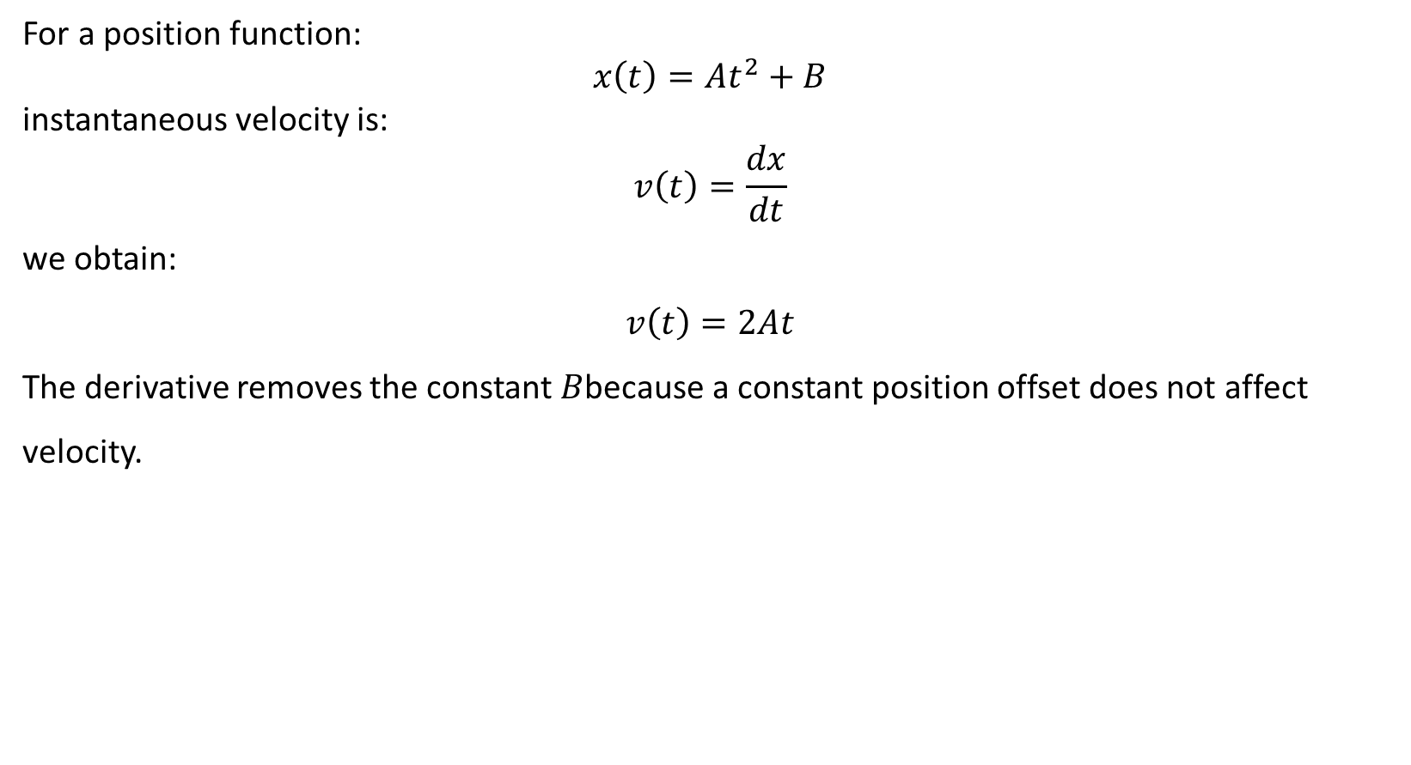
PHYS 2325 | University Physics I
Lecture 02 • Wed Sep 2 • Giancoli Ch. 2
Calculating velocity from x(t)
For a position function:
$$x\left(t\right)=At^{2}+B$$
instantaneous velocity is:
$$v\left(t\right)=\frac{dx}{dt}$$
we obtain:
$$v\left(t\right)=2At$$
The derivative removes the constant $B$because a constant position offset does not affect velocity.
Notes:
Teaching focus: Learning outcomes.
[Sources]
- PHYS 2325 University Physics I Fall 2026 syllabus and semester calendar.
[/Sources]

Slide 44
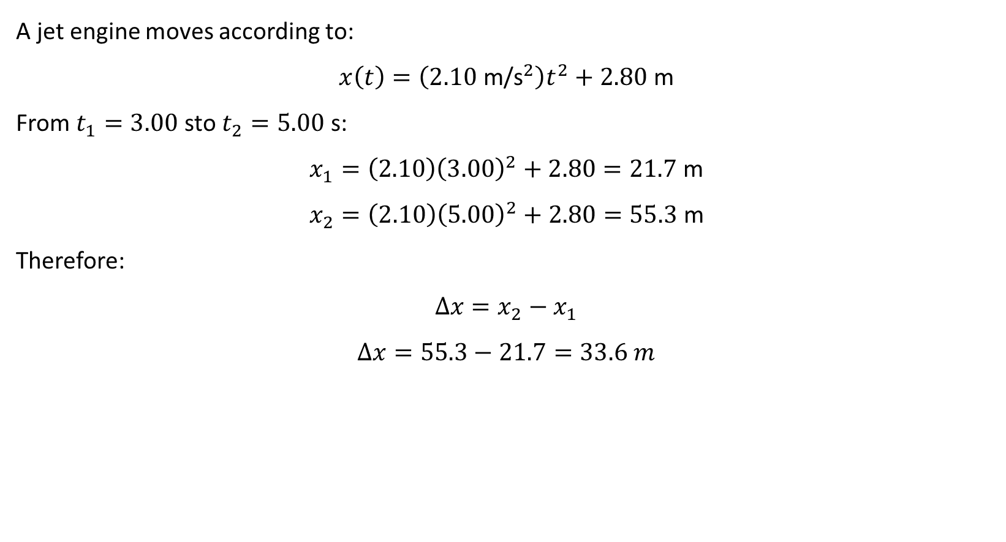
PHYS 2325 | University Physics I
Lecture 02 • Wed Sep 2 • Giancoli Ch. 2
Example 2–4: Position and displacement
A jet engine moves according to:
$$x\left(t\right)=\left(2.10 {\text{m/s}}^{2}\right)t^{2}+2.80\text{ m}$$
From $t_{1}=3.00\text{ s}$to $t_{2}=5.00\text{ s}$:
$$x_{1}=\left(2.10\right){\left(3.00\right)}^{2}+2.80=21.7\text{ m}$$
$$x_{2}=\left(2.10\right){\left(5.00\right)}^{2}+2.80=55.3\text{ m}$$
Therefore:
$$Δx=x_{2}−x_{1}$$
$$Δx=55.3−21.7=33.6 m$$
Notes:
Teaching focus: Learning outcomes.
[Sources]
- PHYS 2325 University Physics I Fall 2026 syllabus and semester calendar.
[/Sources]

Slide 45
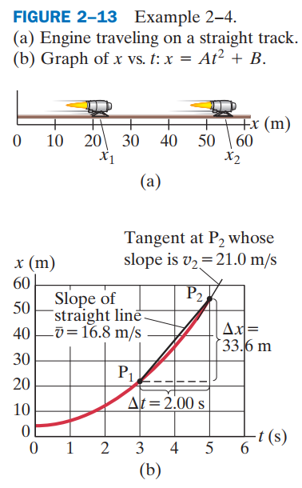
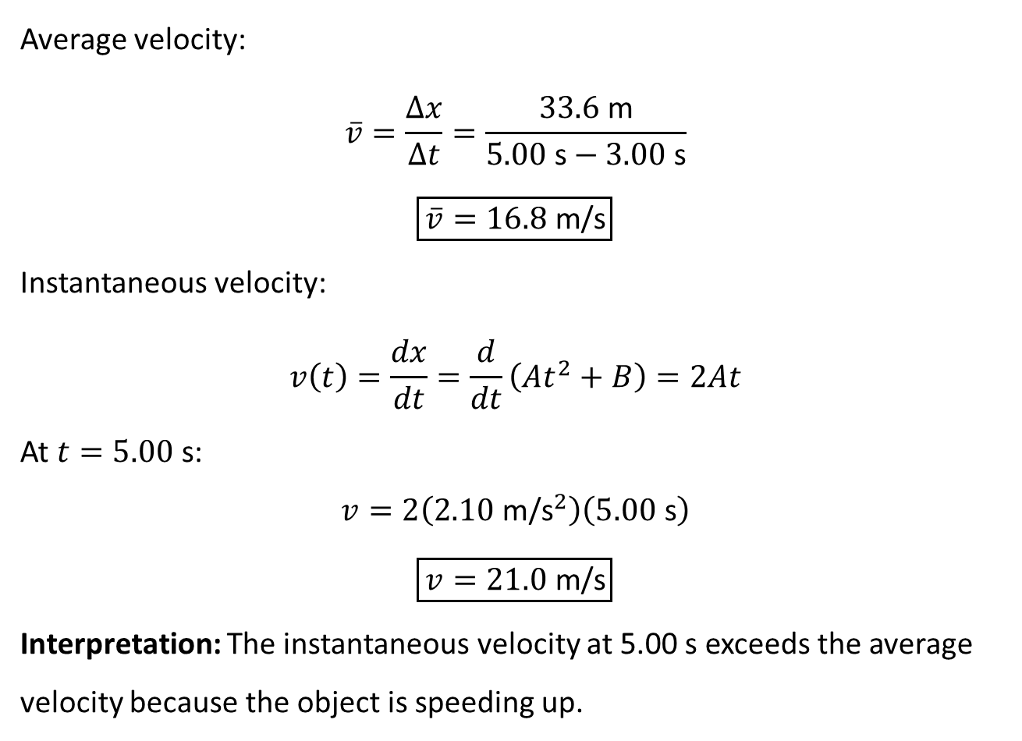
PHYS 2325 | University Physics I
Lecture 02 • Wed Sep 2 • Giancoli Ch. 2
Example 2–4: Average and instantaneous velocity
Average velocity:
$$\overline{v}=\frac{Δx}{Δt}=\frac{33.6\text{ m}}{5.00\text{ s}−3.00\text{ s}}$$
$$\boxed{\overline{v}=16.8\text{ m/s}}$$
Instantaneous velocity:
$$v\left(t\right)=\frac{dx}{dt}=\frac{d}{dt}\left(At^{2}+B\right)=2At$$
At $t=5.00\text{ s}$:
$$v=2\left(2.10 {\text{m/s}}^{2}\right)\left(5.00\text{ s}\right)$$
$$\boxed{v=21.0\text{ m/s}}$$
Interpretation: The instantaneous velocity at 5.00 s exceeds the average velocity because the object is speeding up.
Notes:
Teaching focus: Learning outcomes.
[Sources]
- PHYS 2325 University Physics I Fall 2026 syllabus and semester calendar.
[/Sources]

Slide 46
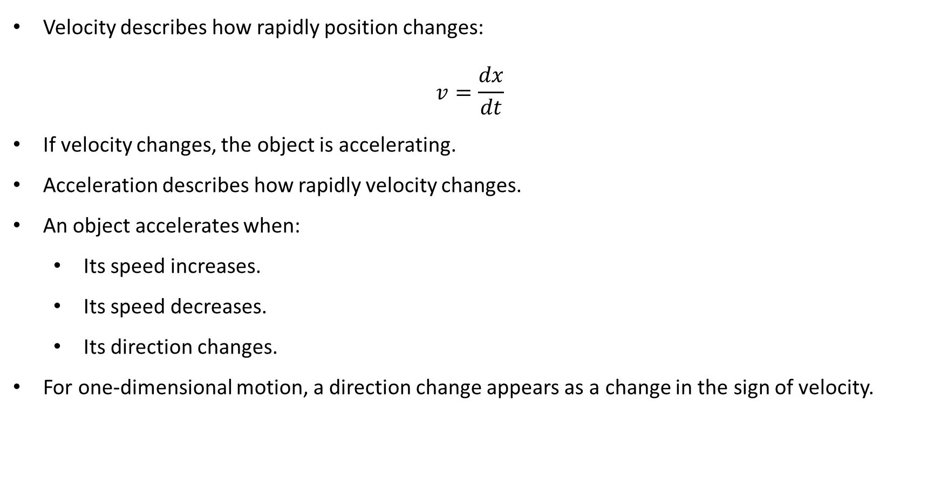
PHYS 2325 | University Physics I
Lecture 02 • Wed Sep 2 • Giancoli Ch. 2
From velocity to acceleration
Velocity describes how rapidly position changes:
$$v=\frac{dx}{dt}$$
If velocity changes, the object is accelerating.
Acceleration describes how rapidly velocity changes.
An object accelerates when:
  Its speed increases.
  Its speed decreases.
  Its direction changes.
For one-dimensional motion, a direction change appears as a change in the sign of velocity.
Notes:
Teaching focus: Learning outcomes.
[Sources]
- PHYS 2325 University Physics I Fall 2026 syllabus and semester calendar.
[/Sources]

Slide 47
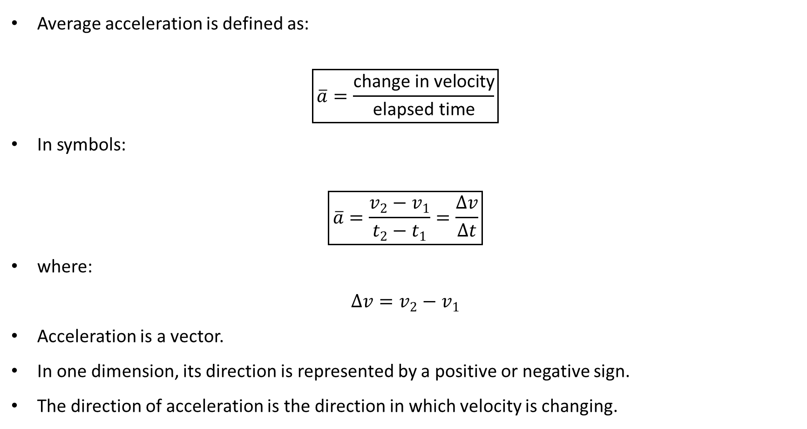
PHYS 2325 | University Physics I
Lecture 02 • Wed Sep 2 • Giancoli Ch. 2
Average acceleration
Average acceleration is defined as:
$$\boxed{\overline{a}=\frac{\text{change in velocity}}{\text{elapsed time}}}$$
In symbols:
$$\boxed{\overline{a}=\frac{v_{2}−v_{1}}{t_{2}−t_{1}}=\frac{Δv}{Δt}}$$
where:
$$Δv=v_{2}−v_{1}$$
Acceleration is a vector.
In one dimension, its direction is represented by a positive or negative sign.
The direction of acceleration is the direction in which velocity is changing.
Notes:
Teaching focus: Learning outcomes.
[Sources]
- PHYS 2325 University Physics I Fall 2026 syllabus and semester calendar.
[/Sources]

Slide 48
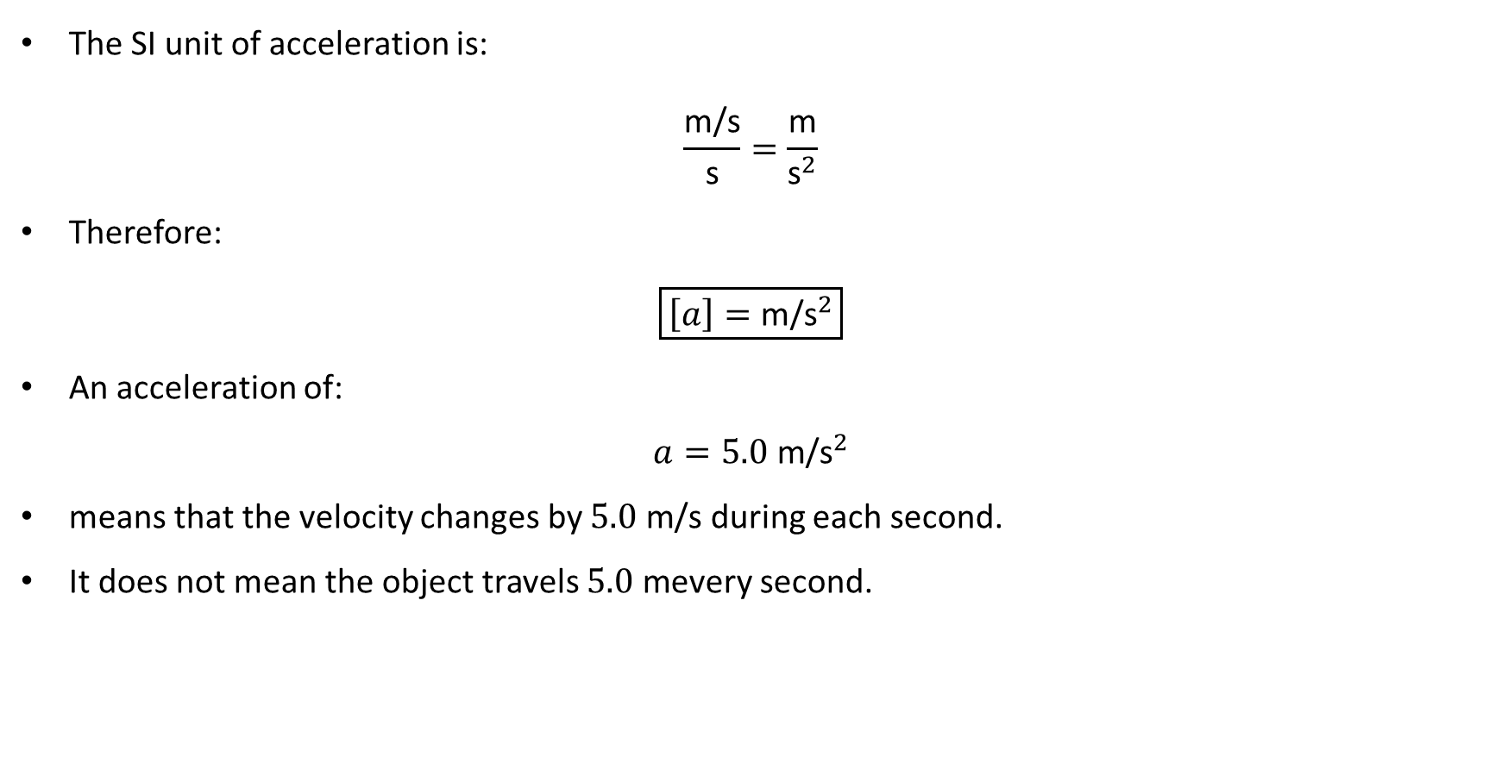
PHYS 2325 | University Physics I
Lecture 02 • Wed Sep 2 • Giancoli Ch. 2
Understanding acceleration units
The SI unit of acceleration is:
$$\frac{\text{m/s}}{\text{s}}=\frac{\text{m}}{{\text{s}}^{2}}$$
Therefore:
$$\boxed{\left[a\right]={\text{m/s}}^{2}}$$
An acceleration of:
$$a=5.0 {\text{m/s}}^{2}$$
means that the velocity changes by $5.0\text{ m/s}$ during each second.
It does not mean the object travels $5.0\text{ m}$every second.
Notes:
Teaching focus: Learning outcomes.
[Sources]
- PHYS 2325 University Physics I Fall 2026 syllabus and semester calendar.
[/Sources]

Slide 49
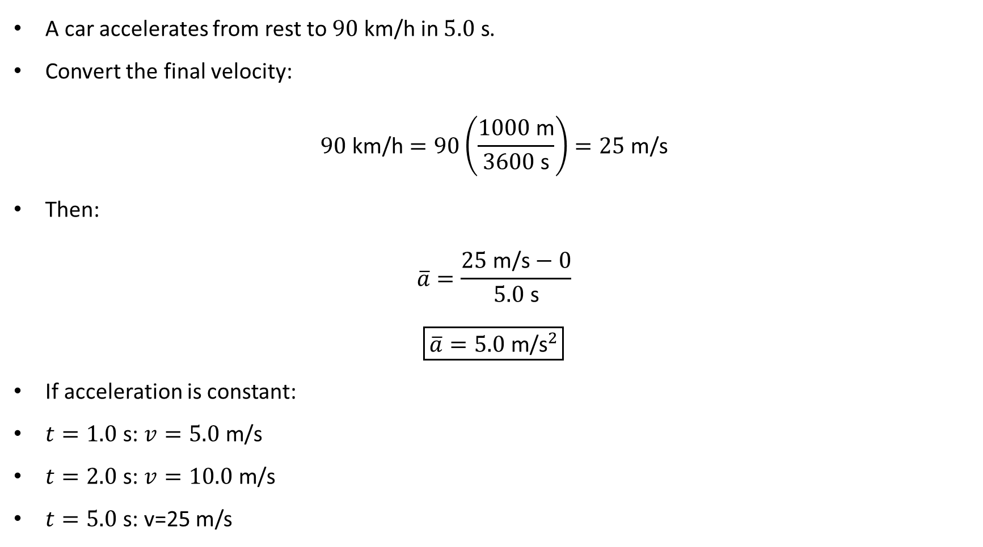
PHYS 2325 | University Physics I
Lecture 02 • Wed Sep 2 • Giancoli Ch. 2
Example 2–5: Average acceleration
A car accelerates from rest to $90\text{ km/h}$ in $5.0\text{ s}$.
Convert the final velocity:
$$90\text{ km/h}=90\left(\frac{1000\text{ m}}{3600\text{ s}}\right)=25\text{ m/s}$$
Then:
$$\overline{a}=\frac{25\text{ m/s}−0}{5.0\text{ s}}$$
$$\boxed{\overline{a}=5.0 {\text{m/s}}^{2}}$$
If acceleration is constant:
$t=1.0\text{ s}$: $v=5.0\text{ m/s}$
$t=2.0\text{ s}$: $v=10.0\text{ m/s}$
$t=5.0\text{ s}$: v=25 m/s
Notes:
Teaching focus: Learning outcomes.
[Sources]
- PHYS 2325 University Physics I Fall 2026 syllabus and semester calendar.
[/Sources]

Slide 50
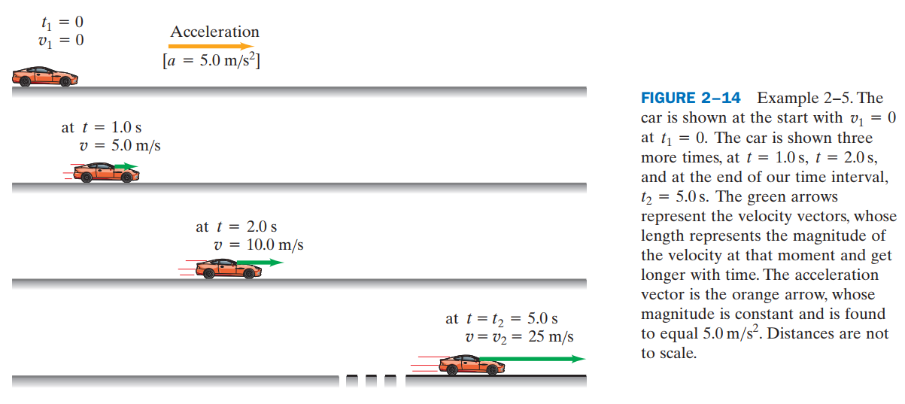
PHYS 2325 | University Physics I
Lecture 02 • Wed Sep 2 • Giancoli Ch. 2
Example 2–5: Average acceleration
Notes:
Teaching focus: Learning outcomes.
[Sources]
- PHYS 2325 University Physics I Fall 2026 syllabus and semester calendar.
[/Sources]

Slide 51

PHYS 2325 | University Physics I
Lecture 02 • Wed Sep 2 • Giancoli Ch. 2
Velocity and acceleration are different
Velocity tells us how rapidly position changes.
Acceleration tells us how rapidly velocity changes.
Zero velocity does not necessarily mean zero acceleration.
Zero acceleration does not necessarily mean zero velocity.
Examples:
A stationary car begins moving:
$$v=0, a≠0$$
at the initial instant.
A car cruises at constant velocity:
$$v≠0, a=0$$
Concept check: A car advertised as going from 0 to 60 mi/h in 5.4 s is being advertised for its strong acceleration, not merely its high speed.
Notes:
Teaching focus: Learning outcomes.
[Sources]
- PHYS 2325 University Physics I Fall 2026 syllabus and semester calendar.
[/Sources]

Slide 52


PHYS 2325 | University Physics I
Lecture 02 • Wed Sep 2 • Giancoli Ch. 2
Example 2–7: Slowing while moving right
Choose right as the positive direction:
$$v_{1}=+15.0\text{ m/s}$$
$$v_{2}=+5.0\text{ m/s}$$
$$Δt=5.0\text{ s}$$
Then:
$$\overline{a}=\frac{v_{2}−v_{1}}{Δt}=\frac{5.0−15.0}{5.0}$$
$$\boxed{\overline{a}=−2.0 {\text{m/s}}^{2}}$$
Velocity points right.
Acceleration points left.
Opposite directions mean the speed decreases.
Notes:
Teaching focus: Learning outcomes.
[Sources]
- PHYS 2325 University Physics I Fall 2026 syllabus and semester calendar.
[/Sources]

Slide 53


PHYS 2325 | University Physics I
Lecture 02 • Wed Sep 2 • Giancoli Ch. 2
“Deceleration” does not mean negative acceleration
“Deceleration” means that the magnitude of velocity is decreasing.
It does not automatically mean $a<0$.
An object slows down whenever velocity and acceleration point in opposite directions.
For a car moving left:
$$v_{1}=−15.0\text{ m/s}$$
$$v_{2}=−5.0\text{ m/s}$$
Then:
$$\overline{a}=\frac{−5.0−\left(−15.0\right)}{5.0}$$
$$\boxed{\overline{a}=+2.0 {\text{m/s}}^{2}}$$
The car moves left but accelerates right, so its speed decreases.
Notes:
Teaching focus: Learning outcomes.
[Sources]
- PHYS 2325 University Physics I Fall 2026 syllabus and semester calendar.
[/Sources]

Slide 54

PHYS 2325 | University Physics I
Lecture 02 • Wed Sep 2 • Giancoli Ch. 2
Signs of velocity and acceleration
Rule:
  Same signs → speed increases.
  Opposite signs → speed decreases.
The sign of acceleration indicates direction—not automatically whether the object speeds up or slows down.
Notes:
Teaching focus: Learning outcomes.
[Sources]
- PHYS 2325 University Physics I Fall 2026 syllabus and semester calendar.
[/Sources]

Slide 55

PHYS 2325 | University Physics I
Lecture 02 • Wed Sep 2 • Giancoli Ch. 2
Instantaneous acceleration
Instantaneous acceleration is the limiting value of average acceleration:
$$\boxed{a=\lim_{Δt→0}\frac{Δv}{Δt}}$$
In calculus notation:
$$\boxed{a=\frac{dv}{dt}}$$
Because:
$$v=\frac{dx}{dt}$$
we can also write:
$$\boxed{a=\frac{d^{2}x}{dt^{2}}}$$
Acceleration is therefore the second derivative of position with respect to time.
Notes:
Teaching focus: Learning outcomes.
[Sources]
- PHYS 2325 University Physics I Fall 2026 syllabus and semester calendar.
[/Sources]

Slide 56


PHYS 2325 | University Physics I
Lecture 02 • Wed Sep 2 • Giancoli Ch. 2
Acceleration from a velocity–time graph
On a $v$-versus-$t$ graph:
$$\text{average acceleration}=\frac{Δv}{Δt}$$
This is the slope of a secant line.
Instantaneous acceleration is:
$$a=\frac{dv}{dt}$$
This is the slope of the tangent line.
Notes:
Teaching focus: Learning outcomes.
[Sources]
- PHYS 2325 University Physics I Fall 2026 syllabus and semester calendar.
[/Sources]

Slide 57


PHYS 2325 | University Physics I
Lecture 02 • Wed Sep 2 • Giancoli Ch. 2
Example 2–8: Acceleration from x(t)
Given:
$$x\left(t\right)=\left(2.10 {\text{m/s}}^{2}\right)t^{2}+2.80\text{ m}$$
First differentiate position:
$$v\left(t\right)=\frac{dx}{dt}=\left(4.20 {\text{m/s}}^{2}\right)t$$
At $t_{1}=3.00\text{ s}$:
$$v_{1}=12.6\text{ m/s}$$
At $t_{2}=5.00\text{ s}$:
$$v_{2}=21.0\text{ m/s}$$
Average acceleration:
$$\overline{a}=\frac{21.0−12.6}{5.00−3.00}$$
$$\boxed{\overline{a}=4.20 {\text{m/s}}^{2}}$$
Instantaneous acceleration:
$$a=\frac{dv}{dt}=\frac{d}{dt}\left[\left(4.20 {\text{m/s}}^{2}\right)t\right]$$
$$\boxed{a=4.20 {\text{m/s}}^{2}}$$
It is constant and independent of time.
Notes:
Teaching focus: Learning outcomes.
[Sources]
- PHYS 2325 University Physics I Fall 2026 syllabus and semester calendar.
[/Sources]

Slide 58


PHYS 2325 | University Physics I
Lecture 02 • Wed Sep 2 • Giancoli Ch. 2
Conceptual graph comparison
Two cars both accelerate from $0$to $100\text{ km/h}$in $10.0\text{ s}$.
They have the same average acceleration because they have the same $Δv$ and $Δt$.
Their instantaneous accelerations differ because the slopes of their $v$-versus-$t$ graphs differ.
Car A has greater acceleration where its graph is steeper.
Car B has greater acceleration during the interval where its graph is steeper.
The car with the greater velocity for most of the interval travels farther.
Notes:
Teaching focus: Learning outcomes.
[Sources]
- PHYS 2325 University Physics I Fall 2026 syllabus and semester calendar.
[/Sources]

Slide 59
LECTURE 03
Problem Solving, Free Fall, and Variable Acceleration
Fri Sep 4 • Giancoli Ch. 2
Muhammad Nauman • PHYS 2325 • Fall 2026
Notes:
Teaching focus: Problem Solving, Free Fall, and Variable Acceleration.
[Sources]
- PHYS 2325 University Physics I Fall 2026 syllabus and semester calendar.
[/Sources]

Slide 60
PHYS 2325 | University Physics I
Lecture 03 • Fri Sep 4 • Giancoli Ch. 2
Learning outcomes
Define and represent solving kinematics problems.
Derive and interpret freely falling objects.
Apply variable acceleration and integral calculus.
Check units, vector directions, assumptions, and limiting behavior in every solution.
Notes:
Teaching focus: Learning outcomes.
[Sources]
- PHYS 2325 University Physics I Fall 2026 syllabus and semester calendar.
[/Sources]

Slide 61

PHYS 2325 | University Physics I
Lecture 02 • Wed Sep 2 • Giancoli Ch. 2
2–5 Motion at Constant Acceleration
What does constant acceleration mean?
We now consider motion along a straight line with constant acceleration.
Constant acceleration means:
$$\boxed{a=\text{constant}}$$
Instantaneous and average acceleration are then equal.
Velocity changes by equal amounts during equal time intervals.
The constant-acceleration equations relate:
$$x, x_{0}, v, v_{0}, a, t$$
These equations do not apply when acceleration changes significantly.
Notes:
Teaching focus: Learning outcomes.
[Sources]
- PHYS 2325 University Physics I Fall 2026 syllabus and semester calendar.
[/Sources]

Slide 62

PHYS 2325 | University Physics I
Lecture 02 • Wed Sep 2 • Giancoli Ch. 2
Notation for constant-acceleration motion
Choose the initial time as:
$$t_{0}=0$$
At $t=0$:
$$x=x_{0}, v=v_{0}$$
At a later time $t$:
$$x=x, v=v$$
Therefore:
$$Δx=x−x_{0}$$
$$Δv=v−v_{0}$$
$$Δt=t−0=t$$
Point: Starting the stopwatch at $t=0$ simplifies the notation but does not change the physics.
Notes:
Teaching focus: Learning outcomes.
[Sources]
- PHYS 2325 University Physics I Fall 2026 syllabus and semester calendar.
[/Sources]

Slide 63


PHYS 2325 | University Physics I
Lecture 02 • Wed Sep 2 • Giancoli Ch. 2
First equation: velocity after time t
Start with average acceleration:
$$a=\frac{Δv}{Δt}$$
For constant acceleration:
$$a=\frac{v−v_{0}}{t}$$
Multiply by $t$:
$$at=v−v_{0}$$
Therefore:
$$\boxed{v=v_{0}+at}$$
This equation gives the final velocity when time is known.
Example:
$$v_{0}=0, a=4.0 {\text{m/s}}^{2}, t=6.0\text{ s}$$
$$v=0+\left(4.0\right)\left(6.0\right)=\boxed{24\text{ m/s}}$$
Notes:
Teaching focus: Learning outcomes.
[Sources]
- PHYS 2325 University Physics I Fall 2026 syllabus and semester calendar.
[/Sources]

Slide 64

PHYS 2325 | University Physics I
Lecture 02 • Wed Sep 2 • Giancoli Ch. 2
Average velocity for constant acceleration
When acceleration is constant, velocity changes uniformly from $v_{0}$to $v$.
Therefore:
$$\boxed{\overline{v}=\frac{v_{0}+v}{2}}$$
Displacement is:
$$x−x_{0}=\overline{v}t$$
Hence:
$$\boxed{x=x_{0}+\overline{v}t}$$
or:
$$\boxed{x=x_{0}+\left(\frac{v_{0}+v}{2}\right)t}$$
Caution: The arithmetic average $\frac{\left(v_{0}+v\right)}{2}$is valid only when acceleration is constant.
Notes:
Teaching focus: Learning outcomes.
[Sources]
- PHYS 2325 University Physics I Fall 2026 syllabus and semester calendar.
[/Sources]

Slide 65

PHYS 2325 | University Physics I
Lecture 02 • Wed Sep 2 • Giancoli Ch. 2
Second equation: position after time t
Begin with:
$$x=x_{0}+\overline{v}t$$
Substitute:
$$\overline{v}=\frac{v_{0}+v}{2}$$
and:
$$v=v_{0}+at$$
Then:
$$x=x_{0}+\left(\frac{v_{0}+v_{0}+at}{2}\right)t$$
Therefore:
$$\boxed{x=x_{0}+v_{0}t+\frac{1}{2}at^{2}}$$
Interpretation:
  $x_{0}$: initial position.
  $v_{0}t$: contribution from initial velocity.
  $\frac{1}{2}at^{2}$: contribution from acceleration.
Notes:
Teaching focus: Learning outcomes.
[Sources]
- PHYS 2325 University Physics I Fall 2026 syllabus and semester calendar.
[/Sources]

Slide 66

PHYS 2325 | University Physics I
Lecture 02 • Wed Sep 2 • Giancoli Ch. 2
Third equation: eliminate time
Sometimes time is not known.
Use:
$$x−x_{0}=\left(\frac{v+v_{0}}{2}\right)t$$
and solve:
$$v=v_{0}+at$$
for time:
$$t=\frac{v−v_{0}}{a}$$
Substitute:
$$x−x_{0}=\left(\frac{v+v_{0}}{2}\right)\left(\frac{v−v_{0}}{a}\right)$$
Using:
$$\left(v+v_{0}\right)\left(v−v_{0}\right)=v^{2}−v_{0}^{2}$$
gives:
$$\boxed{v^{2}=v_{0}^{2}+2a\left(x−x_{0}\right)}$$
This equation is especially useful when time is absent.
Notes:
Teaching focus: Learning outcomes.
[Sources]
- PHYS 2325 University Physics I Fall 2026 syllabus and semester calendar.
[/Sources]

Slide 67

PHYS 2325 | University Physics I
Lecture 02 • Wed Sep 2 • Giancoli Ch. 2
Constant-acceleration equation set
$$\boxed{v=v_{0}+at}$$
$$\boxed{x=x_{0}+v_{0}t+\frac{1}{2}at^{2}}$$
$$\boxed{v^{2}=v_{0}^{2}+2a\left(x−x_{0}\right)}$$
$$\boxed{\overline{v}=\frac{v_{0}+v}{2}}$$
These equations require:
$$\boxed{a=\text{constant}}$$
Additional reminders:
  $x$represents position, not distance traveled.
  $x−x_{0}$is displacement.
  $t$is elapsed time.
  The signs of $v_{0}$, $v$, and $a$ indicate direction.
Notes:
Teaching focus: Learning outcomes.
[Sources]
- PHYS 2325 University Physics I Fall 2026 syllabus and semester calendar.
[/Sources]

Slide 68

PHYS 2325 | University Physics I
Lecture 02 • Wed Sep 2 • Giancoli Ch. 2
Selecting the appropriate equation
Recommended approach:
List the known quantities.
Identify the desired unknown.
Select an equation containing the unknown and only known quantities.
Solve algebraically before substituting numbers.
Notes:
Teaching focus: Learning outcomes.
[Sources]
- PHYS 2325 University Physics I Fall 2026 syllabus and semester calendar.
[/Sources]

Slide 69

PHYS 2325 | University Physics I
Lecture 02 • Wed Sep 2 • Giancoli Ch. 2
Example 2–10: Runway design
An airplane must reach:
$$v=27.8\text{ m/s}$$
It starts from rest:
$$v_{0}=0$$
and accelerates at:
$$a=2.00 {\text{m/s}}^{2}$$
For a $150\text{ m}$runway:
$$v^{2}=v_{0}^{2}+2a\left(x−x_{0}\right)$$
$$v=\sqrt{2\left(2.00\right)\left(150\right)}=\boxed{24.5\text{ m/s}}$$
Since:
$$24.5<27.8$$
the runway is too short.
Required runway length:
$$x−x_{0}=\frac{v^{2}−v_{0}^{2}}{2a}$$
$$x−x_{0}=\frac{{\left(27.8\right)}^{2}}{2\left(2.00\right)}=\boxed{193\text{ m}}$$
A runway of approximately $200\text{ m}$is appropriate.
Notes:
Teaching focus: Learning outcomes.
[Sources]
- PHYS 2325 University Physics I Fall 2026 syllabus and semester calendar.
[/Sources]

Slide 70


PHYS 2325 | University Physics I
Lecture 02 • Wed Sep 2 • Giancoli Ch. 2
Example 2–11: Airbag inflation time
A car traveling at $100\text{ km/h}$strikes a wall.
Convert the speed:
$$100\text{ km/h}≈28\text{ m/s}$$
Assume the car stops over approximately $1.0\text{ m}$:
$$v=0, v_{0}=28\text{ m/s}$$
Use:
$$v^{2}=v_{0}^{2}+2a\left(x−x_{0}\right)$$
$$a=\frac{0−{\left(28\right)}^{2}}{2\left(1.0\right)}=\boxed{−390 {\text{m/s}}^{2}}$$
Then:
$$t=\frac{v−v_{0}}{a}=\frac{0−28}{−390}≈\boxed{0.07\text{ s}}$$
The airbag must inflate in less than approximately $0.07\text{ s}$.
Notes:
Teaching focus: Learning outcomes.
[Sources]
- PHYS 2325 University Physics I Fall 2026 syllabus and semester calendar.
[/Sources]

Slide 71
PHYS 2325 | University Physics I
Lecture 02 • Wed Sep 2 • Giancoli Ch. 2
What do the airbag and seat belt accomplish?
The airbag does not prevent the vehicle from decelerating.
It increases the time and distance over which the driver comes to rest.
A longer stopping time reduces the magnitude of the acceleration.
The airbag distributes the force over a larger area of the chest.
The seat belt:
  Keeps the driver in a stable position.
  Prevents impact with the interior.
  Positions the driver correctly relative to the airbag.
Concept check: Why is a small increase in stopping time physically important during a collision?
Notes:
Teaching focus: Learning outcomes.
[Sources]
- PHYS 2325 University Physics I Fall 2026 syllabus and semester calendar.
[/Sources]

Slide 72

PHYS 2325 | University Physics I
Lecture 02 • Wed Sep 2 • Giancoli Ch. 2
Solving Problems
Physics is more than equation selection
Physics is not simply a collection of equations to memorize.
Searching randomly for a formula can produce an incorrect solution.
A correct equation may still be applied outside its range of validity.
A successful solution begins with:
  Understanding the physical situation.
  Selecting the object and time interval.
  Drawing the motion.
  Choosing coordinates.
  Identifying knowns and unknowns.
  Checking whether the result is reasonable.
Notes:
Teaching focus: Learning outcomes.
[Sources]
- PHYS 2325 University Physics I Fall 2026 syllabus and semester calendar.
[/Sources]

Slide 73

PHYS 2325 | University Physics I
Lecture 02 • Wed Sep 2 • Giancoli Ch. 2
Problem-solving strategy: understand and represent
Read the entire problem carefully.
Identify the object or objects being studied.
Define the relevant time interval.
Draw a diagram of the situation.
Choose the coordinate origin.
Select the positive direction.
Translate verbal information into equations.
Examples:
“Starts from rest” means:
$$v_{0}=0$$
“Comes to rest” means:
$$v=0$$
“Dropped” means:
$$v_{0}=0$$
Notes:
Teaching focus: Learning outcomes.
[Sources]
- PHYS 2325 University Physics I Fall 2026 syllabus and semester calendar.
[/Sources]

Slide 74
PHYS 2325 | University Physics I
Lecture 02 • Wed Sep 2 • Giancoli Ch. 2
Problem-solving strategy: solve and evaluate
List the known quantities and desired unknown.
Identify the applicable physical principles.
Check the conditions under which the equations are valid.
Select an equation with only one unknown.
Solve algebraically before inserting numbers.
Substitute values with consistent units.
Retain extra digits during intermediate calculations.
Round the final result appropriately.
Check:
  Units.
  Sign.
  Magnitude.
  Direction.
  Physical reasonableness.
Notes:
Teaching focus: Learning outcomes.
[Sources]
- PHYS 2325 University Physics I Fall 2026 syllabus and semester calendar.
[/Sources]

Slide 75


PHYS 2325 | University Physics I
Lecture 02 • Wed Sep 2 • Giancoli Ch. 2
Example 2–12: Car crossing an intersection
A $4.0\text{ m}$-long car must cross a $26.0\text{ m}$-wide intersection.
The front of the car must travel:
$$x−x_{0}=26.0+4.0=30.0\text{ m}$$
Given:
$$v_{0}=0$$
$$a=2.00 {\text{m/s}}^{2}$$
Wanted:
$$t=?$$
Notes:
Teaching focus: Learning outcomes.
[Sources]
- PHYS 2325 University Physics I Fall 2026 syllabus and semester calendar.
[/Sources]

Slide 76

PHYS 2325 | University Physics I
Lecture 02 • Wed Sep 2 • Giancoli Ch. 2
Example 2–12: Car crossing an intersection
Use:
$$x=x_{0}+v_{0}t+\frac{1}{2}at^{2}$$
With $x_{0}=0$and $v_{0}=0$:
$$30.0=\frac{1}{2}\left(2.00\right)t^{2}$$
$$t=\sqrt{\frac{2\left(30.0\right)}{2.00}}$$
$$\boxed{t=5.48\text{ s}}$$
Check the final velocity:
$$v=v_{0}+at=\left(2.00\right)\left(5.48\right)=10.96\text{ m/s}$$
Average velocity:
$$\overline{v}=\frac{0+10.96}{2}=5.48\text{ m/s}$$
Then:
$$Δx=\overline{v}t=\left(5.48\right)\left(5.48\right)=30.0\text{ m}$$
The result checks.
Notes:
Teaching focus: Learning outcomes.
[Sources]
- PHYS 2325 University Physics I Fall 2026 syllabus and semester calendar.
[/Sources]

Slide 77

PHYS 2325 | University Physics I
Lecture 02 • Wed Sep 2 • Giancoli Ch. 2
Interpreting mathematical solutions
Solving:
$$t^{2}=\frac{2x}{a}$$
mathematically gives:
$$t=±\sqrt{\frac{2x}{a}}$$
For Example 2–12:
$$t=±5.48\text{ s}$$
$+5.48\text{ s}$lies within the chosen observation interval.
$−5.48\text{ s}$refers to a time before $t=0$.
It does not describe the physical event under consideration.
Therefore:
$$\boxed{t=5.48\text{ s}}$$
Key Point: Mathematics may generate several solutions; physics determines which solutions apply.
Notes:
Teaching focus: Learning outcomes.
[Sources]
- PHYS 2325 University Physics I Fall 2026 syllabus and semester calendar.
[/Sources]

Slide 78


PHYS 2325 | University Physics I
Lecture 02 • Wed Sep 2 • Giancoli Ch. 2
Example 2–13: Stopping distance has two parts
The total stopping distance consists of:
Distance traveled during the driver’s reaction time.
Distance traveled while the brakes slow the car to rest.
Given:
$$v_{0}=14\text{ m/s}$$
Reaction time:
$$t_{r}=0.50\text{ s}$$
Braking acceleration:
$$a=−6.0 {\text{m/s}}^{2}$$
Notes:
Teaching focus: Learning outcomes.
[Sources]
- PHYS 2325 University Physics I Fall 2026 syllabus and semester calendar.
[/Sources]

Slide 79

PHYS 2325 | University Physics I
Lecture 02 • Wed Sep 2 • Giancoli Ch. 2
Reaction distance
During the reaction interval:
$$a=0$$
The car moves at constant velocity:
$$v=14\text{ m/s}$$
Therefore:
$$x_{r}=vt_{r}$$
$$x_{r}=\left(14\right)\left(0.50\right)$$
$$\boxed{x_{r}=7.0\text{ m}}$$
The car travels 7.0 m before the brakes even begin slowing it.
Notes:
Teaching focus: Learning outcomes.
[Sources]
- PHYS 2325 University Physics I Fall 2026 syllabus and semester calendar.
[/Sources]

Slide 80

PHYS 2325 | University Physics I
Lecture 02 • Wed Sep 2 • Giancoli Ch. 2
Braking distance and total stopping distance
During braking:
$$v_{0}=14\text{ m/s}, v=0, a=−6.0 {\text{m/s}}^{2}$$
Use:
$$v^{2}=v_{0}^{2}+2aΔx_{b}$$
$$0={\left(14\right)}^{2}+2\left(−6.0\right)Δx_{b}$$
$$Δx_{b}=\boxed{16\text{ m}}$$
Total stopping distance:
$$x_{\text{total}}=x_{r}+Δx_{b}$$
$$x_{\text{total}}=7.0+16$$
$$\boxed{x_{\text{total}}=23\text{ m}}$$
Notes:
Teaching focus: Learning outcomes.
[Sources]
- PHYS 2325 University Physics I Fall 2026 syllabus and semester calendar.
[/Sources]

Slide 81


PHYS 2325 | University Physics I
Lecture 02 • Wed Sep 2 • Giancoli Ch. 2
Stopping-distance graphs
During the reaction interval:
  Velocity is constant.
  Position increases linearly.
  Acceleration is zero.
During braking:
  Velocity decreases linearly.
  Position continues increasing but with decreasing slope.
  Acceleration is constant and negative.
Important result: Braking distance is proportional to the square of the initial speed:
$$\boxed{Δx_{b}∝v_{0}^{2}}$$
Doubling the speed produces four times the braking distance if the braking acceleration is unchanged.
Notes:
Teaching focus: Learning outcomes.
[Sources]
- PHYS 2325 University Physics I Fall 2026 syllabus and semester calendar.
[/Sources]

Slide 82

PHYS 2325 | University Physics I
Lecture 02 • Wed Sep 2 • Giancoli Ch. 2
Police and speeder
A speeder passes a stationary police car at:
$$v_{S}=150\text{ km/h}≈42\text{ m/s}$$
Estimate the police acceleration using $0$to $100\text{ km/h}$in $5.0\text{ s}$:
$$a_{P}≈5.6 {\text{m/s}}^{2}$$
Speeder:
$$x_{S}=\left(42\text{ m/s}\right)t$$
Police car:
$$x_{P}=\frac{1}{2}\left(5.6 {\text{m/s}}^{2}\right)t^{2}$$
At the catch-up point:
$$x_{S}=x_{P}$$
$$42t=2.8t^{2}$$
Solutions:
$$t=0$$
and:
$$\boxed{t=15\text{ s}}$$
Notes:
Teaching focus: Learning outcomes.
[Sources]
- PHYS 2325 University Physics I Fall 2026 syllabus and semester calendar.
[/Sources]

Slide 83


PHYS 2325 | University Physics I
Lecture 02 • Wed Sep 2 • Giancoli Ch. 2
Test the police-car model
Police velocity after $15\text{ s}$:
$$v_{P}=a_{P}t$$
$$v_{P}=\left(5.6\right)\left(15\right)=84\text{ m/s}$$
$$84\text{ m/s}≈300\text{ km/h}$$
This result is unreasonable.
Therefore, the initial model requires improvement:
  The police car cannot maintain the same acceleration at high speed.
  The speeder may slow after hearing the siren.
  Real acceleration depends on speed and vehicle performance.
Notes:
Teaching focus: Learning outcomes.
[Sources]
- PHYS 2325 University Physics I Fall 2026 syllabus and semester calendar.
[/Sources]

Slide 84



PHYS 2325 | University Physics I
Lecture 02 • Wed Sep 2 • Giancoli Ch. 2
Freely Falling Objects
Free fall is accelerated motion
A freely falling object moves under the influence of gravity alone.
Its speed changes during the fall.
Galileo used inclined planes to slow the motion and study its pattern.
Equal time intervals produce progressively larger displacements.
For an object starting from rest:
$$\boxed{d∝t^{2}}$$
Notes:
Teaching focus: Learning outcomes.
[Sources]
- PHYS 2325 University Physics I Fall 2026 syllabus and semester calendar.
[/Sources]

Slide 85

PHYS 2325 | University Physics I
Lecture 02 • Wed Sep 2 • Giancoli Ch. 2
Do heavier objects fall faster?
In the absence of air resistance:
$$\boxed{\text{All objects at the same location fall with the same acceleration}}$$
Gravitational acceleration does not depend on the object’s mass.
A flat sheet of paper falls slowly because air resistance is significant.
Crumpling the paper reduces its effective area and air resistance.
In a vacuum, a rock and feather fall together.
Notes:
Teaching focus: Learning outcomes.
[Sources]
- PHYS 2325 University Physics I Fall 2026 syllabus and semester calendar.
[/Sources]

Slide 86


PHYS 2325 | University Physics I
Lecture 02 • Wed Sep 2 • Giancoli Ch. 2
Do heavier objects fall faster?
Notes:
Teaching focus: Learning outcomes.
[Sources]
- PHYS 2325 University Physics I Fall 2026 syllabus and semester calendar.
[/Sources]

Slide 87

PHYS 2325 | University Physics I
Lecture 02 • Wed Sep 2 • Giancoli Ch. 2
Acceleration due to gravity
Near Earth’s surface:
$$\boxed{g=9.80 {\text{m/s}}^{2}}$$
or approximately:
$$g≈32 {\text{ft/s}}^{2}$$
The acceleration vector points downward toward Earth’s center.
The value varies slightly with latitude and elevation.
These variations are usually neglected in introductory problems.
Air resistance is neglected unless stated otherwise.
At sufficiently large speeds, air resistance can produce terminal velocity.
Notes:
Teaching focus: Learning outcomes.
[Sources]
- PHYS 2325 University Physics I Fall 2026 syllabus and semester calendar.
[/Sources]

Slide 88

PHYS 2325 | University Physics I
Lecture 02 • Wed Sep 2 • Giancoli Ch. 2
Choose the vertical sign convention
For vertical motion, replace $x$with $y$.
If upward is positive:
$$\boxed{a_{y}=−g=−9.80 {\text{m/s}}^{2}}$$
If downward is positive:
$$\boxed{a_{y}=+g=+9.80 {\text{m/s}}^{2}}$$
Either convention is valid.
The requirement is consistency:
Assign signs according to the selected axis.
Do not change the positive direction during the calculation.
The symbol $g$represents the positive magnitude $9.80 {\text{m/s}}^{2}$.
Notes:
Teaching focus: Learning outcomes.
[Sources]
- PHYS 2325 University Physics I Fall 2026 syllabus and semester calendar.
[/Sources]

Slide 89



PHYS 2325 | University Physics I
Lecture 02 • Wed Sep 2 • Giancoli Ch. 2
Ball dropped from a tower
“Dropped” means:
$$v_{0}=0$$
Choose downward as positive:
$$a=+g=+9.80 {\text{m/s}}^{2}$$
With $y_{0}=0$:
$$y=\frac{1}{2}gt^{2}$$
After $1.00\text{ s}$:
$$y_{1}=\frac{1}{2}\left(9.80\right){\left(1.00\right)}^{2}=\boxed{4.90\text{ m}}$$
After $2.00\text{ s}$:
$$y_{2}=\frac{1}{2}\left(9.80\right){\left(2.00\right)}^{2}=\boxed{19.6\text{ m}}$$
After $3.00\text{ s}$:
$$y_{3}=\frac{1}{2}\left(9.80\right){\left(3.00\right)}^{2}=\boxed{44.1\text{ m}}$$
Notes:
Teaching focus: Learning outcomes.
[Sources]
- PHYS 2325 University Physics I Fall 2026 syllabus and semester calendar.
[/Sources]

Slide 90

PHYS 2325 | University Physics I
Lecture 02 • Wed Sep 2 • Giancoli Ch. 2
Example 2–16: Ball thrown downward
Now give the ball an initial downward velocity:
$$v_{0}=3.00\text{ m/s}$$
With downward positive:
$$a=+9.80 {\text{m/s}}^{2}$$
Position:
$$y=v_{0}t+\frac{1}{2}gt^{2}$$
At $1.00\text{ s}$:
$$y=\left(3.00\right)\left(1.00\right)+\frac{1}{2}\left(9.80\right){\left(1.00\right)}^{2}=\boxed{7.90\text{ m}}$$
At $2.00\text{ s}$:
$$y=\left(3.00\right)\left(2.00\right)+\frac{1}{2}\left(9.80\right){\left(2.00\right)}^{2}=\boxed{25.6\text{ m}}$$
The initial downward velocity makes the ball remain $3.00\text{ m/s}$faster than a ball dropped simultaneously.
Notes:
Teaching focus: Learning outcomes.
[Sources]
- PHYS 2325 University Physics I Fall 2026 syllabus and semester calendar.
[/Sources]

Slide 91

PHYS 2325 | University Physics I
Lecture 02 • Wed Sep 2 • Giancoli Ch. 2
Velocity of the downward-thrown ball
Use:
$$v=v_{0}+gt$$
At $1.00\text{ s}$:
$$v=3.00+\left(9.80\right)\left(1.00\right)=\boxed{12.8\text{ m/s}}$$
At $2.00\text{ s}$:
$$v=3.00+\left(9.80\right)\left(2.00\right)=\boxed{22.6\text{ m/s}}$$
For comparison, a dropped ball has:
$$v=9.80\text{ m/s}$$
after 1.00 s and:
$$v=19.6\text{ m/s}$$
after 2.00 s.
Notes:
Teaching focus: Learning outcomes.
[Sources]
- PHYS 2325 University Physics I Fall 2026 syllabus and semester calendar.
[/Sources]

Slide 92


PHYS 2325 | University Physics I
Lecture 02 • Wed Sep 2 • Giancoli Ch. 2
Example 2–17: Ball thrown upward
A ball is thrown upward with:
$$v_{0}=15.0\text{ m/s}$$
Choose upward as positive:
$$a=−g=−9.80 {\text{m/s}}^{2}$$
At maximum height:
$$v=0$$
Use:
$$v^{2}=v_{0}^{2}+2a\left(y−y_{0}\right)$$
With $y_{0}=0$:
$$0={\left(15.0\right)}^{2}+2\left(−9.80\right)y$$
$$\boxed{y=11.5\text{ m}}$$
Notes:
Teaching focus: Learning outcomes.
[Sources]
- PHYS 2325 University Physics I Fall 2026 syllabus and semester calendar.
[/Sources]

Slide 93

PHYS 2325 | University Physics I
Lecture 02 • Wed Sep 2 • Giancoli Ch. 2
Velocity and acceleration at maximum height
At the highest point:
$$\boxed{v=0}$$
However:
$$\boxed{a=−g=−9.80 {\text{m/s}}^{2}}$$
The ball is momentarily at rest, but gravity is still acting.
Before the highest point:
$$v>0, a<0$$
so the ball slows down.
After the highest point:
$$v<0, a<0$$
so the ball speeds up downward.
Velocity and acceleration do not have to point in the same direction.
If acceleration were zero at the top, the ball would remain there instead of falling.
Notes:
Teaching focus: Learning outcomes.
[Sources]
- PHYS 2325 University Physics I Fall 2026 syllabus and semester calendar.
[/Sources]

Slide 94

PHYS 2325 | University Physics I
Lecture 02 • Wed Sep 2 • Giancoli Ch. 2
Time to maximum height and total flight time
For the ball launched upward with:
$$v_{0}=15.0\text{ m/s}$$
use:
$$v=v_{0}+at$$
At maximum height:
$$v=0, a=−9.80 {\text{m/s}}^{2}$$
Therefore:
$$0=15.0−\left(9.80\right)t$$
$$\boxed{t_{\text{up}}=1.53\text{ s}}$$
Ignoring air resistance, the downward motion is symmetrical:
$$t_{\text{down}}=t_{\text{up}}=1.53\text{ s}$$
Thus, the total time to return to the launch position is:
$$\boxed{t_{\text{total}}=3.06\text{ s}}$$
When the ball returns:
$$\boxed{v=−15.0\text{ m/s}}$$
It has the same speed as initially, but the opposite velocity.
Notes:
Teaching focus: Learning outcomes.
[Sources]
- PHYS 2325 University Physics I Fall 2026 syllabus and semester calendar.
[/Sources]

Slide 95


PHYS 2325 | University Physics I
Lecture 02 • Wed Sep 2 • Giancoli Ch. 2
Graphs summarize the complete motion
Position–time graph
Position increases while the ball rises.
The slope decreases as the ball slows.
At maximum height, the slope is zero.
Position then decreases as the ball falls.
The graph is a downward-opening parabola.
Velocity–time graph
Velocity decreases linearly because acceleration is constant.
The slope is:
$$\boxed{−g=−9.80 {\text{m/s}}^{2}}$$
Velocity is positive while rising.
Velocity is zero at maximum height.
Velocity is negative while falling.
Notes:
Teaching focus: Learning outcomes.
[Sources]
- PHYS 2325 University Physics I Fall 2026 syllabus and semester calendar.
[/Sources]

Slide 96

PHYS 2325 | University Physics I
Lecture 02 • Wed Sep 2 • Giancoli Ch. 2
Essential free-fall problem-solving rules
Choose the positive vertical direction before writing equations.
If upward is positive:
$$a=−g$$
If downward is positive:
$$a=+g$$
“Dropped” means:
$$v_{0}=0$$
At maximum height:
$$v=0, a≠0$$
Use displacement, not total distance, in the kinematic equations.
Keep signs with velocity, acceleration, and displacement.
Check whether mathematical solutions fall within the physical time interval.
All objects have the same free-fall acceleration when air resistance is neglected.
Notes:
Teaching focus: Learning outcomes.
[Sources]
- PHYS 2325 University Physics I Fall 2026 syllabus and semester calendar.
[/Sources]

Slide 97

PHYS 2325 | University Physics I
Lecture 02 • Wed Sep 2 • Giancoli Ch. 2
Calculus connects acceleration, velocity, and position
For any one-dimensional motion:
$\boxed{a=\frac{dv}{dt}}$ →$\boxed{v\left(t\right)=v_{0}+\int_{0}^{t}{a}\left(t^{′}\right) dt^{′}}$
$\boxed{v=\frac{dx}{dt}}$ →$\boxed{x\left(t\right)=x_{0}+\int_{0}^{t}{v}\left(t^{′}\right) dt^{′}}$
For constant acceleration:
$\int_{0}^{t}{a} dt=at$ →$\boxed{v=v_{0}+at}$
A second integration gives:
$$\boxed{x=x_{0}+v_{0}t+\frac{1}{2}at^{2}}$$
Key point: Use the familiar kinematic equations when $a$is constant; use integration when $a$ varies.
Notes:
Teaching focus: Learning outcomes.
[Sources]
- PHYS 2325 University Physics I Fall 2026 syllabus and semester calendar.
[/Sources]

Slide 98


PHYS 2325 | University Physics I
Lecture 02 • Wed Sep 2 • Giancoli Ch. 2
Variable acceleration: one compact example
Suppose a vehicle starts from rest with:
$$a\left(t\right)=\left(7.00 {\text{m/s}}^{3}\right)t$$
Find velocity
$$v\left(t\right)=\int_{0}^{t}{a}\left(t^{′}\right) dt^{′}$$
$$v\left(t\right)=\int_{0}^{t}{(}\left.7.00 {\text{m/s}}^{3}\right)t^{′} dt^{′}$$
$$\boxed{v\left(t\right)=\left(3.50 {\text{m/s}}^{3}\right)t^{2}}$$
At $t=2.00\text{ s}$:
$$\boxed{v=14.0\text{ m/s}}$$
Find displacement
$$x\left(t\right)=\int_{0}^{t}{v}\left(t^{′}\right) dt^{′}$$
$$x\left(t\right)=\int_{0}^{t}{(}\left.3.50 {\text{m/s}}^{3}\right)t^{′2} dt^{′}$$
At $t=2.00\text{ s}$:
$$\boxed{x=9.33\text{ m}}$$
Giancoli Example 2–23.
Notes:
Teaching focus: Learning outcomes.
[Sources]
- PHYS 2325 University Physics I Fall 2026 syllabus and semester calendar.
[/Sources]

