Slide 1
WEEK 03
Vectors and Motion in Two or Three Dimensions
Sep 7-11 • Giancoli Chapter 3
Muhammad Nauman • PHYS 2325 • Fall 2026
Notes:
Teaching focus: Vectors and Motion in Two or Three Dimensions.
[Sources]
- PHYS 2325 University Physics I Fall 2026 syllabus and semester calendar.
[/Sources]

Slide 2
PHYS 2325 | University Physics I
Week 03 • Sep 7-11 • Giancoli Chapter 3
This week follows one connected learning path
01
02
03
MON SEP 7
Labor Day Holiday
WED SEP 9
Vector Language and Component Methods
FRI SEP 11
Vector Kinematics, Projectiles, and Relative Motion
By week's end: Use components to connect vector algebra, projectile motion, and relative velocity.
Notes:
Teaching focus: This week follows one connected learning path.
[Sources]
- PHYS 2325 University Physics I Fall 2026 syllabus and semester calendar.
[/Sources]

Slide 3
NO CLASS
Labor Day Holiday
Mon Sep 7
Muhammad Nauman • PHYS 2325 • Fall 2026
Notes:
Teaching focus: Labor Day Holiday.
[Sources]
- PHYS 2325 University Physics I Fall 2026 syllabus and semester calendar.
[/Sources]

Slide 4
PHYS 2325 | University Physics I
NO CLASS • Mon Sep 7 • Course schedule
Labor Day Holiday
University holiday - no class meeting.
Review Chapter 2 graphs and kinematic equations.
Next meeting begins vector representation and component methods.
Notes:
Teaching focus: Labor Day Holiday.
[Sources]
- PHYS 2325 University Physics I Fall 2026 syllabus and semester calendar.
[/Sources]

Slide 5
LECTURE 02
Vector Language and Component Methods
Wed Sep 9 • Giancoli Ch. 3
Muhammad Nauman • PHYS 2325 • Fall 2026
Notes:
Teaching focus: Vector Language and Component Methods.
[Sources]
- PHYS 2325 University Physics I Fall 2026 syllabus and semester calendar.
[/Sources]

Slide 6
PHYS 2325 | University Physics I
Lecture 02 • Wed Sep 9 • Giancoli Ch. 3
Learning outcomes
Define and represent vectors and scalars.
Derive and interpret addition of vectors: graphical methods.
Apply subtraction and scalar multiplication.
Connect adding vectors by components.
Check units, vector directions, assumptions, and limiting behavior in every solution.
Notes:
Teaching focus: Learning outcomes.
[Sources]
- PHYS 2325 University Physics I Fall 2026 syllabus and semester calendar.
[/Sources]

Slide 7
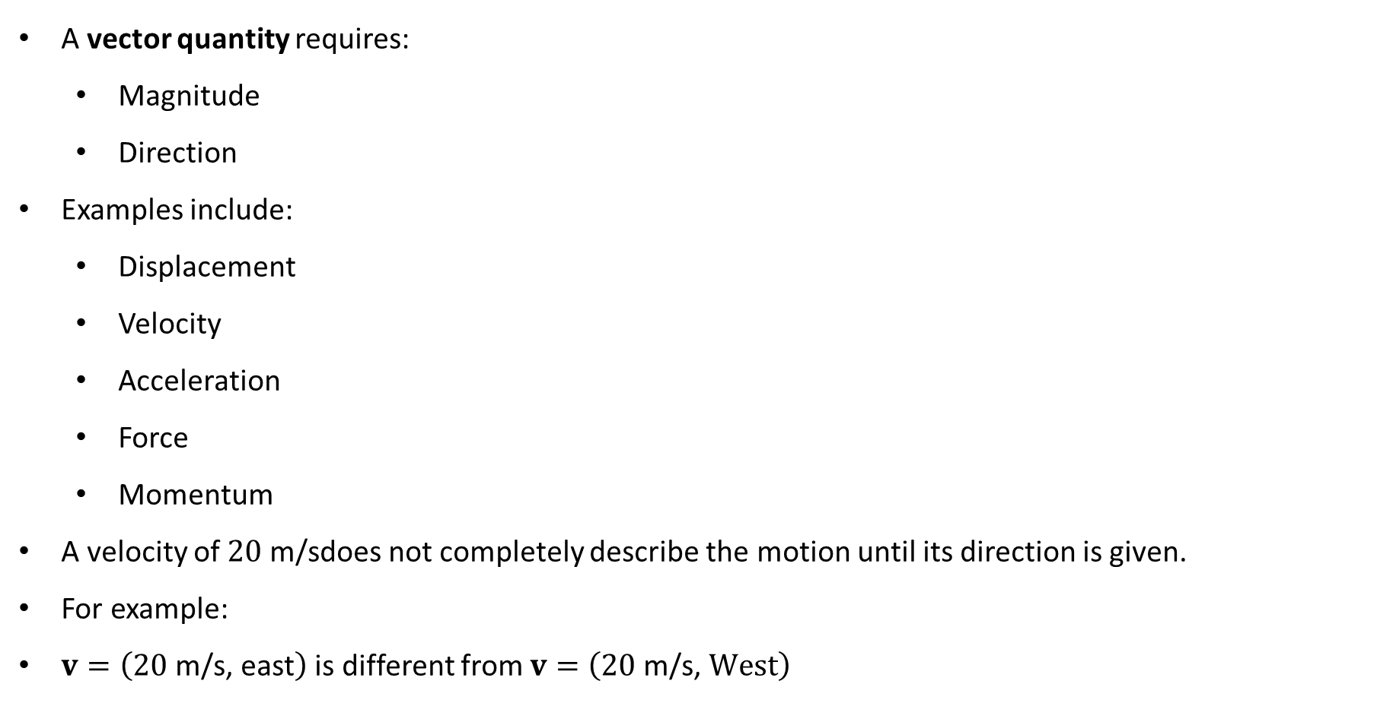
PHYS 2325 | University Physics I
Lecture 02 • Wed Sep 9 • Giancoli Ch. 3
Vectors have magnitude and direction
A vector quantity requires:
  Magnitude
  Direction
Examples include:
  Displacement
  Velocity
  Acceleration
  Force
  Momentum
A velocity of $20 \text{m}\text{/}\text{s}$does not completely describe the motion until its direction is given.
For example:
$v=\left(20 \text{m}\text{/}\text{s}\text{, }\text{east}\right)$ is different from $v=\left(20 \text{m}\text{/}\text{s}\text{, }West\right)$
Notes:
Teaching focus: Concept • Vectors and Scalars.
[Sources]
- Douglas C. Giancoli, Physics for Scientists and Engineers, 5th ed., Chapter 3, Section 3-1, starting p. 55.
[/Sources]

Slide 8
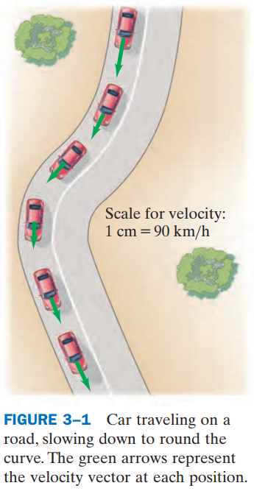
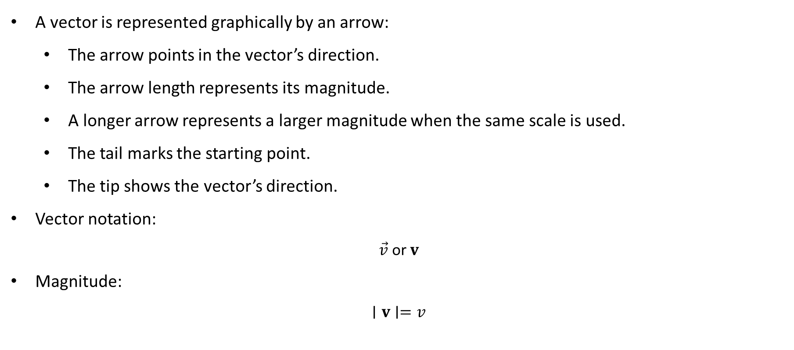
PHYS 2325 | University Physics I
Lecture 02 • Wed Sep 9 • Giancoli Ch. 3
Representing vectors with arrows
A vector is represented graphically by an arrow:
  The arrow points in the vector’s direction.
  The arrow length represents its magnitude.
  A longer arrow represents a larger magnitude when the same scale is used.
  The tail marks the starting point.
  The tip shows the vector’s direction.
Vector notation:
$$\vec{v} \text{or} v$$
Magnitude:
$$∣v∣=v$$
Notes:
Teaching focus: Concept • Vectors and Scalars.
[Sources]
- Douglas C. Giancoli, Physics for Scientists and Engineers, 5th ed., Chapter 3, Section 3-1, starting p. 55.
[/Sources]

Slide 9
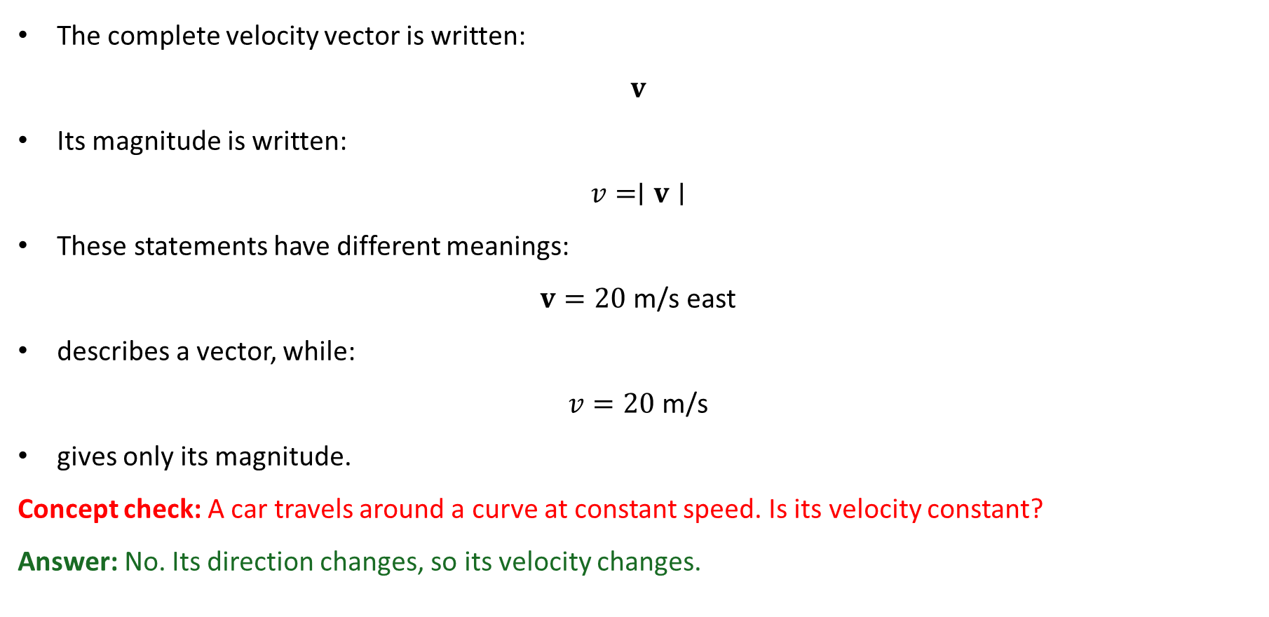
PHYS 2325 | University Physics I
Lecture 02 • Wed Sep 9 • Giancoli Ch. 3
Vector versus magnitude
The complete velocity vector is written:
$$v$$
Its magnitude is written:
$$v=∣v∣$$
These statements have different meanings:
$$v=20 \text{m}\text{/}\text{s} \text{east}$$
describes a vector, while:
$$v=20 \text{m}\text{/}\text{s}$$
gives only its magnitude.
Concept check: A car travels around a curve at constant speed. Is its velocity constant?
Answer: No. Its direction changes, so its velocity changes.
Notes:
Teaching focus: Concept • Vectors and Scalars.
[Sources]
- Douglas C. Giancoli, Physics for Scientists and Engineers, 5th ed., Chapter 3, Section 3-1, starting p. 55.
[/Sources]

Slide 10
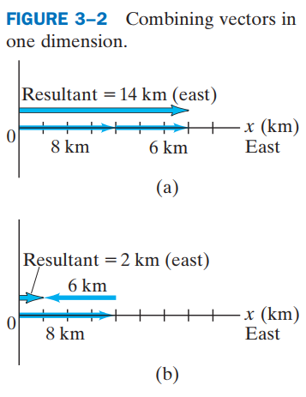
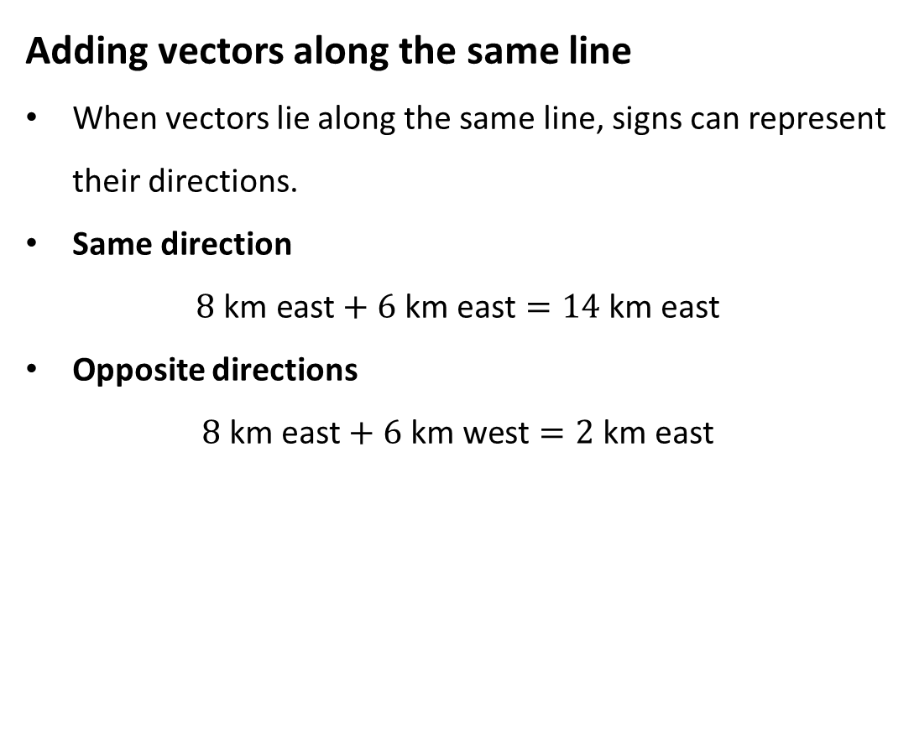
PHYS 2325 | University Physics I
Lecture 02 • Wed Sep 9 • Giancoli Ch. 3
Addition of Vectors: Graphical Methods
Adding vectors along the same line
When vectors lie along the same line, signs can represent their directions.
Same direction
$$8 \text{km} \text{east}+6 \text{km} \text{east}=14 \text{km} \text{east}$$
Opposite directions
$$8 \text{km} \text{east}+6 \text{km} \text{west}=2 \text{km} \text{east}$$
Notes:
Teaching focus: Concept • Vectors and Scalars.
[Sources]
- Douglas C. Giancoli, Physics for Scientists and Engineers, 5th ed., Chapter 3, Section 3-1, starting p. 55.
[/Sources]

Slide 11
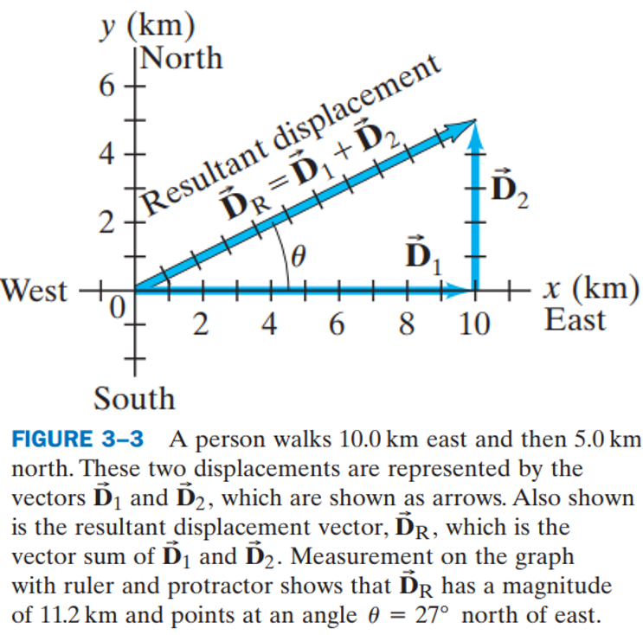
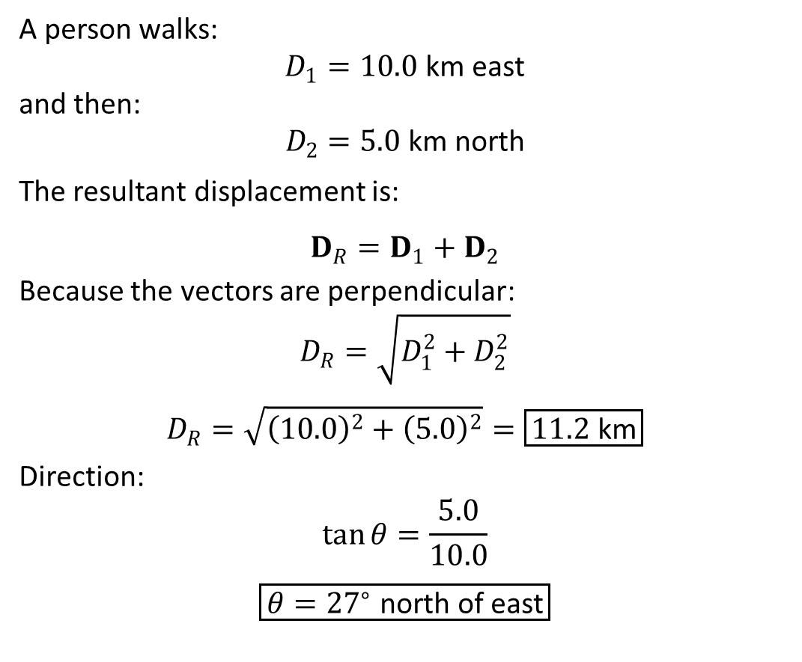
PHYS 2325 | University Physics I
Lecture 02 • Wed Sep 9 • Giancoli Ch. 3
Adding perpendicular displacements
A person walks:
$$D_{1}=10.0 \text{km} \text{east}$$
and then:
$$D_{2}=5.0 \text{km} \text{north}$$
The resultant displacement is:
$$D_{R}=D_{1}+D_{2}$$
Because the vectors are perpendicular:
$$D_{R}=\sqrt{D_{1}^{2}+D_{2}^{2}}$$
$$D_{R}=\sqrt{{\left(10.0\right)}^{2}+{\left(5.0\right)}^{2}}=\boxed{11.2 \text{km}}$$
Direction:
$$\tan{θ}=\frac{5.0}{10.0}$$
$$\boxed{θ={27}^{∘} \text{north} \text{of} \text{east}}$$
Notes:
Teaching focus: Concept • Vectors and Scalars.
[Sources]
- Douglas C. Giancoli, Physics for Scientists and Engineers, 5th ed., Chapter 3, Section 3-1, starting p. 55.
[/Sources]

Slide 12
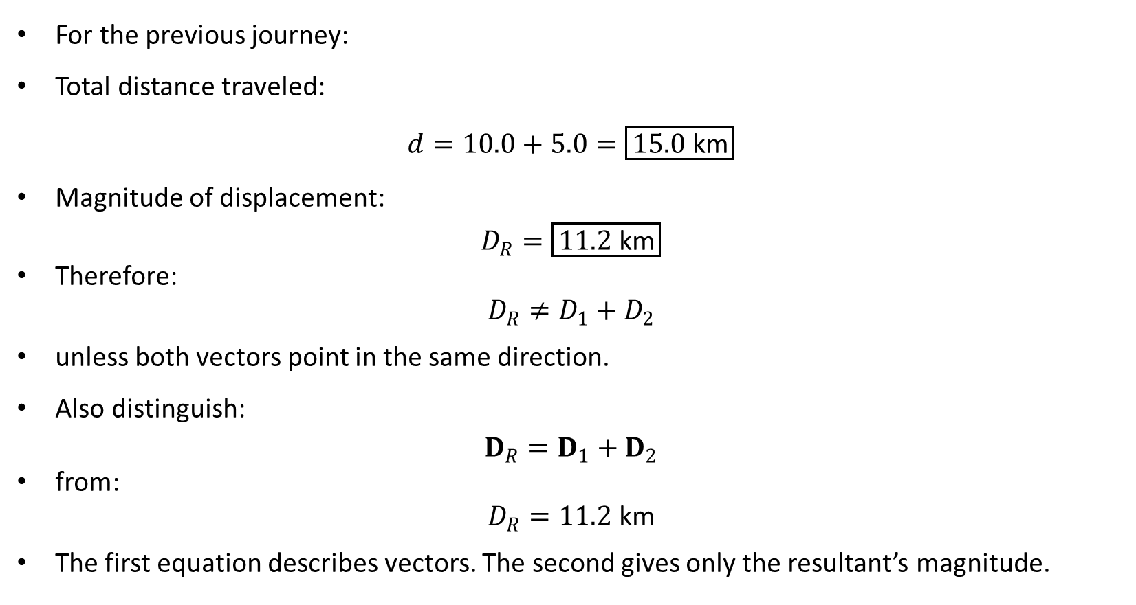
PHYS 2325 | University Physics I
Lecture 02 • Wed Sep 9 • Giancoli Ch. 3
Distance and resultant displacement differ
For the previous journey:
Total distance traveled:
$$d=10.0+5.0=\boxed{15.0 \text{km}}$$
Magnitude of displacement:
$$D_{R}=\boxed{11.2 \text{km}}$$
Therefore:
$$D_{R}≠D_{1}+D_{2}$$
unless both vectors point in the same direction.
Also distinguish:
$$D_{R}=D_{1}+D_{2}$$
from:
$$D_{R}=11.2 \text{km}$$
The first equation describes vectors. The second gives only the resultant’s magnitude.
Notes:
Teaching focus: Concept • Vectors and Scalars.
[Sources]
- Douglas C. Giancoli, Physics for Scientists and Engineers, 5th ed., Chapter 3, Section 3-1, starting p. 55.
[/Sources]

Slide 13
PHYS 2325 | University Physics I
Lecture 02 • Wed Sep 9 • Giancoli Ch. 3
Tail-to-tip method
To add two vectors graphically:
  Draw the first vector to scale.
  Move the second vector parallel to itself until its tail touches the first vector’s tip.
  Preserve the second vector’s magnitude and direction.
  Draw the resultant from the first vector’s tail to the second vector’s tip.
  Measure its length and direction using the selected scale.
Vectors may be moved parallel to themselves without changing them.
Notes:
Teaching focus: Concept • Vectors and Scalars.
[Sources]
- Douglas C. Giancoli, Physics for Scientists and Engineers, 5th ed., Chapter 3, Section 3-1, starting p. 55.
[/Sources]

Slide 14
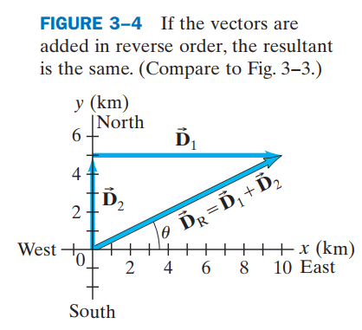
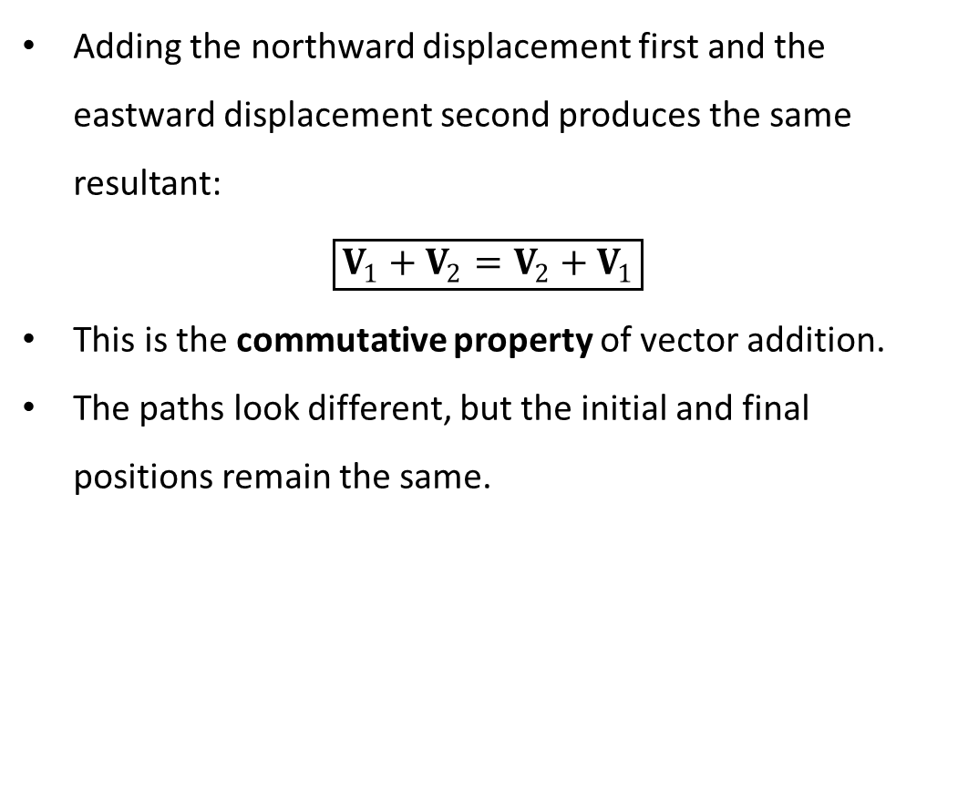
PHYS 2325 | University Physics I
Lecture 02 • Wed Sep 9 • Giancoli Ch. 3
Order does not affect the resultant
Adding the northward displacement first and the eastward displacement second produces the same resultant:
$$\boxed{V_{1}+V_{2}=V_{2}+V_{1}}$$
This is the commutative property of vector addition.
The paths look different, but the initial and final positions remain the same.
Notes:
Teaching focus: Concept • Vectors and Scalars.
[Sources]
- Douglas C. Giancoli, Physics for Scientists and Engineers, 5th ed., Chapter 3, Section 3-1, starting p. 55.
[/Sources]

Slide 15
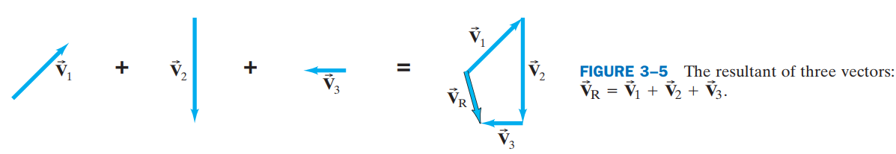
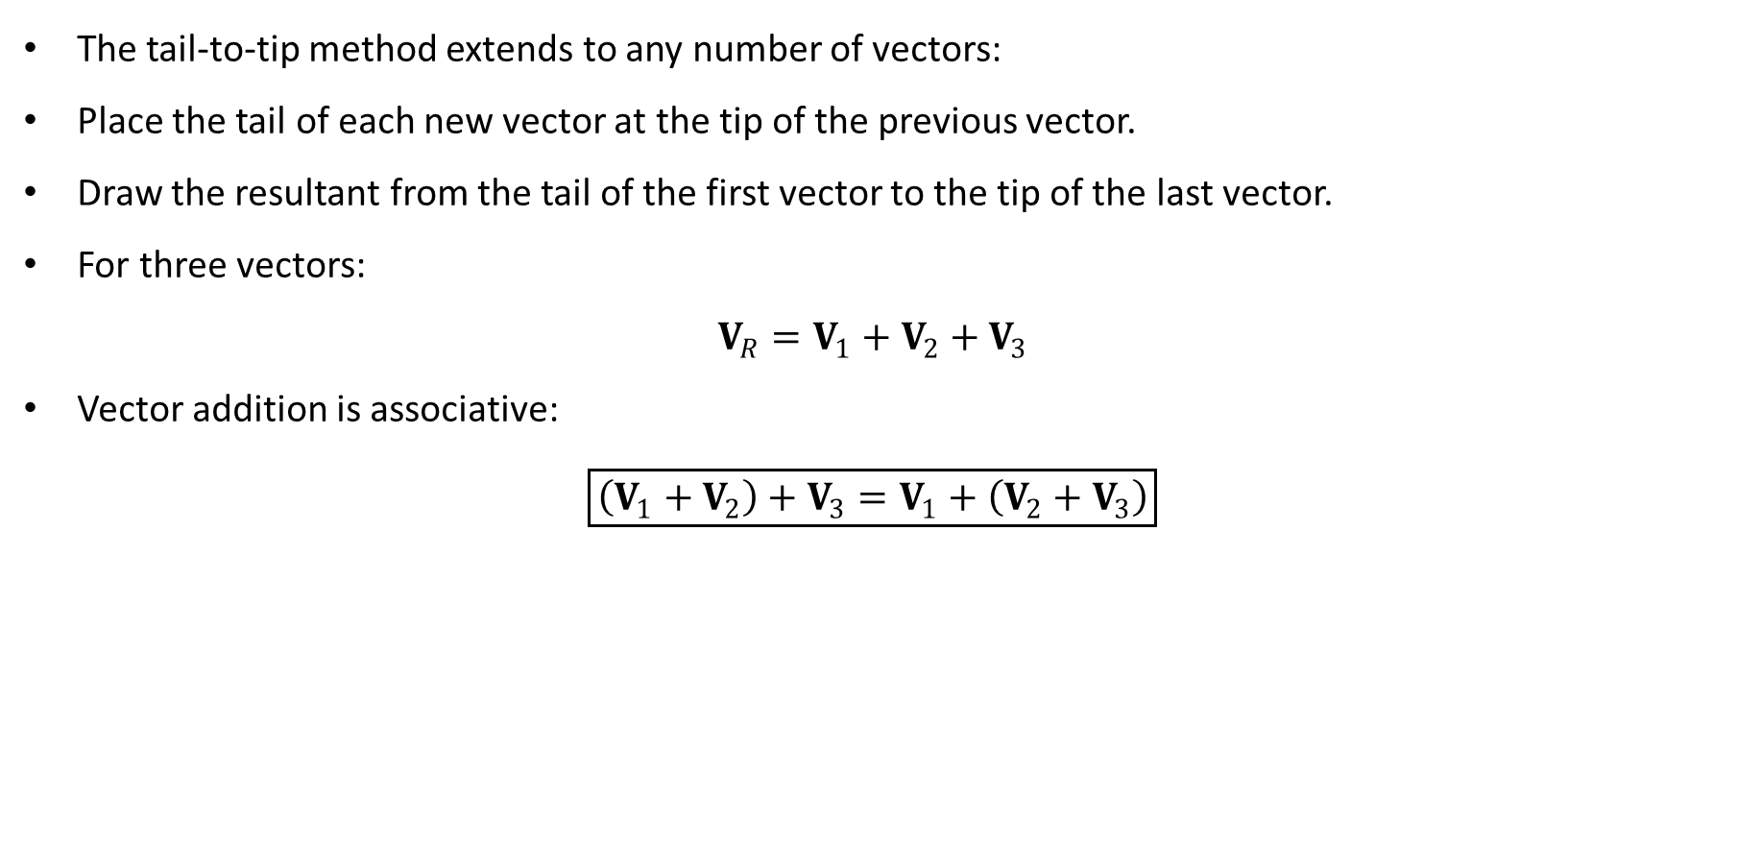
PHYS 2325 | University Physics I
Lecture 02 • Wed Sep 9 • Giancoli Ch. 3
Adding three or more vectors
The tail-to-tip method extends to any number of vectors:
Place the tail of each new vector at the tip of the previous vector.
Draw the resultant from the tail of the first vector to the tip of the last vector.
For three vectors:
$$V_{R}=V_{1}+V_{2}+V_{3}$$
Vector addition is associative:
$$\boxed{\left(V_{1}+V_{2}\right)+V_{3}=V_{1}+\left(V_{2}+V_{3}\right)}$$
Notes:
Teaching focus: Concept • Vectors and Scalars.
[Sources]
- Douglas C. Giancoli, Physics for Scientists and Engineers, 5th ed., Chapter 3, Section 3-1, starting p. 55.
[/Sources]

Slide 16
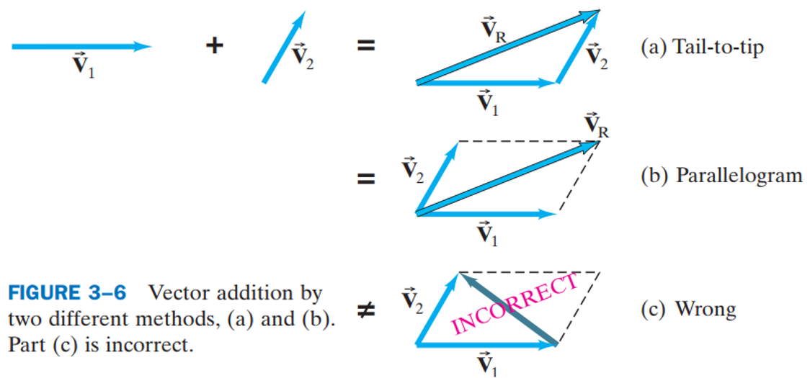
PHYS 2325 | University Physics I
Lecture 02 • Wed Sep 9 • Giancoli Ch. 3
Parallelogram method
A second graphical method starts both vectors at the same point.
Draw the two vectors from a common origin.
Complete the parallelogram.
Draw the diagonal from the common origin.
This diagonal represents the vector sum.
The tail-to-tip and parallelogram methods give the same resultant.
Notes:
Teaching focus: Concept • Vectors and Scalars.
[Sources]
- Douglas C. Giancoli, Physics for Scientists and Engineers, 5th ed., Chapter 3, Section 3-1, starting p. 55.
[/Sources]

Slide 17
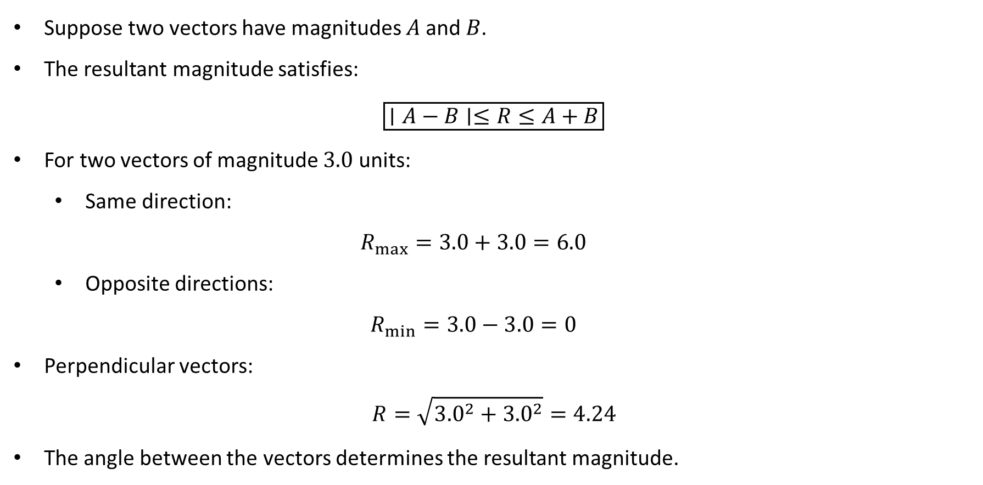
PHYS 2325 | University Physics I
Lecture 02 • Wed Sep 9 • Giancoli Ch. 3
Possible magnitude of a vector sum
Suppose two vectors have magnitudes $A$and $B$.
The resultant magnitude satisfies:
$$\boxed{∣A−B∣≤R≤A+B}$$
For two vectors of magnitude $3.0$ units:
  Same direction:
  $$R_{max}=3.0+3.0=6.0$$
  Opposite directions:
  $$R_{min}=3.0−3.0=0$$
Perpendicular vectors:
$$R=\sqrt{{3.0}^{2}+{3.0}^{2}}=4.24$$
The angle between the vectors determines the resultant magnitude.
Notes:
Teaching focus: Concept • Vectors and Scalars.
[Sources]
- Douglas C. Giancoli, Physics for Scientists and Engineers, 5th ed., Chapter 3, Section 3-1, starting p. 55.
[/Sources]

Slide 18
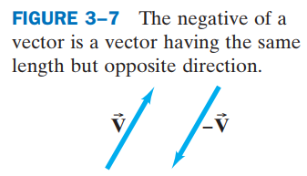
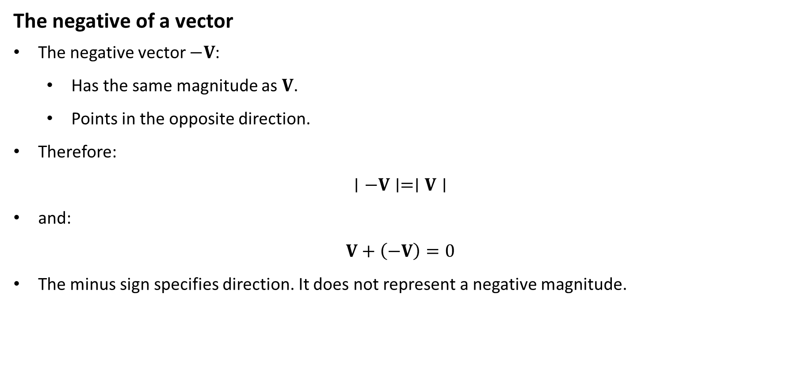
PHYS 2325 | University Physics I
Lecture 02 • Wed Sep 9 • Giancoli Ch. 3
Subtraction and Scalar Multiplication
The negative of a vector
The negative vector $−V$:
  Has the same magnitude as $V$.
  Points in the opposite direction.
Therefore:
$$∣−V∣=∣V∣$$
and:
$$V+\left(−V\right)=0$$
The minus sign specifies direction. It does not represent a negative magnitude.
Notes:
Teaching focus: Concept • Vectors and Scalars.
[Sources]
- Douglas C. Giancoli, Physics for Scientists and Engineers, 5th ed., Chapter 3, Section 3-1, starting p. 55.
[/Sources]

Slide 19
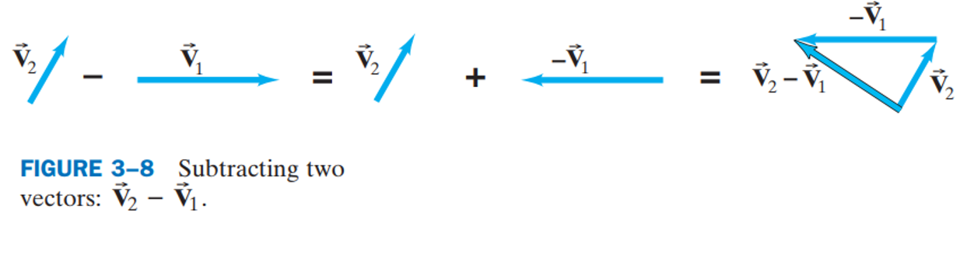
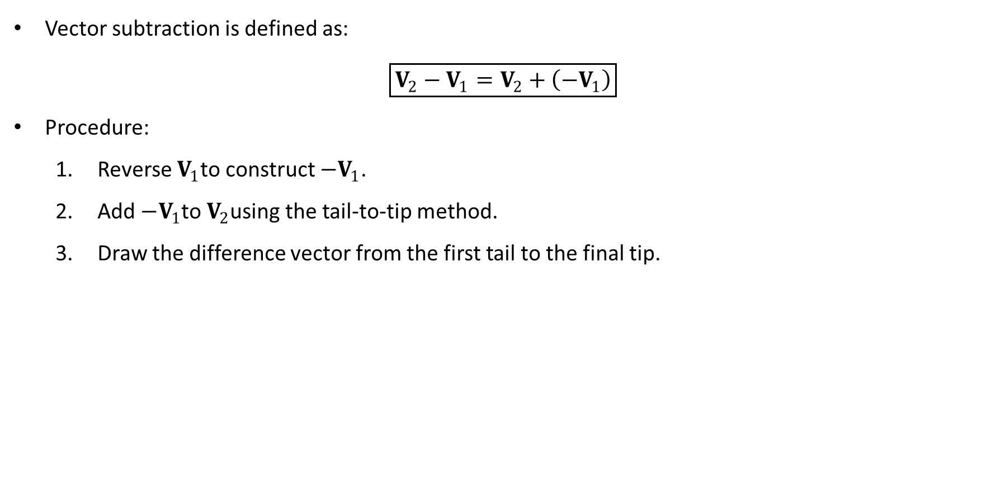
PHYS 2325 | University Physics I
Lecture 02 • Wed Sep 9 • Giancoli Ch. 3
Vector subtraction becomes addition
Vector subtraction is defined as:
$$\boxed{V_{2}−V_{1}=V_{2}+\left(−V_{1}\right)}$$
Procedure:
  Reverse $V_{1}$to construct $−V_{1}$.
  Add $−V_{1}$to $V_{2}$using the tail-to-tip method.
  Draw the difference vector from the first tail to the final tip.
Notes:
Teaching focus: Concept • Vectors and Scalars.
[Sources]
- Douglas C. Giancoli, Physics for Scientists and Engineers, 5th ed., Chapter 3, Section 3-1, starting p. 55.
[/Sources]

Slide 20
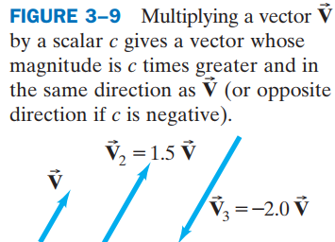
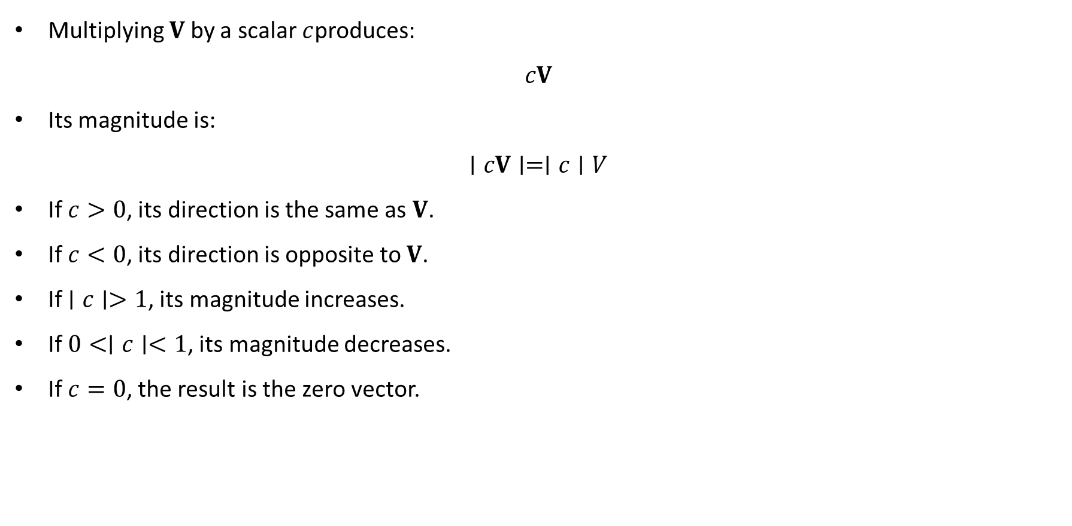
PHYS 2325 | University Physics I
Lecture 02 • Wed Sep 9 • Giancoli Ch. 3
Multiplication by a scalar
Multiplying $V$by a scalar $c$produces:
$$cV$$
Its magnitude is:
$$∣cV∣=∣c∣V$$
If $c>0$, its direction is the same as $V$.
If $c<0$, its direction is opposite to $V$.
If $∣c∣>1$, its magnitude increases.
If $0<∣c∣<1$, its magnitude decreases.
If $c=0$, the result is the zero vector.
Notes:
Teaching focus: Concept • Vectors and Scalars.
[Sources]
- Douglas C. Giancoli, Physics for Scientists and Engineers, 5th ed., Chapter 3, Section 3-1, starting p. 55.
[/Sources]

Slide 21
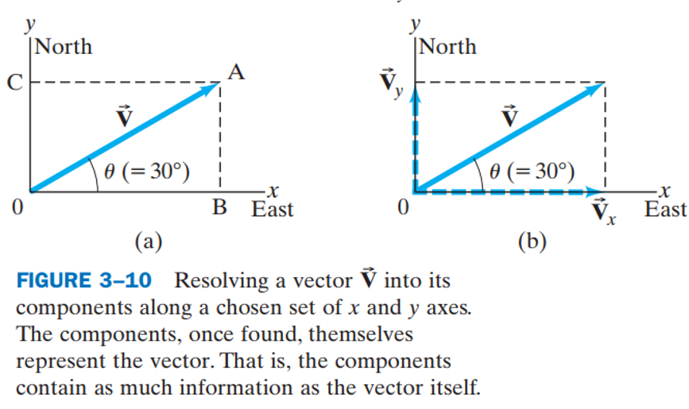
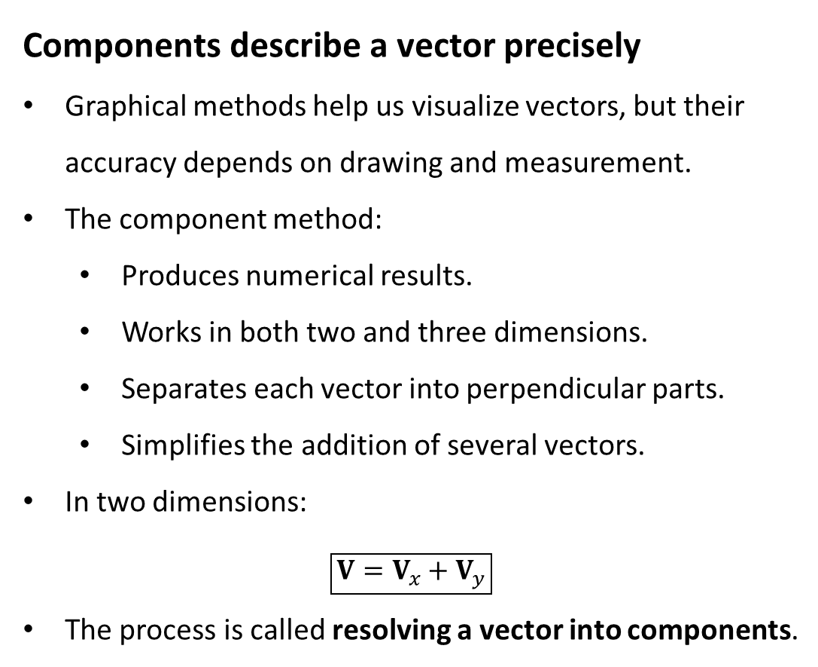
PHYS 2325 | University Physics I
Lecture 02 • Wed Sep 9 • Giancoli Ch. 3
3-4 Adding Vectors by Components
Components describe a vector precisely
Graphical methods help us visualize vectors, but their accuracy depends on drawing and measurement.
The component method:
  Produces numerical results.
  Works in both two and three dimensions.
  Separates each vector into perpendicular parts.
  Simplifies the addition of several vectors.
In two dimensions:
$$\boxed{V=V_{x}+V_{y}}$$
The process is called resolving a vector into components.
Notes:
Teaching focus: Concept • Vectors and Scalars.
[Sources]
- Douglas C. Giancoli, Physics for Scientists and Engineers, 5th ed., Chapter 3, Section 3-1, starting p. 55.
[/Sources]

Slide 22
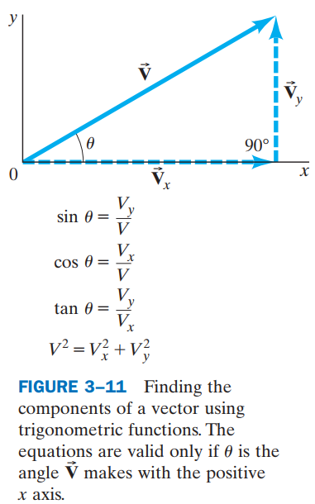
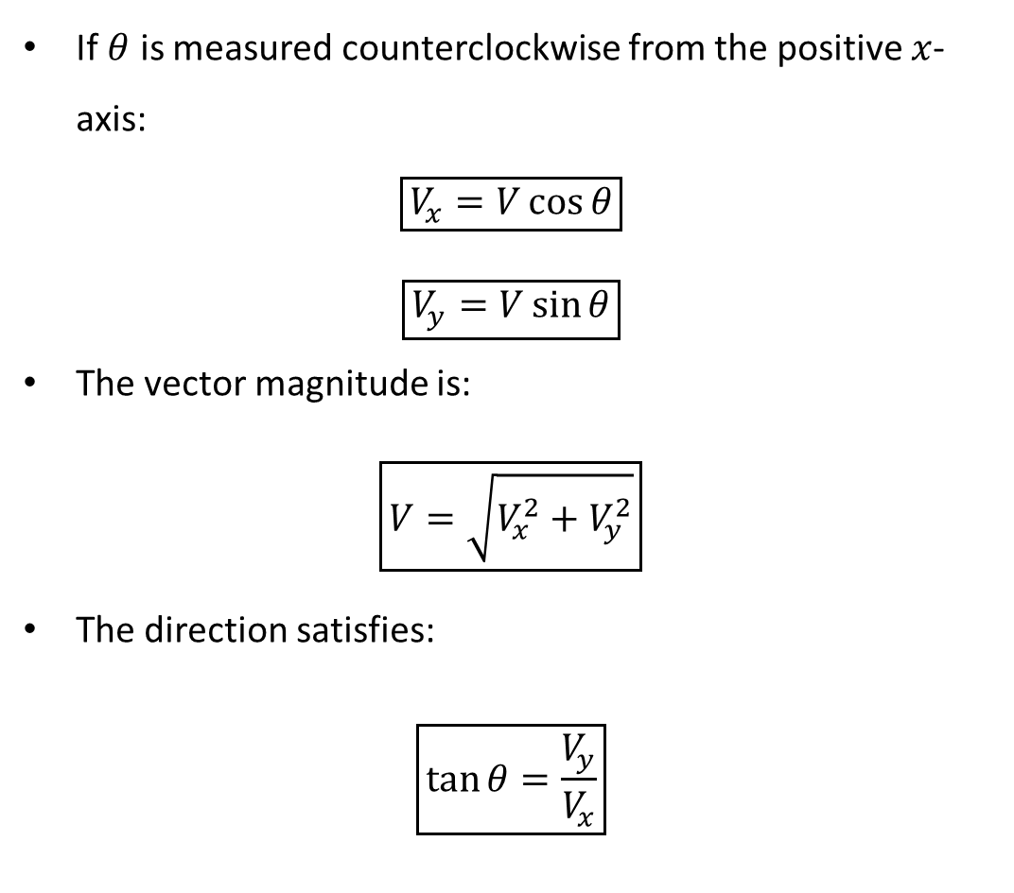
PHYS 2325 | University Physics I
Lecture 02 • Wed Sep 9 • Giancoli Ch. 3
Calculate components using trigonometry
If $θ$ is measured counterclockwise from the positive $x$-axis:
$$\boxed{V_{x}=V\cos{θ}}$$
$$\boxed{V_{y}=V\sin{θ}}$$
The vector magnitude is:
$$\boxed{V=\sqrt{V_{x}^{2}+V_{y}^{2}}}$$
The direction satisfies:
$$\boxed{\tan{θ}=\frac{V_{y}}{V_{x}}}$$
Notes:
Teaching focus: Concept • Vectors and Scalars.
[Sources]
- Douglas C. Giancoli, Physics for Scientists and Engineers, 5th ed., Chapter 3, Section 3-1, starting p. 55.
[/Sources]

Slide 23
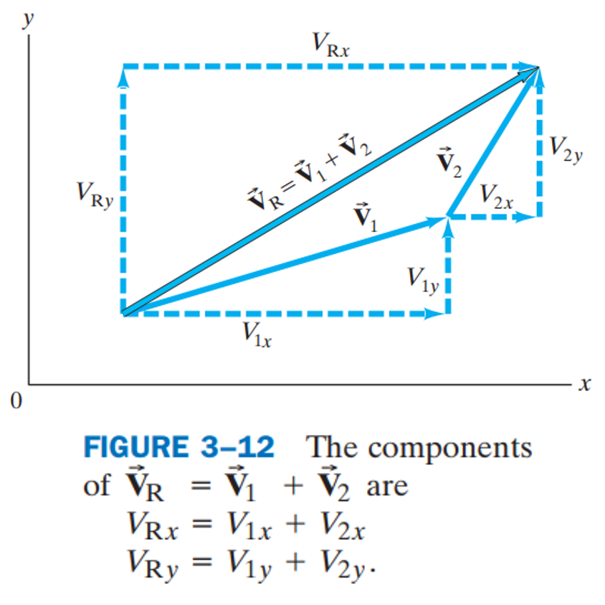
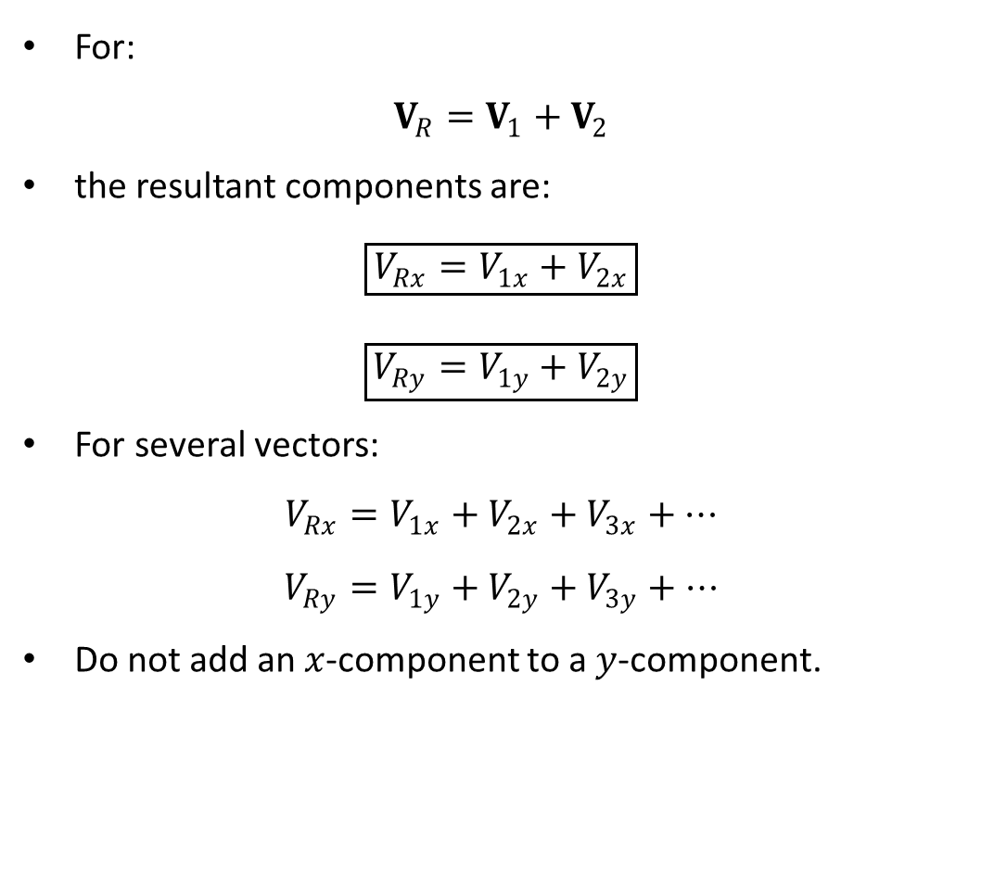
PHYS 2325 | University Physics I
Lecture 02 • Wed Sep 9 • Giancoli Ch. 3
Add vectors component by component
For:
$$V_{R}=V_{1}+V_{2}$$
the resultant components are:
$$\boxed{V_{Rx}=V_{1x}+V_{2x}}$$
$$\boxed{V_{Ry}=V_{1y}+V_{2y}}$$
For several vectors:
$$V_{Rx}=V_{1x}+V_{2x}+V_{3x}+⋯$$
$$V_{Ry}=V_{1y}+V_{2y}+V_{3y}+⋯$$
Do not add an $x$-component to a $y$-component.
Notes:
Teaching focus: Concept • Vectors and Scalars.
[Sources]
- Douglas C. Giancoli, Physics for Scientists and Engineers, 5th ed., Chapter 3, Section 3-1, starting p. 55.
[/Sources]

Slide 24
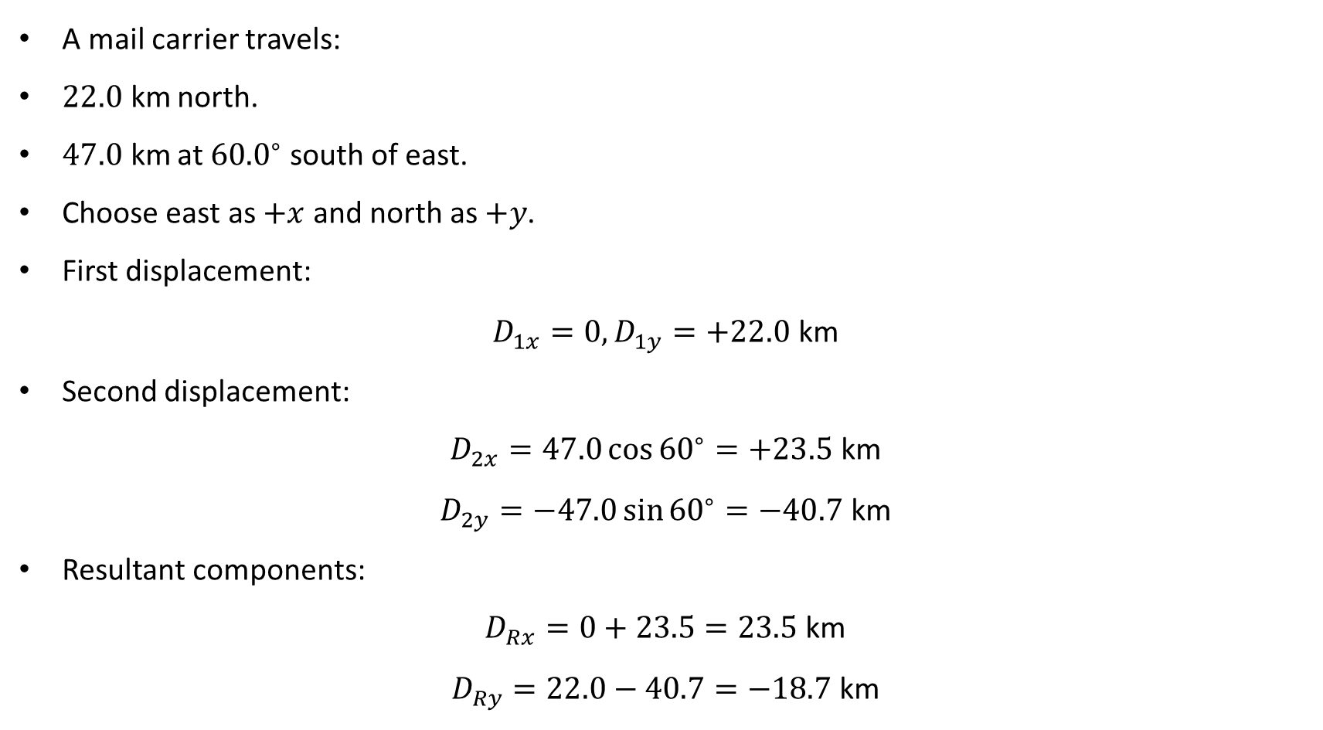
PHYS 2325 | University Physics I
Lecture 02 • Wed Sep 9 • Giancoli Ch. 3
Example 3–2: Mail carrier’s displacement
A mail carrier travels:
$22.0 \text{km}$north.
$47.0 \text{km}$ at ${60.0}^{∘}$ south of east.
Choose east as $+x$ and north as $+y$.
First displacement:
$$D_{1x}=0, D_{1y}=+22.0 \text{km}$$
Second displacement:
$$D_{2x}=47.0\cos{{60}^{∘}}=+23.5 \text{km}$$
$$D_{2y}=−47.0\sin{{60}^{∘}}=−40.7 \text{km}$$
Resultant components:
$$D_{Rx}=0+23.5=23.5 \text{km}$$
$$D_{Ry}=22.0−40.7=−18.7 \text{km}$$
Notes:
Teaching focus: Concept • Vectors and Scalars.
[Sources]
- Douglas C. Giancoli, Physics for Scientists and Engineers, 5th ed., Chapter 3, Section 3-1, starting p. 55.
[/Sources]

Slide 25
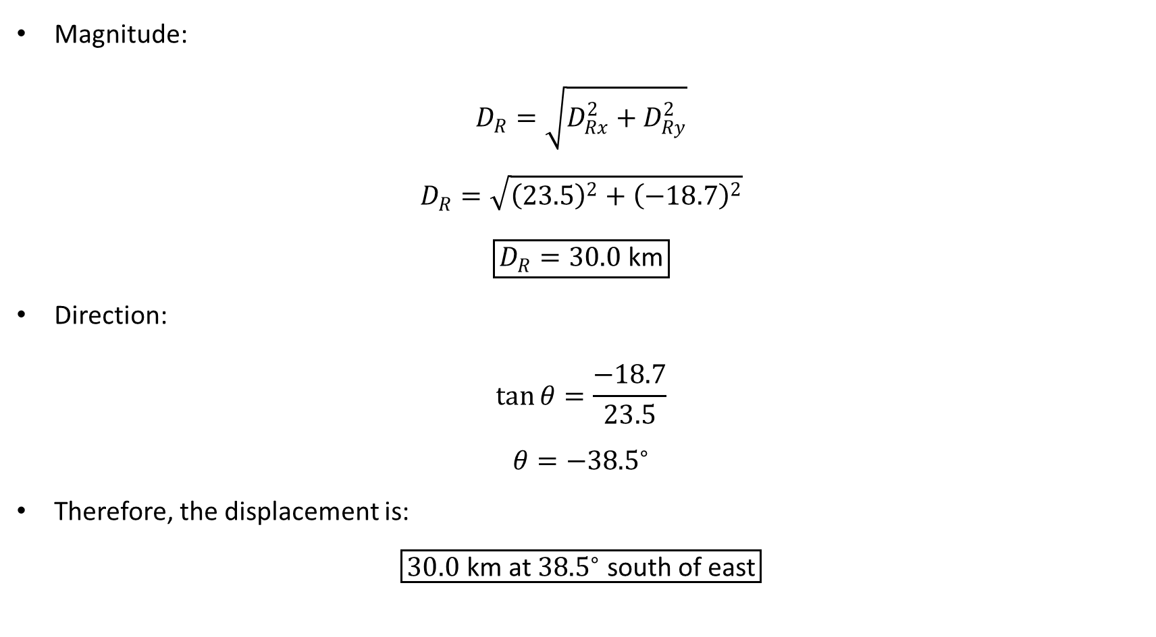
PHYS 2325 | University Physics I
Lecture 02 • Wed Sep 9 • Giancoli Ch. 3
Example 3–2: Mail carrier: magnitude and direction
Magnitude:
$$D_{R}=\sqrt{D_{Rx}^{2}+D_{Ry}^{2}}$$
$$D_{R}=\sqrt{{\left(23.5\right)}^{2}+{\left(−18.7\right)}^{2}}$$
$$\boxed{D_{R}=30.0 \text{km}}$$
Direction:
$$\tan{θ}=\frac{−18.7}{23.5}$$
$$θ=−{38.5}^{∘}$$
Therefore, the displacement is:
$$\boxed{30.0 \text{km} \text{at} {38.5}^{∘} \text{south} \text{of} \text{east}}$$
Notes:
Teaching focus: Concept • Vectors and Scalars.
[Sources]
- Douglas C. Giancoli, Physics for Scientists and Engineers, 5th ed., Chapter 3, Section 3-1, starting p. 55.
[/Sources]

Slide 26
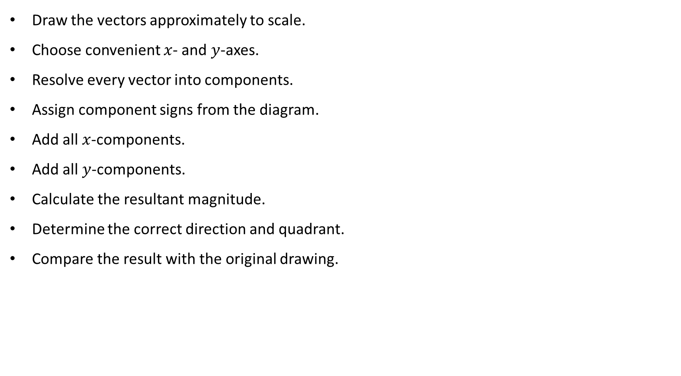
PHYS 2325 | University Physics I
Lecture 02 • Wed Sep 9 • Giancoli Ch. 3
Component-method checklist
Draw the vectors approximately to scale.
Choose convenient $x$- and $y$-axes.
Resolve every vector into components.
Assign component signs from the diagram.
Add all $x$-components.
Add all $y$-components.
Calculate the resultant magnitude.
Determine the correct direction and quadrant.
Compare the result with the original drawing.
Notes:
Teaching focus: Concept • Vectors and Scalars.
[Sources]
- Douglas C. Giancoli, Physics for Scientists and Engineers, 5th ed., Chapter 3, Section 3-1, starting p. 55.
[/Sources]

Slide 27
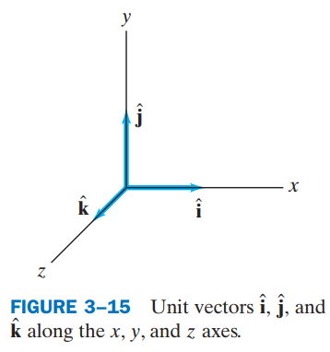
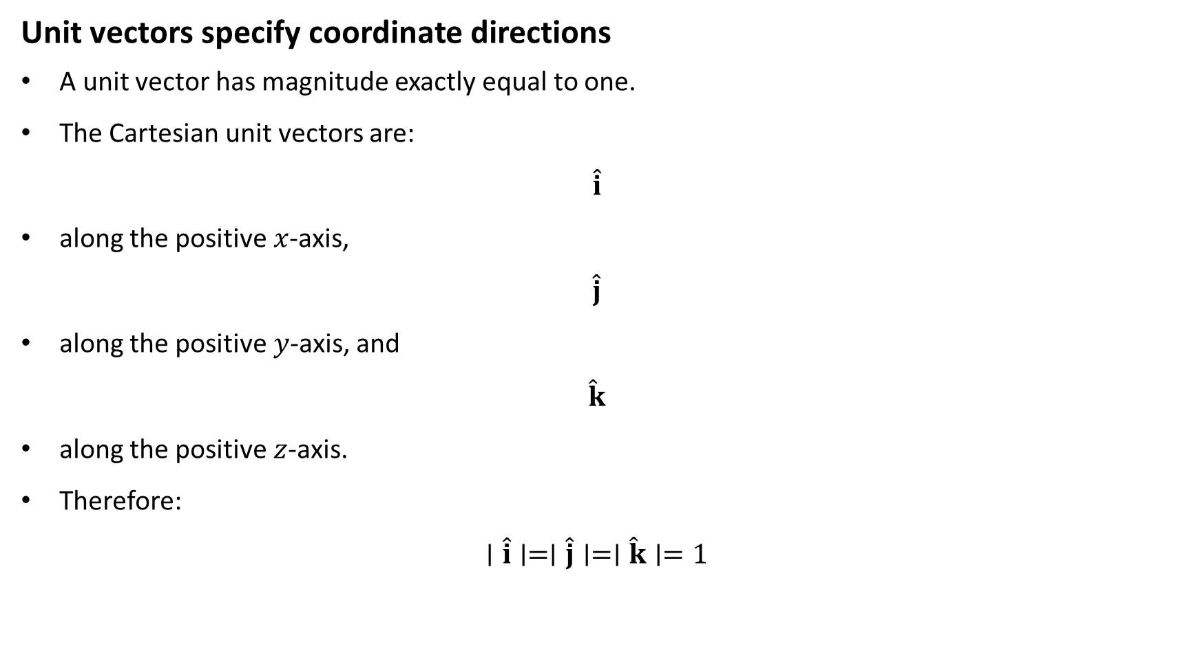
PHYS 2325 | University Physics I
Lecture 02 • Wed Sep 9 • Giancoli Ch. 3
3–5 — Unit Vectors
Unit vectors specify coordinate directions
A unit vector has magnitude exactly equal to one.
The Cartesian unit vectors are:
$$\hat{i}$$
along the positive $x$-axis,
$$\hat{j}$$
along the positive $y$-axis, and
$$\hat{k}$$
along the positive $z$-axis.
Therefore:
$$∣\hat{i}∣=∣\hat{j}∣=∣\hat{k}∣=1$$
Notes:
Teaching focus: Concept • Vectors and Scalars.
[Sources]
- Douglas C. Giancoli, Physics for Scientists and Engineers, 5th ed., Chapter 3, Section 3-1, starting p. 55.
[/Sources]

Slide 28
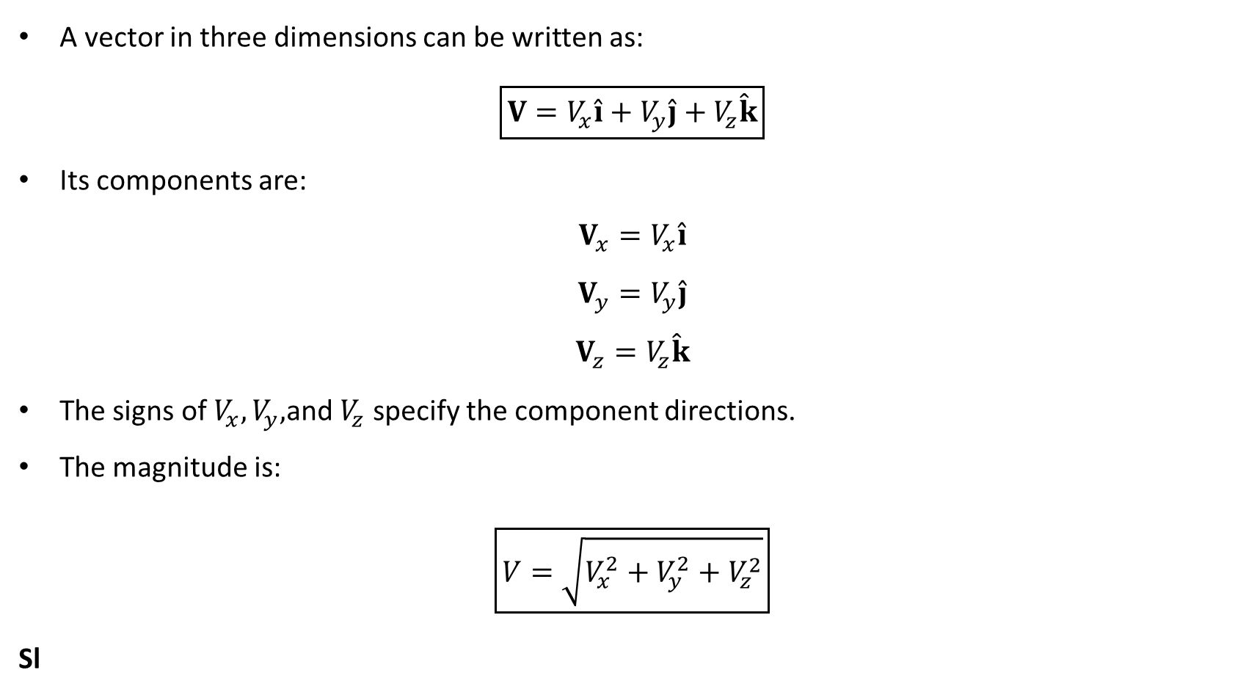
PHYS 2325 | University Physics I
Lecture 02 • Wed Sep 9 • Giancoli Ch. 3
Writing vectors with unit vectors
A vector in three dimensions can be written as:
$$\boxed{V=V_{x}\hat{i}+V_{y}\hat{j}+V_{z}\hat{k}}$$
Its components are:
$$V_{x}=V_{x}\hat{i}$$
$$V_{y}=V_{y}\hat{j}$$
$$V_{z}=V_{z}\hat{k}$$
The signs of $V_{x},V_{y},$and $V_{z}$ specify the component directions.
The magnitude is:
$$\boxed{V=\sqrt{V_{x}^{2}+V_{y}^{2}+V_{z}^{2}}}$$
Sl
Notes:
Teaching focus: Concept • Vectors and Scalars.
[Sources]
- Douglas C. Giancoli, Physics for Scientists and Engineers, 5th ed., Chapter 3, Section 3-1, starting p. 55.
[/Sources]

Slide 29
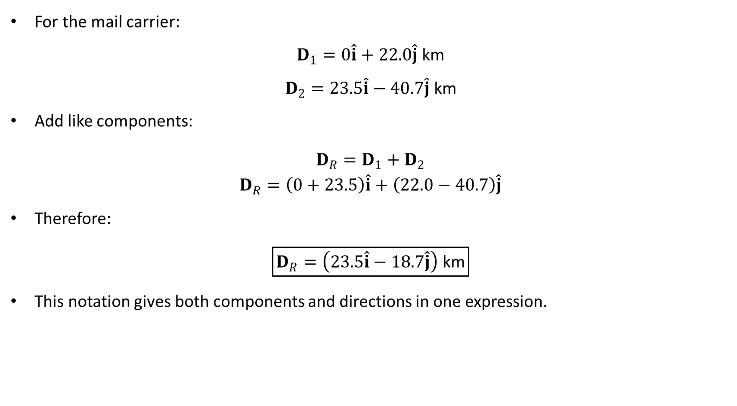
PHYS 2325 | University Physics I
Lecture 02 • Wed Sep 9 • Giancoli Ch. 3
Example 3–4: Addition using unit vectors
For the mail carrier:
$$D_{1}=0\hat{i}+22.0\hat{j} \text{km}$$
$$D_{2}=23.5\hat{i}−40.7\hat{j} \text{km}$$
Add like components:
$$\begin{aligned}D_{R}=D_{1}+D_{2} \\ D_{R}=\left(0+23.5\right)\hat{i}+\left(22.0−40.7\right)\hat{j}\end{aligned}$$
Therefore:
$$\boxed{D_{R}=\left(23.5\hat{i}−18.7\hat{j}\right) \text{km}}$$
This notation gives both components and directions in one expression.
Notes:
Teaching focus: Concept • Vectors and Scalars.
[Sources]
- Douglas C. Giancoli, Physics for Scientists and Engineers, 5th ed., Chapter 3, Section 3-1, starting p. 55.
[/Sources]

Slide 30
LECTURE 03
Vector Kinematics, Projectiles, and Relative Motion
Fri Sep 11 • Giancoli Ch. 3
Muhammad Nauman • PHYS 2325 • Fall 2026
Notes:
Teaching focus: Vector Kinematics, Projectiles, and Relative Motion.
[Sources]
- PHYS 2325 University Physics I Fall 2026 syllabus and semester calendar.
[/Sources]

Slide 31
PHYS 2325 | University Physics I
Lecture 03 • Fri Sep 11 • Giancoli Ch. 3
Learning outcomes
Define and represent vector kinematics.
Derive and interpret projectile motion.
Apply solving projectile problems.
Connect relative velocity.
Check units, vector directions, assumptions, and limiting behavior in every solution.
Notes:
Teaching focus: Learning outcomes.
[Sources]
- PHYS 2325 University Physics I Fall 2026 syllabus and semester calendar.
[/Sources]

Slide 32
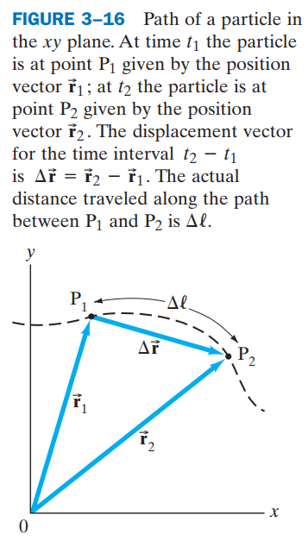
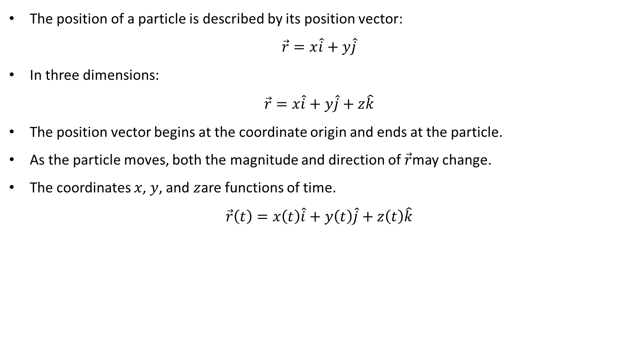
PHYS 2325 | University Physics I
Lecture 02 • Wed Sep 9 • Giancoli Ch. 3
Position in Two Dimensions
The position of a particle is described by its position vector:
$$\vec{r}=x\hat{i}+y\hat{j}$$
In three dimensions:
$$\vec{r}=x\hat{i}+y\hat{j}+z\hat{k}$$
The position vector begins at the coordinate origin and ends at the particle.
As the particle moves, both the magnitude and direction of $\vec{r}$may change.
The coordinates $x$, $y$, and $z$are functions of time.
$$\vec{r}\left(t\right)=x\left(t\right)\hat{i}+y\left(t\right)\hat{j}+z\left(t\right)\hat{k}$$
Notes:
Teaching focus: Concept • Vectors and Scalars.
[Sources]
- Douglas C. Giancoli, Physics for Scientists and Engineers, 5th ed., Chapter 3, Section 3-1, starting p. 55.
[/Sources]

Slide 33
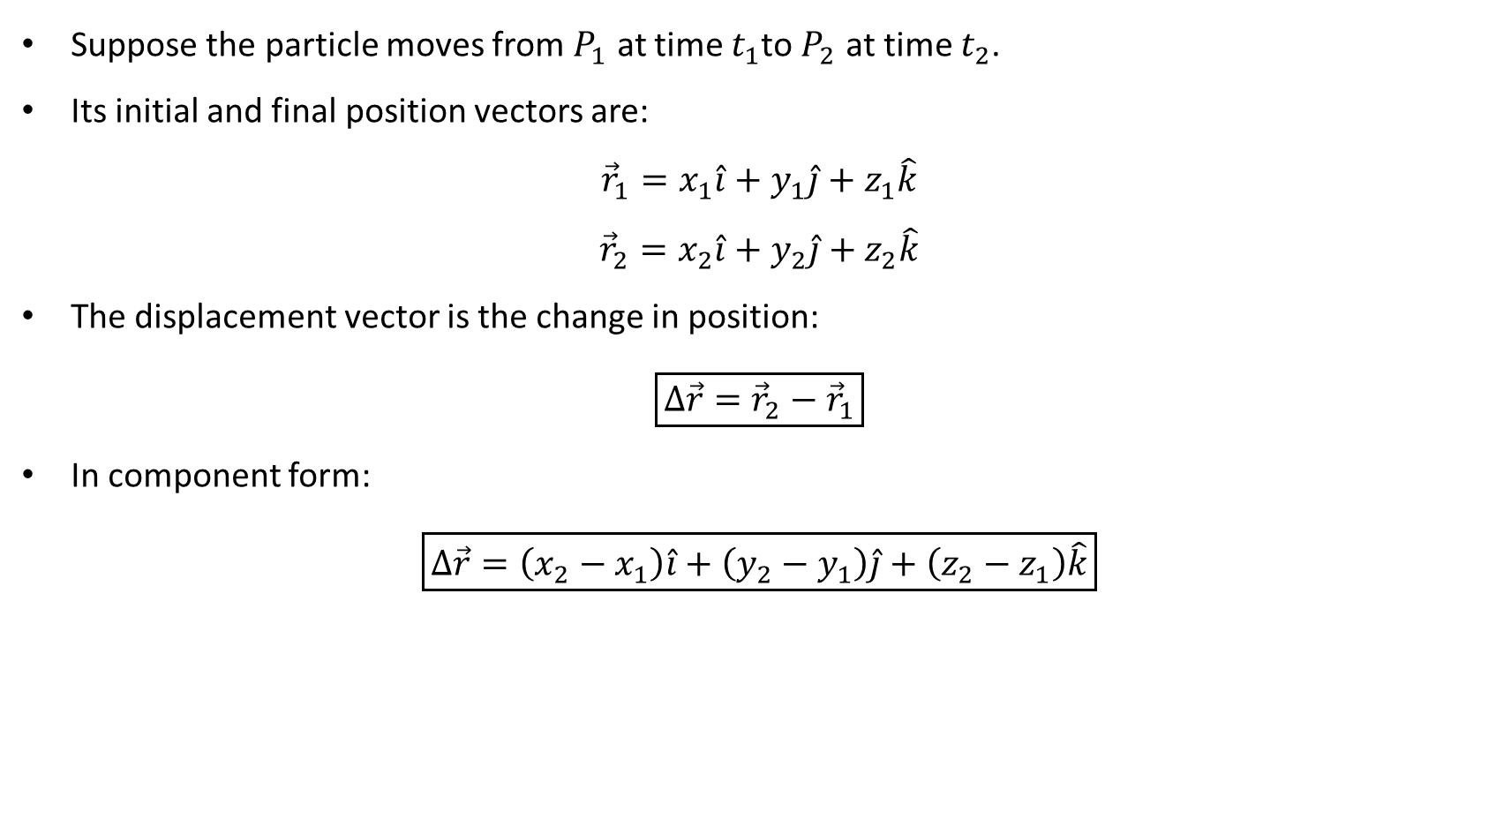
PHYS 2325 | University Physics I
Lecture 02 • Wed Sep 9 • Giancoli Ch. 3
Displacement Vector
Suppose the particle moves from $P_{1}$ at time $t_{1}$to $P_{2}$ at time $t_{2}$.
Its initial and final position vectors are:
$${\vec{r}}_{1}=x_{1}\hat{i}+y_{1}\hat{j}+z_{1}\hat{k}$$
$${\vec{r}}_{2}=x_{2}\hat{i}+y_{2}\hat{j}+z_{2}\hat{k}$$
The displacement vector is the change in position:
$$\boxed{Δ\vec{r}={\vec{r}}_{2}−{\vec{r}}_{1}}$$
In component form:
$$\boxed{Δ\vec{r}=\left(x_{2}−x_{1}\right)\hat{i}+\left(y_{2}−y_{1}\right)\hat{j}+\left(z_{2}−z_{1}\right)\hat{k}}$$
Notes:
Teaching focus: Concept • Vectors and Scalars.
[Sources]
- Douglas C. Giancoli, Physics for Scientists and Engineers, 5th ed., Chapter 3, Section 3-1, starting p. 55.
[/Sources]

Slide 34
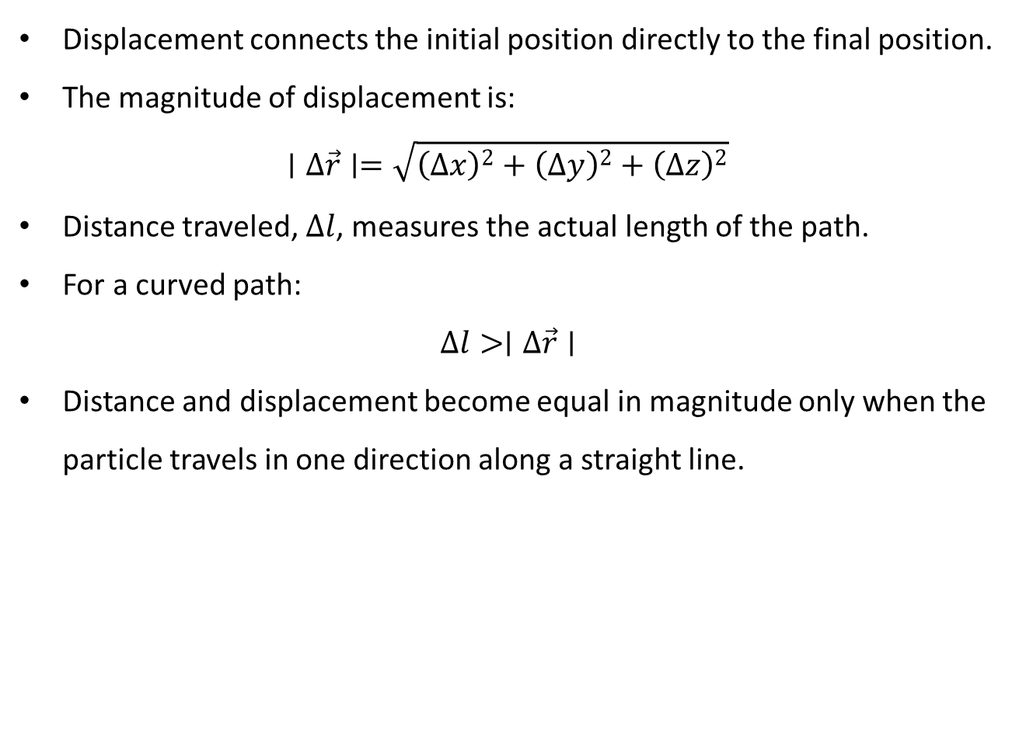
PHYS 2325 | University Physics I
Lecture 02 • Wed Sep 9 • Giancoli Ch. 3
Displacement and Distance Traveled
Displacement connects the initial position directly to the final position.
The magnitude of displacement is:
$$∣Δ\vec{r}∣=\sqrt{{\left(Δx\right)}^{2}+{\left(Δy\right)}^{2}+{\left(Δz\right)}^{2}}$$
Distance traveled, $Δl$, measures the actual length of the path.
For a curved path:
$$Δl>∣Δ\vec{r}∣$$
Distance and displacement become equal in magnitude only when the particle travels in one direction along a straight line.
Notes:
Teaching focus: Concept • Vectors and Scalars.
[Sources]
- Douglas C. Giancoli, Physics for Scientists and Engineers, 5th ed., Chapter 3, Section 3-1, starting p. 55.
[/Sources]

Slide 35
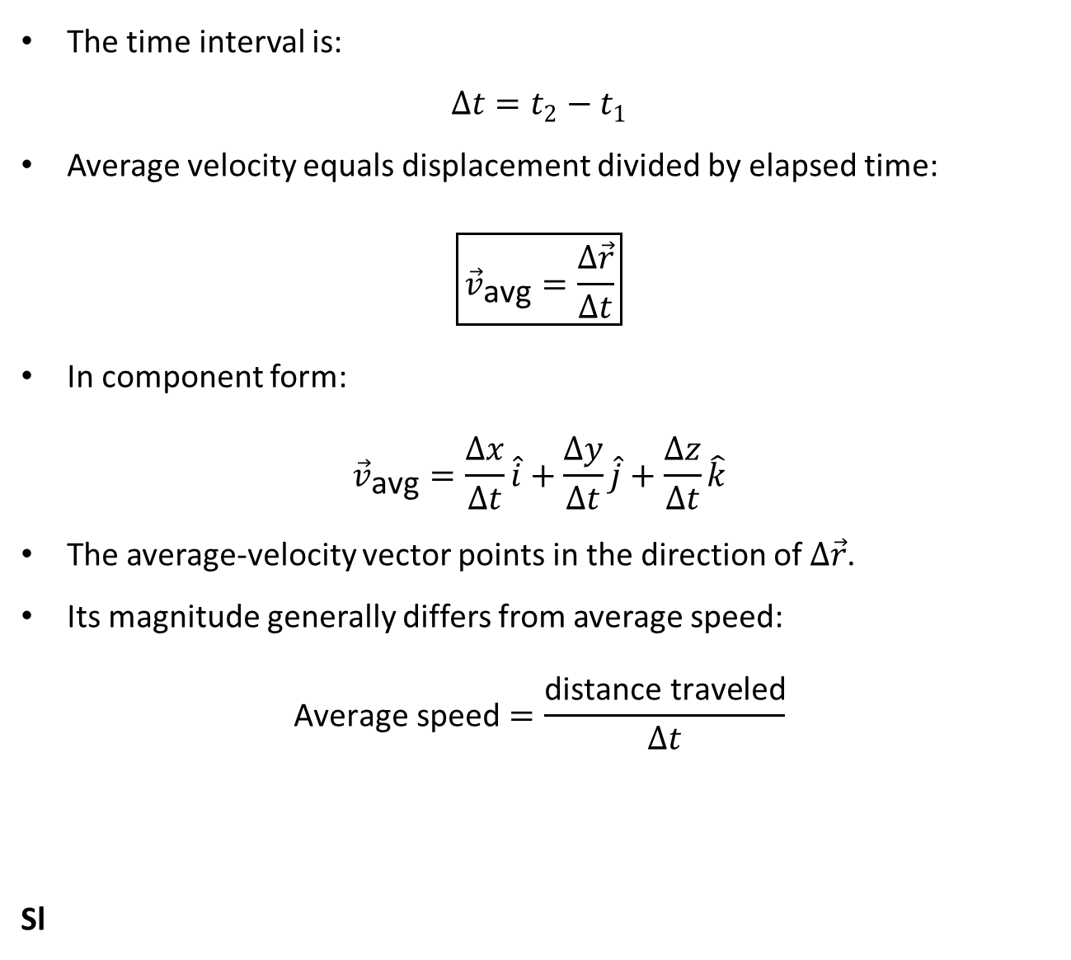
PHYS 2325 | University Physics I
Lecture 02 • Wed Sep 9 • Giancoli Ch. 3
Average Velocity Vector
The time interval is:
$$Δt=t_{2}−t_{1}$$
Average velocity equals displacement divided by elapsed time:
$$\boxed{{\vec{v}}_{\text{avg}}=\frac{Δ\vec{r}}{Δt}}$$
In component form:
$${\vec{v}}_{\text{avg}}=\frac{Δx}{Δt}\hat{i}+\frac{Δy}{Δt}\hat{j}+\frac{Δz}{Δt}\hat{k}$$
The average-velocity vector points in the direction of $Δ\vec{r}$.
Its magnitude generally differs from average speed:
$$\text{Average} \text{speed}=\frac{\text{distance} \text{traveled}}{Δt}$$
Sl
Notes:
Teaching focus: Concept • Vectors and Scalars.
[Sources]
- Douglas C. Giancoli, Physics for Scientists and Engineers, 5th ed., Chapter 3, Section 3-1, starting p. 55.
[/Sources]

Slide 36
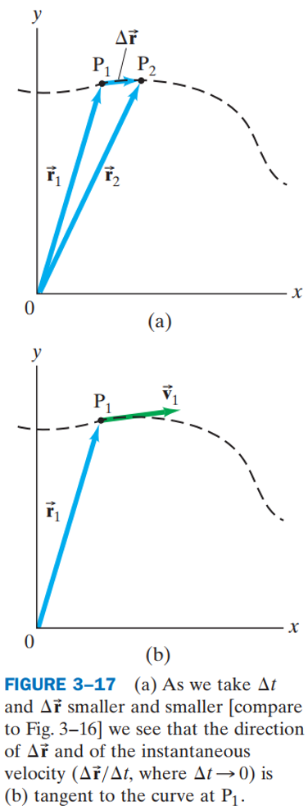
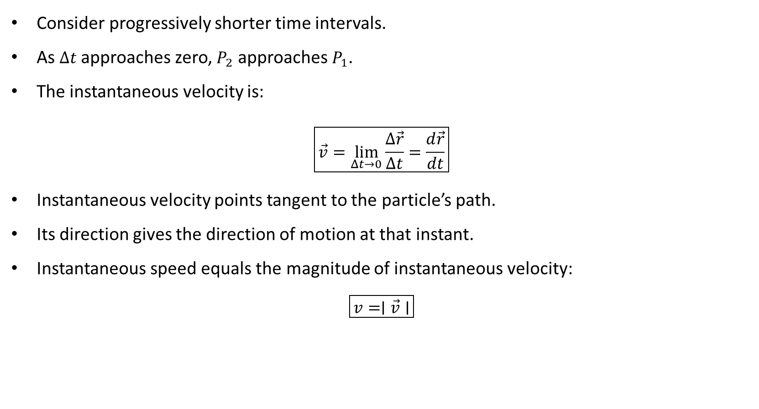
PHYS 2325 | University Physics I
Lecture 02 • Wed Sep 9 • Giancoli Ch. 3
Instantaneous Velocity
Consider progressively shorter time intervals.
As $Δt$ approaches zero, $P_{2}$ approaches $P_{1}$.
The instantaneous velocity is:
$$\boxed{\vec{v}=\lim_{Δt→0}\frac{Δ\vec{r}}{Δt}=\frac{d\vec{r}}{dt}}$$
Instantaneous velocity points tangent to the particle’s path.
Its direction gives the direction of motion at that instant.
Instantaneous speed equals the magnitude of instantaneous velocity:
$$\boxed{v=∣\vec{v}∣}$$

Slide 37
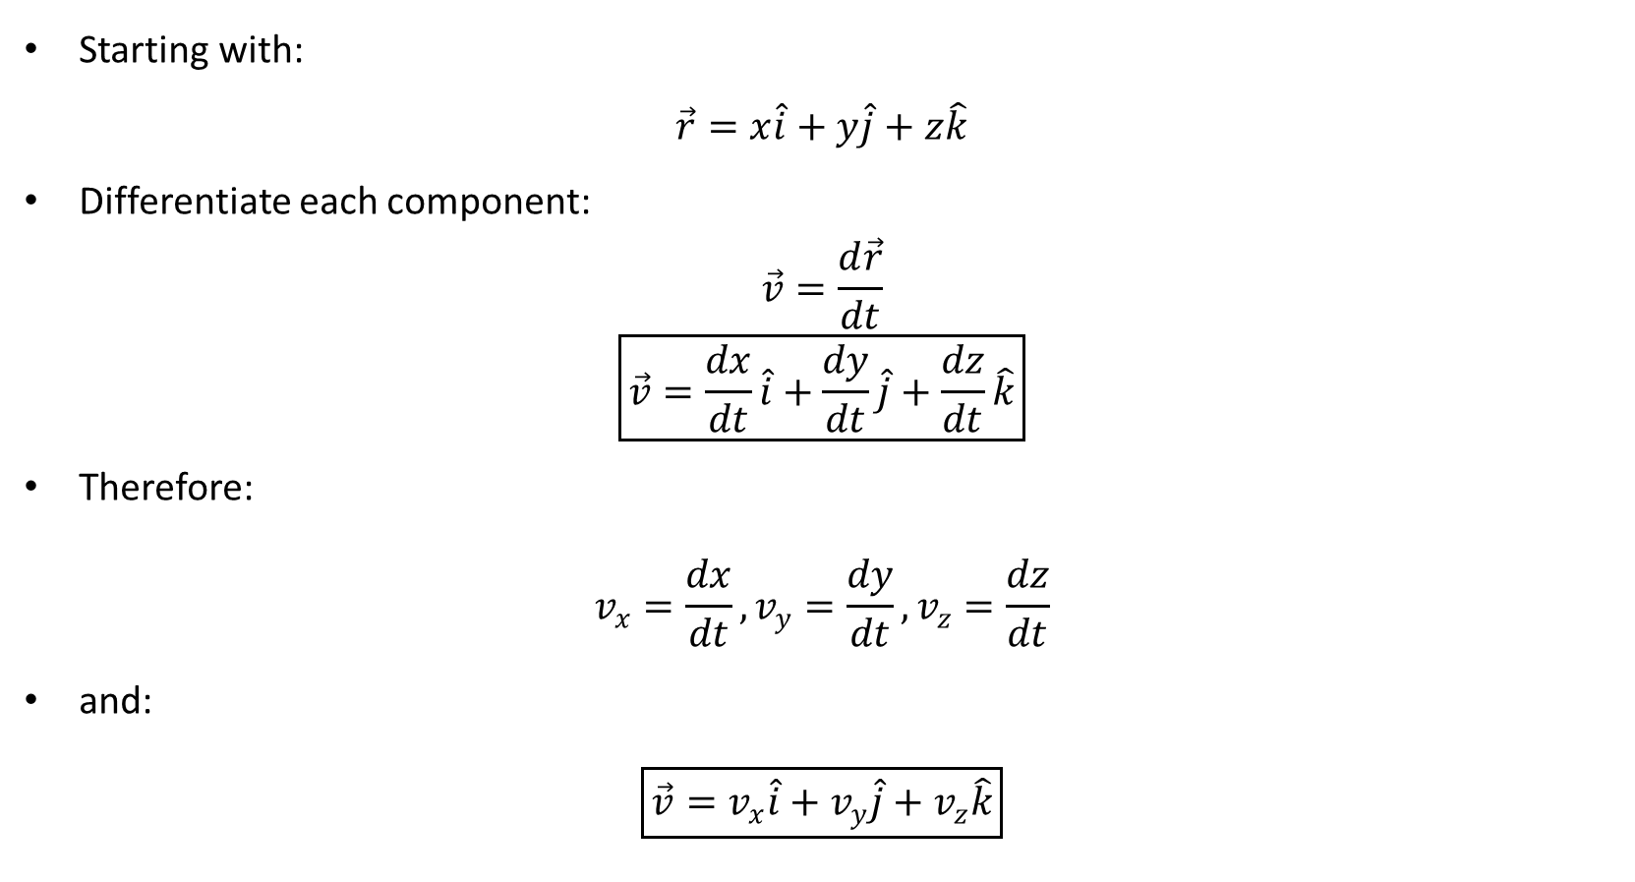
PHYS 2325 | University Physics I
Lecture 02 • Wed Sep 9 • Giancoli Ch. 3
Velocity Components
Starting with:
$$\vec{r}=x\hat{i}+y\hat{j}+z\hat{k}$$
Differentiate each component:
$$\vec{v}=\frac{d\vec{r}}{dt}$$
$$\boxed{\vec{v}=\frac{dx}{dt}\hat{i}+\frac{dy}{dt}\hat{j}+\frac{dz}{dt}\hat{k}}$$
Therefore:
$$v_{x}=\frac{dx}{dt}, v_{y}=\frac{dy}{dt}, v_{z}=\frac{dz}{dt}$$
and:
$$\boxed{\vec{v}=v_{x}\hat{i}+v_{y}\hat{j}+v_{z}\hat{k}}$$

Slide 38
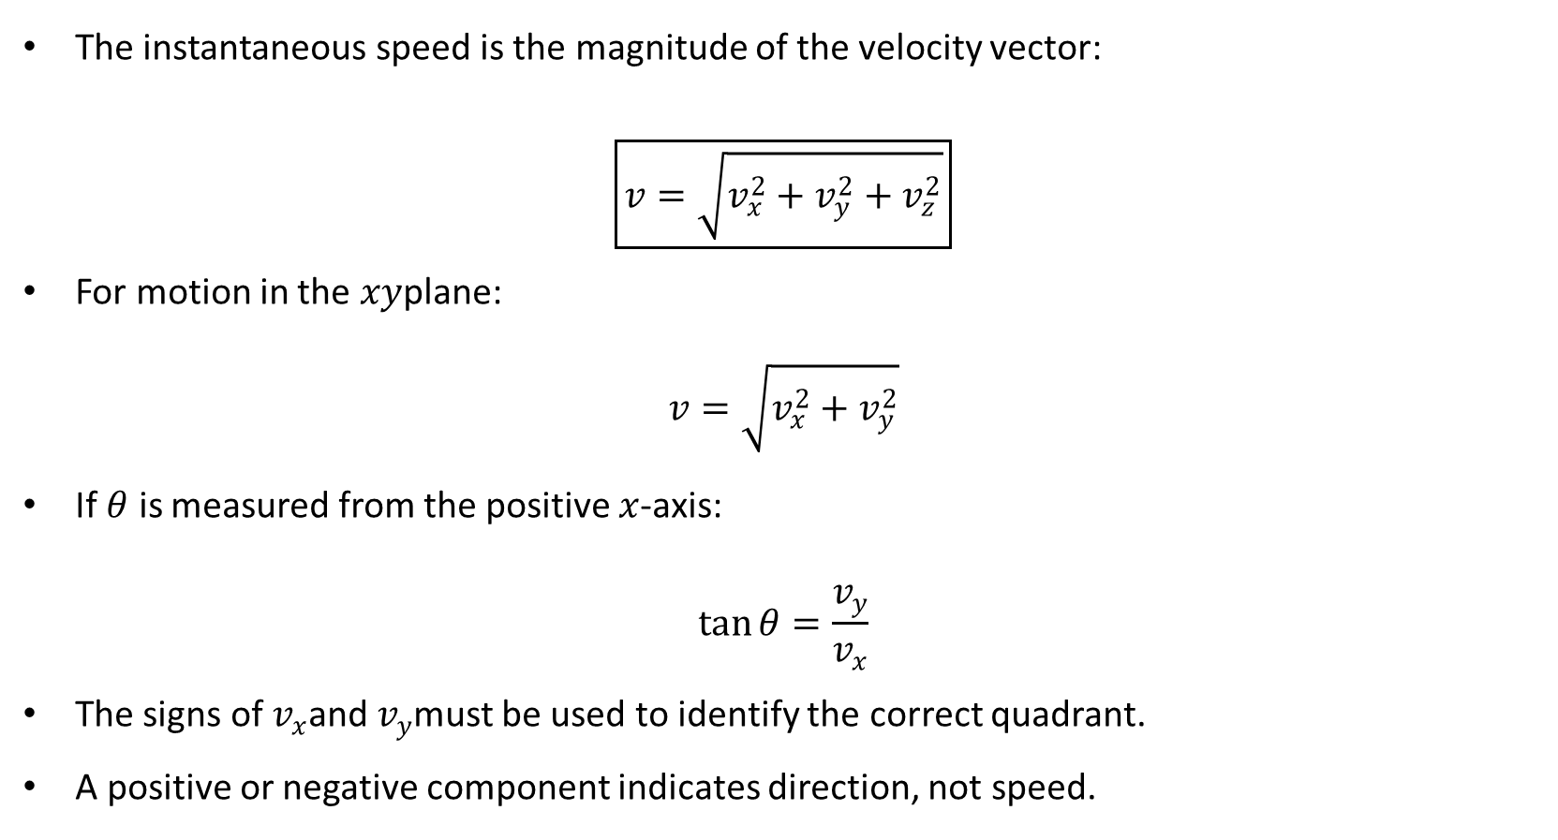
PHYS 2325 | University Physics I
Lecture 02 • Wed Sep 9 • Giancoli Ch. 3
Speed and Direction from Components
The instantaneous speed is the magnitude of the velocity vector:
$$\boxed{v=\sqrt{v_{x}^{2}+v_{y}^{2}+v_{z}^{2}}}$$
For motion in the $xy$plane:
$$v=\sqrt{v_{x}^{2}+v_{y}^{2}}$$
If $θ$ is measured from the positive $x$-axis:
$$\tan{θ}=\frac{v_{y}}{v_{x}}$$
The signs of $v_{x}$and $v_{y}$must be used to identify the correct quadrant.
A positive or negative component indicates direction, not speed.

Slide 39
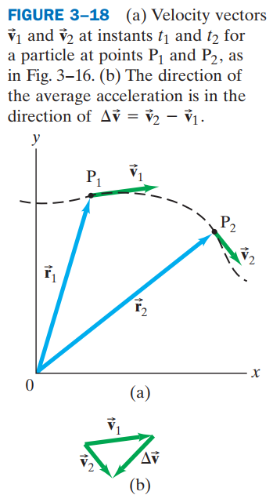
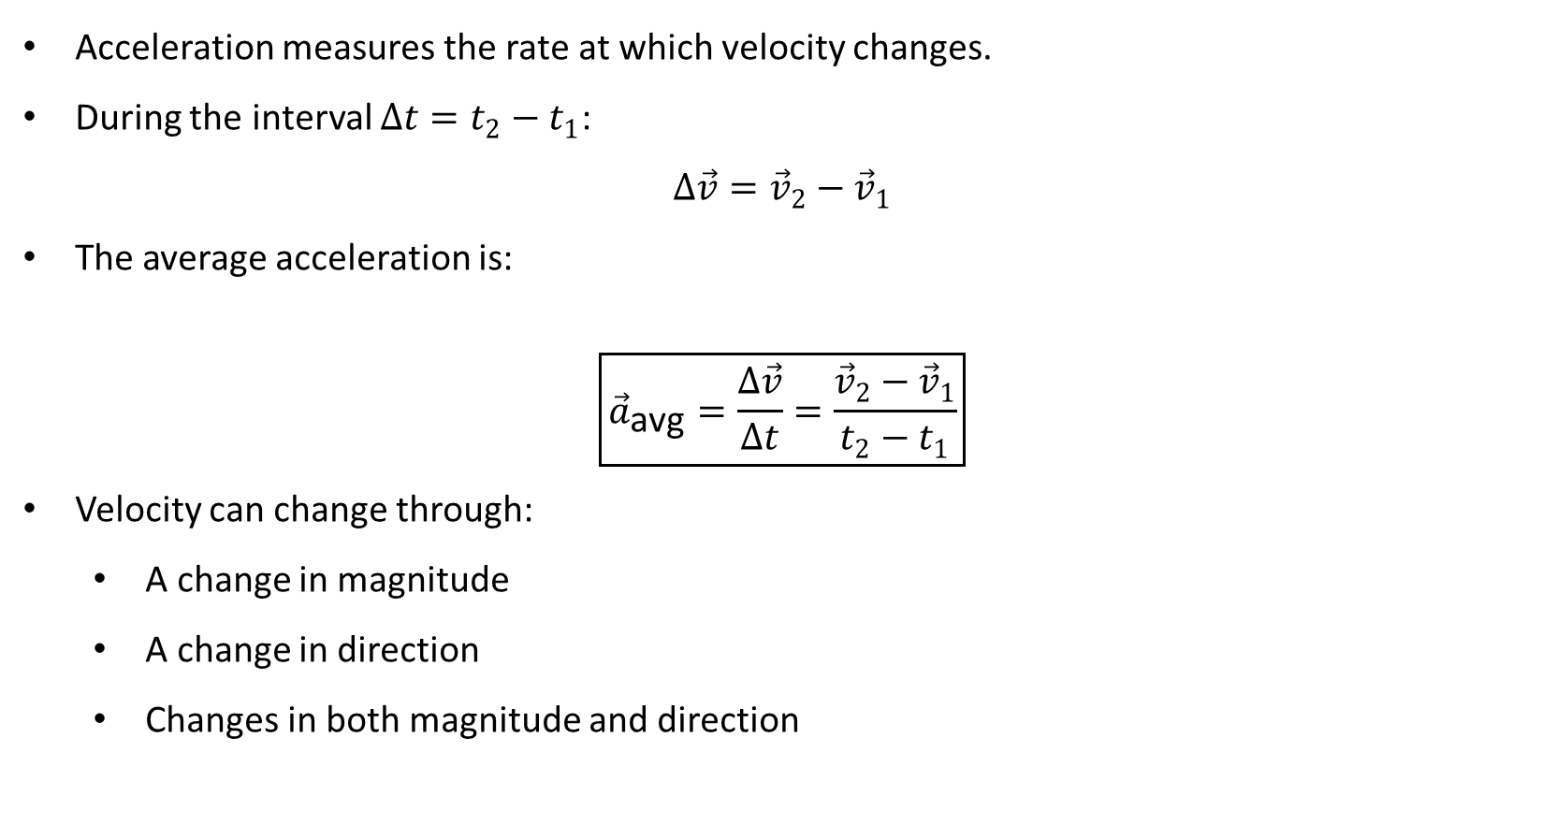
PHYS 2325 | University Physics I
Lecture 02 • Wed Sep 9 • Giancoli Ch. 3
Average Acceleration Vector
Acceleration measures the rate at which velocity changes.
During the interval $Δt=t_{2}−t_{1}$:
$$Δ\vec{v}={\vec{v}}_{2}−{\vec{v}}_{1}$$
The average acceleration is:
$$\boxed{{\vec{a}}_{\text{avg}}=\frac{Δ\vec{v}}{Δt}=\frac{{\vec{v}}_{2}−{\vec{v}}_{1}}{t_{2}−t_{1}}}$$
Velocity can change through:
  A change in magnitude
  A change in direction
  Changes in both magnitude and direction

Slide 40
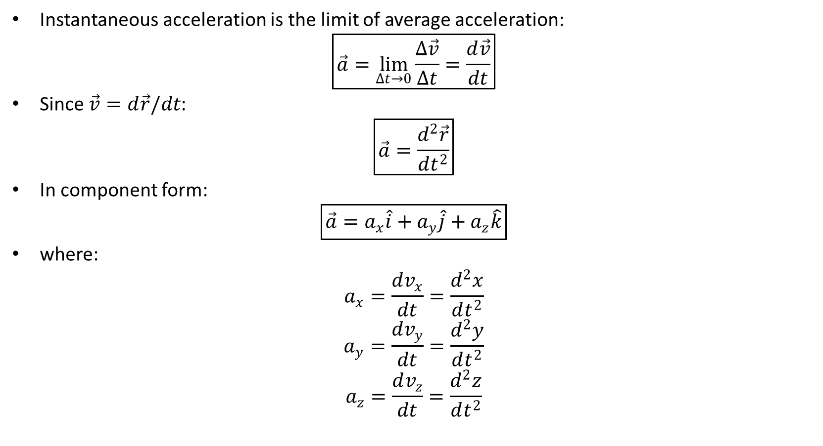
PHYS 2325 | University Physics I
Lecture 02 • Wed Sep 9 • Giancoli Ch. 3
Instantaneous Acceleration
Instantaneous acceleration is the limit of average acceleration:
$$\boxed{\vec{a}=\lim_{Δt→0}\frac{Δ\vec{v}}{Δt}=\frac{d\vec{v}}{dt}}$$
Since $\vec{v}=d\vec{r}/dt$:
$$\boxed{\vec{a}=\frac{d^{2}\vec{r}}{dt^{2}}}$$
In component form:
$$\boxed{\vec{a}=a_{x}\hat{i}+a_{y}\hat{j}+a_{z}\hat{k}}$$
where:
$$a_{x}=\frac{dv_{x}}{dt}=\frac{d^{2}x}{dt^{2}}$$
$$a_{y}=\frac{dv_{y}}{dt}=\frac{d^{2}y}{dt^{2}}$$
$$a_{z}=\frac{dv_{z}}{dt}=\frac{d^{2}z}{dt^{2}}$$

Slide 41
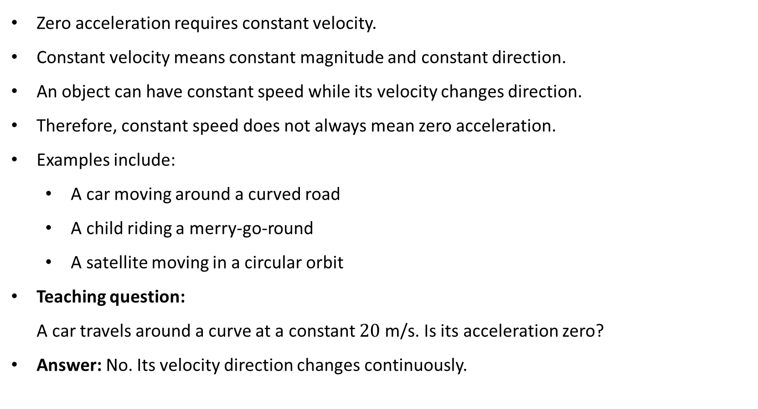
PHYS 2325 | University Physics I
Lecture 02 • Wed Sep 9 • Giancoli Ch. 3
Acceleration at Constant Speed
Zero acceleration requires constant velocity.
Constant velocity means constant magnitude and constant direction.
An object can have constant speed while its velocity changes direction.
Therefore, constant speed does not always mean zero acceleration.
Examples include:
  A car moving around a curved road
  A child riding a merry-go-round
  A satellite moving in a circular orbit
Teaching question:
A car travels around a curve at a constant $20 \text{m}\text{/}\text{s}$. Is its acceleration zero?
Answer: No. Its velocity direction changes continuously.

Slide 42
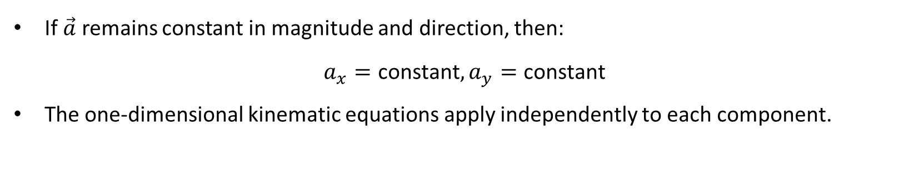
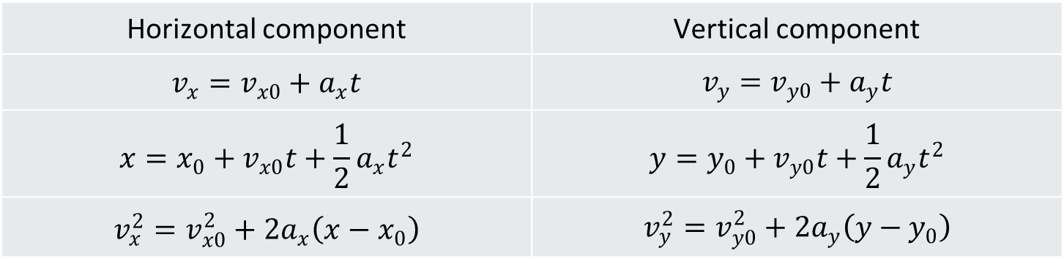
PHYS 2325 | University Physics I
Lecture 02 • Wed Sep 9 • Giancoli Ch. 3
Constant Acceleration in Two Dimensions
If $\vec{a}$ remains constant in magnitude and direction, then:
$$a_{x}=\text{constant}, a_{y}=\text{constant}$$
The one-dimensional kinematic equations apply independently to each component.
Horizontal component | Vertical component
$$v_{x}=v_{x0}+a_{x}t$$ | $$v_{y}=v_{y0}+a_{y}t$$
$$x=x_{0}+v_{x0}t+\frac{1}{2}a_{x}t^{2}$$ | $$y=y_{0}+v_{y0}t+\frac{1}{2}a_{y}t^{2}$$
$$v_{x}^{2}=v_{x0}^{2}+2a_{x}\left(x−x_{0}\right)$$ | $$v_{y}^{2}=v_{y0}^{2}+2a_{y}\left(y−y_{0}\right)$$

Slide 43
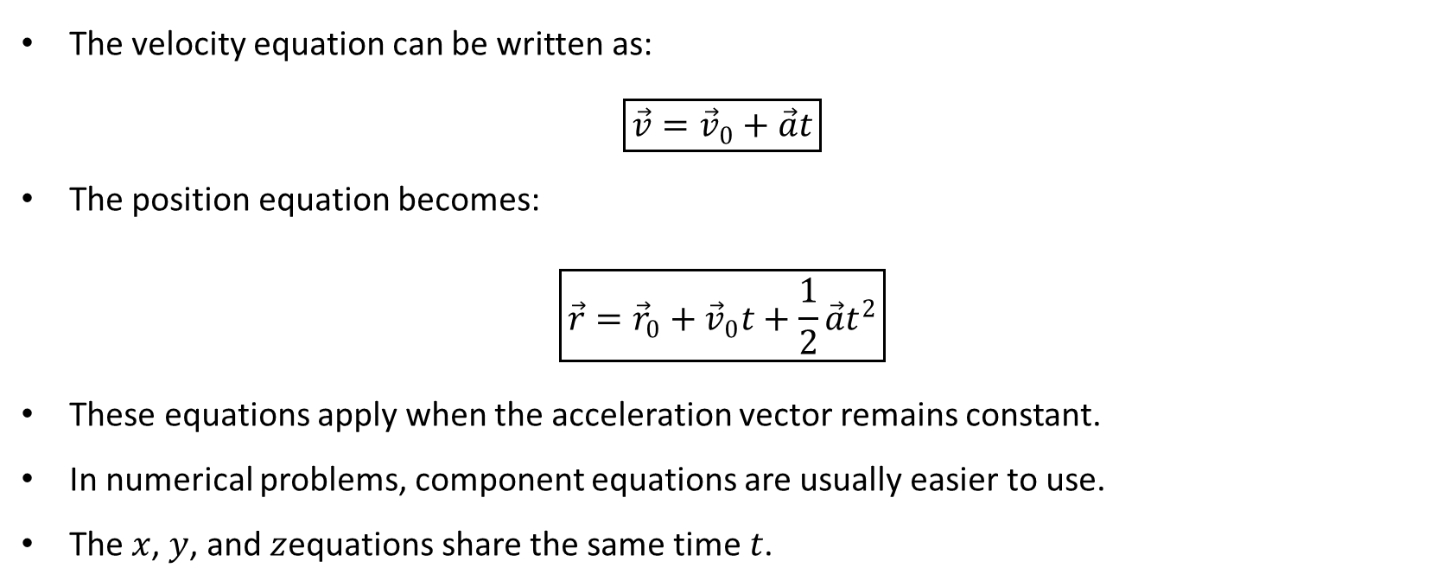
PHYS 2325 | University Physics I
Lecture 02 • Wed Sep 9 • Giancoli Ch. 3
Vector Form of Constant-Acceleration Equations
The velocity equation can be written as:
$$\boxed{\vec{v}={\vec{v}}_{0}+\vec{a}t}$$
The position equation becomes:
$$\boxed{\vec{r}={\vec{r}}_{0}+{\vec{v}}_{0}t+\frac{1}{2}\vec{a}t^{2}}$$
These equations apply when the acceleration vector remains constant.
In numerical problems, component equations are usually easier to use.
The $x$, $y$, and $z$equations share the same time $t$.

Slide 44


PHYS 2325 | University Physics I
Lecture 02 • Wed Sep 9 • Giancoli Ch. 3
Introduction to Projectile Motion
A projectile is an object moving freely after launch under the action of gravity.
Examples include:
  A thrown ball
  A kicked football
  A package released from an aircraft
  A ball rolling off a table
The launch force no longer acts after the object leaves the launcher.
Ignoring air resistance, gravity is the only force acting during flight.
Near Earth’s surface:
$$\boxed{\vec{a}=\vec{g}=−g\hat{j}}$$
where:
$$g=9.80 {\text{m}\text{/}\text{s}}^{2}$$

Slide 45

PHYS 2325 | University Physics I
Lecture 02 • Wed Sep 9 • Giancoli Ch. 3
Assumptions of the Projectile Model
The standard projectile model assumes:
Air resistance is negligible.
Wind can be ignored.
The object remains close enough to Earth that $g$is constant.
Earth’s curvature and rotation can be ignored.
The projectile moves freely after launch.
The analysis ends immediately before the projectile lands or is caught.
With $+y$ upward:
$$a_{x}=0$$
$$a_{y}=−g=−9.80 {\text{m}\text{/}\text{s}}^{2}$$

Slide 46

PHYS 2325 | University Physics I
Lecture 02 • Wed Sep 9 • Giancoli Ch. 3
Assumptions of the Projectile Model
Galileo’s central result:
  Projectile motion can be separated into independent horizontal and vertical motions.
  Horizontal motion has zero acceleration:
$$a_{x}=0$$
$$v_{x}=v_{x0}=\text{constant}$$
$$x=x_{0}+v_{x0}t$$
Vertical motion has constant downward acceleration:
$$a_{y}=−g$$
$$v_{y}=v_{y0}−gt$$
$$y=y_{0}+v_{y0}t−\frac{1}{2}gt^{2}$$
The two motions are connected by the same elapsed time $t$.

Slide 47


PHYS 2325 | University Physics I
Lecture 02 • Wed Sep 9 • Giancoli Ch. 3
Horizontal Launch from a Table
For a ball launched horizontally:
$$v_{x0}≠0, v_{y0}=0$$
Horizontal motion:
$$v_{x}=v_{x0}$$
$$x=x_{0}+v_{x0}t$$
Vertical motion:
$$v_{y}=−gt$$
$$y=y_{0}−\frac{1}{2}gt^{2}$$
The horizontal velocity remains constant.
The downward velocity increases in magnitude.
The total velocity remains tangent to the trajectory.

Slide 48


PHYS 2325 | University Physics I
Lecture 02 • Wed Sep 9 • Giancoli Ch. 3
Dropped and Horizontally Launched Objects
Consider two balls starting from the same height at the same instant.
One ball is dropped from rest.
The other is launched horizontally.
Both have:
$$v_{y0}=0$$
$$a_{y}=−g$$
Their vertical positions are therefore identical at every instant.
They reach the ground at the same time if air resistance is negligible.
Horizontal velocity changes where the launched ball lands, but not when it lands.

Slide 49


PHYS 2325 | University Physics I
Lecture 02 • Wed Sep 9 • Giancoli Ch. 3
Projectile Launched at an Angle
Resolve the initial velocity into components:
$$\boxed{v_{x0}=v_{0}\cos{θ_{0}}}$$
$$\boxed{v_{y0}=v_{0}\sin{θ_{0}}}$$
The horizontal component remains constant:
$$v_{x}=v_{x0}$$
The vertical component changes continuously:
$$v_{y}=v_{y0}−gt$$
At the highest point:
$$\boxed{v_{y}=0}$$
The total velocity at the highest point is generally not zero:
$$\vec{v}=v_{x}\hat{i}$$
Acceleration remains downward throughout the flight.

Slide 50



PHYS 2325 | University Physics I
Lecture 02 • Wed Sep 9 • Giancoli Ch. 3
Projectile-Motion Equation Table
Assuming $+y$upward:
Horizontal motion | Vertical motion
$$a_{x}=0$$ | $$a_{y}=−g$$
$$v_{x}=v_{x0}$$ | $$v_{y}=v_{y0}−gt$$
$$x=x_{0}+v_{x0}t$$ | $$y=y_{0}+v_{y0}t−\frac{1}{2}gt^{2}$$
 | $$v_{y}^{2}=v_{y0}^{2}−2g\left(y−y_{0}\right)$$
Remember:
Use the same time $t$ in both columns.
Horizontal and vertical quantities should not be mixed in one equation.
Choose the coordinate directions before assigning signs.

Slide 51

PHYS 2325 | University Physics I
Lecture 02 • Wed Sep 9 • Giancoli Ch. 3
Projectile-Motion Problem-Solving Method
When solving a projectile problem:
  Identify the projectile and the interval of free flight.
  Draw the path and choose an $xy$coordinate system.
  Mark the initial and final positions.
  Resolve the initial velocity into components.
Use:
$$a_{x}=0, a_{y}=−g$$
List the known and unknown quantities separately for $x$and $y$.
Solve one direction for the common time $t$.
Substitute that time into the equation for the other direction.
Check the signs, units, and physical reasonableness of the answer.

Slide 52


PHYS 2325 | University Physics I
Lecture 02 • Wed Sep 9 • Giancoli Ch. 3
Worked Example: Motorcycle Leaving a Cliff
A motorcycle leaves a $50.0 \text{m}$high cliff horizontally and must land $90.0 \text{m}$ from the cliff’s base.
Find the required horizontal launch speed.
Choose:
$$x_{0}=0, y_{0}=0$$
At landing:
$$x=90.0 \text{m}$$
$$y=−50.0 \text{m}$$
Acceleration and initial velocity components:
$$a_{x}=0, a_{y}=−9.80 {\text{m}\text{/}\text{s}}^{2}$$
$$v_{y0}=0$$
Unknowns:
$$t, v_{x0}$$

Slide 53

PHYS 2325 | University Physics I
Lecture 02 • Wed Sep 9 • Giancoli Ch. 3
Worked Example: Time of Flight
Use the vertical motion first:
$$y=y_{0}+v_{y0}t+\frac{1}{2}a_{y}t^{2}$$
Substitute the known values:
$$−50.0=0+0+\frac{1}{2}\left(−9.80\right)t^{2}$$
$$−50.0=−4.90t^{2}$$
$$t^{2}=\frac{50.0}{4.90}$$
$$\boxed{t=3.19 \text{s}}$$
The vertical motion determines how long the motorcycle remains in the air.
The horizontal velocity does not affect this time.

Slide 54

PHYS 2325 | University Physics I
Lecture 02 • Wed Sep 9 • Giancoli Ch. 3
Worked Example: Horizontal Speed
Use the horizontal motion:
$$x=x_{0}+v_{x0}t$$
$$90.0=0+v_{x0}\left(3.19\right)$$
Therefore:
$$v_{x0}=\frac{90.0}{3.19}$$
$$\boxed{v_{x0}=28.2 \text{m}\text{/}\text{s}}$$
This is approximately:
$$\boxed{102 \text{km}\text{/}\text{h}}$$
Interpretation: The motorcycle must leave the cliff horizontally at approximately $28.2 \text{m}\text{/}\text{s}$.

Slide 55

PHYS 2325 | University Physics I
Lecture 02 • Wed Sep 9 • Giancoli Ch. 3
Concept Check: Apple in a Moving Wagon
A wagon moves horizontally at constant velocity. A child throws an apple straight upward relative to the wagon.
Where does the apple land?
  Behind the child
  In the child’s hand
  In front of the child
Correct answer: In the child’s hand.
At release, the apple has the same horizontal velocity as the wagon.
Gravity changes only the vertical velocity.
With no horizontal acceleration, the apple and wagon continue with equal horizontal velocities.

Slide 56

PHYS 2325 | University Physics I
Lecture 02 • Wed Sep 9 • Giancoli Ch. 3
Common Mistakes
Assuming the velocity is zero at maximum height
  Only $v_{y}=0$
  The horizontal component $v_{x}$remains nonzero
Using $a=0$at maximum height
  Gravity continues to act
  $a_{y}=−g$everywhere in the trajectory
Using different times for horizontal and vertical motion
  Both components describe the same object during the same interval
Using $g=+9.80 {\text{m}\text{/}\text{s}}^{2}$after choosing upward as positive
  With $+y$ upward, $a_{y}=−g$
Applying projectile equations while the object remains in contact with the launcher or ground

Slide 57

PHYS 2325 | University Physics I
Lecture 02 • Wed Sep 9 • Giancoli Ch. 3
Lecture Summary
Position in two or three dimensions is represented by $\vec{r}$.
Displacement is:
$$Δ\vec{r}={\vec{r}}_{2}−{\vec{r}}_{1}$$
Velocity is tangent to the path:
$$\vec{v}=\frac{d\vec{r}}{dt}$$
Acceleration describes changes in velocity:
$$\vec{a}=\frac{d\vec{v}}{dt}$$
In projectile motion:
$$a_{x}=0, a_{y}=−g$$
Horizontal and vertical motions develop independently but share the same time.
At maximum height, $v_{y}=0$, while acceleration remains $−g\hat{j}$.

