Slide 1
WEEK 04
Forces and Newton's Laws
Sep 14-18 • Giancoli Chapter 4
Muhammad Nauman • PHYS 2325 • Fall 2026
Notes:
Teaching focus: Forces and Newton's Laws.
[Sources]
- PHYS 2325 University Physics I Fall 2026 syllabus and semester calendar.
[/Sources]

Slide 2
PHYS 2325 | University Physics I
Week 04 • Sep 14-18 • Giancoli Chapter 4
This week follows one connected learning path
01
02
03
MON SEP 14
Force, Inertia, Mass, and Newton's Second Law
WED SEP 16
Action-Reaction, Weight, and Support Forces
FRI SEP 18
Free-Body Diagrams and a General Solution Method
Notes:
Teaching focus: This week follows one connected learning path.
[Sources]
- PHYS 2325 University Physics I Fall 2026 syllabus and semester calendar.
[/Sources]

Slide 3
LECTURE 01
Force, Inertia, Mass, and Newton's Second Law
Mon Sep 14 • Giancoli Ch. 4
Muhammad Nauman • PHYS 2325 • Fall 2026
Notes:
Teaching focus: Force, Inertia, Mass, and Newton's Second Law.
[Sources]
- PHYS 2325 University Physics I Fall 2026 syllabus and semester calendar.
[/Sources]

Slide 4
PHYS 2325 | University Physics I
Lecture 01 • Mon Sep 14 • Giancoli Ch. 4
Learning outcomes
Define and represent force.
Derive and interpret newton's first law.
Apply mass.
Connect newton's second law.
Check units, vector directions, assumptions, and limiting behavior in every solution.
Notes:
Teaching focus: Learning outcomes.
[Sources]
- PHYS 2325 University Physics I Fall 2026 syllabus and semester calendar.
[/Sources]

Slide 5
PHYS 2325 | University Physics I
Lecture 01 • Mon Sep 14 • Giancoli Ch. 4
From Kinematics to Dynamics
So far, we have described how objects move using:
  Position
  Velocity
  Acceleration
Now we ask:
  Why does an object accelerate?
  What causes:
    an object at rest to start moving?
    a moving object to speed up or slow down?
    an object to change its direction?
  The answer involves force.
Dynamics: The study of the relationship between force and motion.
Notes:
Teaching focus: Where today's lecture fits.
[Sources]
- PHYS 2325 University Physics I Fall 2026 syllabus and semester calendar.
[/Sources]

Slide 6
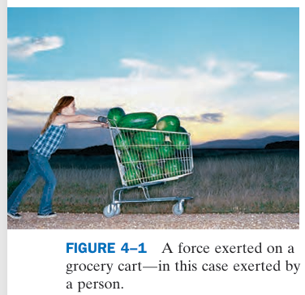
PHYS 2325 | University Physics I
Lecture 01 • Mon Sep 14 • Giancoli Ch. 4
What Is a Force?
A force is commonly described as a push or pull on an object.
Examples:
  Pushing a shopping cart
  Pulling a box
  Gravity pulling an object downward
Two broad types:
  Contact forces
  Require physical contact between objects.
  Non-contact forces
  Can act without physical contact.
  Example: gravitational force.
  A force can change an object's velocity and therefore produce an acceleration.
Notes:
Teaching focus: Where today's lecture fits.
[Sources]
- PHYS 2325 University Physics I Fall 2026 syllabus and semester calendar.
[/Sources]

Slide 7
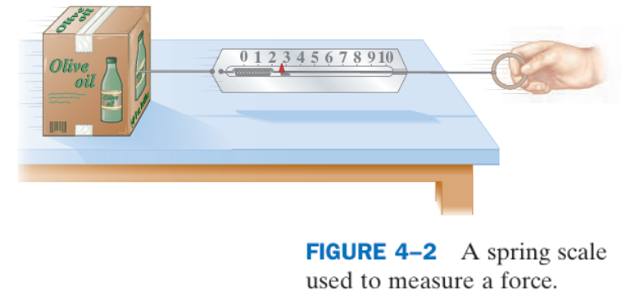
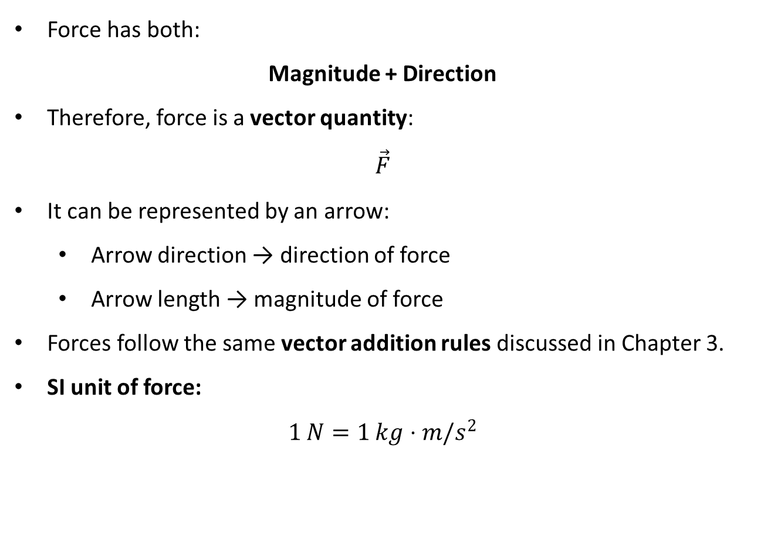
PHYS 2325 | University Physics I
Lecture 01 • Mon Sep 14 • Giancoli Ch. 4
Force Is a Vector
Force has both:
Magnitude + Direction
Therefore, force is a vector quantity:
$$\vec{F}$$
It can be represented by an arrow:
  Arrow direction → direction of force
  Arrow length → magnitude of force
Forces follow the same vector addition rules discussed in Chapter 3.
SI unit of force:
$$1 N=1 kg⋅m/s^{2}$$
Notes:
Teaching focus: Where today's lecture fits.
[Sources]
- PHYS 2325 University Physics I Fall 2026 syllabus and semester calendar.
[/Sources]

Slide 8
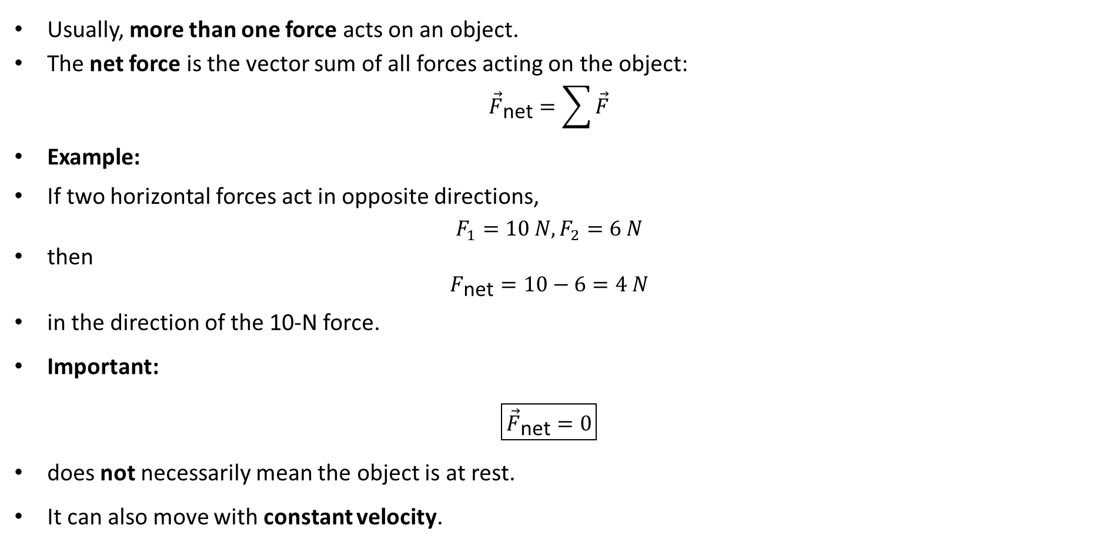
PHYS 2325 | University Physics I
Lecture 01 • Mon Sep 14 • Giancoli Ch. 4
Net Force
Usually, more than one force acts on an object.
The net force is the vector sum of all forces acting on the object:
$${\vec{F}}_{\text{net}}=\sum{\vec{F}}$$
Example:
If two horizontal forces act in opposite directions,
$$F_{1}=10 N, F_{2}=6 N$$
then
$$F_{\text{net}}=10−6=4 N$$
in the direction of the 10-N force.
Important:
$$\boxed{{\vec{F}}_{\text{net}}=0}$$
does not necessarily mean the object is at rest.
It can also move with constant velocity.
Notes:
Teaching focus: Where today's lecture fits.
[Sources]
- PHYS 2325 University Physics I Fall 2026 syllabus and semester calendar.
[/Sources]

Slide 9
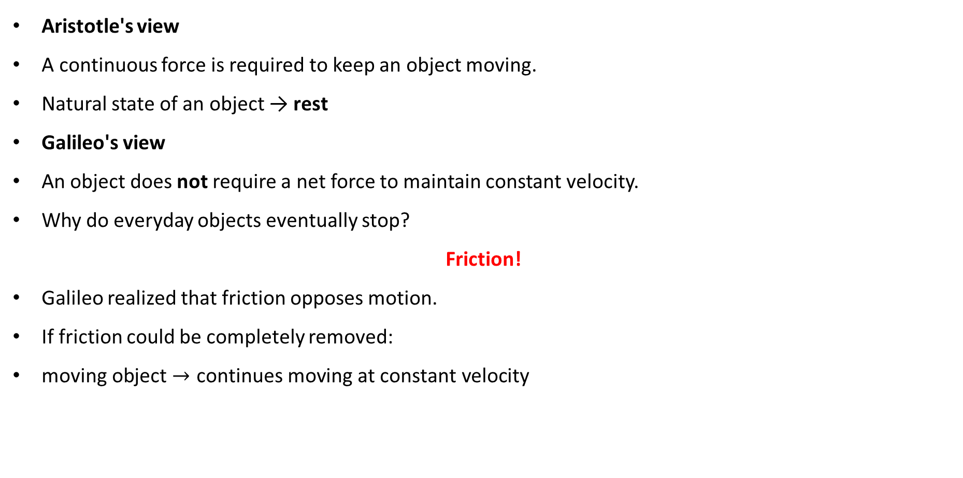
PHYS 2325 | University Physics I
Lecture 01 • Mon Sep 14 • Giancoli Ch. 4
Before Newton: Aristotle vs. Galileo
Aristotle's view
A continuous force is required to keep an object moving.
Natural state of an object → rest
Galileo's view
An object does not require a net force to maintain constant velocity.
Why do everyday objects eventually stop?
Friction!
Galileo realized that friction opposes motion.
If friction could be completely removed:
$\text{moving} \text{object}→\text{continues} \text{moving} \text{at} \text{constant} \text{velocity}$
Notes:
Teaching focus: Where today's lecture fits.
[Sources]
- PHYS 2325 University Physics I Fall 2026 syllabus and semester calendar.
[/Sources]

Slide 10
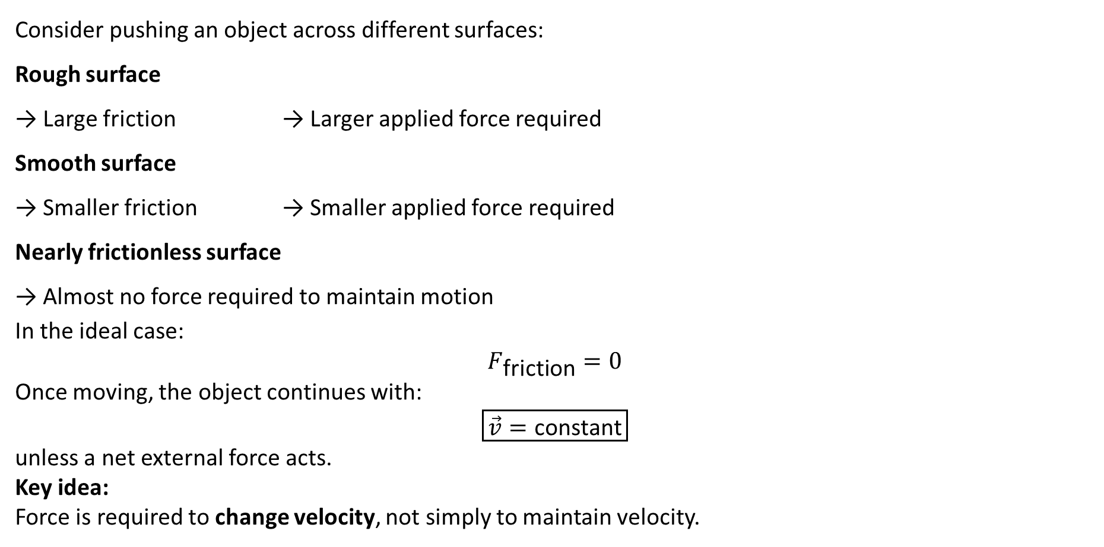
PHYS 2325 | University Physics I
Lecture 01 • Mon Sep 14 • Giancoli Ch. 4
Understanding Galileo's Argument
Consider pushing an object across different surfaces:
Rough surface
→ Large friction → Larger applied force required
Smooth surface
→ Smaller friction → Smaller applied force required
Nearly frictionless surface
→ Almost no force required to maintain motion
In the ideal case:
$$F_{\text{friction}}=0$$
Once moving, the object continues with:
$$\boxed{\vec{v}=\text{constant}}$$
unless a net external force acts.
Key idea:
Force is required to change velocity, not simply to maintain velocity.
Notes:
Teaching focus: Where today's lecture fits.
[Sources]
- PHYS 2325 University Physics I Fall 2026 syllabus and semester calendar.
[/Sources]

Slide 11
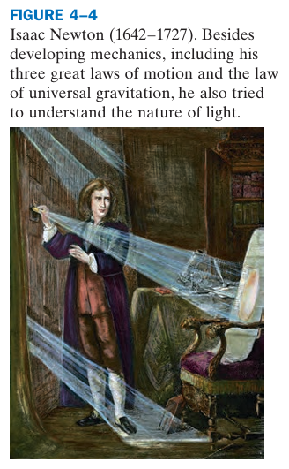
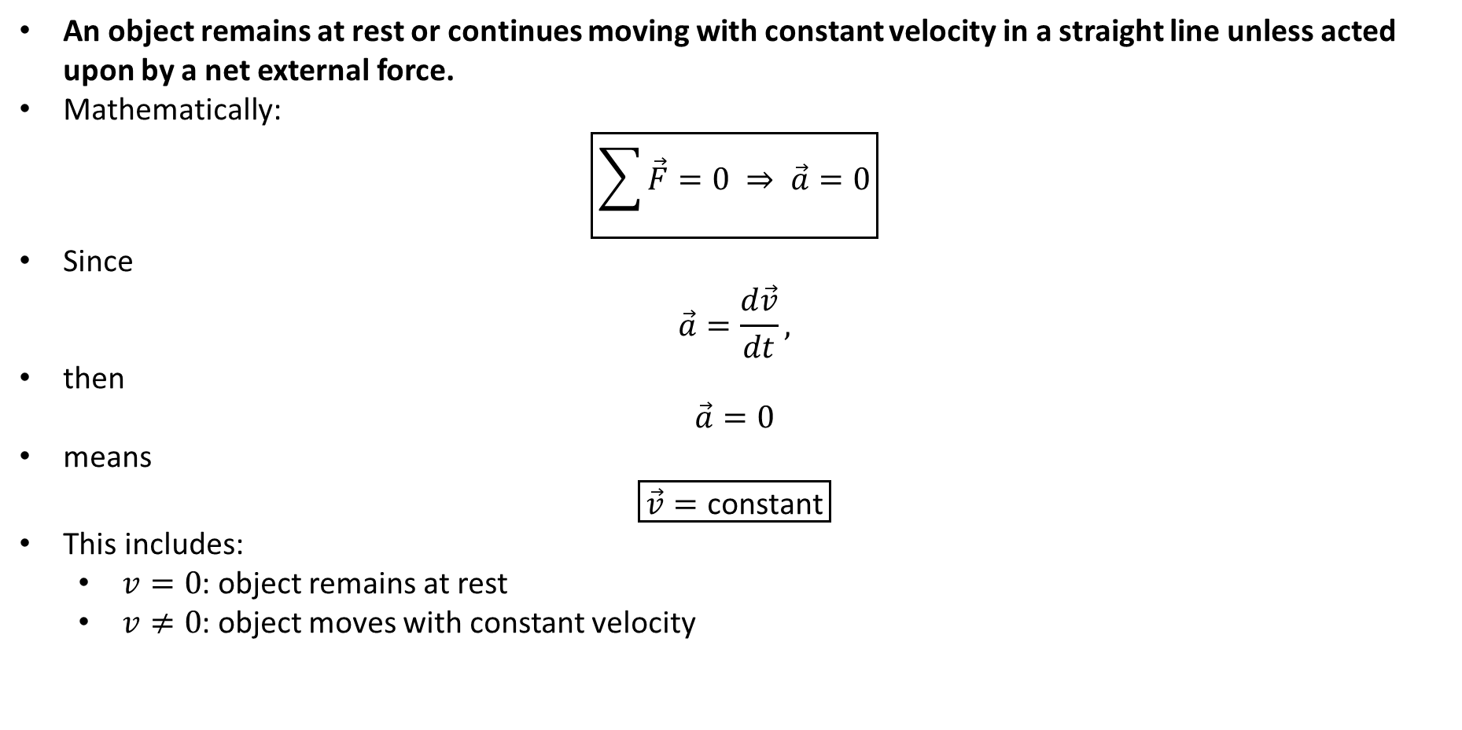
PHYS 2325 | University Physics I
Lecture 01 • Mon Sep 14 • Giancoli Ch. 4
Newton's First Law of Motion
An object remains at rest or continues moving with constant velocity in a straight line unless acted upon by a net external force.
Mathematically:
$$\boxed{\sum{\vec{F}}=0 ⇒ \vec{a}=0}$$
Since
$$\vec{a}=\frac{d\vec{v}}{dt},$$
then
$$\vec{a}=0$$
means
$$\boxed{\vec{v}=\text{constant}}$$
This includes:
  $v=0$: object remains at rest
  $v≠0$: object moves with constant velocity
Notes:
Teaching focus: Where today's lecture fits.
[Sources]
- PHYS 2325 University Physics I Fall 2026 syllabus and semester calendar.
[/Sources]

Slide 12
PHYS 2325 | University Physics I
Lecture 01 • Mon Sep 14 • Giancoli Ch. 4
Inertia
The tendency of an object to resist a change in its state of motion is called Inertia
An object naturally resists changes in:
  Speed
  Direction
  State of rest
Example:
A bus suddenly stops.
The passengers and objects inside tend to continue moving forward.
Why?
Not because a mysterious forward force pushes them.
They simply tend to maintain their previous velocity due to inertia.
Notes:
Teaching focus: Where today's lecture fits.
[Sources]
- PHYS 2325 University Physics I Fall 2026 syllabus and semester calendar.
[/Sources]

Slide 13
PHYS 2325 | University Physics I
Lecture 01 • Mon Sep 14 • Giancoli Ch. 4
Inertial Reference Frames
Newton's First Law is valid in an Inertial Reference Frame
An inertial reference frame is one in which Newton's First Law holds.
Examples approximately include:
  A laboratory fixed to Earth
  A car moving with constant velocity
A frame accelerating relative to an inertial frame is an Non-inertial Reference Frame
Example:
A car suddenly accelerates forward.
A cup on the dashboard appears to move backward relative to the car.
Important:
No real backward force is required to make the cup behave this way.
Notes:
Teaching focus: Where today's lecture fits.
[Sources]
- PHYS 2325 University Physics I Fall 2026 syllabus and semester calendar.
[/Sources]

Slide 14
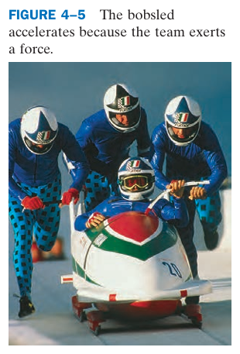
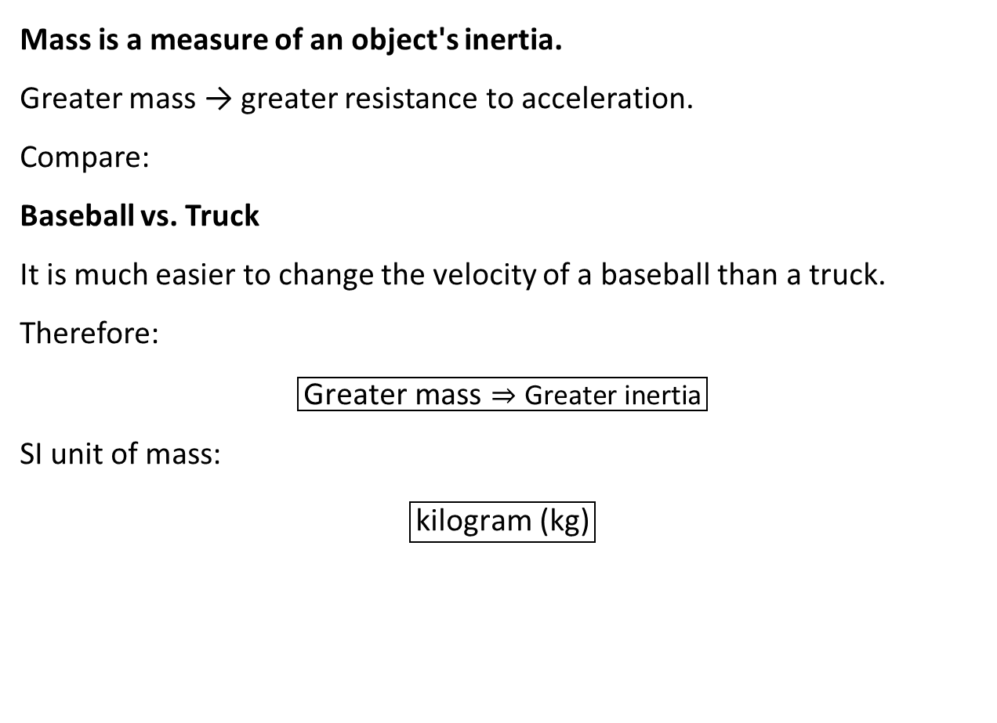
PHYS 2325 | University Physics I
Lecture 01 • Mon Sep 14 • Giancoli Ch. 4
Mass and Inertia
Mass is a measure of an object's inertia.
Greater mass → greater resistance to acceleration.
Compare:
Baseball vs. Truck
It is much easier to change the velocity of a baseball than a truck.
Therefore:
$$\boxed{\text{Greater} \text{mass}⇒\text{Greater} \text{inertia}}$$
SI unit of mass:
$$\boxed{\text{kilogram}\text{ (}\text{kg}\text{)}}$$
Notes:
Teaching focus: Where today's lecture fits.
[Sources]
- PHYS 2325 University Physics I Fall 2026 syllabus and semester calendar.
[/Sources]

Slide 15
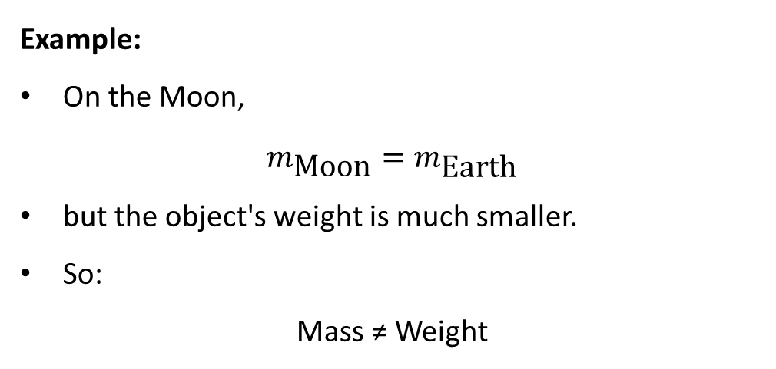
PHYS 2325 | University Physics I
Lecture 01 • Mon Sep 14 • Giancoli Ch. 4
Mass Is Not Weight
Do not confuse mass and weight.
Mass | Weight
Measure of inertia | Force of gravity
Property of an object | Depends on gravitational field
Unit: kg | Unit: N
Same on Earth and Moon | Different on Earth and Moon
Example:
On the Moon,
$$m_{\text{Moon}}=m_{\text{Earth}}$$
but the object's weight is much smaller.
So:
Mass ≠ Weight​
Notes:
Teaching focus: Where today's lecture fits.
[Sources]
- PHYS 2325 University Physics I Fall 2026 syllabus and semester calendar.
[/Sources]

Slide 16
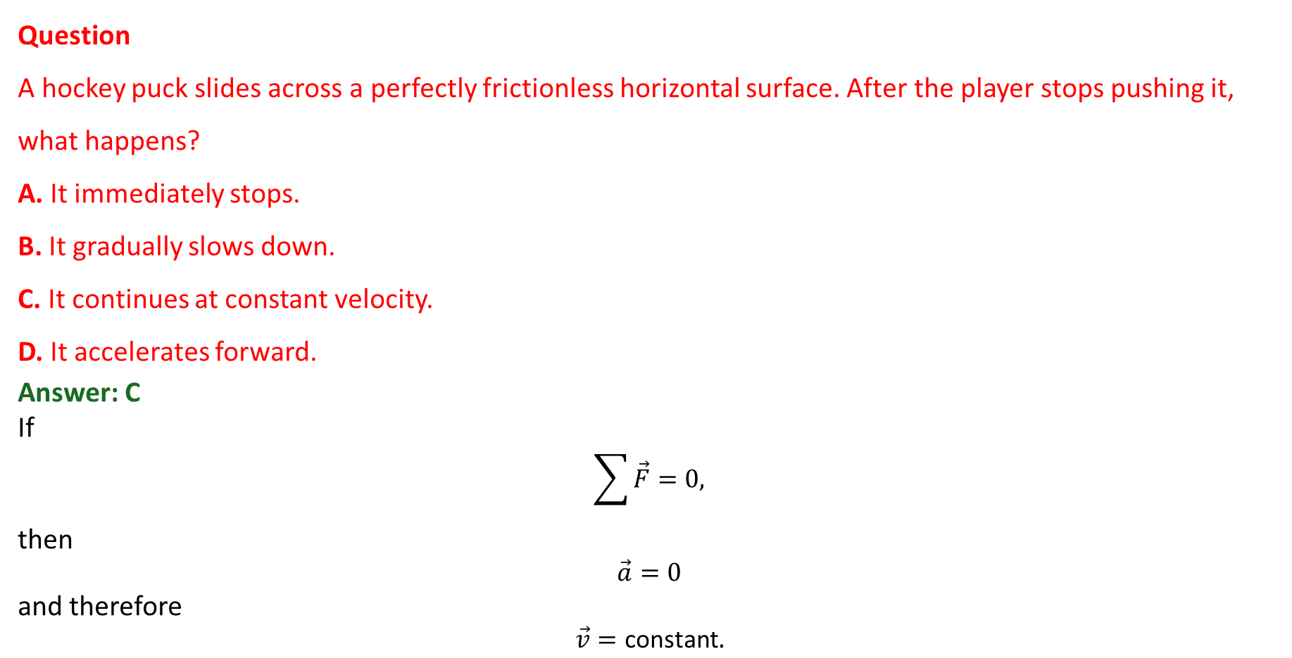
PHYS 2325 | University Physics I
Lecture 01 • Mon Sep 14 • Giancoli Ch. 4
Concept Check
Question
A hockey puck slides across a perfectly frictionless horizontal surface. After the player stops pushing it, what happens?
A. It immediately stops.
B. It gradually slows down.
C. It continues at constant velocity.
D. It accelerates forward.
Answer: C
If
$$\sum{\vec{F}}=0,$$
then
$$\vec{a}=0$$
and therefore
$$\vec{v}=\text{constant}.$$
Notes:
Teaching focus: Where today's lecture fits.
[Sources]
- PHYS 2325 University Physics I Fall 2026 syllabus and semester calendar.
[/Sources]

Slide 17
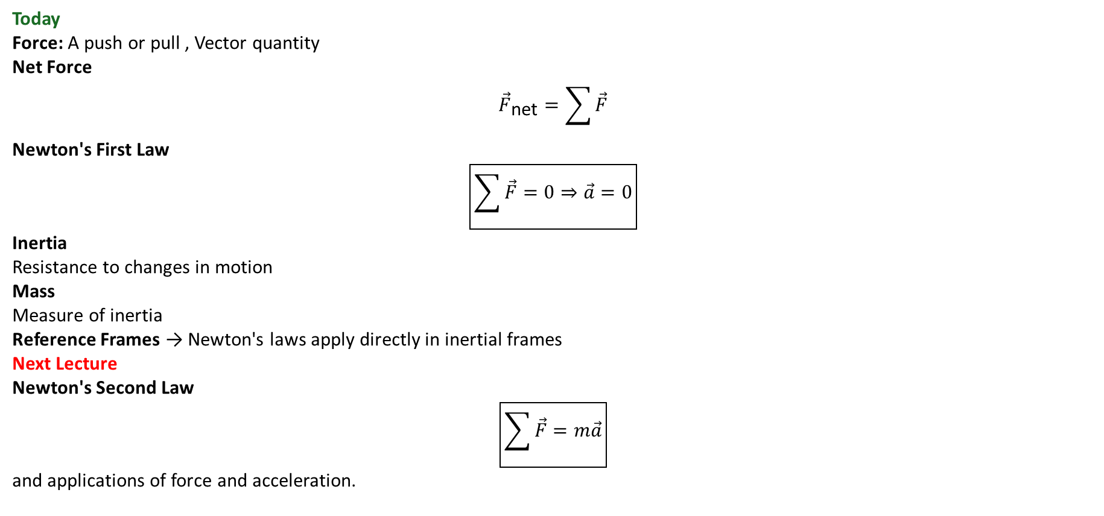
PHYS 2325 | University Physics I
Lecture 01 • Mon Sep 14 • Giancoli Ch. 4
Lecture Summary
Today
Force: A push or pull , Vector quantity
Net Force
$${\vec{F}}_{\text{net}}=\sum{\vec{F}}$$
Newton's First Law
$$\boxed{\sum{\vec{F}}=0⇒\vec{a}=0}$$
Inertia
Resistance to changes in motion
Mass
Measure of inertia
Reference Frames → Newton's laws apply directly in inertial frames
Next Lecture
Newton's Second Law
$$\boxed{\sum{\vec{F}}=m\vec{a}}$$
and applications of force and acceleration.
Notes:
Teaching focus: Where today's lecture fits.
[Sources]
- PHYS 2325 University Physics I Fall 2026 syllabus and semester calendar.
[/Sources]

Slide 18
LECTURE 02
Action-Reaction, Weight, and Support Forces
Wed Sep 16 • Giancoli Ch. 4
Muhammad Nauman • PHYS 2325 • Fall 2026
Notes:
Teaching focus: Action-Reaction, Weight, and Support Forces.
[Sources]
- PHYS 2325 University Physics I Fall 2026 syllabus and semester calendar.
[/Sources]

Slide 19
PHYS 2325 | University Physics I
Lecture 02 • Wed Sep 16 • Giancoli Ch. 4
Learning outcomes
Define and represent newton's third law.
Derive and interpret weight and the normal force.
Check units, vector directions, assumptions, and limiting behavior in every solution.
Notes:
Teaching focus: Learning outcomes.
[Sources]
- PHYS 2325 University Physics I Fall 2026 syllabus and semester calendar.
[/Sources]

Slide 20
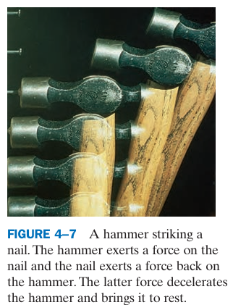
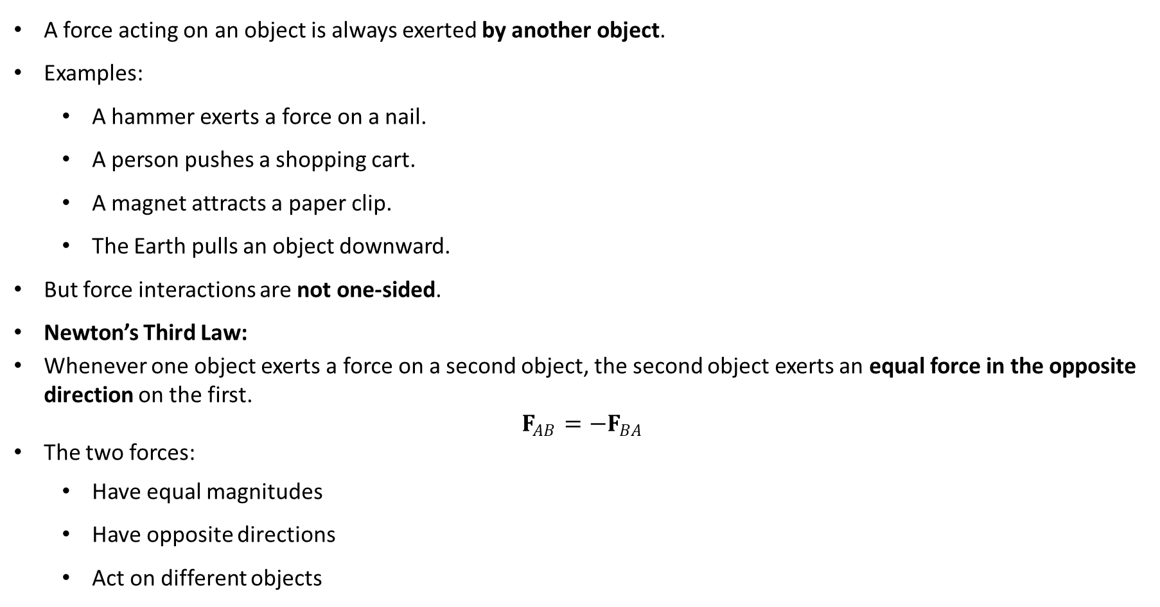
PHYS 2325 | University Physics I
Lecture 02 • Wed Sep 16 • Giancoli Ch. 4
Newton’s Third Law of Motion
A force acting on an object is always exerted by another object.
Examples:
  A hammer exerts a force on a nail.
  A person pushes a shopping cart.
  A magnet attracts a paper clip.
  The Earth pulls an object downward.
But force interactions are not one-sided.
Newton’s Third Law:
Whenever one object exerts a force on a second object, the second object exerts an equal force in the opposite direction on the first.
$$F_{AB}=−F_{BA}$$
The two forces:
  Have equal magnitudes
  Have opposite directions
  Act on different objects
Notes:
Teaching focus: Concept • Newton's Third Law.
[Sources]
- Douglas C. Giancoli, Physics for Scientists and Engineers, 5th ed., Chapter 4, Section 4-5, starting p. 91.
[/Sources]

Slide 21
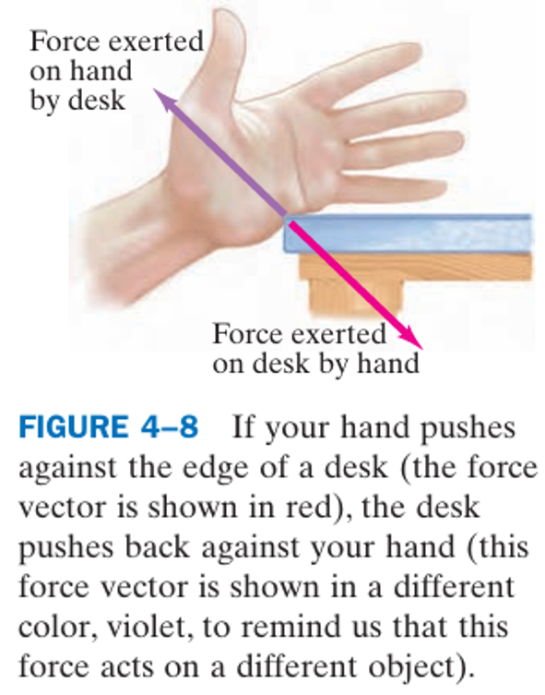
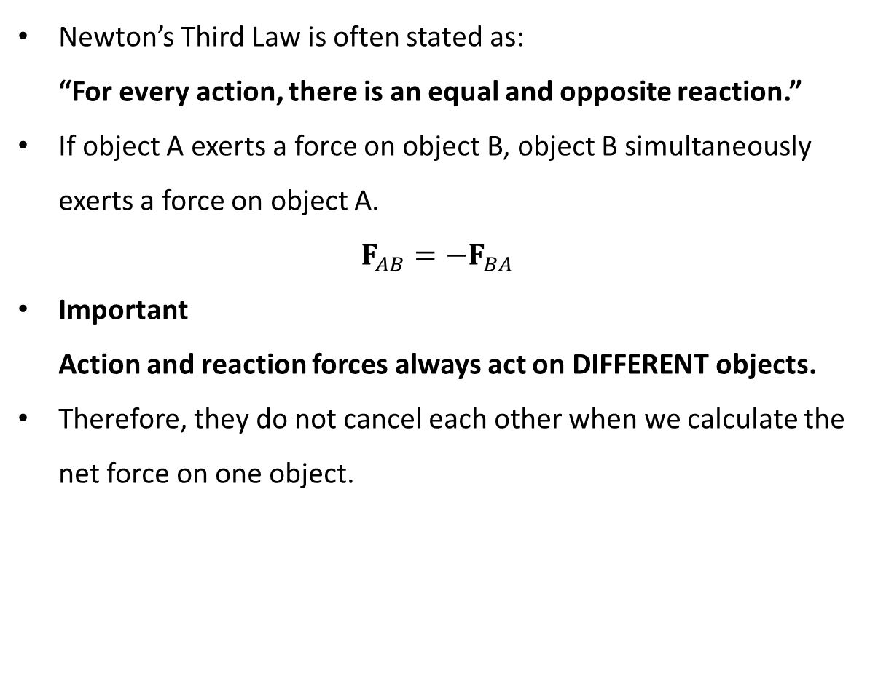
PHYS 2325 | University Physics I
Lecture 02 • Wed Sep 16 • Giancoli Ch. 4
Action–Reaction Force Pairs
Newton’s Third Law is often stated as:
“For every action, there is an equal and opposite reaction.”
If object A exerts a force on object B, object B simultaneously exerts a force on object A.
$$F_{AB}=−F_{BA}$$
Important
Action and reaction forces always act on DIFFERENT objects.
Therefore, they do not cancel each other when we calculate the net force on one object.
Notes:
Teaching focus: Concept • Newton's Third Law.
[Sources]
- Douglas C. Giancoli, Physics for Scientists and Engineers, 5th ed., Chapter 4, Section 4-5, starting p. 91.
[/Sources]

Slide 22
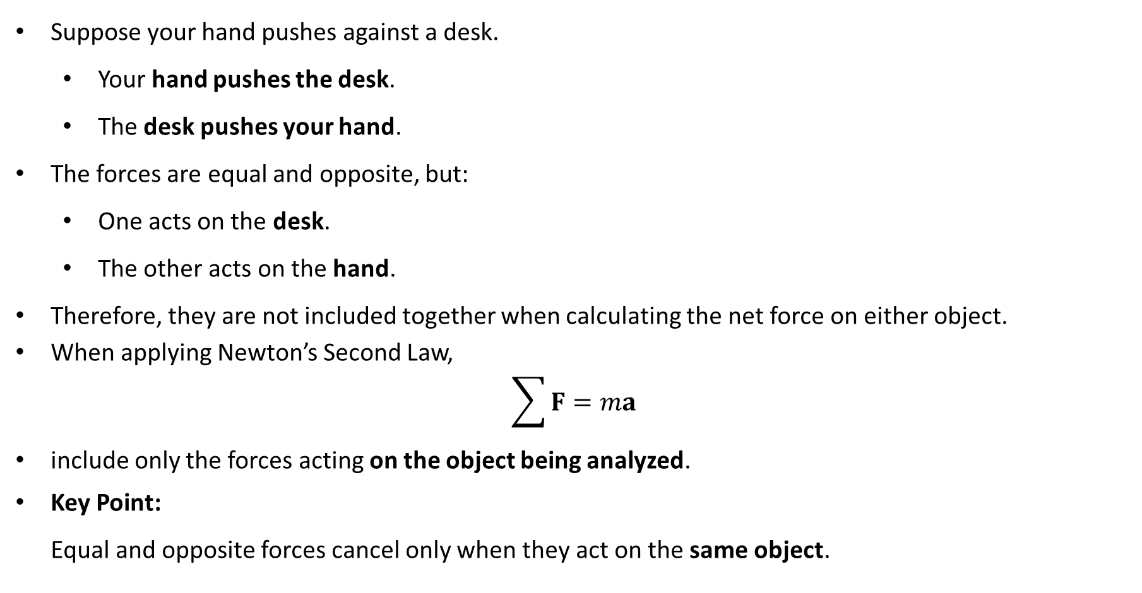
PHYS 2325 | University Physics I
Lecture 02 • Wed Sep 16 • Giancoli Ch. 4
Why Don’t Action–Reaction Forces Cancel?
Suppose your hand pushes against a desk.
  Your hand pushes the desk.
  The desk pushes your hand.
The forces are equal and opposite, but:
  One acts on the desk.
  The other acts on the hand.
Therefore, they are not included together when calculating the net force on either object.
When applying Newton’s Second Law,
$$\sum{F}=ma$$
include only the forces acting on the object being analyzed.
Key Point:
Equal and opposite forces cancel only when they act on the same object.
Notes:
Teaching focus: Concept • Newton's Third Law.
[Sources]
- Douglas C. Giancoli, Physics for Scientists and Engineers, 5th ed., Chapter 4, Section 4-5, starting p. 91.
[/Sources]

Slide 23
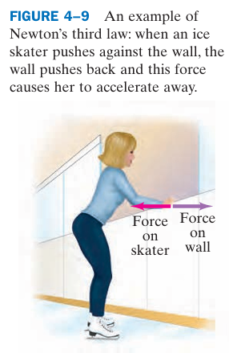
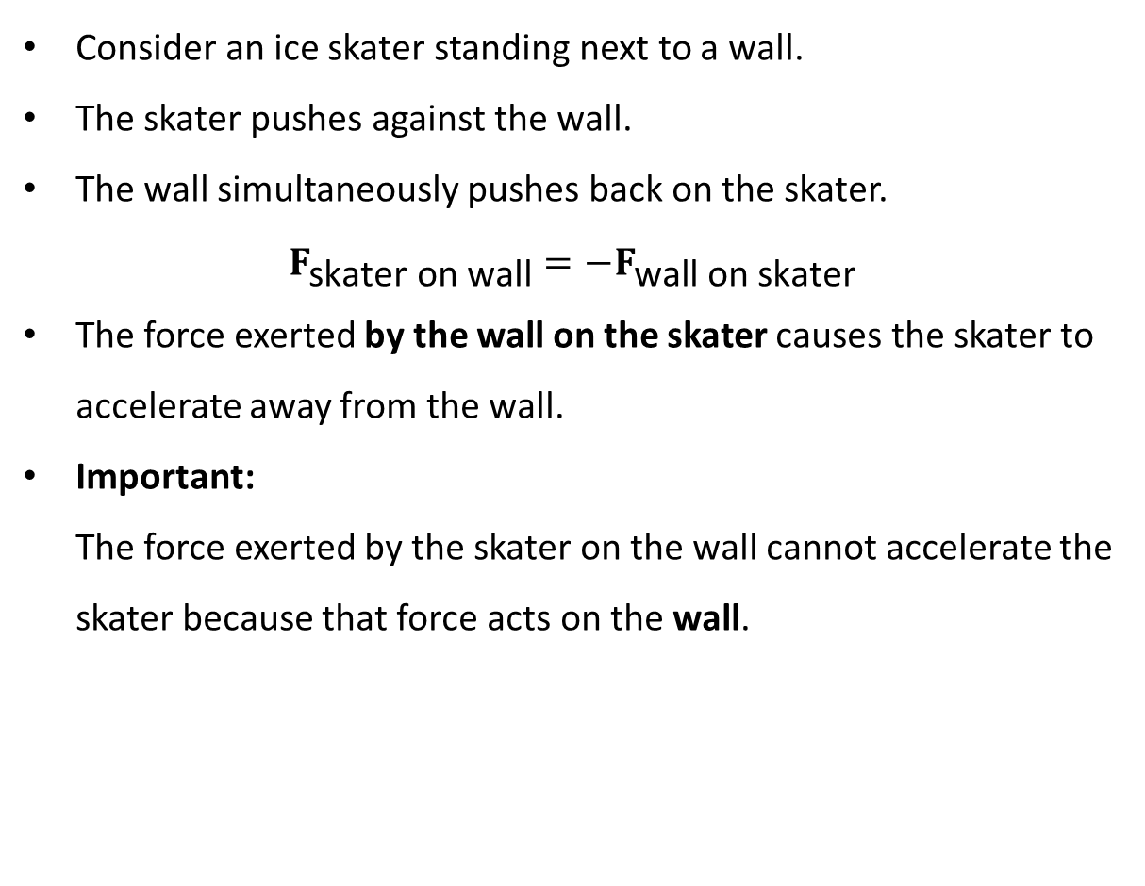
PHYS 2325 | University Physics I
Lecture 02 • Wed Sep 16 • Giancoli Ch. 4
Example: Ice Skater
Consider an ice skater standing next to a wall.
The skater pushes against the wall.
The wall simultaneously pushes back on the skater.
$$F_{\text{skater} \text{on} \text{wall}}=−F_{\text{wall} \text{on} \text{skater}}$$
The force exerted by the wall on the skater causes the skater to accelerate away from the wall.
Important:
The force exerted by the skater on the wall cannot accelerate the skater because that force acts on the wall.
Notes:
Teaching focus: Concept • Newton's Third Law.
[Sources]
- Douglas C. Giancoli, Physics for Scientists and Engineers, 5th ed., Chapter 4, Section 4-5, starting p. 91.
[/Sources]

Slide 24
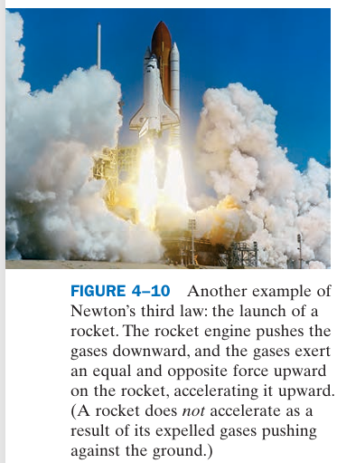
PHYS 2325 | University Physics I
Lecture 02 • Wed Sep 16 • Giancoli Ch. 4
Applications of Newton’s Third Law
Walking
Your foot pushes the ground backward.
The ground pushes your foot forward.
The forward force exerted by the ground accelerates you forward.
Rocket Propulsion
The rocket pushes exhaust gases backward.
The exhaust gases push the rocket forward.
A rocket does not need air or the ground to push against. It can accelerate in empty space.
Notes:
Teaching focus: Concept • Newton's Third Law.
[Sources]
- Douglas C. Giancoli, Physics for Scientists and Engineers, 5th ed., Chapter 4, Section 4-5, starting p. 91.
[/Sources]

Slide 25
PHYS 2325 | University Physics I
Lecture 02 • Wed Sep 16 • Giancoli Ch. 4
What Makes a Car Move Forward?
What actually exerts the forward force on a car?
The engine causes the wheels to rotate.
The tires push backward against the road.
The road then pushes forward on the tires.
So:
  Tires → push road backward
  Road → pushes tires forward
The forward force is due to friction between the tires and the road.
Concept Question:
Why is it difficult for a car to accelerate when its wheels spin on slippery ice?
Answer: Because there is insufficient friction between the tires and the road.
Notes:
Teaching focus: Concept • Newton's Third Law.
[Sources]
- Douglas C. Giancoli, Physics for Scientists and Engineers, 5th ed., Chapter 4, Section 4-5, starting p. 91.
[/Sources]

Slide 26
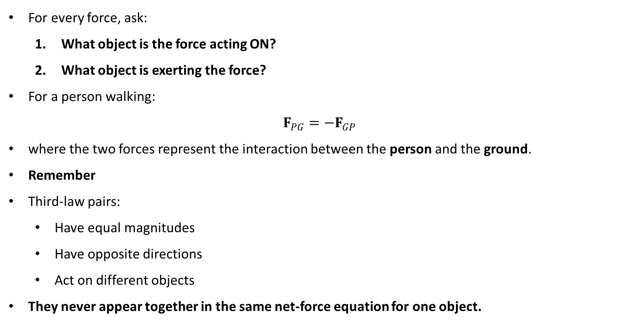
PHYS 2325 | University Physics I
Lecture 02 • Wed Sep 16 • Giancoli Ch. 4
Identifying a Third-Law Pair
For every force, ask:
  What object is the force acting ON?
  What object is exerting the force?
For a person walking:
$$F_{PG}=−F_{GP}$$
where the two forces represent the interaction between the person and the ground.
Remember
Third-law pairs:
  Have equal magnitudes
  Have opposite directions
  Act on different objects
They never appear together in the same net-force equation for one object.
Notes:
Teaching focus: Concept • Newton's Third Law.
[Sources]
- Douglas C. Giancoli, Physics for Scientists and Engineers, 5th ed., Chapter 4, Section 4-5, starting p. 91.
[/Sources]

Slide 27
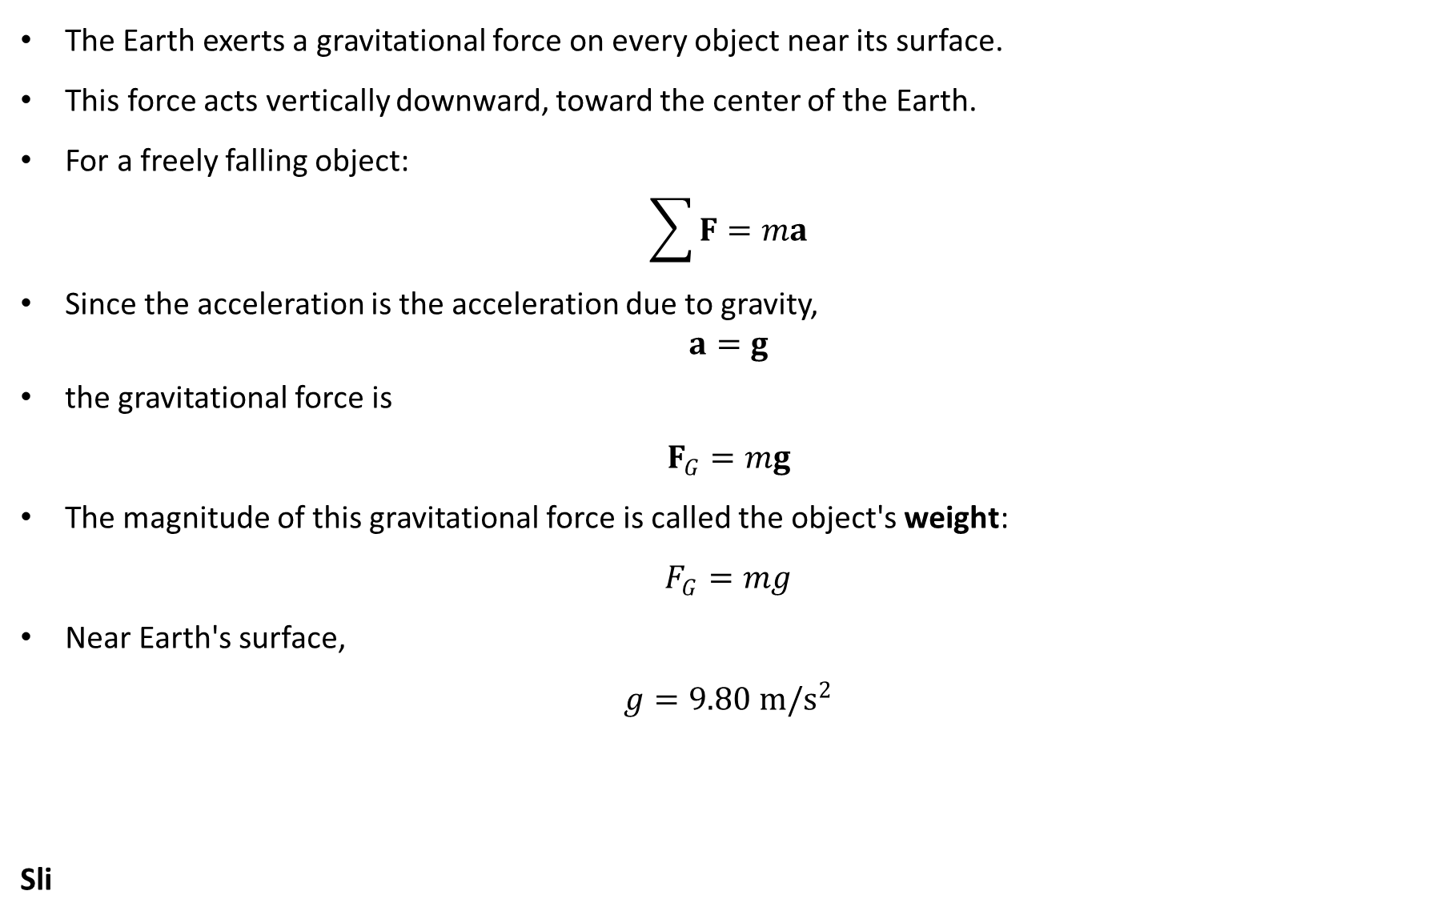
PHYS 2325 | University Physics I
Lecture 02 • Wed Sep 16 • Giancoli Ch. 4
Weight: The Force of Gravity
The Earth exerts a gravitational force on every object near its surface.
This force acts vertically downward, toward the center of the Earth.
For a freely falling object:
$$\sum{F}=ma$$
Since the acceleration is the acceleration due to gravity,
$$a=g$$
the gravitational force is
$$F_{G}=mg$$
The magnitude of this gravitational force is called the object's weight:
$$F_{G}=mg$$
Near Earth's surface,
$$g=9.80 m/s^{2}$$
Sli
Notes:
Teaching focus: Concept • Newton's Third Law.
[Sources]
- Douglas C. Giancoli, Physics for Scientists and Engineers, 5th ed., Chapter 4, Section 4-5, starting p. 91.
[/Sources]

Slide 28
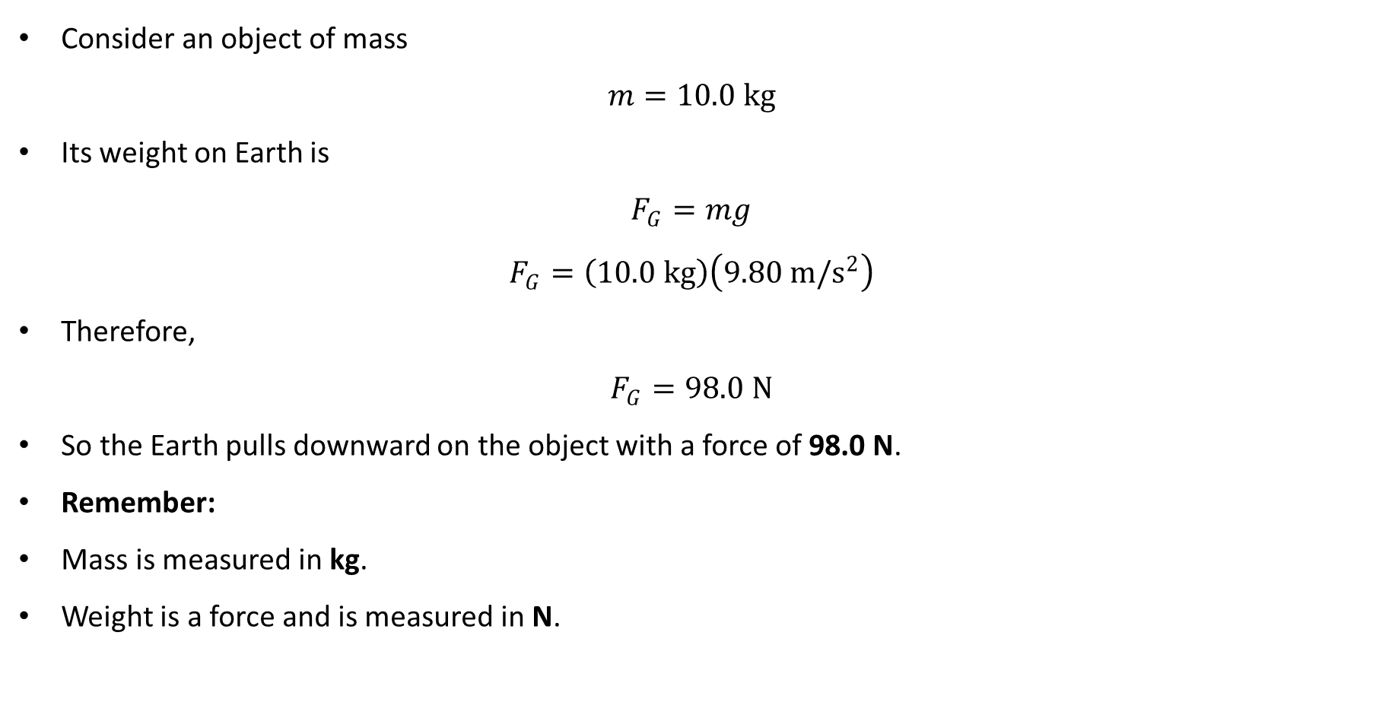
PHYS 2325 | University Physics I
Lecture 02 • Wed Sep 16 • Giancoli Ch. 4
Example: Calculating Weight
Consider an object of mass
$$m=10.0 kg$$
Its weight on Earth is
$$F_{G}=mg$$
$$F_{G}=\left(10.0 kg\right)\left(9.80 m/s^{2}\right)$$
Therefore,
$$F_{G}=98.0 N$$
So the Earth pulls downward on the object with a force of 98.0 N.
Remember:
Mass is measured in kg.
Weight is a force and is measured in N.
Notes:
Teaching focus: Concept • Newton's Third Law.
[Sources]
- Douglas C. Giancoli, Physics for Scientists and Engineers, 5th ed., Chapter 4, Section 4-5, starting p. 91.
[/Sources]

Slide 29
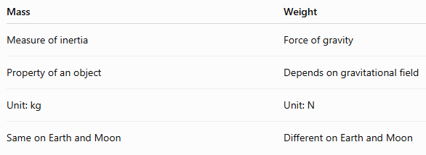
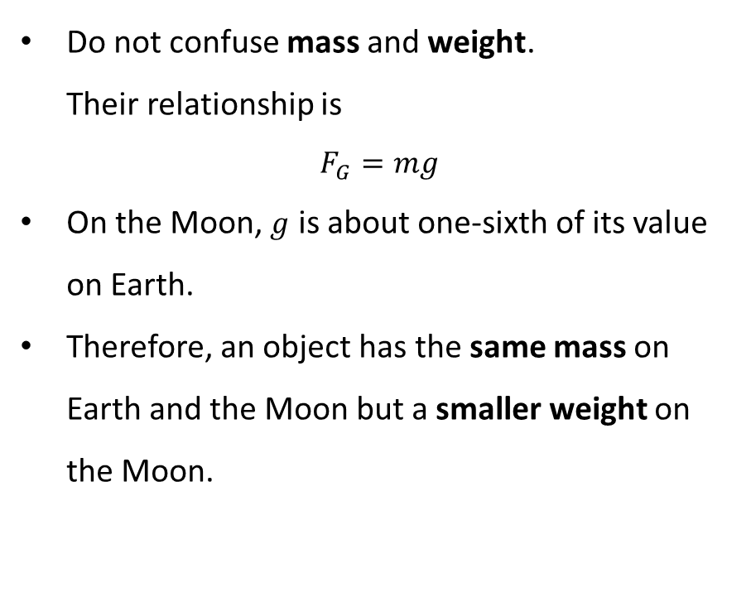
PHYS 2325 | University Physics I
Lecture 02 • Wed Sep 16 • Giancoli Ch. 4
Mass vs. Weight
Do not confuse mass and weight.
Their relationship is
$$F_{G}=mg$$
On the Moon, $g$ is about one-sixth of its value on Earth.
Therefore, an object has the same mass on Earth and the Moon but a smaller weight on the Moon.
Notes:
Teaching focus: Concept • Newton's Third Law.
[Sources]
- Douglas C. Giancoli, Physics for Scientists and Engineers, 5th ed., Chapter 4, Section 4-5, starting p. 91.
[/Sources]

Slide 30
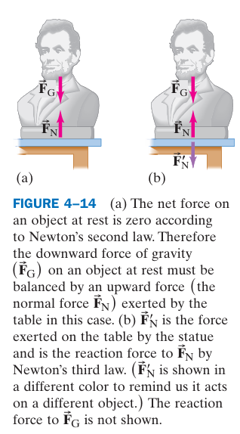
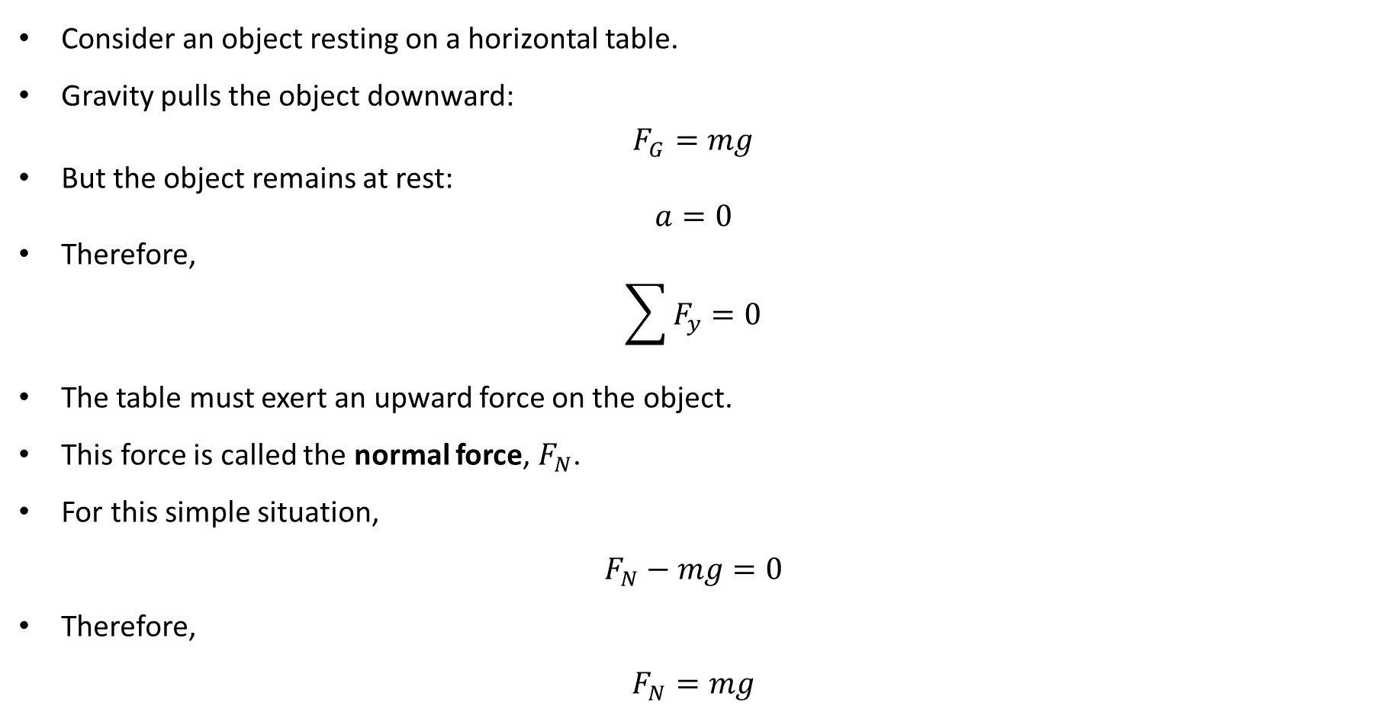
PHYS 2325 | University Physics I
Lecture 02 • Wed Sep 16 • Giancoli Ch. 4
The Normal Force
Consider an object resting on a horizontal table.
Gravity pulls the object downward:
$$F_{G}=mg$$
But the object remains at rest:
$$a=0$$
Therefore,
$$\sum{F_{y}}=0$$
The table must exert an upward force on the object.
This force is called the normal force, $F_{N}$.
For this simple situation,
$$F_{N}−mg=0$$
Therefore,
$$F_{N}=mg$$
Notes:
Teaching focus: Concept • Newton's Third Law.
[Sources]
- Douglas C. Giancoli, Physics for Scientists and Engineers, 5th ed., Chapter 4, Section 4-5, starting p. 91.
[/Sources]

Slide 31
PHYS 2325 | University Physics I
Lecture 02 • Wed Sep 16 • Giancoli Ch. 4
What Does “Normal” Mean?
The normal force is a contact force exerted by a surface on an object.
It always acts perpendicular to the contact surface.
“Normal” means perpendicular.
For a horizontal table, the normal force points vertically upward.
For an inclined surface, the normal force is perpendicular to the incline.
Important:
The normal force is not necessarily vertical.
Notes:
Teaching focus: Concept • Newton's Third Law.
[Sources]
- Douglas C. Giancoli, Physics for Scientists and Engineers, 5th ed., Chapter 4, Section 4-5, starting p. 91.
[/Sources]

Slide 32
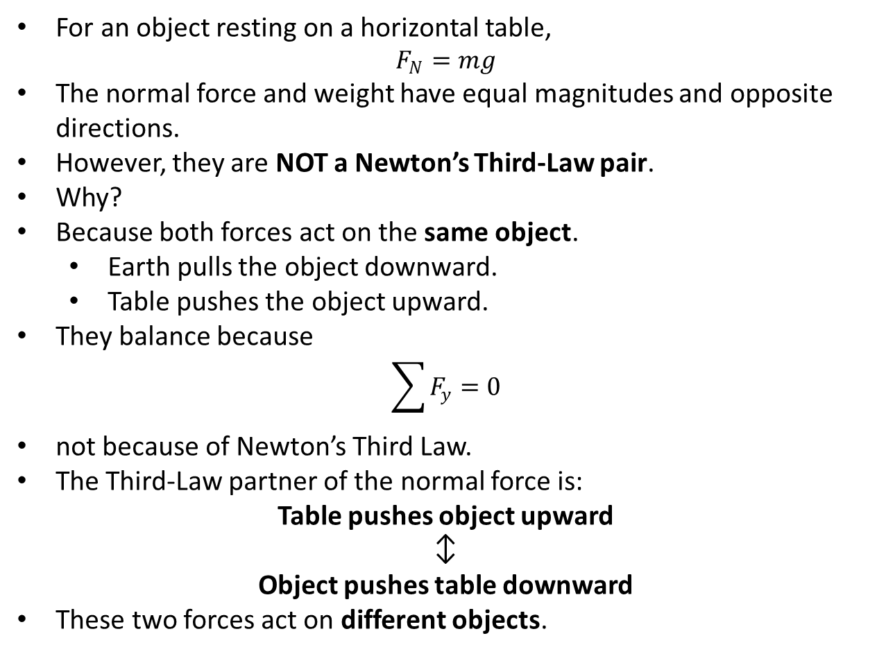
PHYS 2325 | University Physics I
Lecture 02 • Wed Sep 16 • Giancoli Ch. 4
Weight and Normal Force Are NOT a Third-Law Pair
For an object resting on a horizontal table,
$$F_{N}=mg$$
The normal force and weight have equal magnitudes and opposite directions.
However, they are NOT a Newton’s Third-Law pair.
Why?
Because both forces act on the same object.
  Earth pulls the object downward.
  Table pushes the object upward.
They balance because
$$\sum{F_{y}}=0$$
not because of Newton’s Third Law.
The Third-Law partner of the normal force is:
Table pushes object upward
↕
Object pushes table downward
These two forces act on different objects.
Notes:
Teaching focus: Concept • Newton's Third Law.
[Sources]
- Douglas C. Giancoli, Physics for Scientists and Engineers, 5th ed., Chapter 4, Section 4-5, starting p. 91.
[/Sources]

Slide 33
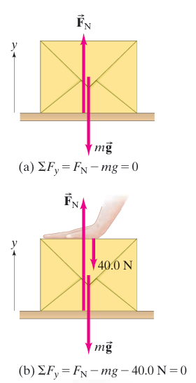
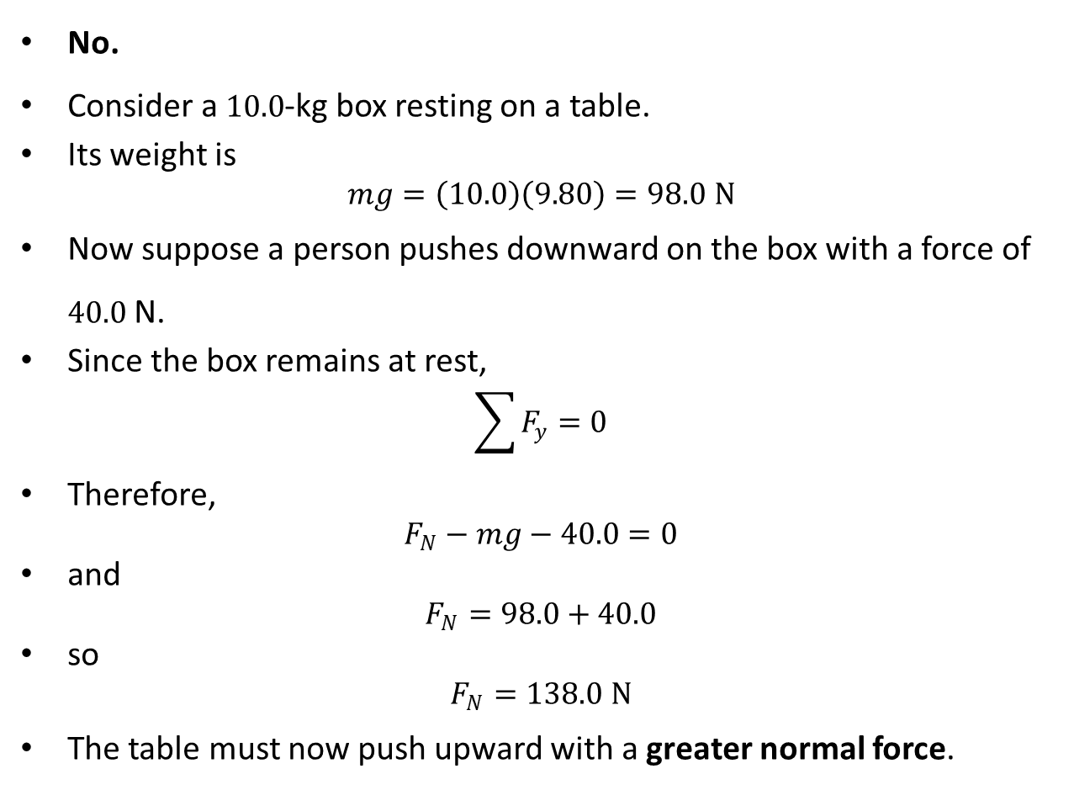
PHYS 2325 | University Physics I
Lecture 02 • Wed Sep 16 • Giancoli Ch. 4
Is the Normal Force Always Equal to Weight?
No.
Consider a $10.0$-kg box resting on a table.
Its weight is
$$mg=\left(10.0\right)\left(9.80\right)=98.0 N$$
Now suppose a person pushes downward on the box with a force of $40.0$N.
Since the box remains at rest,
$$\sum{F_{y}}=0$$
Therefore,
$$F_{N}−mg−40.0=0$$
and
$$F_{N}=98.0+40.0$$
so
$$F_{N}=138.0 N$$
The table must now push upward with a greater normal force.
Notes:
Teaching focus: Concept • Newton's Third Law.
[Sources]
- Douglas C. Giancoli, Physics for Scientists and Engineers, 5th ed., Chapter 4, Section 4-5, starting p. 91.
[/Sources]

Slide 34
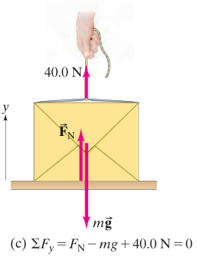
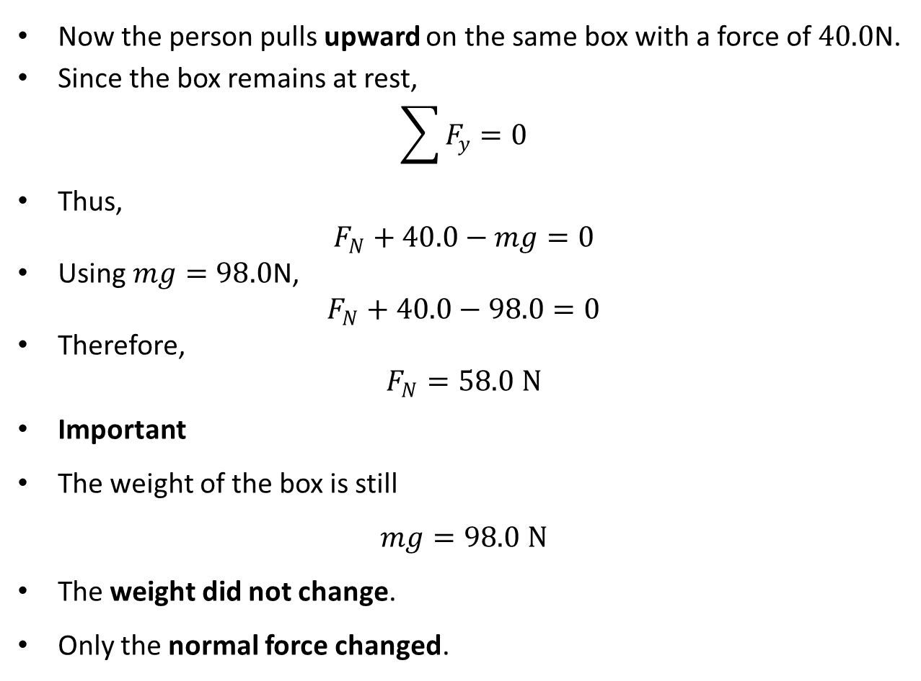
PHYS 2325 | University Physics I
Lecture 02 • Wed Sep 16 • Giancoli Ch. 4
Pulling Upward on the Box
Now the person pulls upward on the same box with a force of $40.0$N.
Since the box remains at rest,
$$\sum{F_{y}}=0$$
Thus,
$$F_{N}+40.0−mg=0$$
Using $mg=98.0$N,
$$F_{N}+40.0−98.0=0$$
Therefore,
$$F_{N}=58.0 N$$
Important
The weight of the box is still
$$mg=98.0 N$$
The weight did not change.
Only the normal force changed.
Notes:
Teaching focus: Concept • Newton's Third Law.
[Sources]
- Douglas C. Giancoli, Physics for Scientists and Engineers, 5th ed., Chapter 4, Section 4-5, starting p. 91.
[/Sources]

Slide 35
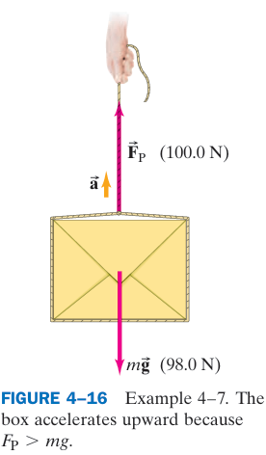
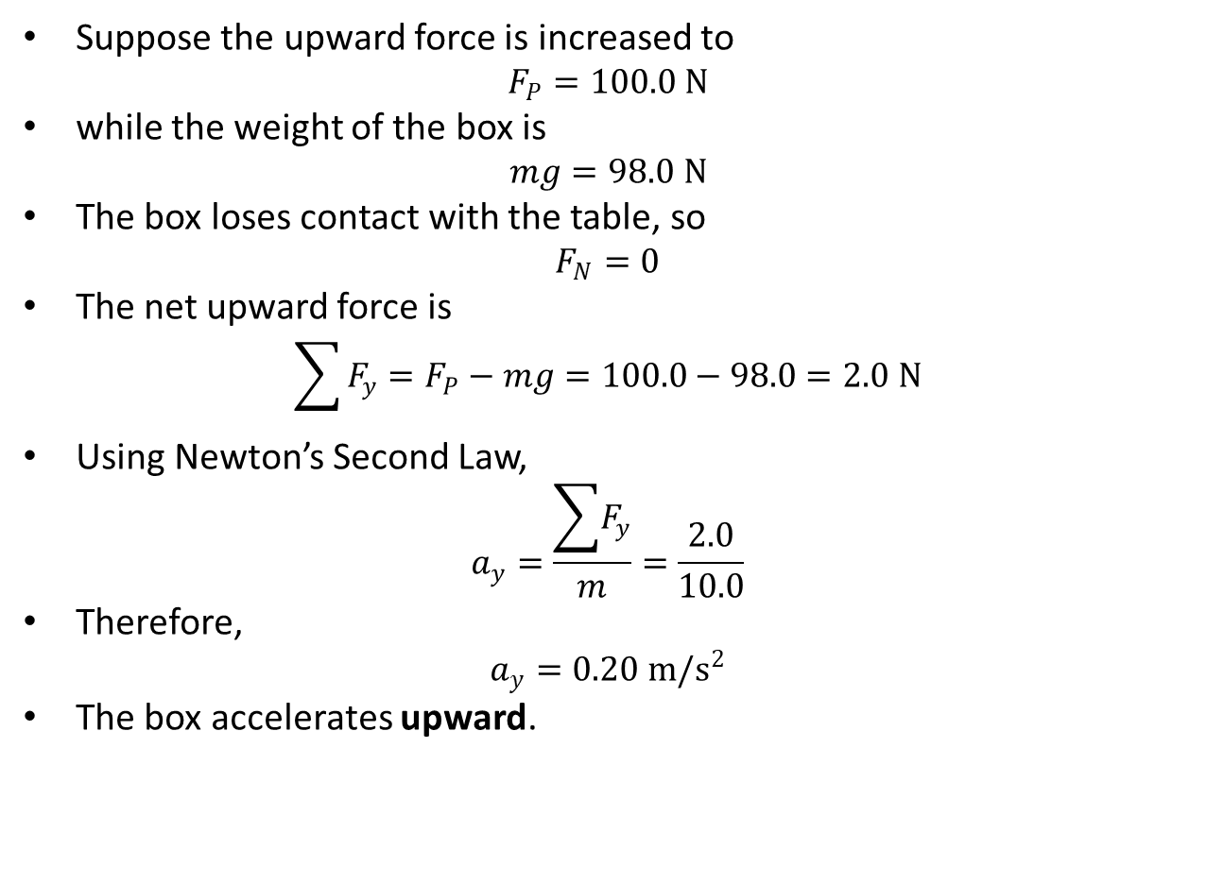
PHYS 2325 | University Physics I
Lecture 02 • Wed Sep 16 • Giancoli Ch. 4
What If the Upward Force Exceeds the Weight?
Suppose the upward force is increased to
$$F_{P}=100.0 N$$
while the weight of the box is
$$mg=98.0 N$$
The box loses contact with the table, so
$$F_{N}=0$$
The net upward force is
$$\sum{F_{y}}=F_{P}−mg=100.0−98.0=2.0 N$$
Using Newton’s Second Law,
$$a_{y}=\frac{\sum{F_{y}}}{m}=\frac{2.0}{10.0}$$
Therefore,
$$a_{y}=0.20 m/s^{2}$$
The box accelerates upward.
Notes:
Teaching focus: Concept • Newton's Third Law.
[Sources]
- Douglas C. Giancoli, Physics for Scientists and Engineers, 5th ed., Chapter 4, Section 4-5, starting p. 91.
[/Sources]

Slide 36
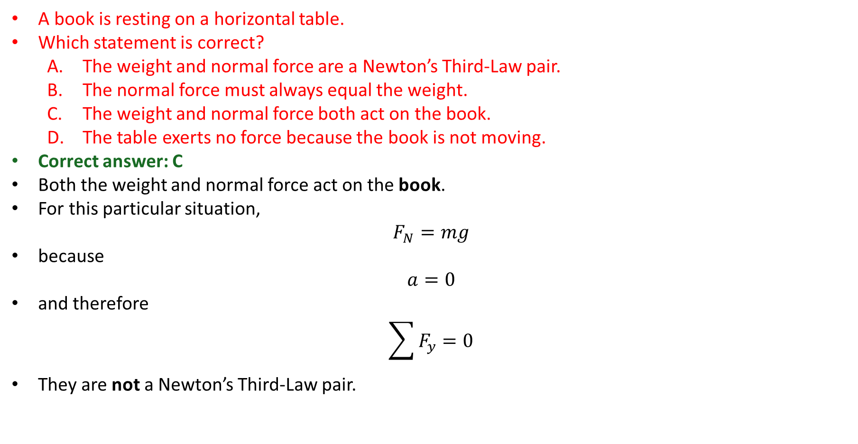
PHYS 2325 | University Physics I
Lecture 02 • Wed Sep 16 • Giancoli Ch. 4
Concept Check
A book is resting on a horizontal table.
Which statement is correct?
  The weight and normal force are a Newton’s Third-Law pair.
  The normal force must always equal the weight.
  The weight and normal force both act on the book.
  The table exerts no force because the book is not moving.
Correct answer: C
Both the weight and normal force act on the book.
For this particular situation,
$$F_{N}=mg$$
because
$$a=0$$
and therefore
$$\sum{F_{y}}=0$$
They are not a Newton’s Third-Law pair.
Notes:
Teaching focus: Concept • Newton's Third Law.
[Sources]
- Douglas C. Giancoli, Physics for Scientists and Engineers, 5th ed., Chapter 4, Section 4-5, starting p. 91.
[/Sources]

Slide 37
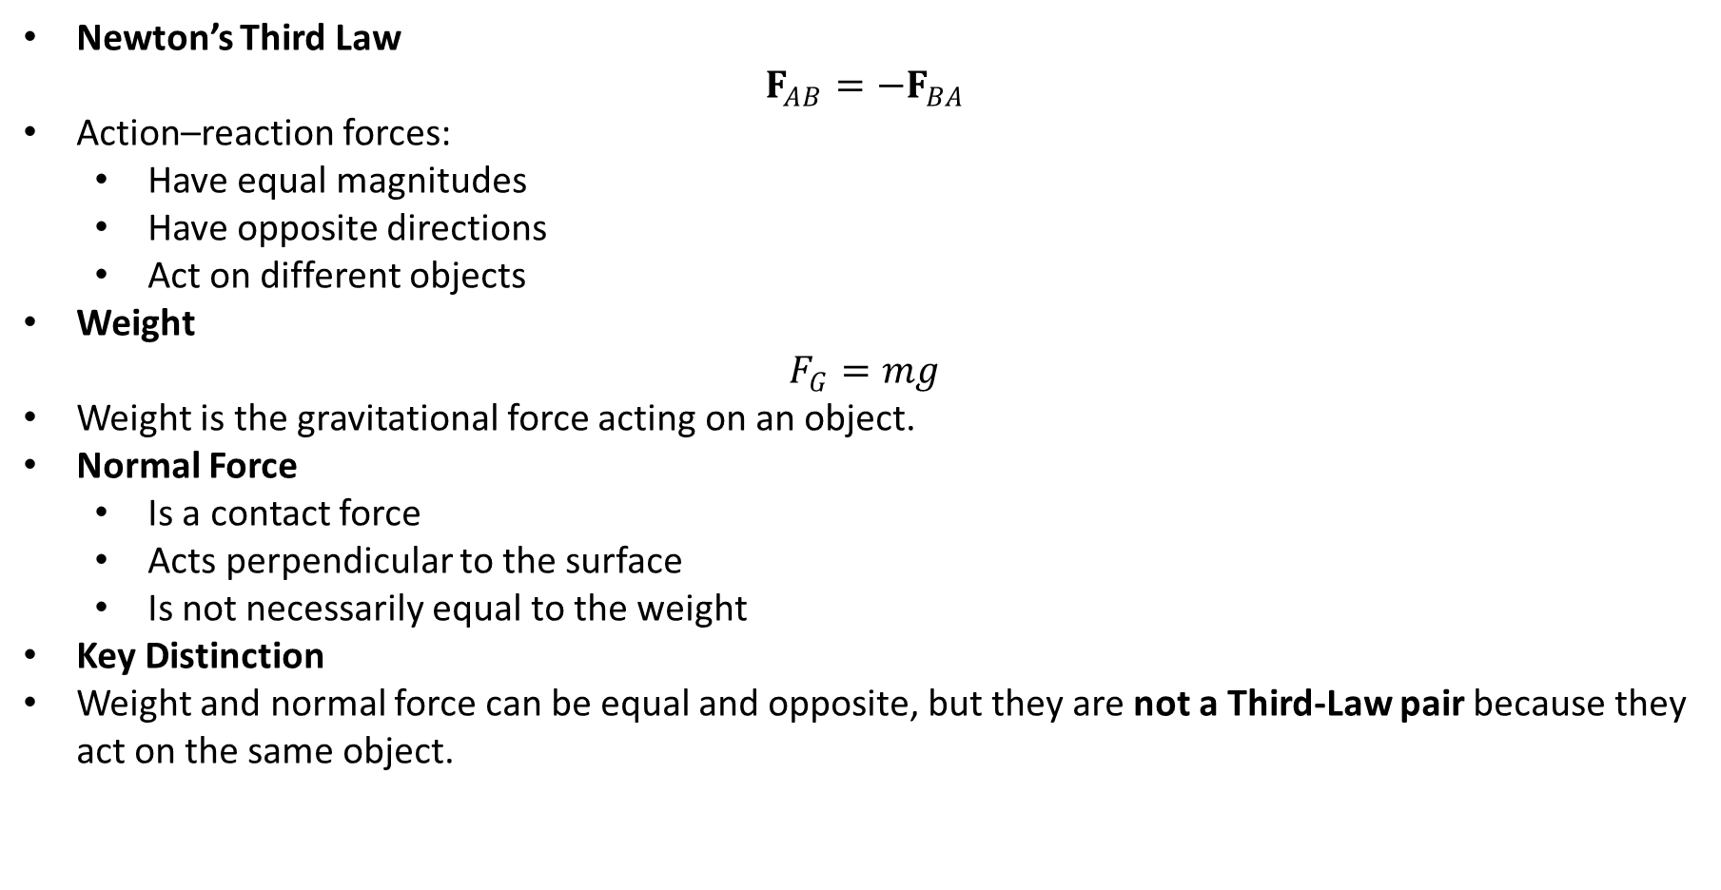
PHYS 2325 | University Physics I
Lecture 02 • Wed Sep 16 • Giancoli Ch. 4
Lecture Summary
Newton’s Third Law
$$F_{AB}=−F_{BA}$$
Action–reaction forces:
  Have equal magnitudes
  Have opposite directions
  Act on different objects
Weight
$$F_{G}=mg$$
Weight is the gravitational force acting on an object.
Normal Force
  Is a contact force
  Acts perpendicular to the surface
  Is not necessarily equal to the weight
Key Distinction
Weight and normal force can be equal and opposite, but they are not a Third-Law pair because they act on the same object.
Notes:
Teaching focus: Concept • Newton's Third Law.
[Sources]
- Douglas C. Giancoli, Physics for Scientists and Engineers, 5th ed., Chapter 4, Section 4-5, starting p. 91.
[/Sources]

Slide 38
LECTURE 03
Free-Body Diagrams and a General Solution Method
Fri Sep 18 • Giancoli Ch. 4
Muhammad Nauman • PHYS 2325 • Fall 2026
Notes:
Teaching focus: Free-Body Diagrams and a General Solution Method.
[Sources]
- PHYS 2325 University Physics I Fall 2026 syllabus and semester calendar.
[/Sources]

Slide 39
PHYS 2325 | University Physics I
Lecture 03 • Fri Sep 18 • Giancoli Ch. 4
Learning outcomes
Define and represent free-body diagrams.
Derive and interpret general problem-solving approach.
Check units, vector directions, assumptions, and limiting behavior in every solution.
Notes:
Teaching focus: Learning outcomes.
[Sources]
- PHYS 2325 University Physics I Fall 2026 syllabus and semester calendar.
[/Sources]

Slide 40
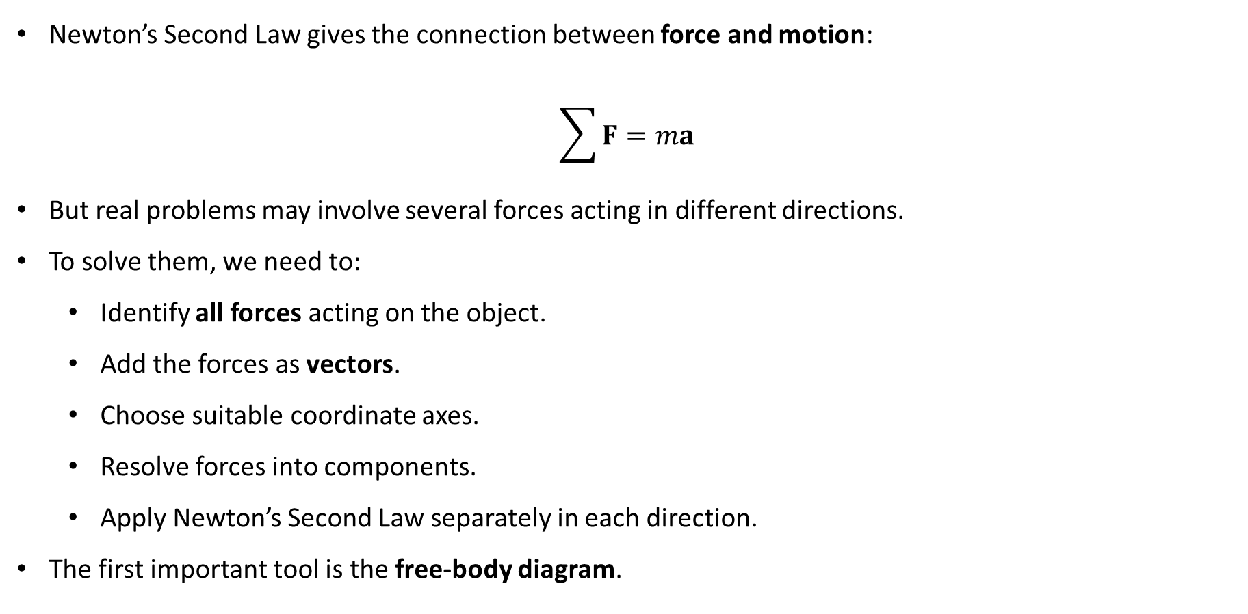
PHYS 2325 | University Physics I
Lecture 03 • Fri Sep 18 • Giancoli Ch. 4
From Newton’s Laws to Solving Problems
Newton’s Second Law gives the connection between force and motion:
$$\sum{F}=ma$$
But real problems may involve several forces acting in different directions.
To solve them, we need to:
  Identify all forces acting on the object.
  Add the forces as vectors.
  Choose suitable coordinate axes.
  Resolve forces into components.
  Apply Newton’s Second Law separately in each direction.
The first important tool is the free-body diagram.
Notes:
Teaching focus: Where today's lecture fits.
[Sources]
- PHYS 2325 University Physics I Fall 2026 syllabus and semester calendar.
[/Sources]

Slide 41
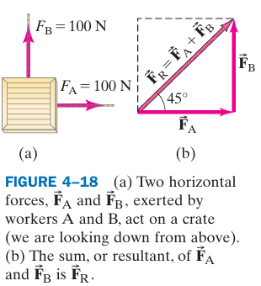
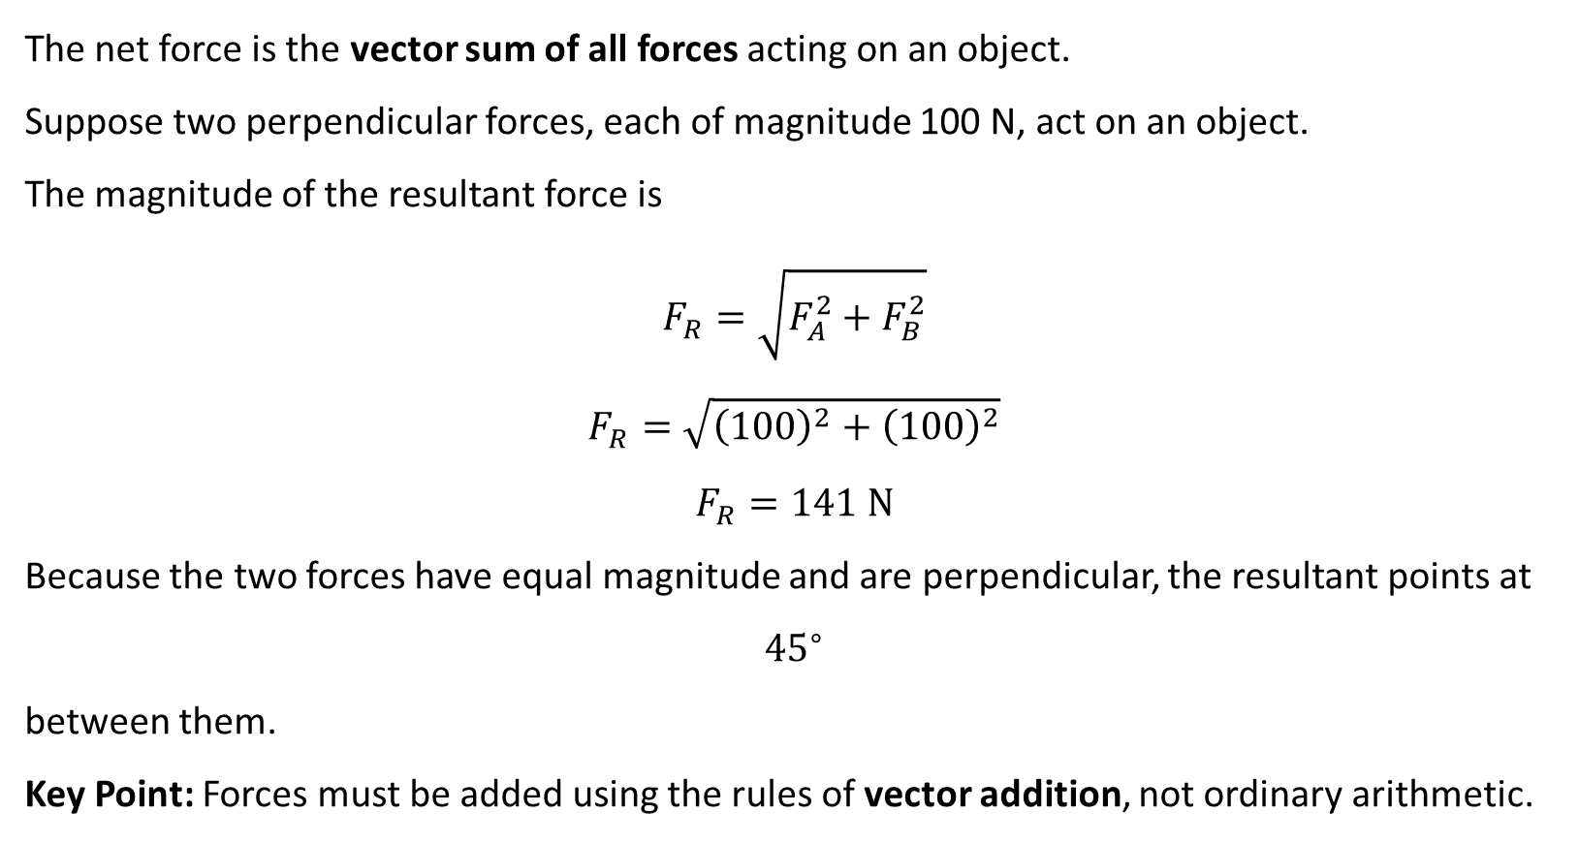
PHYS 2325 | University Physics I
Lecture 03 • Fri Sep 18 • Giancoli Ch. 4
Forces Add as Vectors
The net force is the vector sum of all forces acting on an object.
Suppose two perpendicular forces, each of magnitude 100 N, act on an object.
The magnitude of the resultant force is
$$F_{R}=\sqrt{F_{A}^{2}+F_{B}^{2}}$$
$$F_{R}=\sqrt{{\left(100\right)}^{2}+{\left(100\right)}^{2}}$$
$$F_{R}=141 N$$
Because the two forces have equal magnitude and are perpendicular, the resultant points at
$${45}^{∘}$$
between them.
Key Point: Forces must be added using the rules of vector addition, not ordinary arithmetic.
Notes:
Teaching focus: Where today's lecture fits.
[Sources]
- PHYS 2325 University Physics I Fall 2026 syllabus and semester calendar.
[/Sources]

Slide 42
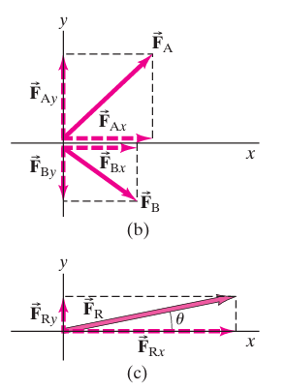
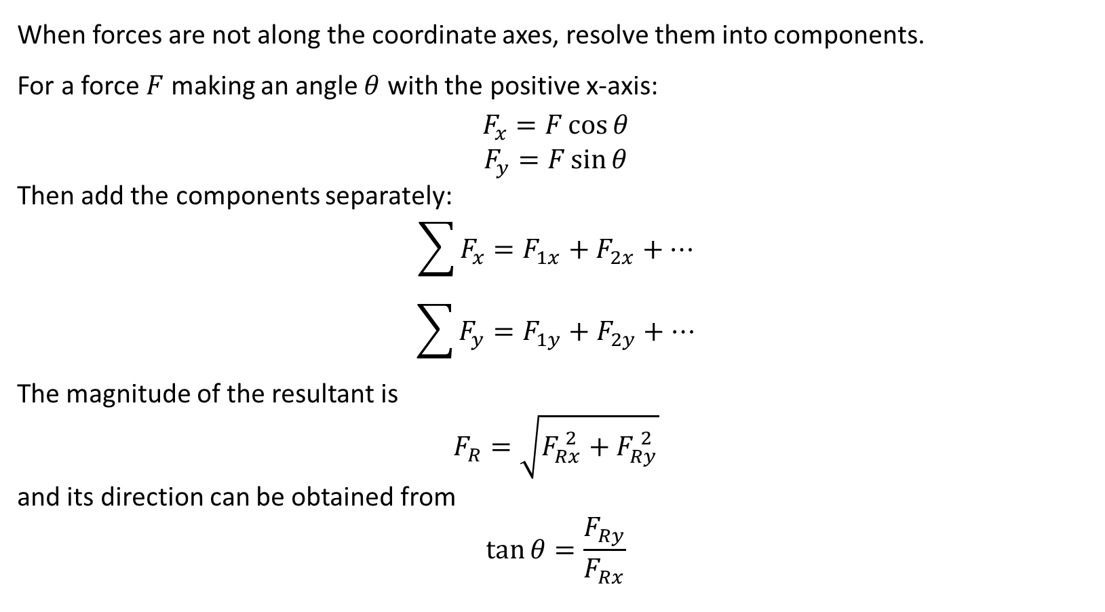
PHYS 2325 | University Physics I
Lecture 03 • Fri Sep 18 • Giancoli Ch. 4
Force Components
When forces are not along the coordinate axes, resolve them into components.
For a force $F$ making an angle $θ$ with the positive x-axis:
$$F_{x}=F\cos{θ}$$
$$F_{y}=F\sin{θ}$$
Then add the components separately:
$$\sum{F_{x}}=F_{1x}+F_{2x}+⋯$$
$$\sum{F_{y}}=F_{1y}+F_{2y}+⋯$$
The magnitude of the resultant is
$$F_{R}=\sqrt{F_{Rx}^{ 2}+F_{Ry}^{ 2}}$$
and its direction can be obtained from
$$\tan{θ}=\frac{F_{Ry}}{F_{Rx}}$$
Notes:
Teaching focus: Where today's lecture fits.
[Sources]
- PHYS 2325 University Physics I Fall 2026 syllabus and semester calendar.
[/Sources]

Slide 43
PHYS 2325 | University Physics I
Lecture 03 • Fri Sep 18 • Giancoli Ch. 4
What Is a Free-Body Diagram?
A free-body diagram (FBD) is a diagram showing all the external forces acting on one chosen object.
To draw an FBD:
  Choose the object you want to analyze.
  Represent the object as a simple box or point.
  Identify every external force acting on that object.
  Draw each force as an arrow.
  Label each force clearly.
Important Rule
  Include forces acting ON the object.
  Do NOT include forces that the object exerts on other objects.
  If several objects are involved, draw a separate FBD for each object.
Notes:
Teaching focus: Where today's lecture fits.
[Sources]
- PHYS 2325 University Physics I Fall 2026 syllabus and semester calendar.
[/Sources]

Slide 44
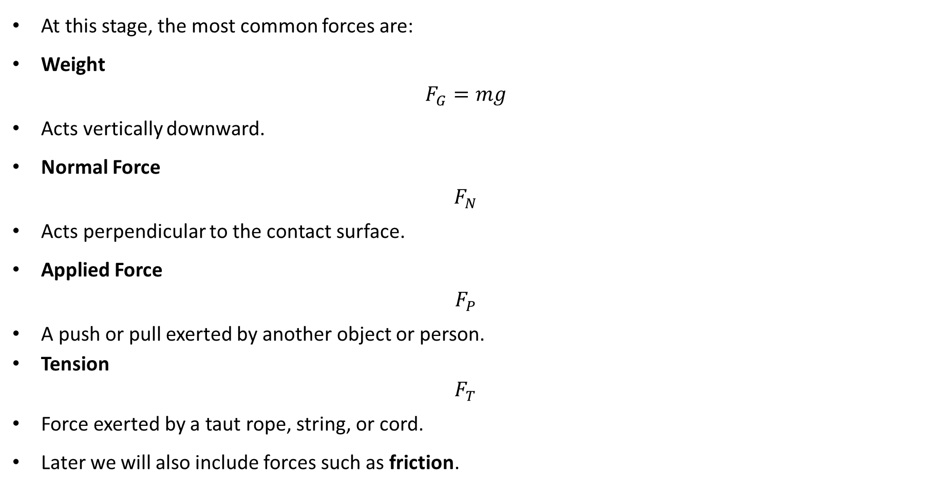
PHYS 2325 | University Physics I
Lecture 03 • Fri Sep 18 • Giancoli Ch. 4
Common Forces in Free-Body Diagrams
At this stage, the most common forces are:
Weight
$$F_{G}=mg$$
Acts vertically downward.
Normal Force
$$F_{N}$$
Acts perpendicular to the contact surface.
Applied Force
$$F_{P}$$
A push or pull exerted by another object or person.
Tension
$$F_{T}$$
Force exerted by a taut rope, string, or cord.
Later we will also include forces such as friction.
Notes:
Teaching focus: Where today's lecture fits.
[Sources]
- PHYS 2325 University Physics I Fall 2026 syllabus and semester calendar.
[/Sources]

Slide 45
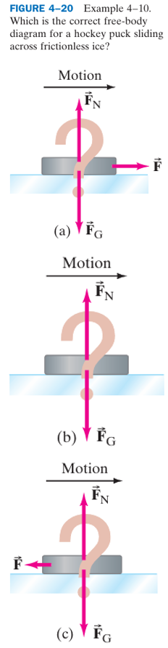
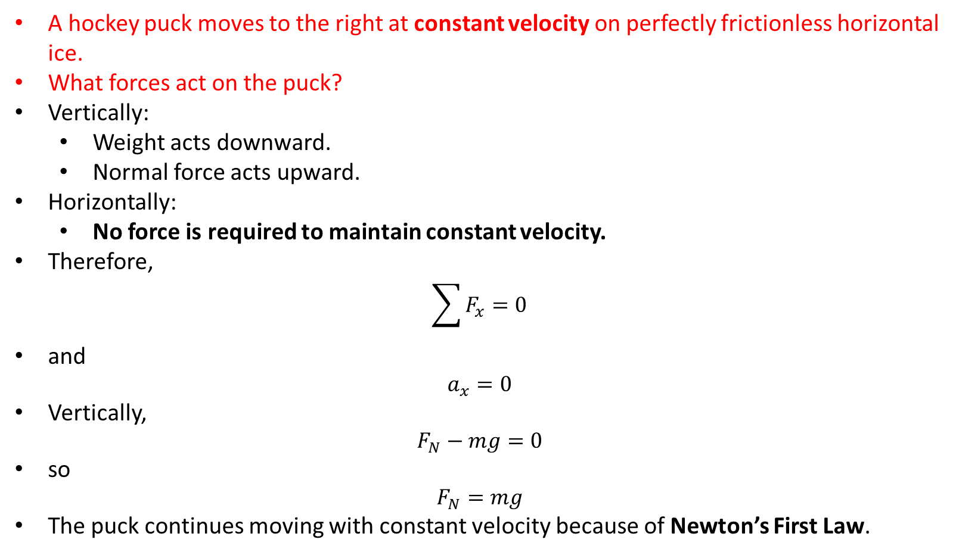
PHYS 2325 | University Physics I
Lecture 03 • Fri Sep 18 • Giancoli Ch. 4
Example: Hockey Puck on Frictionless Ice
A hockey puck moves to the right at constant velocity on perfectly frictionless horizontal ice.
What forces act on the puck?
Vertically:
  Weight acts downward.
  Normal force acts upward.
Horizontally:
  No force is required to maintain constant velocity.
Therefore,
$$\sum{F_{x}}=0$$
and
$$a_{x}=0$$
Vertically,
$$F_{N}−mg=0$$
so
$$F_{N}=mg$$
The puck continues moving with constant velocity because of Newton’s First Law.
Notes:
Teaching focus: Where today's lecture fits.
[Sources]
- PHYS 2325 University Physics I Fall 2026 syllabus and semester calendar.
[/Sources]

Slide 46
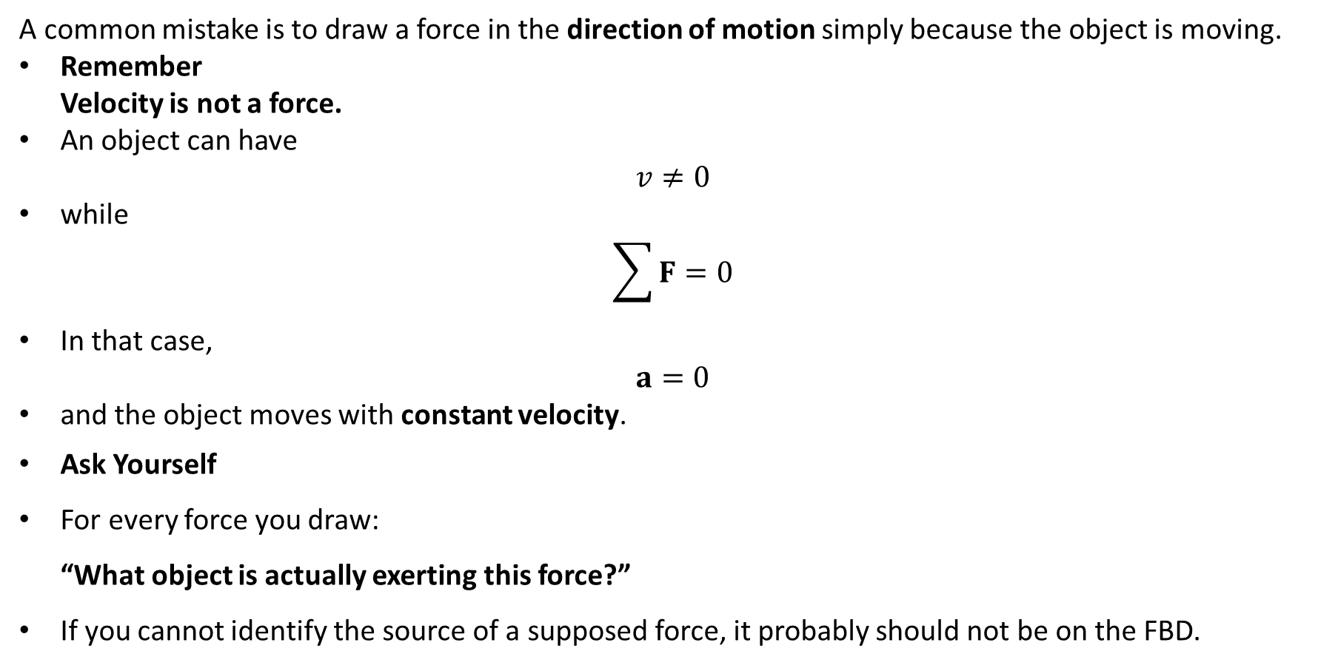
PHYS 2325 | University Physics I
Lecture 03 • Fri Sep 18 • Giancoli Ch. 4
A Common FBD Mistake
A common mistake is to draw a force in the direction of motion simply because the object is moving.
Remember
Velocity is not a force.
An object can have
$$v≠0$$
while
$$\sum{F}=0$$
In that case,
$$a=0$$
and the object moves with constant velocity.
Ask Yourself
For every force you draw:
“What object is actually exerting this force?”
If you cannot identify the source of a supposed force, it probably should not be on the FBD.
Notes:
Teaching focus: Where today's lecture fits.
[Sources]
- PHYS 2325 University Physics I Fall 2026 syllabus and semester calendar.
[/Sources]

Slide 47
PHYS 2325 | University Physics I
Lecture 03 • Fri Sep 18 • Giancoli Ch. 4
General Strategy for Newton’s-Law Problems
When solving a force problem:
Step 1 — Read the problem carefully
Determine what is happening physically.
Step 2 — Draw a sketch
Show the objects and the physical situation.
Step 3 — Draw a free-body diagram
Include every force acting on the chosen object.
Step 4 — Choose coordinate axes
Choose axes that make the problem as simple as possible.
Step 5 — Resolve forces into components
Find x- and y-components where necessary.
Notes:
Teaching focus: Where today's lecture fits.
[Sources]
- PHYS 2325 University Physics I Fall 2026 syllabus and semester calendar.
[/Sources]

Slide 48
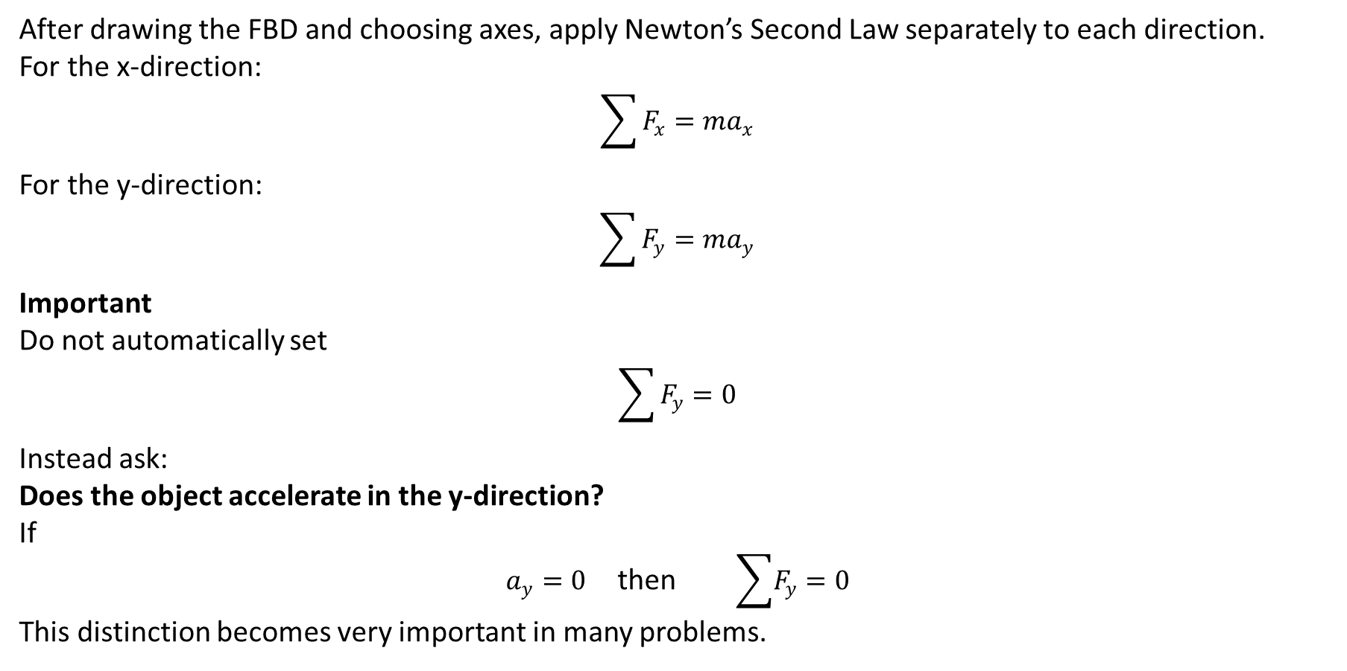
PHYS 2325 | University Physics I
Lecture 03 • Fri Sep 18 • Giancoli Ch. 4
Apply Newton’s Second Law
After drawing the FBD and choosing axes, apply Newton’s Second Law separately to each direction.
For the x-direction:
$$\sum{F_{x}}=ma_{x}$$
For the y-direction:
$$\sum{F_{y}}=ma_{y}$$
Important
Do not automatically set
$$\sum{F_{y}}=0$$
Instead ask:
Does the object accelerate in the y-direction?
If
$a_{y}=0$ then $\sum{F_{y}}=0$
This distinction becomes very important in many problems.
Notes:
Teaching focus: Where today's lecture fits.
[Sources]
- PHYS 2325 University Physics I Fall 2026 syllabus and semester calendar.
[/Sources]

Slide 49
PHYS 2325 | University Physics I
Lecture 03 • Fri Sep 18 • Giancoli Ch. 4
Complete Problem-Solving Procedure
After writing Newton’s Second Law:
Step 6 — Identify knowns and unknowns
What quantities are given?
What are you trying to determine?
Step 7 — Solve algebraically
Whenever possible, solve the equations symbolically before inserting numbers.
Step 8 — Substitute numerical values
Keep track of units.
Step 9 — Check the result
Ask:
Are the units correct?
Is the sign reasonable?
Is the magnitude reasonable?
Does the answer make physical sense?
This general method can be used throughout physics, not only for Newton’s laws.
Notes:
Teaching focus: Where today's lecture fits.
[Sources]
- PHYS 2325 University Physics I Fall 2026 syllabus and semester calendar.
[/Sources]

Slide 50
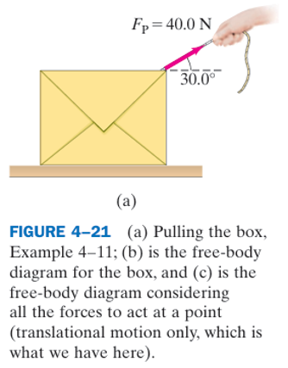
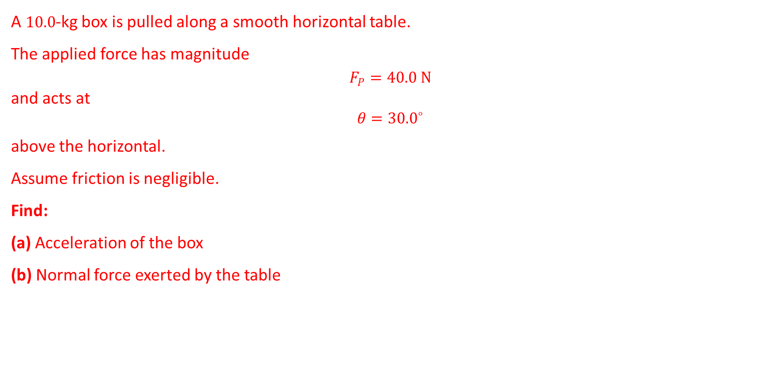
PHYS 2325 | University Physics I
Lecture 03 • Fri Sep 18 • Giancoli Ch. 4
Worked Example: Pulling a Box
A $10.0$-kg box is pulled along a smooth horizontal table.
The applied force has magnitude
$$F_{P}=40.0 N$$
and acts at
$$θ={30.0}^{∘}$$
above the horizontal.
Assume friction is negligible.
Find:
(a) Acceleration of the box
(b) Normal force exerted by the table
Notes:
Teaching focus: Where today's lecture fits.
[Sources]
- PHYS 2325 University Physics I Fall 2026 syllabus and semester calendar.
[/Sources]

Slide 51
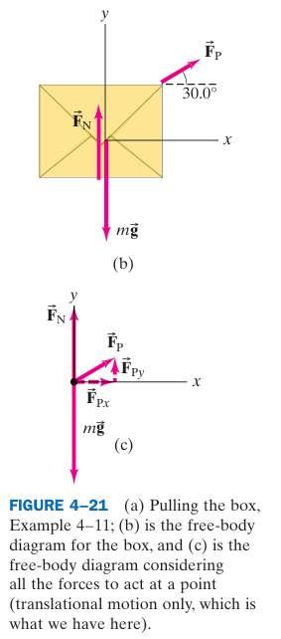

PHYS 2325 | University Physics I
Lecture 03 • Fri Sep 18 • Giancoli Ch. 4
Worked Example: Pulling a Box
Step 1: Draw the Free-Body Diagram
Three forces act on the box:
  Weight $mg$downward
  Normal force $F_{N}$upward
  Applied force $F_{P}$at ${30}^{∘}$
There is no friction.
Choose:
  +x horizontally to the right
  +y vertically upward
Resolve the applied force:
$$F_{Px}=F_{P}\cos{{30}^{∘}}$$
$$F_{Py}=F_{P}\sin{{30}^{∘}}$$
Notes:
Teaching focus: Where today's lecture fits.
[Sources]
- PHYS 2325 University Physics I Fall 2026 syllabus and semester calendar.
[/Sources]

Slide 52

PHYS 2325 | University Physics I
Lecture 03 • Fri Sep 18 • Giancoli Ch. 4
Worked Example: Pulling a Box
Resolve the Applied Force
For
$$F_{P}=40.0 N$$
the horizontal component is
$$F_{Px}=\left(40.0\right)\cos{{30}^{∘}}$$
$$F_{Px}=34.6 N$$
The vertical component is
$$F_{Py}=\left(40.0\right)\sin{{30}^{∘}}$$
$$F_{Py}=20.0 N$$
Now we can apply Newton’s Second Law independently in the x- and y-directions.
Notes:
Teaching focus: Where today's lecture fits.
[Sources]
- PHYS 2325 University Physics I Fall 2026 syllabus and semester calendar.
[/Sources]

Slide 53

PHYS 2325 | University Physics I
Lecture 03 • Fri Sep 18 • Giancoli Ch. 4
Worked Example: Pulling a Box
Find the Acceleration
In the horizontal direction, the only force is $F_{Px}$.
Therefore,
$$\sum{F_{x}}=ma_{x}$$
so
$$F_{Px}=ma_{x}$$
Therefore,
$$a_{x}=\frac{F_{Px}}{m}$$
Substituting,
$$a_{x}=\frac{34.6 N}{10.0 kg}$$
$$a_{x}=3.46 m/s^{2}$$
The box accelerates to the right at $3.46 m/s^{2}$.
Notes:
Teaching focus: Where today's lecture fits.
[Sources]
- PHYS 2325 University Physics I Fall 2026 syllabus and semester calendar.
[/Sources]

Slide 54

PHYS 2325 | University Physics I
Lecture 03 • Fri Sep 18 • Giancoli Ch. 4
Worked Example: Pulling a Box
Find the Normal Force
There is no vertical acceleration:
$$a_{y}=0$$
Therefore,
$$\sum{F_{y}}=0$$
The vertical forces give
$$F_{N}+F_{Py}−mg=0$$
Thus,
$$F_{N}=mg−F_{Py}$$
The weight is
$$mg=\left(10.0\right)\left(9.80\right)=98.0 N$$
Therefore,
$$F_{N}=98.0−20.0$$
$$F_{N}=78.0 N$$
Why is $F_{N}<mg$?
Because the upward component of the applied force supports part of the box’s weight.
Notes:
Teaching focus: Where today's lecture fits.
[Sources]
- PHYS 2325 University Physics I Fall 2026 syllabus and semester calendar.
[/Sources]

Slide 55

PHYS 2325 | University Physics I
Lecture 03 • Fri Sep 18 • Giancoli Ch. 4
Tension in a Cord
When a flexible cord, rope, or string pulls on an object, the cord is under tension.
The force exerted by the cord is called the tension force:
$$F_{T}$$
For an ideal cord:
  Its mass is negligible.
  The cord is taut.
  The tension has the same magnitude throughout the cord.
Important
  A flexible cord can pull, but it cannot push.
  The tension force always acts along the cord and away from the object.
Notes:
Teaching focus: Where today's lecture fits.
[Sources]
- PHYS 2325 University Physics I Fall 2026 syllabus and semester calendar.
[/Sources]

Slide 56


PHYS 2325 | University Physics I
Lecture 03 • Fri Sep 18 • Giancoli Ch. 4
Two Boxes Connected by a Cord
Consider two boxes connected by a lightweight cord on a frictionless table.
Given:
$$m_{A}=10.0 kg$$
$$m_{B}=12.0 kg$$
An external force
$$F_{P}=40.0 N$$
pulls box A.
Because the cord remains taut,
$$a_{A}=a_{B}=a$$
But we need a separate free-body diagram for each box.
Notes:
Teaching focus: Where today's lecture fits.
[Sources]
- PHYS 2325 University Physics I Fall 2026 syllabus and semester calendar.
[/Sources]

Slide 57

PHYS 2325 | University Physics I
Lecture 03 • Fri Sep 18 • Giancoli Ch. 4
Two Boxes Connected by a Cord
Apply Newton’s Second Law to Each Box
For Box A:
$$F_{P}−F_{T}=m_{A}a$$
For Box B:
$$F_{T}=m_{B}a$$
Notice that $F_{P}$does not act directly on box B.
Box B is accelerated by the tension force.
Adding the two equations:
$$F_{P}=\left(m_{A}+m_{B}\right)a$$
Therefore,
$$a=\frac{F_{P}}{m_{A}+m_{B}}$$
Substituting,
$$a=\frac{40.0}{10.0+12.0}$$
$$a=1.82 m/s^{2}$$
Notes:
Teaching focus: Where today's lecture fits.
[Sources]
- PHYS 2325 University Physics I Fall 2026 syllabus and semester calendar.
[/Sources]

Slide 58

PHYS 2325 | University Physics I
Lecture 03 • Fri Sep 18 • Giancoli Ch. 4
Two Boxes Connected by a Cord
Find the Tension
Use the equation for box B:
$$F_{T}=m_{B}a$$
Therefore,
$$F_{T}=\left(12.0\right)\left(1.82\right)$$
$$F_{T}=21.8 N$$
So:
$$a=1.82 m/s^{2}$$
and
$$F_{T}=21.8 N$$
Physical Interpretation
The applied force $F_{P}$accelerates both boxes.
The tension $F_{T}$accelerates only box B.
Therefore,
$$F_{T}<F_{P}$$
Giancoli also notes that the two boxes can alternatively be treated as a single system; in that description, tension is an internal force and cancels from the system’s net force.
Notes:
Teaching focus: Where today's lecture fits.
[Sources]
- PHYS 2325 University Physics I Fall 2026 syllabus and semester calendar.
[/Sources]

Slide 59

PHYS 2325 | University Physics I
Lecture 03 • Fri Sep 18 • Giancoli Ch. 4
Common Mistakes to Avoid
Mistake 1: Drawing forces that the object exerts on something else.
→ Draw only forces acting on the chosen object.
Mistake 2: Drawing a force simply because an object is moving.
→ Motion does not require a net force.
Mistake 3: Assuming
$$F_{N}=mg$$
in every problem.
→ The normal force depends on the other forces and acceleration.
Mistake 4: Forgetting that forces are vectors.
→ Resolve forces into components.
Mistake 5: Mixing forces from different objects in one equation.
→ Use a separate FBD and Newton’s Second Law for each object.
Notes:
Teaching focus: Where today's lecture fits.
[Sources]
- PHYS 2325 University Physics I Fall 2026 syllabus and semester calendar.
[/Sources]

Slide 60

PHYS 2325 | University Physics I
Lecture 03 • Fri Sep 18 • Giancoli Ch. 4
Concept Check
Two boxes are connected by a massless cord and pulled across a frictionless table.
Which statement is correct?
A. The applied force acts directly on both boxes.
B. The tension must equal the applied force.
C. Both boxes have the same acceleration if the cord remains taut.
D. The heavier box has the greater acceleration.
Correct Answer: C
Because the boxes remain connected by a taut, non-stretching cord,
$$a_{A}=a_{B}$$
However, the forces acting on the two boxes are not the same.
Notes:
Teaching focus: Where today's lecture fits.
[Sources]
- PHYS 2325 University Physics I Fall 2026 syllabus and semester calendar.
[/Sources]

Slide 61

PHYS 2325 | University Physics I
Lecture 03 • Fri Sep 18 • Giancoli Ch. 4
Lecture Summary
Free-Body Diagram
Show all and only the forces acting on the chosen object.
Choose Appropriate Axes
Resolve forces into components when necessary.
Apply Newton’s Second Law
$$\sum{F_{x}}=ma_{x}$$
$$\sum{F_{y}}=ma_{y}$$
For Multiple Objects
Draw a separate FBD and Newton’s-law equation for each object.
General Procedure
Sketch → FBD → Axes → Components → Newton’s Second Law → Solve → Check
Notes:
Teaching focus: Where today's lecture fits.
[Sources]
- PHYS 2325 University Physics I Fall 2026 syllabus and semester calendar.
[/Sources]

