Slide 1
WEEK 05
Friction, Circular Motion, and Gravitation
Sep 21-25 • Giancoli Chapters 5-6
Muhammad Nauman • PHYS 2325 • Fall 2026
Notes:
Teaching focus: Friction, Circular Motion, and Gravitation.
[Sources]
- PHYS 2325 University Physics I Fall 2026 syllabus and semester calendar.
[/Sources]

Slide 2
PHYS 2325 | University Physics I
Week 05 • Sep 21-25 • Giancoli Chapters 5-6
This week follows one connected learning path
01
02
03
MON SEP 21
Friction and Circular-Motion Kinematics
WED SEP 23
Circular Dynamics, Banking, and Drag
FRI SEP 25
Universal Gravitation, Orbits, and Newton's Synthesis
Notes:
Teaching focus: This week follows one connected learning path.
[Sources]
- PHYS 2325 University Physics I Fall 2026 syllabus and semester calendar.
[/Sources]

Slide 3
LECTURE 01
Friction and Circular-Motion Kinematics
Mon Sep 21 • Giancoli Ch. 5
Muhammad Nauman • PHYS 2325 • Fall 2026
Notes:
Teaching focus: Friction and Circular-Motion Kinematics.
[Sources]
- PHYS 2325 University Physics I Fall 2026 syllabus and semester calendar.
[/Sources]

Slide 4
PHYS 2325 | University Physics I
Lecture 01 • Mon Sep 21 • Giancoli Ch. 5
Learning objectives
Distinguish static friction from kinetic friction.
Calculate friction using the normal force.
Determine whether an object remains at rest or begins to slide.
Apply Newton’s second law to objects on horizontal and inclined surfaces.
Explain why circular motion requires acceleration.
Calculate centripetal acceleration from speed, radius, period, or frequency.
Notes:
Teaching focus: Learning outcomes.
[Sources]
- PHYS 2325 University Physics I Fall 2026 syllabus and semester calendar.
[/Sources]

Slide 5
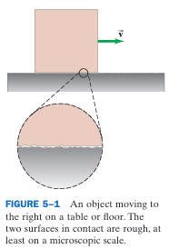
PHYS 2325 | University Physics I
Lecture 01 • Mon Sep 21 • Giancoli Ch. 5
Using Newton’s Laws with Friction
Microscopic Origin of Friction
Surfaces that appear smooth contain microscopic bumps and irregularities.
These irregularities resist relative motion between surfaces.
Atoms on opposing surfaces may briefly bond at points of contact.
Sliding requires these microscopic connections to form and break repeatedly.
Friction can therefore produce jerky motion and thermal energy.
Types of friction
  Static friction: acts when the surfaces do not slide relative to each other.
  Kinetic friction: acts when one surface slides over another.
  Rolling friction: acts during rolling and is usually smaller than sliding friction.
Notes:
Teaching focus: Where today's lecture fits.
[Sources]
- PHYS 2325 University Physics I Fall 2026 syllabus and semester calendar.
[/Sources]

Slide 6
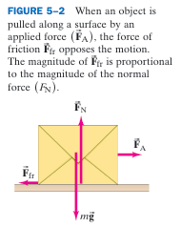
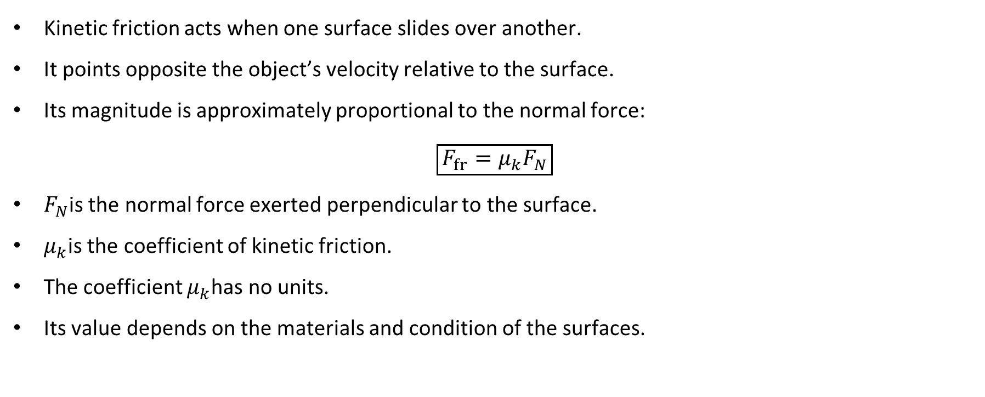
PHYS 2325 | University Physics I
Lecture 01 • Mon Sep 21 • Giancoli Ch. 5
Kinetic Friction
Kinetic friction acts when one surface slides over another.
It points opposite the object’s velocity relative to the surface.
Its magnitude is approximately proportional to the normal force:
$$\boxed{F_{fr}=μ_{k}F_{N}}$$
$F_{N}$is the normal force exerted perpendicular to the surface.
$μ_{k}$is the coefficient of kinetic friction.
The coefficient $μ_{k}$has no units.
Its value depends on the materials and condition of the surfaces.
Notes:
Teaching focus: Where today's lecture fits.
[Sources]
- PHYS 2325 University Physics I Fall 2026 syllabus and semester calendar.
[/Sources]

Slide 7
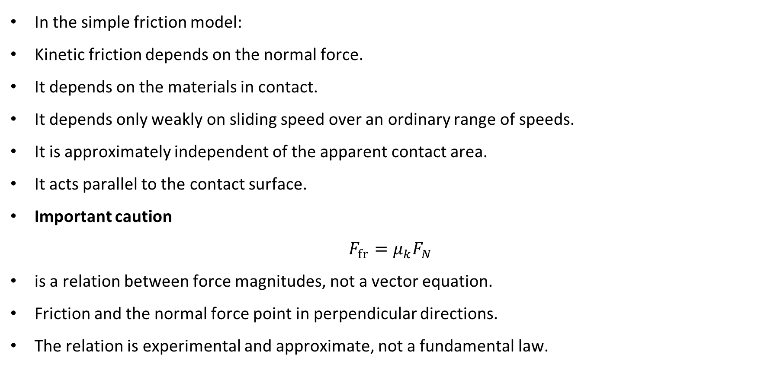
PHYS 2325 | University Physics I
Lecture 01 • Mon Sep 21 • Giancoli Ch. 5
Important Features of Kinetic Friction
In the simple friction model:
Kinetic friction depends on the normal force.
It depends on the materials in contact.
It depends only weakly on sliding speed over an ordinary range of speeds.
It is approximately independent of the apparent contact area.
It acts parallel to the contact surface.
Important caution
$$F_{fr}=μ_{k}F_{N}$$
is a relation between force magnitudes, not a vector equation.
Friction and the normal force point in perpendicular directions.
The relation is experimental and approximate, not a fundamental law.
Notes:
Teaching focus: Where today's lecture fits.
[Sources]
- PHYS 2325 University Physics I Fall 2026 syllabus and semester calendar.
[/Sources]

Slide 8
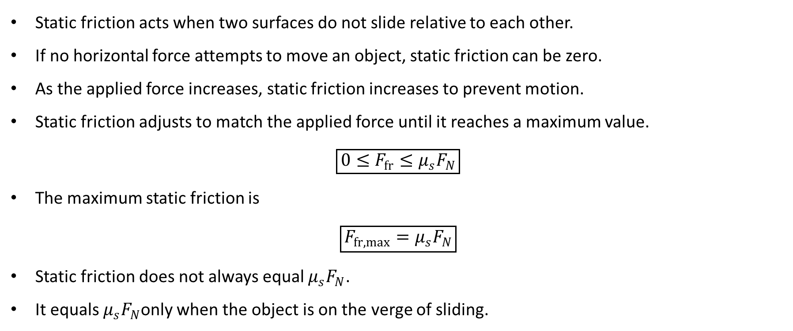
PHYS 2325 | University Physics I
Lecture 01 • Mon Sep 21 • Giancoli Ch. 5
Static Friction
Static friction acts when two surfaces do not slide relative to each other.
If no horizontal force attempts to move an object, static friction can be zero.
As the applied force increases, static friction increases to prevent motion.
Static friction adjusts to match the applied force until it reaches a maximum value.
$$\boxed{0≤F_{fr}≤μ_{s}F_{N}}$$
The maximum static friction is
$$\boxed{F_{fr,max}=μ_{s}F_{N}}$$
Static friction does not always equal $μ_{s}F_{N}$.
It equals $μ_{s}F_{N}$only when the object is on the verge of sliding.
Notes:
Teaching focus: Where today's lecture fits.
[Sources]
- PHYS 2325 University Physics I Fall 2026 syllabus and semester calendar.
[/Sources]

Slide 9
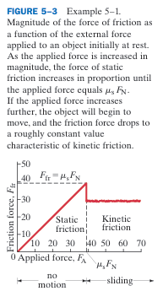
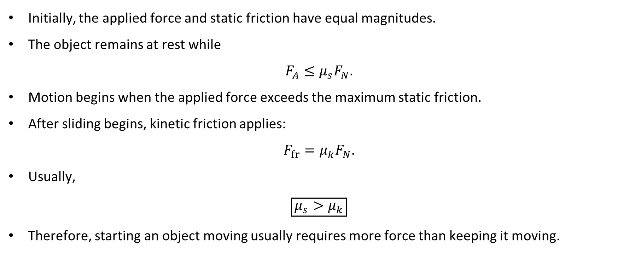
PHYS 2325 | University Physics I
Lecture 01 • Mon Sep 21 • Giancoli Ch. 5
Static-to-Kinetic Transition
Initially, the applied force and static friction have equal magnitudes.
The object remains at rest while
$$F_{A}≤μ_{s}F_{N}.$$
Motion begins when the applied force exceeds the maximum static friction.
After sliding begins, kinetic friction applies:
$$F_{fr}=μ_{k}F_{N}.$$
Usually,
$$\boxed{μ_{s}>μ_{k}}$$
Therefore, starting an object moving usually requires more force than keeping it moving.
Notes:
Teaching focus: Where today's lecture fits.
[Sources]
- PHYS 2325 University Physics I Fall 2026 syllabus and semester calendar.
[/Sources]

Slide 10
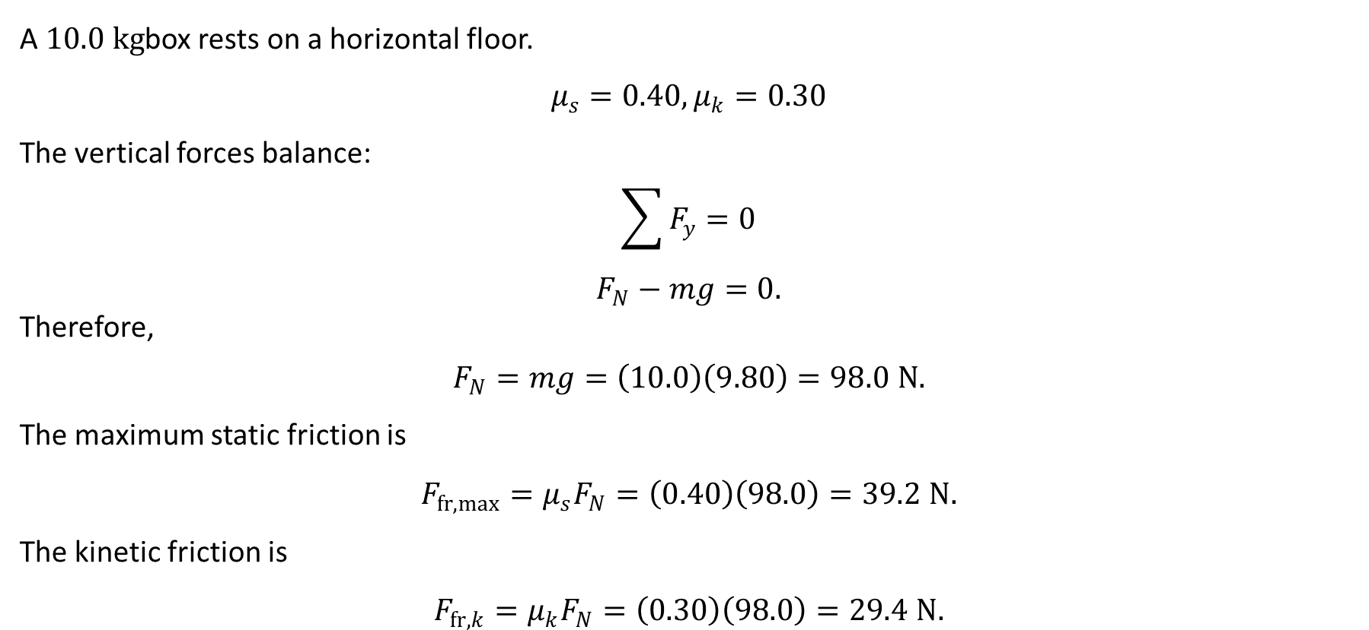
PHYS 2325 | University Physics I
Lecture 01 • Mon Sep 21 • Giancoli Ch. 5
Static and Kinetic Friction: Setup
A $10.0 kg$box rests on a horizontal floor.
$$μ_{s}=0.40, μ_{k}=0.30$$
The vertical forces balance:
$$\sum{F_{y}}=0$$
$$F_{N}−mg=0.$$
Therefore,
$$F_{N}=mg=\left(10.0\right)\left(9.80\right)=98.0 N.$$
The maximum static friction is
$$F_{fr,max}=μ_{s}F_{N}=\left(0.40\right)\left(98.0\right)=39.2 N.$$
The kinetic friction is
$$F_{fr,k}=μ_{k}F_{N}=\left(0.30\right)\left(98.0\right)=29.4 N.$$
Notes:
Teaching focus: Where today's lecture fits.
[Sources]
- PHYS 2325 University Physics I Fall 2026 syllabus and semester calendar.
[/Sources]

Slide 11
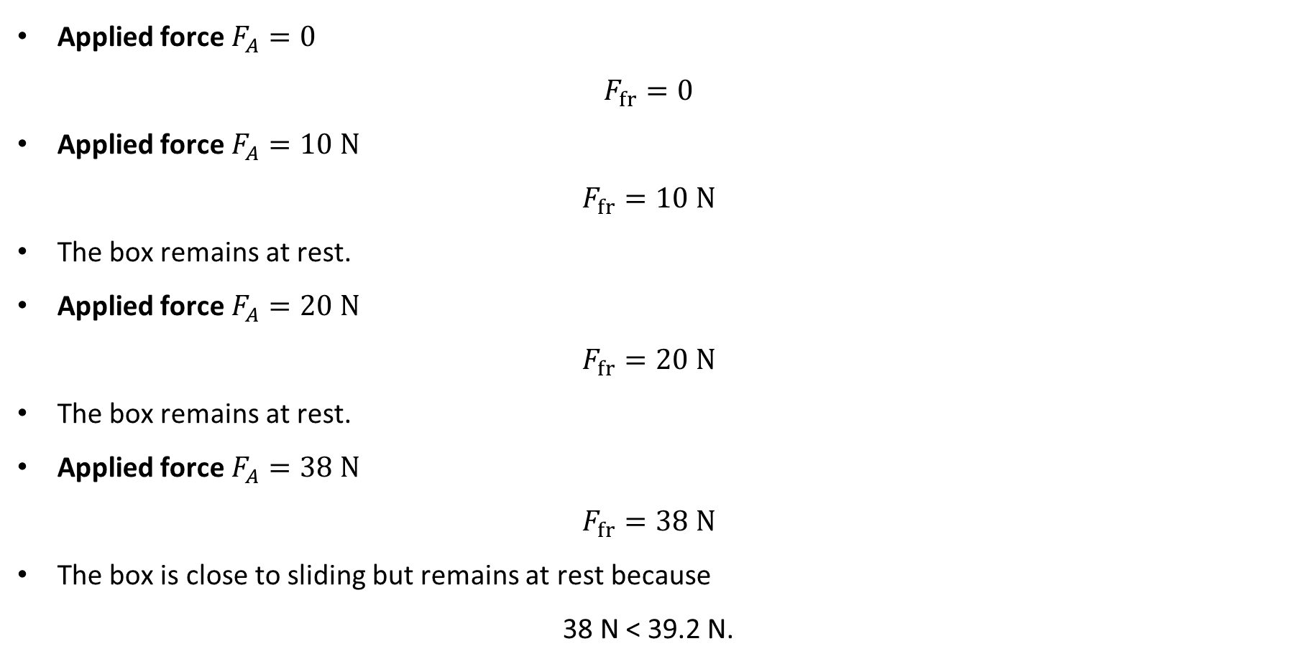
PHYS 2325 | University Physics I
Lecture 01 • Mon Sep 21 • Giancoli Ch. 5
Example 5–1: Different Applied Forces
Applied force $F_{A}=0$
$$F_{fr}=0$$
Applied force $F_{A}=10 N$
$$F_{fr}=10 N$$
The box remains at rest.
Applied force $F_{A}=20 N$
$$F_{fr}=20 N$$
The box remains at rest.
Applied force $F_{A}=38 N$
$$F_{fr}=38 N$$
The box is close to sliding but remains at rest because
38 N < 39.2 N.
Notes:
Teaching focus: Where today's lecture fits.
[Sources]
- PHYS 2325 University Physics I Fall 2026 syllabus and semester calendar.
[/Sources]

Slide 12
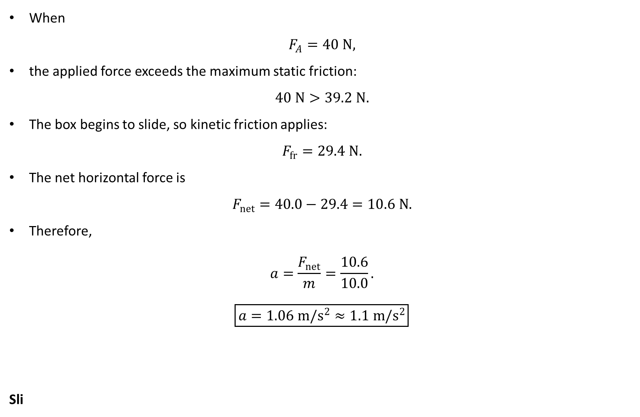
PHYS 2325 | University Physics I
Lecture 01 • Mon Sep 21 • Giancoli Ch. 5
Example 5–1: Motion Begins
When
$$F_{A}=40 N,$$
the applied force exceeds the maximum static friction:
$$40 N>39.2 N.$$
The box begins to slide, so kinetic friction applies:
$$F_{fr}=29.4 N.$$
The net horizontal force is
$$F_{net}=40.0−29.4=10.6 N.$$
Therefore,
$$a=\frac{F_{net}}{m}=\frac{10.6}{10.0}.$$
$$\boxed{a=1.06 m/s^{2}≈1.1 m/s^{2}}$$
Sli
Notes:
Teaching focus: Where today's lecture fits.
[Sources]
- PHYS 2325 University Physics I Fall 2026 syllabus and semester calendar.
[/Sources]

Slide 13
PHYS 2325 | University Physics I
Lecture 01 • Mon Sep 21 • Giancoli Ch. 5
Helpful and Harmful Friction
Friction can be harmful
  It slows moving objects.
  It causes heating.
  It causes wear in machinery.
  Lubricants reduce friction between moving surfaces.
Friction can be useful
  Static friction allows us to walk without slipping.
  Tires require friction to accelerate, brake, and turn.
  Friction allows objects to remain at rest on inclined surfaces.
  Low friction on ice makes walking and driving difficult.
Notes:
Teaching focus: Where today's lecture fits.
[Sources]
- PHYS 2325 University Physics I Fall 2026 syllabus and semester calendar.
[/Sources]

Slide 14
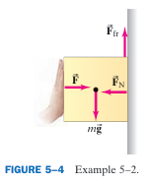
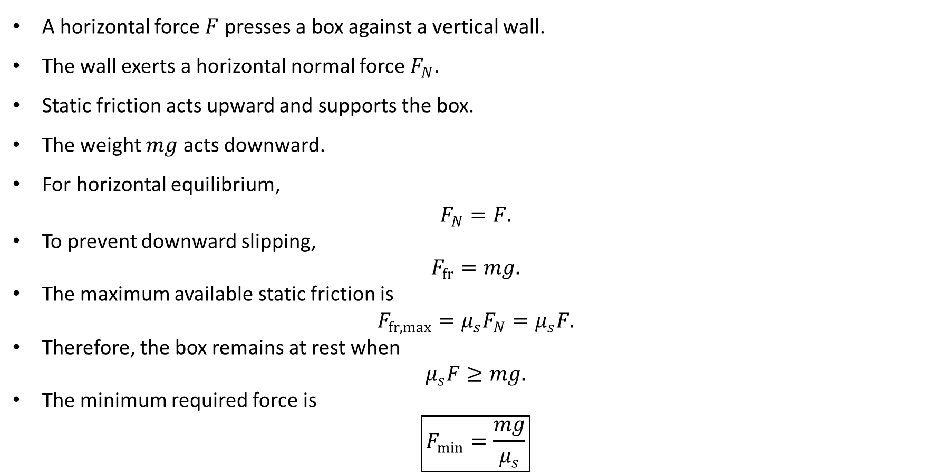
PHYS 2325 | University Physics I
Lecture 01 • Mon Sep 21 • Giancoli Ch. 5
Conceptual Example 5–2: Box Against a Wall
A horizontal force $F$ presses a box against a vertical wall.
The wall exerts a horizontal normal force $F_{N}$.
Static friction acts upward and supports the box.
The weight $mg$ acts downward.
For horizontal equilibrium,
$$F_{N}=F.$$
To prevent downward slipping,
$$F_{fr}=mg.$$
The maximum available static friction is
$$F_{fr,max}=μ_{s}F_{N}=μ_{s}F.$$
Therefore, the box remains at rest when
$$μ_{s}F≥mg.$$
The minimum required force is
$$\boxed{F_{min}=\frac{mg}{μ_{s}}}$$
Notes:
Teaching focus: Where today's lecture fits.
[Sources]
- PHYS 2325 University Physics I Fall 2026 syllabus and semester calendar.
[/Sources]

Slide 15
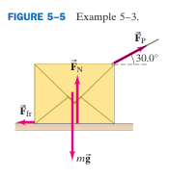
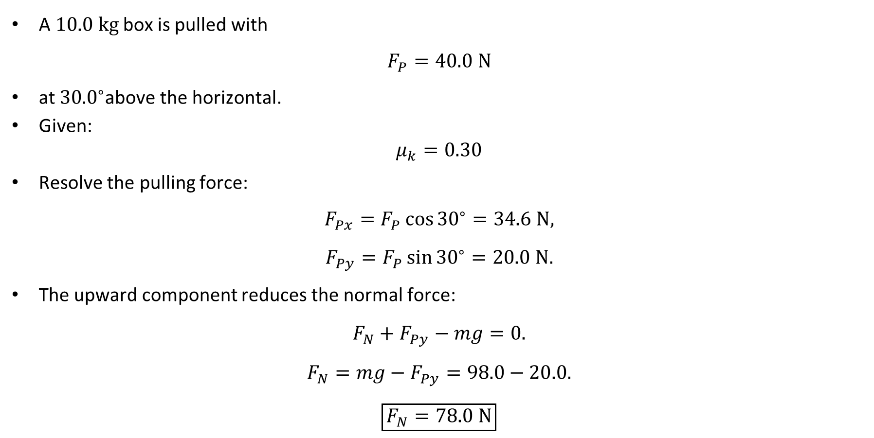
PHYS 2325 | University Physics I
Lecture 01 • Mon Sep 21 • Giancoli Ch. 5
Example 5–3 Pulling a Box at an Angle
A $10.0 kg$ box is pulled with
$$F_{P}=40.0 N$$
at ${30.0}^{∘}$above the horizontal.
Given:
$$μ_{k}=0.30$$
Resolve the pulling force:
$$F_{Px}=F_{P}\cos{{30}^{∘}}=34.6 N,$$
$$F_{Py}=F_{P}\sin{{30}^{∘}}=20.0 N.$$
The upward component reduces the normal force:
$$F_{N}+F_{Py}−mg=0.$$
$$F_{N}=mg−F_{Py}=98.0−20.0.$$
$$\boxed{F_{N}=78.0 N}$$
Notes:
Teaching focus: Where today's lecture fits.
[Sources]
- PHYS 2325 University Physics I Fall 2026 syllabus and semester calendar.
[/Sources]

Slide 16
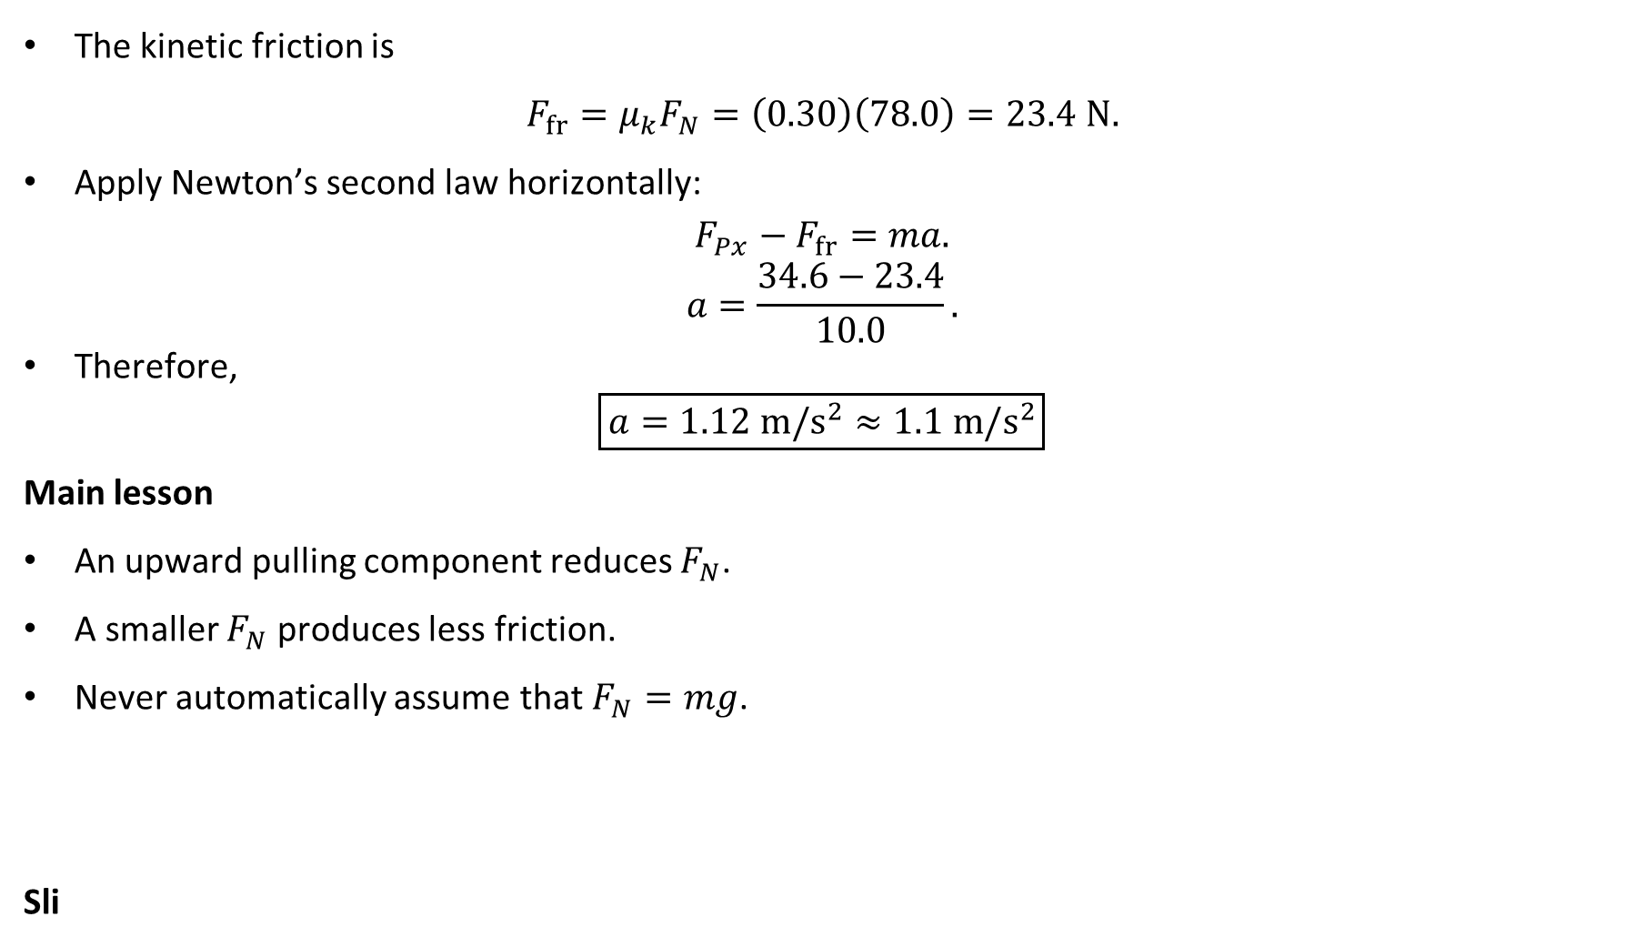
PHYS 2325 | University Physics I
Lecture 01 • Mon Sep 21 • Giancoli Ch. 5
Pulling a Box: Acceleration
The kinetic friction is
$$F_{fr}=μ_{k}F_{N}=\left(0.30\right)\left(78.0\right)=23.4 N.$$
Apply Newton’s second law horizontally:
$$F_{Px}−F_{fr}=ma.$$
$$a=\frac{34.6−23.4}{10.0}.$$
Therefore,
$$\boxed{a=1.12 m/s^{2}≈1.1 m/s^{2}}$$
Main lesson
An upward pulling component reduces $F_{N}$.
A smaller $F_{N}$ produces less friction.
Never automatically assume that $F_{N}=mg$.
Sli
Notes:
Teaching focus: Where today's lecture fits.
[Sources]
- PHYS 2325 University Physics I Fall 2026 syllabus and semester calendar.
[/Sources]

Slide 17
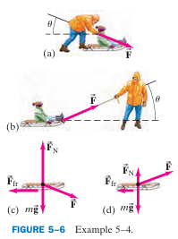
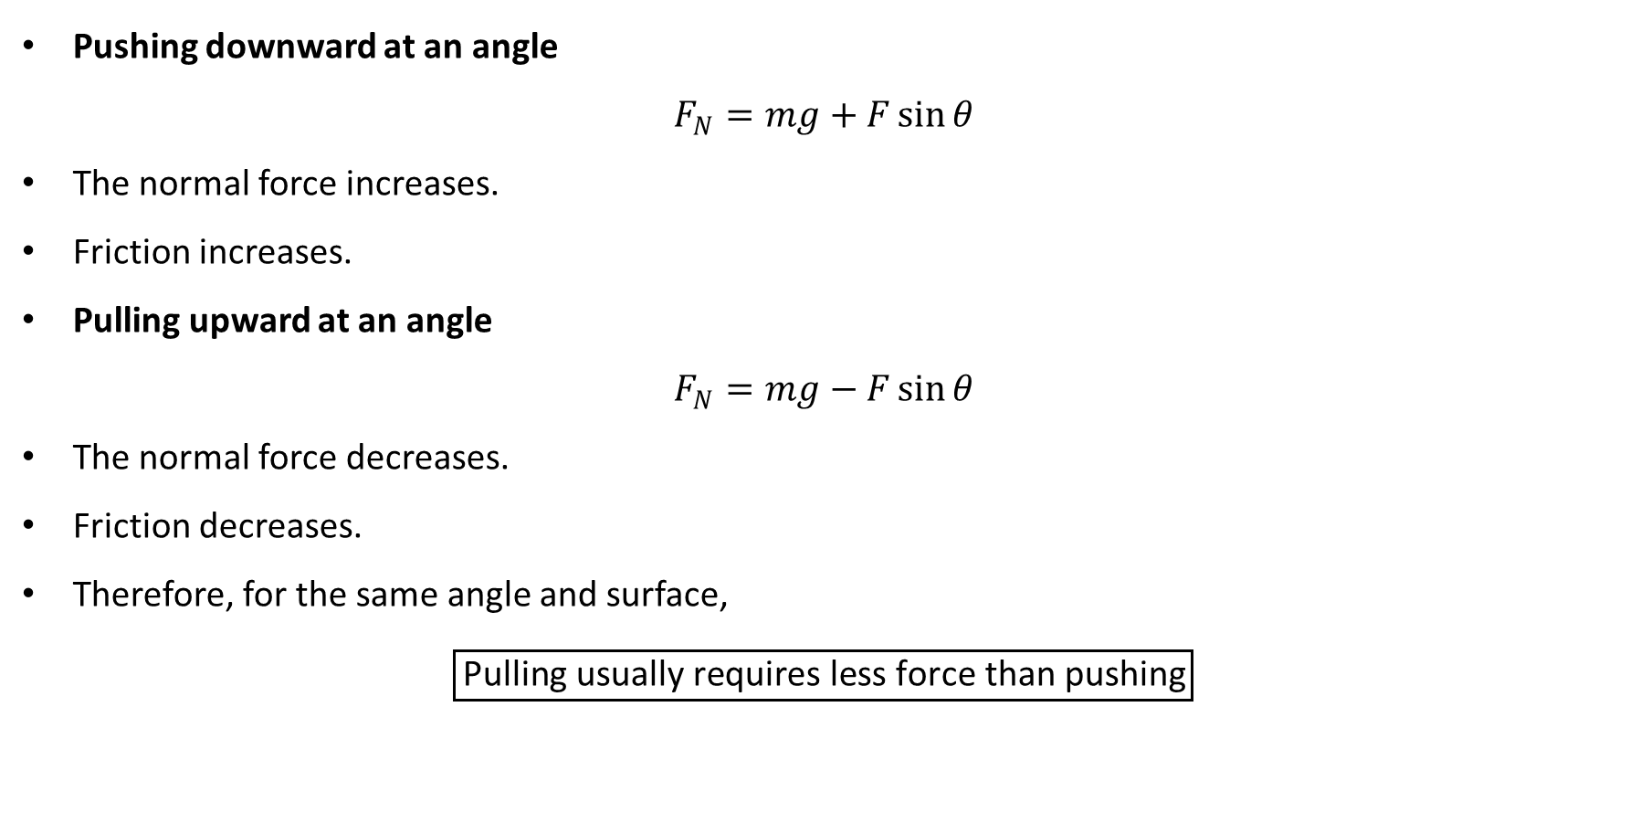
PHYS 2325 | University Physics I
Lecture 01 • Mon Sep 21 • Giancoli Ch. 5
Is It Easier to Push or Pull?
Pushing downward at an angle
$$F_{N}=mg+F\sin{θ}$$
The normal force increases.
Friction increases.
Pulling upward at an angle
$$F_{N}=mg−F\sin{θ}$$
The normal force decreases.
Friction decreases.
Therefore, for the same angle and surface,
$$\boxed{\text{Pulling usually requires less force than pushing}}$$
Notes:
Teaching focus: Where today's lecture fits.
[Sources]
- PHYS 2325 University Physics I Fall 2026 syllabus and semester calendar.
[/Sources]

Slide 18
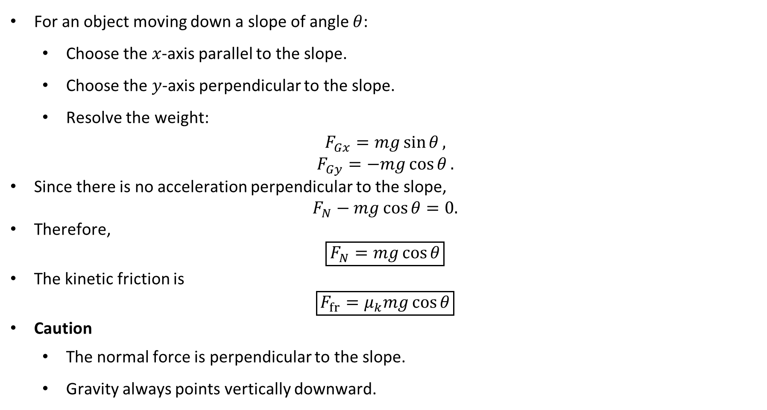
PHYS 2325 | University Physics I
Lecture 01 • Mon Sep 21 • Giancoli Ch. 5
Friction on an Inclined Plane
For an object moving down a slope of angle $θ$:
  Choose the $x$-axis parallel to the slope.
  Choose the $y$-axis perpendicular to the slope.
  Resolve the weight:
$$F_{Gx}=mg\sin{θ},$$
$$F_{Gy}=−mg\cos{θ}.$$
Since there is no acceleration perpendicular to the slope,
$$F_{N}−mg\cos{θ}=0.$$
Therefore,
$$\boxed{F_{N}=mg\cos{θ}}$$
The kinetic friction is
$$\boxed{F_{fr}=μ_{k}mg\cos{θ}}$$
Caution
  The normal force is perpendicular to the slope.
  Gravity always points vertically downward.
Notes:
Teaching focus: Where today's lecture fits.
[Sources]
- PHYS 2325 University Physics I Fall 2026 syllabus and semester calendar.
[/Sources]

Slide 19
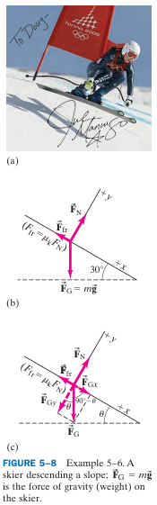
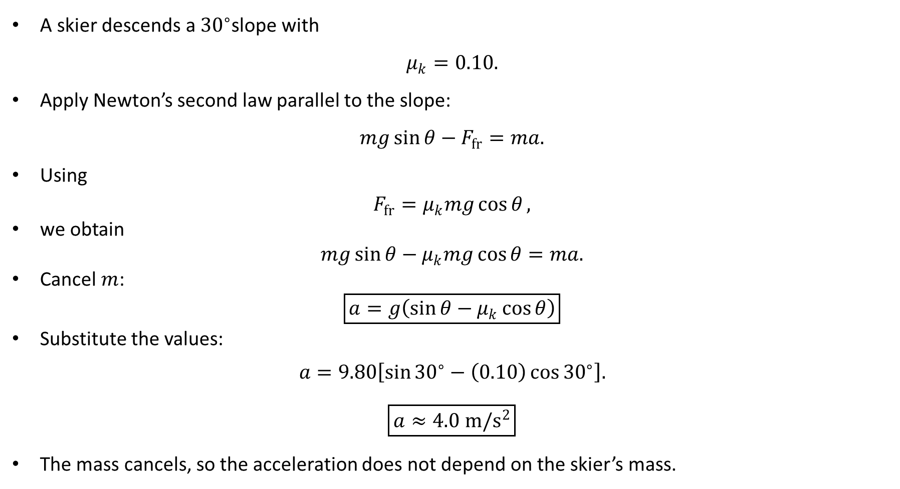
PHYS 2325 | University Physics I
Lecture 01 • Mon Sep 21 • Giancoli Ch. 5
Example 5–6 Skier on a Rough Slope
A skier descends a ${30}^{∘}$slope with
$$μ_{k}=0.10.$$
Apply Newton’s second law parallel to the slope:
$$mg\sin{θ}−F_{fr}=ma.$$
Using
$$F_{fr}=μ_{k}mg\cos{θ},$$
we obtain
$$mg\sin{θ}−μ_{k}mg\cos{θ}=ma.$$
Cancel $m$:
$$\boxed{a=g\left(\sin{θ}−μ_{k}\cos{θ}\right)}$$
Substitute the values:
$$a=9.80\left[\sin{{30}^{∘}}−\left(0.10\right)\cos{{30}^{∘}}\right].$$
$$\boxed{a≈4.0 m/s^{2}}$$
The mass cancels, so the acceleration does not depend on the skier’s mass.
Notes:
Teaching focus: Where today's lecture fits.
[Sources]
- PHYS 2325 University Physics I Fall 2026 syllabus and semester calendar.
[/Sources]

Slide 20
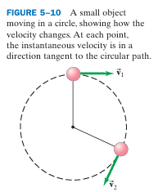
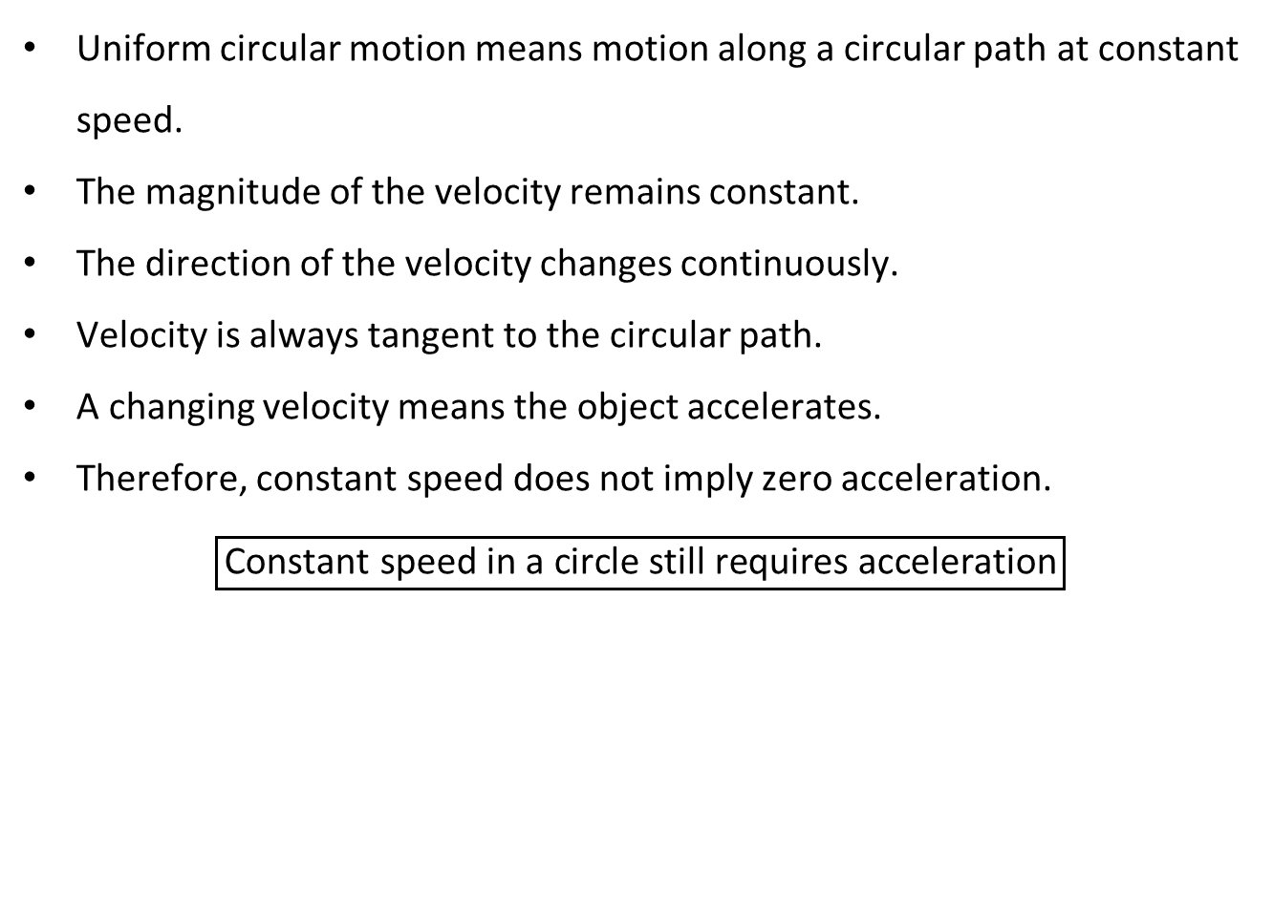
PHYS 2325 | University Physics I
Lecture 01 • Mon Sep 21 • Giancoli Ch. 5
Uniform Circular Motion
Uniform circular motion means motion along a circular path at constant speed.
The magnitude of the velocity remains constant.
The direction of the velocity changes continuously.
Velocity is always tangent to the circular path.
A changing velocity means the object accelerates.
Therefore, constant speed does not imply zero acceleration.
$$\boxed{\text{Constant speed in a circle still requires acceleration}}$$
Notes:
Teaching focus: Where today's lecture fits.
[Sources]
- PHYS 2325 University Physics I Fall 2026 syllabus and semester calendar.
[/Sources]

Slide 21
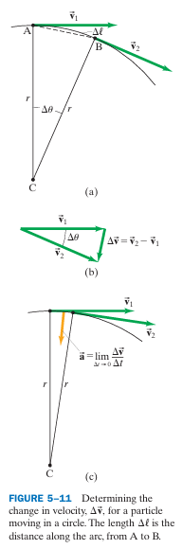
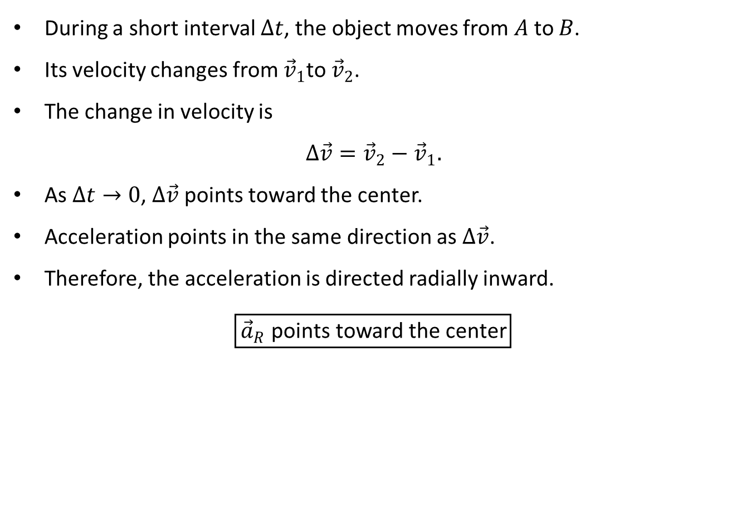
PHYS 2325 | University Physics I
Lecture 01 • Mon Sep 21 • Giancoli Ch. 5
Direction of Centripetal Acceleration
During a short interval $Δt$, the object moves from $A$to $B$.
Its velocity changes from ${\vec{v}}_{1}$to ${\vec{v}}_{2}$.
The change in velocity is
$$Δ\vec{v}={\vec{v}}_{2}−{\vec{v}}_{1}.$$
As $Δt→0$, $Δ\vec{v}$ points toward the center.
Acceleration points in the same direction as $Δ\vec{v}$.
Therefore, the acceleration is directed radially inward.
$$\boxed{{\vec{a}}_{R}\text{ points toward the center}}$$
Notes:
Teaching focus: Where today's lecture fits.
[Sources]
- PHYS 2325 University Physics I Fall 2026 syllabus and semester calendar.
[/Sources]

Slide 22
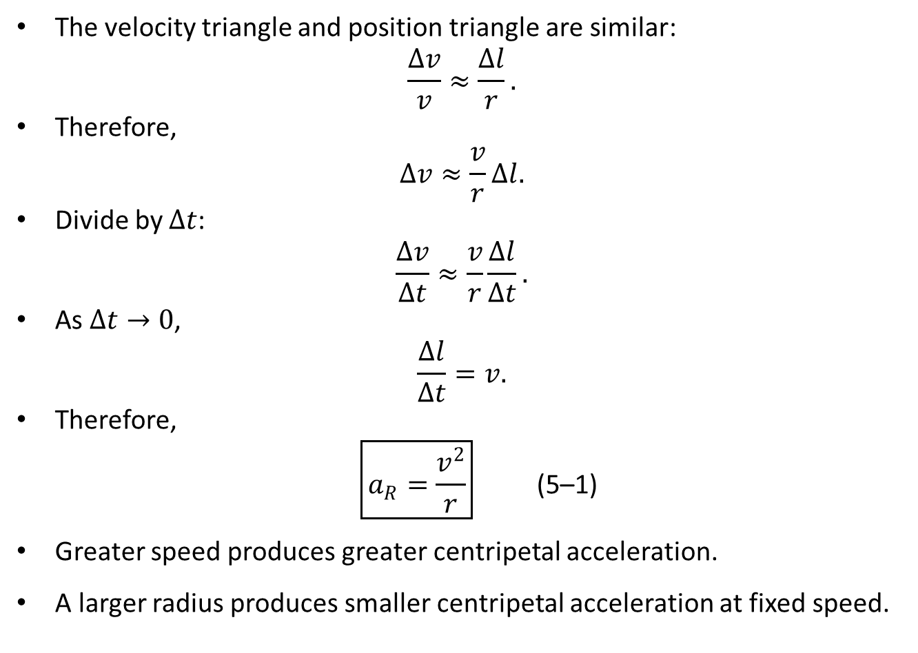
PHYS 2325 | University Physics I
Lecture 01 • Mon Sep 21 • Giancoli Ch. 5
Magnitude of Centripetal Acceleration
The velocity triangle and position triangle are similar:
$$\frac{Δv}{v}≈\frac{Δl}{r}.$$
Therefore,
$$Δv≈\frac{v}{r}Δl.$$
Divide by $Δt$:
$$\frac{Δv}{Δt}≈\frac{v}{r}\frac{Δl}{Δt}.$$
As $Δt→0$,
$$\frac{Δl}{Δt}=v.$$
Therefore,
$$\begin{matrix} & \boxed{a_{R}=\frac{v^{2}}{r}} & & \text{(5–1)}\end{matrix}$$
Greater speed produces greater centripetal acceleration.
A larger radius produces smaller centripetal acceleration at fixed speed.
Notes:
Teaching focus: Where today's lecture fits.
[Sources]
- PHYS 2325 University Physics I Fall 2026 syllabus and semester calendar.
[/Sources]

Slide 23
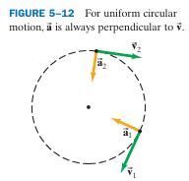
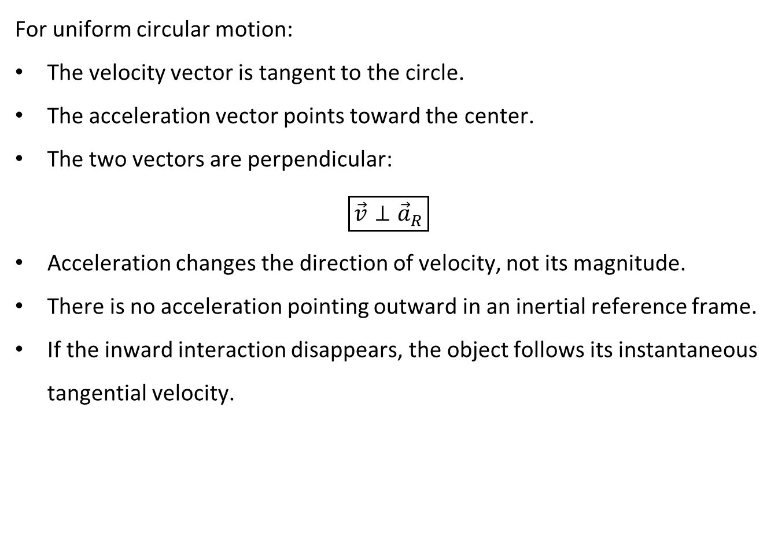
PHYS 2325 | University Physics I
Lecture 01 • Mon Sep 21 • Giancoli Ch. 5
Velocity and Acceleration Directions
For uniform circular motion:
The velocity vector is tangent to the circle.
The acceleration vector points toward the center.
The two vectors are perpendicular:
$$\boxed{\vec{v}⊥{\vec{a}}_{R}}$$
Acceleration changes the direction of velocity, not its magnitude.
There is no acceleration pointing outward in an inertial reference frame.
If the inward interaction disappears, the object follows its instantaneous tangential velocity.
Notes:
Teaching focus: Where today's lecture fits.
[Sources]
- PHYS 2325 University Physics I Fall 2026 syllabus and semester calendar.
[/Sources]

Slide 24
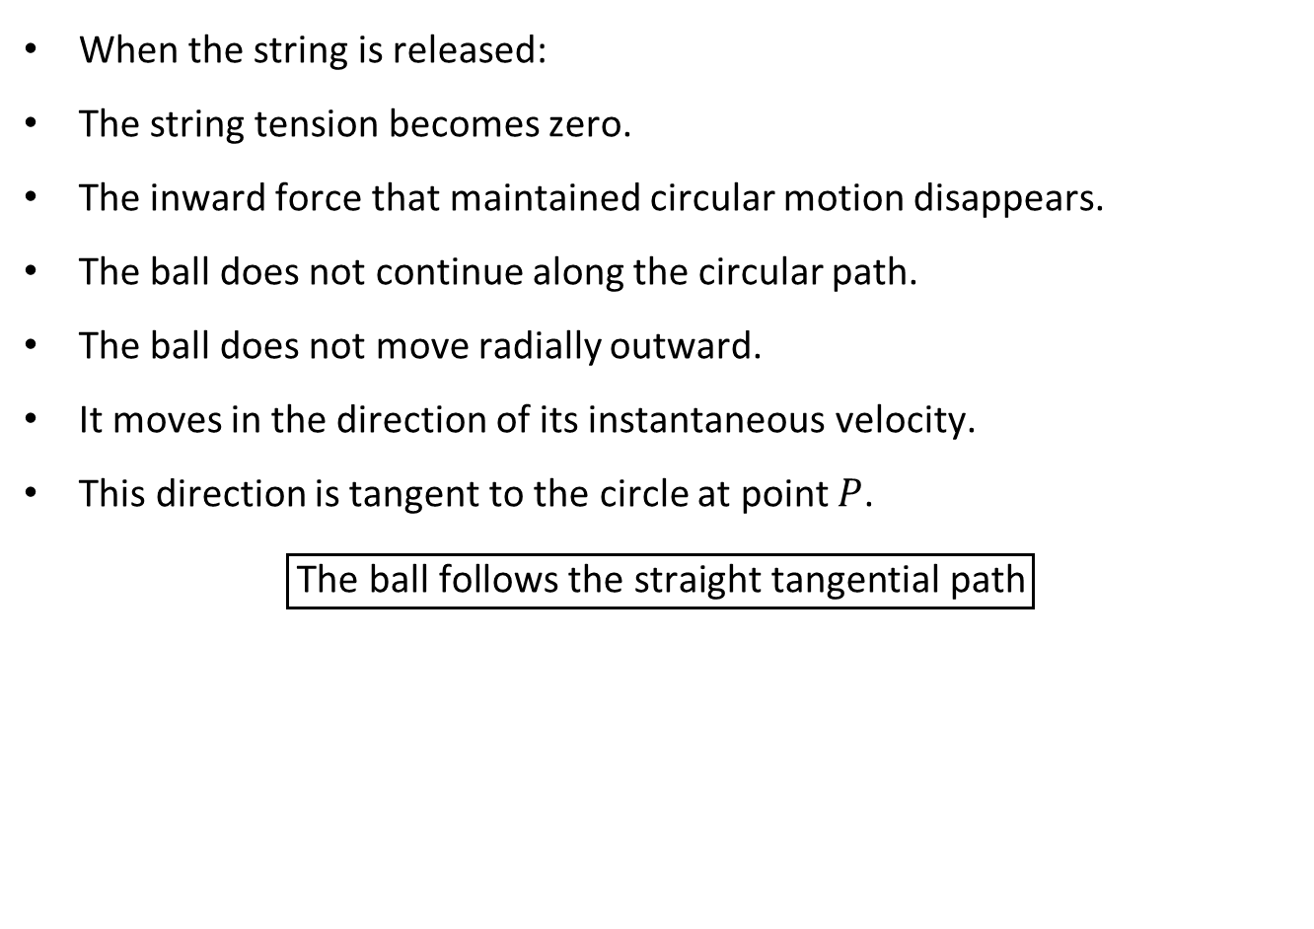
PHYS 2325 | University Physics I
Lecture 01 • Mon Sep 21 • Giancoli Ch. 5
Return to the Opening Question
When the string is released:
The string tension becomes zero.
The inward force that maintained circular motion disappears.
The ball does not continue along the circular path.
The ball does not move radially outward.
It moves in the direction of its instantaneous velocity.
This direction is tangent to the circle at point $P$.
$$\boxed{\text{The ball follows the straight tangential path}}$$
Notes:
Teaching focus: Where today's lecture fits.
[Sources]
- PHYS 2325 University Physics I Fall 2026 syllabus and semester calendar.
[/Sources]

Slide 25
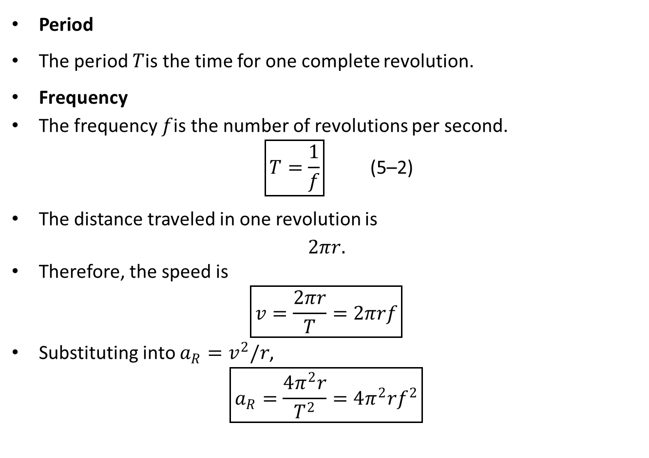
PHYS 2325 | University Physics I
Lecture 01 • Mon Sep 21 • Giancoli Ch. 5
Period, Frequency, and Speed
Period
The period $T$is the time for one complete revolution.
Frequency
The frequency $f$is the number of revolutions per second.
$$\begin{matrix} & \boxed{T=\frac{1}{f}} & & \text{(5–2)}\end{matrix}$$
The distance traveled in one revolution is
$$2πr.$$
Therefore, the speed is
$$\boxed{v=\frac{2πr}{T}=2πrf}$$
Substituting into $a_{R}=v^{2}/r$,
$$\boxed{a_{R}=\frac{4π^{2}r}{T^{2}}=4π^{2}rf^{2}}$$
Notes:
Teaching focus: Where today's lecture fits.
[Sources]
- PHYS 2325 University Physics I Fall 2026 syllabus and semester calendar.
[/Sources]

Slide 26
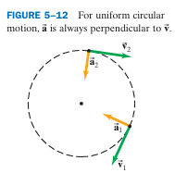
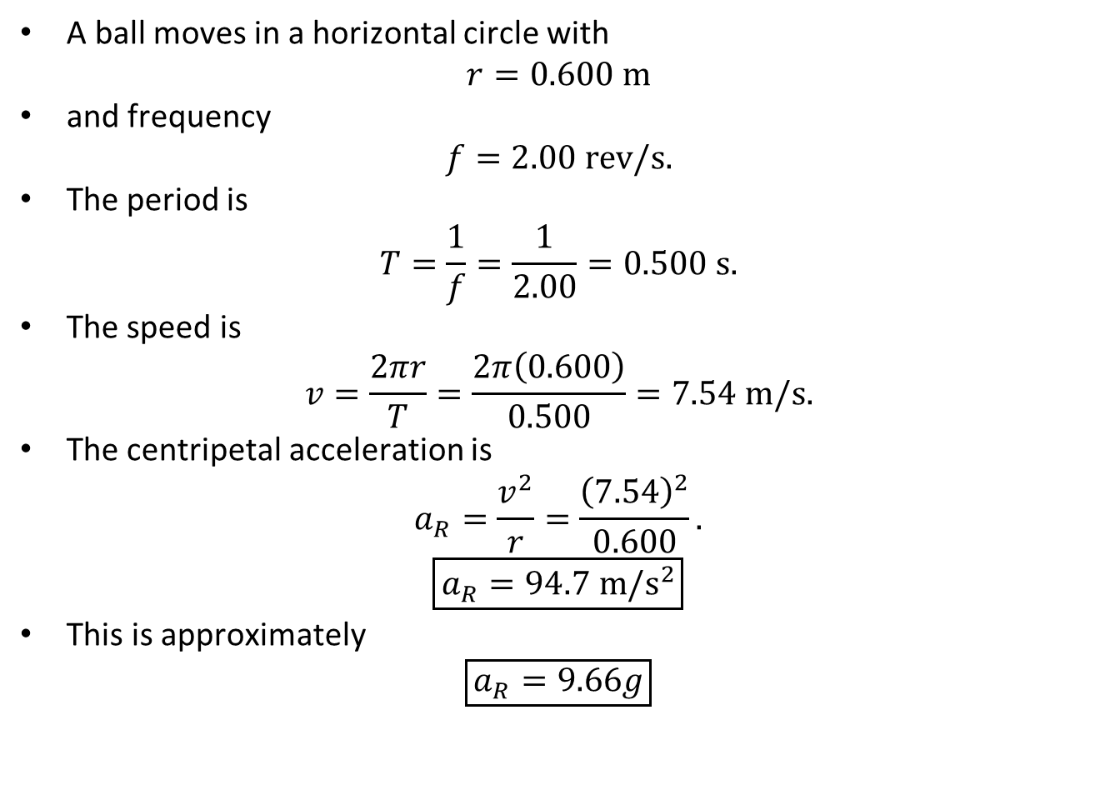
PHYS 2325 | University Physics I
Lecture 01 • Mon Sep 21 • Giancoli Ch. 5
Example 5–8 Acceleration of a Revolving Ball
A ball moves in a horizontal circle with
$$r=0.600 m$$
and frequency
$$f=2.00 rev/s.$$
The period is
$$T=\frac{1}{f}=\frac{1}{2.00}=0.500 s.$$
The speed is
$$v=\frac{2πr}{T}=\frac{2π\left(0.600\right)}{0.500}=7.54 m/s.$$
The centripetal acceleration is
$$a_{R}=\frac{v^{2}}{r}=\frac{{\left(7.54\right)}^{2}}{0.600}.$$
$$\boxed{a_{R}=94.7 m/s^{2}}$$
This is approximately
$$\boxed{a_{R}=9.66g}$$
Notes:
Teaching focus: Where today's lecture fits.
[Sources]
- PHYS 2325 University Physics I Fall 2026 syllabus and semester calendar.
[/Sources]

Slide 27
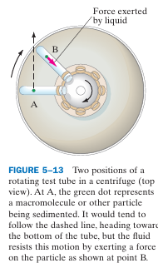
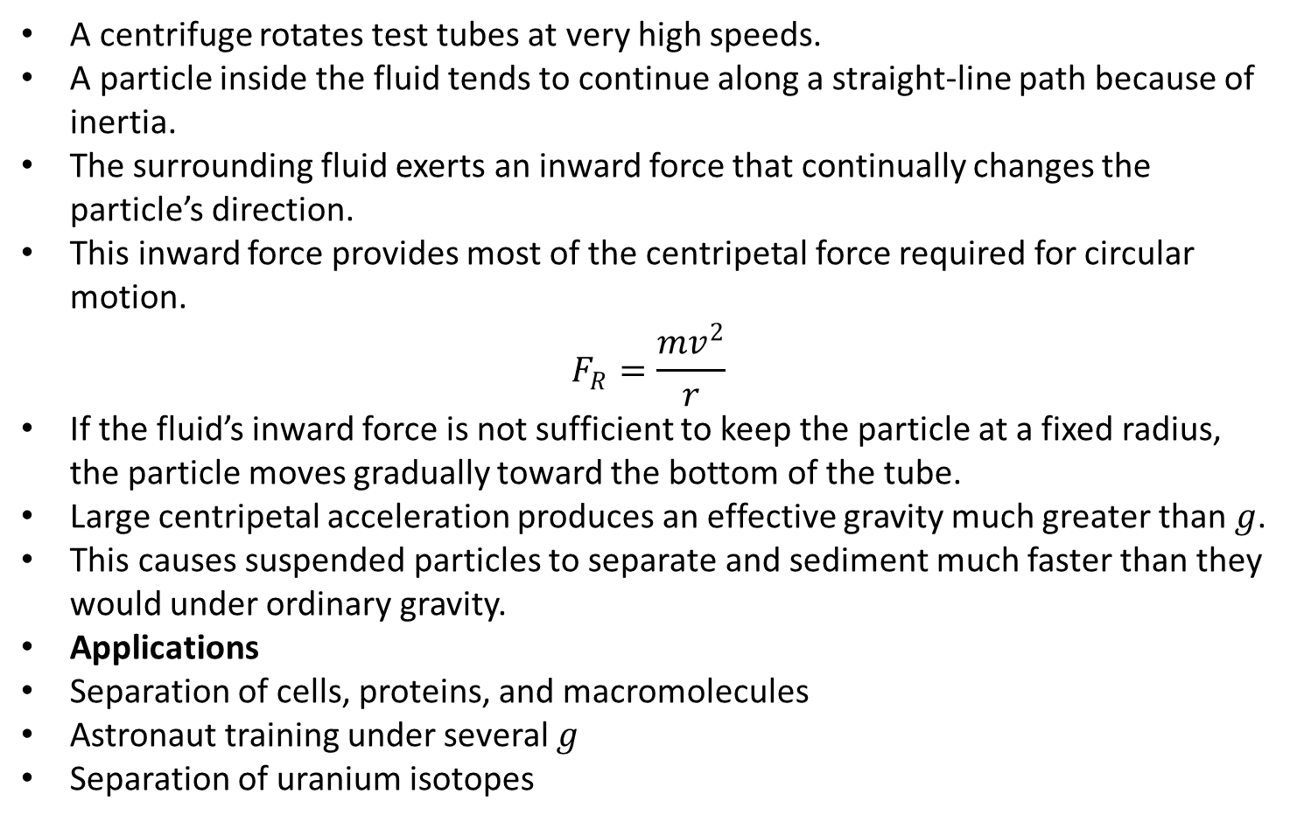
PHYS 2325 | University Physics I
Lecture 01 • Mon Sep 21 • Giancoli Ch. 5
Centrifugation
A centrifuge rotates test tubes at very high speeds.
A particle inside the fluid tends to continue along a straight-line path because of inertia.
The surrounding fluid exerts an inward force that continually changes the particle’s direction.
This inward force provides most of the centripetal force required for circular motion.
$$F_{R}=\frac{mv^{2}}{r}$$
If the fluid’s inward force is not sufficient to keep the particle at a fixed radius, the particle moves gradually toward the bottom of the tube.
Large centripetal acceleration produces an effective gravity much greater than $g$.
This causes suspended particles to separate and sediment much faster than they would under ordinary gravity.
Applications
Separation of cells, proteins, and macromolecules
Astronaut training under several $g$
Separation of uranium isotopes
Notes:
Teaching focus: Where today's lecture fits.
[Sources]
- PHYS 2325 University Physics I Fall 2026 syllabus and semester calendar.
[/Sources]

Slide 28
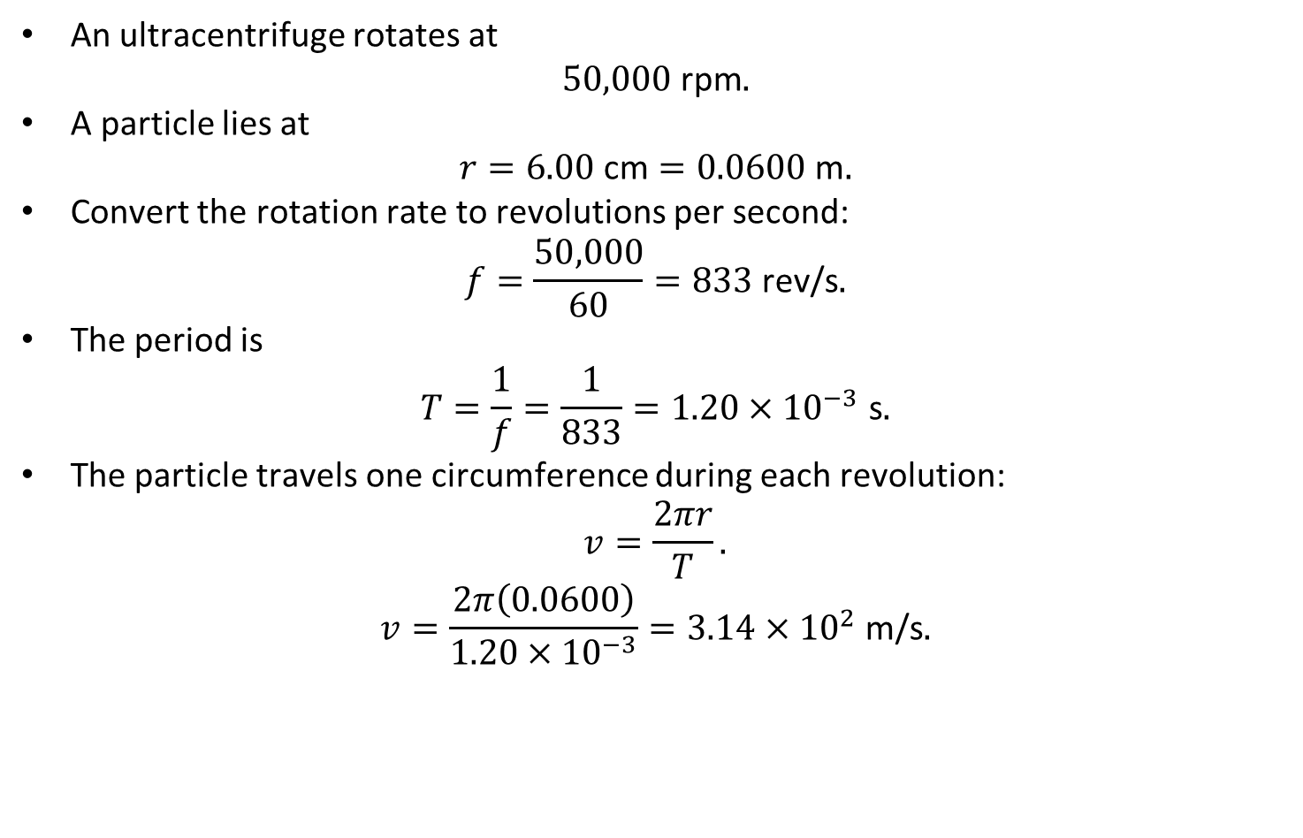
PHYS 2325 | University Physics I
Lecture 01 • Mon Sep 21 • Giancoli Ch. 5
Example 5–10: Ultracentrifuge
An ultracentrifuge rotates at
$$50,000\text{ rpm}.$$
A particle lies at
$$r=6.00\text{ cm}=0.0600\text{ m}.$$
Convert the rotation rate to revolutions per second:
$$f=\frac{50,000}{60}=833\text{ rev/s}.$$
The period is
$$T=\frac{1}{f}=\frac{1}{833}=1.20×{10}^{−3}\text{ s}.$$
The particle travels one circumference during each revolution:
$$v=\frac{2πr}{T}.$$
$$v=\frac{2π\left(0.0600\right)}{1.20×{10}^{−3}}=3.14×{10}^{2}\text{ m/s}.$$
Notes:
Teaching focus: Where today's lecture fits.
[Sources]
- PHYS 2325 University Physics I Fall 2026 syllabus and semester calendar.
[/Sources]

Slide 29
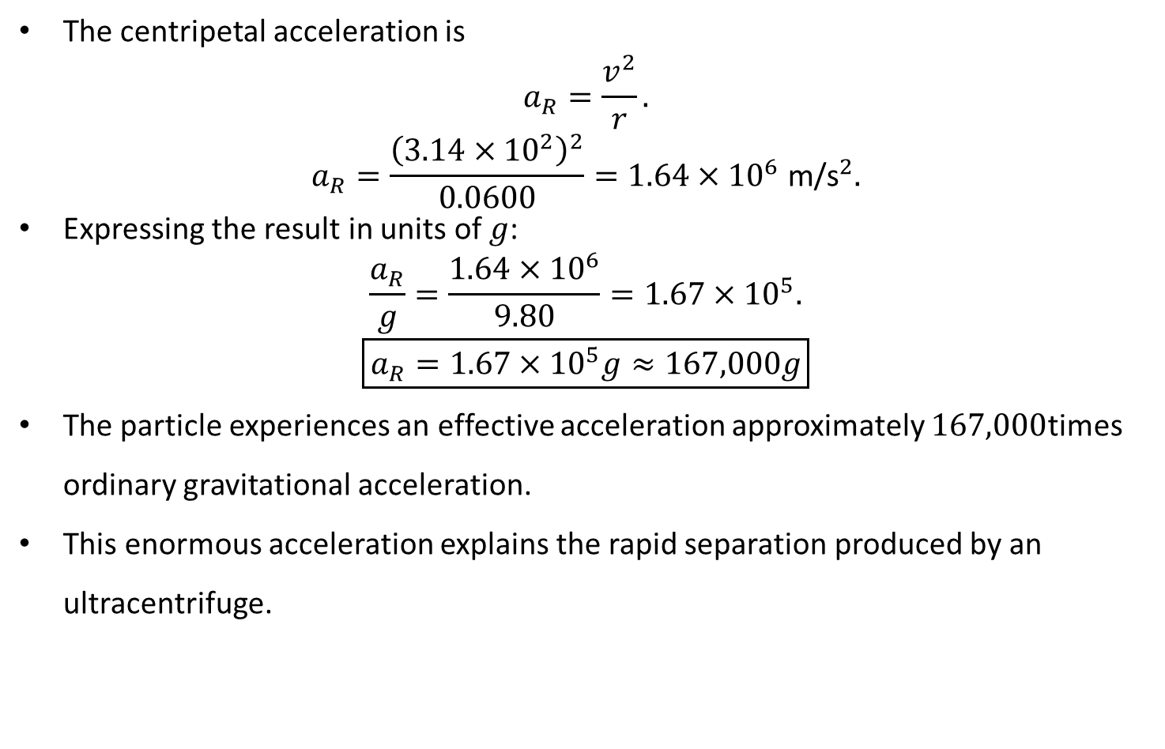
PHYS 2325 | University Physics I
Lecture 01 • Mon Sep 21 • Giancoli Ch. 5
Example 5–10: Ultracentrifuge…..
The centripetal acceleration is
$$a_{R}=\frac{v^{2}}{r}.$$
$$a_{R}=\frac{{\left(3.14×{10}^{2}\right)}^{2}}{0.0600}=1.64×{10}^{6} {\text{m/s}}^{2}.$$
Expressing the result in units of $g$:
$$\frac{a_{R}}{g}=\frac{1.64×{10}^{6}}{9.80}=1.67×{10}^{5}.$$
$$\boxed{a_{R}=1.67×{10}^{5}g≈167,000g}$$
The particle experiences an effective acceleration approximately $167,000$times ordinary gravitational acceleration.
This enormous acceleration explains the rapid separation produced by an ultracentrifuge.
Notes:
Teaching focus: Where today's lecture fits.
[Sources]
- PHYS 2325 University Physics I Fall 2026 syllabus and semester calendar.
[/Sources]

Slide 30
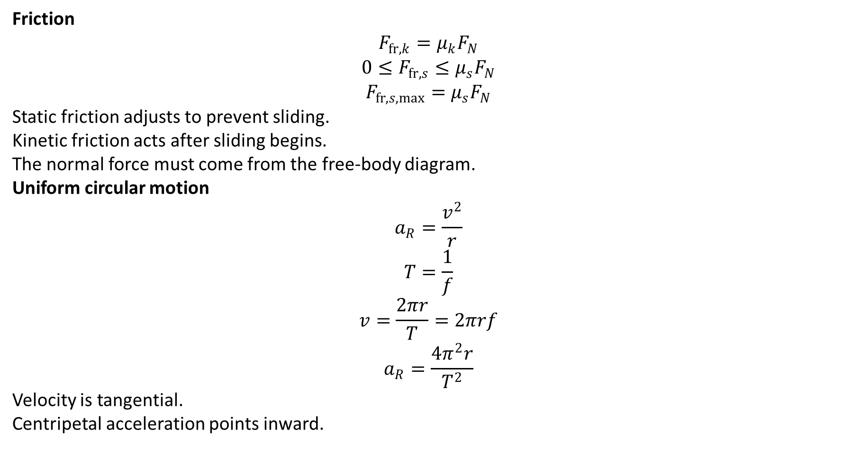
PHYS 2325 | University Physics I
Lecture 01 • Mon Sep 21 • Giancoli Ch. 5
Lecture Summary
Friction
$$F_{fr,k}=μ_{k}F_{N}$$
$$0≤F_{fr,s}≤μ_{s}F_{N}$$
$$F_{fr,s,max}=μ_{s}F_{N}$$
Static friction adjusts to prevent sliding.
Kinetic friction acts after sliding begins.
The normal force must come from the free-body diagram.
Uniform circular motion
$$a_{R}=\frac{v^{2}}{r}$$
$$T=\frac{1}{f}$$
$$v=\frac{2πr}{T}=2πrf$$
$$a_{R}=\frac{4π^{2}r}{T^{2}}$$
Velocity is tangential.
Centripetal acceleration points inward.
Notes:
Teaching focus: Where today's lecture fits.
[Sources]
- PHYS 2325 University Physics I Fall 2026 syllabus and semester calendar.
[/Sources]

Slide 31
LECTURE 02
Circular Dynamics, Banking, and Drag
Wed Sep 23 • Giancoli Ch. 5
Muhammad Nauman • PHYS 2325 • Fall 2026
Notes:
Teaching focus: Circular Dynamics, Banking, and Drag.
[Sources]
- PHYS 2325 University Physics I Fall 2026 syllabus and semester calendar.
[/Sources]

Slide 32
PHYS 2325 | University Physics I
Lecture 02 • Wed Sep 23 • Giancoli Ch. 5
Learning Objectives
Define and represent dynamics of uniform circular motion.
Derive and interpret highway curves: banked and unbanked.
Apply nonuniform circular motion.
Connect drag forces and terminal velocity.
Check units, vector directions, assumptions, and limiting behavior in every solution.
Notes:
Teaching focus: Learning outcomes.
[Sources]
- PHYS 2325 University Physics I Fall 2026 syllabus and semester calendar.
[/Sources]

Slide 33
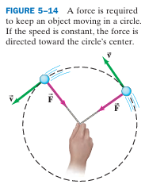
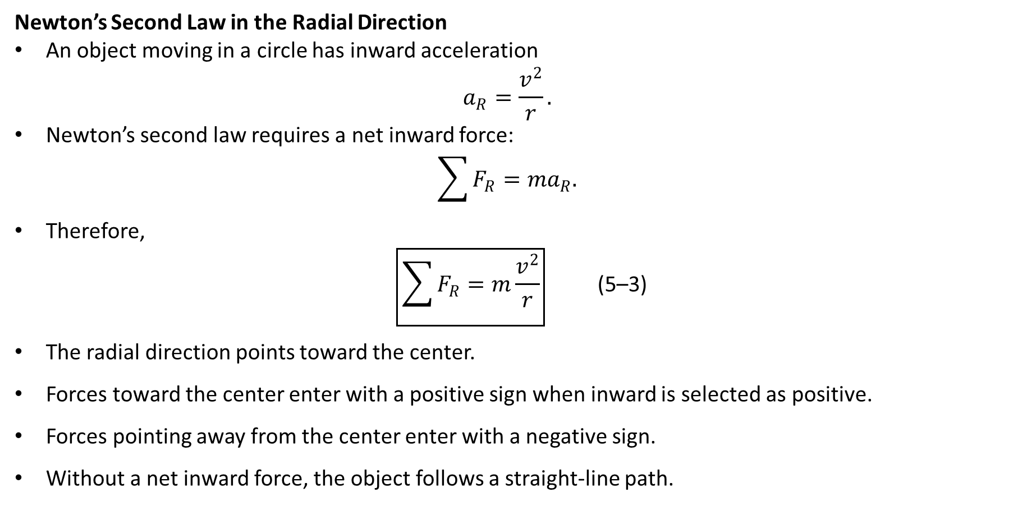
PHYS 2325 | University Physics I
Lecture 01 • Mon Sep 21 • Giancoli Ch. 5
Dynamics of Uniform Circular Motion
Newton’s Second Law in the Radial Direction
An object moving in a circle has inward acceleration
$$a_{R}=\frac{v^{2}}{r}.$$
Newton’s second law requires a net inward force:
$$\sum{F_{R}}=ma_{R}.$$
Therefore,
$$\begin{matrix} & \boxed{\sum{F_{R}}=m\frac{v^{2}}{r}} & & \text{(5–3)}\end{matrix}$$
The radial direction points toward the center.
Forces toward the center enter with a positive sign when inward is selected as positive.
Forces pointing away from the center enter with a negative sign.
Without a net inward force, the object follows a straight-line path.
Notes:
Teaching focus: Where today's lecture fits.
[Sources]
- PHYS 2325 University Physics I Fall 2026 syllabus and semester calendar.
[/Sources]

Slide 34
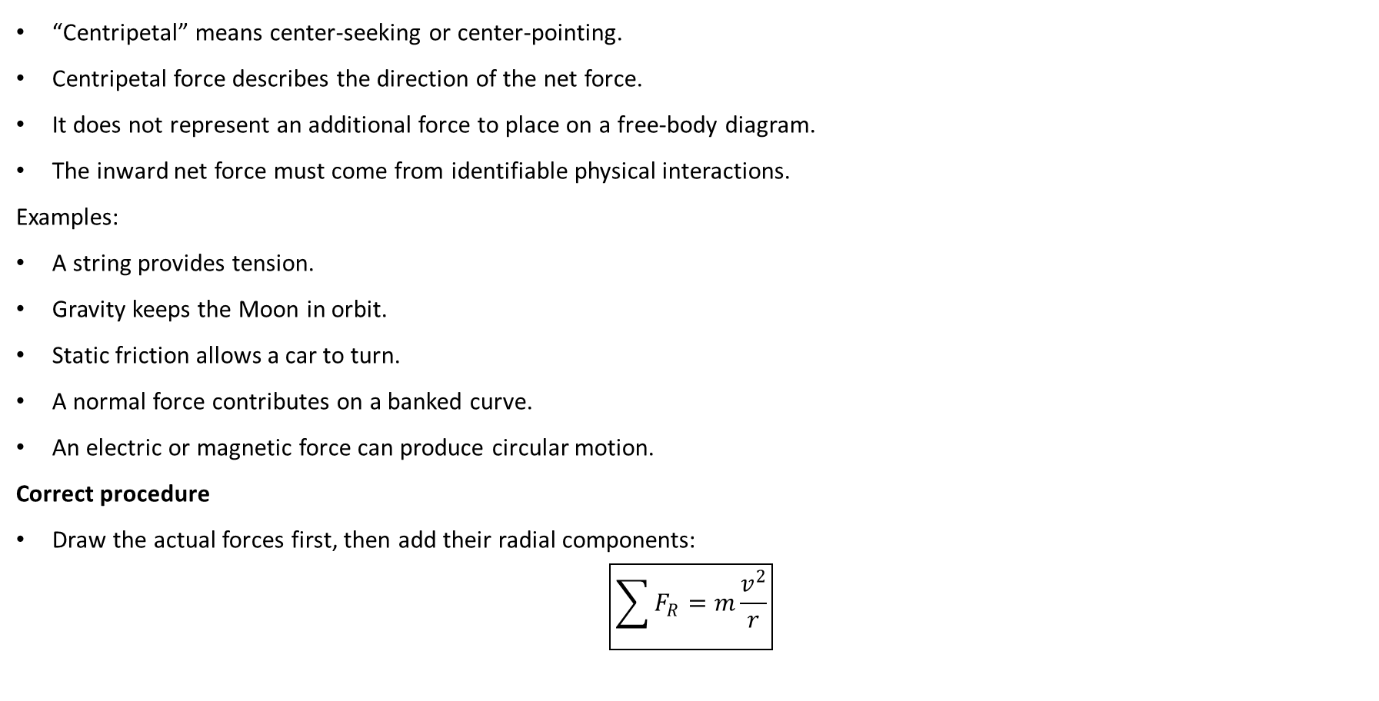
PHYS 2325 | University Physics I
Lecture 01 • Mon Sep 21 • Giancoli Ch. 5
Centripetal Force Is Not a New Force
“Centripetal” means center-seeking or center-pointing.
Centripetal force describes the direction of the net force.
It does not represent an additional force to place on a free-body diagram.
The inward net force must come from identifiable physical interactions.
Examples:
A string provides tension.
Gravity keeps the Moon in orbit.
Static friction allows a car to turn.
A normal force contributes on a banked curve.
An electric or magnetic force can produce circular motion.
Correct procedure
Draw the actual forces first, then add their radial components:
$$\boxed{\sum{F_{R}}=m\frac{v^{2}}{r}}$$
Notes:
Teaching focus: Where today's lecture fits.
[Sources]
- PHYS 2325 University Physics I Fall 2026 syllabus and semester calendar.
[/Sources]

Slide 35
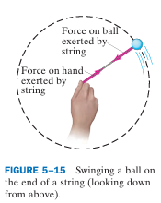
PHYS 2325 | University Physics I
Lecture 01 • Mon Sep 21 • Giancoli Ch. 5
No Real Outward Centrifugal Force
A person pulls inward on a string to keep a ball moving in a circle.
The string exerts an inward force on the ball.
The ball exerts an equal and opposite force on the string.
The outward pull felt by the hand is the ball’s force on the string.
It is not an outward force acting on the ball.
Newton’s third-law pair
  String pulls inward on ball.
  Ball pulls outward on string.
These forces act on different objects and therefore do not cancel.
Notes:
Teaching focus: Where today's lecture fits.
[Sources]
- PHYS 2325 University Physics I Fall 2026 syllabus and semester calendar.
[/Sources]

Slide 36
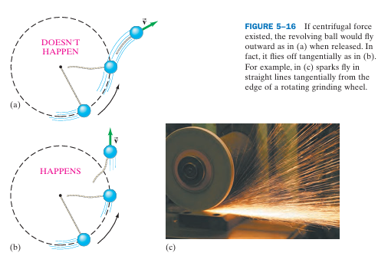
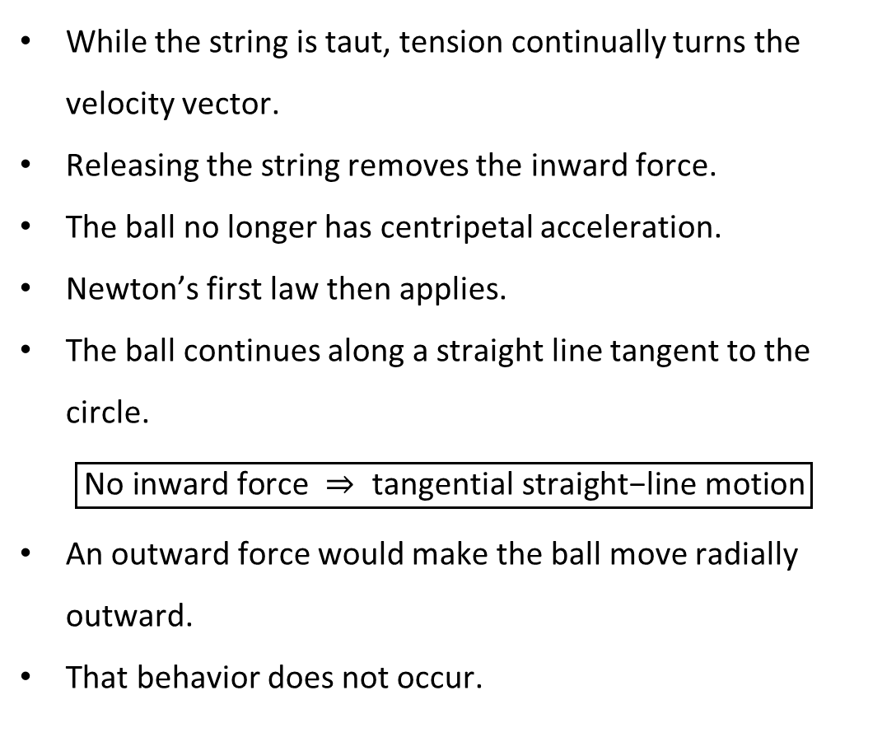
PHYS 2325 | University Physics I
Lecture 01 • Mon Sep 21 • Giancoli Ch. 5
What Happens When the String Is Released?
While the string is taut, tension continually turns the velocity vector.
Releasing the string removes the inward force.
The ball no longer has centripetal acceleration.
Newton’s first law then applies.
The ball continues along a straight line tangent to the circle.
$$\boxed{\text{No inward force} ⇒ \text{tangential straight−line motion}}$$
An outward force would make the ball move radially outward.
That behavior does not occur.
Notes:
Teaching focus: Where today's lecture fits.
[Sources]
- PHYS 2325 University Physics I Fall 2026 syllabus and semester calendar.
[/Sources]

Slide 37

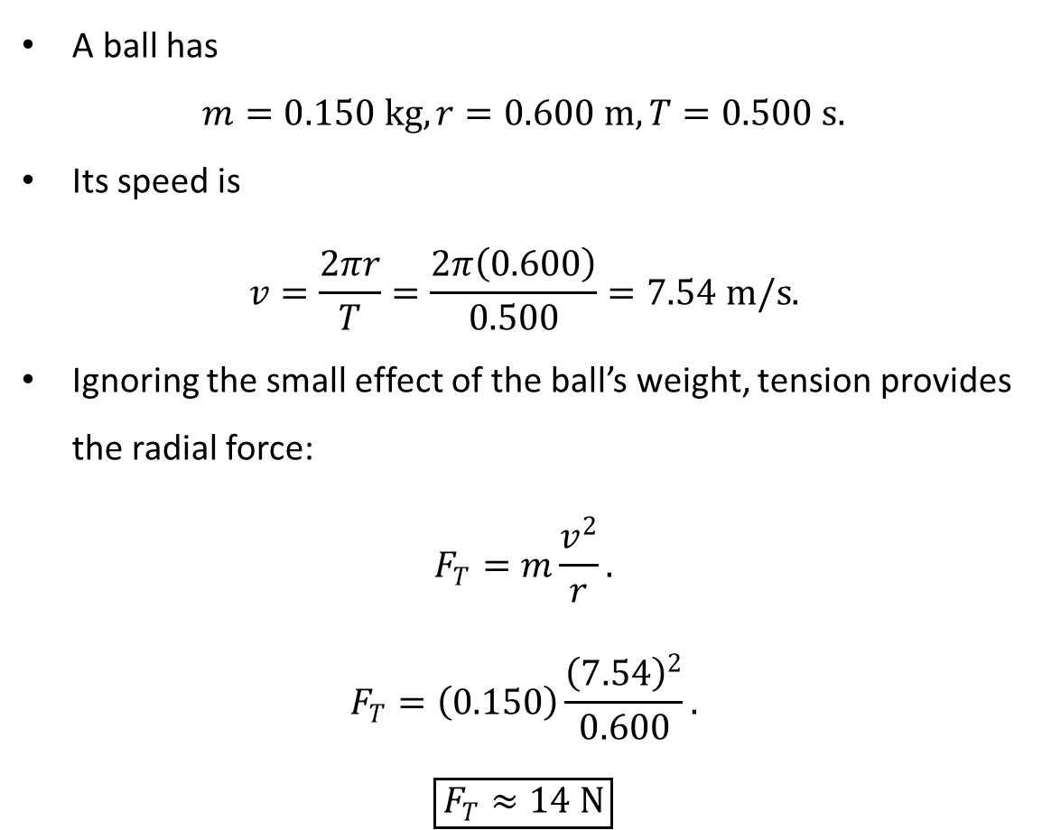
PHYS 2325 | University Physics I
Lecture 01 • Mon Sep 21 • Giancoli Ch. 5
Example 5–11 Force on a Revolving Ball
A ball has
$$m=0.150 kg, r=0.600 m, T=0.500 s.$$
Its speed is
$$v=\frac{2πr}{T}=\frac{2π\left(0.600\right)}{0.500}=7.54 m/s.$$
Ignoring the small effect of the ball’s weight, tension provides the radial force:
$$F_{T}=m\frac{v^{2}}{r}.$$
$$F_{T}=\left(0.150\right)\frac{{\left(7.54\right)}^{2}}{0.600}.$$
$$\boxed{F_{T}≈14 N}$$
Notes:
Teaching focus: Where today's lecture fits.
[Sources]
- PHYS 2325 University Physics I Fall 2026 syllabus and semester calendar.
[/Sources]

Slide 38
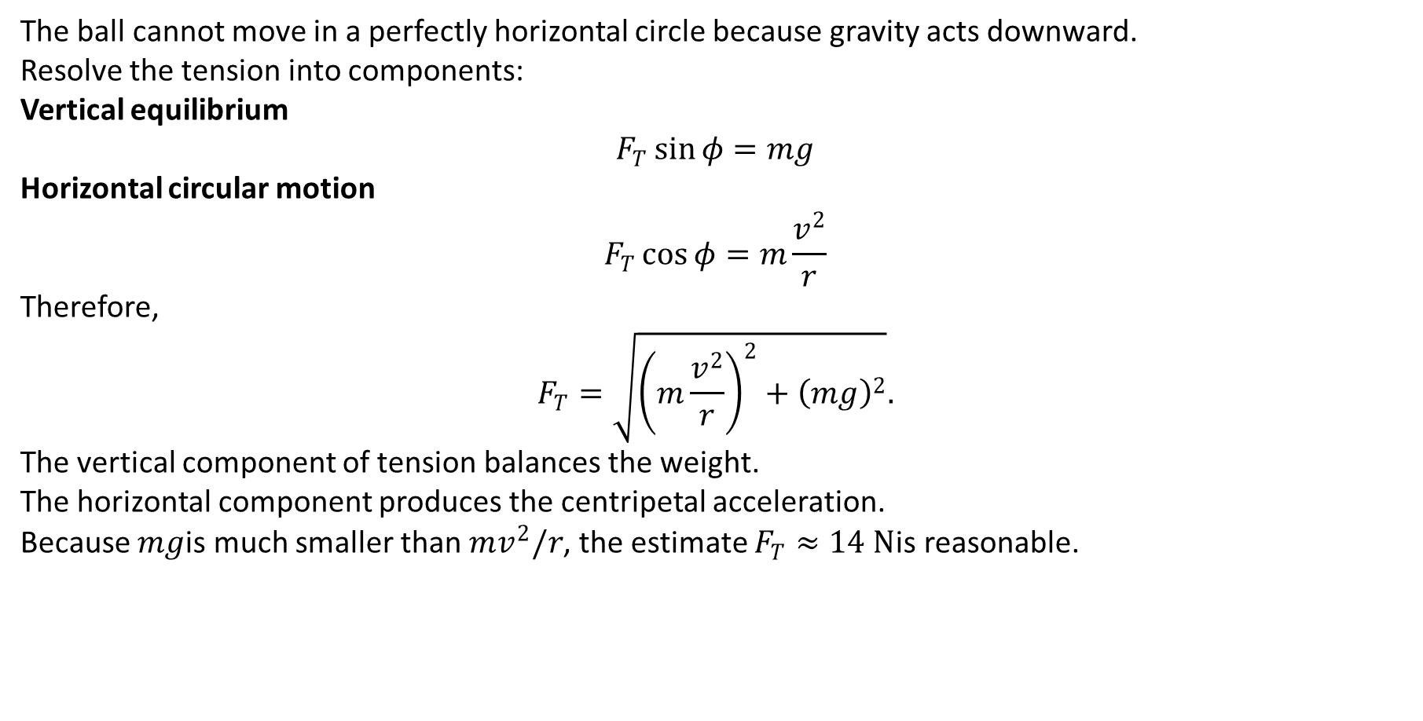
PHYS 2325 | University Physics I
Lecture 01 • Mon Sep 21 • Giancoli Ch. 5
Example 5–11 Effect of the Ball’s Weight
The ball cannot move in a perfectly horizontal circle because gravity acts downward.
Resolve the tension into components:
Vertical equilibrium
$$F_{T}\sin{φ}=mg$$
Horizontal circular motion
$$F_{T}\cos{φ}=m\frac{v^{2}}{r}$$
Therefore,
$$F_{T}=\sqrt{{\left(m\frac{v^{2}}{r}\right)}^{2}+{\left(mg\right)}^{2}}.$$
The vertical component of tension balances the weight.
The horizontal component produces the centripetal acceleration.
Because $mg$is much smaller than $mv^{2}/r$, the estimate $F_{T}≈14 N$is reasonable.
Notes:
Teaching focus: Where today's lecture fits.
[Sources]
- PHYS 2325 University Physics I Fall 2026 syllabus and semester calendar.
[/Sources]

Slide 39
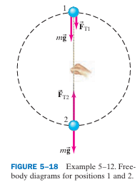
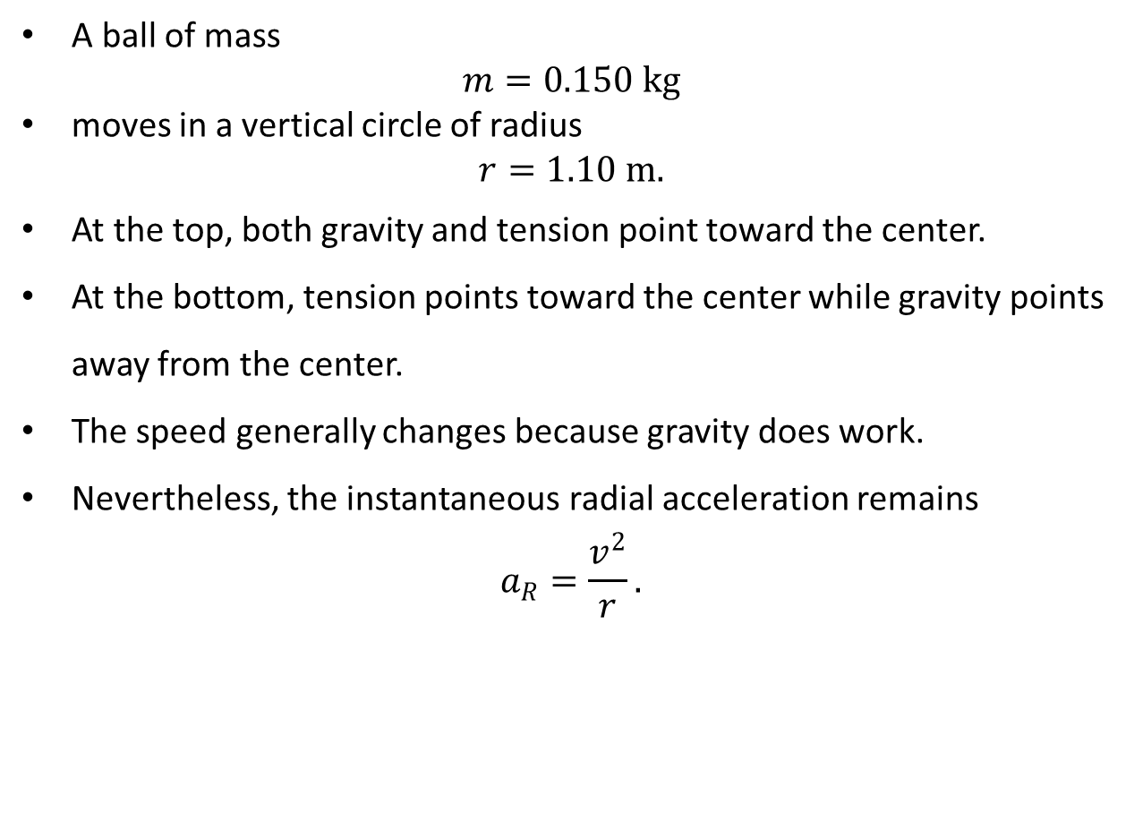
PHYS 2325 | University Physics I
Lecture 01 • Mon Sep 21 • Giancoli Ch. 5
Example 5–12 Ball Moving in a Vertical Circle
A ball of mass
$$m=0.150 kg$$
moves in a vertical circle of radius
$$r=1.10 m.$$
At the top, both gravity and tension point toward the center.
At the bottom, tension points toward the center while gravity points away from the center.
The speed generally changes because gravity does work.
Nevertheless, the instantaneous radial acceleration remains
$$a_{R}=\frac{v^{2}}{r}.$$
Notes:
Teaching focus: Where today's lecture fits.
[Sources]
- PHYS 2325 University Physics I Fall 2026 syllabus and semester calendar.
[/Sources]

Slide 40
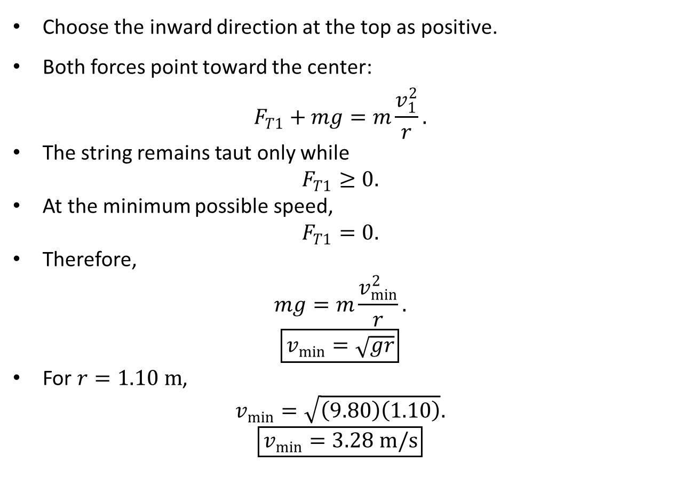
PHYS 2325 | University Physics I
Lecture 01 • Mon Sep 21 • Giancoli Ch. 5
Minimum Speed at the Top
Choose the inward direction at the top as positive.
Both forces point toward the center:
$$F_{T1}+mg=m\frac{v_{1}^{2}}{r}.$$
The string remains taut only while
$$F_{T1}≥0.$$
At the minimum possible speed,
$$F_{T1}=0.$$
Therefore,
$$mg=m\frac{v_{min}^{2}}{r}.$$
$$\boxed{v_{min}=\sqrt{gr}}$$
For $r=1.10 m$,
$$v_{min}=\sqrt{\left(9.80\right)\left(1.10\right)}.$$
$$\boxed{v_{min}=3.28 m/s}$$
Notes:
Teaching focus: Where today's lecture fits.
[Sources]
- PHYS 2325 University Physics I Fall 2026 syllabus and semester calendar.
[/Sources]

Slide 41
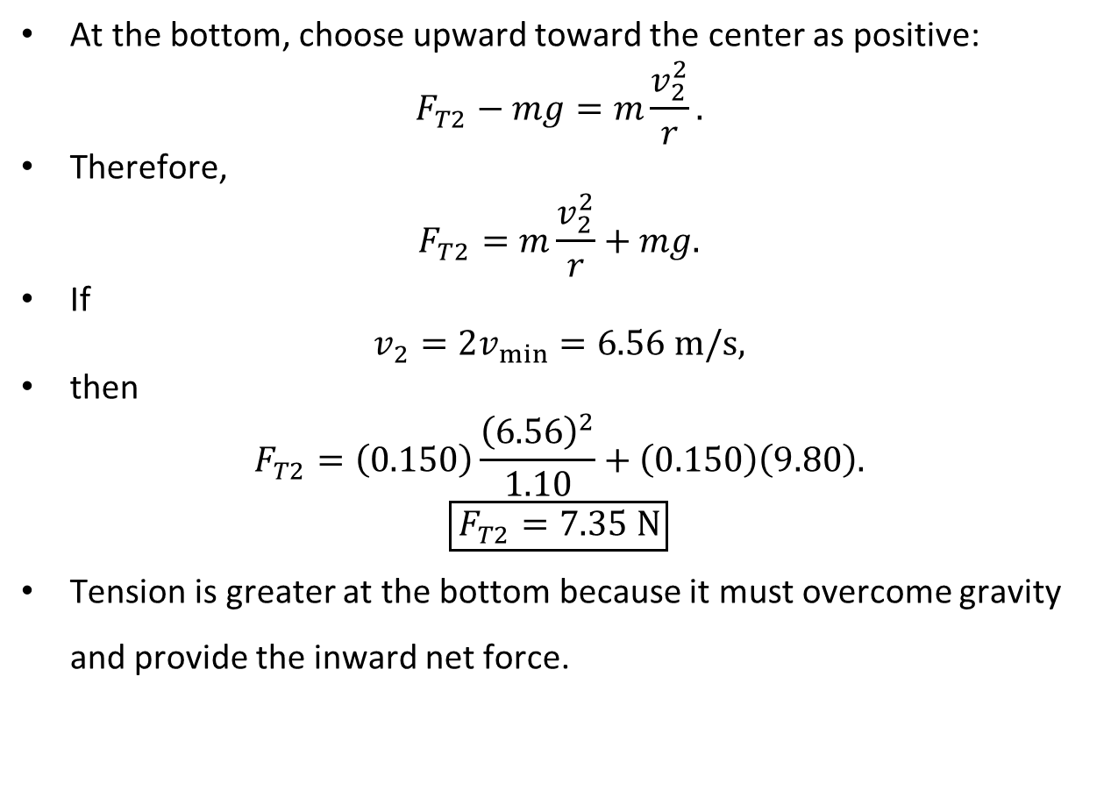
PHYS 2325 | University Physics I
Lecture 01 • Mon Sep 21 • Giancoli Ch. 5
Tension at the Bottom
At the bottom, choose upward toward the center as positive:
$$F_{T2}−mg=m\frac{v_{2}^{2}}{r}.$$
Therefore,
$$F_{T2}=m\frac{v_{2}^{2}}{r}+mg.$$
If
$$v_{2}=2v_{min}=6.56 m/s,$$
then
$$F_{T2}=\left(0.150\right)\frac{{\left(6.56\right)}^{2}}{1.10}+\left(0.150\right)\left(9.80\right).$$
$$\boxed{F_{T2}=7.35 N}$$
Tension is greater at the bottom because it must overcome gravity and provide the inward net force.
Notes:
Teaching focus: Where today's lecture fits.
[Sources]
- PHYS 2325 University Physics I Fall 2026 syllabus and semester calendar.
[/Sources]

Slide 42
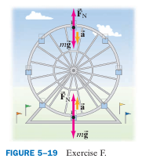
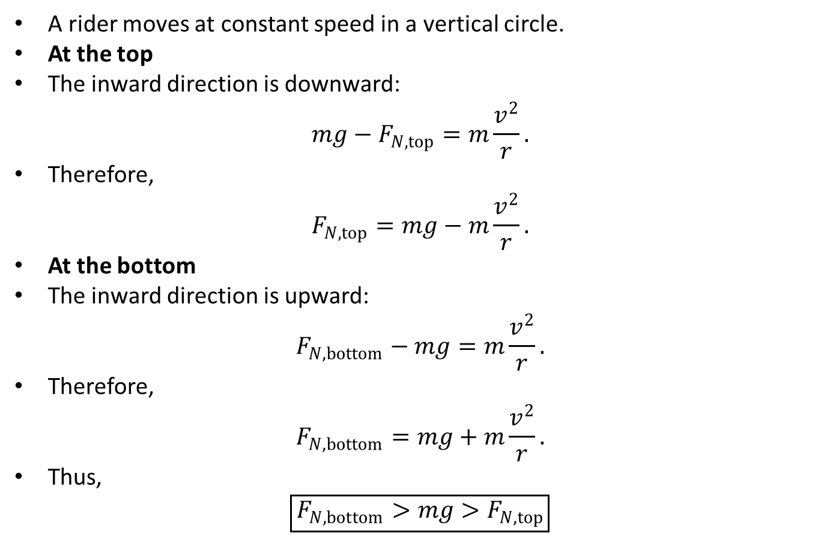
PHYS 2325 | University Physics I
Lecture 01 • Mon Sep 21 • Giancoli Ch. 5
Ferris-Wheel Concept Check
A rider moves at constant speed in a vertical circle.
At the top
The inward direction is downward:
$$mg−F_{N,top}=m\frac{v^{2}}{r}.$$
Therefore,
$$F_{N,top}=mg−m\frac{v^{2}}{r}.$$
At the bottom
The inward direction is upward:
$$F_{N,bottom}−mg=m\frac{v^{2}}{r}.$$
Therefore,
$$F_{N,bottom}=mg+m\frac{v^{2}}{r}.$$
Thus,
$$\boxed{F_{N,bottom}>mg>F_{N,top}}$$
Notes:
Teaching focus: Where today's lecture fits.
[Sources]
- PHYS 2325 University Physics I Fall 2026 syllabus and semester calendar.
[/Sources]

Slide 43


PHYS 2325 | University Physics I
Lecture 01 • Mon Sep 21 • Giancoli Ch. 5
Example 5–13 Conical Pendulum
A ball of mass $m$hangs from a string of length $l$.
The string makes an angle $θ$with the vertical.
The ball moves in a horizontal circle of radius
$$r=l\sin{θ}.$$
The acceleration points horizontally toward the center.
The forces are:
  Weight $mg$ downward
  Tension $F_{T}$ along the string
Resolve the tension:
$$F_{T}\cos{θ}=mg,$$
$$F_{T}\sin{θ}=m\frac{v^{2}}{r}.$$
Notes:
Teaching focus: Where today's lecture fits.
[Sources]
- PHYS 2325 University Physics I Fall 2026 syllabus and semester calendar.
[/Sources]

Slide 44

PHYS 2325 | University Physics I
Lecture 01 • Mon Sep 21 • Giancoli Ch. 5
Example 5–13 Conical Pendulum: Speed and Period
Divide the horizontal equation by the vertical equation:
$$\tan{θ}=\frac{v^{2}}{rg}.$$
Therefore,
$$\boxed{v=\sqrt{rg\tan{θ}}}$$
Using
$$r=l\sin{θ},$$
$$\boxed{v=\sqrt{\frac{lg\sin^{2}θ}{\cos{θ}}}}$$
The period is
$$T=\frac{2πr}{v}.$$
Substitution gives
$$\boxed{T=2π\sqrt{\frac{l\cos{θ}}{g}}}$$
The speed and period do not depend on the mass.
Notes:
Teaching focus: Where today's lecture fits.
[Sources]
- PHYS 2325 University Physics I Fall 2026 syllabus and semester calendar.
[/Sources]

Slide 45

PHYS 2325 | University Physics I
Lecture 01 • Mon Sep 21 • Giancoli Ch. 5
Circular-Motion Problem Strategy
Draw a free-body diagram containing only real forces.
Identify the center of the circular path.
Choose one axis in the radial direction.
Resolve each force into radial and nonradial components.
Apply Newton’s second law radially:
$$\boxed{\sum{F_{R}}=m\frac{v^{2}}{r}}$$
Apply Newton’s second law in any other required direction.
Avoid these mistakes
Do not add a separate centripetal force.
Do not add a centrifugal force in an inertial frame.
Do not automatically assume $F_{N}=mg$.
Do not assume the speed remains constant in vertical circular motion.
Notes:
Teaching focus: Where today's lecture fits.
[Sources]
- PHYS 2325 University Physics I Fall 2026 syllabus and semester calendar.
[/Sources]

Slide 46



PHYS 2325 | University Physics I
Lecture 01 • Mon Sep 21 • Giancoli Ch. 5
Highway Curves
A car tends to continue in a straight line because of inertia.
The road must exert an inward force to make the car follow a curve.
On a flat road, static friction between the tires and road provides this force.
When the tires roll without slipping, their contact points are instantaneously at rest relative to the road.
$$\boxed{F_{fr}=m\frac{v^{2}}{r}}$$
If the available static friction is too small, the car skids toward a straighter path.
Notes:
Teaching focus: Where today's lecture fits.
[Sources]
- PHYS 2325 University Physics I Fall 2026 syllabus and semester calendar.
[/Sources]

Slide 47

PHYS 2325 | University Physics I
Lecture 01 • Mon Sep 21 • Giancoli Ch. 5
Maximum Speed on a Flat Curve
On a flat road,
$$F_{N}=mg.$$
The maximum static friction is
$$F_{fr,max}=μ_{s}F_{N}=μ_{s}mg.$$
At the maximum safe speed,
$$μ_{s}mg=m\frac{v_{max}^{2}}{r}.$$
Cancel the mass:
$$\boxed{v_{max}=\sqrt{μ_{s}rg}}$$
The maximum speed does not depend on the vehicle’s mass.
Adding weight does not increase the maximum safe speed in this simplified model.
Notes:
Teaching focus: Where today's lecture fits.
[Sources]
- PHYS 2325 University Physics I Fall 2026 syllabus and semester calendar.
[/Sources]

Slide 48


PHYS 2325 | University Physics I
Lecture 01 • Mon Sep 21 • Giancoli Ch. 5
Example 5–14 Skidding on a Curve: Required Force
A car has
$$m=1000 kg, r=50 m, v=15 m/s.$$
The required inward force is
$$F_{R}=m\frac{v^{2}}{r}.$$
$$F_{R}=\left(1000\right)\frac{{\left(15\right)}^{2}}{50}.$$
$$\boxed{F_{R}=4500 N}$$
The normal force is
$$F_{N}=mg=9800 N.$$
Notes:
Teaching focus: Where today's lecture fits.
[Sources]
- PHYS 2325 University Physics I Fall 2026 syllabus and semester calendar.
[/Sources]

Slide 49

PHYS 2325 | University Physics I
Lecture 01 • Mon Sep 21 • Giancoli Ch. 5
Dry Road Versus Icy Road
Dry road
$$μ_{s}=0.60$$
$$F_{fr,max}=μ_{s}F_{N}=\left(0.60\right)\left(9800\right)=5880 N.$$
Since
$$5880 N>4500 N,$$
the car follows the curve safely.
Icy road
$$μ_{s}=0.25$$
$$F_{fr,max}=\left(0.25\right)\left(9800\right)=2450 N.$$
Since
$$2450 N<4500 N,$$
$$\boxed{\text{the car skids}}$$
Notes:
Teaching focus: Where today's lecture fits.
[Sources]
- PHYS 2325 University Physics I Fall 2026 syllabus and semester calendar.
[/Sources]

Slide 50

PHYS 2325 | University Physics I
Lecture 01 • Mon Sep 21 • Giancoli Ch. 5
Locked Wheels and Antilock Brakes
Rolling tires use static friction.
If the wheels lock, the tires slide and kinetic friction applies.
Kinetic friction is generally smaller than maximum static friction.
During sliding, friction points opposite the velocity.
It may no longer point toward the center of the curve.
The car then follows a path closer to a straight line.
Antilock braking systems reduce brake pressure before prolonged sliding begins.
Sandbag question
Adding mass increases both:
$F_{fr,max}=μ_{s}mg$ & $F_{required}=m\frac{v^{2}}{r}$
by the same factor.
Therefore, adding mass does not change $v_{max}$in this model.
Notes:
Teaching focus: Where today's lecture fits.
[Sources]
- PHYS 2325 University Physics I Fall 2026 syllabus and semester calendar.
[/Sources]

Slide 51


PHYS 2325 | University Physics I
Lecture 01 • Mon Sep 21 • Giancoli Ch. 5
Banked Curves
Banking tilts the road surface.
The normal force is perpendicular to the road.
Its horizontal component points toward the center of the curve.
This component can provide some or all of the required centripetal force.
At one design speed, no friction is required.
Resolve the normal force:
$$F_{N}\cos{θ}=mg,$$
$$F_{N}\sin{θ}=m\frac{v^{2}}{r}.$$
Important caution
The centripetal acceleration is horizontal, not parallel to the road.
Notes:
Teaching focus: Where today's lecture fits.
[Sources]
- PHYS 2325 University Physics I Fall 2026 syllabus and semester calendar.
[/Sources]

Slide 52

PHYS 2325 | University Physics I
Lecture 01 • Mon Sep 21 • Giancoli Ch. 5
Example 5–15 Banking Angle Without Friction
Divide the horizontal equation by the vertical equation:
$$\frac{F_{N}\sin{θ}}{F_{N}\cos{θ}}=\frac{mv^{2}/r}{mg}.$$
Therefore,
$$\boxed{\tan{θ}=\frac{v^{2}}{rg}}$$
For
$$r=50 m$$
and
$$v=50 km/h=13.9 m/s,$$
$$\tan{θ}=\frac{{\left(13.9\right)}^{2}}{\left(50\right)\left(9.80\right)}≈0.40.$$
Thus,
$$\boxed{θ=\tan^{−1}\left(0.40\right)≈{22}^{∘}}$$
The design angle does not depend on vehicle mass.
Notes:
Teaching focus: Where today's lecture fits.
[Sources]
- PHYS 2325 University Physics I Fall 2026 syllabus and semester calendar.
[/Sources]

Slide 53


PHYS 2325 | University Physics I
Lecture 01 • Mon Sep 21 • Giancoli Ch. 5
Nonuniform Circular Motion
Radial and Tangential Acceleration
When speed changes during circular motion, acceleration has two components.
Radial component
$$\boxed{a_{R}=\frac{v^{2}}{r}}$$
Points toward the center.
Changes the direction of velocity.
Tangential component
$$\begin{matrix} & \boxed{a_{tan}=\frac{dv}{dt}} & & \text{(5–4)}\end{matrix}$$
Points tangent to the path.
Changes the magnitude of velocity.
The total acceleration is
$$\begin{matrix} & \boxed{\vec{a}={\vec{a}}_{R}+{\vec{a}}_{tan}} & & \text{(5–5)}\end{matrix}$$
Since the components are perpendicular,
$$\boxed{a=\sqrt{a_{R}^{2}+a_{tan}^{2}}}$$
Notes:
Teaching focus: Where today's lecture fits.
[Sources]
- PHYS 2325 University Physics I Fall 2026 syllabus and semester calendar.
[/Sources]

Slide 54

PHYS 2325 | University Physics I
Lecture 01 • Mon Sep 21 • Giancoli Ch. 5
Example 5–16 Two Components of Acceleration
A race car accelerates from rest to
$$35 m/s$$
in
$$11 s$$
on a circular track of radius
$$r=250 m.$$
Tangential acceleration
$$a_{tan}=\frac{Δv}{Δt}=\frac{35−0}{11}.$$
$$\boxed{a_{tan}=3.2 m/s^{2}}$$
When the speed is $15 m/s$,
$$a_{R}=\frac{v^{2}}{r}=\frac{{\left(15\right)}^{2}}{250}.$$
$$\boxed{a_{R}=0.90 m/s^{2}}$$
The total acceleration is
$$a=\sqrt{{\left(3.2\right)}^{2}+{\left(0.90\right)}^{2}}≈3.3 m/s^{2}.$$
Notes:
Teaching focus: Where today's lecture fits.
[Sources]
- PHYS 2325 University Physics I Fall 2026 syllabus and semester calendar.
[/Sources]

Slide 55


PHYS 2325 | University Physics I
Lecture 01 • Mon Sep 21 • Giancoli Ch. 5
Motion Along a General Curved Path
Any small portion of a smooth curved path can be approximated by an arc of a circle.
The local circle has radius of curvature $r$.
Velocity is tangent to the path.
Radial acceleration points toward the local center of curvature:
$$a_{R}=\frac{v^{2}}{r}.$$
Tangential acceleration describes the change in speed:
$$a_{tan}=\frac{dv}{dt}.$$
A sharply curved path has a small $r$and therefore a larger radial acceleration at the same speed.
Notes:
Teaching focus: Where today's lecture fits.
[Sources]
- PHYS 2325 University Physics I Fall 2026 syllabus and semester calendar.
[/Sources]

Slide 56

PHYS 2325 | University Physics I
Lecture 01 • Mon Sep 21 • Giancoli Ch. 5
Lecture Summary
Circular dynamics
$$\sum{F_{R}}=m\frac{v^{2}}{r}$$
Centripetal force is the inward net force, not a new force.
No real outward centrifugal force acts in an inertial frame.
Flat curve
$$v_{max}=\sqrt{μ_{s}rg}$$
Banked curve without friction
$$\tan{θ}=\frac{v^{2}}{rg}$$
Nonuniform circular motion
$$a_{R}=\frac{v^{2}}{r}$$
$$a_{tan}=\frac{dv}{dt}$$
$$a=\sqrt{a_{R}^{2}+a_{tan}^{2}}$$
Notes:
Teaching focus: Where today's lecture fits.
[Sources]
- PHYS 2325 University Physics I Fall 2026 syllabus and semester calendar.
[/Sources]

Slide 57
LECTURE 03
Universal Gravitation, Orbits, and Newton's Synthesis
Fri Sep 25 • Giancoli Ch. 6
Muhammad Nauman • PHYS 2325 • Fall 2026
Notes:
Teaching focus: Universal Gravitation, Orbits, and Newton's Synthesis.
[Sources]
- PHYS 2325 University Physics I Fall 2026 syllabus and semester calendar.
[/Sources]

Slide 58
PHYS 2325 | University Physics I
Lecture 03 • Fri Sep 25 • Giancoli Ch. 6
Learning Objectives
Define and represent newton's law of universal gravitation.
Derive and interpret vector form of gravitation.
Apply gravity near earth's surface.
Connect satellites and weightlessness.
Check units, vector directions, assumptions, and limiting behavior in every solution.
Notes:
Teaching focus: Learning outcomes.
[Sources]
- PHYS 2325 University Physics I Fall 2026 syllabus and semester calendar.
[/Sources]

Slide 59

PHYS 2325 | University Physics I
Lecture 03 • Fri Sep 25 • Giancoli Ch. 6
From Falling Objects to the Moon
Objects near Earth accelerate downward because Earth exerts a gravitational force.
“Downward” means toward the center of Earth, regardless of the observer’s location.
Newton proposed that the same force that makes an apple fall also holds the Moon in orbit.
Gravity therefore acts over large distances without physical contact.
The Moon is continuously accelerating toward Earth even though it does not fall onto Earth.
Teaching question:
If the Moon accelerates toward Earth, why does it not collide with Earth?
Notes:
Teaching focus: Where today's lecture fits.
[Sources]
- PHYS 2325 University Physics I Fall 2026 syllabus and semester calendar.
[/Sources]

Slide 60

PHYS 2325 | University Physics I
Lecture 03 • Fri Sep 25 • Giancoli Ch. 6
Why an Inverse-Square Law?
The distance from Earth’s center to the Moon is approximately 60 times Earth’s radius:
$$r_{Moon}≈60R_{E}$$
The Moon’s centripetal acceleration toward Earth is approximately:
$$a_{Moon}≈\frac{g}{3600}$$
Notice that:
$${60}^{2}=3600$$
Newton therefore concluded that gravitational force decreases with the square of the distance:
$$F_{G}∝\frac{1}{r^{2}}$$
Doubling the distance reduces the force to one-fourth.
Tripling the distance reduces the force to one-ninth.
Notes:
Teaching focus: Where today's lecture fits.
[Sources]
- PHYS 2325 University Physics I Fall 2026 syllabus and semester calendar.
[/Sources]

Slide 61

PHYS 2325 | University Physics I
Lecture 03 • Fri Sep 25 • Giancoli Ch. 6
Newton’s Law of Universal Gravitation
Every particle in the universe attracts every other particle.
The gravitational force is proportional to the product of the two masses.
It is inversely proportional to the square of their separation.
$$F_{G}=G\frac{m_{1}m_{2}}{r^{2}}$$
where:
$m_{1}$ and $m_{2}$ are the interacting masses.
$r$ is the center-to-center separation.
$G$ is the universal gravitational constant:
$$G=6.67×{10}^{−11} N m^{2}/kg^{2}$$
Gravity is always attractive.
The force acts along the line joining the two masses.
Notes:
Teaching focus: Where today's lecture fits.
[Sources]
- PHYS 2325 University Physics I Fall 2026 syllabus and semester calendar.
[/Sources]

Slide 62


PHYS 2325 | University Physics I
Lecture 03 • Fri Sep 25 • Giancoli Ch. 6
Direction of the Gravitational Force
Earth pulls the Moon toward Earth.
The Moon simultaneously pulls Earth toward the Moon.
These forces form a Newton’s third-law pair:
$${\vec{F}}_{Earth on Moon}=−{\vec{F}}_{Moon on Earth}$$
The two forces have equal magnitudes and opposite directions.
Earth’s acceleration is much smaller because Earth has a much greater mass:
$$a=\frac{F}{m}$$
Notes:
Teaching focus: Where today's lecture fits.
[Sources]
- PHYS 2325 University Physics I Fall 2026 syllabus and semester calendar.
[/Sources]

Slide 63

PHYS 2325 | University Physics I
Lecture 03 • Fri Sep 25 • Giancoli Ch. 6
Direction of the Gravitational Force
Earth pulls the Moon toward Earth.
The Moon simultaneously pulls Earth toward the Moon.
These forces form a Newton’s third-law pair:
$${\vec{F}}_{Earth on Moon}=−{\vec{F}}_{Moon on Earth}$$
The two forces have equal magnitudes and opposite directions.
Earth’s acceleration is much smaller because Earth has a much greater mass:
$$a=\frac{F}{m}$$
Important misconception:
Earth does not exert a larger force on the Moon. The forces are equal, but their accelerations are different.
Notes:
Teaching focus: Where today's lecture fits.
[Sources]
- PHYS 2325 University Physics I Fall 2026 syllabus and semester calendar.
[/Sources]

Slide 64


PHYS 2325 | University Physics I
Lecture 03 • Fri Sep 25 • Giancoli Ch. 6
Measuring the Gravitational Constant
Gravitational forces between ordinary laboratory objects are extremely small.
Henry Cavendish measured this force using a torsion balance.
Two small spheres were attached to a horizontal rod suspended by a thin fiber.
Nearby large spheres gravitationally attracted the smaller spheres.
The attraction twisted the suspension fiber through a small angle.
Measuring the twist allowed Cavendish to determine the gravitational force.
Using the measured force, masses, and separation, the value of $G$ could be calculated.
Key significance:
Once $G$ was known, scientists could calculate Earth’s mass.
Notes:
Teaching focus: Where today's lecture fits.
[Sources]
- PHYS 2325 University Physics I Fall 2026 syllabus and semester calendar.
[/Sources]

Slide 65

PHYS 2325 | University Physics I
Lecture 03 • Fri Sep 25 • Giancoli Ch. 6
Extended Spherical Objects
Newton’s gravitational equation is written directly for point particles.
A spherically symmetric body can be treated as though all its mass were concentrated at its center, provided the observation point is outside the body.
Therefore, for planets and stars:
$$F_{G}=G\frac{m_{1}m_{2}}{r^{2}}$$
where $r$ is the distance between their centers.
A thin, uniform spherical shell produces zero net gravitational force at every point inside it.
Inside a spherical planet, only the mass enclosed within the object’s radial position contributes to the net gravitational force.
Notes:
Teaching focus: Where today's lecture fits.
[Sources]
- PHYS 2325 University Physics I Fall 2026 syllabus and semester calendar.
[/Sources]

Slide 66



PHYS 2325 | University Physics I
Lecture 03 • Fri Sep 25 • Giancoli Ch. 6
Vector Form of Newton’s Gravitational Law
The gravitational force on particle 1 due to particle 2 is:
$${\vec{F}}_{12}=−G\frac{m_{1}m_{2}}{r_{21}^{ 2}}{\overset{ˆ}{r}}_{21}$$
${\overset{ˆ}{r}}_{21}$points from particle 2 toward particle 1.
The negative sign indicates that the force on particle 1 points toward particle 2.
The gravitational interaction is always attractive.
For several interacting masses:
$${\vec{F}}_{1}={\vec{F}}_{12}+{\vec{F}}_{13}+⋯+{\vec{F}}_{1n}=\sum_{i=2}^{n}{{\vec{F}}_{1i}}$$
Calculate the force due to each mass separately.
Add the forces vectorially.
Notes:
Teaching focus: Where today's lecture fits.
[Sources]
- PHYS 2325 University Physics I Fall 2026 syllabus and semester calendar.
[/Sources]

Slide 67

PHYS 2325 | University Physics I
Lecture 03 • Fri Sep 25 • Giancoli Ch. 6
Gravity Near Earth’s Surface
For an object of mass $m$ at Earth’s surface:
$$F_{G}=G\frac{mM_{E}}{R_{E}^{2}}$$
The gravitational force on the object is also its weight:
$$F_{G}=mg$$
Equating the two expressions:
$$mg=G\frac{mM_{E}}{R_{E}^{2}}$$
The object’s mass cancels:
$$g=G\frac{M_{E}}{R_{E}^{2}}$$
The value of $g$is determined by Earth’s mass and radius.
The falling object’s mass does not affect its free-fall acceleration.
Neglecting air resistance, all objects fall with the same acceleration at the same location.
Notes:
Teaching focus: Where today's lecture fits.
[Sources]
- PHYS 2325 University Physics I Fall 2026 syllabus and semester calendar.
[/Sources]

Slide 68

PHYS 2325 | University Physics I
Lecture 03 • Fri Sep 25 • Giancoli Ch. 6
Distinguishing $G$from $g$
Universal gravitational constant
$$G=6.67×{10}^{−11} N m^{2}/kg^{2}$$
$G$is a universal constant.
It has the same value everywhere.
Local gravitational acceleration
$$g=\frac{GM}{r^{2}}$$
$g$ depends on the attracting body’s mass.
It also depends on the distance from that body’s center.
Near Earth’s surface:
$$g≈9.80 m/s^{2}$$
Equivalent gravitational-field units are:
$$1 N/kg=1 m/s^{2}$$
Notes:
Teaching focus: Where today's lecture fits.
[Sources]
- PHYS 2325 University Physics I Fall 2026 syllabus and semester calendar.
[/Sources]

Slide 69

PHYS 2325 | University Physics I
Lecture 03 • Fri Sep 25 • Giancoli Ch. 6
Determining Earth’s Mass
Starting from:
$$g=\frac{GM_{E}}{R_{E}^{2}}$$
solve for Earth’s mass:
$$M_{E}=\frac{gR_{E}^{2}}{G}$$
Using:
$$g=9.80 m/s^{2}$$
$$R_{E}=6.38×{10}^{6} m$$
$$G=6.67×{10}^{−11} N m^{2}/kg^{2}$$
gives:
$$M_{E}≈5.98×{10}^{24} kg$$
Cavendish’s measurement of $G$ made this calculation possible.
His experiment is sometimes described as “weighing the Earth.”
Notes:
Teaching focus: Where today's lecture fits.
[Sources]
- PHYS 2325 University Physics I Fall 2026 syllabus and semester calendar.
[/Sources]

Slide 70


PHYS 2325 | University Physics I
Lecture 03 • Fri Sep 25 • Giancoli Ch. 6
How Gravity Changes with Altitude
At altitude $h$, the distance from Earth’s center is:
$$r=R_{E}+h$$
Therefore:
$$g\left(h\right)=\frac{GM_{E}}{{\left(R_{E}+h\right)}^{2}}$$
Since:
$$g_{0}=\frac{GM_{E}}{R_{E}^{2}}$$
we can write:
$$g\left(h\right)=g_{0}{\left(\frac{R_{E}}{R_{E}+h}\right)}^{2}$$
Gravity decreases continuously with altitude.
It does not suddenly disappear above the atmosphere.
At ordinary aircraft or mountain altitudes, the reduction in $g$ is relatively small.
Even astronauts in low-Earth orbit experience a strong gravitational force.

Slide 71


PHYS 2325 | University Physics I
Lecture 03 • Fri Sep 25 • Giancoli Ch. 6
Example: Spacecraft at $2R_{E}$
A $2000 kg$ spacecraft orbits at a distance:
$$r=2R_{E}$$
from Earth’s center.
Because gravitational force follows an inverse-square law:
$$F_{G}\left(2R_{E}\right)=F_{G}\left(R_{E}\right){\left(\frac{R_{E}}{2R_{E}}\right)}^{2}$$
Therefore:
$$F_{G}\left(2R_{E}\right)=\frac{14}{m}g$$
Substituting the values:
$$F_{G}=\frac{14}{\left(2000 kg\right)}\left(9.80 m/s^{2}\right)=4.90×{10}^{3} N$$
At twice Earth’s radius, gravity is one-fourth its surface value.
Gravity is reduced, but it is not zero.
Notes:
Teaching focus: Where today's lecture fits.
[Sources]
- PHYS 2325 University Physics I Fall 2026 syllabus and semester calendar.
[/Sources]

Slide 72


PHYS 2325 | University Physics I
Lecture 03 • Fri Sep 25 • Giancoli Ch. 6
Satellites Are Continuously Falling
Without gravity, a moving satellite would follow a straight-line path.
Gravity continuously accelerates the satellite toward Earth.
At the same time, Earth’s curved surface falls away beneath the satellite.
The satellite therefore continues to fall around Earth without striking it.
An orbit is continuous free fall around a planet.
$$\text{Orbital motion}=\text{forward motion}+\text{continuous gravitational fall}$$
Notes:
Teaching focus: Where today's lecture fits.
[Sources]
- PHYS 2325 University Physics I Fall 2026 syllabus and semester calendar.
[/Sources]

Slide 73

PHYS 2325 | University Physics I
Lecture 03 • Fri Sep 25 • Giancoli Ch. 6
What Keeps a Satellite in Orbit?
A satellite does not remain in orbit because gravity is absent.
It remains in orbit because it has sufficient horizontal speed.
If its horizontal speed were zero, it would fall directly toward Earth.
If its speed is too low, its path intersects Earth.
At the correct speed, the satellite follows a circular or elliptical orbit.
At sufficiently high speed, the satellite can escape Earth’s gravitational influence.
Notes:
Teaching focus: Where today's lecture fits.
[Sources]
- PHYS 2325 University Physics I Fall 2026 syllabus and semester calendar.
[/Sources]

Slide 74

PHYS 2325 | University Physics I
Lecture 03 • Fri Sep 25 • Giancoli Ch. 6
Orbital Speed
For a satellite in a circular orbit, gravitational force provides the required centripetal force:
$$F_{G}=F_{c}$$
Therefore:
$$G\frac{Mm}{r^{2}}=\frac{mv^{2}}{r}$$
The satellite’s mass cancels:
$$\frac{GM}{r}=v^{2}$$
Thus, the circular orbital speed is:
$$v=\sqrt{\frac{GM}{r}}$$
Consequences:
  Orbital speed does not depend on the satellite’s mass.
  Satellites in larger orbits move more slowly.
  Satellites in smaller orbits move more rapidly.
  In an ideal orbit, continuous propulsion is not required.
Notes:
Teaching focus: Where today's lecture fits.
[Sources]
- PHYS 2325 University Physics I Fall 2026 syllabus and semester calendar.
[/Sources]

Slide 75

PHYS 2325 | University Physics I
Lecture 03 • Fri Sep 25 • Giancoli Ch. 6
Orbital Period
For a circular orbit, the satellite travels one circumference during one period:
$$v=\frac{2πr}{T}$$
Using:
$$v=\sqrt{\frac{GM}{r}}$$
we obtain:
$$\frac{2πr}{T}=\sqrt{\frac{GM}{r}} →T=2π\sqrt{\frac{r^{3}}{GM}}$$
Squaring both sides gives:
$$T^{2}=\frac{4π^{2}}{GM}r^{3}$$
A larger orbital radius produces a longer orbital period.
This result is the circular-orbit form of Kepler’s third law.
Notes:
Teaching focus: Where today's lecture fits.
[Sources]
- PHYS 2325 University Physics I Fall 2026 syllabus and semester calendar.
[/Sources]

Slide 76


PHYS 2325 | University Physics I
Lecture 03 • Fri Sep 25 • Giancoli Ch. 6
True Weight and Apparent Weight
True weight is the gravitational force:
$$W=mg$$
A scale does not directly measure gravitational force.
A scale measures the supporting normal force:
$$W_{app}=F_{N}$$
For a person in an elevator accelerating upward:
$$F_{N}−mg=ma$$
Therefore:
$$F_{N}=m\left(g+a\right)$$
If the elevator accelerates upward, the apparent weight increases.
If it accelerates downward, the apparent weight decreases.
Notes:
Teaching focus: Where today's lecture fits.
[Sources]
- PHYS 2325 University Physics I Fall 2026 syllabus and semester calendar.
[/Sources]

Slide 77

PHYS 2325 | University Physics I
Lecture 03 • Fri Sep 25 • Giancoli Ch. 6
Apparent Weightlessness in Free Fall
During free fall:
$$a=−g$$
Using:
$$F_{N}=m\left(g+a\right)$$
we obtain:
$$F_{N}=m\left(g−g\right)=0$$
A scale therefore reads zero during free fall.
The gravitational force is still acting.
The person and the supporting structure fall together with the same acceleration.
With no supporting normal force, the person experiences apparent weightlessness.
$$F_{G}≠0$$
but
$$F_{N}=0$$
Notes:
Teaching focus: Where today's lecture fits.
[Sources]
- PHYS 2325 University Physics I Fall 2026 syllabus and semester calendar.
[/Sources]

Slide 78

PHYS 2325 | University Physics I
Lecture 03 • Fri Sep 25 • Giancoli Ch. 6
Why Astronauts Appear Weightless
An orbiting astronaut and the spacecraft are both falling toward Earth.
They have the same gravitational acceleration.
The astronaut does not press against the spacecraft floor.
Therefore, the floor provides essentially no normal force.
The astronaut floats relative to the spacecraft.
This is apparent weightlessness, not the absence of gravity.
Notes:
Teaching focus: Where today's lecture fits.
[Sources]
- PHYS 2325 University Physics I Fall 2026 syllabus and semester calendar.
[/Sources]

Slide 79

PHYS 2325 | University Physics I
Lecture 03 • Fri Sep 25 • Giancoli Ch. 6
Return to the Opening Question
A space station orbits $100 km$ above Earth.
Earth’s radius is approximately:
$$R_{E}=6380 km$$
The orbital distance from Earth’s center is:
$$r=6380 km+100 km$$
$$r=6480 km$$
Therefore:
$$\frac{g\left(h\right)}{g_{0}}={\left(\frac{6380}{6480}\right)}^{2}≈0.97$$
Gravity at this altitude is approximately $97\%$ of its surface value.
The gravitational force on the astronaut is only slightly less than her surface weight.
She appears weightless because the astronaut and space station are falling together.
Correct answer: The net gravitational force is a little less than her weight on Earth—not zero.
Notes:
Teaching focus: Where today's lecture fits.
[Sources]
- PHYS 2325 University Physics I Fall 2026 syllabus and semester calendar.
[/Sources]

Slide 80

PHYS 2325 | University Physics I
Lecture 03 • Fri Sep 25 • Giancoli Ch. 6
Kepler’s First Law
Every planet moves in an elliptical orbit, with the Sun at one focus.
An ellipse has two focal points.
The Sun occupies one focus, not the geometrical center.
A circle is a special ellipse in which the two foci coincide.
The distance between a planet and the Sun changes during the orbit.
Important positions:
Perihelion: the planet is closest to the Sun.
Aphelion: the planet is farthest from the Sun.
Notes:
Teaching focus: Where today's lecture fits.
[Sources]
- PHYS 2325 University Physics I Fall 2026 syllabus and semester calendar.
[/Sources]

Slide 81

PHYS 2325 | University Physics I
Lecture 03 • Fri Sep 25 • Giancoli Ch. 6
Kepler’s Second Law
A line joining a planet and the Sun sweeps out equal areas in equal time intervals.
A planet moves fastest when it is closest to the Sun.
It moves slowest when it is farthest from the Sun.
The planet’s orbital speed is therefore not constant in an elliptical orbit.
Equal areas are swept out during equal intervals of time.
Kepler’s second law is related to conservation of angular momentum.
Notes:
Teaching focus: Where today's lecture fits.
[Sources]
- PHYS 2325 University Physics I Fall 2026 syllabus and semester calendar.
[/Sources]

Slide 82

PHYS 2325 | University Physics I
Lecture 03 • Fri Sep 25 • Giancoli Ch. 6
Kepler’s Third Law
The square of a planet’s orbital period is proportional to the cube of its average orbital radius.
$$T^{2}∝r^{3}$$
For planets orbiting the same central mass:
$$\frac{T^{2}}{r^{3}}=\text{constant}$$
Newton’s gravitational law gives:
$$\frac{T^{2}}{r^{3}}=\frac{4π^{2}}{GM}$$
More distant planets move more slowly.
More distant planets take longer to complete an orbit.
Newton showed that Kepler’s empirical law follows from universal gravitation.
Notes:
Teaching focus: Where today's lecture fits.
[Sources]
- PHYS 2325 University Physics I Fall 2026 syllabus and semester calendar.
[/Sources]

Slide 83

PHYS 2325 | University Physics I
Lecture 03 • Fri Sep 25 • Giancoli Ch. 6
Newton’s Synthesis
Newton connected phenomena that had previously appeared unrelated:
  Falling objects near Earth
  The Moon’s motion around Earth
  Artificial satellites
  Planetary motion around the Sun
  Ocean tides
All these phenomena can be understood using the same gravitational law:
$$F_{G}=G\frac{m_{1}m_{2}}{r^{2}}$$
  The same laws of physics apply on Earth and in the heavens.
  This unification is known as Newton’s synthesis.
Notes:
Teaching focus: Where today's lecture fits.
[Sources]
- PHYS 2325 University Physics I Fall 2026 syllabus and semester calendar.
[/Sources]

Slide 84

PHYS 2325 | University Physics I
Lecture 03 • Fri Sep 25 • Giancoli Ch. 6
Gravitational Field
A mass produces a gravitational field throughout the surrounding space.
The gravitational field is defined as gravitational force per unit test mass:
$$\vec{g}=\frac{{\vec{F}}_{G}}{m}$$
For a spherical mass $M$:
$$\vec{g}=−\frac{GM}{r^{2}}\overset{ˆ}{r}$$
The field points toward the mass producing it.
Its units are:
$$N/kg$$
Since:
$$1 N/kg=1 m/s^{2}$$
the gravitational field has the same numerical value as the free-fall acceleration.
The field does not depend on the test mass.
Fields produced by several masses add vectorially.
Notes:
Teaching focus: Where today's lecture fits.
[Sources]
- PHYS 2325 University Physics I Fall 2026 syllabus and semester calendar.
[/Sources]

Slide 85


PHYS 2325 | University Physics I
Lecture 03 • Fri Sep 25 • Giancoli Ch. 6
Ocean Tides: An Application of Gravity
The Moon’s gravitational pull is stronger on the side of Earth closest to the Moon.
It is weaker on the side farthest from the Moon.
This difference in gravitational attraction produces tidal effects.
Water forms two tidal bulges:
  one approximately toward the Moon,
  one approximately away from the Moon.
As Earth rotates, a location generally passes through two high tides and two low tides.
Key idea:
Tides are produced mainly by differences in gravitational force across Earth, not simply by the total gravitational force.
Notes:
Teaching focus: Where today's lecture fits.
[Sources]
- PHYS 2325 University Physics I Fall 2026 syllabus and semester calendar.
[/Sources]

Slide 86

PHYS 2325 | University Physics I
Lecture 03 • Fri Sep 25 • Giancoli Ch. 6
Lecture Summary
Every mass attracts every other mass:
$$F_{G}=G\frac{m_{1}m_{2}}{r^{2}}$$
Gravitational force decreases with the square of distance.
Near the surface of a planet:
$$g=\frac{GM}{R^{2}}$$
Gravity becomes weaker with altitude but does not suddenly disappear.
Satellites remain in orbit because gravity supplies centripetal acceleration.
Orbital speed is:
$$v=\sqrt{\frac{GM}{r}}$$
Orbiting astronauts experience apparent weightlessness because the normal force is approximately zero.
Kepler’s laws describe planetary motion.
Newton’s law of gravitation explains why Kepler’s laws work.
Notes:
Teaching focus: Where today's lecture fits.
[Sources]
- PHYS 2325 University Physics I Fall 2026 syllabus and semester calendar.
[/Sources]

