Slide 1
WEEK 06
Work, Kinetic Energy, Power, and Unit Exam 1
Sep 28-Oct 2 • Giancoli Chapter 7 and Section 8-8
Muhammad Nauman • PHYS 2325 • Fall 2026
Notes:
Teaching focus: Work, Kinetic Energy, Power, and Unit Exam 1.
[Sources]
- PHYS 2325 University Physics I Fall 2026 syllabus and semester calendar.
[/Sources]

Slide 2
PHYS 2325 | University Physics I
Week 06 • Sep 28-Oct 2 • Giancoli Chapter 7 and Section 8-8
This week follows one connected learning path
01
02
03
MON SEP 28
Work, Dot Products, and Variable Forces
WED SEP 30
Work-Energy Principle and Power
FRI OCT 2
Unit Exam 1 - No New Lecture Content
Notes:
Teaching focus: This week follows one connected learning path.
[Sources]
- PHYS 2325 University Physics I Fall 2026 syllabus and semester calendar.
[/Sources]

Slide 3
LECTURE 01
Work, Dot Products, and Variable Forces
Mon Sep 28 • Giancoli Ch. 7
Muhammad Nauman • PHYS 2325 • Fall 2026
Notes:
Teaching focus: Work, Dot Products, and Variable Forces.
[Sources]
- PHYS 2325 University Physics I Fall 2026 syllabus and semester calendar.
[/Sources]

Slide 4
PHYS 2325 | University Physics I
Lecture 01 • Mon Sep 28 • Giancoli Ch. 7
Learning outcomes
Define and represent work done by a constant force.
Derive and interpret scalar product of two vectors.
Apply work done by a varying force.
Check units, vector directions, assumptions, and limiting behavior in every solution.

Slide 5
PHYS 2325 | University Physics I
Lecture 01 • Mon Sep 28 • Giancoli Ch. 7
Opening Conceptual Question
You push very hard against a heavy desk, but the desk does not move.
Do you perform mechanical work on the desk?
A force is exerted on the desk.
However, the displacement of the desk is zero.
Therefore, according to the physical definition of work:
W = 0
Key idea
A force alone is not sufficient to perform mechanical work. The point of application of the force must undergo a displacement.

Slide 6
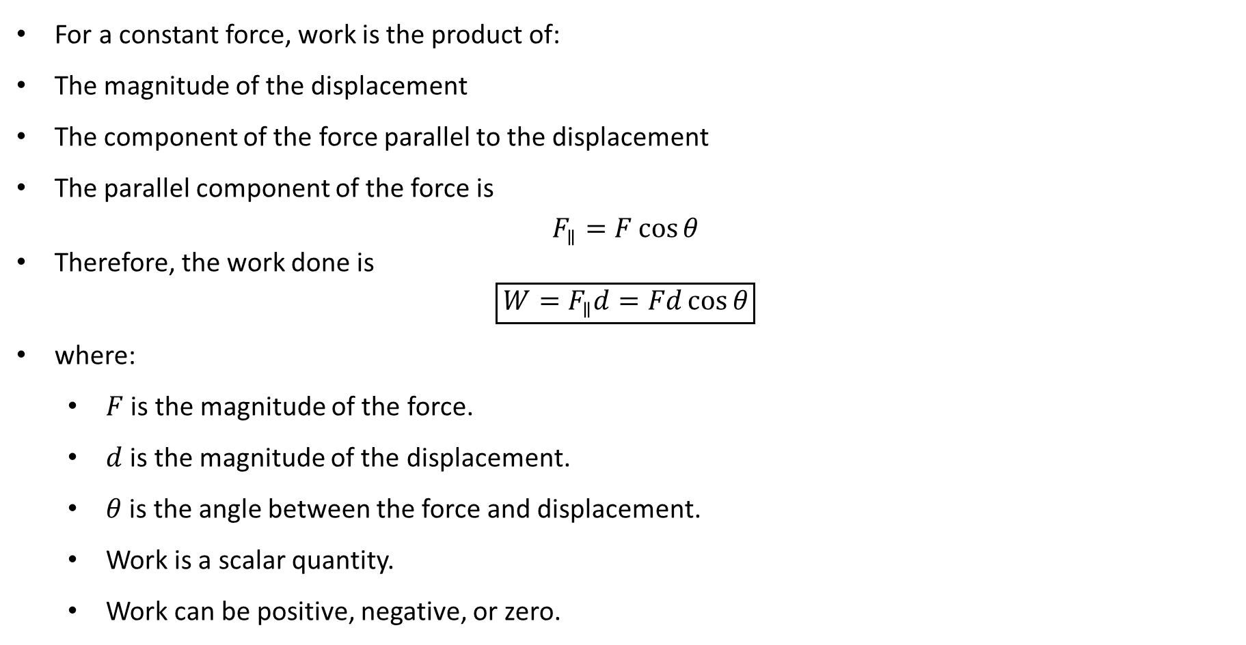
PHYS 2325 | University Physics I
Lecture 01 • Mon Sep 28 • Giancoli Ch. 7
Definition of Work
For a constant force, work is the product of:
The magnitude of the displacement
The component of the force parallel to the displacement
The parallel component of the force is
$$F_{∥}=F\cos{θ}$$
Therefore, the work done is
$$\boxed{W=F_{∥}d=Fd\cos{θ}}$$
where:
  $F$ is the magnitude of the force.
  $d$ is the magnitude of the displacement.
  $θ$ is the angle between the force and displacement.
  Work is a scalar quantity.
  Work can be positive, negative, or zero.

Slide 7
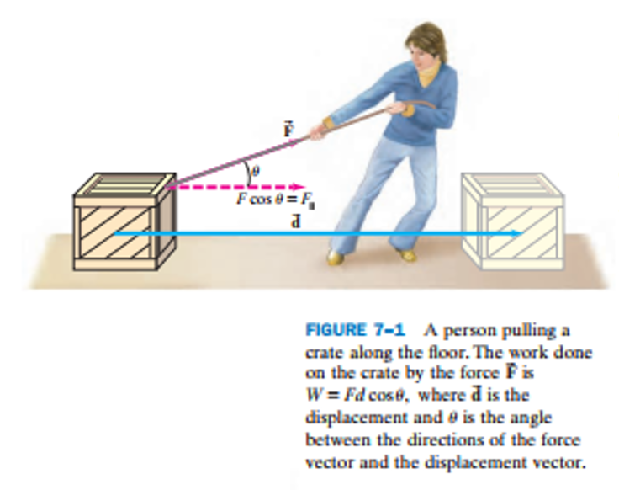
PHYS 2325 | University Physics I
Lecture 01 • Mon Sep 28 • Giancoli Ch. 7
Definition of Work
For a constant force, work is the product of:
The magnitude of the displacement
The component of the force parallel to the displacement
The parallel component of the force is
$$F_{∥}=F\cos{θ}$$
Therefore, the work done is
$$\boxed{W=F_{∥}d=Fd\cos{θ}}$$
where:
  $F$ is the magnitude of the force.
  $d$ is the magnitude of the displacement.
  $θ$ is the angle between the force and displacement.
  Work is a scalar quantity.
  Work can be positive, negative, or zero.

Slide 8
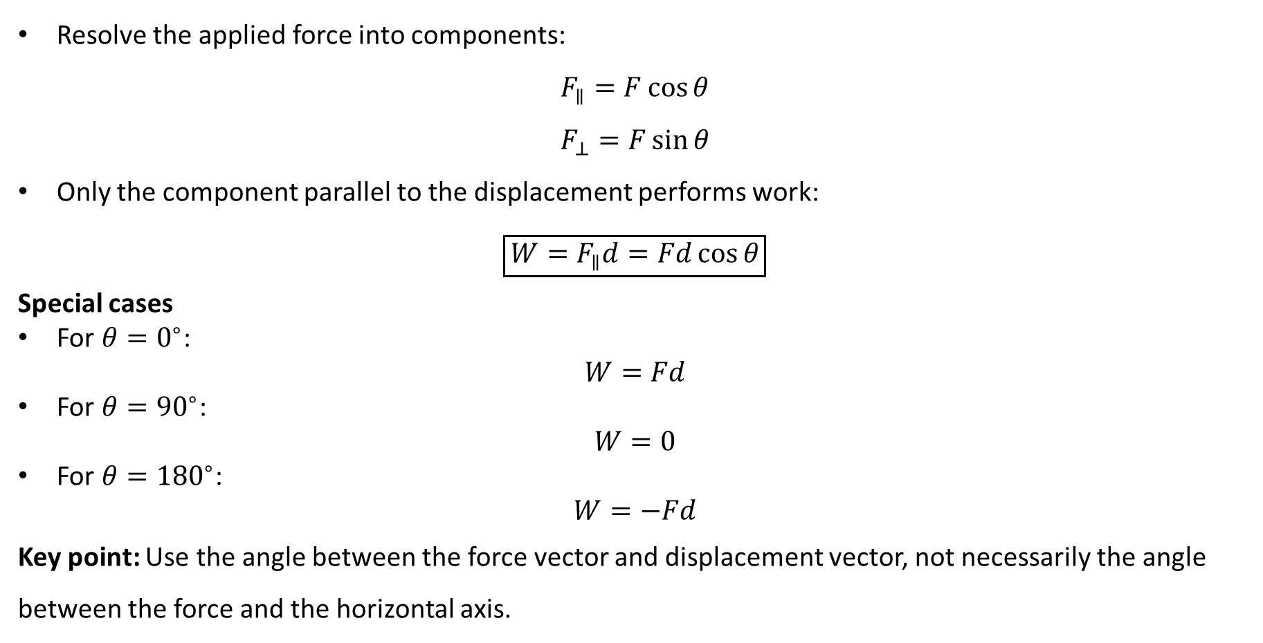
PHYS 2325 | University Physics I
Lecture 01 • Mon Sep 28 • Giancoli Ch. 7
Only the Parallel Force Component Does Work
Resolve the applied force into components:
$$F_{∥}=F\cos{θ}$$
$$F_{⊥}=F\sin{θ}$$
Only the component parallel to the displacement performs work:
$$\boxed{W=F_{∥}d=Fd\cos{θ}}$$
Special cases
For $θ=0^{∘}$:
$$W=Fd$$
For $θ={90}^{∘}$:
$$W=0$$
For $θ={180}^{∘}$:
$$W=−Fd$$
Key point: Use the angle between the force vector and displacement vector, not necessarily the angle between the force and the horizontal axis.

Slide 9
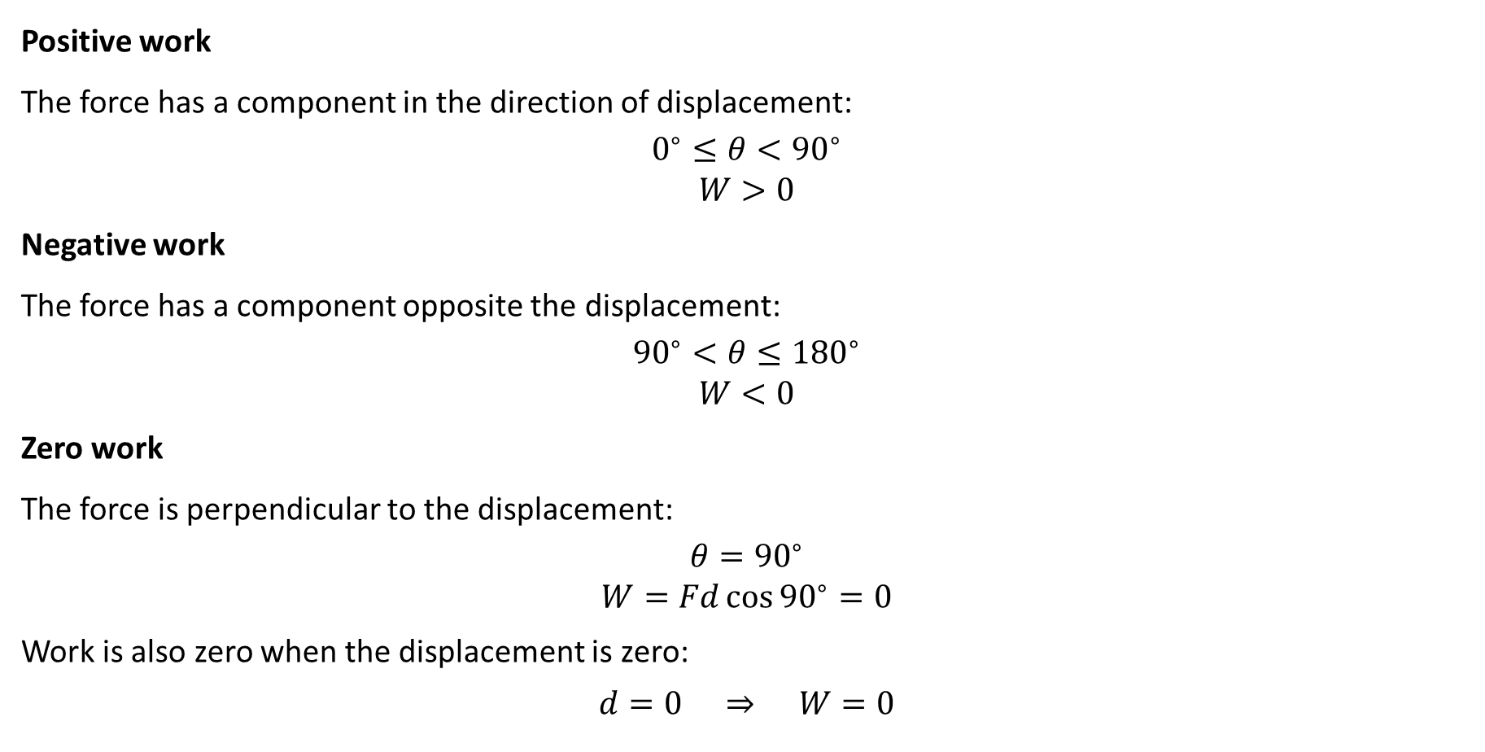
PHYS 2325 | University Physics I
Lecture 01 • Mon Sep 28 • Giancoli Ch. 7
Positive, Negative, and Zero Work
Positive work
The force has a component in the direction of displacement:
$$0^{∘}≤θ<{90}^{∘}$$
$$W>0$$
Negative work
The force has a component opposite the displacement:
$${90}^{∘}<θ≤{180}^{∘}$$
$$W<0$$
Zero work
The force is perpendicular to the displacement:
$$θ={90}^{∘}$$
$$W=Fd{\cos{90}}^{∘}=0$$
Work is also zero when the displacement is zero:
$$d=0 ⇒ W=0$$

Slide 10
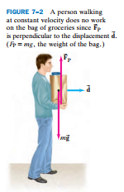
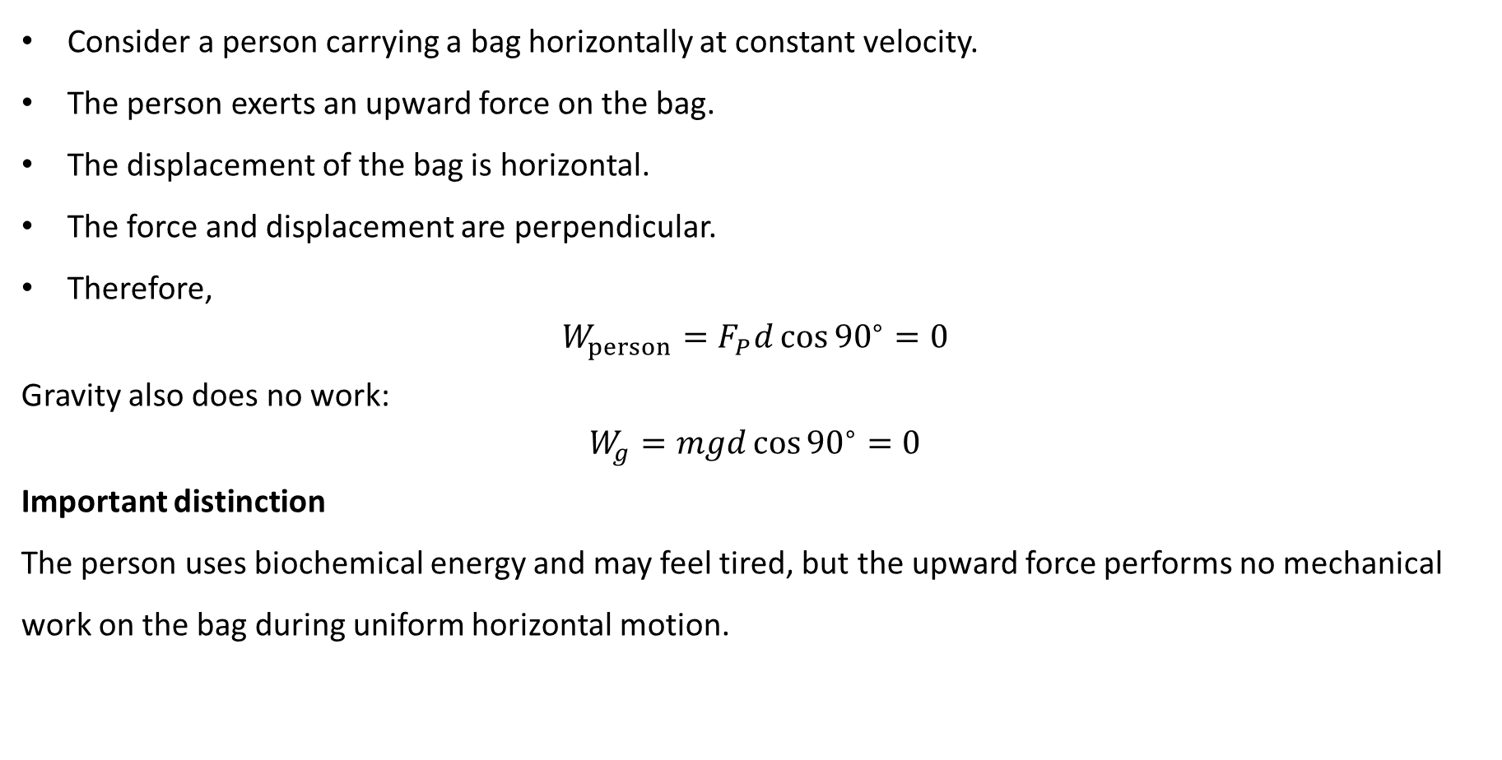
PHYS 2325 | University Physics I
Lecture 01 • Mon Sep 28 • Giancoli Ch. 7
Force Without Mechanical Work
Consider a person carrying a bag horizontally at constant velocity.
The person exerts an upward force on the bag.
The displacement of the bag is horizontal.
The force and displacement are perpendicular.
Therefore,
$$W_{person}=F_{P}d{\cos{90}}^{∘}=0$$
Gravity also does no work:
$$W_{g}=mgd{\cos{90}}^{∘}=0$$
Important distinction
The person uses biochemical energy and may feel tired, but the upward force performs no mechanical work on the bag during uniform horizontal motion.

Slide 11
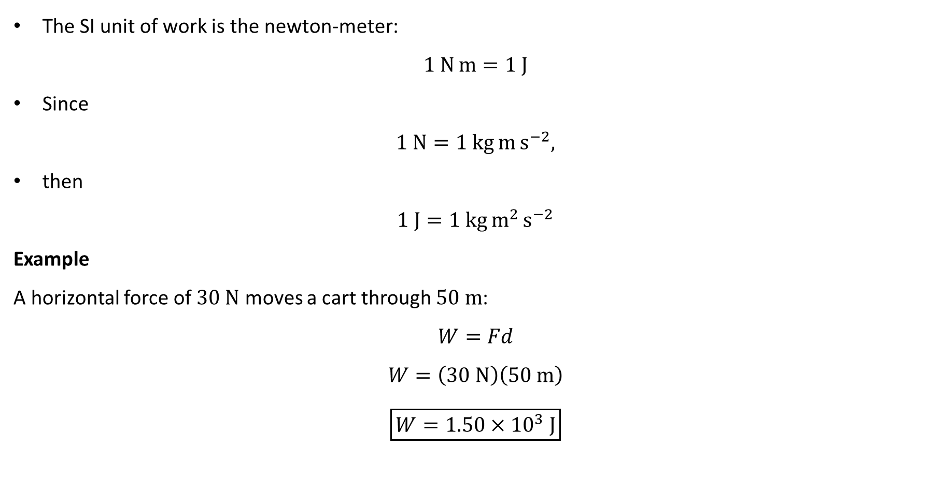
PHYS 2325 | University Physics I
Lecture 01 • Mon Sep 28 • Giancoli Ch. 7
Units of Work
The SI unit of work is the newton-meter:
$$1 N m=1 J$$
Since
$$1 N=1 kg m s^{−2},$$
then
$$1 J=1 kg m^{2} s^{−2}$$
Example
A horizontal force of $30 N$ moves a cart through $50 m$:
$$W=Fd$$
$$W=\left(30 N\right)\left(50 m\right)$$
$$\boxed{W=1.50×{10}^{3} J}$$

Slide 12

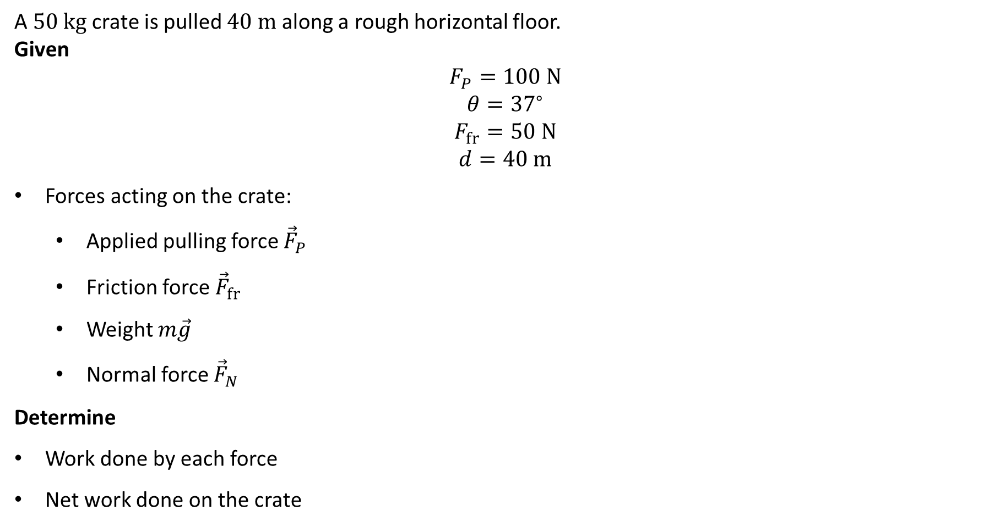
PHYS 2325 | University Physics I
Lecture 01 • Mon Sep 28 • Giancoli Ch. 7
Example 7–1: Pulling a Crate
A $50 kg$ crate is pulled $40 m$ along a rough horizontal floor.
Given
$$F_{P}=100 N$$
$$θ={37}^{∘}$$
$$F_{fr}=50 N$$
$$d=40 m$$
Forces acting on the crate:
  Applied pulling force ${\vec{F}}_{P}$
  Friction force ${\vec{F}}_{fr}$
  Weight $m\vec{g}$
  Normal force ${\vec{F}}_{N}$
Determine
Work done by each force
Net work done on the crate

Slide 13
PHYS 2325 | University Physics I
Lecture 01 • Mon Sep 28 • Giancoli Ch. 7
Example 7–1: Pulling a Crate
A $50 kg$ crate is pulled $40 m$ along a rough horizontal floor.
Given
$$F_{P}=100 N$$
$$θ={37}^{∘}$$
$$F_{fr}=50 N$$
$$d=40 m$$
Forces acting on the crate:
  Applied pulling force ${\vec{F}}_{P}$
  Friction force ${\vec{F}}_{fr}$
  Weight $m\vec{g}$
  Normal force ${\vec{F}}_{N}$
Determine
Work done by each force
Net work done on the crate

Slide 14
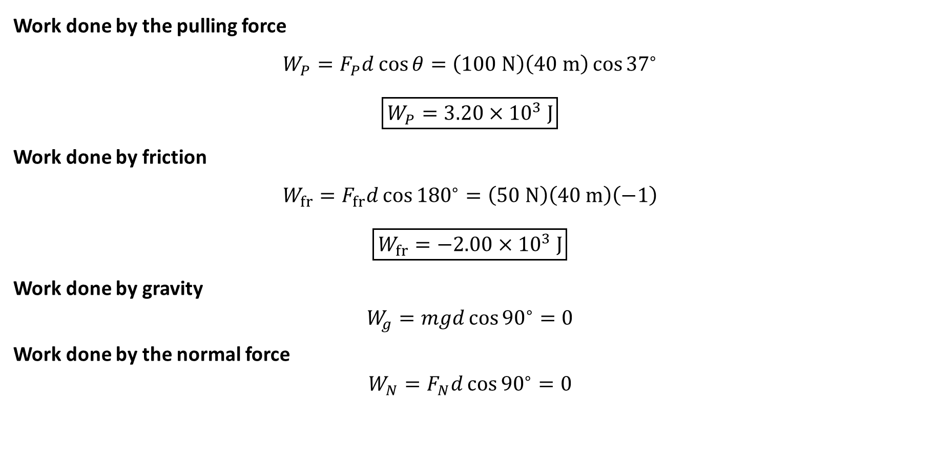
PHYS 2325 | University Physics I
Lecture 01 • Mon Sep 28 • Giancoli Ch. 7
Example 7–1: Work Done by Each Force
Work done by the pulling force
$$W_{P}=F_{P}d\cos{θ}=\left(100 N\right)\left(40 m\right){\cos{37}}^{∘}$$
$$\boxed{W_{P}=3.20×{10}^{3} J}$$
Work done by friction
$$W_{fr}=F_{fr}d{\cos{180}}^{∘}=\left(50 N\right)\left(40 m\right)\left(−1\right)$$
$$\boxed{W_{fr}=−2.00×{10}^{3} J}$$
Work done by gravity
$$W_{g}=mgd{\cos{90}}^{∘}=0$$
Work done by the normal force
$$W_{N}=F_{N}d{\cos{90}}^{∘}=0$$

Slide 15
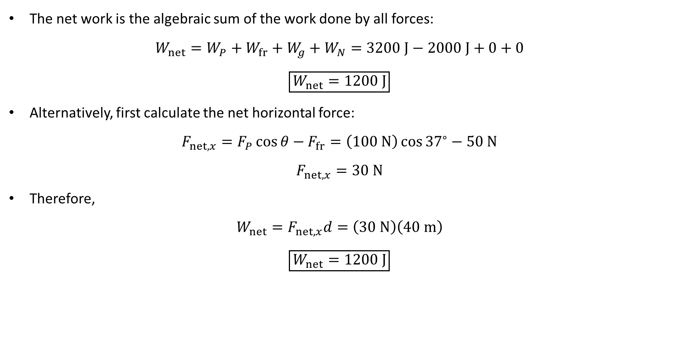
PHYS 2325 | University Physics I
Lecture 01 • Mon Sep 28 • Giancoli Ch. 7
Example 7–1: Net Work
The net work is the algebraic sum of the work done by all forces:
$W_{net}=W_{P}+W_{fr}+W_{g}+W_{N}=3200 J−2000 J+0+0$
$$\boxed{W_{net}=1200 J}$$
Alternatively, first calculate the net horizontal force:
$$F_{net,x}=F_{P}\cos{θ}−F_{fr}=\left(100 N\right){\cos{37}}^{∘}−50 N$$
$$F_{net,x}=30 N$$
Therefore,
$$W_{net}=F_{net,x}d=\left(30 N\right)\left(40 m\right)$$
$$\boxed{W_{net}=1200 J}$$

Slide 16
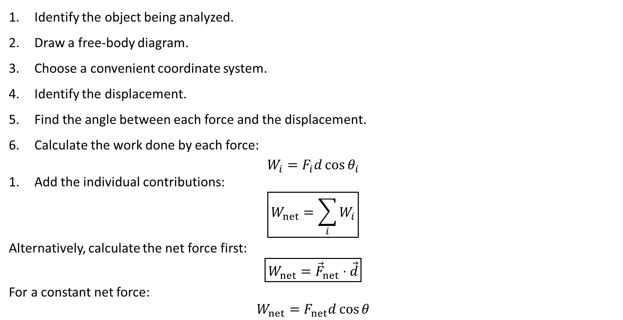
PHYS 2325 | University Physics I
Lecture 01 • Mon Sep 28 • Giancoli Ch. 7
Strategy for Solving Work Problems
Identify the object being analyzed.
Draw a free-body diagram.
Choose a convenient coordinate system.
Identify the displacement.
Find the angle between each force and the displacement.
Calculate the work done by each force:
$$W_{i}=F_{i}d{\cos{θ}}_{i}$$
Add the individual contributions:
$$\boxed{W_{net}=\sum_{i}{W_{i}}}$$
Alternatively, calculate the net force first:
$$\boxed{W_{net}={\vec{F}}_{net}⋅\vec{d}}$$
For a constant net force:
$$W_{net}=F_{net}d\cos{θ}$$

Slide 17
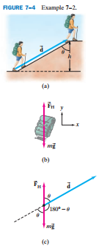
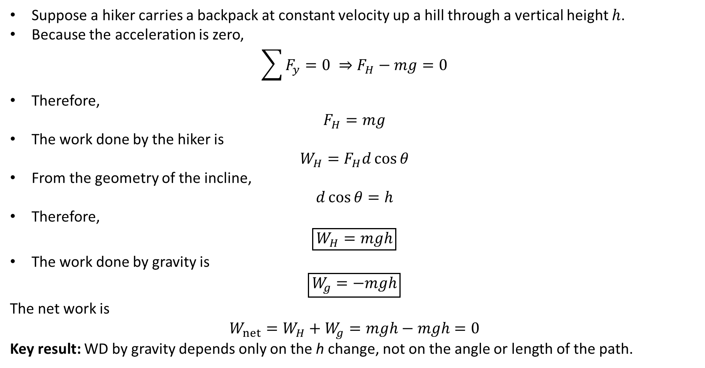
PHYS 2325 | University Physics I
Lecture 01 • Mon Sep 28 • Giancoli Ch. 7
Work Done by Gravity Depends on Height
Suppose a hiker carries a backpack at constant velocity up a hill through a vertical height $h$.
Because the acceleration is zero,
$$\sum{F_{y}}=0 ⇒F_{H}−mg=0$$
Therefore,
$$F_{H}=mg$$
The work done by the hiker is
$$W_{H}=F_{H}d\cos{θ}$$
From the geometry of the incline,
$$d\cos{θ}=h$$
Therefore,
$$\boxed{W_{H}=mgh}$$
The work done by gravity is
$$\boxed{W_{g}=−mgh}$$
The net work is
$$W_{net}=W_{H}+W_{g}=mgh−mgh=0$$
Key result: WD by gravity depends only on the h change, not on the angle or length of the path.

Slide 18
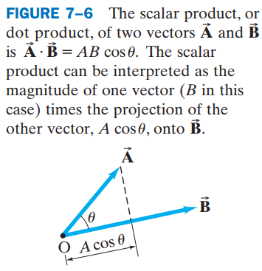
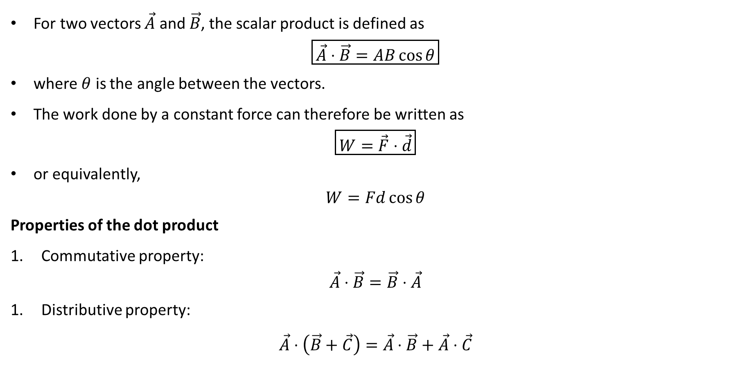
PHYS 2325 | University Physics I
Lecture 01 • Mon Sep 28 • Giancoli Ch. 7
Scalar or Dot Product
For two vectors $\vec{A}$ and $\vec{B}$, the scalar product is defined as
$$\boxed{\vec{A}⋅\vec{B}=AB\cos{θ}}$$
where $θ$ is the angle between the vectors.
The work done by a constant force can therefore be written as
$$\boxed{W=\vec{F}⋅\vec{d}}$$
or equivalently,
$$W=Fd\cos{θ}$$
Properties of the dot product
Commutative property:
$$\vec{A}⋅\vec{B}=\vec{B}⋅\vec{A}$$
Distributive property:
$$\vec{A}⋅\left(\vec{B}+\vec{C}\right)=\vec{A}⋅\vec{B}+\vec{A}⋅\vec{C}$$

Slide 19
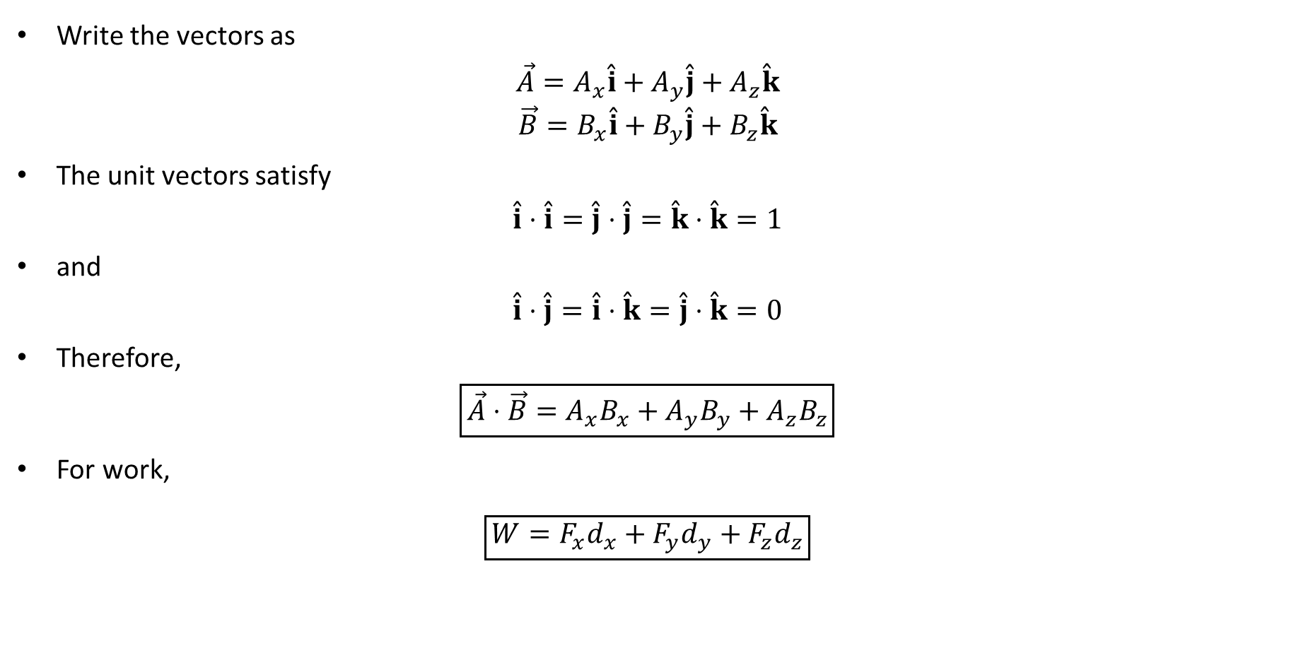
PHYS 2325 | University Physics I
Lecture 01 • Mon Sep 28 • Giancoli Ch. 7
Dot Product Using Components
Write the vectors as
$$\vec{A}=A_{x}\overset{ˆ}{i}+A_{y}\overset{ˆ}{j}+A_{z}\overset{ˆ}{k}$$
$$\vec{B}=B_{x}\overset{ˆ}{i}+B_{y}\overset{ˆ}{j}+B_{z}\overset{ˆ}{k}$$
The unit vectors satisfy
$$\overset{ˆ}{i}⋅\overset{ˆ}{i}=\overset{ˆ}{j}⋅\overset{ˆ}{j}=\overset{ˆ}{k}⋅\overset{ˆ}{k}=1$$
and
$$\overset{ˆ}{i}⋅\overset{ˆ}{j}=\overset{ˆ}{i}⋅\overset{ˆ}{k}=\overset{ˆ}{j}⋅\overset{ˆ}{k}=0$$
Therefore,
$$\boxed{\vec{A}⋅\vec{B}=A_{x}B_{x}+A_{y}B_{y}+A_{z}B_{z}}$$
For work,
$$\boxed{W=F_{x}d_{x}+F_{y}d_{y}+F_{z}d_{z}}$$

Slide 20
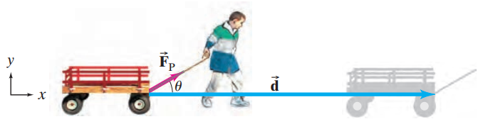

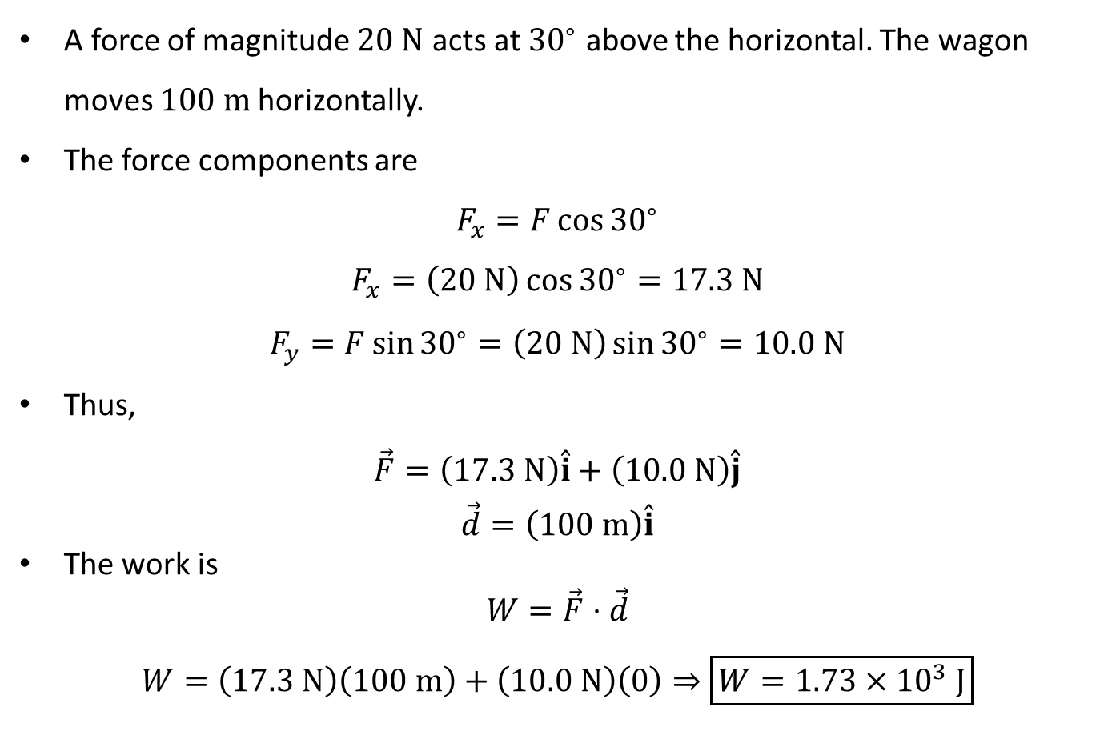
PHYS 2325 | University Physics I
Lecture 01 • Mon Sep 28 • Giancoli Ch. 7
Example: Work Using Components
A force of magnitude $20 N$ acts at ${30}^{∘}$ above the horizontal. The wagon moves $100 m$horizontally.
The force components are
$$F_{x}=F{\cos{30}}^{∘}$$
$$F_{x}=\left(20 N\right){\cos{30}}^{∘}=17.3 N$$
$$F_{y}=F{\sin{30}}^{∘}=\left(20 N\right){\sin{30}}^{∘}=10.0 N$$
Thus,
$$\vec{F}=\left(17.3 N\right)\overset{ˆ}{i}+\left(10.0 N\right)\overset{ˆ}{j}$$
$$\vec{d}=\left(100 m\right)\overset{ˆ}{i}$$
The work is
$$W=\vec{F}⋅\vec{d}$$
$$W=\left(17.3 N\right)\left(100 m\right)+\left(10.0 N\right)\left(0\right)⇒\boxed{W=1.73×{10}^{3} J}$$

Slide 21
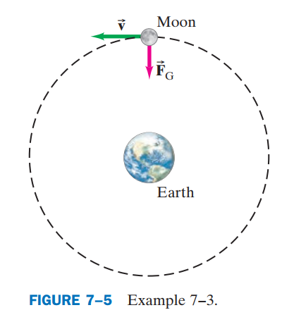
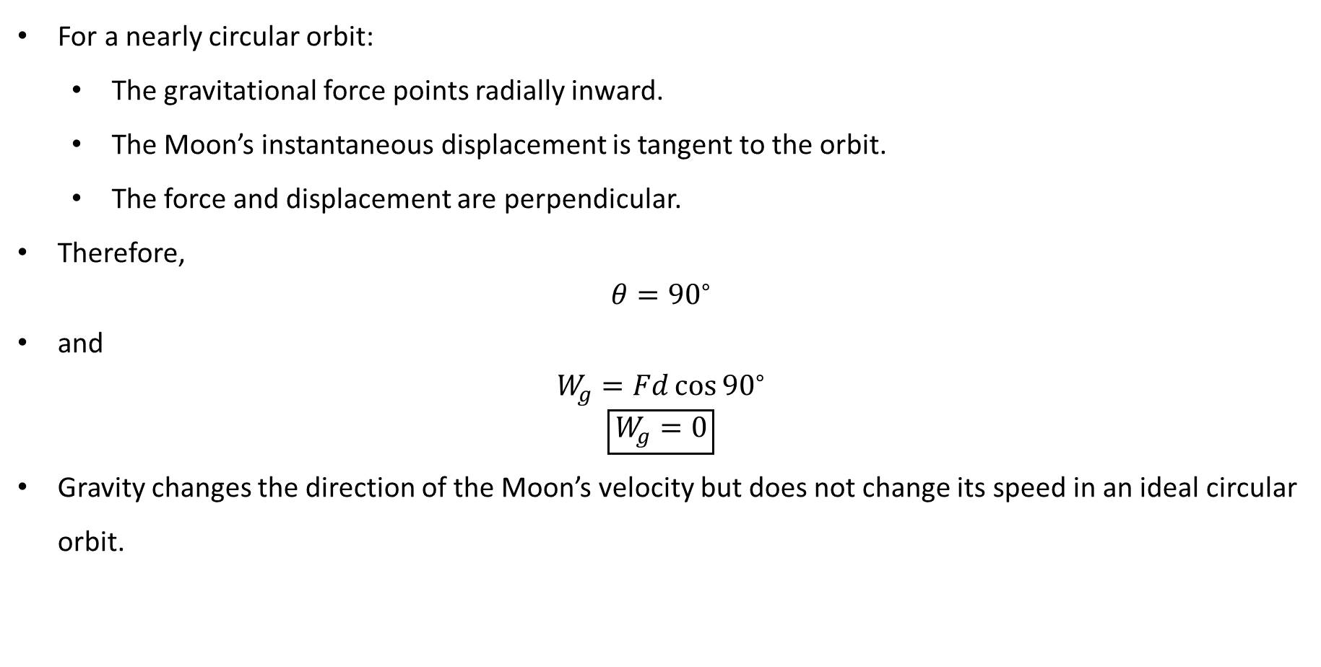
PHYS 2325 | University Physics I
Lecture 01 • Mon Sep 28 • Giancoli Ch. 7
Does Earth Do Work on the Moon?
For a nearly circular orbit:
  The gravitational force points radially inward.
  The Moon’s instantaneous displacement is tangent to the orbit.
  The force and displacement are perpendicular.
Therefore,
$$θ={90}^{∘}$$
and
$$W_{g}=Fd{\cos{90}}^{∘}$$
$$\boxed{W_{g}=0}$$
Gravity changes the direction of the Moon’s velocity but does not change its speed in an ideal circular orbit.

Slide 22
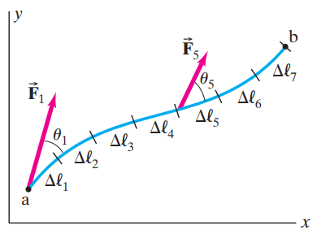
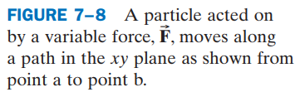
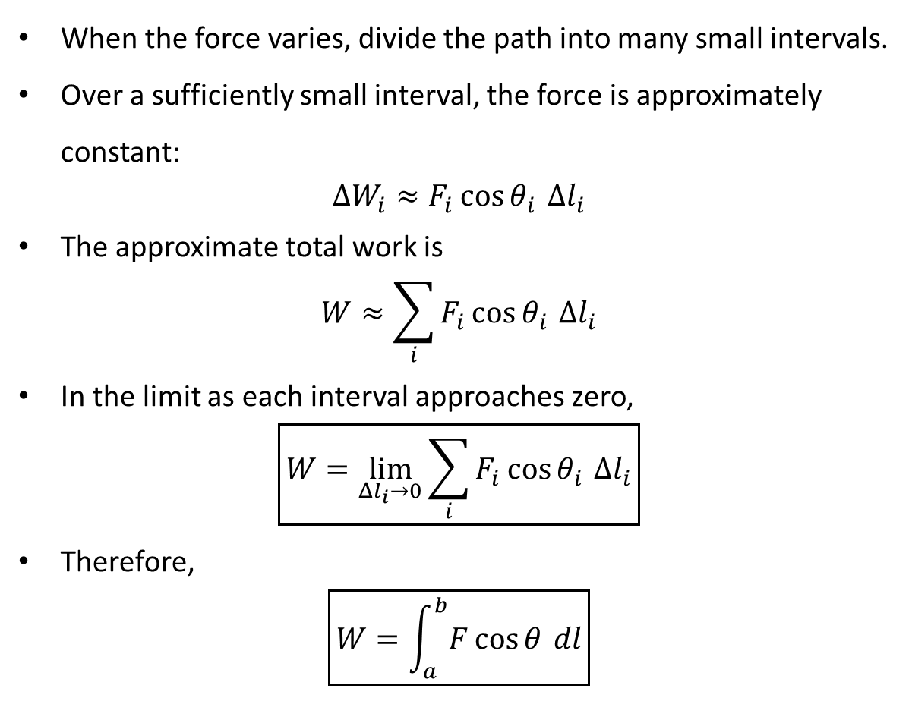
PHYS 2325 | University Physics I
Lecture 01 • Mon Sep 28 • Giancoli Ch. 7
Work Done by a Varying Force
When the force varies, divide the path into many small intervals.
Over a sufficiently small interval, the force is approximately constant:
$$ΔW_{i}≈F_{i}{\cos{θ}}_{i} Δl_{i}$$
The approximate total work is
$$W≈\sum_{i}{F_{i}}{\cos{θ}}_{i} Δl_{i}$$
In the limit as each interval approaches zero,
$$\boxed{W=\lim_{Δl_{i}→0}{\sum_{i}{F_{i}}}{\cos{θ}}_{i} Δl_{i}}$$
Therefore,
$$\boxed{W=\int_{a}^{b}{F}\cos{θ} dl}$$

Slide 23
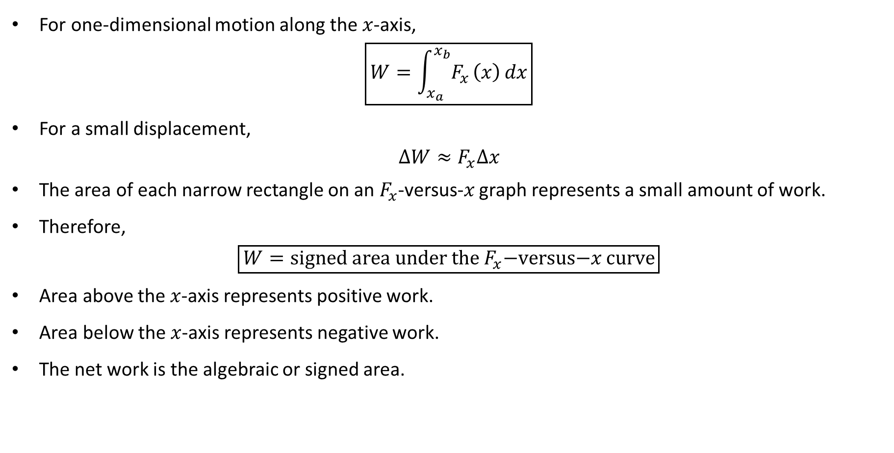
PHYS 2325 | University Physics I
Lecture 01 • Mon Sep 28 • Giancoli Ch. 7
Work as Area Under a Force Curve
For one-dimensional motion along the $x$-axis,
$$\boxed{W=\int_{x_{a}}^{x_{b}}{F_{x}}\left(x\right) dx}$$
For a small displacement,
$$ΔW≈F_{x}Δx$$
The area of each narrow rectangle on an $F_{x}$-versus-$x$ graph represents a small amount of work.
Therefore,
$$\boxed{W=\text{signed area under the }F_{x}\text{−versus−}x\text{ curve}}$$
Area above the $x$-axis represents positive work.
Area below the $x$-axis represents negative work.
The net work is the algebraic or signed area.

Slide 24
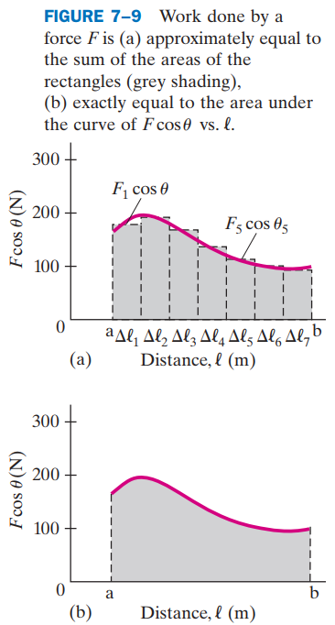
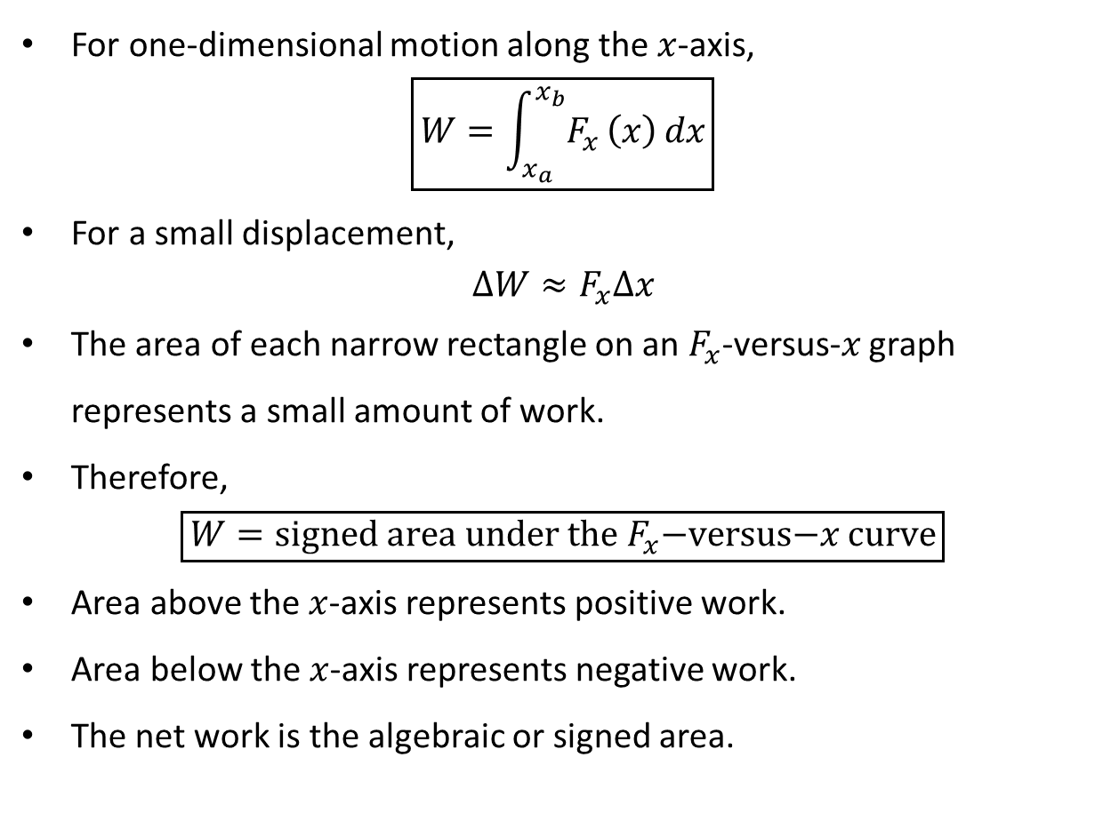
PHYS 2325 | University Physics I
Lecture 01 • Mon Sep 28 • Giancoli Ch. 7
Work as Area Under a Force Curve
For one-dimensional motion along the $x$-axis,
$$\boxed{W=\int_{x_{a}}^{x_{b}}{F_{x}}\left(x\right) dx}$$
For a small displacement,
$$ΔW≈F_{x}Δx$$
The area of each narrow rectangle on an $F_{x}$-versus-$x$ graph represents a small amount of work.
Therefore,
$$\boxed{W=\text{signed area under the }F_{x}\text{−versus−}x\text{ curve}}$$
Area above the $x$-axis represents positive work.
Area below the $x$-axis represents negative work.
The net work is the algebraic or signed area.

Slide 25
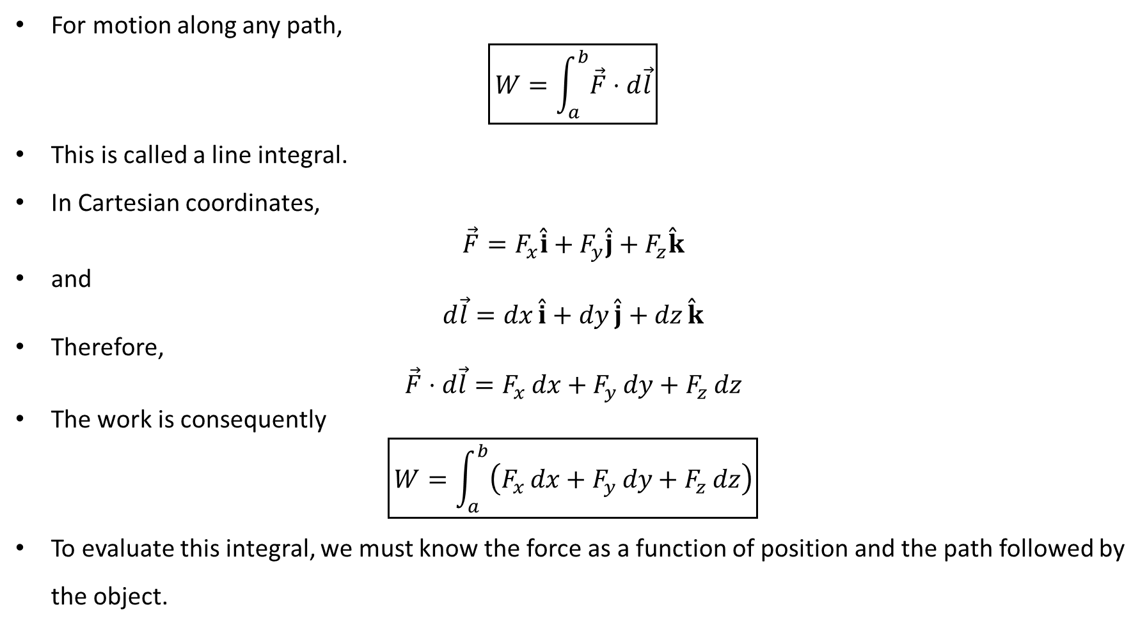
PHYS 2325 | University Physics I
Lecture 01 • Mon Sep 28 • Giancoli Ch. 7
General Definition of Work
For motion along any path,
$$\boxed{W=\int_{a}^{b}{\vec{F}}⋅d\vec{l}}$$
This is called a line integral.
In Cartesian coordinates,
$$\vec{F}=F_{x}\overset{ˆ}{i}+F_{y}\overset{ˆ}{j}+F_{z}\overset{ˆ}{k}$$
and
$$d\vec{l}=dx \overset{ˆ}{i}+dy \overset{ˆ}{j}+dz \overset{ˆ}{k}$$
Therefore,
$$\vec{F}⋅d\vec{l}=F_{x} dx+F_{y} dy+F_{z} dz$$
The work is consequently
$$\boxed{W=\int_{a}^{b}{\left(F_{x} dx+F_{y} dy+F_{z} dz\right)}}$$
To evaluate this integral, we must know the force as a function of position and the path followed by the object.

Slide 26
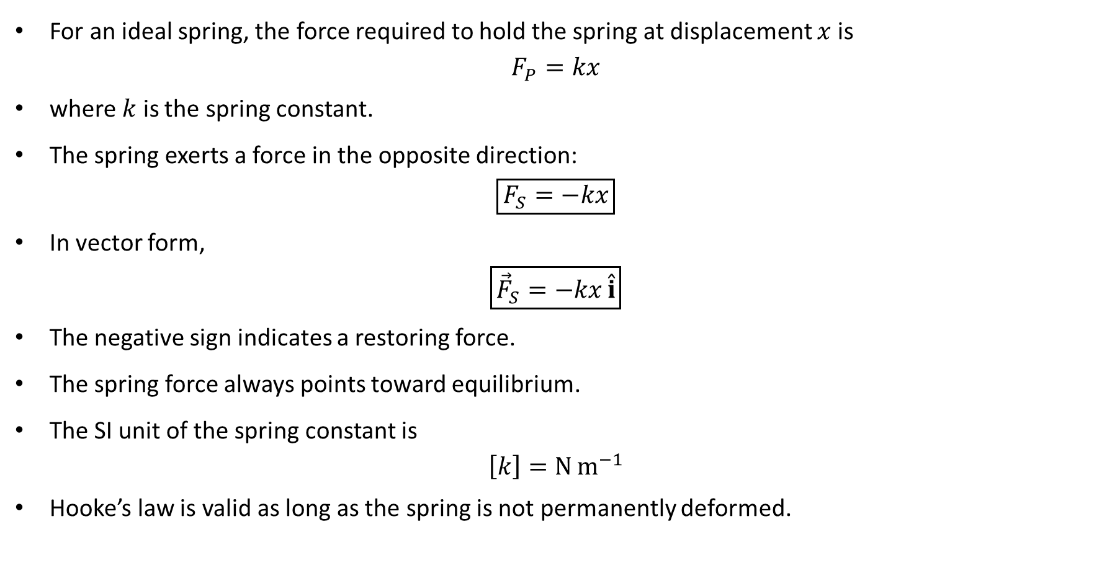
PHYS 2325 | University Physics I
Lecture 01 • Mon Sep 28 • Giancoli Ch. 7
Hooke’s Law for a Spring
For an ideal spring, the force required to hold the spring at displacement $x$is
$$F_{P}=kx$$
where $k$ is the spring constant.
The spring exerts a force in the opposite direction:
$$\boxed{F_{S}=−kx}$$
In vector form,
$$\boxed{{\vec{F}}_{S}=−kx \overset{ˆ}{i}}$$
The negative sign indicates a restoring force.
The spring force always points toward equilibrium.
The SI unit of the spring constant is
$$\left[k\right]=N m^{−1}$$
Hooke’s law is valid as long as the spring is not permanently deformed.

Slide 27
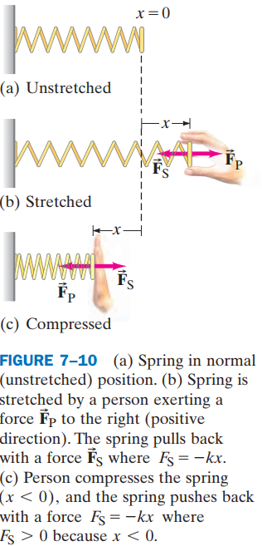
PHYS 2325 | University Physics I
Lecture 01 • Mon Sep 28 • Giancoli Ch. 7
Hooke’s Law for a Spring
For an ideal spring, the force required to hold the spring at displacement $x$is
$$F_{P}=kx$$
where $k$ is the spring constant.
The spring exerts a force in the opposite direction:
$$\boxed{F_{S}=−kx}$$
In vector form,
$$\boxed{{\vec{F}}_{S}=−kx \overset{ˆ}{i}}$$
The negative sign indicates a restoring force.
The spring force always points toward equilibrium.
The SI unit of the spring constant is
$$\left[k\right]=N m^{−1}$$
Hooke’s law is valid as long as the spring is not permanently deformed.

Slide 28
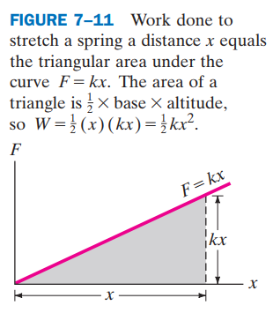
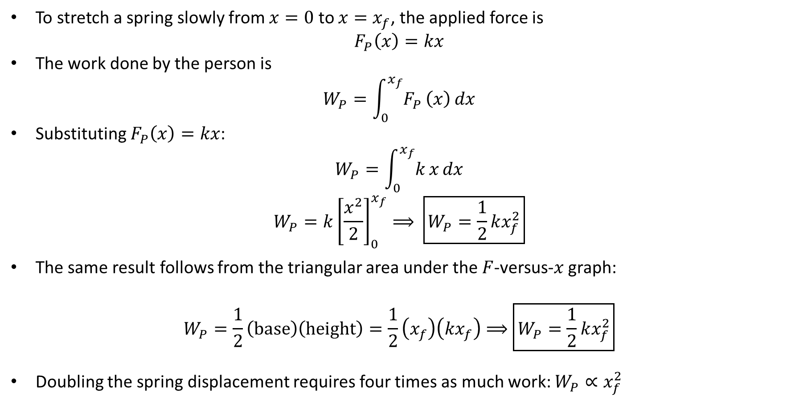
PHYS 2325 | University Physics I
Lecture 01 • Mon Sep 28 • Giancoli Ch. 7
Work Required to Stretch a Spring
To stretch a spring slowly from $x=0$ to $x=x_{f}$, the applied force is
$$F_{P}\left(x\right)=kx$$
The work done by the person is
$$W_{P}=\int_{0}^{x_{f}}{F_{P}}\left(x\right) dx$$
Substituting $F_{P}\left(x\right)=kx$:
$$W_{P}=\int_{0}^{x_{f}}{k}x dx$$
$$W_{P}=k{\left[\frac{x^{2}}{2}\right]}_{0}^{x_{f}}⟹ \boxed{W_{P}=\frac{1}{2}kx_{f}^{2}}$$
The same result follows from the triangular area under the $F$-versus-$x$ graph:
$$W_{P}=\frac{1}{2}\left(\text{base}\right)\left(\text{height}\right)=\frac{1}{2}\left(x_{f}\right)\left(kx_{f}\right)⟹\boxed{W_{P}=\frac{1}{2}kx_{f}^{2}}$$
Doubling the spring displacement requires four times as much work: $W_{P}∝x_{f}^{2}$

Slide 29
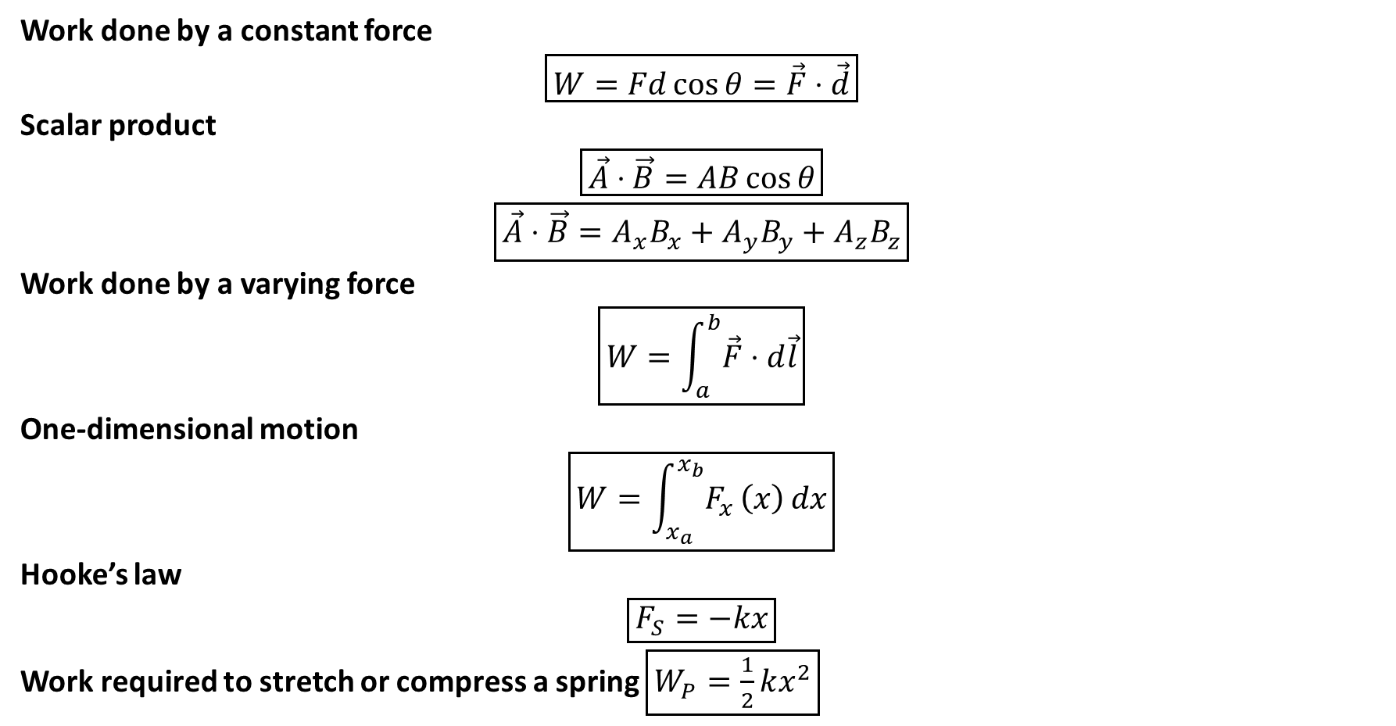
PHYS 2325 | University Physics I
Lecture 01 • Mon Sep 28 • Giancoli Ch. 7
Lecture Summary
Work done by a constant force
$$\boxed{W=Fd\cos{θ}=\vec{F}⋅\vec{d}}$$
Scalar product
$$\boxed{\vec{A}⋅\vec{B}=AB\cos{θ}}$$
$$\boxed{\vec{A}⋅\vec{B}=A_{x}B_{x}+A_{y}B_{y}+A_{z}B_{z}}$$
Work done by a varying force
$$\boxed{W=\int_{a}^{b}{\vec{F}}⋅d\vec{l}}$$
One-dimensional motion
$$\boxed{W=\int_{x_{a}}^{x_{b}}{F_{x}}\left(x\right) dx}$$
Hooke’s law
$$\boxed{F_{S}=−kx}$$
Work required to stretch or compress a spring $\boxed{W_{P}=\frac{1}{2}kx^{2}}$

Slide 30
LECTURE 02
Work-Energy Principle and Power
Wed Sep 30 • Giancoli Chs. 7 & 8
Muhammad Nauman • PHYS 2325 • Fall 2026
Notes:
Teaching focus: Work-Energy Principle and Power.
[Sources]
- PHYS 2325 University Physics I Fall 2026 syllabus and semester calendar.
[/Sources]

Slide 31
PHYS 2325 | University Physics I
Lecture 02 • Wed Sep 30 • Giancoli Chs. 7 & 8
Learning outcomes
Define and represent kinetic energy and the work-energy principle.
Derive and interpret power.
Check units, vector directions, assumptions, and limiting behavior in every solution.
Notes:
Teaching focus: Learning outcomes.
[Sources]
- PHYS 2325 University Physics I Fall 2026 syllabus and semester calendar.
[/Sources]

Slide 32
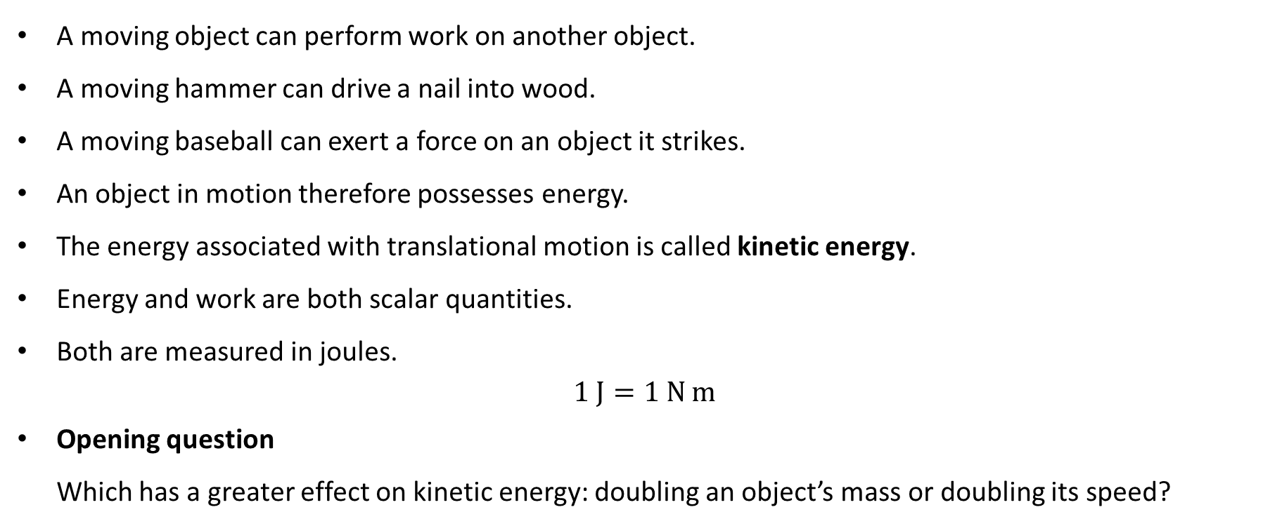
PHYS 2325 | University Physics I
Lecture 02 • Wed Sep 30 • Giancoli Chs. 7 & 8
From Work to Energy
A moving object can perform work on another object.
A moving hammer can drive a nail into wood.
A moving baseball can exert a force on an object it strikes.
An object in motion therefore possesses energy.
The energy associated with translational motion is called kinetic energy.
Energy and work are both scalar quantities.
Both are measured in joules.
$$1 J=1 N m$$
Opening question
Which has a greater effect on kinetic energy: doubling an object’s mass or doubling its speed?

Slide 33
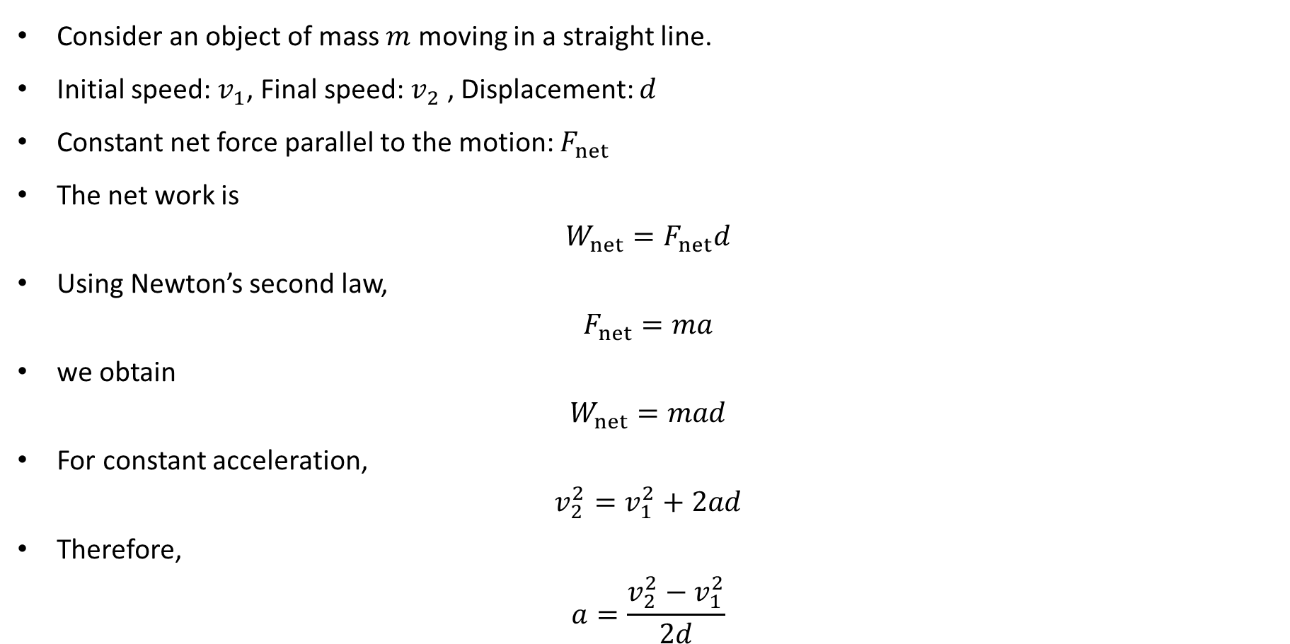
PHYS 2325 | University Physics I
Lecture 02 • Wed Sep 30 • Giancoli Chs. 7 & 8
Deriving the Kinetic-Energy Expression
Consider an object of mass $m$ moving in a straight line.
Initial speed: $v_{1}$, Final speed: $v_{2}$ , Displacement: $d$
Constant net force parallel to the motion: $F_{net}$
The net work is
$$W_{net}=F_{net}d$$
Using Newton’s second law,
$$F_{net}=ma$$
we obtain
$$W_{net}=mad$$
For constant acceleration,
$$v_{2}^{2}=v_{1}^{2}+2ad$$
Therefore,
$$a=\frac{v_{2}^{2}−v_{1}^{2}}{2d}$$

Slide 34
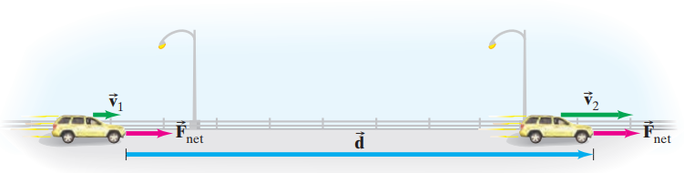
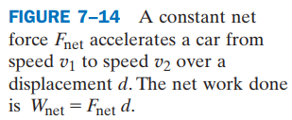
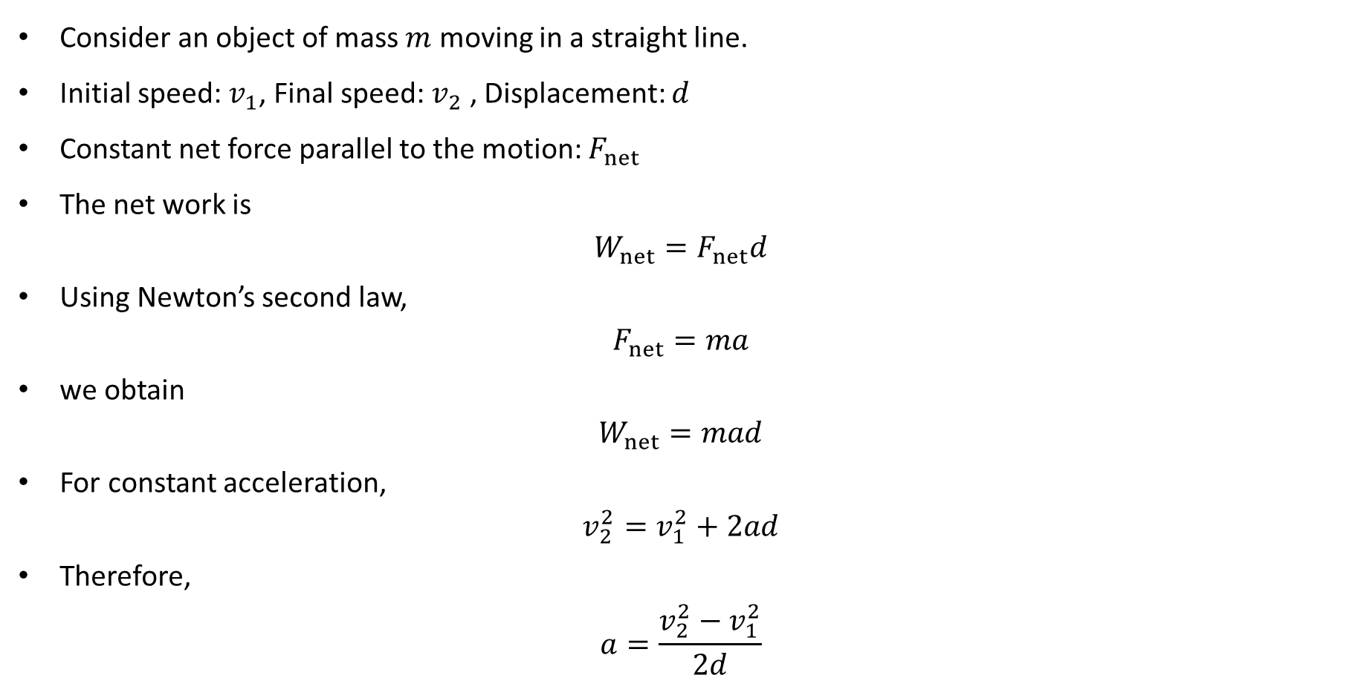
PHYS 2325 | University Physics I
Lecture 02 • Wed Sep 30 • Giancoli Chs. 7 & 8
Deriving the Kinetic-Energy Expression
Consider an object of mass $m$ moving in a straight line.
Initial speed: $v_{1}$, Final speed: $v_{2}$ , Displacement: $d$
Constant net force parallel to the motion: $F_{net}$
The net work is
$$W_{net}=F_{net}d$$
Using Newton’s second law,
$$F_{net}=ma$$
we obtain
$$W_{net}=mad$$
For constant acceleration,
$$v_{2}^{2}=v_{1}^{2}+2ad$$
Therefore,
$$a=\frac{v_{2}^{2}−v_{1}^{2}}{2d}$$

Slide 35
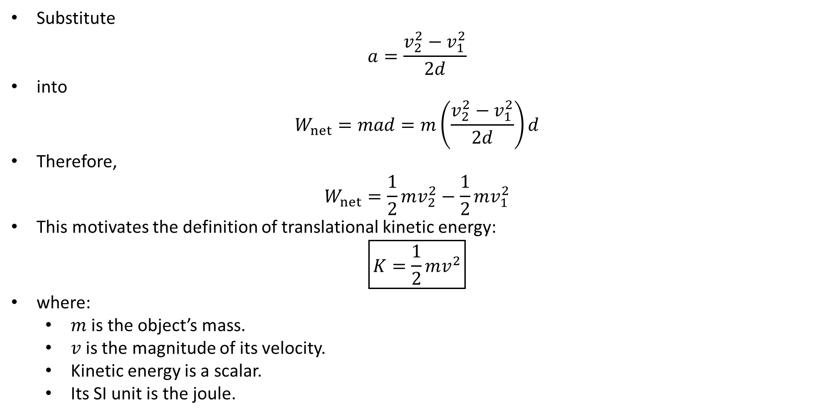
PHYS 2325 | University Physics I
Lecture 02 • Wed Sep 30 • Giancoli Chs. 7 & 8
Definition of Translational Kinetic Energy
Substitute
$$a=\frac{v_{2}^{2}−v_{1}^{2}}{2d}$$
into
$$W_{net}=mad=m\left(\frac{v_{2}^{2}−v_{1}^{2}}{2d}\right)d$$
Therefore,
$$W_{net}=\frac{1}{2}mv_{2}^{2}−\frac{1}{2}mv_{1}^{2}$$
This motivates the definition of translational kinetic energy:
$$\boxed{K=\frac{1}{2}mv^{2}}$$
where:
  $m$ is the object’s mass.
  $v$is the magnitude of its velocity.
  Kinetic energy is a scalar.
  Its SI unit is the joule.

Slide 36
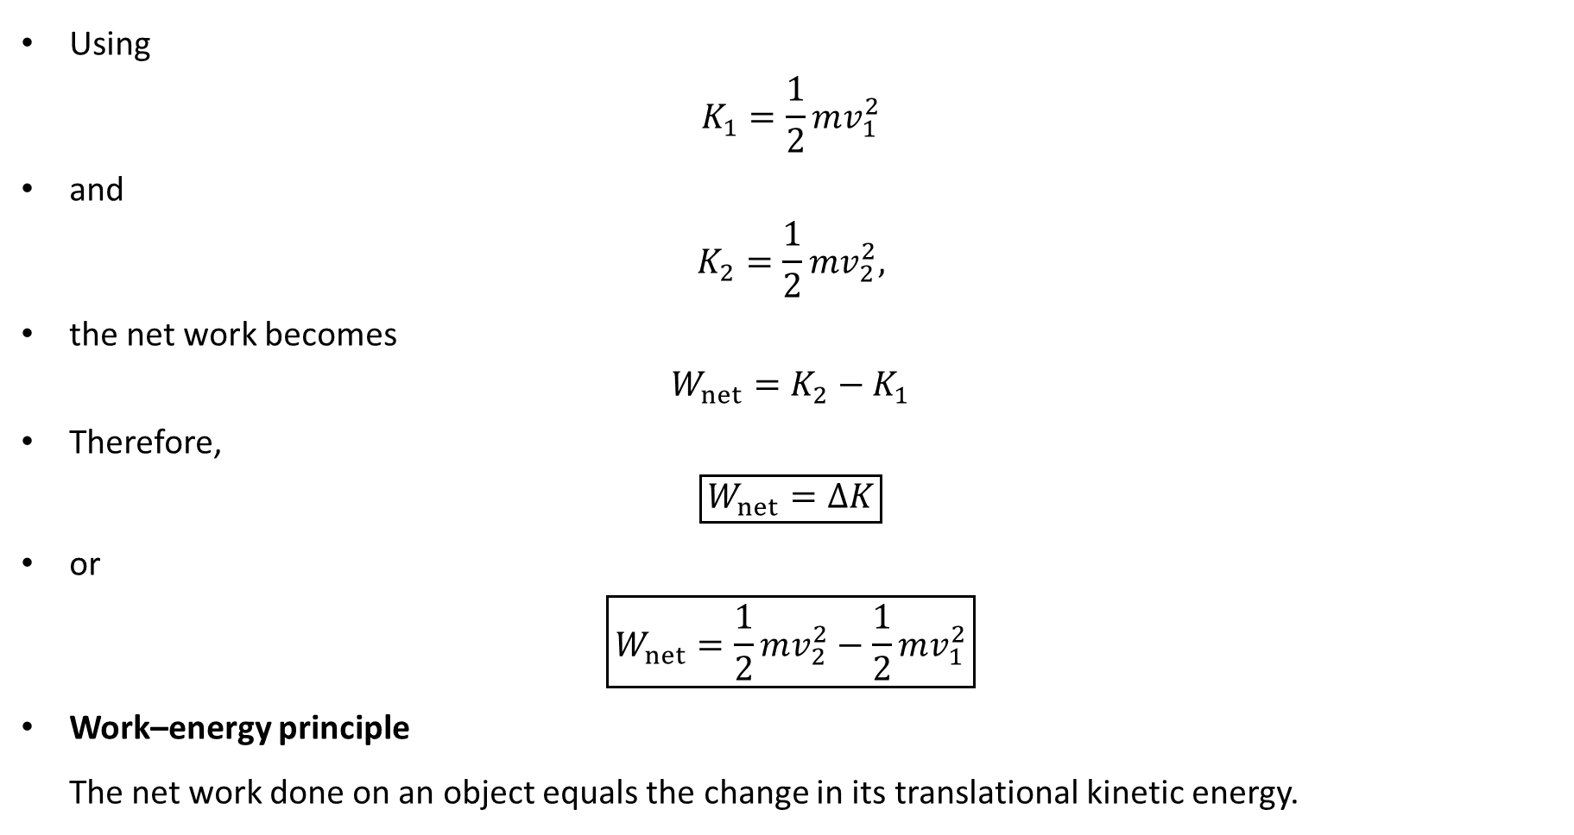
PHYS 2325 | University Physics I
Lecture 02 • Wed Sep 30 • Giancoli Chs. 7 & 8
The Work–Energy Principle
Using
$$K_{1}=\frac{1}{2}mv_{1}^{2}$$
and
$$K_{2}=\frac{1}{2}mv_{2}^{2},$$
the net work becomes
$$W_{net}=K_{2}−K_{1}$$
Therefore,
$$\boxed{W_{net}=ΔK}$$
or
$$\boxed{W_{net}=\frac{1}{2}mv_{2}^{2}−\frac{1}{2}mv_{1}^{2}}$$
Work–energy principle
The net work done on an object equals the change in its translational kinetic energy.

Slide 37
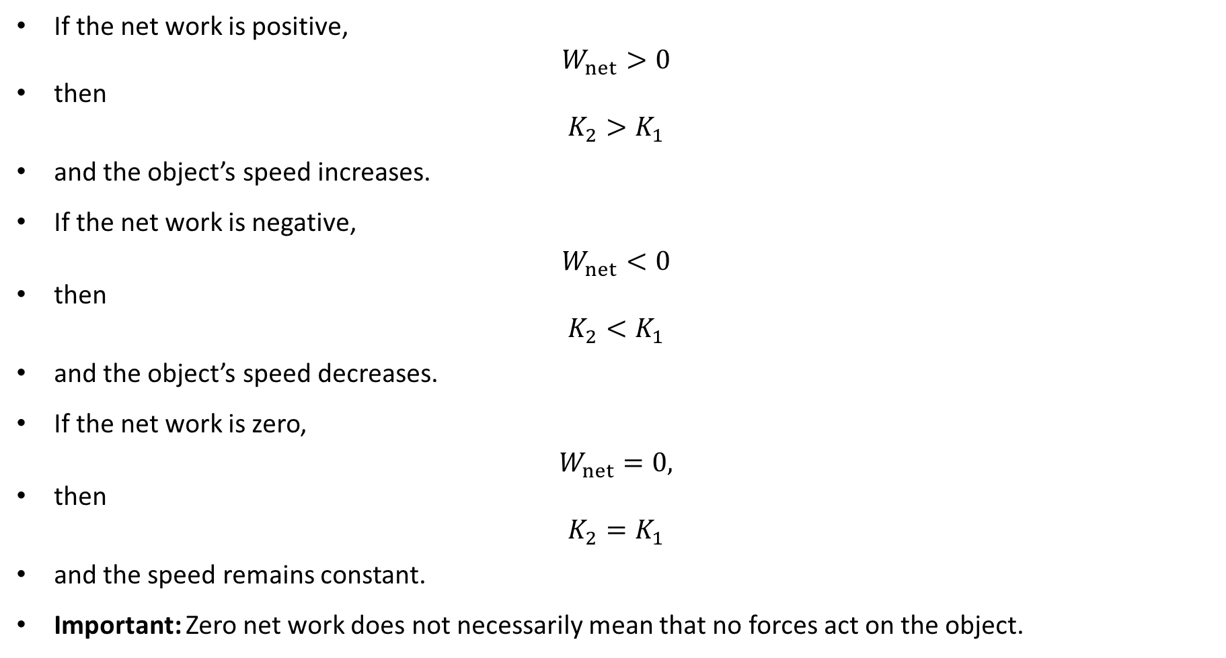
PHYS 2325 | University Physics I
Lecture 02 • Wed Sep 30 • Giancoli Chs. 7 & 8
Meaning of Positive and Negative Net Work
If the net work is positive,
$$W_{net}>0$$
then
$$K_{2}>K_{1}$$
and the object’s speed increases.
If the net work is negative,
$$W_{net}<0$$
then
$$K_{2}<K_{1}$$
and the object’s speed decreases.
If the net work is zero,
$$W_{net}=0,$$
then
$$K_{2}=K_{1}$$
and the speed remains constant.
Important: Zero net work does not necessarily mean that no forces act on the object.

Slide 38
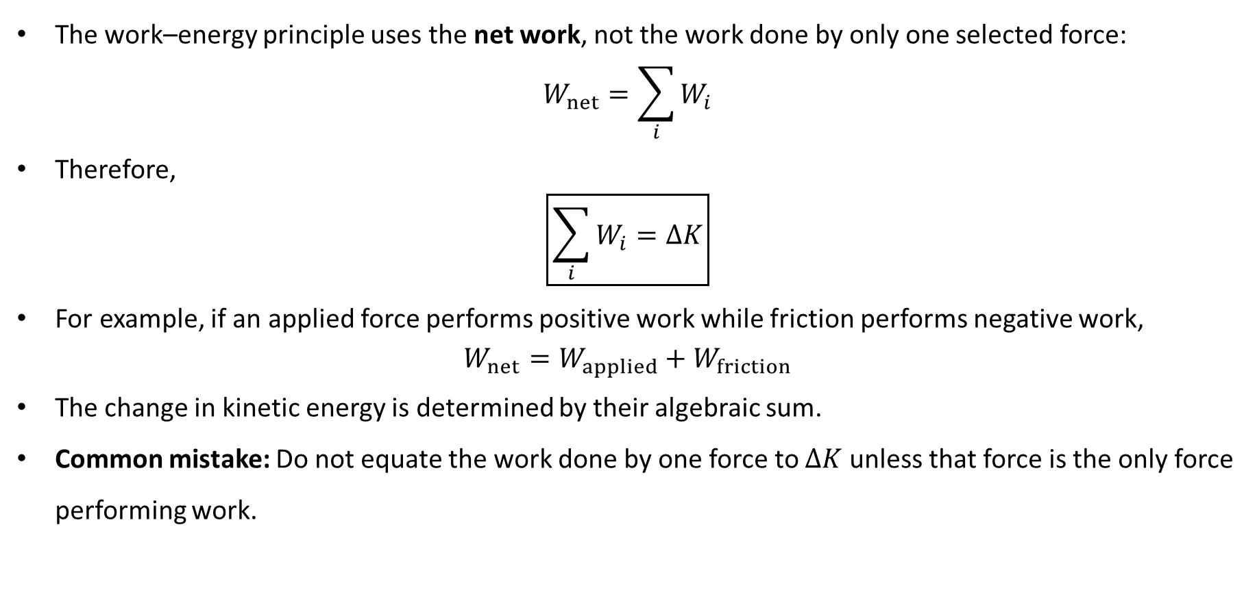
PHYS 2325 | University Physics I
Lecture 02 • Wed Sep 30 • Giancoli Chs. 7 & 8
Net Work Means Work by All Forces
The work–energy principle uses the net work, not the work done by only one selected force:
$$W_{net}=\sum_{i}{W_{i}}$$
Therefore,
$$\boxed{\sum_{i}{W_{i}}=ΔK}$$
For example, if an applied force performs positive work while friction performs negative work,
$$W_{net}=W_{applied}+W_{friction}$$
The change in kinetic energy is determined by their algebraic sum.
Common mistake: Do not equate the work done by one force to $ΔK$ unless that force is the only force performing work.

Slide 39
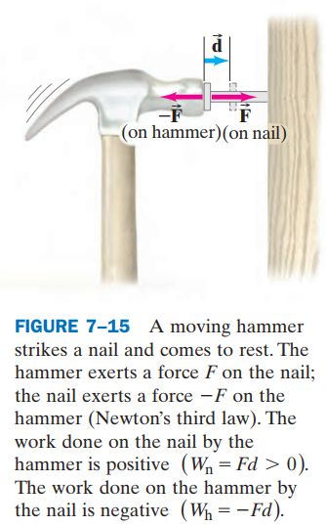
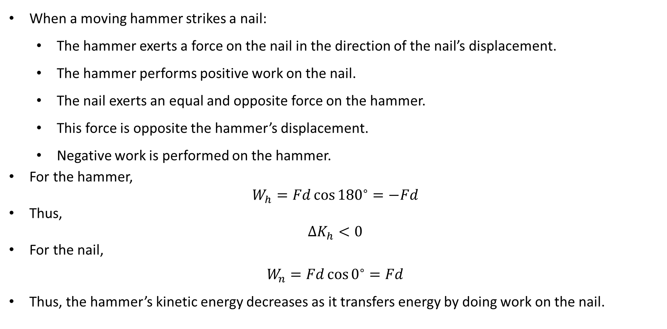
PHYS 2325 | University Physics I
Lecture 02 • Wed Sep 30 • Giancoli Chs. 7 & 8
Hammer and Nail: Energy Transfer
When a moving hammer strikes a nail:
  The hammer exerts a force on the nail in the direction of the nail’s displacement.
  The hammer performs positive work on the nail.
  The nail exerts an equal and opposite force on the hammer.
  This force is opposite the hammer’s displacement.
  Negative work is performed on the hammer.
For the hammer,
$$W_{h}=Fd{\cos{180}}^{∘}=−Fd$$
Thus,
$$ΔK_{h}<0$$
For the nail,
$$W_{n}=Fd{\cos{0}}^{∘}=Fd$$
Thus, the hammer’s kinetic energy decreases as it transfers energy by doing work on the nail.

Slide 40
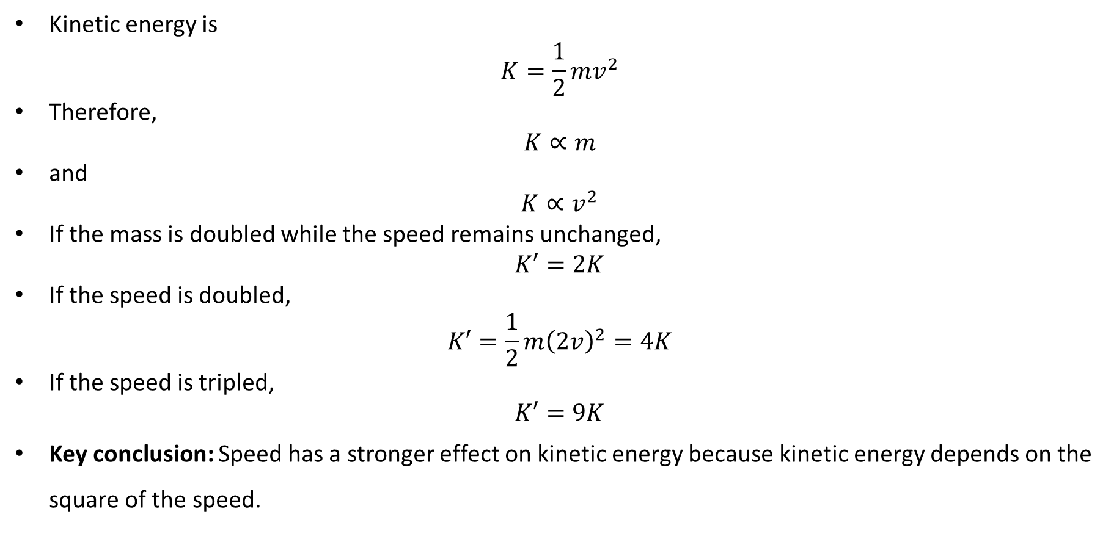
PHYS 2325 | University Physics I
Lecture 02 • Wed Sep 30 • Giancoli Chs. 7 & 8
Dependence of Kinetic Energy on Mass and Speed
Kinetic energy is
$$K=\frac{1}{2}mv^{2}$$
Therefore,
$$K∝m$$
and
$$K∝v^{2}$$
If the mass is doubled while the speed remains unchanged,
$$K′=2K$$
If the speed is doubled,
$$K′=\frac{1}{2}m{\left(2v\right)}^{2}=4K$$
If the speed is tripled,
$$K′=9K$$
Key conclusion: Speed has a stronger effect on kinetic energy because kinetic energy depends on the square of the speed.

Slide 41
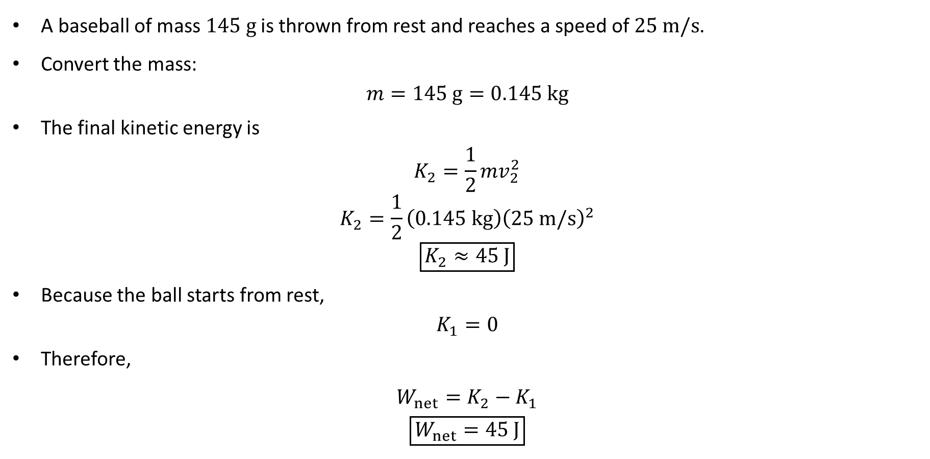
PHYS 2325 | University Physics I
Lecture 02 • Wed Sep 30 • Giancoli Chs. 7 & 8
Example 7–7: Baseball
A baseball of mass $145 g$is thrown from rest and reaches a speed of $25 m/s$.
Convert the mass:
$$m=145 g=0.145 kg$$
The final kinetic energy is
$$K_{2}=\frac{1}{2}mv_{2}^{2}$$
$$K_{2}=\frac{1}{2}\left(0.145 kg\right){\left(25 m/s\right)}^{2}$$
$$\boxed{K_{2}≈45 J}$$
Because the ball starts from rest,
$$K_{1}=0$$
Therefore,
$$W_{net}=K_{2}−K_{1}$$
$$\boxed{W_{net}=45 J}$$

Slide 42
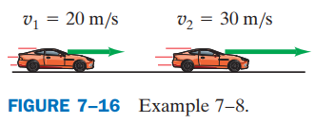
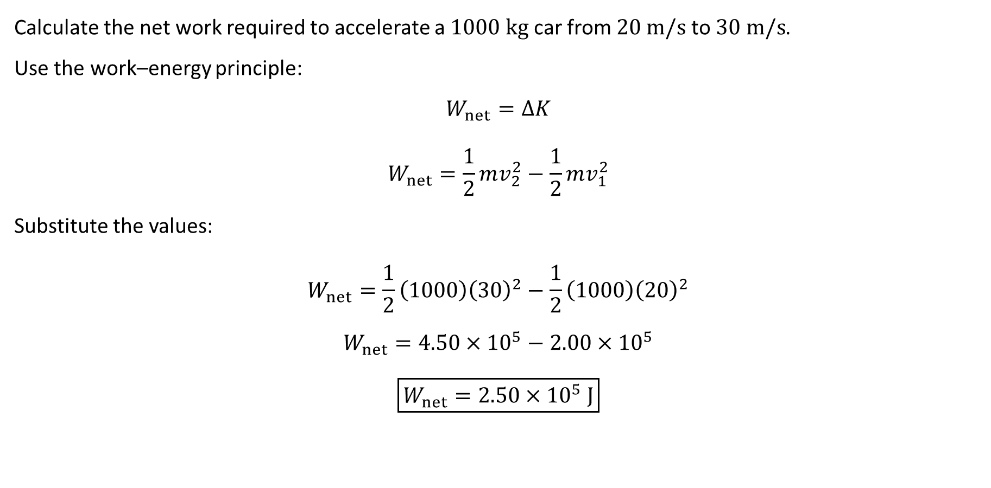
PHYS 2325 | University Physics I
Lecture 02 • Wed Sep 30 • Giancoli Chs. 7 & 8
Example 7–8: Accelerating a Car
Calculate the net work required to accelerate a $1000 kg$ car from $20 m/s$to $30 m/s$.
Use the work–energy principle:
$$W_{net}=ΔK$$
$$W_{net}=\frac{1}{2}mv_{2}^{2}−\frac{1}{2}mv_{1}^{2}$$
Substitute the values:
$$W_{net}=\frac{1}{2}\left(1000\right){\left(30\right)}^{2}−\frac{1}{2}\left(1000\right){\left(20\right)}^{2}$$
$$W_{net}=4.50×{10}^{5}−2.00×{10}^{5}$$
$$\boxed{W_{net}=2.50×{10}^{5} J}$$

Slide 43
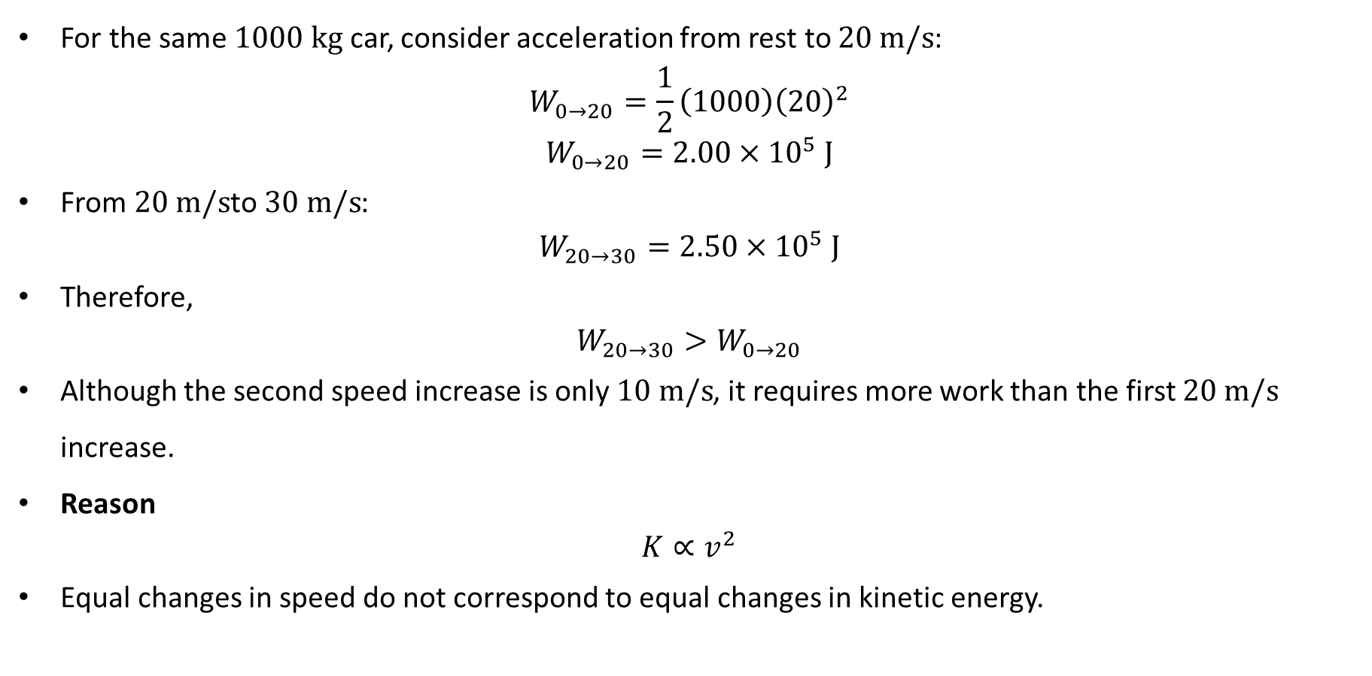
PHYS 2325 | University Physics I
Lecture 02 • Wed Sep 30 • Giancoli Chs. 7 & 8
Is Equal Speed Increase Equal Work?
For the same $1000 kg$ car, consider acceleration from rest to $20 m/s$:
$$W_{0→20}=\frac{1}{2}\left(1000\right){\left(20\right)}^{2}$$
$$W_{0→20}=2.00×{10}^{5} J$$
From $20 m/s$to $30 m/s$:
$$W_{20→30}=2.50×{10}^{5} J$$
Therefore,
$$W_{20→30}>W_{0→20}$$
Although the second speed increase is only $10 m/s$, it requires more work than the first $20 m/s$ increase.
Reason
$$K∝v^{2}$$
Equal changes in speed do not correspond to equal changes in kinetic energy.

Slide 44
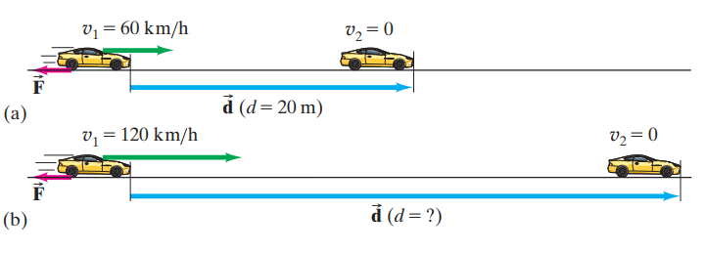

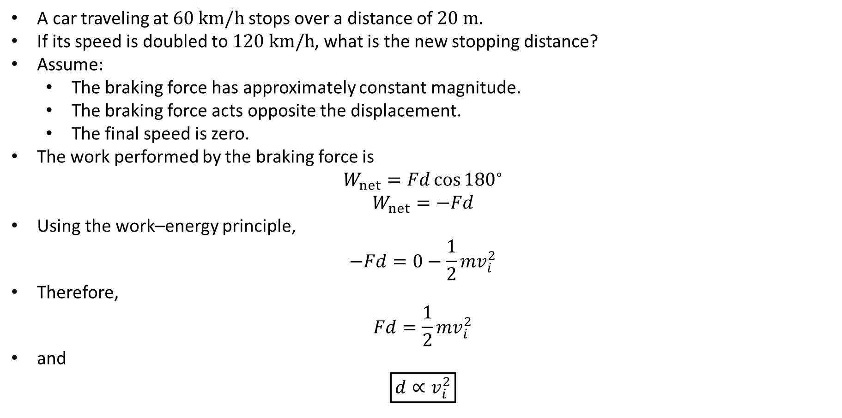
PHYS 2325 | University Physics I
Lecture 02 • Wed Sep 30 • Giancoli Chs. 7 & 8
Example 7–9: Stopping Distance
A car traveling at $60 km/h$stops over a distance of $20 m$.
If its speed is doubled to $120 km/h$, what is the new stopping distance?
Assume:
  The braking force has approximately constant magnitude.
  The braking force acts opposite the displacement.
  The final speed is zero.
The work performed by the braking force is
$$W_{net}=Fd{\cos{180}}^{∘}$$
$$W_{net}=−Fd$$
Using the work–energy principle,
$$−Fd=0−\frac{1}{2}mv_{i}^{2}$$
Therefore,
$$Fd=\frac{1}{2}mv_{i}^{2}$$
and
$$\boxed{d∝v_{i}^{2}}$$

Slide 45

PHYS 2325 | University Physics I
Lecture 02 • Wed Sep 30 • Giancoli Chs. 7 & 8
Why Doubling Speed Quadruples Stopping Distance
The original stopping distance is
$$d_{1}=20 m$$
The second speed is twice the first:
$$v_{2}=2v_{1}$$
Because
$$d∝v^{2},$$
we have
$$\frac{d_{2}}{d_{1}}={\left(\frac{v_{2}}{v_{1}}\right)}^{2}$$
$$\frac{d_{2}}{d_{1}}=2^{2}=4$$
Therefore,
$$d_{2}=4d_{1}$$
$$d_{2}=4\left(20 m\right)$$
$$\boxed{d_{2}=80 m}$$
Safety implication: A modest increase in driving speed can produce a much larger increase in stopping distance.

Slide 46

PHYS 2325 | University Physics I
Lecture 02 • Wed Sep 30 • Giancoli Chs. 7 & 8
General Validity of the Work–Energy Principle
The work–energy principle also applies when:
The net force varies with position.
The motion follows a curved path.
The motion occurs in two or three dimensions.
The general expression for net work is
$$W_{net}=\int_{1}^{2}{{\vec{F}}_{net}}⋅d\vec{l}$$
Only the component of force parallel to the instantaneous displacement contributes:
$$W_{net}=\int_{1}^{2}{F_{∥}} dl$$
Using Newton’s second law,
$$F_{∥}=ma_{∥}$$
and
$$a_{∥}=\frac{dv}{dt}$$

Slide 47

PHYS 2325 | University Physics I
Lecture 02 • Wed Sep 30 • Giancoli Chs. 7 & 8
General Derivation
Using the chain rule,
$$\frac{dv}{dt}=\frac{dv}{dl}\frac{dl}{dt}$$
Since
$$\frac{dl}{dt}=v,$$
we obtain
$$\frac{dv}{dt}=v\frac{dv}{dl}$$
Therefore,
$$W_{net}=\int_{1}^{2}{m}\frac{dv}{dt} dl$$
$$W_{net}=\int_{v_{1}}^{v_{2}}{m}v dv$$
Integrating,
$$W_{net}={\left[\frac{1}{2}mv^{2}\right]}_{v_{1}}^{v_{2}}⟹\boxed{W_{net}=\frac{1}{2}mv_{2}^{2}−\frac{1}{2}mv_{1}^{2}=ΔK}$$

Slide 48

PHYS 2325 | University Physics I
Lecture 02 • Wed Sep 30 • Giancoli Chs. 7 & 8
Perpendicular Forces and Kinetic Energy
If a force is perpendicular to the instantaneous displacement,
$$\vec{F}⋅d\vec{l}=0$$
and therefore,
$$W=0$$
A perpendicular force can change the direction of the velocity but cannot change its magnitude.
For uniform circular motion:
The centripetal force points toward the center.
The instantaneous displacement is tangential.
The angle between them is ${90}^{∘}$.
Thus,
$$W_{centripetal}=0$$
and
$$ΔK=0$$
The object’s speed remains constant even though its velocity continuously changes direction.

Slide 49

PHYS 2325 | University Physics I
Lecture 02 • Wed Sep 30 • Giancoli Chs. 7 & 8
Lecture Summary
Translational kinetic energy
$$\boxed{K=\frac{1}{2}mv^{2}}$$
Work–energy principle
$$\boxed{W_{net}=ΔK}$$
$$\boxed{W_{net}=\frac{1}{2}mv_{2}^{2}−\frac{1}{2}mv_{1}^{2}}$$
Interpretation
$$W_{net}>0 ⇒ K\text{ increases}$$
$$W_{net}<0 ⇒ K\text{ decreases}$$
$$W_{net}=0 ⇒ K\text{ remains constant}$$
Important consequences
$$K∝v^{2}$$
$$d_{stopping}∝v^{2}$$
The work–energy principle remains valid for varying forces and motion in multiple dimensions.

Slide 50
UNIT EXAM 1
Quiy 1 - No New Lecture Content
Fri Oct 2 • Course schedule
Muhammad Nauman • PHYS 2325 • Fall 2026
Notes:
Teaching focus: Unit Exam 1 - No New Lecture Content.
[Sources]
- PHYS 2325 University Physics I Fall 2026 syllabus and semester calendar.
[/Sources]

Slide 51
PHYS 2325 | University Physics I
UNIT EXAM 1 • Fri Oct 2 • Course schedule
Quiz 1 - No New Lecture Content
Coverage: Weeks 1-6, Giancoli Chapters 1-7 as taught.
Show free-body diagrams, equations, units, and reasoning for partial credit.
Check the official LMS announcement for room and exam instructions.

