Slide 1
WEEK 07
Potential Energy and Conservation of Energy
Oct 5-9 • Giancoli Chapter 8
Muhammad Nauman • PHYS 2325 • Fall 2026
Notes:
Teaching focus: Potential Energy and Conservation of Energy.
[Sources]
- PHYS 2325 University Physics I Fall 2026 syllabus and semester calendar.
[/Sources]

Slide 2
PHYS 2325 | University Physics I
Week 07 • Oct 5-9 • Giancoli Chapter 8
This week follows one connected learning path
01
02
03
MON OCT 5
Conservative Forces and Potential Energy
WED OCT 7
Mechanical Energy and Dissipative Forces
FRI OCT 9
Universal Gravitational Energy and Energy Diagrams
Notes:
Teaching focus: This week follows one connected learning path.
[Sources]
- PHYS 2325 University Physics I Fall 2026 syllabus and semester calendar.
[/Sources]

Slide 3
LECTURE 01
Conservative Forces and Potential Energy
Mon Oct 5 • Giancoli Ch. 8
Muhammad Nauman • PHYS 2325 • Fall 2026
Notes:
Teaching focus: Conservative Forces and Potential Energy.
[Sources]
- PHYS 2325 University Physics I Fall 2026 syllabus and semester calendar.
[/Sources]

Slide 4
PHYS 2325 | University Physics I
Lecture 01 • Mon Oct 5 • Giancoli Ch. 8
Learning outcomes
Define and represent conservative and nonconservative forces.
Derive and interpret potential energy.
Apply mechanical energy conservation.
Check units, vector directions, assumptions, and limiting behavior in every solution.

Slide 5
PHYS 2325 | University Physics I
Lecture 01 • Mon Oct 5 • Giancoli Ch. 8
Conservation of Energy
Energy conservation is one of the major unifying principles of physics.
Energy can change from one form to another.
Energy can be transferred between objects.
The total energy of an isolated system remains constant.
Energy methods often simplify problems that would be difficult to solve directly using Newton’s laws.
Topics
  Conservative and nonconservative forces
  Gravitational potential energy
  Reference levels and systems
  General definition of potential energy
  Elastic potential energy
  Relationship between force and potential energy

Slide 6
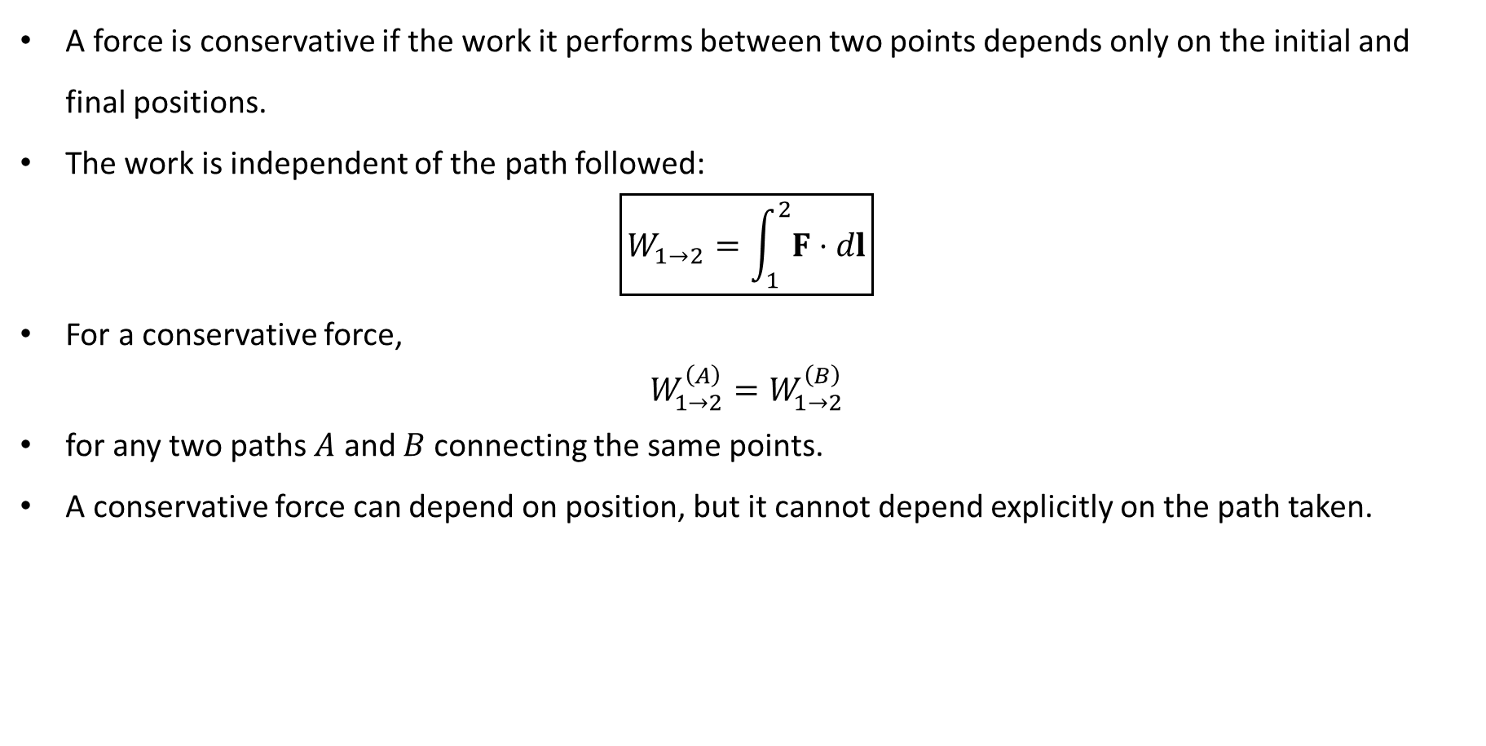
PHYS 2325 | University Physics I
Lecture 01 • Mon Oct 5 • Giancoli Ch. 8
Conservative Forces
A force is conservative if the work it performs between two points depends only on the initial and final positions.
The work is independent of the path followed:
$$\boxed{W_{1→2}=\int_{1}^{2}{F}⋅dl}$$
For a conservative force,
$$W_{1→2}^{\left(A\right)}=W_{1→2}^{\left(B\right)}$$
for any two paths $A$ and $B$ connecting the same points.
A conservative force can depend on position, but it cannot depend explicitly on the path taken.

Slide 7
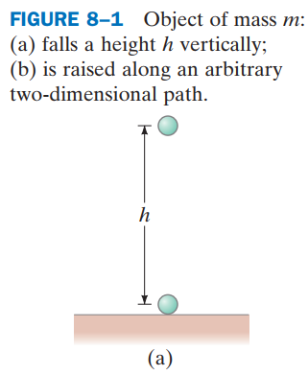
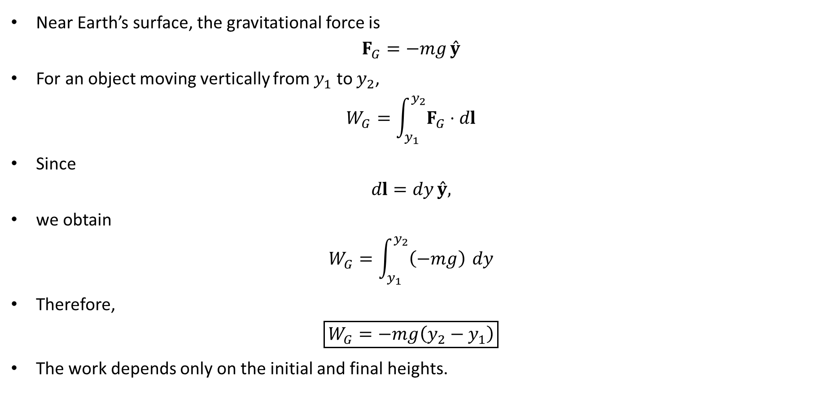
PHYS 2325 | University Physics I
Lecture 01 • Mon Oct 5 • Giancoli Ch. 8
Gravity as a Conservative Force
Near Earth’s surface, the gravitational force is
$$F_{G}=−mg \overset{ˆ}{y}$$
For an object moving vertically from $y_{1}$ to $y_{2}$,
$$W_{G}=\int_{y_{1}}^{y_{2}}{F_{G}}⋅dl$$
Since
$$dl=dy \overset{ˆ}{y},$$
we obtain
$$W_{G}=\int_{y_{1}}^{y_{2}}{\left(−mg\right)} dy$$
Therefore,
$$\boxed{W_{G}=−mg\left(y_{2}−y_{1}\right)}$$
The work depends only on the initial and final heights.

Slide 8
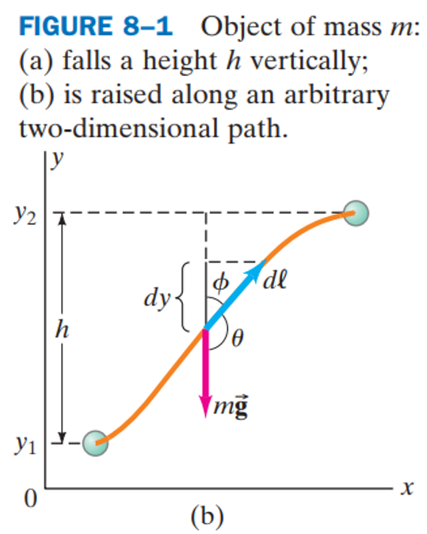
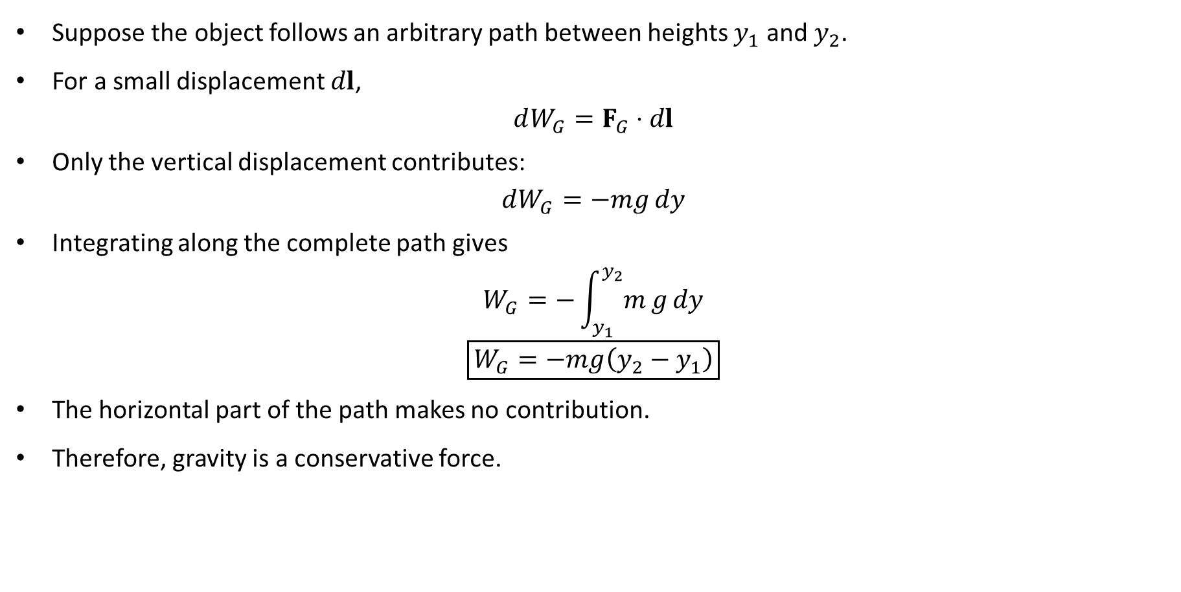
PHYS 2325 | University Physics I
Lecture 01 • Mon Oct 5 • Giancoli Ch. 8
Gravity: Independence of Path
Suppose the object follows an arbitrary path between heights $y_{1}$ and $y_{2}$.
For a small displacement $dl$,
$$dW_{G}=F_{G}⋅dl$$
Only the vertical displacement contributes:
$$dW_{G}=−mg dy$$
Integrating along the complete path gives
$$W_{G}=−\int_{y_{1}}^{y_{2}}{m}g dy$$
$$\boxed{W_{G}=−mg\left(y_{2}−y_{1}\right)}$$
The horizontal part of the path makes no contribution.
Therefore, gravity is a conservative force.

Slide 9
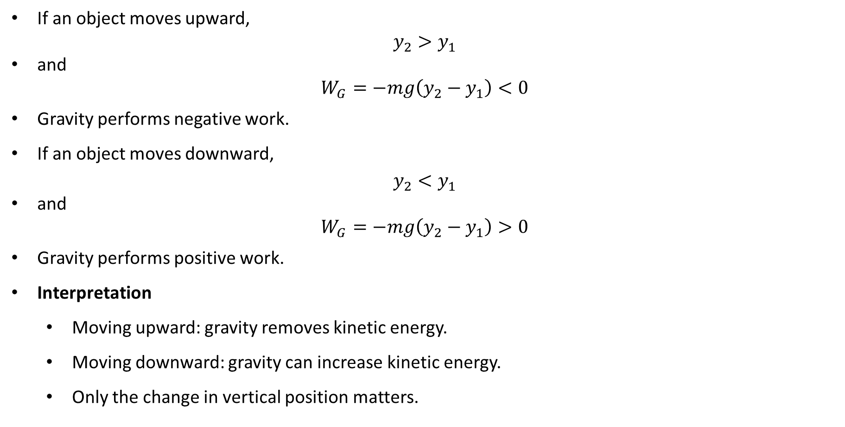
PHYS 2325 | University Physics I
Lecture 01 • Mon Oct 5 • Giancoli Ch. 8
Sign of the Work Done by Gravity
If an object moves upward,
$$y_{2}>y_{1}$$
and
$$W_{G}=−mg\left(y_{2}−y_{1}\right)<0$$
Gravity performs negative work.
If an object moves downward,
$$y_{2}<y_{1}$$
and
$$W_{G}=−mg\left(y_{2}−y_{1}\right)>0$$
Gravity performs positive work.
Interpretation
  Moving upward: gravity removes kinetic energy.
  Moving downward: gravity can increase kinetic energy.
  Only the change in vertical position matters.

Slide 10
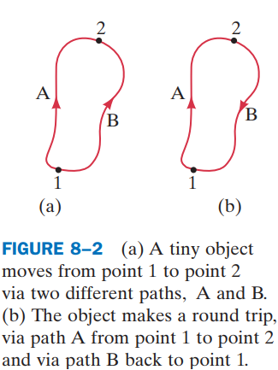
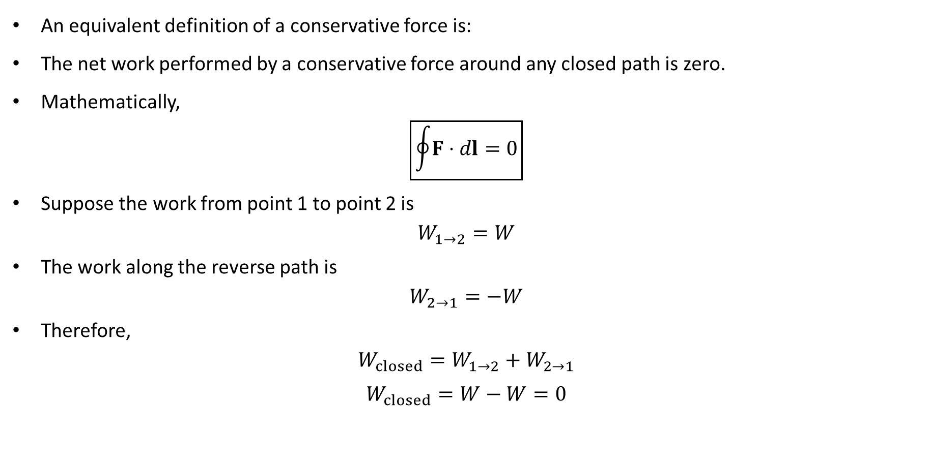
PHYS 2325 | University Physics I
Lecture 01 • Mon Oct 5 • Giancoli Ch. 8
Closed-Path Test
An equivalent definition of a conservative force is:
The net work performed by a conservative force around any closed path is zero.
Mathematically,
$$\boxed{\oint{F}⋅dl=0}$$
Suppose the work from point 1 to point 2 is
$$W_{1→2}=W$$
The work along the reverse path is
$$W_{2→1}=−W$$
Therefore,
$$W_{closed}=W_{1→2}+W_{2→1}$$
$$W_{closed}=W−W=0$$

Slide 11
PHYS 2325 | University Physics I
Lecture 01 • Mon Oct 5 • Giancoli Ch. 8
Recoverable Work
For a conservative force:
  Positive work performed along one part of a closed path is recovered as negative work along the return path.
  No net mechanical energy is lost during a complete cycle.
  Energy can be stored as potential energy and later recovered.
Examples of conservative forces include:
  Gravitational force
  Ideal spring force
  Electrostatic force
For these forces, potential energy can be defined.

Slide 12
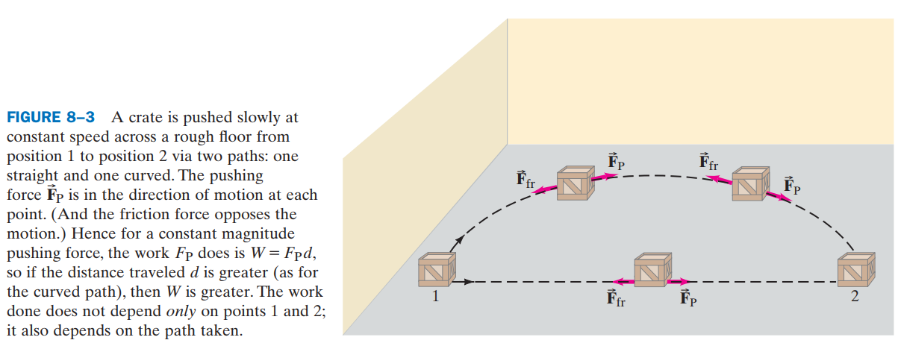
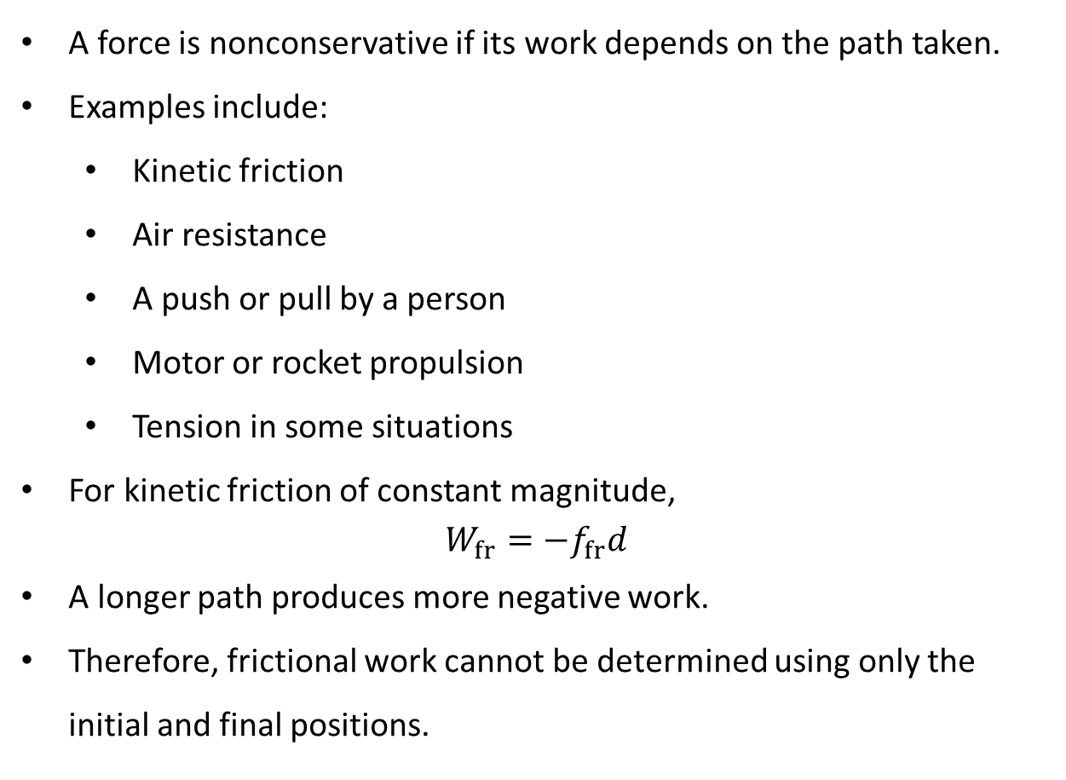
PHYS 2325 | University Physics I
Lecture 01 • Mon Oct 5 • Giancoli Ch. 8
Nonconservative Forces
A force is nonconservative if its work depends on the path taken.
Examples include:
  Kinetic friction
  Air resistance
  A push or pull by a person
  Motor or rocket propulsion
  Tension in some situations
For kinetic friction of constant magnitude,
$$W_{fr}=−f_{fr}d$$
A longer path produces more negative work.
Therefore, frictional work cannot be determined using only the initial and final positions.

Slide 13
PHYS 2325 | University Physics I
Lecture 01 • Mon Oct 5 • Giancoli Ch. 8
Conservative vs. Nonconservative Forces
Conservative forces | Nonconservative forces
Work is path independent | Work depends on the path
Closed-path work is zero | Closed-path work is generally nonzero
Potential energy can be defined | No unique potential energy can be defined
Mechanical energy can be stored and recovered | Mechanical energy is often transformed into thermal energy
Gravity, spring, electric force | Friction, drag, propulsion
Important: Potential energy is associated only with conservative forces.

Slide 14
PHYS 2325 | University Physics I
Lecture 01 • Mon Oct 5 • Giancoli Ch. 8
What Is Potential Energy?
Potential energy is energy associated with the position or configuration of a system.
Examples include:
  An object raised above Earth
  A compressed or stretched spring
  Two interacting electric charges
Potential energy is associated with a system—not with an isolated object alone.
Examples:
  Gravitational potential energy belongs to the object–Earth system.
  Elastic potential energy belongs to the object–spring system.
  Electric potential energy belongs to the system of interacting charges.

Slide 15
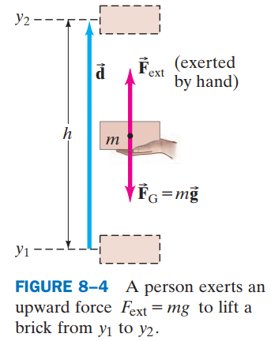
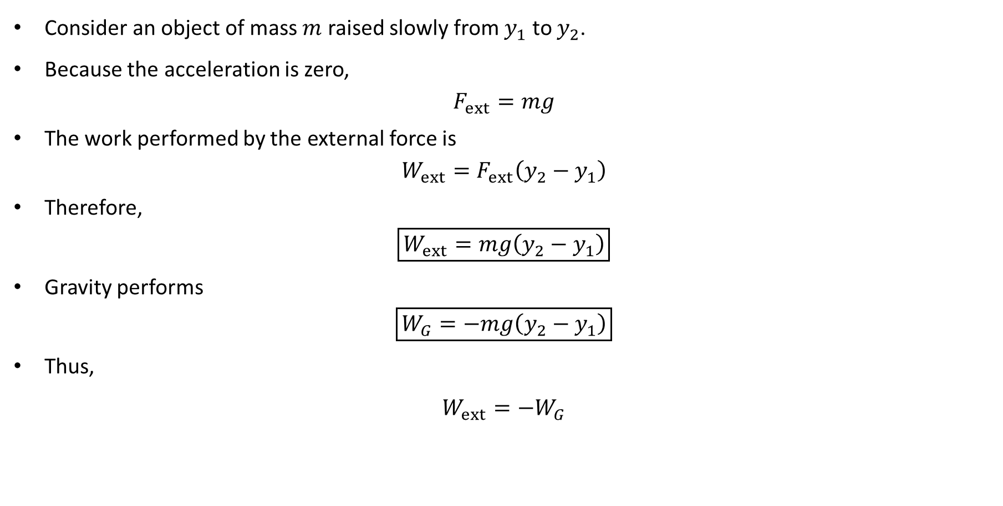
PHYS 2325 | University Physics I
Lecture 01 • Mon Oct 5 • Giancoli Ch. 8
Lifting an Object
Consider an object of mass $m$ raised slowly from $y_{1}$ to $y_{2}$.
Because the acceleration is zero,
$$F_{ext}=mg$$
The work performed by the external force is
$$W_{ext}=F_{ext}\left(y_{2}−y_{1}\right)$$
Therefore,
$$\boxed{W_{ext}=mg\left(y_{2}−y_{1}\right)}$$
Gravity performs
$$\boxed{W_{G}=−mg\left(y_{2}−y_{1}\right)}$$
Thus,
$$W_{ext}=−W_{G}$$

Slide 16
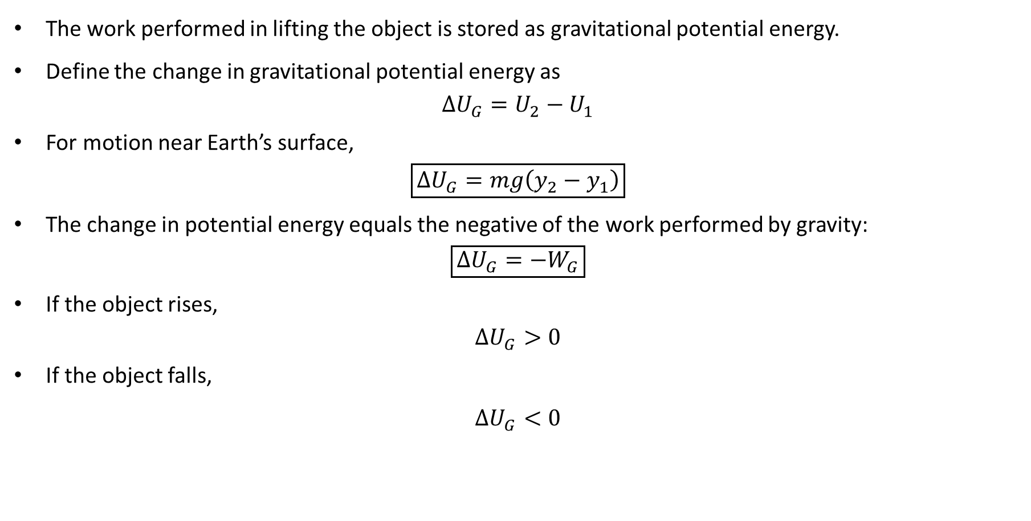
PHYS 2325 | University Physics I
Lecture 01 • Mon Oct 5 • Giancoli Ch. 8
Gravitational Potential Energy
The work performed in lifting the object is stored as gravitational potential energy.
Define the change in gravitational potential energy as
$$ΔU_{G}=U_{2}−U_{1}$$
For motion near Earth’s surface,
$$\boxed{ΔU_{G}=mg\left(y_{2}−y_{1}\right)}$$
The change in potential energy equals the negative of the work performed by gravity:
$$\boxed{ΔU_{G}=−W_{G}}$$
If the object rises,
$$ΔU_{G}>0$$
If the object falls,
$$ΔU_{G}<0$$

Slide 17
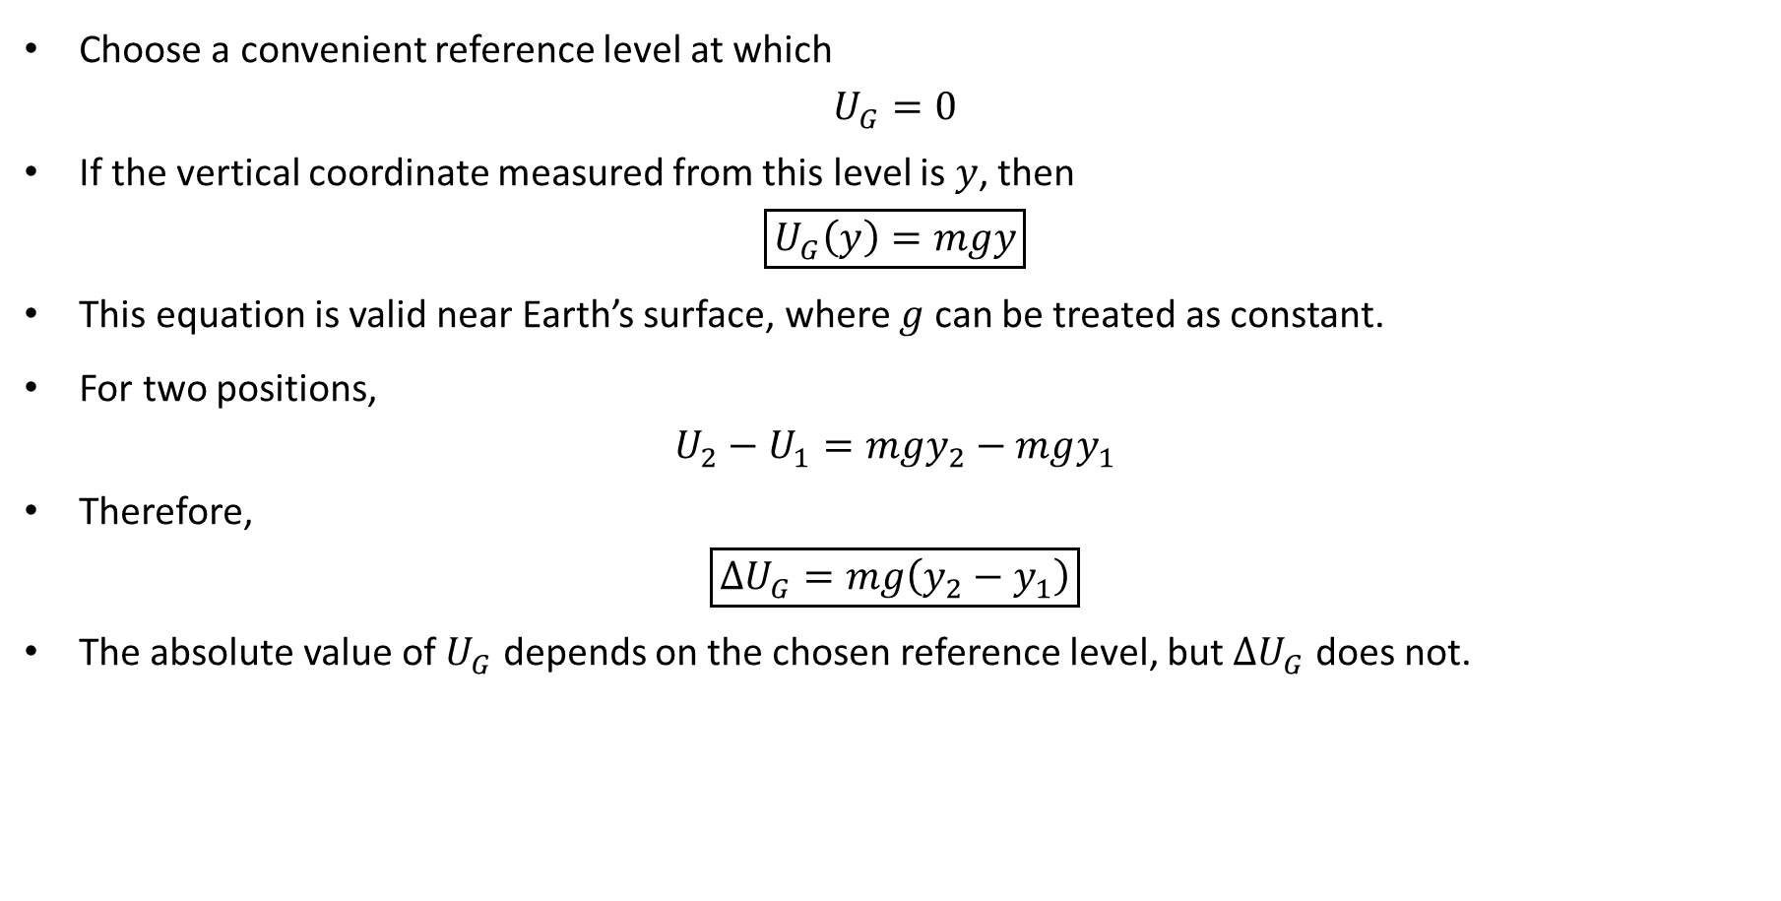
PHYS 2325 | University Physics I
Lecture 01 • Mon Oct 5 • Giancoli Ch. 8
Gravitational Potential-Energy Function
Choose a convenient reference level at which
$$U_{G}=0$$
If the vertical coordinate measured from this level is $y$, then
$$\boxed{U_{G}\left(y\right)=mgy}$$
This equation is valid near Earth’s surface, where $g$ can be treated as constant.
For two positions,
$$U_{2}−U_{1}=mgy_{2}−mgy_{1}$$
Therefore,
$$\boxed{ΔU_{G}=mg\left(y_{2}−y_{1}\right)}$$
The absolute value of $U_{G}$ depends on the chosen reference level, but $ΔU_{G}$ does not.

Slide 18
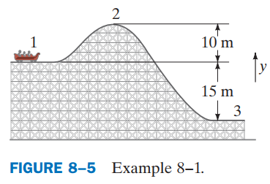
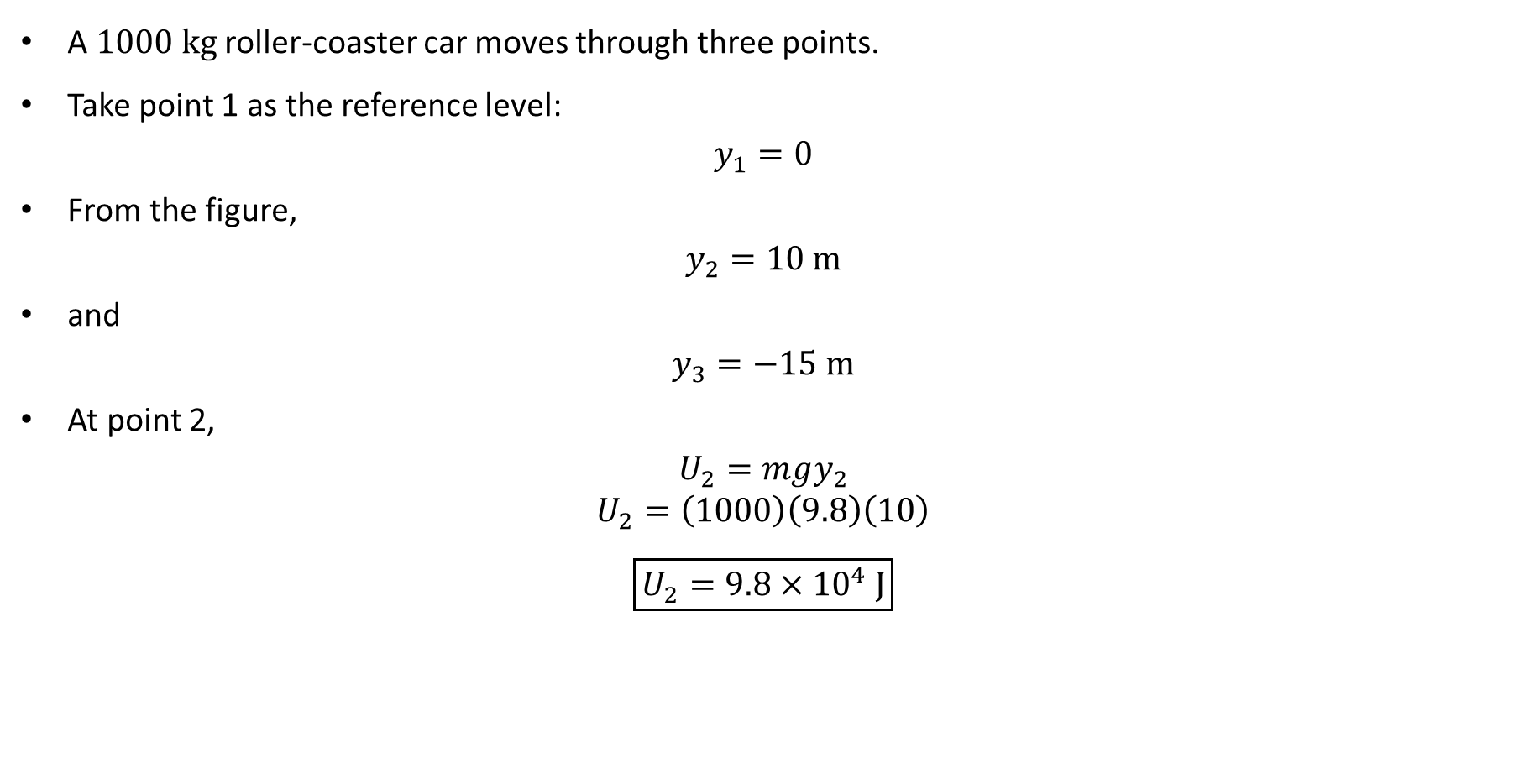
PHYS 2325 | University Physics I
Lecture 01 • Mon Oct 5 • Giancoli Ch. 8
Example 8–1: Roller Coaster
A $1000 kg$ roller-coaster car moves through three points.
Take point 1 as the reference level:
$$y_{1}=0$$
From the figure,
$$y_{2}=10 m$$
and
$$y_{3}=−15 m$$
At point 2,
$$U_{2}=mgy_{2}$$
$$U_{2}=\left(1000\right)\left(9.8\right)\left(10\right)$$
$$\boxed{U_{2}=9.8×{10}^{4} J}$$

Slide 19
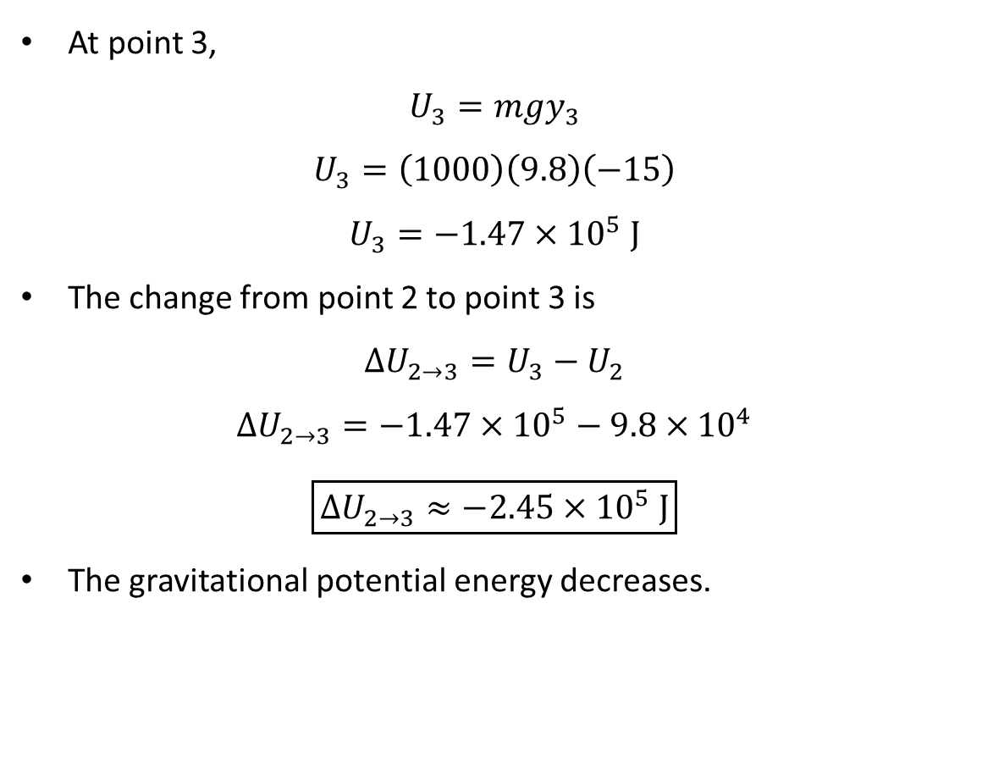
PHYS 2325 | University Physics I
Lecture 01 • Mon Oct 5 • Giancoli Ch. 8
Roller-Coaster Potential-Energy Change
At point 3,
$$U_{3}=mgy_{3}$$
$$U_{3}=\left(1000\right)\left(9.8\right)\left(−15\right)$$
$$U_{3}=−1.47×{10}^{5} J$$
The change from point 2 to point 3 is
$$ΔU_{2→3}=U_{3}−U_{2}$$
$$ΔU_{2→3}=−1.47×{10}^{5}−9.8×{10}^{4}$$
$$\boxed{ΔU_{2→3}≈−2.45×{10}^{5} J}$$
The gravitational potential energy decreases.

Slide 20
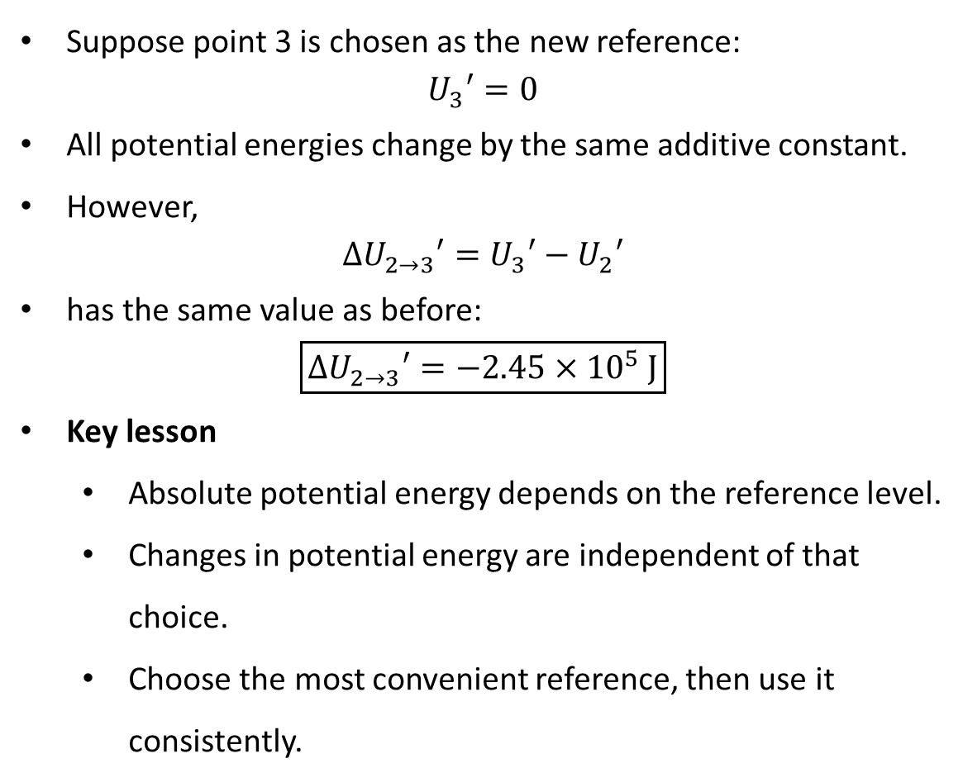
PHYS 2325 | University Physics I
Lecture 01 • Mon Oct 5 • Giancoli Ch. 8
Choice of Reference Level
Suppose point 3 is chosen as the new reference:
$$U_{3}′=0$$
All potential energies change by the same additive constant.
However,
$$ΔU_{2→3}′=U_{3}′−U_{2}′$$
has the same value as before:
$$\boxed{ΔU_{2→3}′=−2.45×{10}^{5} J}$$
Key lesson
  Absolute potential energy depends on the reference level.
  Changes in potential energy are independent of that choice.
  Choose the most convenient reference, then use it consistently.

Slide 21
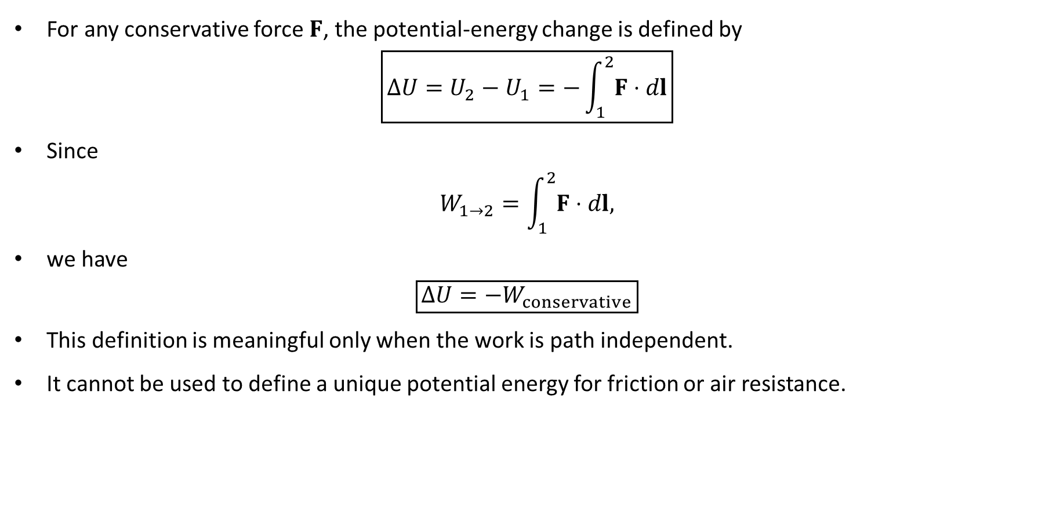
PHYS 2325 | University Physics I
Lecture 01 • Mon Oct 5 • Giancoli Ch. 8
General Definition of Potential Energy
For any conservative force $F$, the potential-energy change is defined by
$$\boxed{ΔU=U_{2}−U_{1}=−\int_{1}^{2}{F}⋅dl}$$
Since
$$W_{1→2}=\int_{1}^{2}{F}⋅dl,$$
we have
$$\boxed{ΔU=−W_{conservative}}$$
This definition is meaningful only when the work is path independent.
It cannot be used to define a unique potential energy for friction or air resistance.

Slide 22
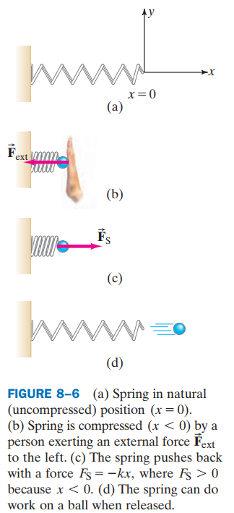
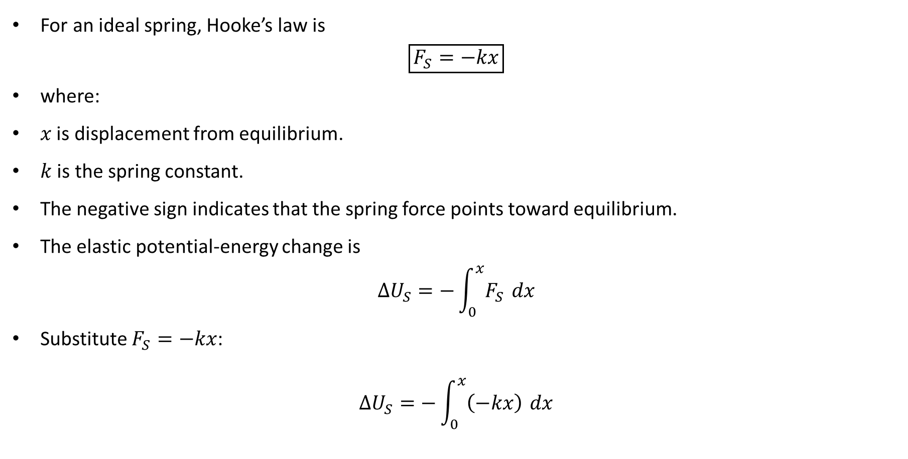
PHYS 2325 | University Physics I
Lecture 01 • Mon Oct 5 • Giancoli Ch. 8
Elastic Potential Energy
For an ideal spring, Hooke’s law is
$$\boxed{F_{S}=−kx}$$
where:
$x$ is displacement from equilibrium.
$k$ is the spring constant.
The negative sign indicates that the spring force points toward equilibrium.
The elastic potential-energy change is
$$ΔU_{S}=−\int_{0}^{x}{F_{S}} dx$$
Substitute $F_{S}=−kx$:
$$ΔU_{S}=−\int_{0}^{x}{\left(−kx\right)} dx$$

Slide 23
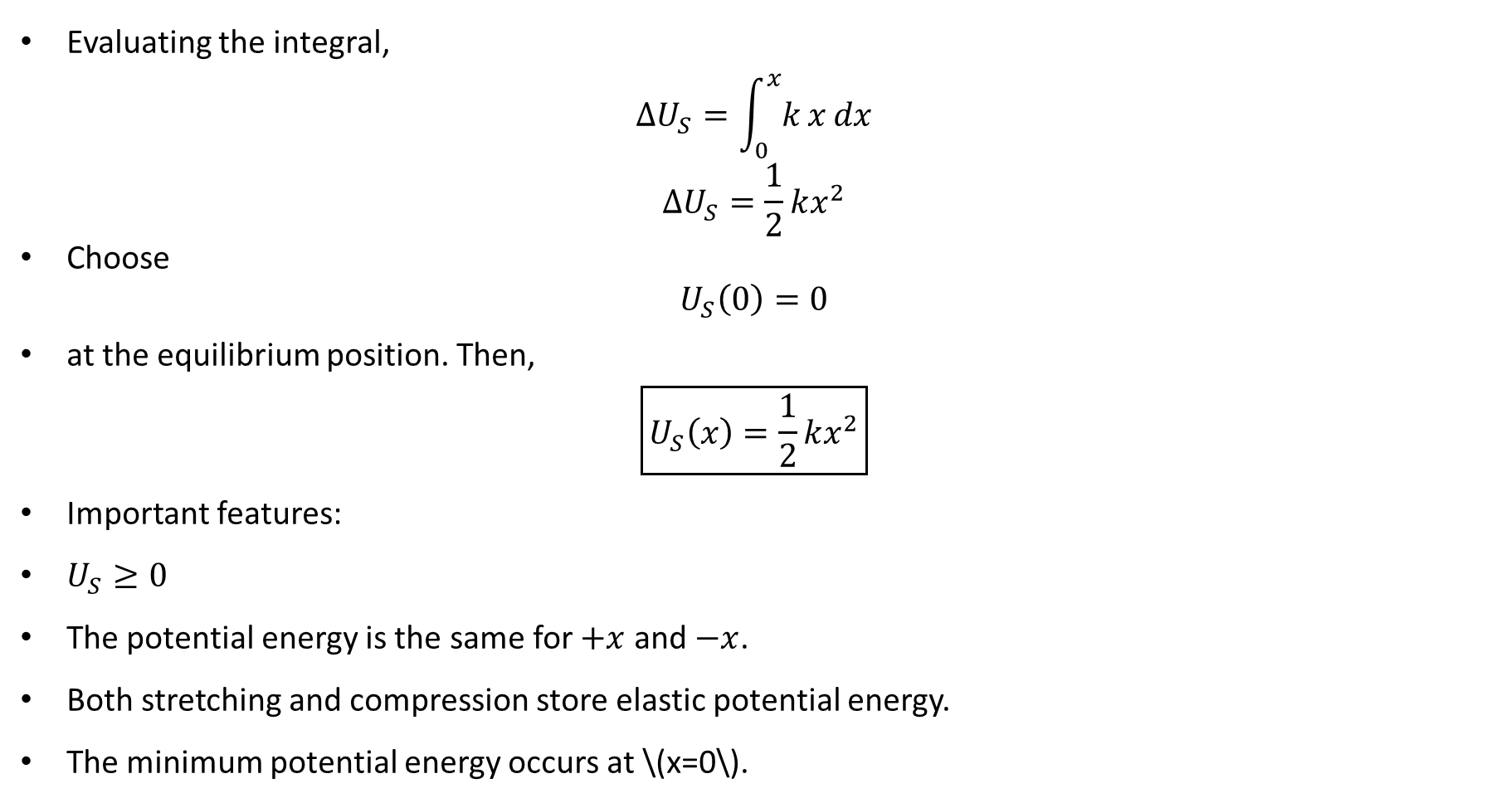
PHYS 2325 | University Physics I
Lecture 01 • Mon Oct 5 • Giancoli Ch. 8
Spring Potential-Energy Function
Evaluating the integral,
$$ΔU_{S}=\int_{0}^{x}{k}x dx$$
$$ΔU_{S}=\frac{1}{2}kx^{2}$$
Choose
$$U_{S}\left(0\right)=0$$
at the equilibrium position. Then,
$$\boxed{U_{S}\left(x\right)=\frac{1}{2}kx^{2}}$$
Important features:
$U_{S}≥0$
The potential energy is the same for $+x$ and $−x$.
Both stretching and compression store elastic potential energy.
The minimum potential energy occurs at \(x=0\).

Slide 24
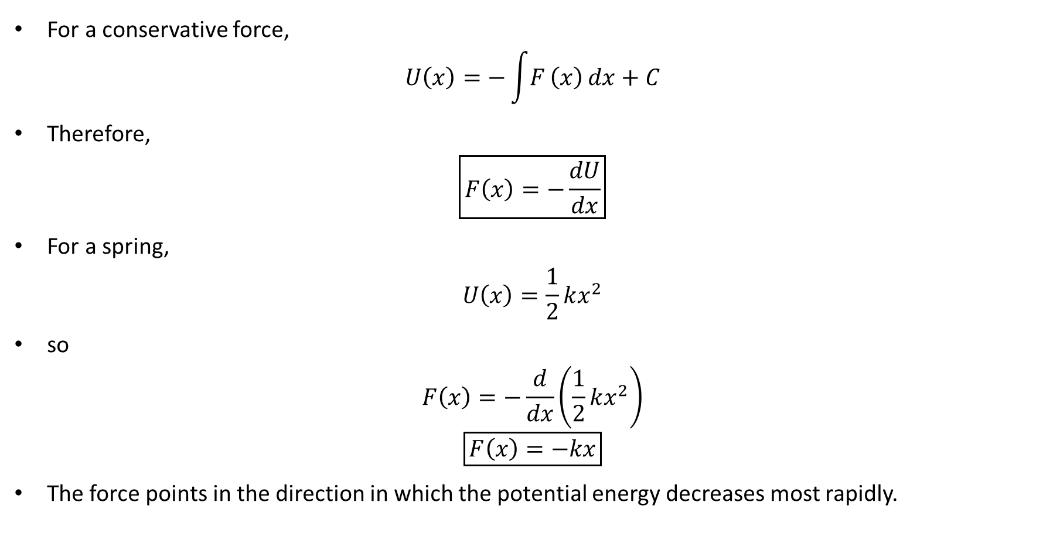
PHYS 2325 | University Physics I
Lecture 01 • Mon Oct 5 • Giancoli Ch. 8
Force from Potential Energy in One Dimension
For a conservative force,
$$U\left(x\right)=−\int{F}\left(x\right) dx+C$$
Therefore,
$$\boxed{F\left(x\right)=−\frac{dU}{dx}}$$
For a spring,
$$U\left(x\right)=\frac{1}{2}kx^{2}$$
so
$$F\left(x\right)=−\frac{d}{dx}\left(\frac{1}{2}kx^{2}\right)$$
$$\boxed{F\left(x\right)=−kx}$$
The force points in the direction in which the potential energy decreases most rapidly.

Slide 25
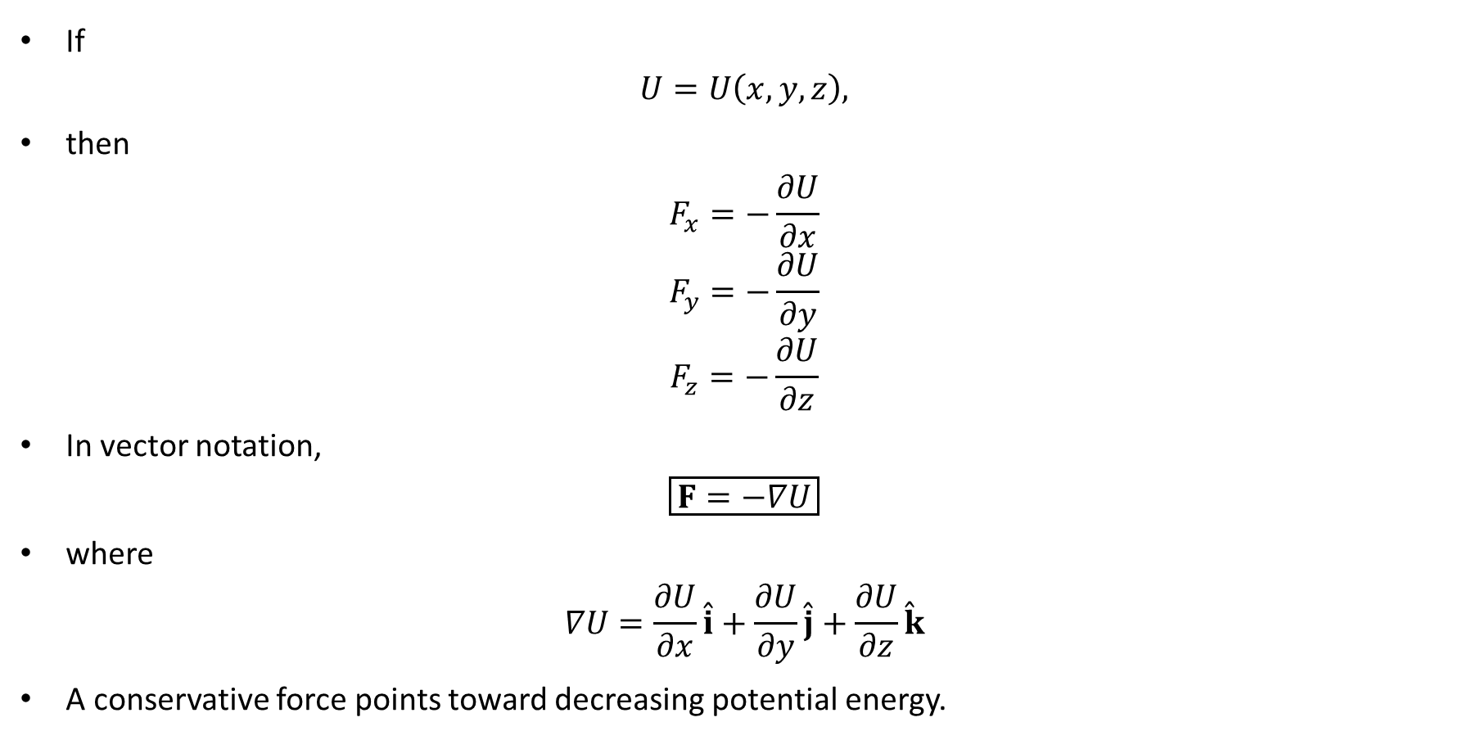
PHYS 2325 | University Physics I
Lecture 01 • Mon Oct 5 • Giancoli Ch. 8
Force and Potential Energy in Three Dimensions
If
$$U=U\left(x,y,z\right),$$
then
$$F_{x}=−\frac{∂U}{∂x}$$
$$F_{y}=−\frac{∂U}{∂y}$$
$$F_{z}=−\frac{∂U}{∂z}$$
In vector notation,
$$\boxed{F=−∇U}$$
where
$$∇U=\frac{∂U}{∂x}\overset{ˆ}{i}+\frac{∂U}{∂y}\overset{ˆ}{j}+\frac{∂U}{∂z}\overset{ˆ}{k}$$
A conservative force points toward decreasing potential energy.

Slide 26
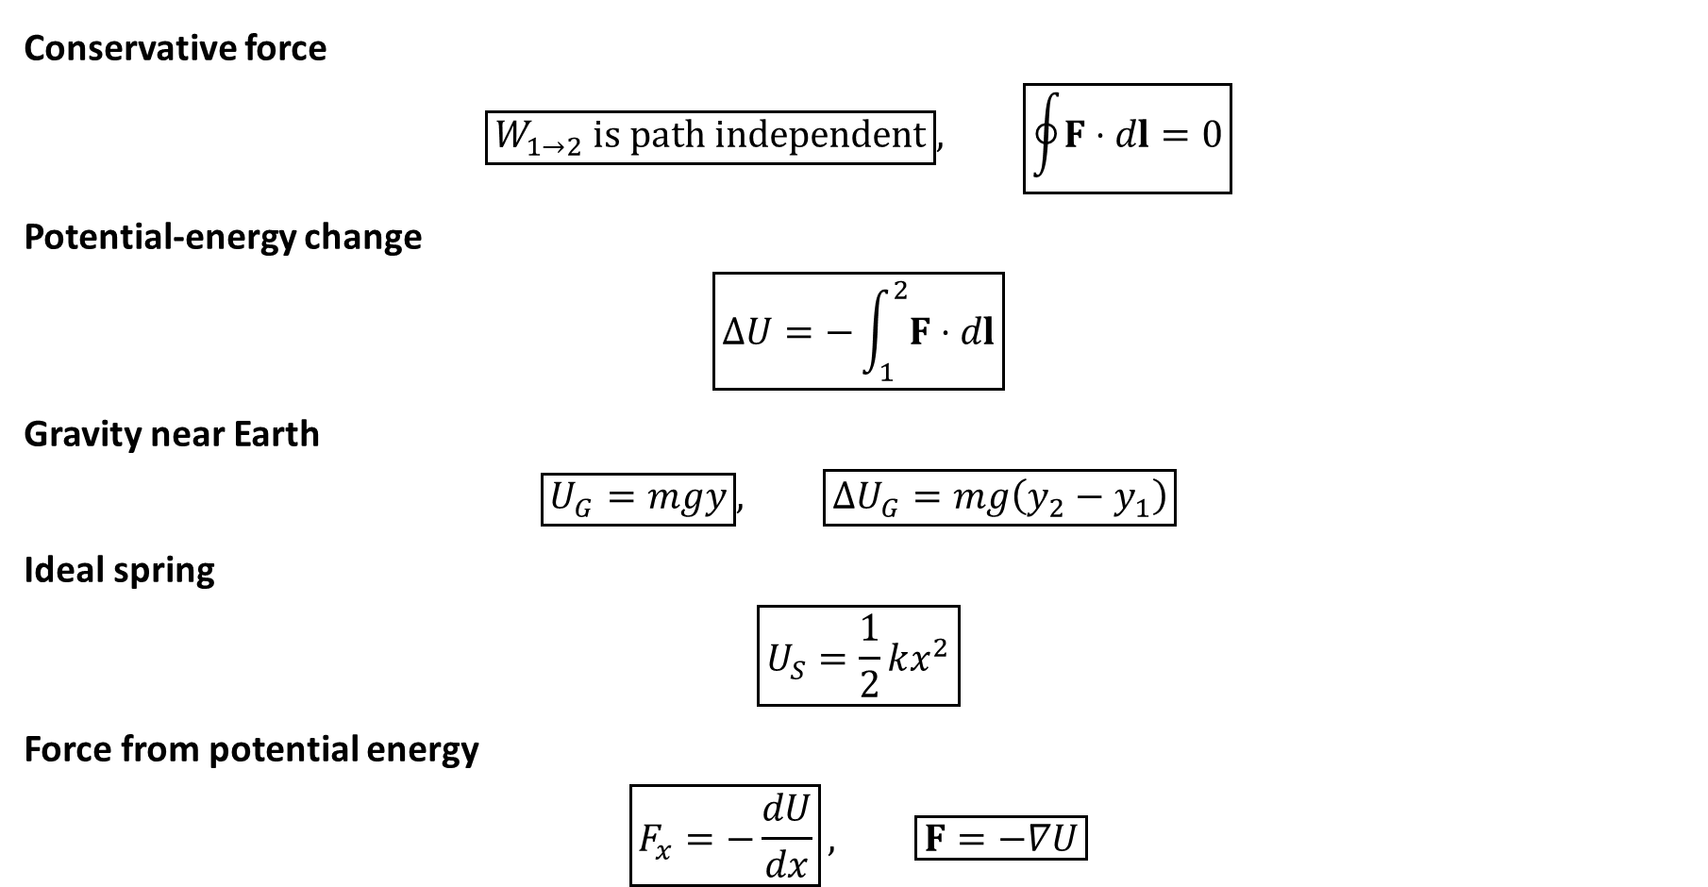
PHYS 2325 | University Physics I
Lecture 01 • Mon Oct 5 • Giancoli Ch. 8
Lecture Summary
Conservative force
$$\boxed{W_{1→2}\text{ is path independent}}, \boxed{\oint{F}⋅dl=0}$$
Potential-energy change
$$\boxed{ΔU=−\int_{1}^{2}{F}⋅dl}$$
Gravity near Earth
$$\boxed{U_{G}=mgy}, \boxed{ΔU_{G}=mg\left(y_{2}−y_{1}\right)}$$
Ideal spring
$$\boxed{U_{S}=\frac{1}{2}kx^{2}}$$
Force from potential energy
$$\boxed{F_{x}=−\frac{dU}{dx}}, \boxed{F=−∇U}$$

Slide 27
LECTURE 02
Mechanical Energy and Dissipative Forces
Wed Oct 7 • Giancoli Ch. 8
Muhammad Nauman • PHYS 2325 • Fall 2026
Notes:
Teaching focus: Mechanical Energy and Dissipative Forces.
[Sources]
- PHYS 2325 University Physics I Fall 2026 syllabus and semester calendar.
[/Sources]

Slide 28
PHYS 2325 | University Physics I
Lecture 02 • Wed Oct 7 • Giancoli Ch. 8
Learning outcomes
Define and represent solving with mechanical energy.
Derive and interpret the law of conservation of energy.
Apply energy with dissipative forces.
Check units, vector directions, assumptions, and limiting behavior in every solution.

Slide 29
PHYS 2325 | University Physics I
Lecture 02 • Wed Oct 7 • Giancoli Ch. 8
Mechanical Energy and Its Conservation
Topics
Mechanical energy
Derivation of mechanical-energy conservation
Gravitational systems
Elastic systems
Energy transformations
Nonconservative and dissipative forces
General conservation-of-energy equation
Choosing between work–energy and energy conservation

Slide 30
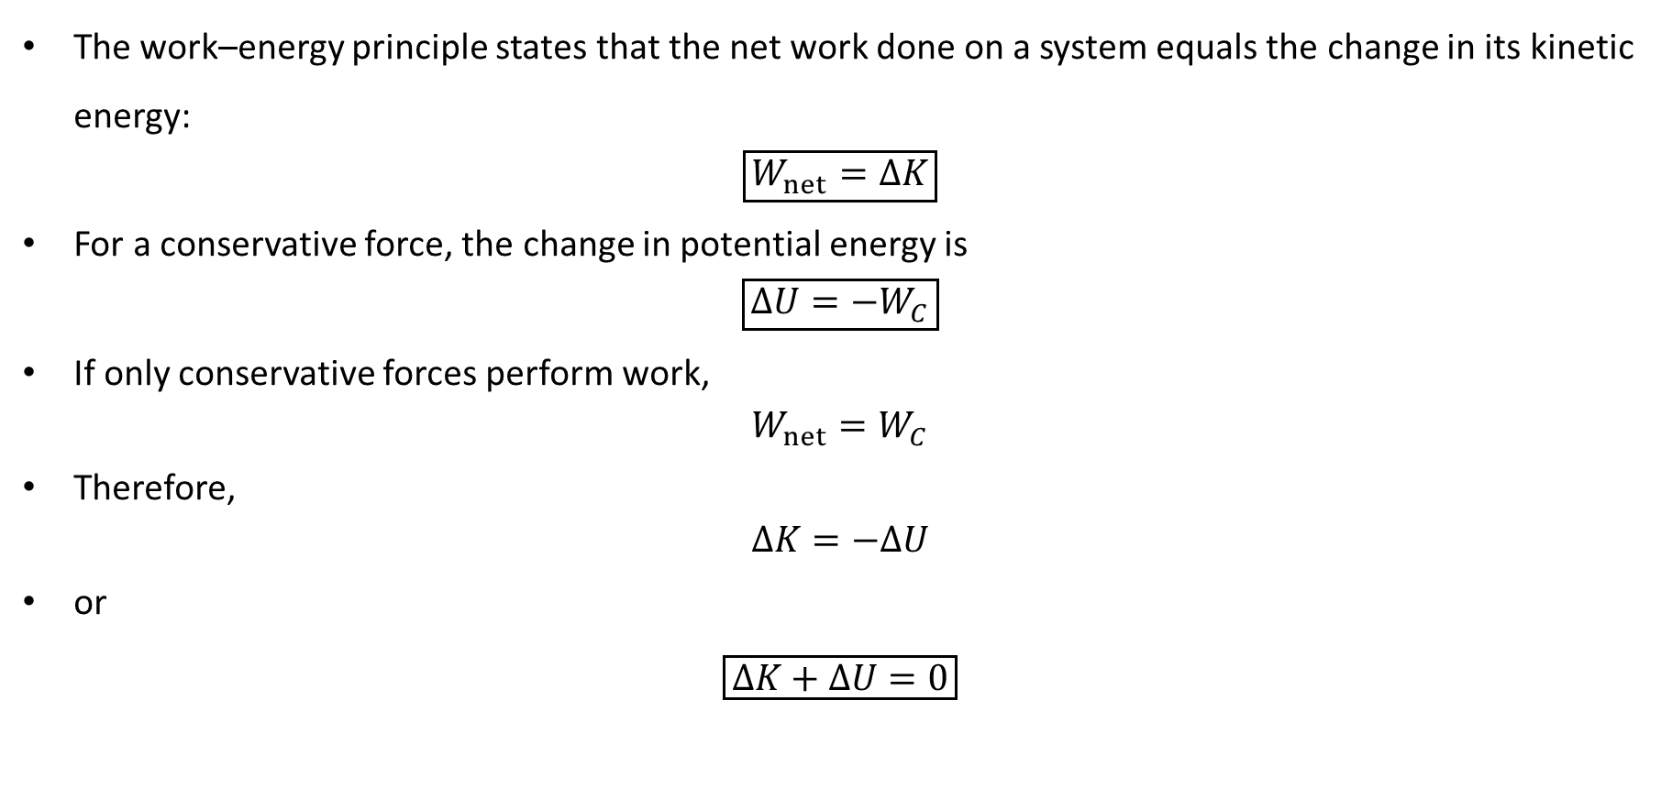
PHYS 2325 | University Physics I
Lecture 02 • Wed Oct 7 • Giancoli Ch. 8
Starting from the Work–Energy Principle
The work–energy principle states that the net work done on a system equals the change in its kinetic energy:
$$\boxed{W_{net}=ΔK}$$
For a conservative force, the change in potential energy is
$$\boxed{ΔU=−W_{C}}$$
If only conservative forces perform work,
$$W_{net}=W_{C}$$
Therefore,
$$ΔK=−ΔU$$
or
$$\boxed{ΔK+ΔU=0}$$

Slide 31
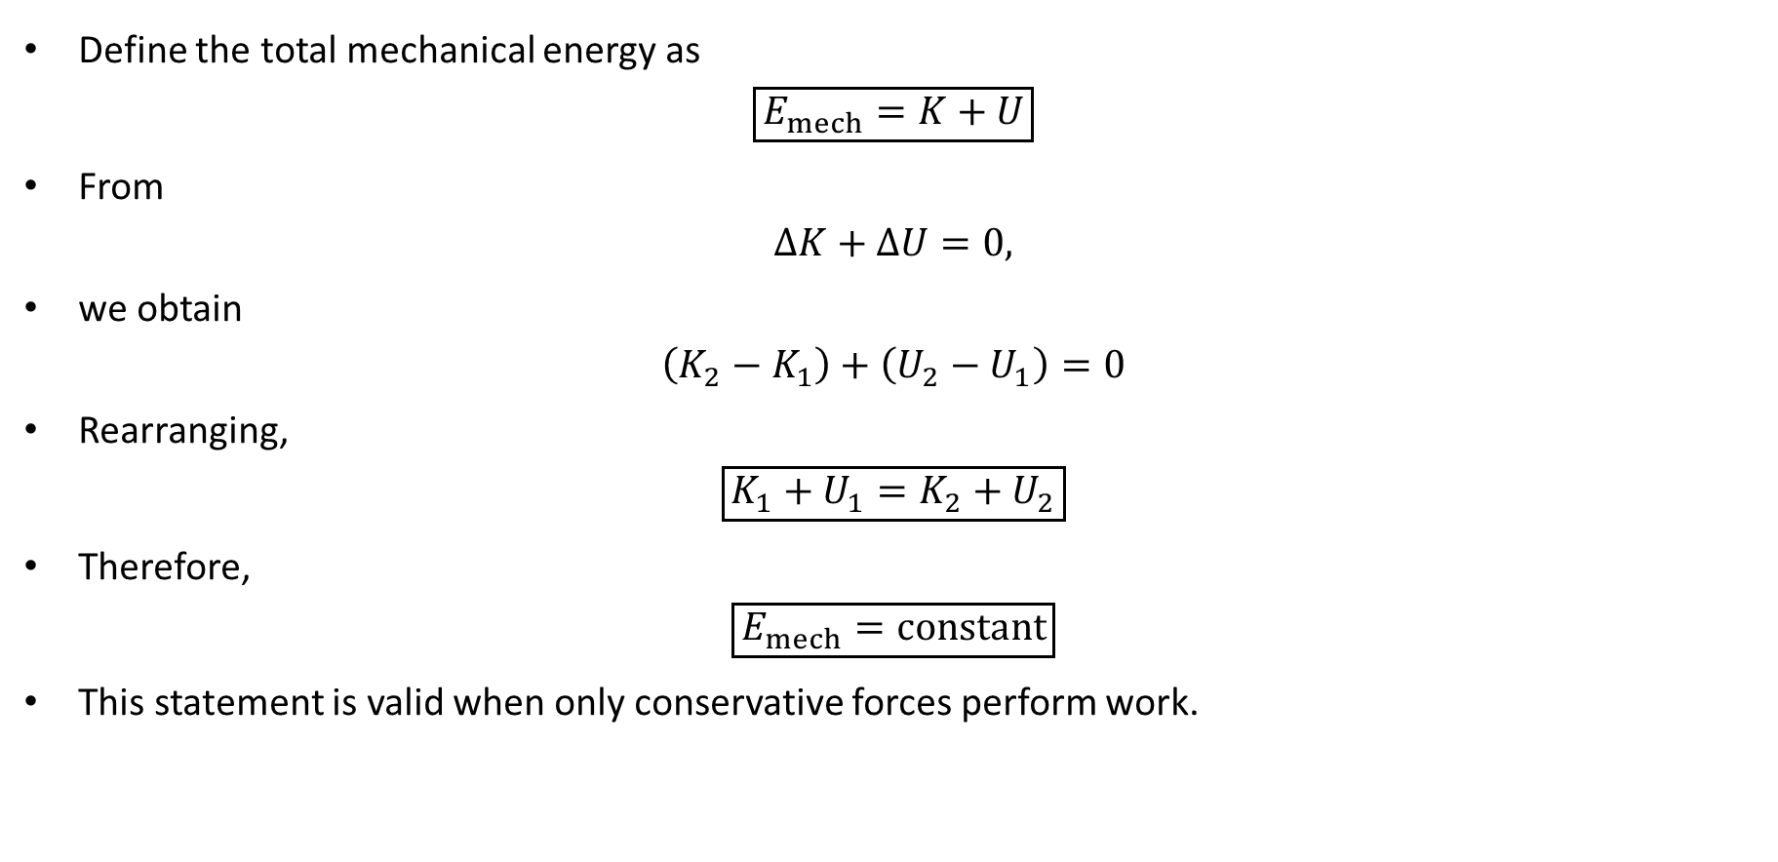
PHYS 2325 | University Physics I
Lecture 02 • Wed Oct 7 • Giancoli Ch. 8
Conservation of Mechanical Energy
Define the total mechanical energy as
$$\boxed{E_{mech}=K+U}$$
From
$$ΔK+ΔU=0,$$
we obtain
$$\left(K_{2}−K_{1}\right)+\left(U_{2}−U_{1}\right)=0$$
Rearranging,
$$\boxed{K_{1}+U_{1}=K_{2}+U_{2}}$$
Therefore,
$$\boxed{E_{mech}=\text{constant}}$$
This statement is valid when only conservative forces perform work.

Slide 32
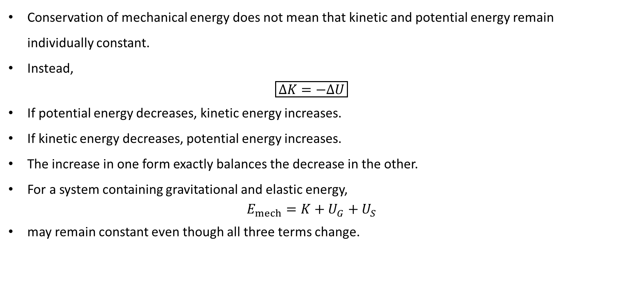
PHYS 2325 | University Physics I
Lecture 02 • Wed Oct 7 • Giancoli Ch. 8
Energy Transformation
Conservation of mechanical energy does not mean that kinetic and potential energy remain individually constant.
Instead,
$$\boxed{ΔK=−ΔU}$$
If potential energy decreases, kinetic energy increases.
If kinetic energy decreases, potential energy increases.
The increase in one form exactly balances the decrease in the other.
For a system containing gravitational and elastic energy,
$$E_{mech}=K+U_{G}+U_{S}$$
may remain constant even though all three terms change.

Slide 33
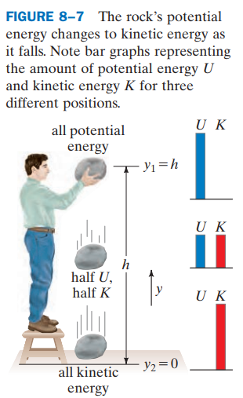
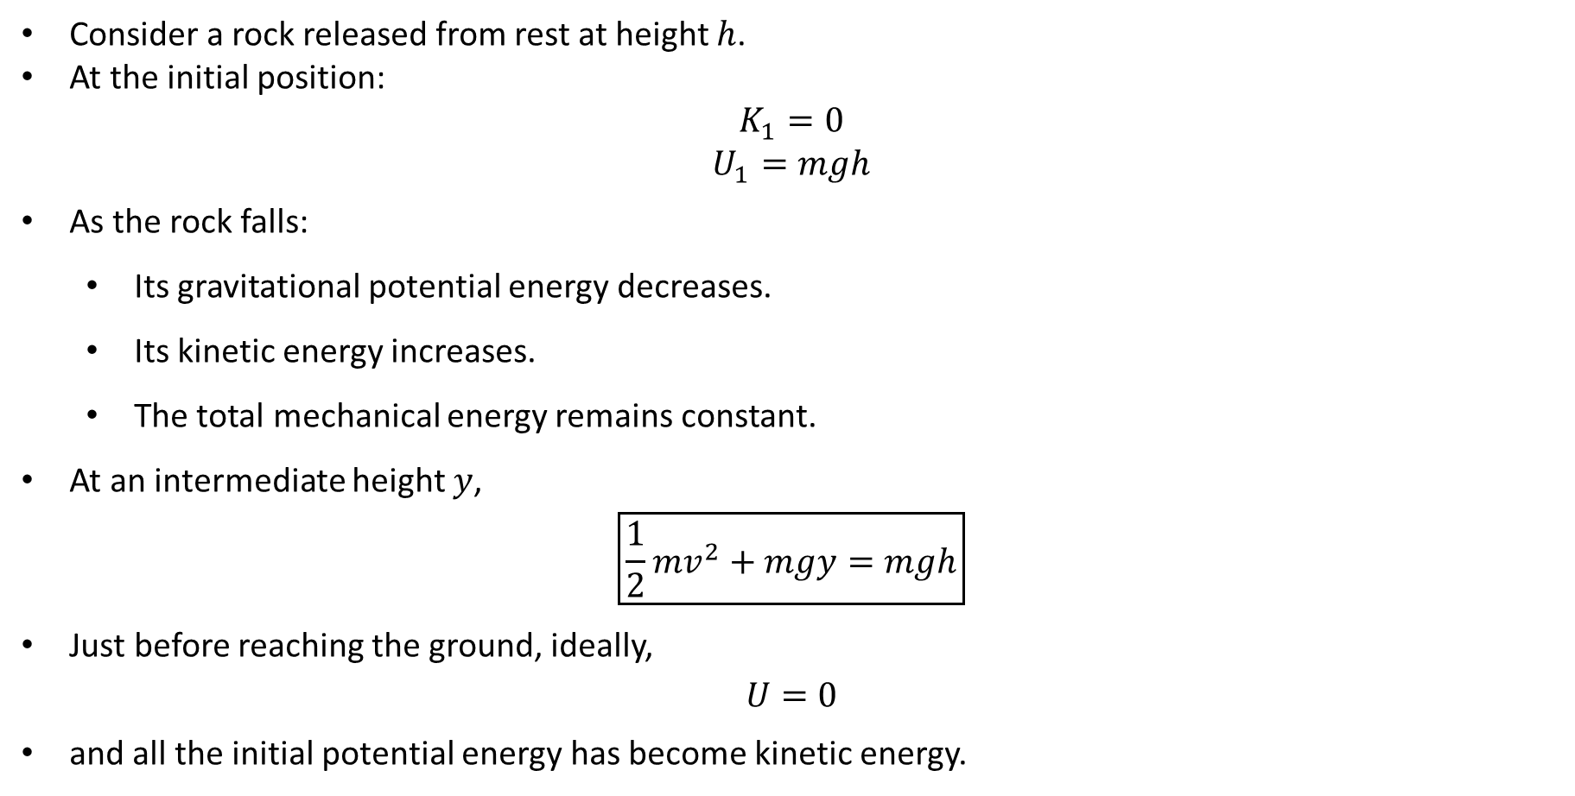
PHYS 2325 | University Physics I
Lecture 02 • Wed Oct 7 • Giancoli Ch. 8
Falling Object: Energy Description
Consider a rock released from rest at height $h$.
At the initial position:
$$K_{1}=0$$
$$U_{1}=mgh$$
As the rock falls:
  Its gravitational potential energy decreases.
  Its kinetic energy increases.
  The total mechanical energy remains constant.
At an intermediate height $y$,
$$\boxed{\frac{1}{2}mv^{2}+mgy=mgh}$$
Just before reaching the ground, ideally,
$$U=0$$
and all the initial potential energy has become kinetic energy.

Slide 34
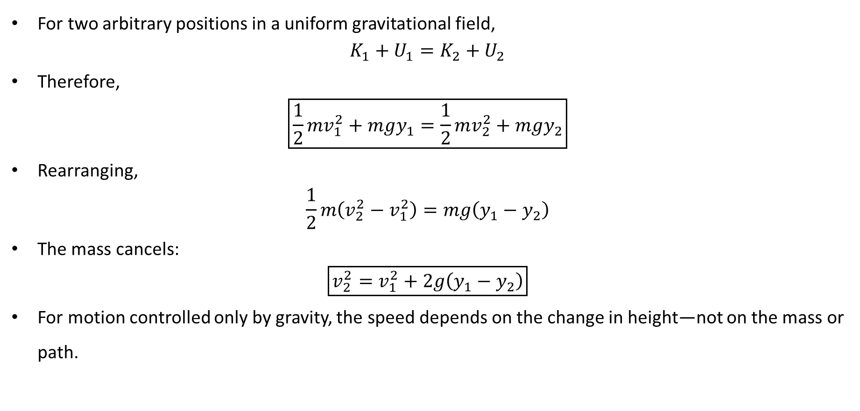
PHYS 2325 | University Physics I
Lecture 02 • Wed Oct 7 • Giancoli Ch. 8
General Gravitational Energy Equation
For two arbitrary positions in a uniform gravitational field,
$$K_{1}+U_{1}=K_{2}+U_{2}$$
Therefore,
$$\boxed{\frac{1}{2}mv_{1}^{2}+mgy_{1}=\frac{1}{2}mv_{2}^{2}+mgy_{2}}$$
Rearranging,
$$\frac{1}{2}m\left(v_{2}^{2}−v_{1}^{2}\right)=mg\left(y_{1}−y_{2}\right)$$
The mass cancels:
$$\boxed{v_{2}^{2}=v_{1}^{2}+2g\left(y_{1}−y_{2}\right)}$$
For motion controlled only by gravity, the speed depends on the change in height—not on the mass or path.

Slide 35
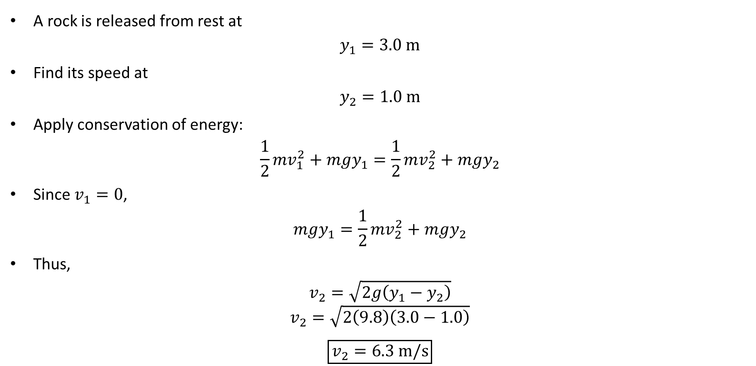
PHYS 2325 | University Physics I
Lecture 02 • Wed Oct 7 • Giancoli Ch. 8
Example 8–3: Falling Rock
A rock is released from rest at
$$y_{1}=3.0 m$$
Find its speed at
$$y_{2}=1.0 m$$
Apply conservation of energy:
$$\frac{1}{2}mv_{1}^{2}+mgy_{1}=\frac{1}{2}mv_{2}^{2}+mgy_{2}$$
Since $v_{1}=0$,
$$mgy_{1}=\frac{1}{2}mv_{2}^{2}+mgy_{2}$$
Thus,
$$v_{2}=\sqrt{2g\left(y_{1}−y_{2}\right)}$$
$$v_{2}=\sqrt{2\left(9.8\right)\left(3.0−1.0\right)}$$
$$\boxed{v_{2}=6.3 m/s}$$

Slide 36
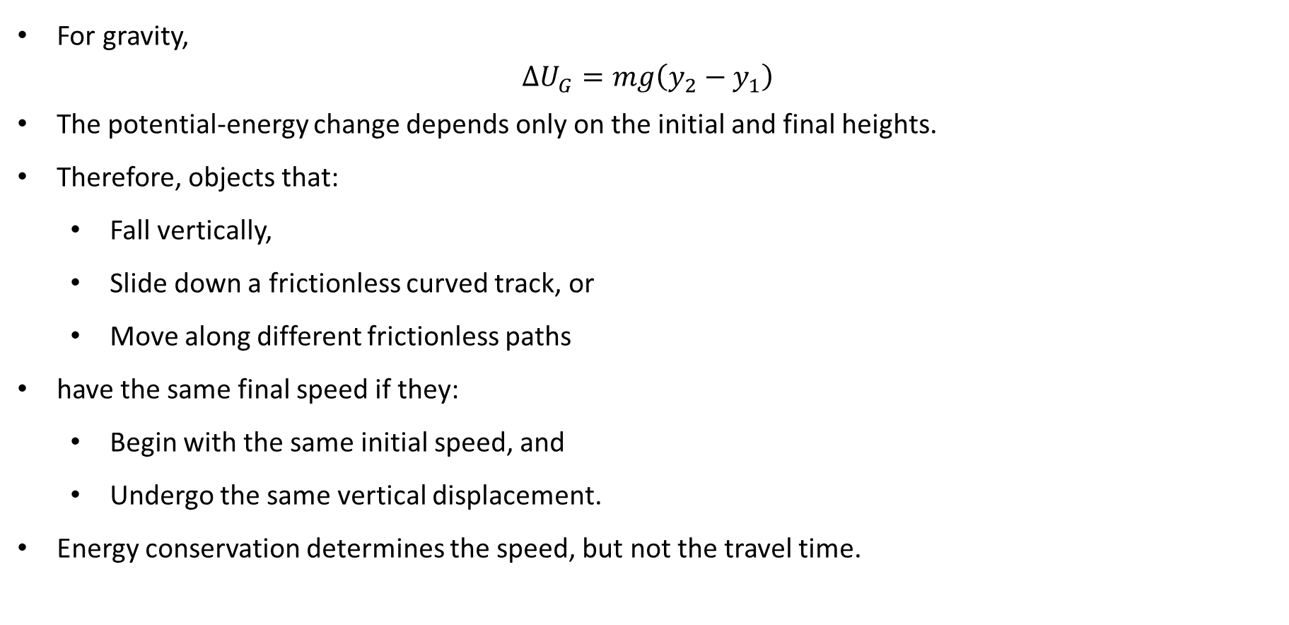
PHYS 2325 | University Physics I
Lecture 02 • Wed Oct 7 • Giancoli Ch. 8
Why the Path Does Not Matter
For gravity,
$$ΔU_{G}=mg\left(y_{2}−y_{1}\right)$$
The potential-energy change depends only on the initial and final heights.
Therefore, objects that:
  Fall vertically,
  Slide down a frictionless curved track, or
  Move along different frictionless paths
have the same final speed if they:
  Begin with the same initial speed, and
  Undergo the same vertical displacement.
Energy conservation determines the speed, but not the travel time.

Slide 37
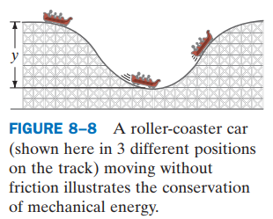
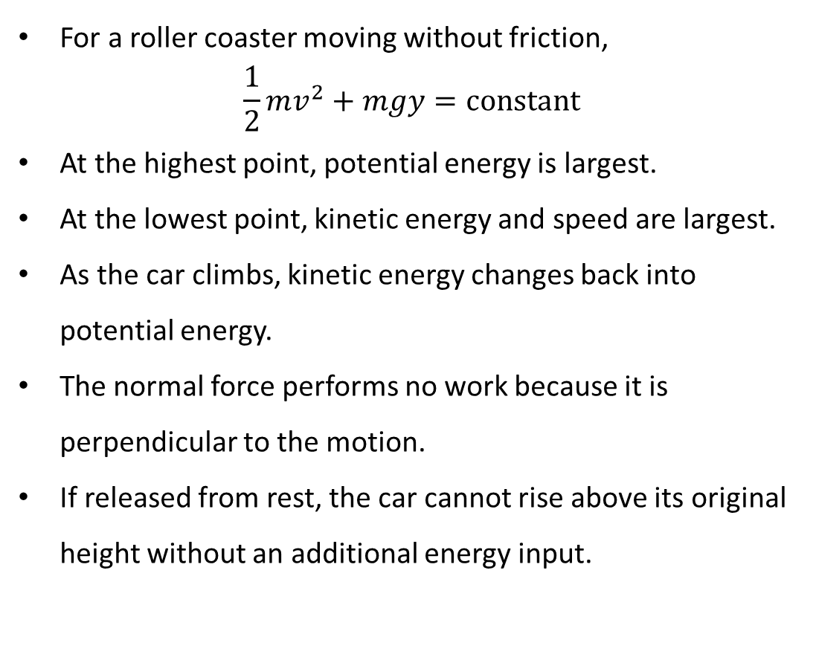
PHYS 2325 | University Physics I
Lecture 02 • Wed Oct 7 • Giancoli Ch. 8
Frictionless Roller Coaster
For a roller coaster moving without friction,
$$\frac{1}{2}mv^{2}+mgy=\text{constant}$$
At the highest point, potential energy is largest.
At the lowest point, kinetic energy and speed are largest.
As the car climbs, kinetic energy changes back into potential energy.
The normal force performs no work because it is perpendicular to the motion.
If released from rest, the car cannot rise above its original height without an additional energy input.

Slide 38
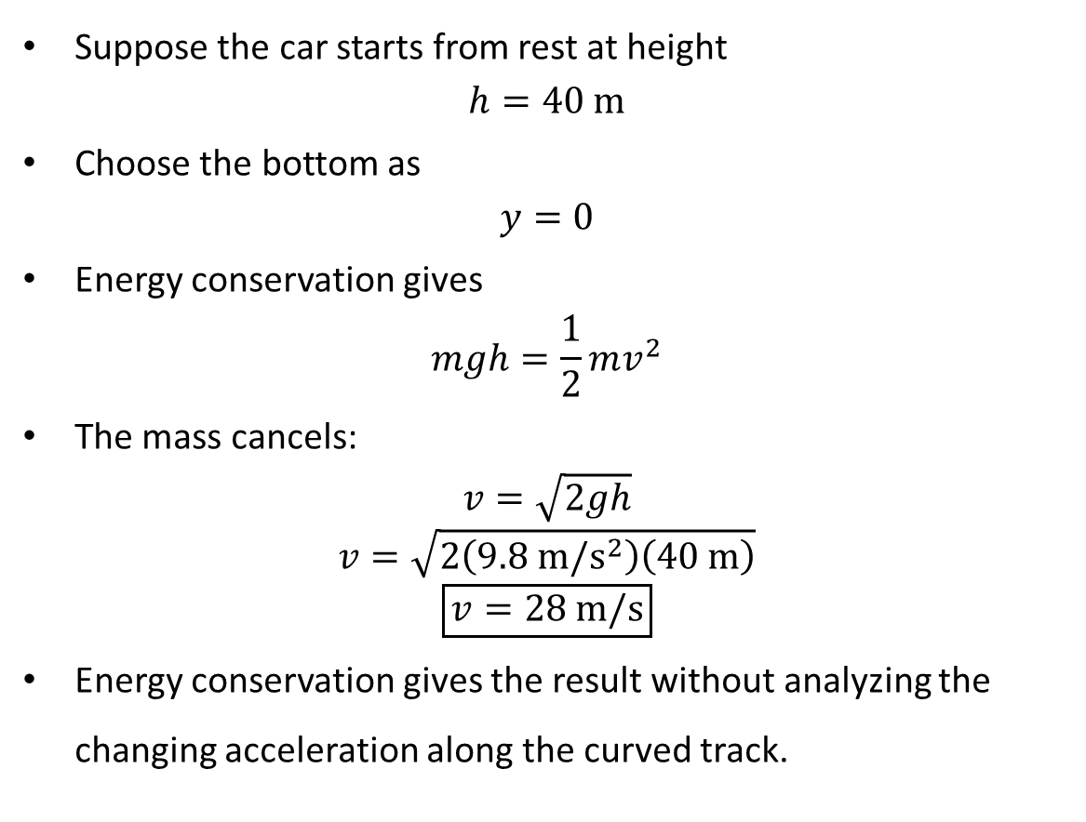
PHYS 2325 | University Physics I
Lecture 02 • Wed Oct 7 • Giancoli Ch. 8
Roller-Coaster Speed at the Bottom
Suppose the car starts from rest at height
$$h=40 m$$
Choose the bottom as
$$y=0$$
Energy conservation gives
$$mgh=\frac{1}{2}mv^{2}$$
The mass cancels:
$$v=\sqrt{2gh}$$
$$v=\sqrt{2\left(9.8 m/s^{2}\right)\left(40 m\right)}$$
$$\boxed{v=28 m/s}$$
Energy conservation gives the result without analyzing the changing acceleration along the curved track.

Slide 39
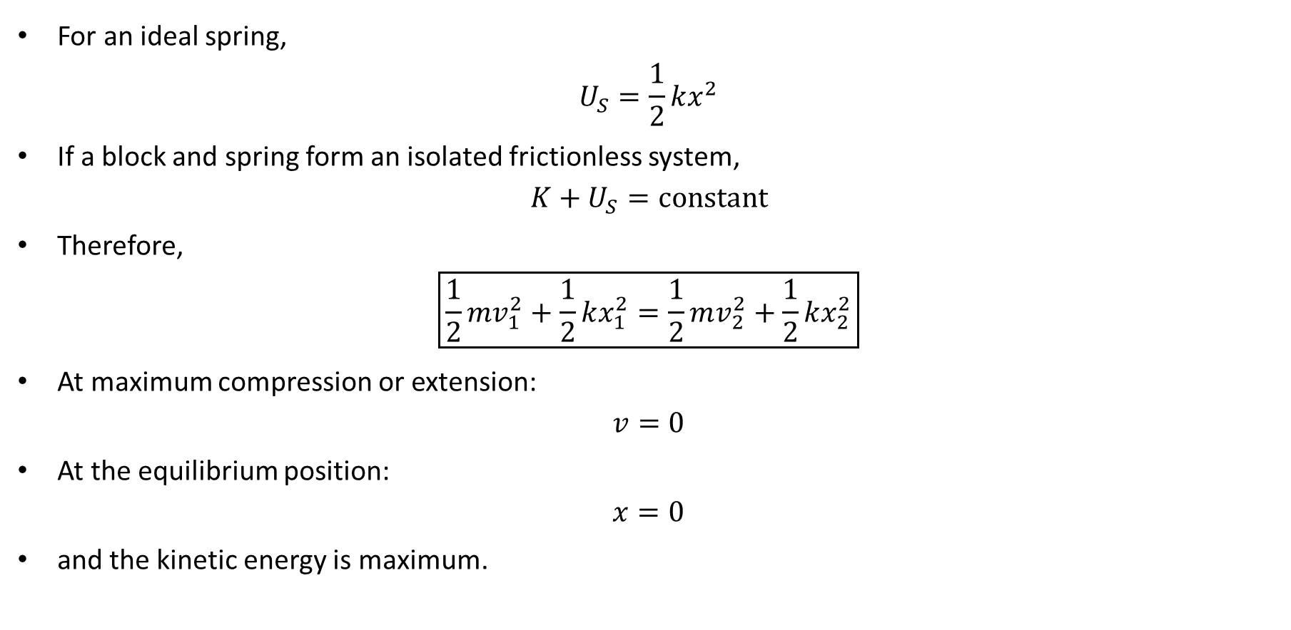
PHYS 2325 | University Physics I
Lecture 02 • Wed Oct 7 • Giancoli Ch. 8
Energy Stored in a Spring
For an ideal spring,
$$U_{S}=\frac{1}{2}kx^{2}$$
If a block and spring form an isolated frictionless system,
$$K+U_{S}=\text{constant}$$
Therefore,
$$\boxed{\frac{1}{2}mv_{1}^{2}+\frac{1}{2}kx_{1}^{2}=\frac{1}{2}mv_{2}^{2}+\frac{1}{2}kx_{2}^{2}}$$
At maximum compression or extension:
$$v=0$$
At the equilibrium position:
$$x=0$$
and the kinetic energy is maximum.

Slide 40
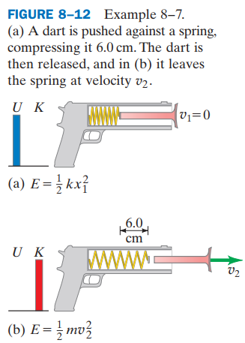
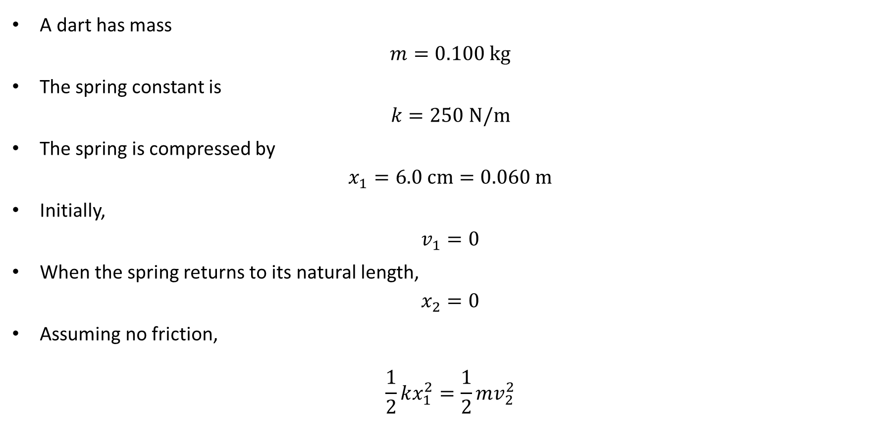
PHYS 2325 | University Physics I
Lecture 02 • Wed Oct 7 • Giancoli Ch. 8
Example 8–7: Toy Dart Gun
A dart has mass
$$m=0.100 kg$$
The spring constant is
$$k=250 N/m$$
The spring is compressed by
$$x_{1}=6.0 cm=0.060 m$$
Initially,
$$v_{1}=0$$
When the spring returns to its natural length,
$$x_{2}=0$$
Assuming no friction,
$$\frac{1}{2}kx_{1}^{2}=\frac{1}{2}mv_{2}^{2}$$

Slide 41
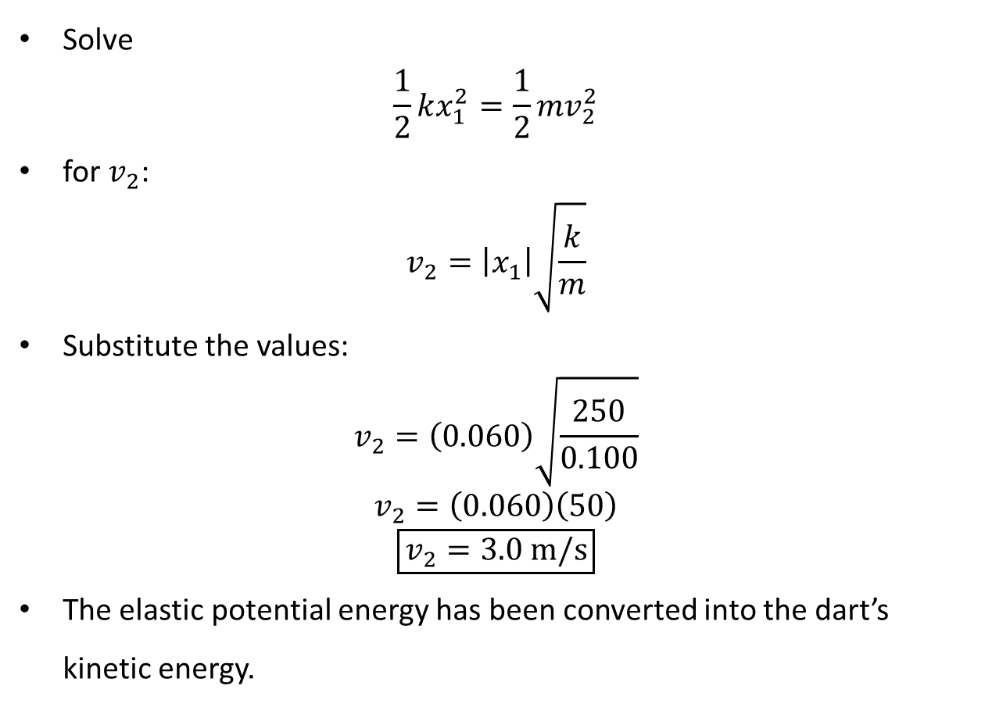
PHYS 2325 | University Physics I
Lecture 02 • Wed Oct 7 • Giancoli Ch. 8
Toy Dart Gun: Solution
Solve
$$\frac{1}{2}kx_{1}^{2}=\frac{1}{2}mv_{2}^{2}$$
for $v_{2}$:
$$v_{2}=\left|x_{1}\right|\sqrt{\frac{k}{m}}$$
Substitute the values:
$$v_{2}=\left(0.060\right)\sqrt{\frac{250}{0.100}}$$
$$v_{2}=\left(0.060\right)\left(50\right)$$
$$\boxed{v_{2}=3.0 m/s}$$
The elastic potential energy has been converted into the dart’s kinetic energy.

Slide 42
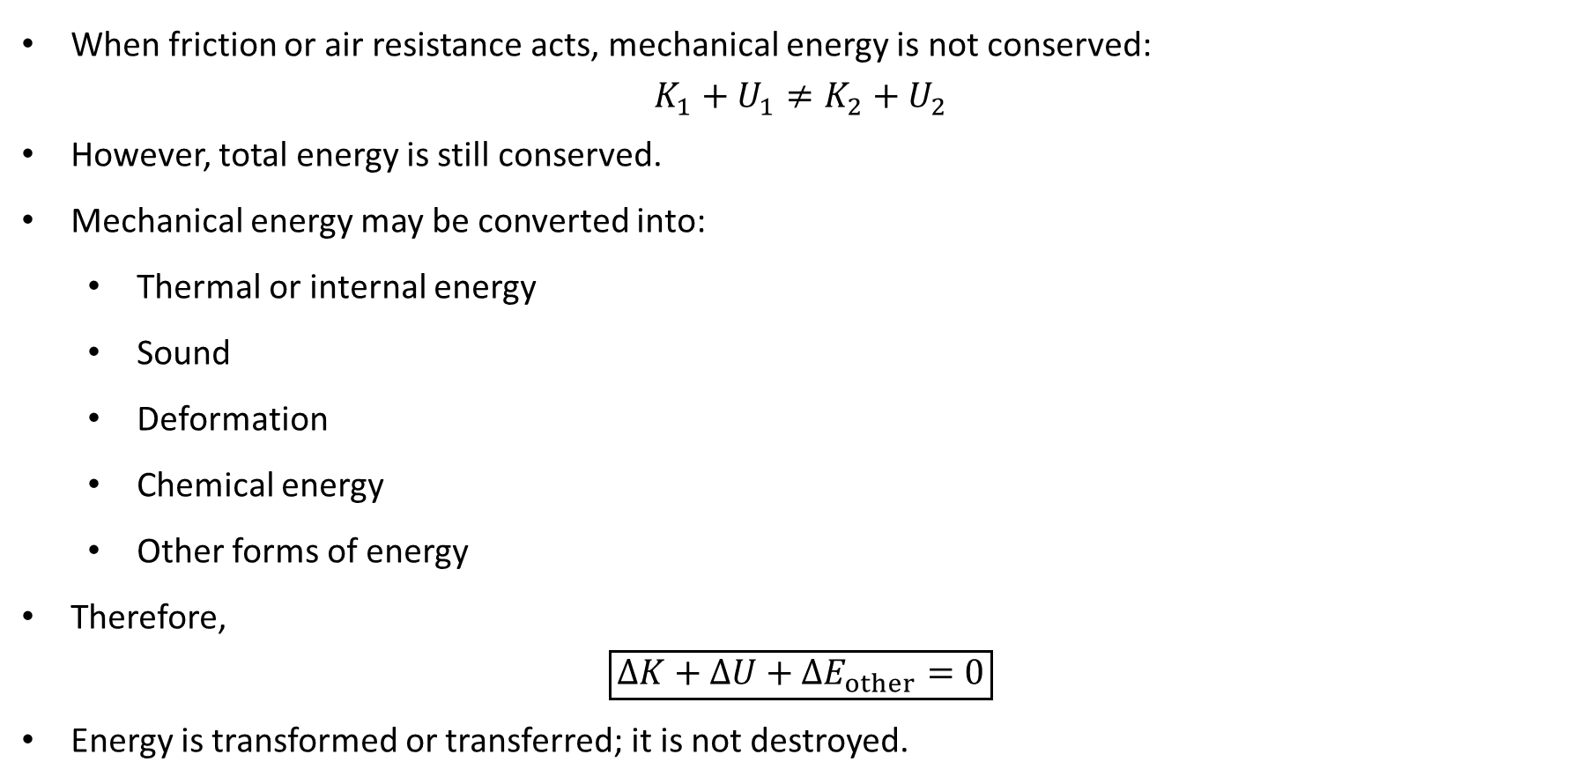
PHYS 2325 | University Physics I
Lecture 02 • Wed Oct 7 • Giancoli Ch. 8
Mechanical Energy vs. Total Energy
When friction or air resistance acts, mechanical energy is not conserved:
$$K_{1}+U_{1}≠K_{2}+U_{2}$$
However, total energy is still conserved.
Mechanical energy may be converted into:
  Thermal or internal energy
  Sound
  Deformation
  Chemical energy
  Other forms of energy
Therefore,
$$\boxed{ΔK+ΔU+ΔE_{other}=0}$$
Energy is transformed or transferred; it is not destroyed.

Slide 43
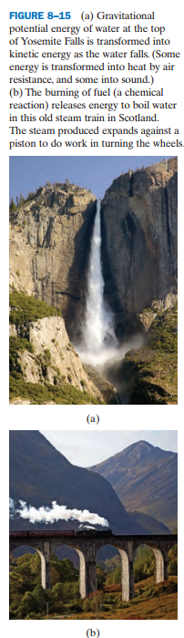
PHYS 2325 | University Physics I
Lecture 02 • Wed Oct 7 • Giancoli Ch. 8
Mechanical Energy vs. Total Energy
When friction or air resistance acts, mechanical energy is not conserved:
$$K_{1}+U_{1}≠K_{2}+U_{2}$$
However, total energy is still conserved.
Mechanical energy may be converted into:
  Thermal or internal energy
  Sound
  Deformation
  Chemical energy
  Other forms of energy
Therefore,
$$\boxed{ΔK+ΔU+ΔE_{other}=0}$$
Energy is transformed or transferred; it is not destroyed.

Slide 44
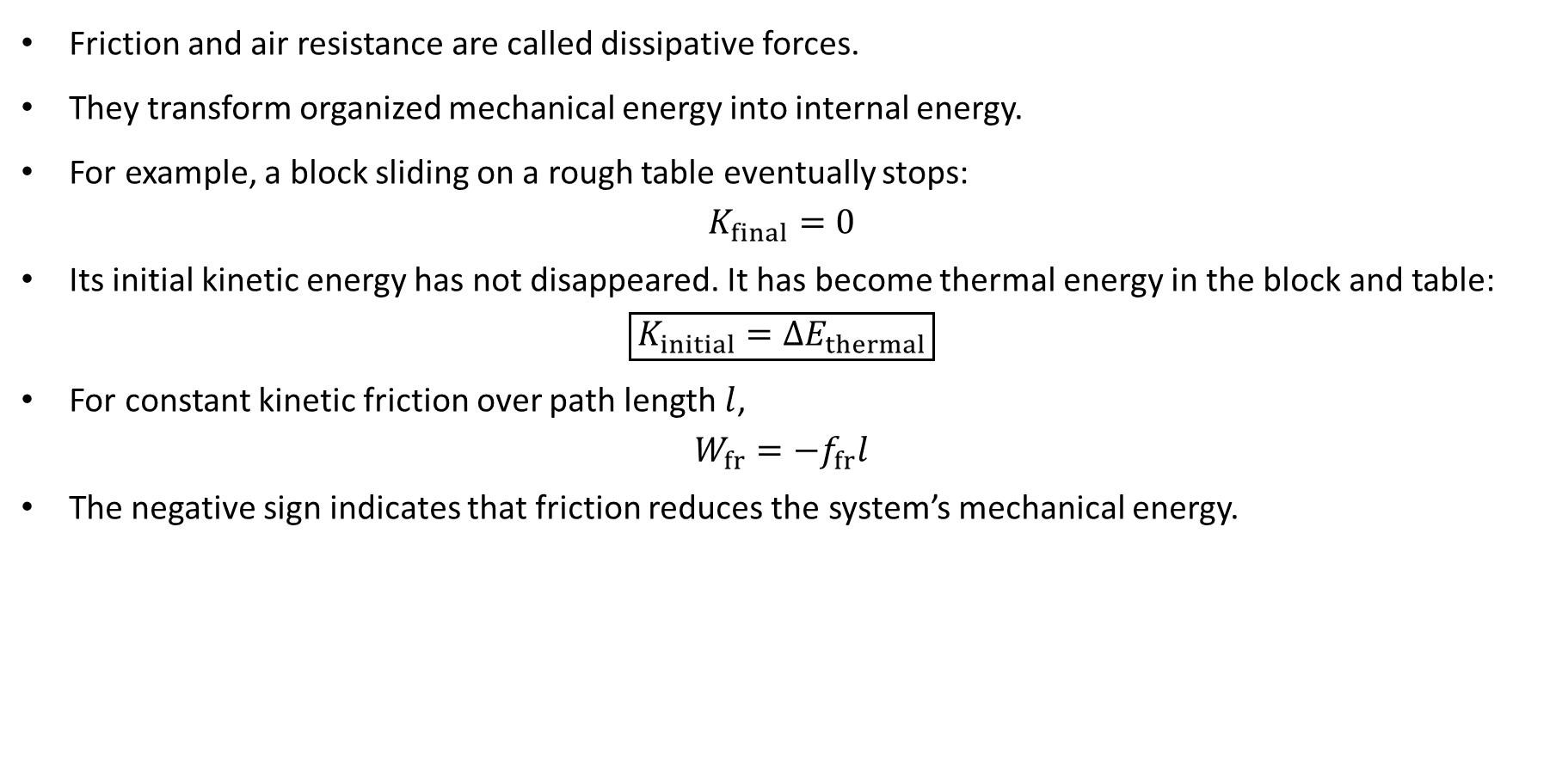
PHYS 2325 | University Physics I
Lecture 02 • Wed Oct 7 • Giancoli Ch. 8
Dissipative Forces
Friction and air resistance are called dissipative forces.
They transform organized mechanical energy into internal energy.
For example, a block sliding on a rough table eventually stops:
$$K_{final}=0$$
Its initial kinetic energy has not disappeared. It has become thermal energy in the block and table:
$$\boxed{K_{initial}=ΔE_{thermal}}$$
For constant kinetic friction over path length $l$,
$$W_{fr}=−f_{fr}l$$
The negative sign indicates that friction reduces the system’s mechanical energy.

Slide 45
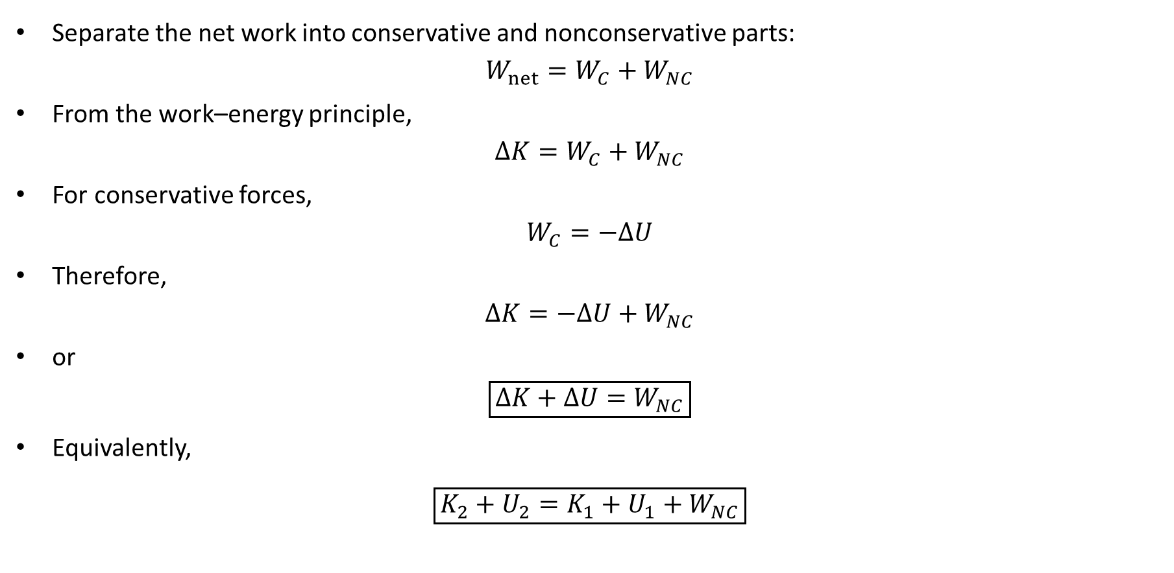
PHYS 2325 | University Physics I
Lecture 02 • Wed Oct 7 • Giancoli Ch. 8
General Energy Equation with Nonconservative Forces
Separate the net work into conservative and nonconservative parts:
$$W_{net}=W_{C}+W_{NC}$$
From the work–energy principle,
$$ΔK=W_{C}+W_{NC}$$
For conservative forces,
$$W_{C}=−ΔU$$
Therefore,
$$ΔK=−ΔU+W_{NC}$$
or
$$\boxed{ΔK+ΔU=W_{NC}}$$
Equivalently,
$$\boxed{K_{2}+U_{2}=K_{1}+U_{1}+W_{NC}}$$

Slide 46
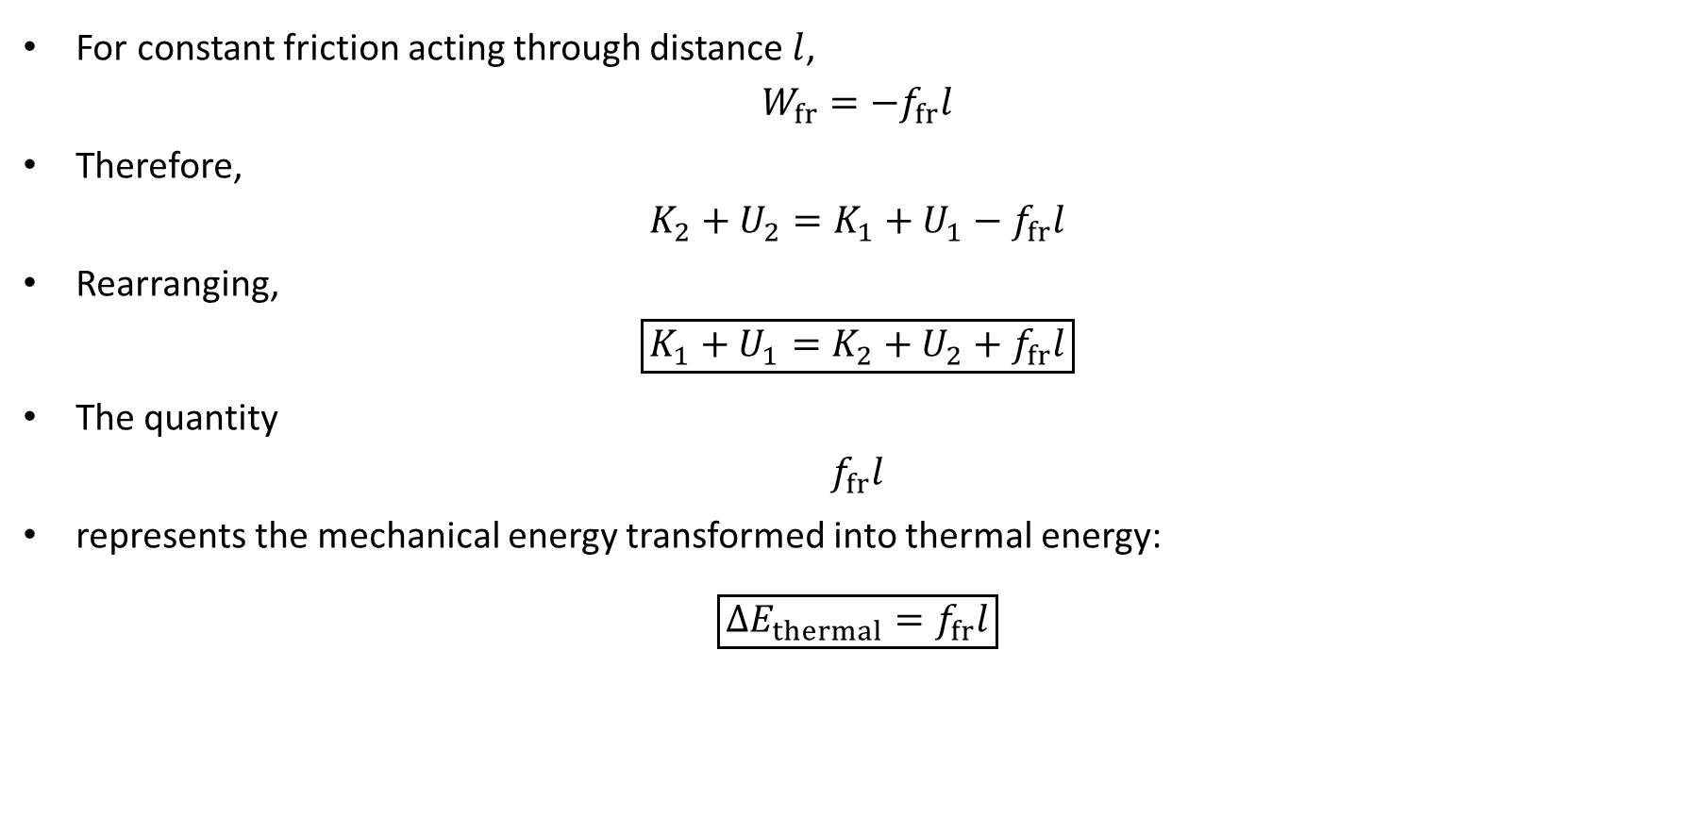
PHYS 2325 | University Physics I
Lecture 02 • Wed Oct 7 • Giancoli Ch. 8
Friction Written as Thermal Energy
For constant friction acting through distance $l$,
$$W_{fr}=−f_{fr}l$$
Therefore,
$$K_{2}+U_{2}=K_{1}+U_{1}−f_{fr}l$$
Rearranging,
$$\boxed{K_{1}+U_{1}=K_{2}+U_{2}+f_{fr}l}$$
The quantity
$$f_{fr}l$$
represents the mechanical energy transformed into thermal energy:
$$\boxed{ΔE_{thermal}=f_{fr}l}$$

Slide 47
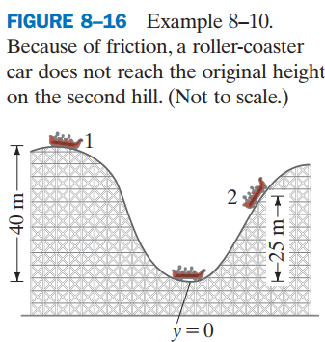
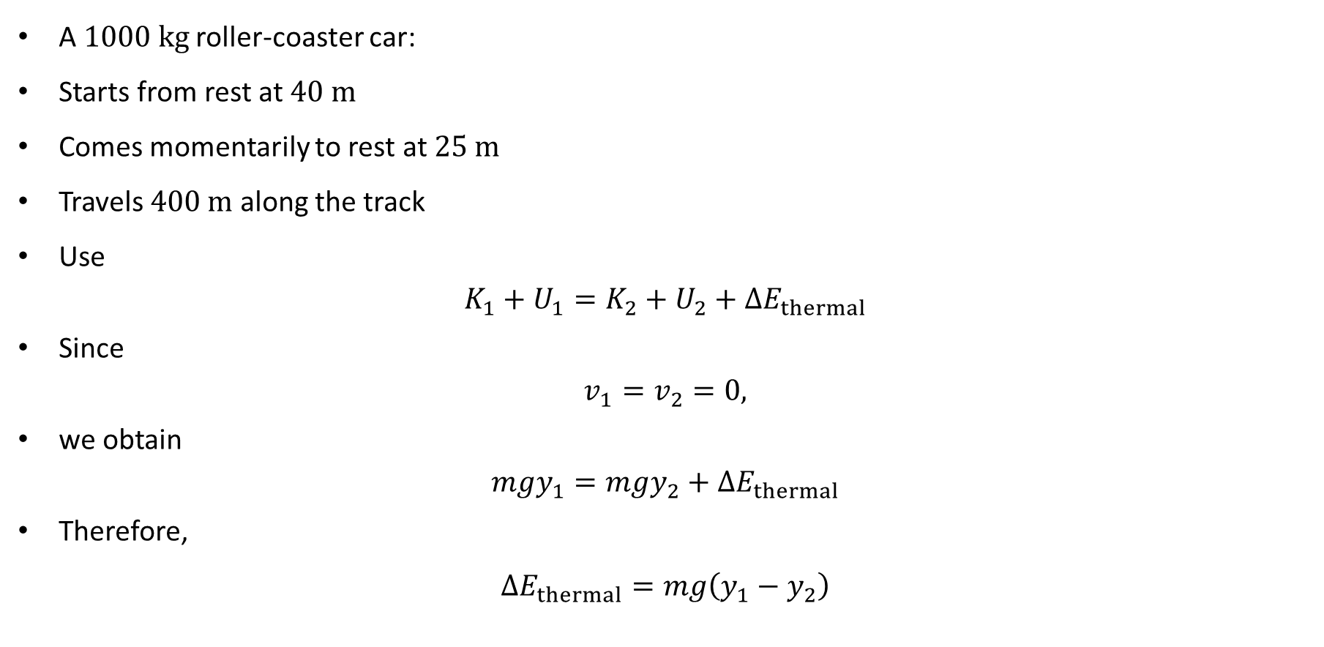
PHYS 2325 | University Physics I
Lecture 02 • Wed Oct 7 • Giancoli Ch. 8
Example 8–10: Roller Coaster with Friction
A $1000 kg$ roller-coaster car:
Starts from rest at $40 m$
Comes momentarily to rest at $25 m$
Travels $400 m$ along the track
Use
$$K_{1}+U_{1}=K_{2}+U_{2}+ΔE_{thermal}$$
Since
$$v_{1}=v_{2}=0,$$
we obtain
$$mgy_{1}=mgy_{2}+ΔE_{thermal}$$
Therefore,
$$ΔE_{thermal}=mg\left(y_{1}−y_{2}\right)$$

Slide 48
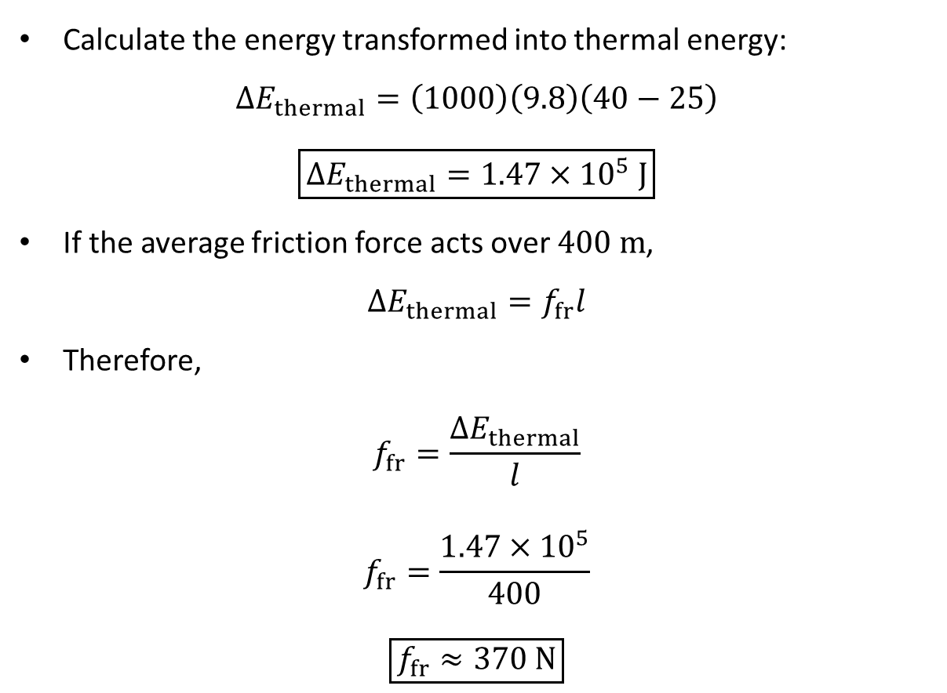
PHYS 2325 | University Physics I
Lecture 02 • Wed Oct 7 • Giancoli Ch. 8
Roller Coaster with Friction: Solution
Calculate the energy transformed into thermal energy:
$$ΔE_{thermal}=\left(1000\right)\left(9.8\right)\left(40−25\right)$$
$$\boxed{ΔE_{thermal}=1.47×{10}^{5} J}$$
If the average friction force acts over $400 m$,
$$ΔE_{thermal}=f_{fr}l$$
Therefore,
$$f_{fr}=\frac{ΔE_{thermal}}{l}$$
$$f_{fr}=\frac{1.47×{10}^{5}}{400}$$
$$\boxed{f_{fr}≈370 N}$$

Slide 49
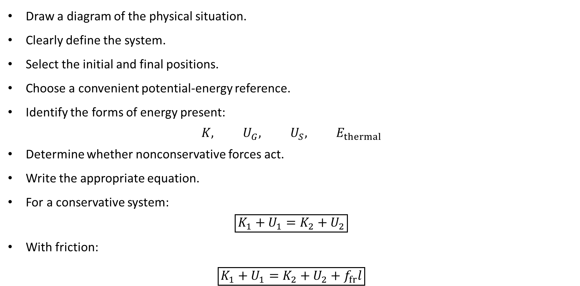
PHYS 2325 | University Physics I
Lecture 02 • Wed Oct 7 • Giancoli Ch. 8
Energy Problem-Solving Strategy
Draw a diagram of the physical situation.
Clearly define the system.
Select the initial and final positions.
Choose a convenient potential-energy reference.
Identify the forms of energy present:
$$K, U_{G}, U_{S}, E_{thermal}$$
Determine whether nonconservative forces act.
Write the appropriate equation.
For a conservative system:
$$\boxed{K_{1}+U_{1}=K_{2}+U_{2}}$$
With friction:
$$\boxed{K_{1}+U_{1}=K_{2}+U_{2}+f_{fr}l}$$

Slide 50
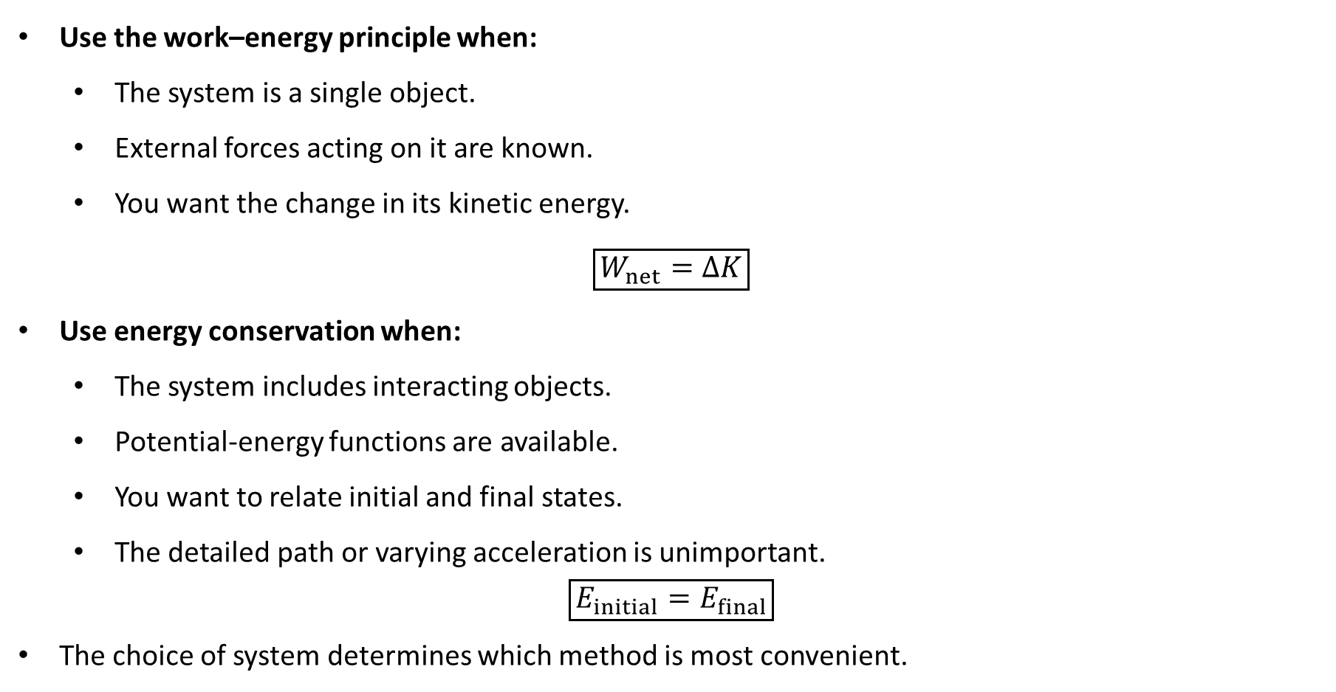
PHYS 2325 | University Physics I
Lecture 02 • Wed Oct 7 • Giancoli Ch. 8
Work–Energy or Energy Conservation?
Use the work–energy principle when:
  The system is a single object.
  External forces acting on it are known.
  You want the change in its kinetic energy.
$$\boxed{W_{net}=ΔK}$$
Use energy conservation when:
  The system includes interacting objects.
  Potential-energy functions are available.
  You want to relate initial and final states.
  The detailed path or varying acceleration is unimportant.
$$\boxed{E_{initial}=E_{final}}$$
The choice of system determines which method is most convenient.

Slide 51

PHYS 2325 | University Physics I
Lecture 02 • Wed Oct 7 • Giancoli Ch. 8
Lecture Summary
Mechanical energy
$$\boxed{E_{mech}=K+U}$$
Conservative system
$$\boxed{K_{1}+U_{1}=K_{2}+U_{2}}$$
Gravity
$$\boxed{\frac{1}{2}mv_{1}^{2}+mgy_{1}=\frac{1}{2}mv_{2}^{2}+mgy_{2}}$$
Spring
$$\boxed{\frac{1}{2}mv_{1}^{2}+\frac{1}{2}kx_{1}^{2}=\frac{1}{2}mv_{2}^{2}+\frac{1}{2}kx_{2}^{2}}$$
Nonconservative forces
$$\boxed{ΔK+ΔU=W_{NC}}$$
Friction and thermal energy
$$\boxed{K_{1}+U_{1}=K_{2}+U_{2}+ΔE_{thermal}}$$
Total energy is conserved even when mechanical energy is not.

Slide 52
LECTURE 03
Universal Gravitational Energy and Energy Diagrams
Fri Oct 9 • Giancoli Ch. 8
Muhammad Nauman • PHYS 2325 • Fall 2026
Notes:
Teaching focus: Universal Gravitational Energy and Energy Diagrams.
[Sources]
- PHYS 2325 University Physics I Fall 2026 syllabus and semester calendar.
[/Sources]

Slide 53
PHYS 2325 | University Physics I
Lecture 03 • Fri Oct 9 • Giancoli Ch. 8
Learning outcomes
Define and represent gravitational potential energy and escape velocity.
Derive and interpret potential-energy diagrams and equilibrium.
Apply gravitational assist.
Check units, vector directions, assumptions, and limiting behavior in every solution.

Slide 54

PHYS 2325 | University Physics I
Lecture 03 • Fri Oct 9 • Giancoli Ch. 8
Gravity Beyond Earth’s Surface
Near Earth’s surface, we use
$$U_{G}=mgy$$
because the gravitational force is approximately constant.
At large distances, however, gravity decreases with distance:
$$\boxed{F_{G}=−\frac{GMm}{r^{2}}\overset{ˆ}{r}}$$
where:
  $M$ is the mass of the planet.
  $m$ is the mass of the object.
  $r$ is the distance between their centers.
  $\overset{ˆ}{r}$ points radially outward.
The negative sign indicates that gravity points inward.

Slide 55


PHYS 2325 | University Physics I
Lecture 03 • Fri Oct 9 • Giancoli Ch. 8
Work Done by Gravity
Suppose an object moves from distance $r_{1}$ to $r_{2}$ along an arbitrary path.
The work done by gravity is
$$W_{G}=\int_{1}^{2}{F_{G}}⋅dl$$
Since only the radial component contributes,
$$\overset{ˆ}{r}⋅dl=dr$$
Therefore,
$$W_{G}=−\int_{r_{1}}^{r_{2}}{\frac{GMm}{r^{2}}} dr$$
Evaluating the integral,
$$\boxed{W_{G}=GMm\left(\frac{1}{r_{2}}−\frac{1}{r_{1}}\right)}$$
The result depends only on $r_{1}$ and $r_{2}$, confirming that gravity is conservative.

Slide 56

PHYS 2325 | University Physics I
Lecture 03 • Fri Oct 9 • Giancoli Ch. 8
General Gravitational Potential Energy
Potential-energy change is defined by
$$ΔU_{G}=−W_{G}$$
Therefore,
$$U_{2}−U_{1}=−GMm\left(\frac{1}{r_{2}}−\frac{1}{r_{1}}\right)$$
or
$$\boxed{U_{2}−U_{1}=−\frac{GMm}{r_{2}}+\frac{GMm}{r_{1}}}$$
Choose the reference
$$U\left(∞\right)=0$$
Then the gravitational potential energy is
$$\boxed{U_{G}\left(r\right)=−\frac{GMm}{r}}$$
This equation applies outside a spherically symmetric planet or star.

Slide 57


PHYS 2325 | University Physics I
Lecture 03 • Fri Oct 9 • Giancoli Ch. 8
Why Is Gravitational Potential Energy Negative?
With the choice
$$U\left(∞\right)=0,$$
the gravitational potential energy at every finite distance is negative:
$$U\left(r\right)=−\frac{GMm}{r}<0$$
Physical interpretation:
  Gravity is attractive.
  Positive work must be done to separate the masses to infinity.
  A gravitationally bound object has negative potential energy.
  As the object approaches Earth, $U$ becomes more negative.
  As it moves away, $U$ increases toward zero.

Slide 58

PHYS 2325 | University Physics I
Lecture 03 • Fri Oct 9 • Giancoli Ch. 8
Connection with $U=mgy$
Near Earth’s surface, write
$$r=R_{E}+y$$
where
$$y≪R_{E}$$
The gravitational potential energy is
$$U\left(r\right)=−\frac{GM_{E}m}{R_{E}+y}$$
For small height changes,
$$ΔU≈\frac{GM_{E}m}{R_{E}^{2}}Δy$$
Since
$$g=\frac{GM_{E}}{R_{E}^{2}},$$
we recover
$$\boxed{ΔU≈mgΔy}$$
Thus, $mgy$ is the near-surface approximation to the general gravitational potential energy.

Slide 59

PHYS 2325 | University Physics I
Lecture 03 • Fri Oct 9 • Giancoli Ch. 8
Conservation of Energy in a Gravitational Field
If gravity is the only force performing work,
$$K+U_{G}=\text{constant}$$
Therefore,
$$\boxed{\frac{1}{2}mv_{1}^{2}−\frac{GMm}{r_{1}}=\frac{1}{2}mv_{2}^{2}−\frac{GMm}{r_{2}}}$$
The mass $m$ appears in every term and often cancels.
This equation can be used for:
  Satellites
  Rockets
  Meteors
  Objects falling from large altitudes
  Escape from planets or moons

Slide 60

PHYS 2325 | University Physics I
Lecture 03 • Fri Oct 9 • Giancoli Ch. 8
Escape Velocity
Escape velocity is the minimum initial speed required for an object to move infinitely far from a planet without returning.
At the planet’s surface:
$$r_{1}=R$$
$$v_{1}=v_{esc}$$
For minimum escape, at infinity:
$$r_{2}→∞$$
$$v_{2}→0$$
Apply energy conservation:
$$\frac{1}{2}mv_{esc}^{2}−\frac{GMm}{R}=0$$
because
$$U\left(∞\right)=0$$

Slide 61

PHYS 2325 | University Physics I
Lecture 03 • Fri Oct 9 • Giancoli Ch. 8
Escape-Velocity Formula
Solving
$$\frac{1}{2}mv_{esc}^{2}=\frac{GMm}{R},$$
we obtain
$$\boxed{v_{esc}=\sqrt{\frac{2GM}{R}}}$$
Using
$$g=\frac{GM}{R^{2}},$$
this can also be written as
$$\boxed{v_{esc}=\sqrt{2gR}}$$
The escaping object’s mass cancels.
Therefore, escape velocity depends only on:
  The mass of the planet
  The radius of the planet

Slide 62

PHYS 2325 | University Physics I
Lecture 03 • Fri Oct 9 • Giancoli Ch. 8
Escape Velocity from Earth
For Earth,
$$M_{E}=5.98×{10}^{24} kg$$
$$R_{E}=6.38×{10}^{6} m$$
Therefore,
$$v_{esc}=\sqrt{\frac{2\left(6.67×{10}^{−11}\right)\left(5.98×{10}^{24}\right)}{6.38×{10}^{6}}}$$
$$\boxed{v_{esc}=1.12×{10}^{4} m/s}$$
or
$$\boxed{v_{esc}=11.2 km/s}$$
This calculation neglects atmospheric resistance and Earth’s rotation.

Slide 63

PHYS 2325 | University Physics I
Lecture 03 • Fri Oct 9 • Giancoli Ch. 8
Understanding Escape Velocity
Escape velocity does not mean that gravity becomes zero.
The gravitational force is
$$F_{G}=\frac{GMm}{r^{2}}$$
and remains nonzero at every finite $r$.
However, it decreases toward zero as
$$r→∞$$
An object launched exactly at escape velocity:
  Continues slowing as it moves outward
  Approaches zero speed only as $r→∞$
  Never returns, ideally
If
$$v_{0}<v_{esc},$$
the object remains gravitationally bound.

Slide 64

PHYS 2325 | University Physics I
Lecture 03 • Fri Oct 9 • Giancoli Ch. 8
Comparing Earth and Moon
Escape velocity is
$$v_{esc}=\sqrt{\frac{2GM}{R}}$$
Therefore,
$$\frac{v_{esc,E}}{v_{esc,M}}=\sqrt{\frac{M_{E}/R_{E}}{M_{M}/R_{M}}}$$
Using Earth and Moon data gives approximately
$$\boxed{\frac{v_{esc,E}}{v_{esc,M}}≈4.7}$$
The energy per unit mass required for escape is proportional to
$$v_{esc}^{2}$$
Therefore, escaping Earth requires approximately
$${\left(4.7\right)}^{2}≈22$$
times more energy per unit mass than escaping the Moon.

Slide 65

PHYS 2325 | University Physics I
Lecture 03 • Fri Oct 9 • Giancoli Ch. 8
Definition of Power
Power measures how rapidly work is done or energy is transferred.
Average power is
$$\boxed{P_{avg}=\frac{W}{Δt}}$$
Instantaneous power is
$$\boxed{P=\frac{dW}{dt}}$$
Because work represents energy transfer,
$$\boxed{P=\frac{dE}{dt}}$$
Power describes the rate of energy transfer—not the total amount of energy transferred.

Slide 66

PHYS 2325 | University Physics I
Lecture 03 • Fri Oct 9 • Giancoli Ch. 8
Units of Power
The SI unit of power is the watt:
$$\boxed{1 W=1 J/s}$$
Other commonly used units include:
$$1 kW=1000 W$$
and
$$\boxed{1 hp=746 W}$$
Two people may perform the same amount of work, but the person who completes it in less time produces greater power.

Slide 67


PHYS 2325 | University Physics I
Lecture 03 • Fri Oct 9 • Giancoli Ch. 8
Example 8–14: Stair-Climbing Power
A $60 kg$ jogger climbs a vertical height of $4.5 m$ in $4.0 s$.
The work done against gravity is
$$W=mgh$$
$$W=\left(60\right)\left(9.8\right)\left(4.5\right)$$
$$W=2.65×{10}^{3} J$$
The average power is
$$P_{avg}=\frac{W}{Δt}$$
$$P_{avg}=\frac{2.65×{10}^{3}}{4.0}$$
$$\boxed{P_{avg}≈660 W}$$

Slide 68

PHYS 2325 | University Physics I
Lecture 03 • Fri Oct 9 • Giancoli Ch. 8
Power in Terms of Force and Velocity
For an infinitesimal displacement,
$$dW=F⋅dl$$
Divide by $dt$:
$$\frac{dW}{dt}=F⋅\frac{dl}{dt}$$
Since
$$v=\frac{dl}{dt},$$
instantaneous power is
$$\boxed{P=F⋅v}$$
or
$$\boxed{P=Fv\cos{θ}}$$
Only the component of force parallel to the velocity contributes to power.

Slide 69

PHYS 2325 | University Physics I
Lecture 03 • Fri Oct 9 • Giancoli Ch. 8
Interpreting $P=F⋅v$
If force and velocity point in the same direction,
$$P=Fv>0$$
Energy is being supplied to the object.
If the force is opposite the velocity,
$$P=−Fv<0$$
The force removes mechanical energy.
If the force is perpendicular to the velocity,
$$P=0$$
Examples:
  Normal force on a car moving along a track
  Centripetal force in uniform circular motion
Such forces can change the direction of motion without transferring energy.

Slide 70

PHYS 2325 | University Physics I
Lecture 03 • Fri Oct 9 • Giancoli Ch. 8
Efficiency
Efficiency is the fraction of input power converted into useful output power:
$$\boxed{η=\frac{P_{out}}{P_{in}}}$$
It can also be written using energy:
$$\boxed{η=\frac{E_{useful}}{E_{input}}}$$
Usually,
$$0<η<1$$
or, as a percentage,
$$\boxed{η\left(\%\right)=\frac{P_{out}}{P_{in}}×100\%}$$
Energy not converted into useful output commonly becomes thermal energy.

Slide 71


PHYS 2325 | University Physics I
Lecture 03 • Fri Oct 9 • Giancoli Ch. 8
Reading a Potential-Energy Diagram
For a conservative system,
$$E=K+U\left(x\right)$$
Therefore,
$$\boxed{K=E−U\left(x\right)}$$
Because kinetic energy cannot be negative,
$$\boxed{U\left(x\right)≤E}$$
Consequences:
  Motion is allowed where $U\left(x\right)≤E$.
  Motion is forbidden classically where $U\left(x\right)>E$.
  The vertical distance between the total-energy line and $U\left(x\right)$ represents kinetic energy.
  A larger separation means a greater speed.

Slide 72

PHYS 2325 | University Physics I
Lecture 03 • Fri Oct 9 • Giancoli Ch. 8
Turning Points and Allowed Motion
At a turning point,
$$U\left(x\right)=E$$
Therefore,
$$K=E−U=0$$
and
$$v=0$$
The object momentarily stops and reverses direction.
For energy $E_{1}$ in Figure 8–23, the object is confined between two turning points.
It cannot enter a region where
$$U\left(x\right)>E_{1}$$
because this would require
$$K<0$$
which is impossible in classical mechanics.

Slide 73

PHYS 2325 | University Physics I
Lecture 03 • Fri Oct 9 • Giancoli Ch. 8
Force from a Potential-Energy Diagram
In one dimension,
$$\boxed{F_{x}=−\frac{dU}{dx}}$$
Therefore:
If $dU/dx>0$, then $F_{x}<0$.
If $dU/dx<0$, then $F_{x}>0$.
If $dU/dx=0$, then $F_{x}=0$.
The force points in the direction of decreasing potential energy.
Equilibrium occurs where
$$\boxed{\frac{dU}{dx}=0}$$

Slide 74

PHYS 2325 | University Physics I
Lecture 03 • Fri Oct 9 • Giancoli Ch. 8
Stable, Unstable, and Neutral Equilibrium
Stable equilibrium
Occurs at a local minimum of $U\left(x\right)$:
$$\frac{dU}{dx}=0, \frac{d^{2}U}{dx^{2}}>0$$
A small displacement produces a restoring force.
Unstable equilibrium
Occurs at a local maximum:
$$\frac{dU}{dx}=0, \frac{d^{2}U}{dx^{2}}<0$$
A small displacement pushes the object farther away.
Neutral equilibrium
Occurs where $U\left(x\right)$ is constant over a region:
$$\frac{dU}{dx}=0$$
A displacement produces no restoring or destabilizing force.

Slide 75


PHYS 2325 | University Physics I
Lecture 03 • Fri Oct 9 • Giancoli Ch. 8
Gravitational Assist: Basic Idea
A spacecraft can gain or lose energy by passing near a moving planet.
In the planet’s reference frame:
  The spacecraft accelerates as it approaches.
  It decelerates as it moves away.
  Far before and after the encounter, its speed is approximately unchanged.
  Its direction changes.
In the Sun’s reference frame:
  The planet itself is moving.
  The spacecraft can leave with a different speed.
  Energy is transferred between the planet and spacecraft.

Slide 76

PHYS 2325 | University Physics I
Lecture 03 • Fri Oct 9 • Giancoli Ch. 8
Energy Transfer in a Gravitational Assist
A spacecraft passing behind a planet can gain kinetic energy.
  The spacecraft receives a tiny amount of energy from the planet’s orbital motion.
  The planet loses an equal amount of energy.
  The planet’s speed change is immeasurably small because its mass is enormous.
  Total energy and momentum remain conserved.
Passing in front of a planet can instead reduce the spacecraft’s speed.
Gravitational assists allow missions to:
  Reach distant planets
  Reduce fuel requirements
  Increase or decrease spacecraft speed
  Change the direction of travel

Slide 77

PHYS 2325 | University Physics I
Lecture 03 • Fri Oct 9 • Giancoli Ch. 8
Lecture Summary
General gravitational potential energy
$$\boxed{U_{G}\left(r\right)=−\frac{GMm}{r}}$$
Gravitational energy conservation
$$\boxed{\frac{1}{2}mv_{1}^{2}−\frac{GMm}{r_{1}}=\frac{1}{2}mv_{2}^{2}−\frac{GMm}{r_{2}}}$$
Escape velocity
$$\boxed{v_{esc}=\sqrt{\frac{2GM}{R}}}$$
Power
$$\boxed{P=\frac{dW}{dt}=\frac{dE}{dt}}$$
$$\boxed{P=F⋅v}$$
Efficiency
$$\boxed{η=\frac{P_{out}}{P_{in}}}$$
Potential-energy diagrams
$$\boxed{K=E−U\left(x\right)}$$
$$\boxed{F_{x}=−\frac{dU}{dx}}$$

