Slide 1
WEEK 08
Momentum, Impulse, and Collisions
Oct 12-16 • Giancoli Chapter 9, Sections 9-1 to 9-7
Muhammad Nauman • PHYS 2325 • Fall 2026

Slide 2
PHYS 2325 | University Physics I
Week 08 • Oct 12-16 • Giancoli Chapter 9, Sections 9-1 to 9-7
This week follows one connected learning path
01
02
03
MON OCT 12
Momentum, Force, and Conservation
WED OCT 14
Impulse and Collision Classification
FRI OCT 16
Elastic, Inelastic, and Two-Dimensional Collisions

Slide 3
LECTURE 01
Momentum, Force, and Conservation
Mon Oct 12 • Giancoli Ch. 9
Muhammad Nauman • PHYS 2325 • Fall 2026

Slide 4
PHYS 2325 | University Physics I
Lecture 01 • Mon Oct 12 • Giancoli Ch. 9
Learning outcomes
Define and represent momentum and its relation to force.
Derive and interpret conservation of momentum.
Check units, vector directions, assumptions, and limiting behavior in every solution.

Slide 5
PHYS 2325 | University Physics I
Lecture 01 • Mon Oct 12 • Giancoli Ch. 9
Linear Momentum
Momentum is especially useful when studying:
Collisions
Explosions
Recoil
Rocket propulsion
Systems containing several interacting objects
Topics
  Definition of linear momentum
  Momentum as a vector
  Newton’s second law in momentum form
  Average force and momentum change
  Total momentum of a system
  Internal and external forces
  Conservation of momentum
  Applications to collisions, recoil, and rockets

Slide 6
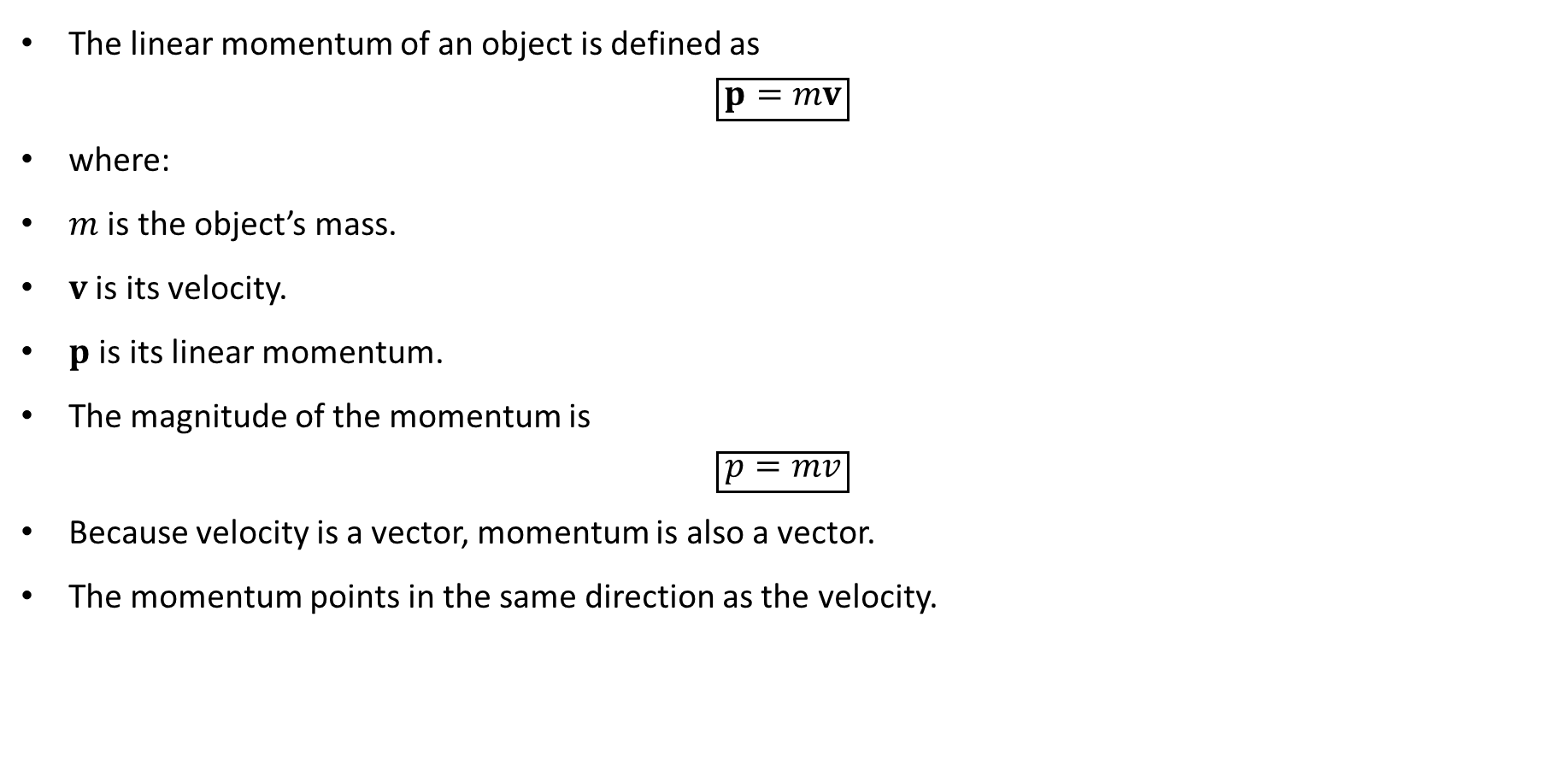
PHYS 2325 | University Physics I
Lecture 01 • Mon Oct 12 • Giancoli Ch. 9
Definition of Linear Momentum
The linear momentum of an object is defined as
$$\boxed{p=mv}$$
where:
$m$ is the object’s mass.
$v$ is its velocity.
$p$ is its linear momentum.
The magnitude of the momentum is
$$\boxed{p=mv}$$
Because velocity is a vector, momentum is also a vector.
The momentum points in the same direction as the velocity.

Slide 7
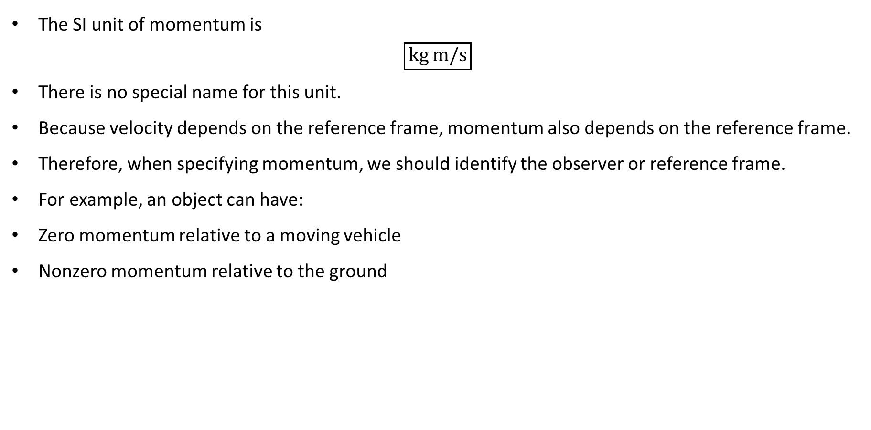
PHYS 2325 | University Physics I
Lecture 01 • Mon Oct 12 • Giancoli Ch. 9
Units and Reference Frame
The SI unit of momentum is
$$\boxed{kg m/s}$$
There is no special name for this unit.
Because velocity depends on the reference frame, momentum also depends on the reference frame.
Therefore, when specifying momentum, we should identify the observer or reference frame.
For example, an object can have:
Zero momentum relative to a moving vehicle
Nonzero momentum relative to the ground

Slide 8
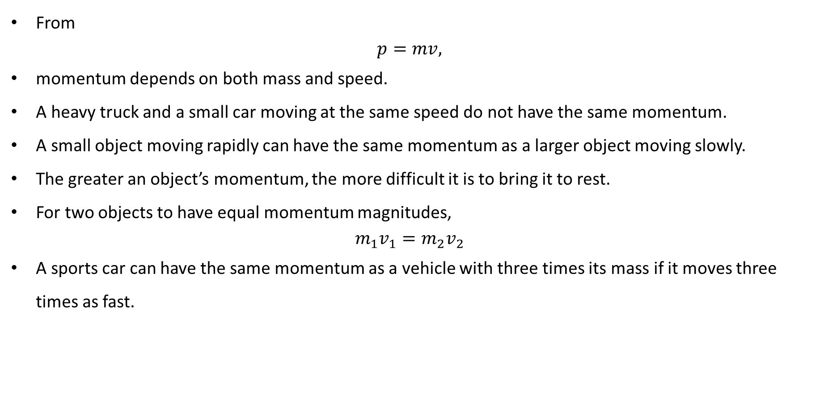
PHYS 2325 | University Physics I
Lecture 01 • Mon Oct 12 • Giancoli Ch. 9
What Determines Momentum?
From
$$p=mv,$$
momentum depends on both mass and speed.
A heavy truck and a small car moving at the same speed do not have the same momentum.
A small object moving rapidly can have the same momentum as a larger object moving slowly.
The greater an object’s momentum, the more difficult it is to bring it to rest.
For two objects to have equal momentum magnitudes,
$$m_{1}v_{1}=m_{2}v_{2}$$
A sports car can have the same momentum as a vehicle with three times its mass if it moves three times as fast.

Slide 9
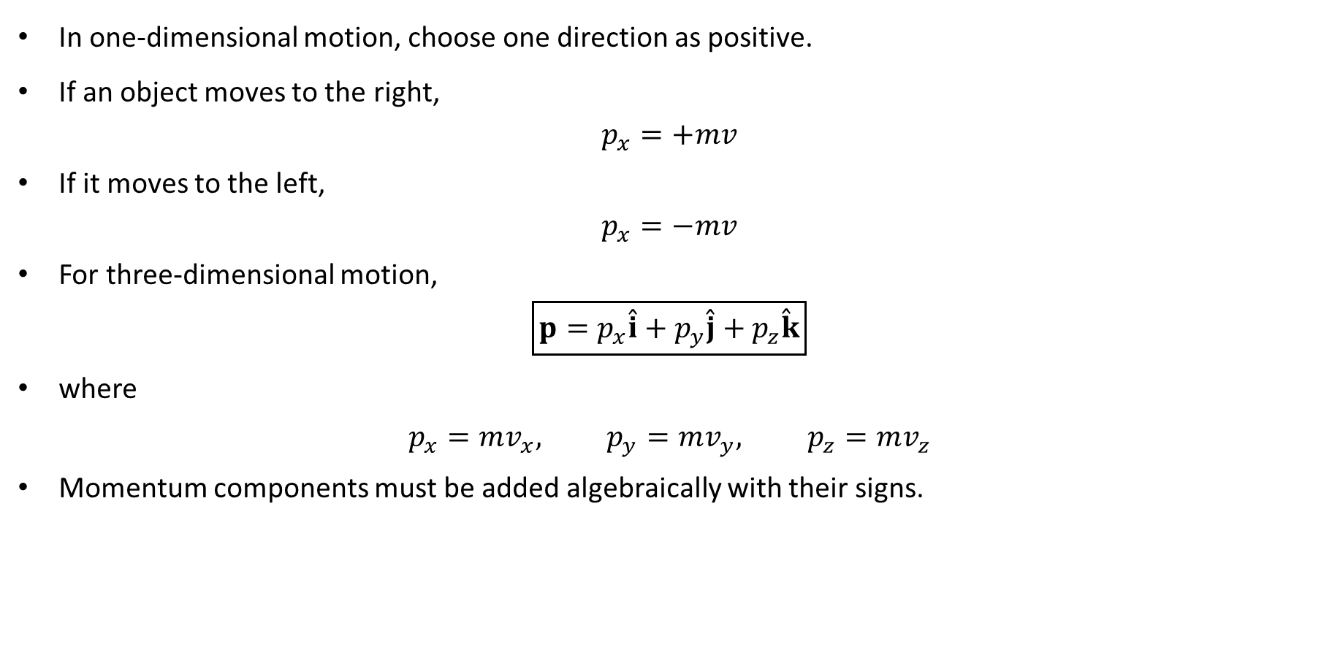
PHYS 2325 | University Physics I
Lecture 01 • Mon Oct 12 • Giancoli Ch. 9
Momentum Is a Vector
In one-dimensional motion, choose one direction as positive.
If an object moves to the right,
$$p_{x}=+mv$$
If it moves to the left,
$$p_{x}=−mv$$
For three-dimensional motion,
$$\boxed{p=p_{x}\overset{ˆ}{i}+p_{y}\overset{ˆ}{j}+p_{z}\overset{ˆ}{k}}$$
where
$$p_{x}=mv_{x}, p_{y}=mv_{y}, p_{z}=mv_{z}$$
Momentum components must be added algebraically with their signs.

Slide 10
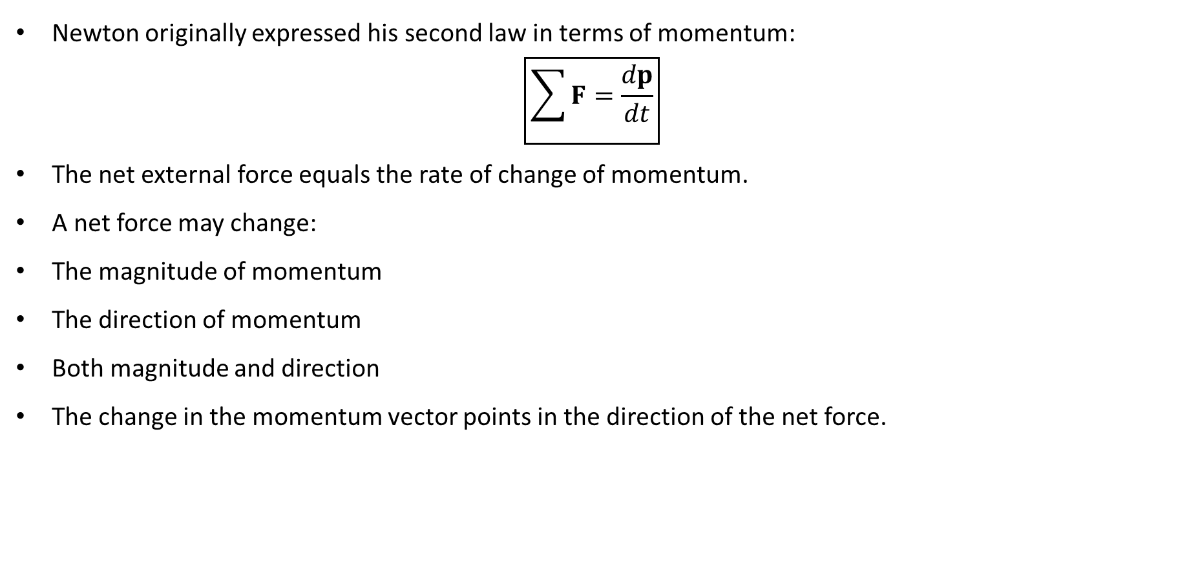
PHYS 2325 | University Physics I
Lecture 01 • Mon Oct 12 • Giancoli Ch. 9
Newton’s Second Law in Momentum Form
Newton originally expressed his second law in terms of momentum:
$$\boxed{\sum{F}=\frac{dp}{dt}}$$
The net external force equals the rate of change of momentum.
A net force may change:
The magnitude of momentum
The direction of momentum
Both magnitude and direction
The change in the momentum vector points in the direction of the net force.

Slide 11
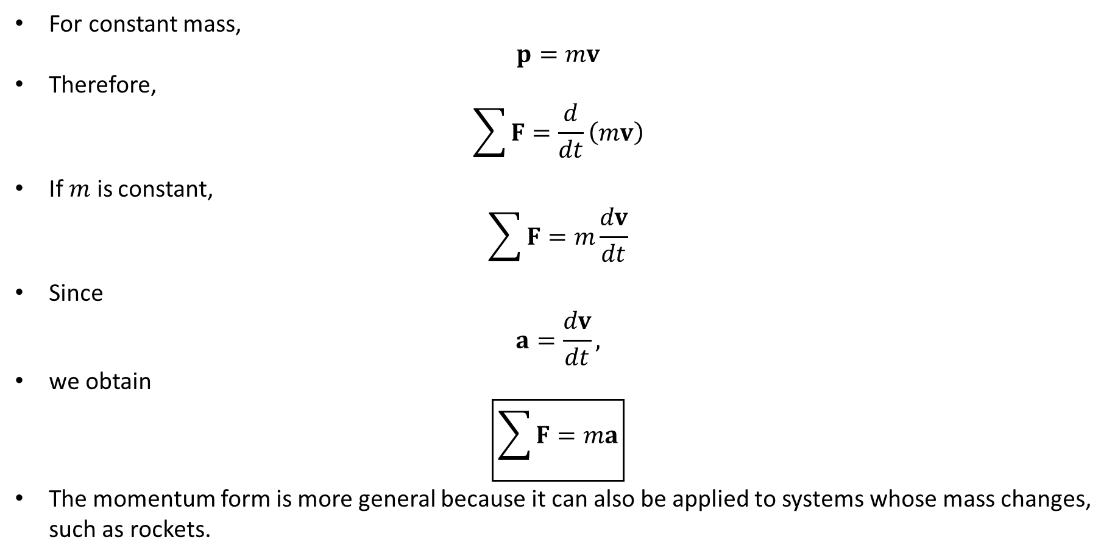
PHYS 2325 | University Physics I
Lecture 01 • Mon Oct 12 • Giancoli Ch. 9
Recovering $\sum{F}=ma$
For constant mass,
$$p=mv$$
Therefore,
$$\sum{F}=\frac{d}{dt}\left(mv\right)$$
If $m$ is constant,
$$\sum{F}=m\frac{dv}{dt}$$
Since
$$a=\frac{dv}{dt},$$
we obtain
$$\boxed{\sum{F}=ma}$$
The momentum form is more general because it can also be applied to systems whose mass changes, such as rockets.

Slide 12
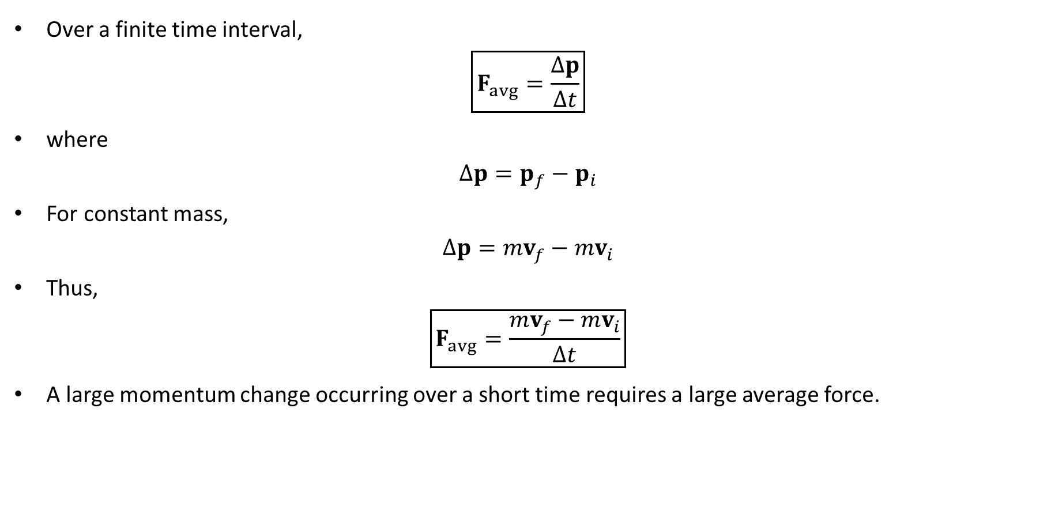
PHYS 2325 | University Physics I
Lecture 01 • Mon Oct 12 • Giancoli Ch. 9
Average Force and Momentum Change
Over a finite time interval,
$$\boxed{F_{avg}=\frac{Δp}{Δt}}$$
where
$$Δp=p_{f}−p_{i}$$
For constant mass,
$$Δp=mv_{f}−mv_{i}$$
Thus,
$$\boxed{F_{avg}=\frac{mv_{f}−mv_{i}}{Δt}}$$
A large momentum change occurring over a short time requires a large average force.

Slide 13
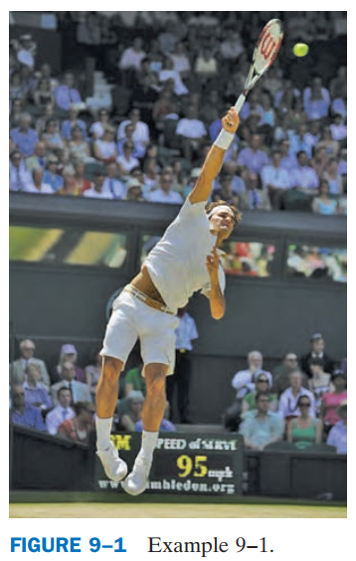
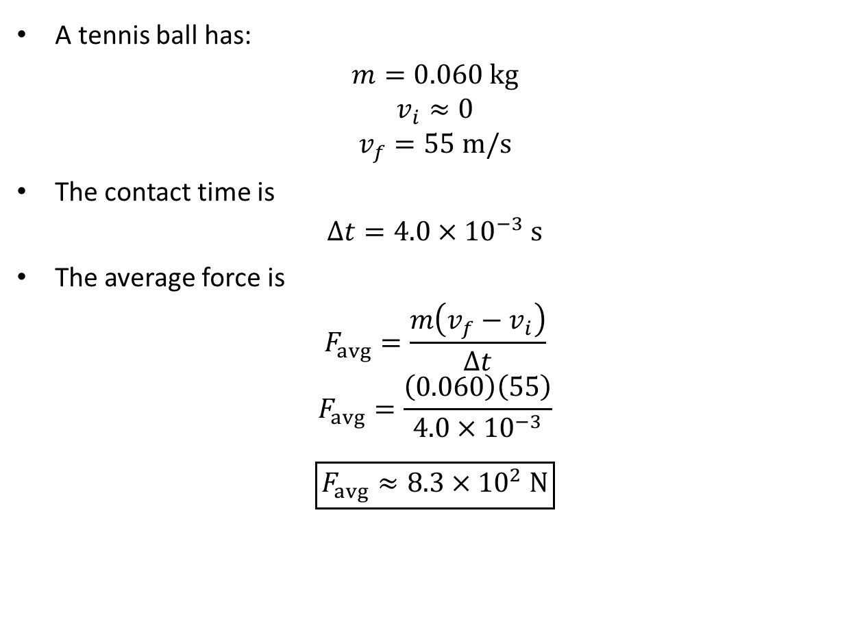
PHYS 2325 | University Physics I
Lecture 01 • Mon Oct 12 • Giancoli Ch. 9
Example 9–1: Force of a Tennis Serve
A tennis ball has:
$$m=0.060 kg$$
$$v_{i}≈0$$
$$v_{f}=55 m/s$$
The contact time is
$$Δt=4.0×{10}^{−3} s$$
The average force is
$$F_{avg}=\frac{m\left(v_{f}−v_{i}\right)}{Δt}$$
$$F_{avg}=\frac{\left(0.060\right)\left(55\right)}{4.0×{10}^{−3}}$$
$$\boxed{F_{avg}≈8.3×{10}^{2} N}$$

Slide 14
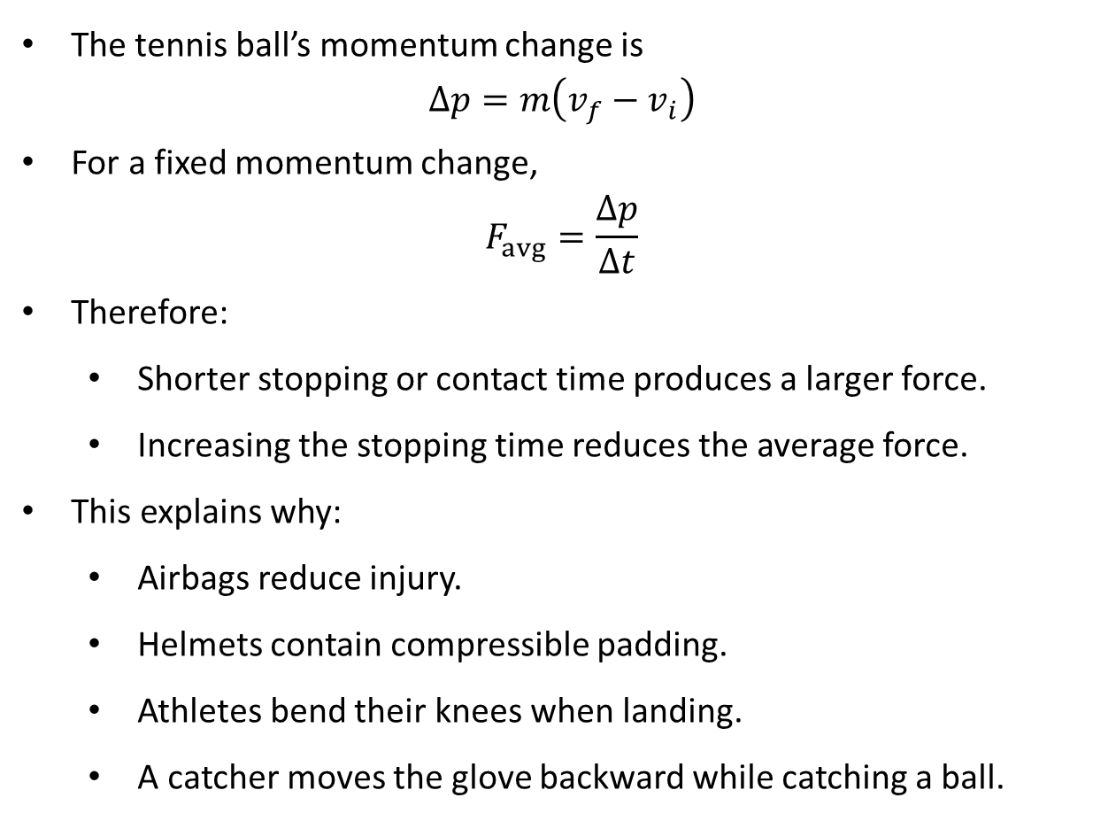
PHYS 2325 | University Physics I
Lecture 01 • Mon Oct 12 • Giancoli Ch. 9
Why Short Collision Times Produce Large Forces
The tennis ball’s momentum change is
$$Δp=m\left(v_{f}−v_{i}\right)$$
For a fixed momentum change,
$$F_{avg}=\frac{Δp}{Δt}$$
Therefore:
  Shorter stopping or contact time produces a larger force.
  Increasing the stopping time reduces the average force.
This explains why:
  Airbags reduce injury.
  Helmets contain compressible padding.
  Athletes bend their knees when landing.
  A catcher moves the glove backward while catching a ball.

Slide 15
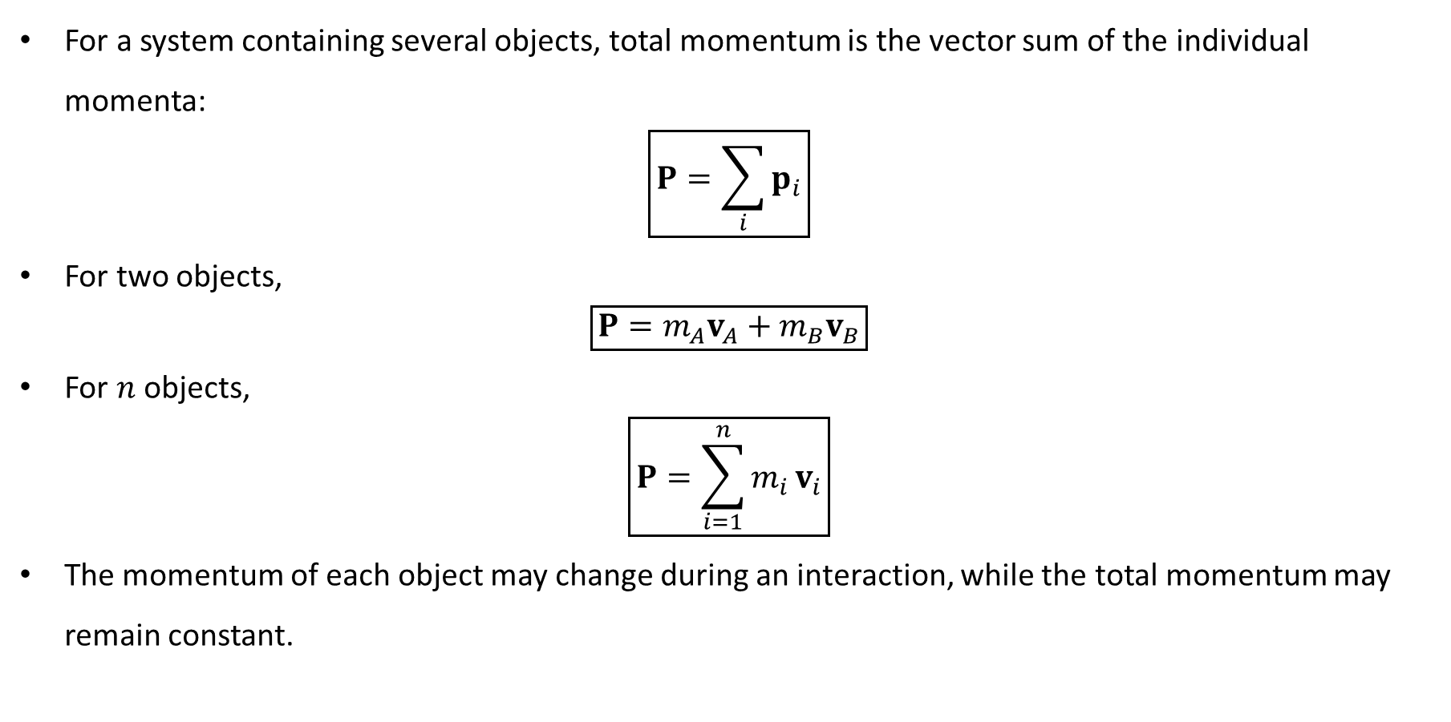
PHYS 2325 | University Physics I
Lecture 01 • Mon Oct 12 • Giancoli Ch. 9
Total Momentum of a System
For a system containing several objects, total momentum is the vector sum of the individual momenta:
$$\boxed{P=\sum_{i}{p_{i}}}$$
For two objects,
$$\boxed{P=m_{A}v_{A}+m_{B}v_{B}}$$
For $n$ objects,
$$\boxed{P=\sum_{i=1}^{n}{m_{i}}v_{i}}$$
The momentum of each object may change during an interaction, while the total momentum may remain constant.

Slide 16
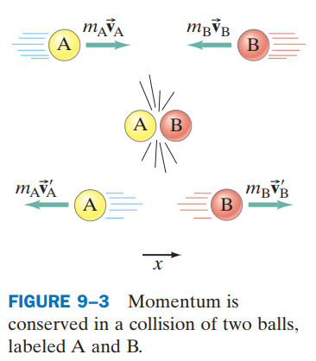
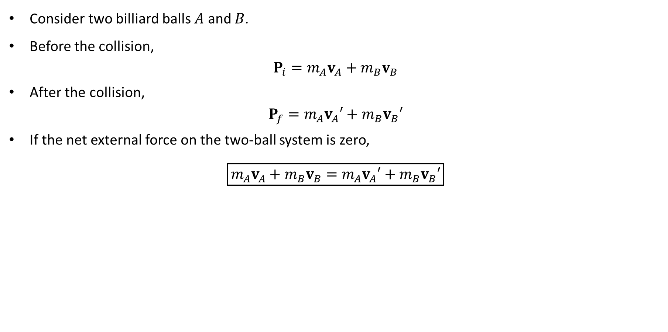
PHYS 2325 | University Physics I
Lecture 01 • Mon Oct 12 • Giancoli Ch. 9
Two-Object Collision
Consider two billiard balls $A$ and $B$.
Before the collision,
$$P_{i}=m_{A}v_{A}+m_{B}v_{B}$$
After the collision,
$$P_{f}=m_{A}v_{A}′+m_{B}v_{B}′$$
If the net external force on the two-ball system is zero,
$$\boxed{m_{A}v_{A}+m_{B}v_{B}=m_{A}v_{A}′+m_{B}v_{B}′}$$

Slide 17
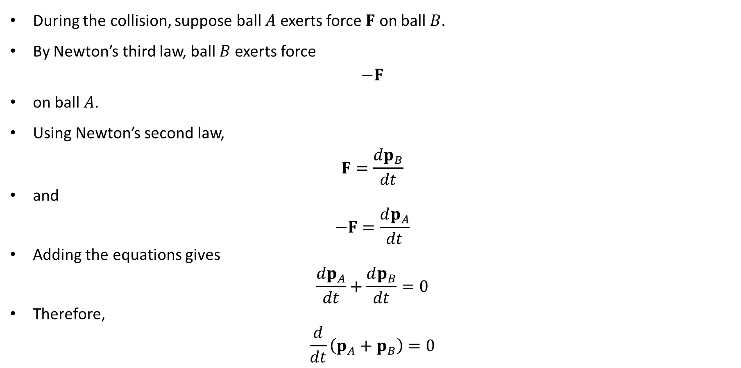
PHYS 2325 | University Physics I
Lecture 01 • Mon Oct 12 • Giancoli Ch. 9
Derivation from Newton’s Laws
During the collision, suppose ball $A$ exerts force $F$ on ball $B$.
By Newton’s third law, ball $B$ exerts force
$$−F$$
on ball $A$.
Using Newton’s second law,
$$F=\frac{dp_{B}}{dt}$$
and
$$−F=\frac{dp_{A}}{dt}$$
Adding the equations gives
$$\frac{dp_{A}}{dt}+\frac{dp_{B}}{dt}=0$$
Therefore,
$$\frac{d}{dt}\left(p_{A}+p_{B}\right)=0$$

Slide 18
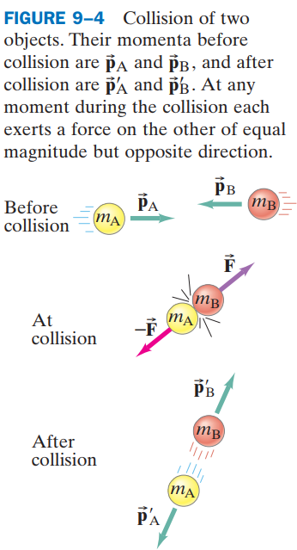
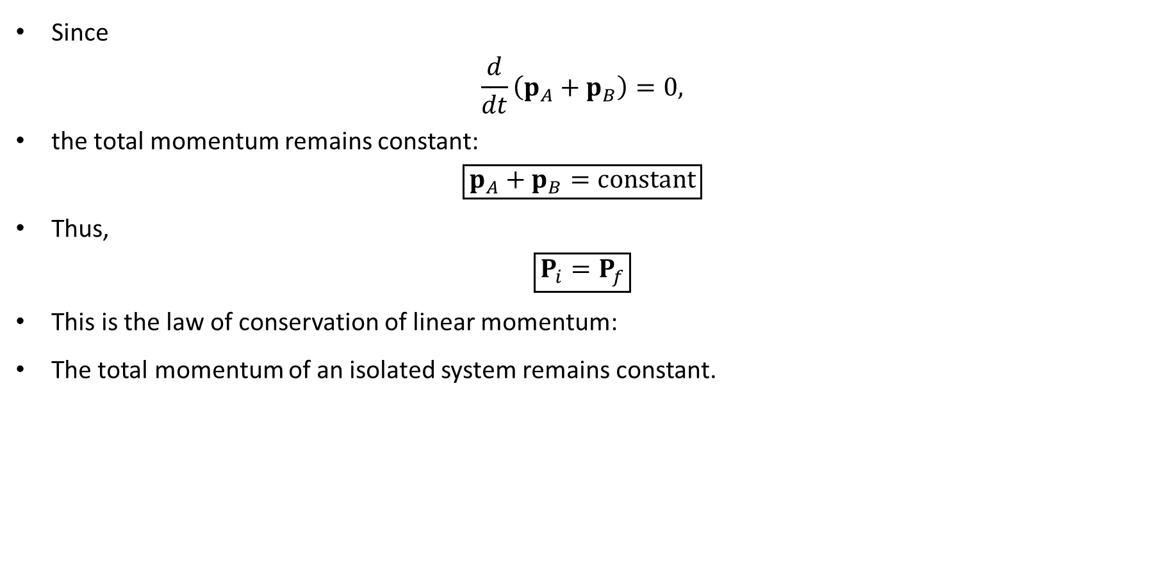
PHYS 2325 | University Physics I
Lecture 01 • Mon Oct 12 • Giancoli Ch. 9
Conservation of Momentum
Since
$$\frac{d}{dt}\left(p_{A}+p_{B}\right)=0,$$
the total momentum remains constant:
$$\boxed{p_{A}+p_{B}=\text{constant}}$$
Thus,
$$\boxed{P_{i}=P_{f}}$$
This is the law of conservation of linear momentum:
The total momentum of an isolated system remains constant.

Slide 19
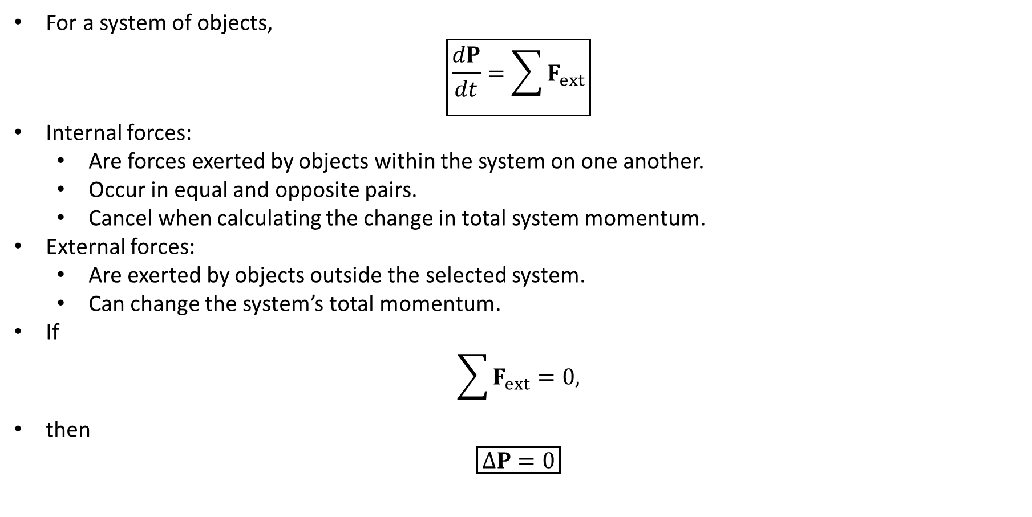
PHYS 2325 | University Physics I
Lecture 01 • Mon Oct 12 • Giancoli Ch. 9
Internal and External Forces
For a system of objects,
$$\boxed{\frac{dP}{dt}=\sum{F_{ext}}}$$
Internal forces:
  Are forces exerted by objects within the system on one another.
  Occur in equal and opposite pairs.
  Cancel when calculating the change in total system momentum.
External forces:
  Are exerted by objects outside the selected system.
  Can change the system’s total momentum.
If
$$\sum{F_{ext}}=0,$$
then
$$\boxed{ΔP=0}$$

Slide 20
PHYS 2325 | University Physics I
Lecture 01 • Mon Oct 12 • Giancoli Ch. 9
Choosing the System
Momentum conservation depends on how the system is defined.
Falling rock alone
  Earth’s gravitational force is external.
  The rock’s momentum is not conserved.
Rock plus Earth
  Gravity is now an internal force.
  The total momentum of the rock–Earth system is conserved.
The Earth moves upward toward the falling rock, but its speed is extremely small because its mass is enormous.
Key point: Always identify the system before applying momentum conservation.

Slide 21
PHYS 2325 | University Physics I
Lecture 01 • Mon Oct 12 • Giancoli Ch. 9
When Can External Forces Be Ignored?
In real collisions, external forces may be present:
  Gravity
  Friction
  Air resistance
However, collision forces are often much larger and act during a very short interval.
Therefore, momentum is approximately conserved between:
  The instant immediately before the collision
  The instant immediately after the collision
Do not wait long after the collision, because external forces may then significantly change the momentum.

Slide 22
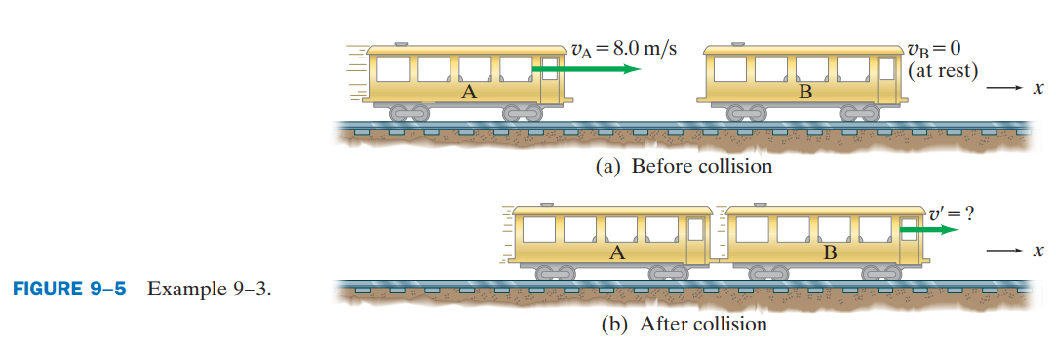
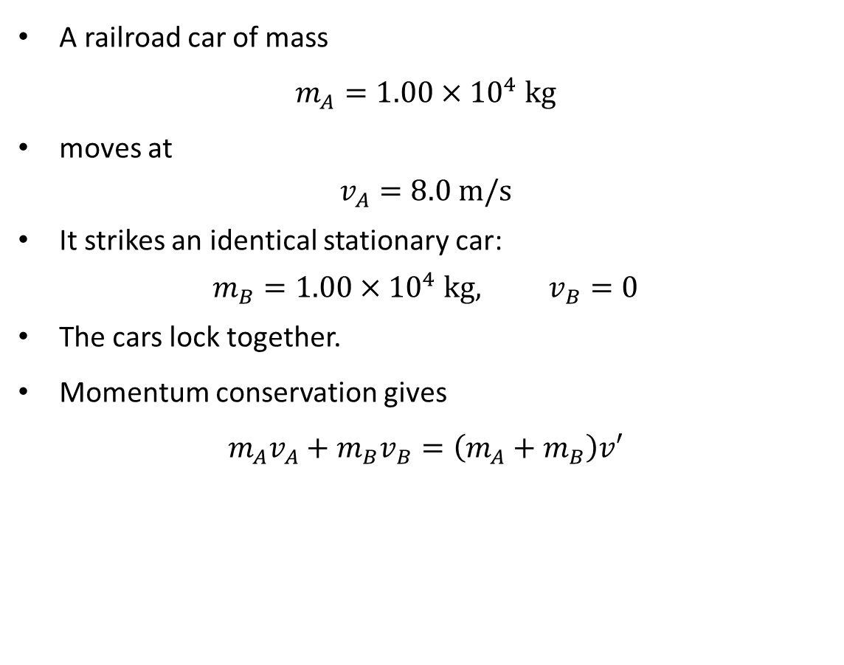
PHYS 2325 | University Physics I
Lecture 01 • Mon Oct 12 • Giancoli Ch. 9
Example 9–3: Railroad Cars
A railroad car of mass
$$m_{A}=1.00×{10}^{4} kg$$
moves at
$$v_{A}=8.0 m/s$$
It strikes an identical stationary car:
$$m_{B}=1.00×{10}^{4} kg, v_{B}=0$$
The cars lock together.
Momentum conservation gives
$$m_{A}v_{A}+m_{B}v_{B}=\left(m_{A}+m_{B}\right)v′$$

Slide 23
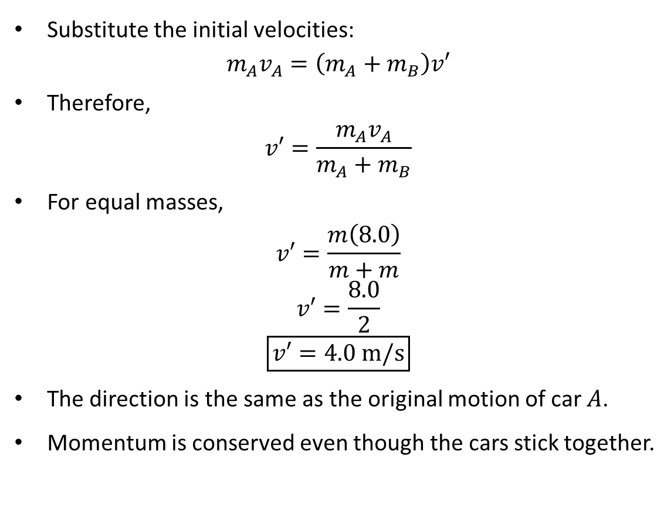
PHYS 2325 | University Physics I
Lecture 01 • Mon Oct 12 • Giancoli Ch. 9
Railroad Cars: Solution
Substitute the initial velocities:
$$m_{A}v_{A}=\left(m_{A}+m_{B}\right)v′$$
Therefore,
$$v′=\frac{m_{A}v_{A}}{m_{A}+m_{B}}$$
For equal masses,
$$v′=\frac{m\left(8.0\right)}{m+m}$$
$$v′=\frac{8.0}{2}$$
$$\boxed{v′=4.0 m/s}$$
The direction is the same as the original motion of car $A$.
Momentum is conserved even though the cars stick together.

Slide 24
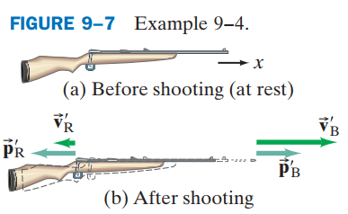
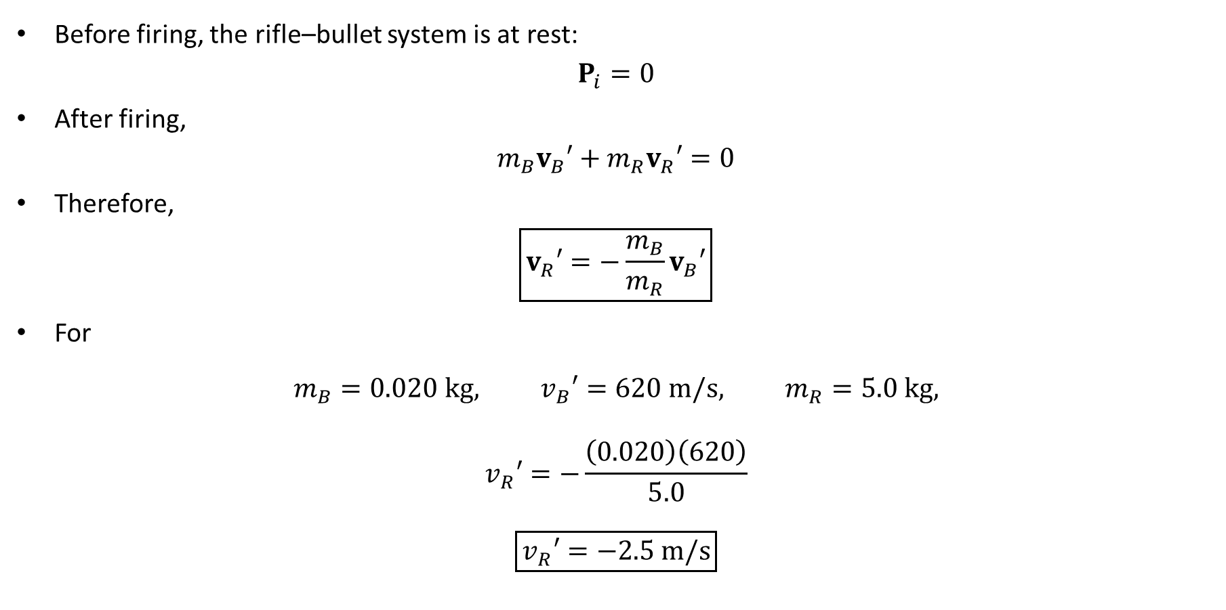
PHYS 2325 | University Physics I
Lecture 01 • Mon Oct 12 • Giancoli Ch. 9
Rifle Recoil
Before firing, the rifle–bullet system is at rest:
$$P_{i}=0$$
After firing,
$$m_{B}v_{B}′+m_{R}v_{R}′=0$$
Therefore,
$$\boxed{v_{R}′=−\frac{m_{B}}{m_{R}}v_{B}′}$$
For
$$m_{B}=0.020 kg, v_{B}′=620 m/s, m_{R}=5.0 kg,$$
$$v_{R}′=−\frac{\left(0.020\right)\left(620\right)}{5.0}$$
$$\boxed{v_{R}′=−2.5 m/s}$$

Slide 25
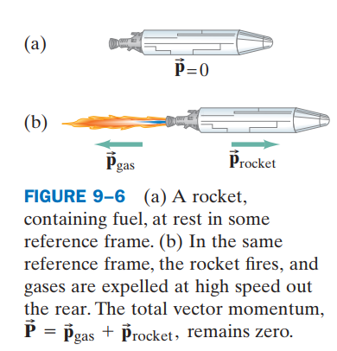
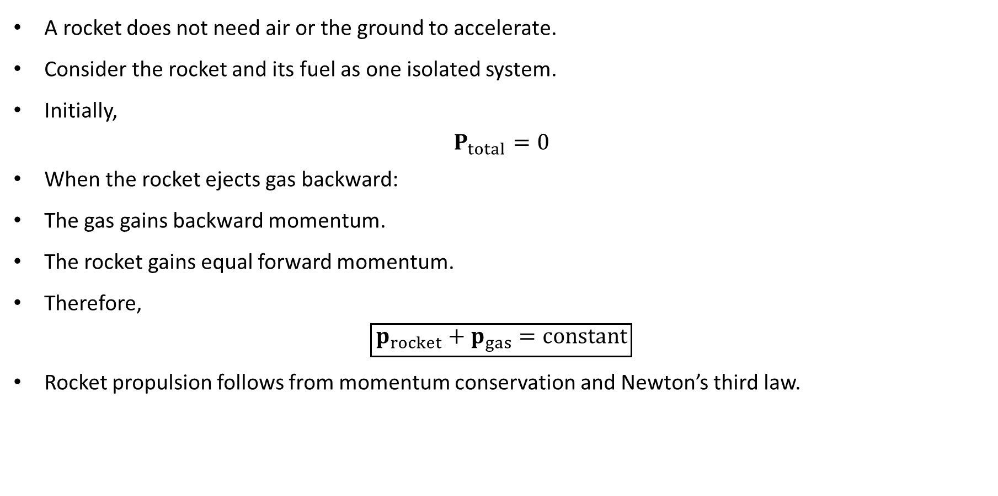
PHYS 2325 | University Physics I
Lecture 01 • Mon Oct 12 • Giancoli Ch. 9
Rocket Propulsion
A rocket does not need air or the ground to accelerate.
Consider the rocket and its fuel as one isolated system.
Initially,
$$P_{total}=0$$
When the rocket ejects gas backward:
The gas gains backward momentum.
The rocket gains equal forward momentum.
Therefore,
$$\boxed{p_{rocket}+p_{gas}=\text{constant}}$$
Rocket propulsion follows from momentum conservation and Newton’s third law.

Slide 26
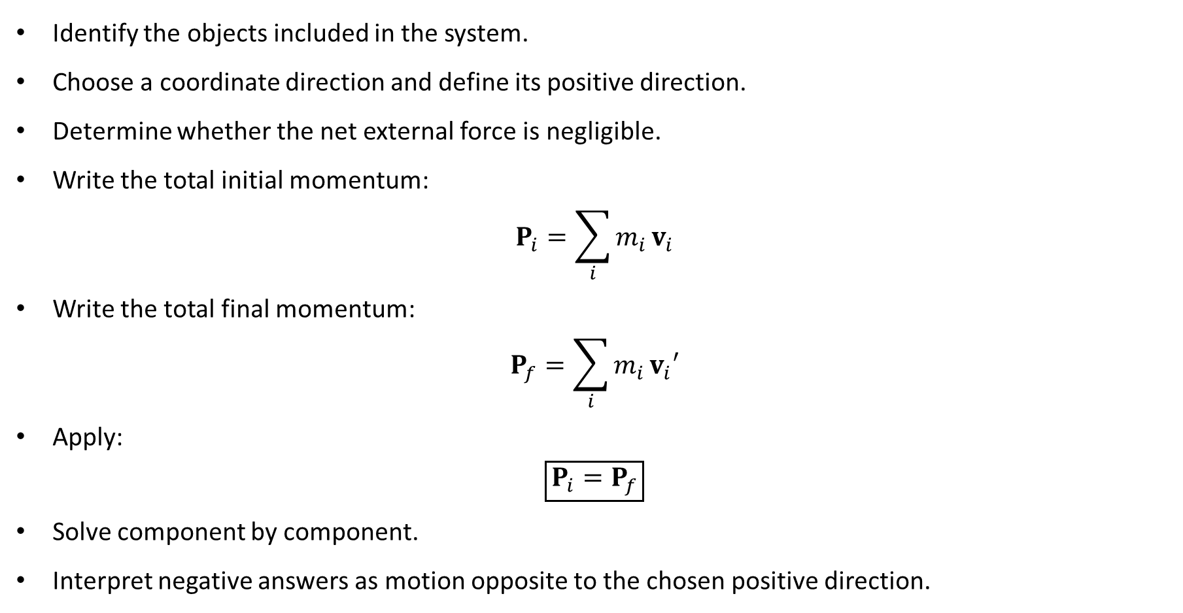
PHYS 2325 | University Physics I
Lecture 01 • Mon Oct 12 • Giancoli Ch. 9
Momentum Conservation: Problem Strategy
Identify the objects included in the system.
Choose a coordinate direction and define its positive direction.
Determine whether the net external force is negligible.
Write the total initial momentum:
$$P_{i}=\sum_{i}{m_{i}}v_{i}$$
Write the total final momentum:
$$P_{f}=\sum_{i}{m_{i}}v_{i}′$$
Apply:
$$\boxed{P_{i}=P_{f}}$$
Solve component by component.
Interpret negative answers as motion opposite to the chosen positive direction.

Slide 27
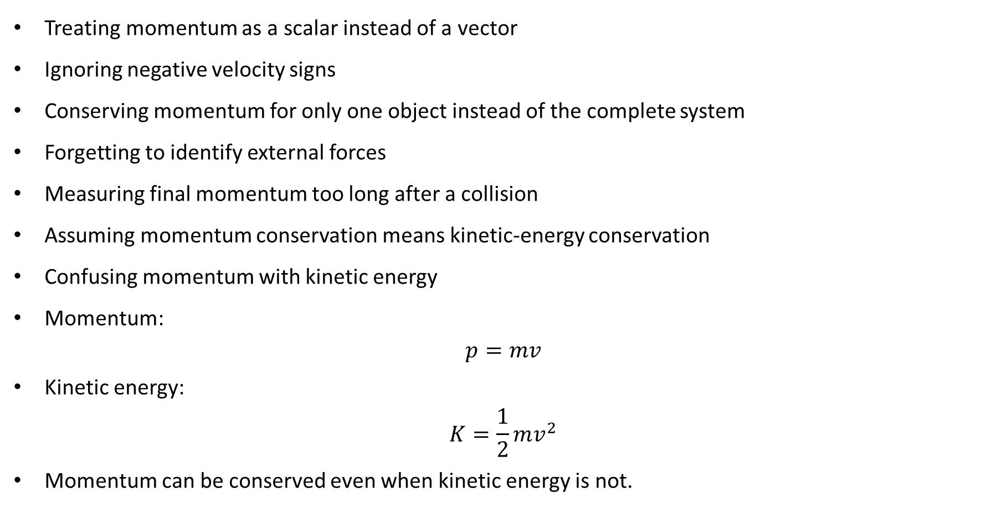
PHYS 2325 | University Physics I
Lecture 01 • Mon Oct 12 • Giancoli Ch. 9
Common Mistakes
Treating momentum as a scalar instead of a vector
Ignoring negative velocity signs
Conserving momentum for only one object instead of the complete system
Forgetting to identify external forces
Measuring final momentum too long after a collision
Assuming momentum conservation means kinetic-energy conservation
Confusing momentum with kinetic energy
Momentum:
$$p=mv$$
Kinetic energy:
$$K=\frac{1}{2}mv^{2}$$
Momentum can be conserved even when kinetic energy is not.

Slide 28
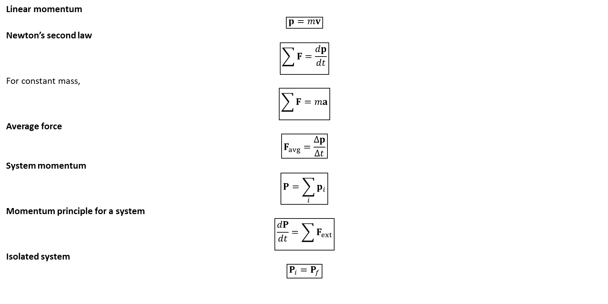
PHYS 2325 | University Physics I
Lecture 01 • Mon Oct 12 • Giancoli Ch. 9
Lecture Summary
Linear momentum
$$\boxed{p=mv}$$
Newton’s second law
$$\boxed{\sum{F}=\frac{dp}{dt}}$$
For constant mass,
$$\boxed{\sum{F}=ma}$$
Average force
$$\boxed{F_{avg}=\frac{Δp}{Δt}}$$
System momentum
$$\boxed{P=\sum_{i}{p_{i}}}$$
Momentum principle for a system
$$\boxed{\frac{dP}{dt}=\sum{F_{ext}}}$$
Isolated system
$$\boxed{P_{i}=P_{f}}$$

Slide 29
LECTURE 02
Impulse and Collision Classification
Wed Oct 14 • Giancoli Ch. 9
Muhammad Nauman • PHYS 2325 • Fall 2026

Slide 30
PHYS 2325 | University Physics I
Lecture 02 • Wed Oct 14 • Giancoli Ch. 9
Learning outcomes
Define and represent collisions and impulse.
Derive and interpret energy and momentum in collisions.
Check units, vector directions, assumptions, and limiting behavior in every solution.

Slide 31
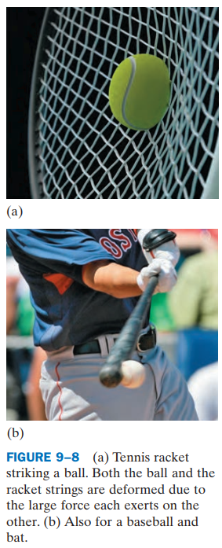
PHYS 2325 | University Physics I
Lecture 02 • Wed Oct 14 • Giancoli Ch. 9
What Happens During a Collision?
During a collision:
  The objects exert very large forces on each other.
  Both objects usually deform.
  The interaction time is extremely short.
  For macroscopic collisions, the contact time is commonly measured in milliseconds.
  Collision forces are often much larger than external forces such as gravity.
Therefore, during the brief collision interval, total momentum is often approximately conserved.
Notes:
Teaching focus: Where today's lecture fits.
[Sources]
- PHYS 2325 University Physics I Fall 2026 syllabus and semester calendar.
[/Sources]

Slide 32
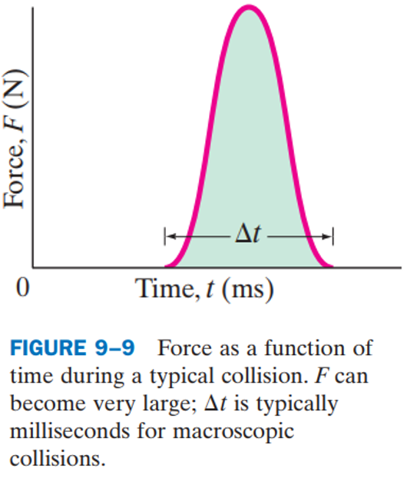
PHYS 2325 | University Physics I
Lecture 02 • Wed Oct 14 • Giancoli Ch. 9
Force During a Collision
A collision force is generally not constant.
It typically:
  Begins at zero when contact starts
  Increases rapidly to a large value
  Reaches a maximum
  Decreases rapidly to zero when contact ends
The exact force-versus-time function may be complicated and difficult to measure.
However, its total effect can be described using impulse.
Notes:
Teaching focus: Where today's lecture fits.
[Sources]
- PHYS 2325 University Physics I Fall 2026 syllabus and semester calendar.
[/Sources]

Slide 33
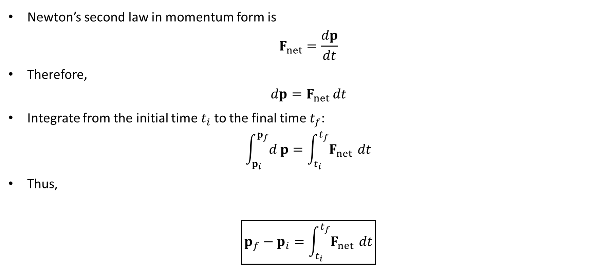
PHYS 2325 | University Physics I
Lecture 02 • Wed Oct 14 • Giancoli Ch. 9
Derivation of Impulse
Newton’s second law in momentum form is
$$F_{net}=\frac{dp}{dt}$$
Therefore,
$$dp=F_{net} dt$$
Integrate from the initial time $t_{i}$ to the final time $t_{f}$:
$$\int_{p_{i}}^{p_{f}}{d}p=\int_{t_{i}}^{t_{f}}{F_{net}} dt$$
Thus,
$$\boxed{p_{f}−p_{i}=\int_{t_{i}}^{t_{f}}{F_{net}} dt}$$
Notes:
Teaching focus: Where today's lecture fits.
[Sources]
- PHYS 2325 University Physics I Fall 2026 syllabus and semester calendar.
[/Sources]

Slide 34
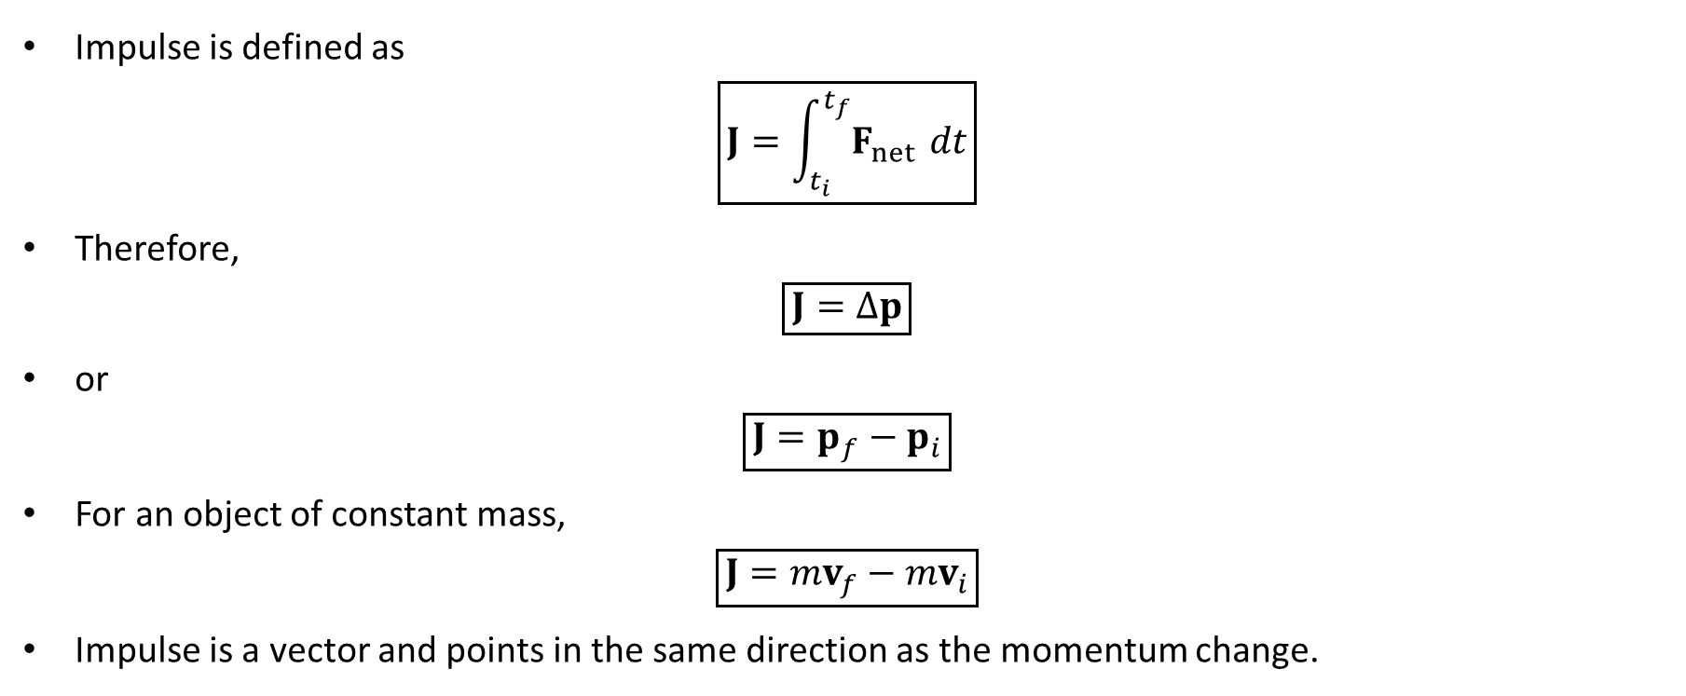
PHYS 2325 | University Physics I
Lecture 02 • Wed Oct 14 • Giancoli Ch. 9
Impulse–Momentum Theorem
Impulse is defined as
$$\boxed{J=\int_{t_{i}}^{t_{f}}{F_{net}} dt}$$
Therefore,
$$\boxed{J=Δp}$$
or
$$\boxed{J=p_{f}−p_{i}}$$
For an object of constant mass,
$$\boxed{J=mv_{f}−mv_{i}}$$
Impulse is a vector and points in the same direction as the momentum change.
Notes:
Teaching focus: Where today's lecture fits.
[Sources]
- PHYS 2325 University Physics I Fall 2026 syllabus and semester calendar.
[/Sources]

Slide 35
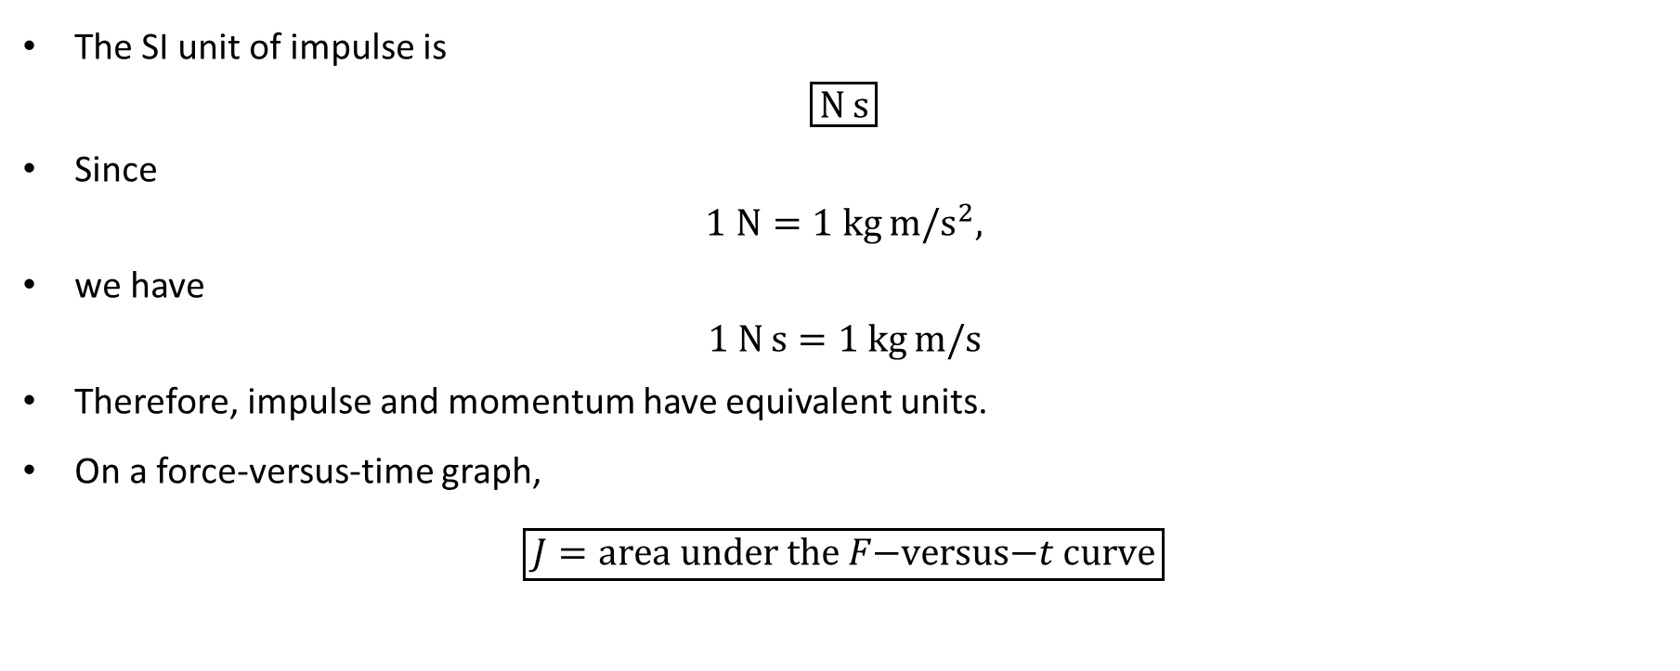
PHYS 2325 | University Physics I
Lecture 02 • Wed Oct 14 • Giancoli Ch. 9
Units and Graphical Meaning of Impulse
The SI unit of impulse is
$$\boxed{N s}$$
Since
$$1 N=1 kg m/s^{2},$$
we have
$$1 N s=1 kg m/s$$
Therefore, impulse and momentum have equivalent units.
On a force-versus-time graph,
$$\boxed{J=\text{area under the }F\text{−versus−}t\text{ curve}}$$
Notes:
Teaching focus: Where today's lecture fits.
[Sources]
- PHYS 2325 University Physics I Fall 2026 syllabus and semester calendar.
[/Sources]

Slide 36
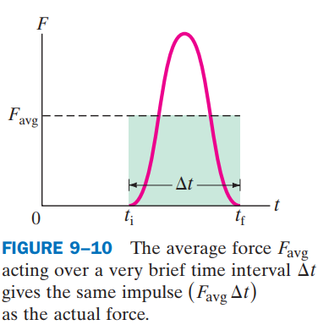
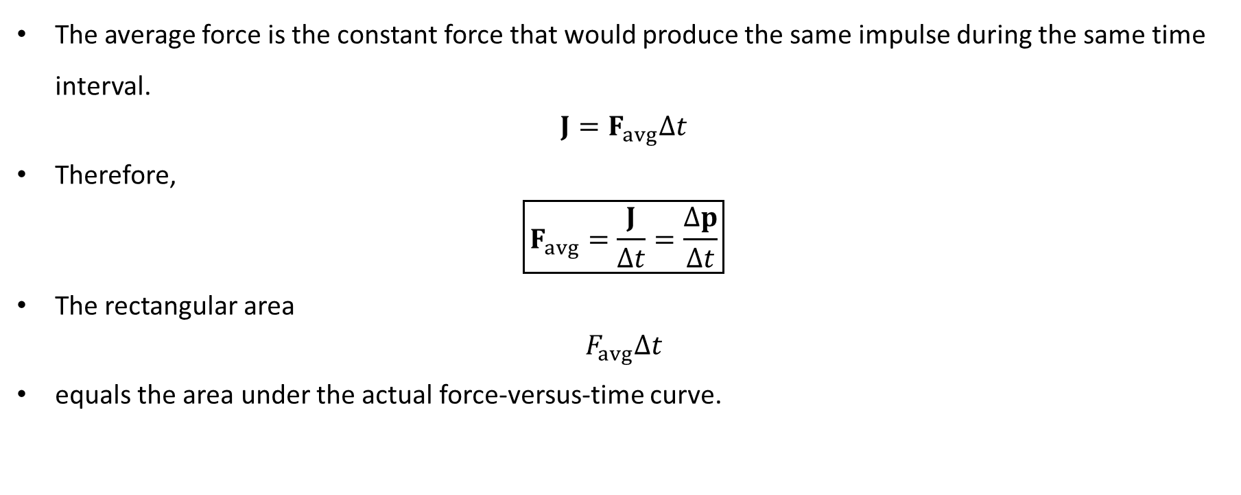
PHYS 2325 | University Physics I
Lecture 02 • Wed Oct 14 • Giancoli Ch. 9
Average Collision Force
The average force is the constant force that would produce the same impulse during the same time interval.
$$J=F_{avg}Δt$$
Therefore,
$$\boxed{F_{avg}=\frac{J}{Δt}=\frac{Δp}{Δt}}$$
The rectangular area
$$F_{avg}Δt$$
equals the area under the actual force-versus-time curve.
Notes:
Teaching focus: Where today's lecture fits.
[Sources]
- PHYS 2325 University Physics I Fall 2026 syllabus and semester calendar.
[/Sources]

Slide 37
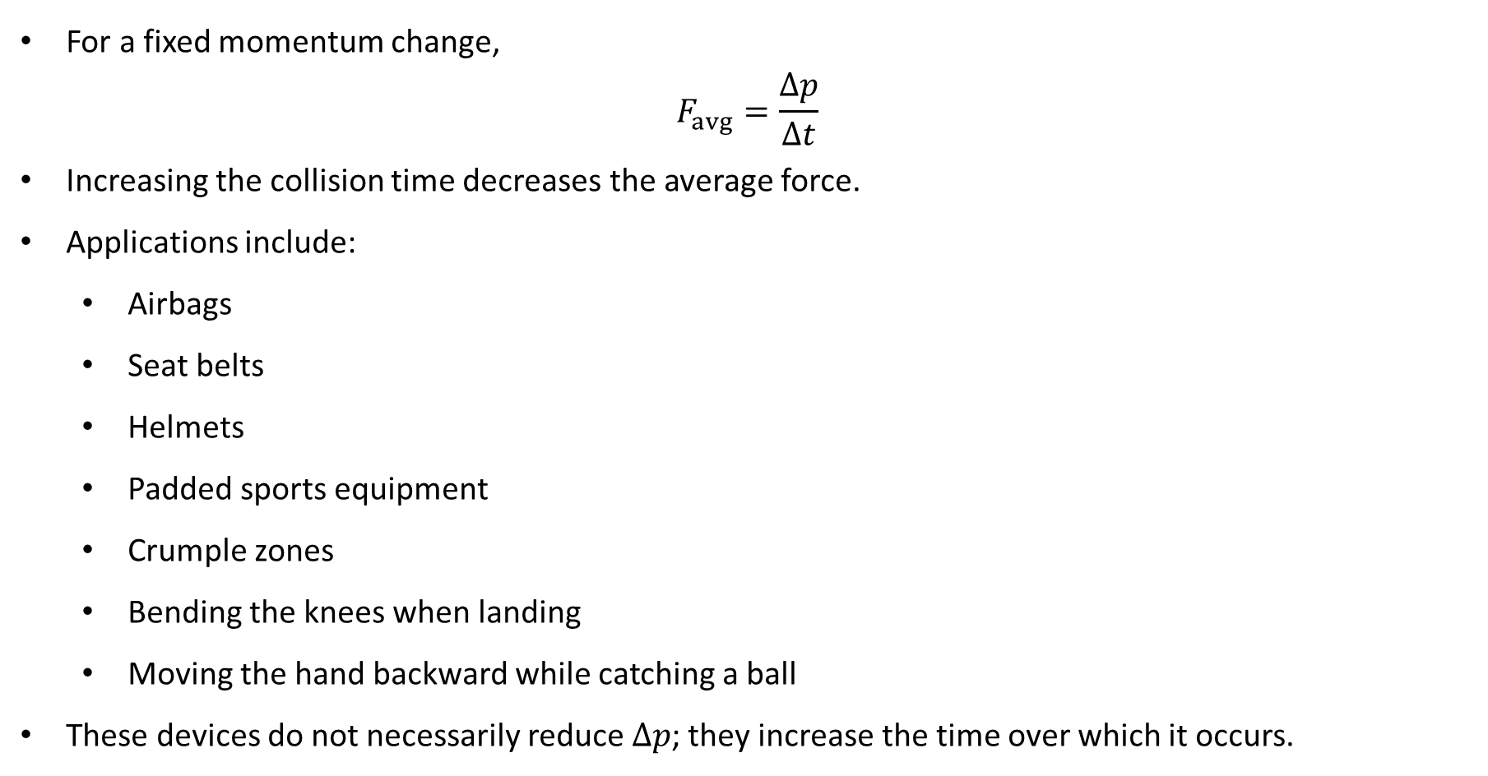
PHYS 2325 | University Physics I
Lecture 02 • Wed Oct 14 • Giancoli Ch. 9
Reducing Collision Forces
For a fixed momentum change,
$$F_{avg}=\frac{Δp}{Δt}$$
Increasing the collision time decreases the average force.
Applications include:
  Airbags
  Seat belts
  Helmets
  Padded sports equipment
  Crumple zones
  Bending the knees when landing
  Moving the hand backward while catching a ball
These devices do not necessarily reduce $Δp$; they increase the time over which it occurs.
Notes:
Teaching focus: Where today's lecture fits.
[Sources]
- PHYS 2325 University Physics I Fall 2026 syllabus and semester calendar.
[/Sources]

Slide 38
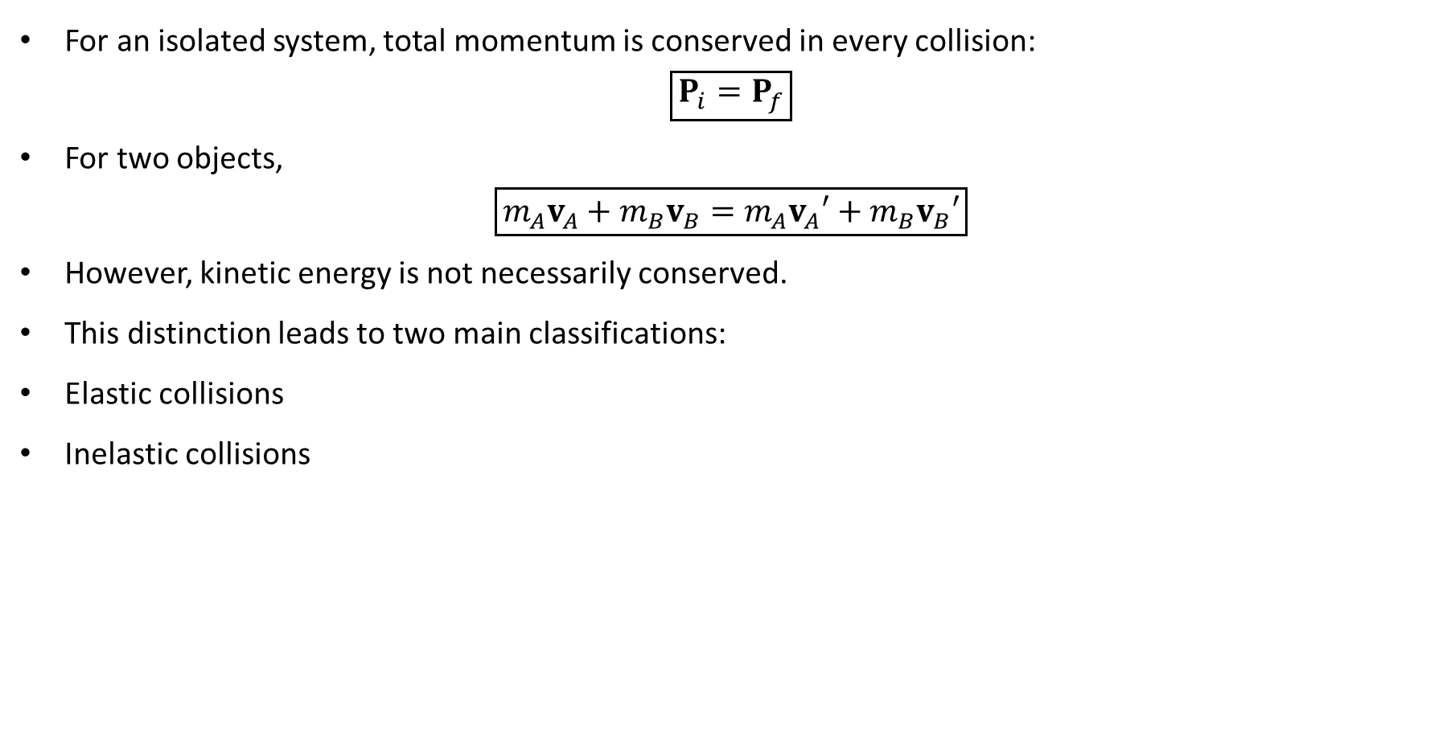
PHYS 2325 | University Physics I
Lecture 02 • Wed Oct 14 • Giancoli Ch. 9
Momentum and Energy in Collisions
For an isolated system, total momentum is conserved in every collision:
$$\boxed{P_{i}=P_{f}}$$
For two objects,
$$\boxed{m_{A}v_{A}+m_{B}v_{B}=m_{A}v_{A}′+m_{B}v_{B}′}$$
However, kinetic energy is not necessarily conserved.
This distinction leads to two main classifications:
Elastic collisions
Inelastic collisions
Notes:
Teaching focus: Where today's lecture fits.
[Sources]
- PHYS 2325 University Physics I Fall 2026 syllabus and semester calendar.
[/Sources]

Slide 39
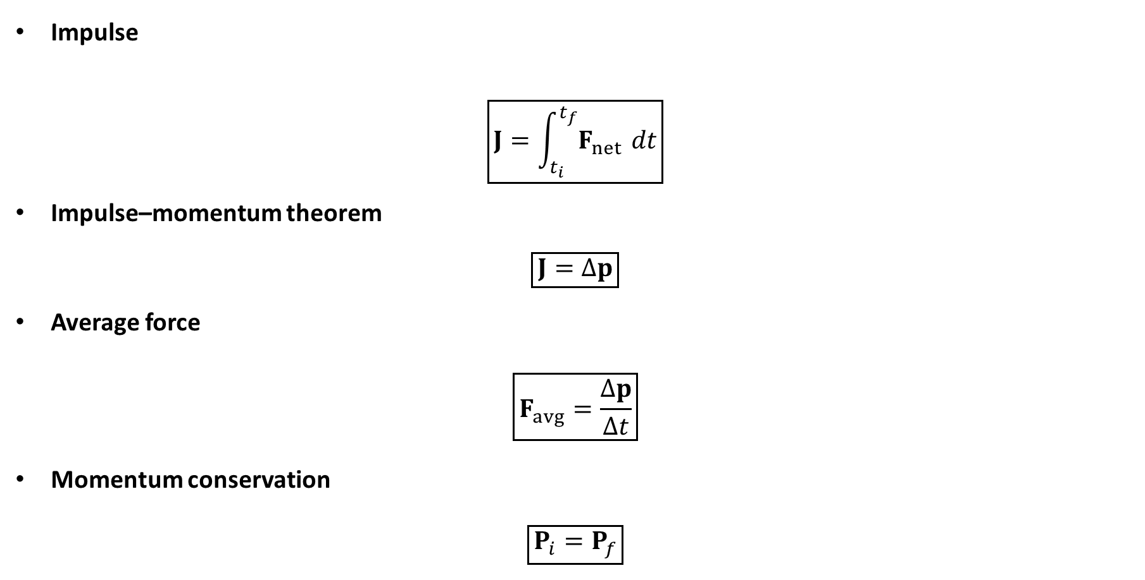
PHYS 2325 | University Physics I
Lecture 02 • Wed Oct 14 • Giancoli Ch. 9
Lecture Summary
Impulse
$$\boxed{J=\int_{t_{i}}^{t_{f}}{F_{net}} dt}$$
Impulse–momentum theorem
$$\boxed{J=Δp}$$
Average force
$$\boxed{F_{avg}=\frac{Δp}{Δt}}$$
Momentum conservation
$$\boxed{P_{i}=P_{f}}$$
Notes:
Teaching focus: Where today's lecture fits.
[Sources]
- PHYS 2325 University Physics I Fall 2026 syllabus and semester calendar.
[/Sources]

Slide 40
LECTURE 03
Elastic, Inelastic, and Two-Dimensional Collisions
Fri Oct 16 • Giancoli Ch. 9
Muhammad Nauman • PHYS 2325 • Fall 2026

Slide 41
PHYS 2325 | University Physics I
Lecture 03 • Fri Oct 16 • Giancoli Ch. 9
Learning outcomes
Define and represent elastic collisions in one dimension.
Derive and interpret inelastic collisions.
Apply collisions in two or three dimensions.
Check units, vector directions, assumptions, and limiting behavior in every solution.
Notes:
Teaching focus: Learning outcomes.
[Sources]
- PHYS 2325 University Physics I Fall 2026 syllabus and semester calendar.
[/Sources]

Slide 42
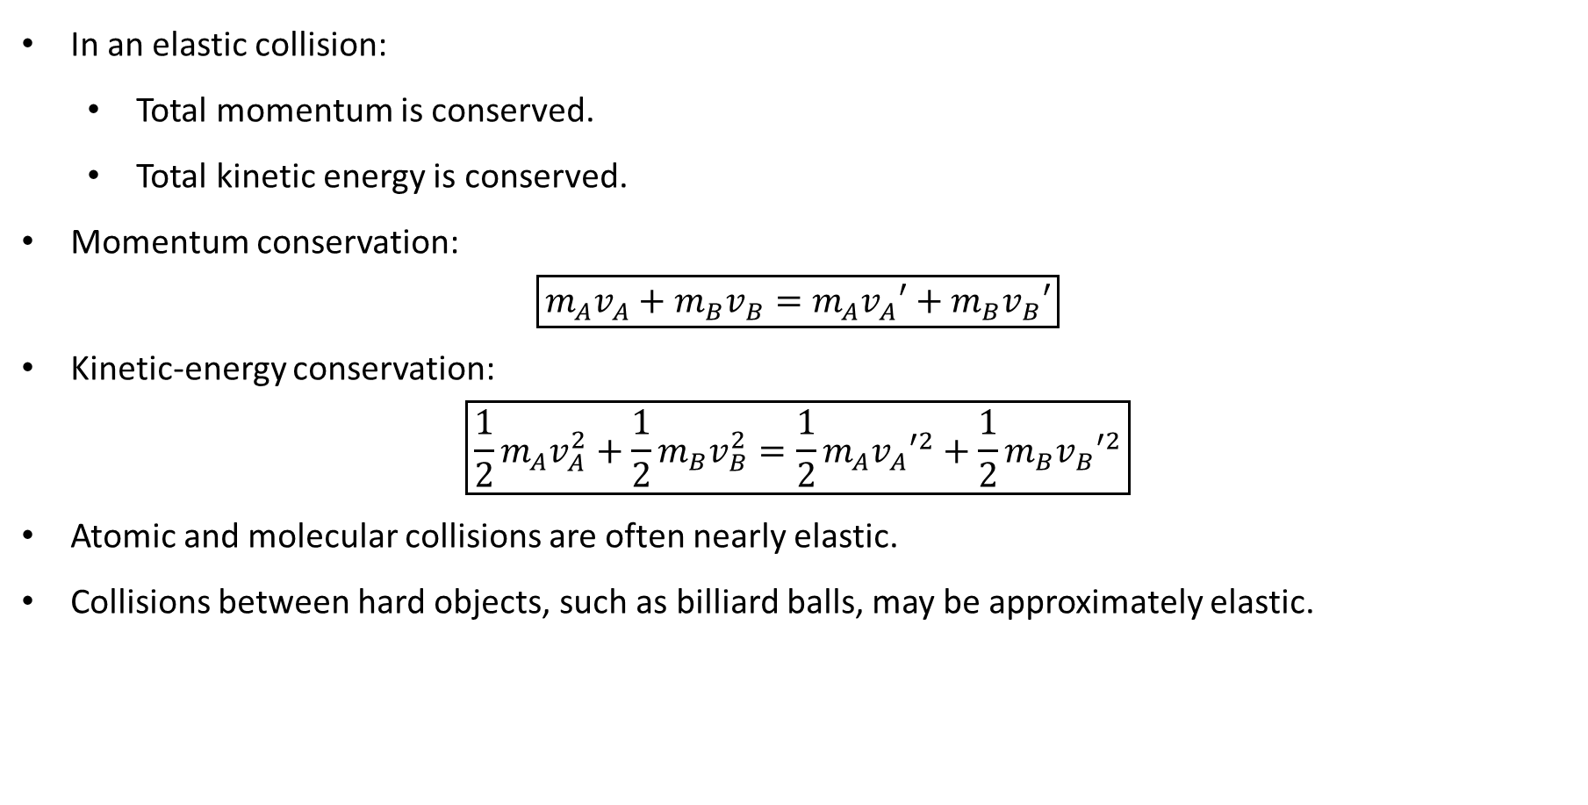
PHYS 2325 | University Physics I
Lecture 02 • Wed Oct 14 • Giancoli Ch. 9
Elastic Collisions
In an elastic collision:
  Total momentum is conserved.
  Total kinetic energy is conserved.
Momentum conservation:
$$\boxed{m_{A}v_{A}+m_{B}v_{B}=m_{A}v_{A}′+m_{B}v_{B}′}$$
Kinetic-energy conservation:
$$\boxed{\frac{1}{2}m_{A}v_{A}^{2}+\frac{1}{2}m_{B}v_{B}^{2}=\frac{1}{2}m_{A}v_{A}′^{2}+\frac{1}{2}m_{B}v_{B}′^{2}}$$
Atomic and molecular collisions are often nearly elastic.
Collisions between hard objects, such as billiard balls, may be approximately elastic.
Notes:
Teaching focus: Where today's lecture fits.
[Sources]
- PHYS 2325 University Physics I Fall 2026 syllabus and semester calendar.
[/Sources]

Slide 43
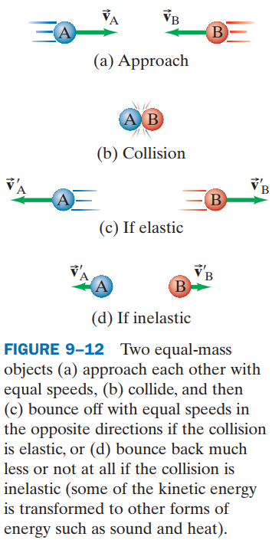
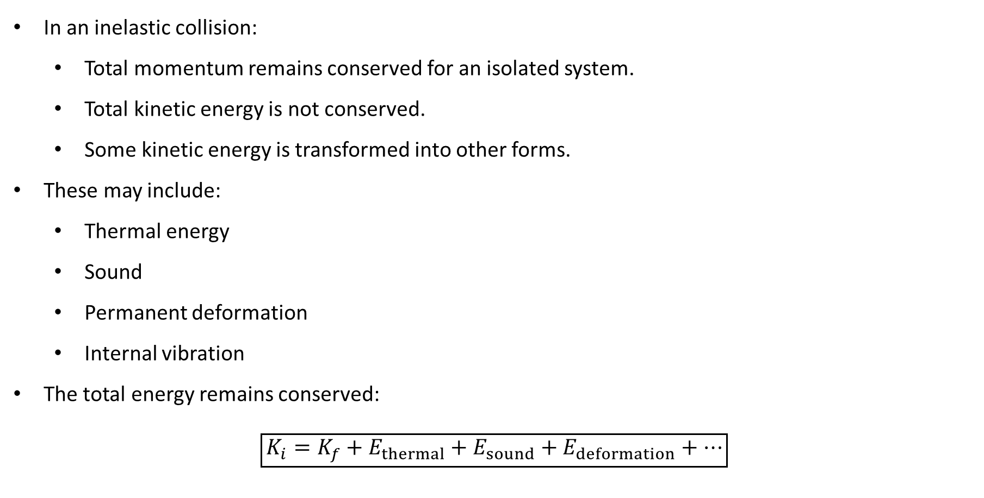
PHYS 2325 | University Physics I
Lecture 02 • Wed Oct 14 • Giancoli Ch. 9
Inelastic Collisions
In an inelastic collision:
  Total momentum remains conserved for an isolated system.
  Total kinetic energy is not conserved.
  Some kinetic energy is transformed into other forms.
These may include:
  Thermal energy
  Sound
  Permanent deformation
  Internal vibration
The total energy remains conserved:
$$\boxed{K_{i}=K_{f}+E_{thermal}+E_{sound}+E_{deformation}+⋯}$$
Notes:
Teaching focus: Where today's lecture fits.
[Sources]
- PHYS 2325 University Physics I Fall 2026 syllabus and semester calendar.
[/Sources]

Slide 44
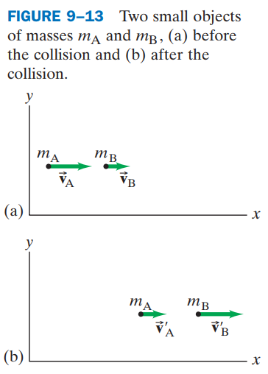
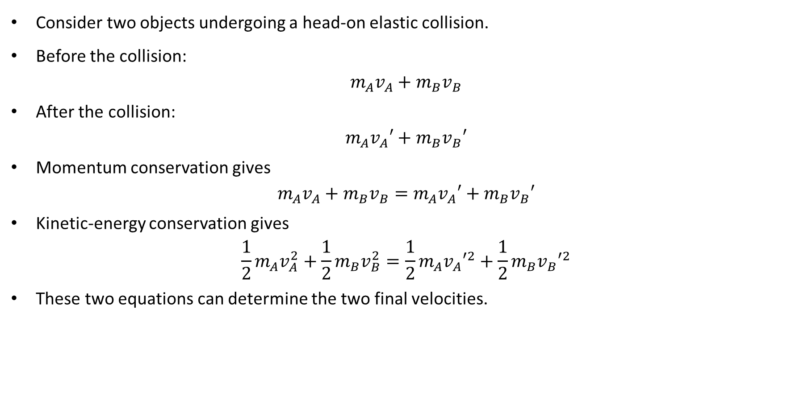
PHYS 2325 | University Physics I
Lecture 02 • Wed Oct 14 • Giancoli Ch. 9
One-Dimensional Elastic Collision
Consider two objects undergoing a head-on elastic collision.
Before the collision:
$$m_{A}v_{A}+m_{B}v_{B}$$
After the collision:
$$m_{A}v_{A}′+m_{B}v_{B}′$$
Momentum conservation gives
$$m_{A}v_{A}+m_{B}v_{B}=m_{A}v_{A}′+m_{B}v_{B}′$$
Kinetic-energy conservation gives
$$\frac{1}{2}m_{A}v_{A}^{2}+\frac{1}{2}m_{B}v_{B}^{2}=\frac{1}{2}m_{A}v_{A}′^{2}+\frac{1}{2}m_{B}v_{B}′^{2}$$
These two equations can determine the two final velocities.
Notes:
Teaching focus: Where today's lecture fits.
[Sources]
- PHYS 2325 University Physics I Fall 2026 syllabus and semester calendar.
[/Sources]

Slide 45
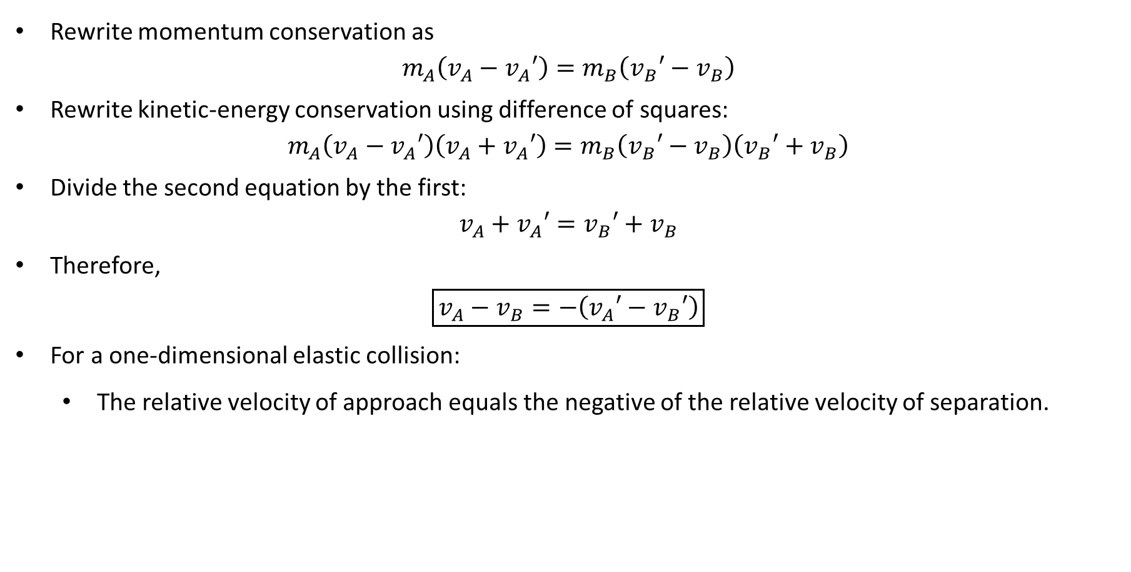
PHYS 2325 | University Physics I
Lecture 02 • Wed Oct 14 • Giancoli Ch. 9
Relative-Speed Relation
Rewrite momentum conservation as
$$m_{A}\left(v_{A}−v_{A}′\right)=m_{B}\left(v_{B}′−v_{B}\right)$$
Rewrite kinetic-energy conservation using difference of squares:
$$m_{A}\left(v_{A}−v_{A}′\right)\left(v_{A}+v_{A}′\right)=m_{B}\left(v_{B}′−v_{B}\right)\left(v_{B}′+v_{B}\right)$$
Divide the second equation by the first:
$$v_{A}+v_{A}′=v_{B}′+v_{B}$$
Therefore,
$$\boxed{v_{A}−v_{B}=−\left(v_{A}′−v_{B}′\right)}$$
For a one-dimensional elastic collision:
  The relative velocity of approach equals the negative of the relative velocity of separation.
Notes:
Teaching focus: Where today's lecture fits.
[Sources]
- PHYS 2325 University Physics I Fall 2026 syllabus and semester calendar.
[/Sources]

Slide 46
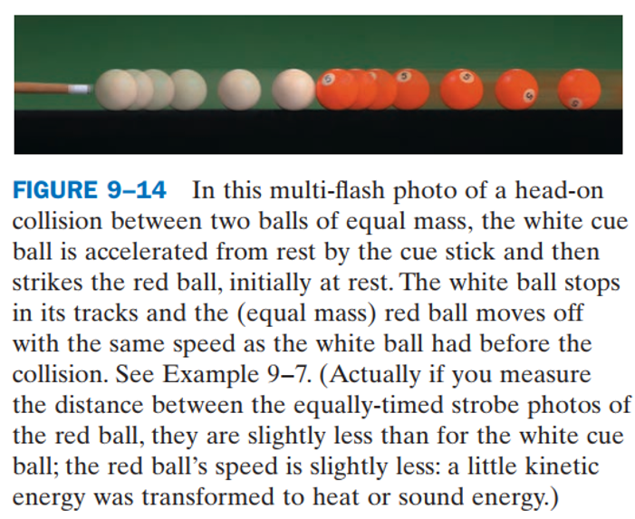
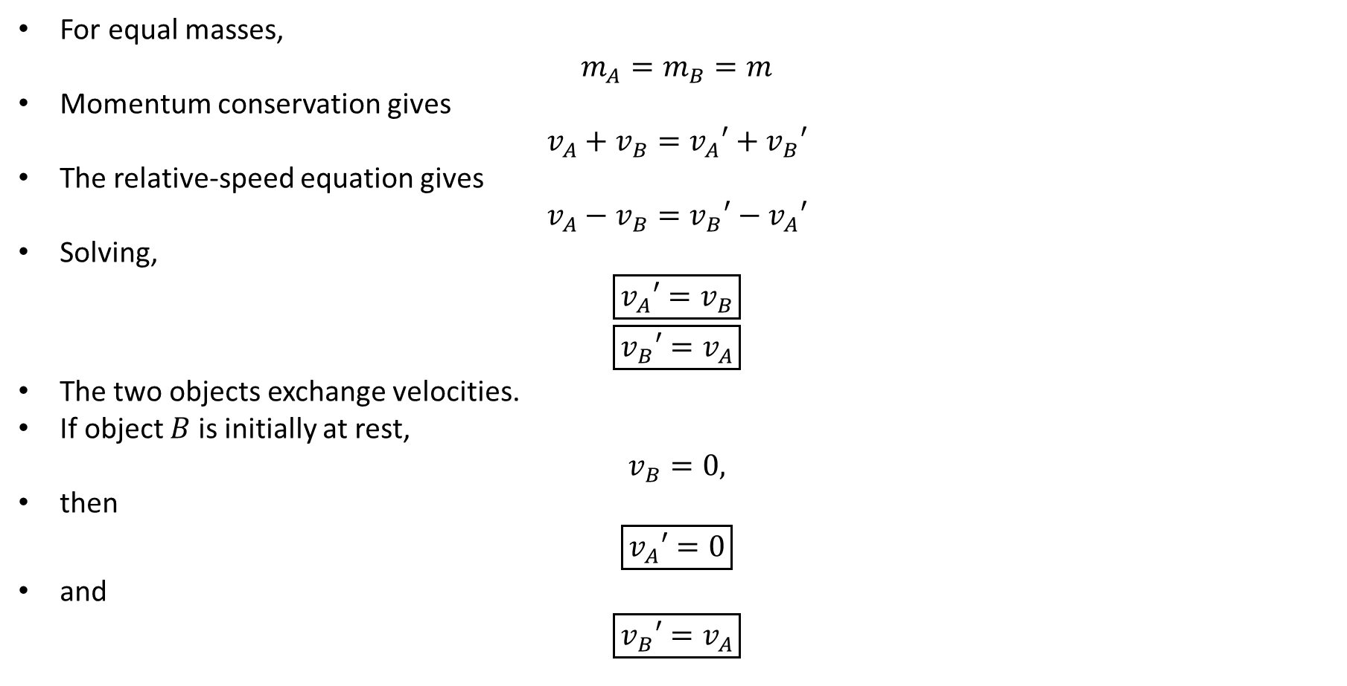
PHYS 2325 | University Physics I
Lecture 02 • Wed Oct 14 • Giancoli Ch. 9
Equal Masses Exchange Velocities
For equal masses,
$$m_{A}=m_{B}=m$$
Momentum conservation gives
$$v_{A}+v_{B}=v_{A}′+v_{B}′$$
The relative-speed equation gives
$$v_{A}−v_{B}=v_{B}′−v_{A}′$$
Solving,
$$\boxed{v_{A}′=v_{B}}$$
$$\boxed{v_{B}′=v_{A}}$$
The two objects exchange velocities.
If object $B$ is initially at rest,
$$v_{B}=0,$$
then
$$\boxed{v_{A}′=0}$$
and
$$\boxed{v_{B}′=v_{A}}$$
Notes:
Teaching focus: Where today's lecture fits.
[Sources]
- PHYS 2325 University Physics I Fall 2026 syllabus and semester calendar.
[/Sources]

Slide 47
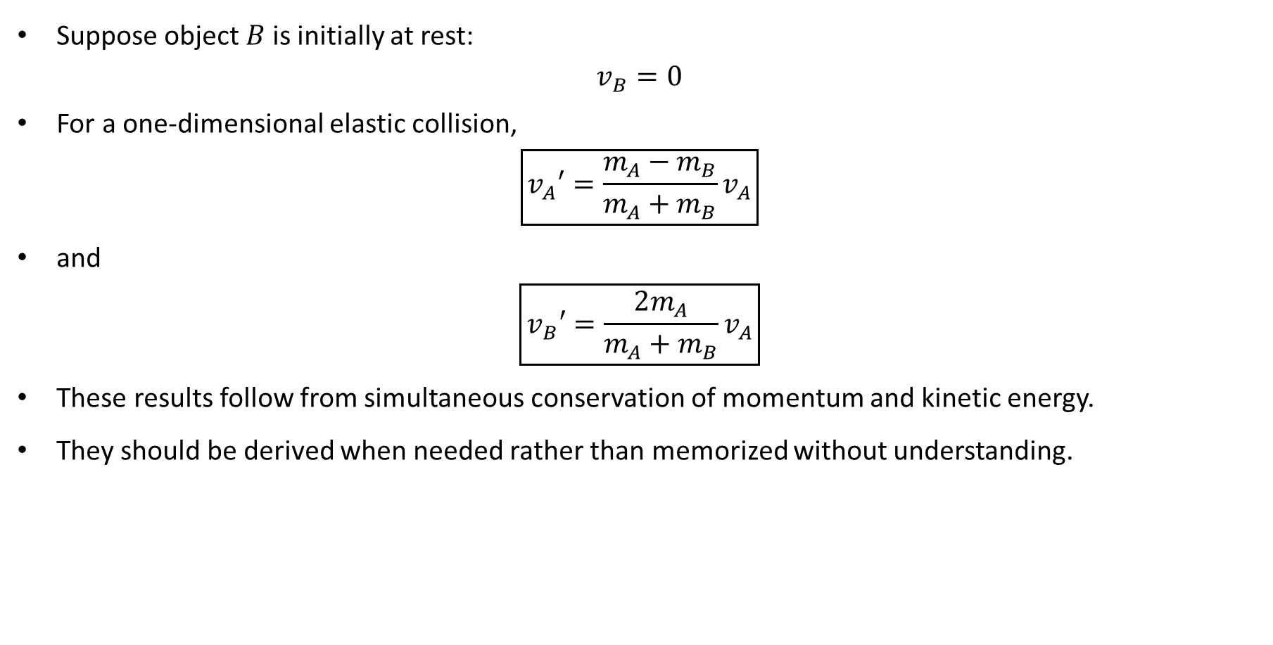
PHYS 2325 | University Physics I
Lecture 02 • Wed Oct 14 • Giancoli Ch. 9
Unequal Masses: Target Initially at Rest
Suppose object $B$ is initially at rest:
$$v_{B}=0$$
For a one-dimensional elastic collision,
$$\boxed{v_{A}′=\frac{m_{A}−m_{B}}{m_{A}+m_{B}}v_{A}}$$
and
$$\boxed{v_{B}′=\frac{2m_{A}}{m_{A}+m_{B}}v_{A}}$$
These results follow from simultaneous conservation of momentum and kinetic energy.
They should be derived when needed rather than memorized without understanding.
Notes:
Teaching focus: Where today's lecture fits.
[Sources]
- PHYS 2325 University Physics I Fall 2026 syllabus and semester calendar.
[/Sources]

Slide 48
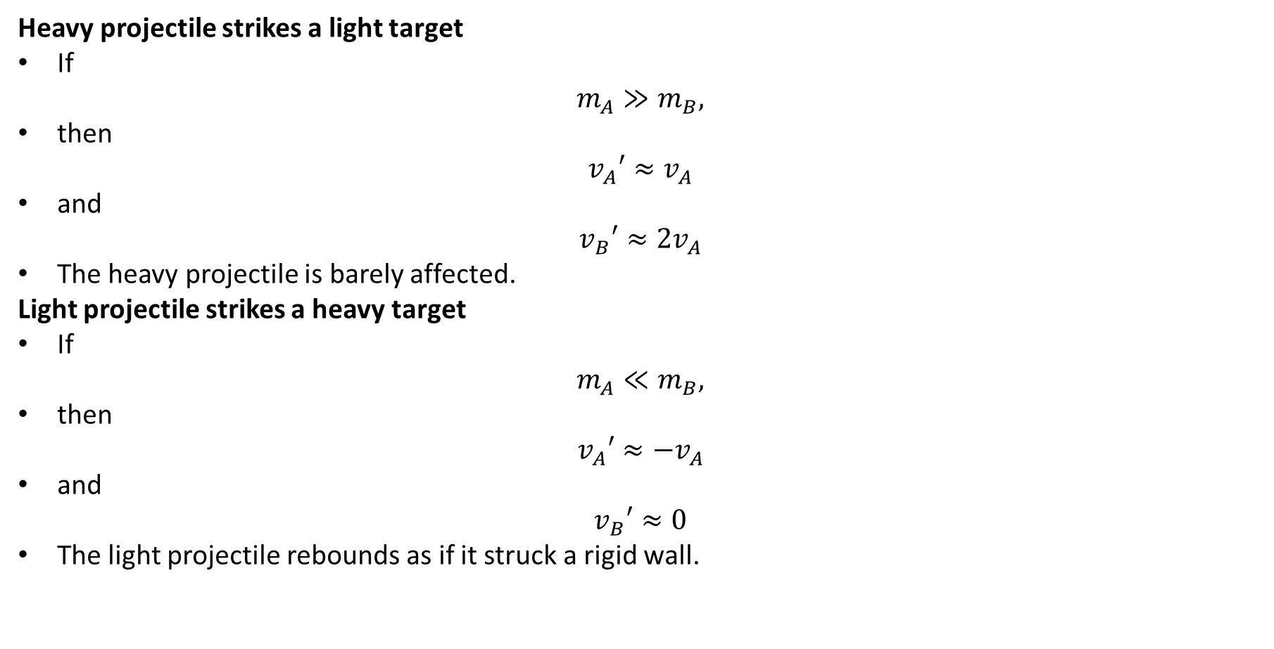
PHYS 2325 | University Physics I
Lecture 02 • Wed Oct 14 • Giancoli Ch. 9
Important Limiting Cases
Heavy projectile strikes a light target
If
$$m_{A}≫m_{B},$$
then
$$v_{A}′≈v_{A}$$
and
$$v_{B}′≈2v_{A}$$
The heavy projectile is barely affected.
Light projectile strikes a heavy target
If
$$m_{A}≪m_{B},$$
then
$$v_{A}′≈−v_{A}$$
and
$$v_{B}′≈0$$
The light projectile rebounds as if it struck a rigid wall.
Notes:
Teaching focus: Where today's lecture fits.
[Sources]
- PHYS 2325 University Physics I Fall 2026 syllabus and semester calendar.
[/Sources]

Slide 49
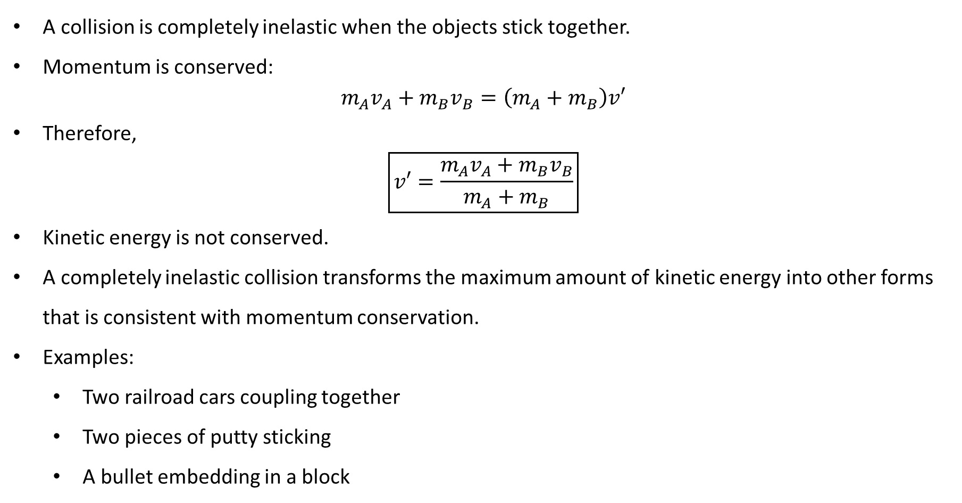
PHYS 2325 | University Physics I
Lecture 02 • Wed Oct 14 • Giancoli Ch. 9
Completely Inelastic Collision
A collision is completely inelastic when the objects stick together.
Momentum is conserved:
$$m_{A}v_{A}+m_{B}v_{B}=\left(m_{A}+m_{B}\right)v′$$
Therefore,
$$\boxed{v′=\frac{m_{A}v_{A}+m_{B}v_{B}}{m_{A}+m_{B}}}$$
Kinetic energy is not conserved.
A completely inelastic collision transforms the maximum amount of kinetic energy into other forms that is consistent with momentum conservation.
Examples:
  Two railroad cars coupling together
  Two pieces of putty sticking
  A bullet embedding in a block
Notes:
Teaching focus: Where today's lecture fits.
[Sources]
- PHYS 2325 University Physics I Fall 2026 syllabus and semester calendar.
[/Sources]

Slide 50
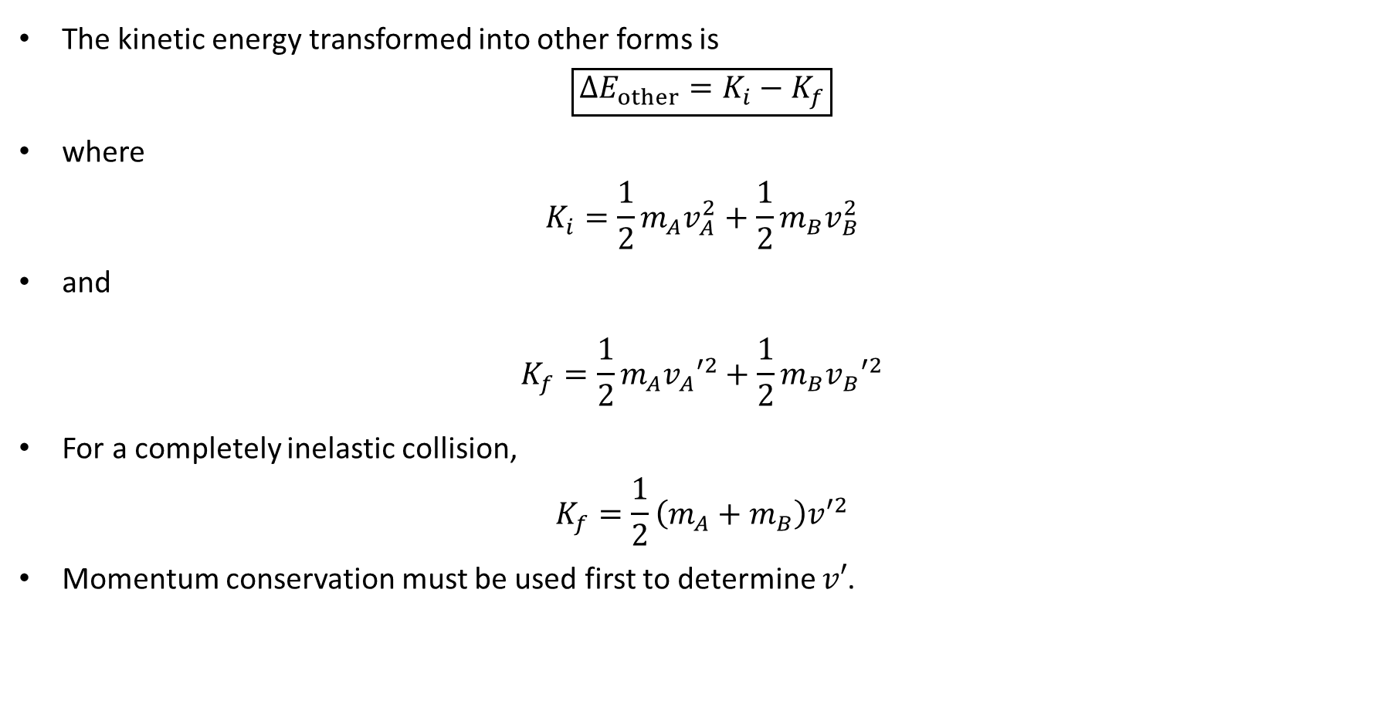
PHYS 2325 | University Physics I
Lecture 02 • Wed Oct 14 • Giancoli Ch. 9
Kinetic-Energy Loss in a Collision
The kinetic energy transformed into other forms is
$$\boxed{ΔE_{other}=K_{i}−K_{f}}$$
where
$$K_{i}=\frac{1}{2}m_{A}v_{A}^{2}+\frac{1}{2}m_{B}v_{B}^{2}$$
and
$$K_{f}=\frac{1}{2}m_{A}v_{A}′^{2}+\frac{1}{2}m_{B}v_{B}′^{2}$$
For a completely inelastic collision,
$$K_{f}=\frac{1}{2}\left(m_{A}+m_{B}\right)v′^{2}$$
Momentum conservation must be used first to determine $v′$.
Notes:
Teaching focus: Where today's lecture fits.
[Sources]
- PHYS 2325 University Physics I Fall 2026 syllabus and semester calendar.
[/Sources]

Slide 51
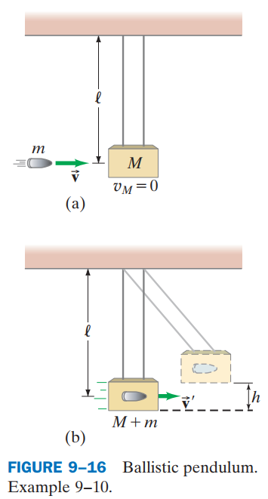

PHYS 2325 | University Physics I
Lecture 02 • Wed Oct 14 • Giancoli Ch. 9
Ballistic Pendulum: Two-Stage Method
A projectile of mass $m$ embeds in a suspended block of mass $M$.
The process must be divided into two stages.
Stage 1: Collision
Very short time interval
Momentum is conserved
Mechanical energy is not conserved
$$mv=\left(m+M\right)v′$$
Stage 2: Upward swing
Gravity is conservative
Mechanical energy is conserved
Momentum is not conserved
$$\frac{1}{2}\left(m+M\right)v′^{2}=\left(m+M\right)gh$$
Notes:
Teaching focus: Where today's lecture fits.
[Sources]
- PHYS 2325 University Physics I Fall 2026 syllabus and semester calendar.
[/Sources]

Slide 52


PHYS 2325 | University Physics I
Lecture 02 • Wed Oct 14 • Giancoli Ch. 9
Two-Dimensional Collisions
Momentum is a vector, so each component is conserved separately.
For a projectile $A$ striking a stationary target $B$,
$$P_{i}=P_{f}$$
In the $x$-direction:
$$\boxed{m_{A}v_{A}=m_{A}v_{A}′{\cos{θ}}_{A}′+m_{B}v_{B}′{\cos{θ}}_{B}′}$$
In the $y$-direction:
$$\boxed{0=m_{A}v_{A}′{\sin{θ}}_{A}′+m_{B}v_{B}′{\sin{θ}}_{B}′}$$
Two independent component equations can determine at most two unknown quantities.
Notes:
Teaching focus: Where today's lecture fits.
[Sources]
- PHYS 2325 University Physics I Fall 2026 syllabus and semester calendar.
[/Sources]

Slide 53


PHYS 2325 | University Physics I
Lecture 02 • Wed Oct 14 • Giancoli Ch. 9
Example: Equal-Mass Billiard Balls
Ball $A$ moves initially at
$$v_{A}=3.0 m/s$$
Ball $B$ is at rest. After collision:
$$θ_{A}′={45}^{∘}$$
$$θ_{B}′=−{45}^{∘}$$
The $y$-momentum equation gives
$$0=mv_{A}′{\sin{45}}^{∘}+mv_{B}′\sin\left(−{45}^{∘}\right)$$
Therefore,
$$v_{A}′=v_{B}′$$
The $x$-momentum equation becomes
$$3.0=2v_{A}′{\cos{45}}^{∘}$$
Thus,
$$\boxed{v_{A}′=v_{B}′=2.1 m/s}$$
Notes:
Teaching focus: Where today's lecture fits.
[Sources]
- PHYS 2325 University Physics I Fall 2026 syllabus and semester calendar.
[/Sources]

Slide 54

PHYS 2325 | University Physics I
Lecture 02 • Wed Oct 14 • Giancoli Ch. 9
Collision Problem-Solving Strategy
Clearly define the system.
Choose coordinate axes and positive directions.
Write the initial and final momentum components.
Apply momentum conservation:
$$P_{i}=P_{f}$$
Determine the collision type.
For an elastic collision, also use:
$$K_{i}=K_{f}$$
For a completely inelastic collision, use a common final velocity.
Preserve the signs of all velocity components.
Check that the result is physically reasonable.
Notes:
Teaching focus: Where today's lecture fits.
[Sources]
- PHYS 2325 University Physics I Fall 2026 syllabus and semester calendar.
[/Sources]

Slide 55

PHYS 2325 | University Physics I
Lecture 02 • Wed Oct 14 • Giancoli Ch. 9
Lecture Summary
Elastic collision
$$\boxed{K_{i}=K_{f}}$$
Completely inelastic collision
$$\boxed{v′=\frac{m_{A}v_{A}+m_{B}v_{B}}{m_{A}+m_{B}}}$$
In two dimensions, momentum must be conserved independently along each coordinate axis.
Notes:
Teaching focus: Where today's lecture fits.
[Sources]
- PHYS 2325 University Physics I Fall 2026 syllabus and semester calendar.
[/Sources]

