Slide 1
WEEK 01
Introduction, Measurement, and Motion
Mon–Fri Aug 24–28 • Giancoli Chapters 1–2
Muhammad Nauman • PHYS 2325 • Fall 2026

Slide 2
PHYS 2325 | University Physics I
Lecture 01 • Mon Aug 24 • Giancoli Chapters 1–2
Textbook and Course Materials
Required Textbook
Physics for Scientists and Engineers
Douglas C. Giancoli, 5th edition, Pearson
ISBN: 9780134378053
How We Will Use the Textbook
Lectures will generally follow Giancoli
Assigned sections should be read before class
Homework will be based on the assigned chapters
Additional notes, examples, and announcements will be posted online

Slide 3
PHYS 2325 | University Physics I
Lecture 01 • Mon Aug 24 • Giancoli Chapters 1–2
Course Logistics and Communication
Class Meetings
  Monday, Wednesday, and Friday
  10:00–10:50 a.m.
  Classes will be conducted in person
Office Hours
  Monday and Wednesday, 2:00–3:00 p.m.
  New Science Building, Room 330M
  Additional meetings are available by appointment
Communication
  Email: munauman@pvamu.edu
  Course announcements, lecture materials, assignments, and grades will be posted online
  Please allow up to 48 hours for an email response, excluding weekends and holidays

Slide 4
PHYS 2325 | University Physics I
Lecture 01 • Mon Aug 24 • Giancoli Chapters 1–2
Course Expectations and How to Succeed
What I Expect From You
  Attend every class and arrive on time
  Read the assigned textbook sections before class
  Participate in discussions and problem-solving activities
  Bring a scientific calculator to class
  Submit assignments by the posted deadlines
  Ask questions whenever something is unclear
  Follow the academic-integrity and AI-use policies
A Complete Physics Solution Should Include
  A diagram of the physical situation
  Known and unknown quantities
  The relevant physical principle or equation
  Substitution with consistent SI units
  Clear mathematical steps
A final answer with units and reasonable precision

Slide 5
PHYS 2325 | University Physics I
Lecture 01 • Mon Aug 24 • Giancoli Chapters 1–2
Exams, Homework, and Course Projects
Assessments
  Three free-response unit examinations
  A cumulative final examination
  Regular chapter-based homework assignments
  Two guided AI-evaluation projects
  An individual oral assessment
What the Exams Will Assess
  Conceptual understanding
  Selection of appropriate physical principles
  Mathematical problem-solving
  Diagrams, graphs, and interpretation of results
  Correct units and significant figures
  Clear explanation of your reasoning

Slide 6

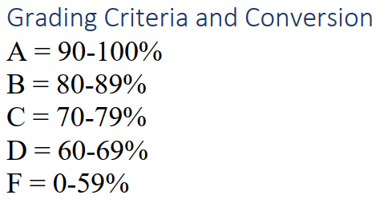
PHYS 2325 | University Physics I
Lecture 01 • Mon Aug 24 • Giancoli Chapters 1–2
Grading Details

Slide 7
PHYS 2325 | University Physics I
Week 01 • Aug 24–28 • Giancoli Chs. 1–2
Three meetings establish the language of mechanics
01
02
03
MONDAY
Course overview; physics and measurement
WEDNESDAY
SI units, uncertainty, and significant figures
FRIDAY
Estimation, unit conversions, and motion preview
By Friday: report measurements correctly, convert units, estimate physical quantities, and connect them to motion.

Slide 8
LECTURE 01
Course Overview and Introduction to Physics
Mon Aug 24 • Giancoli Chapters 1–2
Muhammad Nauman • PHYS 2325 • Fall 2026

Slide 9
PHYS 2325 | University Physics I
Lecture 01 • Mon Aug 24 • Giancoli Chapters 1–2
Learning Outcomes
• Explain the course structure, expectations, and learning resources
• Describe physics as an experimental science
• Identify physical quantities and the role of measurement

Slide 10
PHYS 2325 | University Physics I
Lecture 01 • Mon Aug 24 • Giancoli Chapters 1–2
Lecture 01 content — Introduction, Measurement, and Estimating
Physics helps us understand and describe the natural world.
Many physical quantities cannot be measured directly.
Scientists often combine:
  Careful observations
  Measurable quantities
  Mathematical relationships
  Reasonable approximations
With a clever experiment, we can even estimate the radius of Earth without traveling into space.
How could you measure the radius of Earth while standing near a lake or bay? (Al-beruni did in 1030 A.D)

Slide 11
PHYS 2325 | University Physics I
Lecture 01 • Mon Aug 24 • Giancoli Chapters 1–2
Lecture 01 content — Why Is the Sky Black in Space?
The sky appears black in space because there are very few molecules present to reflect or scatter sunlight.
On Earth, sunlight passes through the atmosphere.
Molecules in the atmosphere scatter sunlight in different directions.
Shorter wavelengths, especially blue light, are scattered more strongly.
This scattered blue light reaches our eyes from many directions.
Therefore, the daytime sky appears blue when viewed from Earth.
Without a substantial atmosphere, the surrounding sky remains black even when the Sun is shining.

Slide 12
PHYS 2325 | University Physics I
Lecture 01 • Mon Aug 24 • Giancoli Chapters 1–2
What Is Physics?— Physics: The Most Basic Science
Physics is the most basic of the sciences.
It studies the behavior and structure of matter.
Physics seeks to explain:
  How matter moves
  How matter interacts
  How energy is transferred
  How nature behaves from the smallest particles to the entire universe
Because physics deals with fundamental principles, it provides the foundation for many other branches of science and technology.

Slide 13
PHYS 2325 | University Physics I
Lecture 01 • Mon Aug 24 • Giancoli Chapters 1–2
Major Areas of Physics— Classical Physics and Modern Physics
Classical Physics, Includes:
Motion
Fluids
Heat
Sound
Light
Electricity
Magnetism
It mainly describes phenomena encountered at ordinary sizes and speeds.
Modern Physics, includes:
Relativity
Atomic structure
Condensed-matter physics
Nuclear physics
Elementary-particle physics
It extends our understanding to:
Atoms and subatomic particles
Matter under unusual conditions
Very high speeds

Slide 14
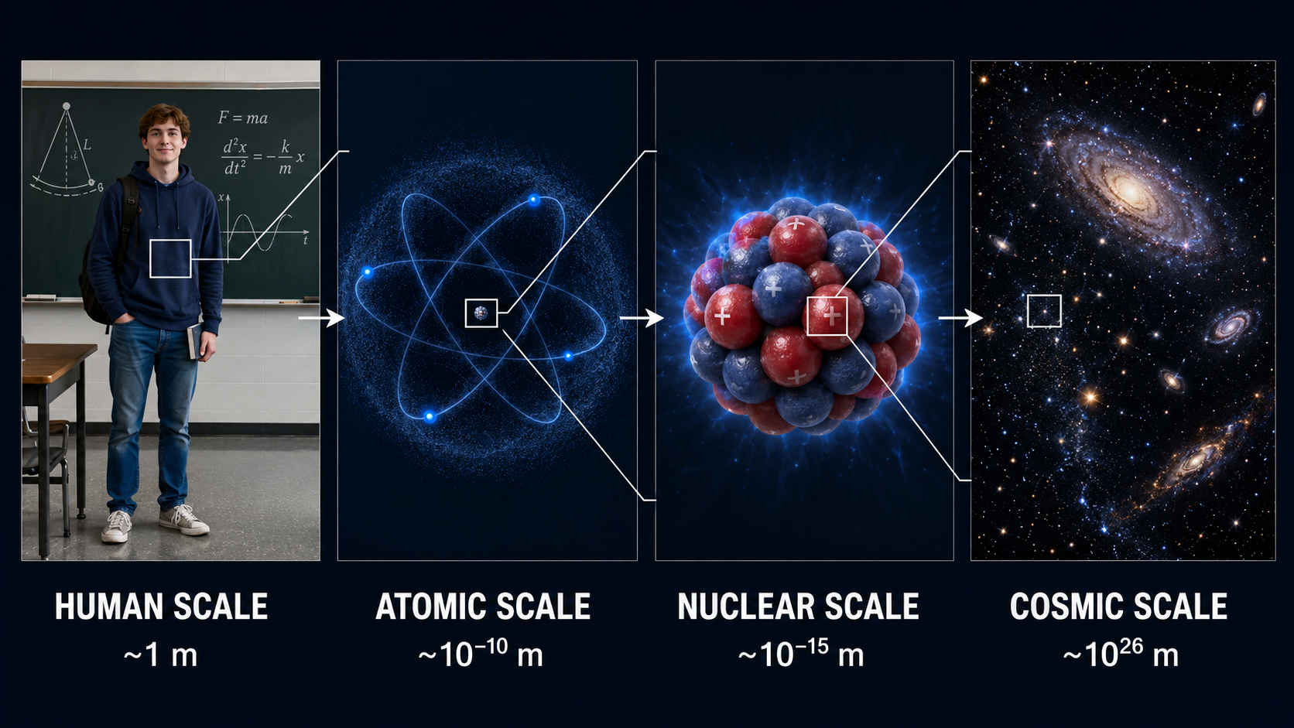
PHYS 2325 | University Physics I
Lecture 01 • Mon Aug 24 • Giancoli Chapters 1–2
Why Is Physics Useful?:

Slide 15
PHYS 2325 | University Physics I
Lecture 01 • Mon Aug 24 • Giancoli Chapters 1–2
How Science Works?
A real physical world exists around us.
We can move through the world without consciously thinking about how it works.
Scientists take a different approach: they actively observe and investigate nature.
The goal of science is to:
  Identify order in observations
  Recognize patterns in nature
  Develop deeper descriptions of the physical world
  Explain how and why natural phenomena occur
Scientific theories are attempts to describe and explain nature.
No theory is a completely perfect or final description of the physical world
  e.g. Classical vs Quantum

Slide 16
PHYS 2325 | University Physics I
Lecture 01 • Mon Aug 24 • Giancoli Chapters 1–2
Science as a Creative Process
Science involves collecting facts, organizing observations, and developing theories—but it is not merely a mechanical process.
Like music, writing, and art, science is a creative human activity requiring imagination, insight, and careful reasoning.
Scientists use creativity to:
  Ask meaningful questions
  Design suitable experiments
  Decide what to measure
  Identify relevant observations
Experiments must be carefully performed, interpreted, and evaluated.
Scientific progress ultimately depends on both reliable evidence and informed human judgment.

Slide 17
PHYS 2325 | University Physics I
Lecture 01 • Mon Aug 24 • Giancoli Chapters 1–2
Aristotle’s View of Motion
Aristotle observed that a ball rolling along the ground gradually slows down and stops.
He concluded that the natural state of an object is to be at rest.
According to this view, continuous motion requires a continuous push.
The explanation appeared consistent with everyday experience.
However, it did not properly account for friction opposing the ball’s motion.

Slide 18
PHYS 2325 | University Physics I
Lecture 01 • Mon Aug 24 • Giancoli Chapters 1–2
Galileo’s Study of Motion
Galileo tested ideas about motion through observations and inclined-plane experiments.
He recognized that friction is a force that opposes motion.
A ball travels farther as the surface becomes smoother and friction decreases.
Galileo reasoned that without friction, an object given an initial push would continue moving indefinitely.
His experiments challenged Aristotle’s explanation and established the foundation of modern mechanics.
No net force ⇒ constant velocity

Slide 19
PHYS 2325 | University Physics I
Lecture 01 • Mon Aug 24 • Giancoli Chapters 1–2
Galileo’s Scientific Contributions
Galileo combined observation, controlled experiments, measurement, and logical reasoning.
His work established the modern experimental study of motion.
He also developed and improved the telescope.
His astronomical observations produced important discoveries about the sky.
His work demonstrated that explanations of nature must be tested experimentally.

Slide 20
PHYS 2325 | University Physics I
Lecture 01 • Mon Aug 24 • Giancoli Chapters 1–2
Observation and Theory
Observation, experimentation, and measurement provide scientific evidence.
Theories explain observations and make predictions that can be tested.
Theories are not produced automatically or directly from observations; they also require imagination.
Atomic theory and Newton’s universal gravitation were creative ideas later tested against evidence.
Experimental results may support, modify, or lead to the rejection of a theory.
Observation ⇄ Theory and Prediction

Slide 21
PHYS 2325 | University Physics I
Lecture 01 • Mon Aug 24 • Giancoli Chapters 1–2
Can a Theory Be Proven?
Scientific theories are major achievements, but they are not final or absolute truths.
A theory must agree with observations and experiments within its tested range.
Every measurement contains uncertainty, so perfect experimental confirmation is impossible.
A theory cannot be tested under every possible condition.
Therefore, evidence can strongly support a theory but cannot prove it absolutely.
Scientific history shows that long-held theories may be modified or replaced.

Slide 22
PHYS 2325 | University Physics I
Lecture 01 • Mon Aug 24 • Giancoli Chapters 1–2
Bridges and Structural Safety
The River Tiber bridge in Rome was built approximately 2,000 years ago and still stands.
In contrast, the Hartford Civic Center roof collapsed in 1978—only two years after construction.
Structural safety depends on correct physical models, force calculations, materials, and loading assumptions.
Engineering failures can reveal weaknesses in models, calculations, or designs.
Scientific and engineering knowledge is continuously examined and improved.
Science is not static; it changes and develops through testing and experience.

Slide 23
PHYS 2325 | University Physics I
Lecture 01 • Mon Aug 24 • Giancoli Chapters 1–2
Scientific Models
A model is an analogy or mental picture used to understand a physical phenomenon.
It represents important features of something that may not be directly observable.
Example: the wave model of light uses an analogy with water waves, although light waves cannot be seen directly.
A useful model:
  Explains known observations
  Suggests new experiments
  Predicts related phenomena
Models are simplified representations—not the physical world itself.

Slide 24
PHYS 2325 | University Physics I
Lecture 01 • Mon Aug 24 • Giancoli Chapters 1–2
Models and Theories
A model is usually simple and provides a structural similarity to the phenomenon being studied.
A theory is broader, more detailed, and capable of making precise, quantitatively testable predictions.
Neither a model nor a theory should be confused with the physical phenomenon itself.
Models and theories are human inventions created to describe nature.
They cannot be proven absolutely and may be modified or replaced when new evidence appears.
Models represent; theories explain and predict.

Slide 25
PHYS 2325 | University Physics I
Lecture 01 • Mon Aug 24 • Giancoli Chapters 1–2
Scientific Laws and Principles
A scientific law is a concise statement describing a general relationship in nature.
Laws are often expressed mathematically—for example, Newton’s second law:
F = ma
A law must be experimentally valid over many observations and show no exceptions within its established range.
A principle is generally less broad than a law and may apply to a narrower range of phenomena.
Example: Archimedes’ principle describes the buoyant force on an immersed object.
A theory usually provides a broader explanation than either a law or a principle.

Slide 26
PHYS 2325 | University Physics I
Lecture 01 • Mon Aug 24 • Giancoli Chapters 1–2
What Scientific Laws Mean
Scientific laws are descriptive, not prescriptive: they describe how nature behaves, not how it must behave.
Few laws can be considered absolutely true under every possible condition.
The term “law” is used when a relationship has been tested widely and its limitations are clearly understood.
Scientists use accepted laws and theories as reliable while remaining open to new evidence.
New observations may alter a theory or reveal the limits of a law.
Laws and theories are human constructions based on observation, experiment, reasoning, and intuition—not unchangeable facts waiting to be discovered.

Slide 27
LECTURE 02
Measurement, SI Units, and Uncertainty
Wed Aug 26 • Giancoli Chapters 1–2
Muhammad Nauman • PHYS 2325 • Fall 2026
Notes:
50-minute plan: 5 min opening/retrieval; 30 min concept development and examples; 10 min guided practice; 5 min exit check.
[Sources]
- Kevin Storr, University Physics I syllabus, Spring 2026.
- Giancoli, Physics for Scientists and Engineers, 5th ed., Chapters 1–2.
[/Sources]

Slide 28
PHYS 2325 | University Physics I
Lecture 02 • Wed Aug 26 • Giancoli Chapters 1–2
Learning Outcomes
• Use SI base and derived units consistently
• Express values with scientific notation and significant figures
• Distinguish precision, accuracy, and measurement uncertainty
Notes:
Use these objectives to frame the lecture and revisit them during the closing check.
[Sources]
- Kevin Storr, University Physics I syllabus, Spring 2026.
- Giancoli, Physics for Scientists and Engineers, 5th ed., Chapters 1–2.
[/Sources]

Slide 29
PHYS 2325 | University Physics I
Lecture 02 • Wed Aug 26 • Giancoli Chapters 1–2
Measurement always includes uncertainty
Physics relates quantities that can be measured.
No measurement is absolutely exact.
Uncertainty comes from instrument resolution, scale reading, and experimental conditions.
Report a best estimate together with its uncertainty: x = x_{best} ± Δx.
Every measurement represents a defensible range—not a perfect value.
8.7 8.8 8.9 cm

Slide 30
PHYS 2325 | University Physics I
Lecture 02 • Wed Aug 26 • Giancoli Chapters 1–2
Estimate uncertainty from the instrument
The smallest scale division does not always fix the exact uncertainty.
A millimeter ruler may allow an estimate between adjacent marks.
If a board lies between 8.7 and 8.9 cm, report w = 8.8 ± 0.1 cm.
The reported interval is therefore 8.7–8.9 cm.
Uncertainty depends on both the instrument and our ability to read it.
8.7 8.8 8.9 cm
Notes:
[Animation]
Reveal the bullets one at a time; then build the right-side sketch from its main object to labels and final result.
[/Animation]
[Sources]
- Giancoli, Physics: Principles with Applications, Chapter 1, Sections 1-3 and 1-4 (user-provided screenshots).
[/Sources]

Slide 31
PHYS 2325 | University Physics I
Lecture 02 • Wed Aug 26 • Giancoli Chapters 1–2
Percent uncertainty measures relative precision
Percent uncertainty = (uncertainty ÷ measured value) × 100%.
For 8.8 ± 0.1 cm: (0.1 ÷ 8.8) × 100% ≈ 1%.
The same result can be written as 8.8 cm ± 1%.
A smaller percent uncertainty indicates a more precise measurement.
≈ 1%
0.1
8.8 cm total
Notes:
[Animation]
Reveal the bullets one at a time; then build the right-side sketch from its main object to labels and final result.
[/Animation]
[Sources]
- Giancoli, Physics: Principles with Applications, Chapter 1, Sections 1-3 and 1-4 (user-provided screenshots).
[/Sources]

Slide 32
PHYS 2325 | University Physics I
Lecture 02 • Wed Aug 26 • Giancoli Chapters 1–2
The last reported digit implies uncertainty
The first digit after the decimal point is the tenths place (0.1).
The second digit after the decimal point is the hundredths place (0.01).
In 5.6 cm, the final digit 6 is in the tenths place.
  Uncertainty is typically on the order of 0.1 cm.
In 5.60 cm, the final digit 0 is in the hundredths place.
  Uncertainty is typically on the order of 0.01 cm.
The final zero in 5.60 cm is meaningful: it indicates greater reported precision.
5.6 cm and 5.60 cm have the same value—but not the same reported precision.
5.6 cm
5.60 cm
More digits ⇒ more claimed precision
Notes:
[Animation]
Reveal the bullets one at a time; then build the right-side sketch from its main object to labels and final result.
[/Animation]
[Sources]
- Giancoli, Physics: Principles with Applications, Chapter 1, Sections 1-3 and 1-4 (user-provided screenshots).
[/Sources]

Slide 33
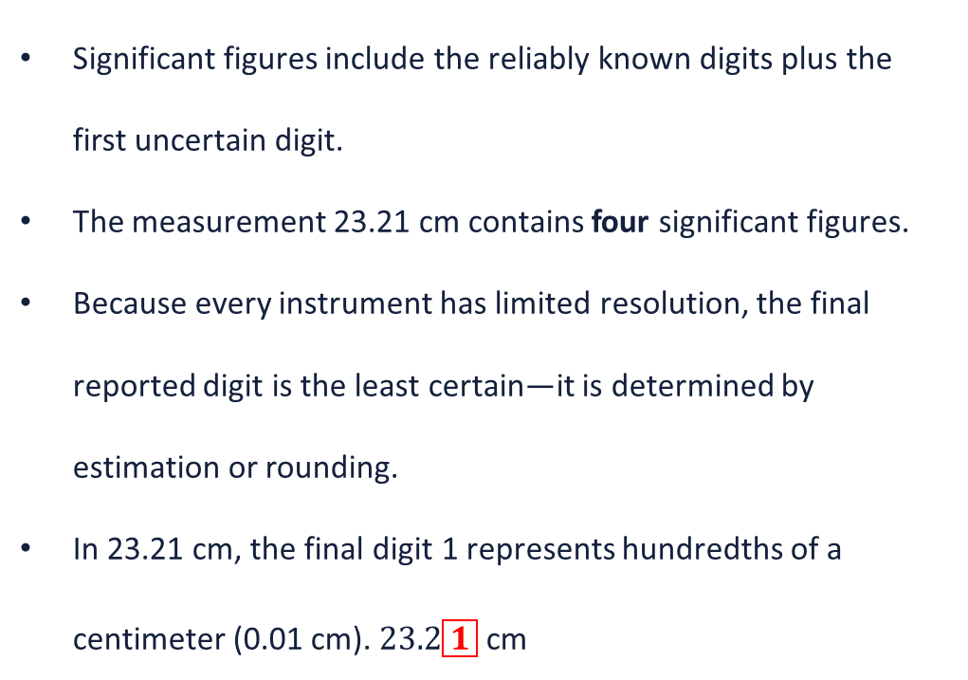
PHYS 2325 | University Physics I
Lecture 02 • Wed Aug 26 • Giancoli Chapters 1–2
Significant figures communicate precision
Significant figures include the reliably known digits plus the first uncertain digit.
The measurement 23.21 cm contains four significant figures.
Because every instrument has limited resolution, the final reported digit is the least certain—it is determined by estimation or rounding.
In 23.21 cm, the final digit 1 represents hundredths of a centimeter (0.01 cm). $23.2\boxed{1} \text{cm}$
23.21 cm
known digits + uncertain digit
Notes:
[Animation]
Reveal the bullets one at a time; then build the right-side sketch from its main object to labels and final result.
[/Animation]
[Sources]
- Giancoli, Physics: Principles with Applications, Chapter 1, Sections 1-3 and 1-4 (user-provided screenshots).
[/Sources]

Slide 34
PHYS 2325 | University Physics I
Lecture 02 • Wed Aug 26 • Giancoli Chapters 1–2
Count significant figures carefully
All nonzero digits are significant: 347 has 3 significant figures.
Zeros between nonzero digits are significant: 1002 has 4 significant figures.
Leading zeros are not significant; they only locate the decimal point:
  0.0025 has 2 significant figures.
Trailing zeros after a decimal point are significant:
  3.60 has 3 significant figures.
Trailing zeros in a whole number may be ambiguous:
  80 could have 1 or 2 significant figures.
Use scientific notation to show the intended precision clearly:
  8 × 10¹ has 1 significant figure & 8.0 × 10¹ has 2 significant figures.
0.0025 | 3.60
placeholders significant zero
Notes:
[Animation]
Reveal the bullets one at a time; then build the right-side sketch from its main object to labels and final result.
[/Animation]
[Sources]
- Giancoli, Physics: Principles with Applications, Chapter 1, Sections 1-3 and 1-4 (user-provided screenshots).
[/Sources]

Slide 35
PHYS 2325 | University Physics I
Lecture 02 • Wed Aug 26 • Giancoli Chapters 1–2
Multiplication and division follow the least precise input
First, perform the calculation without rounding:
  11.2 cm × 6.8 cm = 76.16 cm²
Count the significant figures in each measured value:
  11.2 has 3 significant figures.
  6.8 has 2 significant figures.
The answer must have the same number of significant figures as the least precise input.
Therefore, round 76.16 to 2 significant figures:
  76.16 cm² → 76 cm²
Keep all calculator digits during intermediate steps and round only the final answer.
11.2 × 6.8 = 76
fewest significant figures
ROUND LAST
Notes:
[Animation]
Reveal the bullets one at a time; then build the right-side sketch from its main object to labels and final result.
[/Animation]
[Sources]
- Giancoli, Physics: Principles with Applications, Chapter 1, Sections 1-3 and 1-4 (user-provided screenshots).
[/Sources]

Slide 36
PHYS 2325 | University Physics I
Lecture 02 • Wed Aug 26 • Giancoli Chapters 1–2
Addition and subtraction follow decimal place
The result has no more decimal places than the least precise input.
3.6 + 0.57 = 4.17 on a calculator.
Because 3.6 is known only to tenths, report 4.2.
Decimal position—not total significant figures—controls this rule.
3.6 + 0.57 = 4.2
fewest decimal places
ROUND LAST
Notes:
[Animation]
Reveal the bullets one at a time; then build the right-side sketch from its main object to labels and final result.
[/Animation]
[Sources]
- Giancoli, Physics: Principles with Applications, Chapter 1, Sections 1-3 and 1-4 (user-provided screenshots).
[/Sources]

Slide 37
PHYS 2325 | University Physics I
Lecture 02 • Wed Aug 26 • Giancoli Chapters 1–2
A calculator does not create precision
Calculators display many digits, but not all are physically meaningful.
2.0 ÷ 3.0 = 0.666666…; both inputs have two significant figures.
The defensible result is therefore 0.67.
Retain one or two guard digits and round only at the end.
Round up when the first discarded digit is 5 or greater.
0.66666667
0.67
Notes:
[Animation]
Reveal the bullets one at a time; then build the right-side sketch from its main object to labels and final result.
[/Animation]
[Sources]
- Giancoli, Physics: Principles with Applications, Chapter 1, Sections 1-3 and 1-4 (user-provided screenshots).
[/Sources]

Slide 38
PHYS 2325 | University Physics I
Lecture 02 • Wed Aug 26 • Giancoli Chapters 1–2
Functions inherit the precision of their inputs
A calculated function cannot be more reliable than its measured argument.
For θ = 30° with two significant figures, a calculator gives cos θ = 0.866025…
Report cos 30° = 0.87.
The extra calculator digits do not represent additional experimental knowledge.
cos 30° = 0.866025…
0.87
Notes:
[Animation]
Reveal the bullets one at a time; then build the right-side sketch from its main object to labels and final result.
[/Animation]
[Sources]
- Giancoli, Physics: Principles with Applications, Chapter 1, Sections 1-3 and 1-4 (user-provided screenshots).
[/Sources]

Slide 39
PHYS 2325 | University Physics I
Lecture 02 • Wed Aug 26 • Giancoli Chapters 1–2
Scientific notation makes precision explicit
Write numbers as N = a × 10ⁿ, where 1 ≤ |a| < 10.
36,900 = 3.69 × 10⁴ has three significant figures.
3.7 × 10⁴ has two; 3.690 × 10⁴ has four.
The exponent sets the magnitude but does not affect the significant-figure count.
36,900
3.69 × 10⁴
coefficient × scale
Notes:
[Animation]
Reveal the bullets one at a time; then build the right-side sketch from its main object to labels and final result.
[/Animation]
[Sources]
- Giancoli, Physics: Principles with Applications, Chapter 1, Sections 1-3 and 1-4 (user-provided screenshots).
[/Sources]

Slide 40
PHYS 2325 | University Physics I
Lecture 02 • Wed Aug 26 • Giancoli Chapters 1–2
Significant figures approximate uncertainty
Significant-figure rules are useful shortcuts, not exact uncertainty calculations.
A calculator gives: 97 ÷ 92 = 1.054…
Both input values have 2 significant figures, so the standard rule gives 1.1.
However, rounding to 1.1 removes considerable information. In this case, reporting 1.05 may better represent the precision of the original measurements.
When actual measurement uncertainties are provided, use them instead of relying only on significant-figure rules.
97 ÷ 92
1.1 ↔ 1.05
rule realistic precision
Notes:
[Animation]
Reveal the bullets one at a time; then build the right-side sketch from its main object to labels and final result.
[/Animation]
[Sources]
- Giancoli, Physics: Principles with Applications, Chapter 1, Sections 1-3 and 1-4 (user-provided screenshots).
[/Sources]

Slide 41
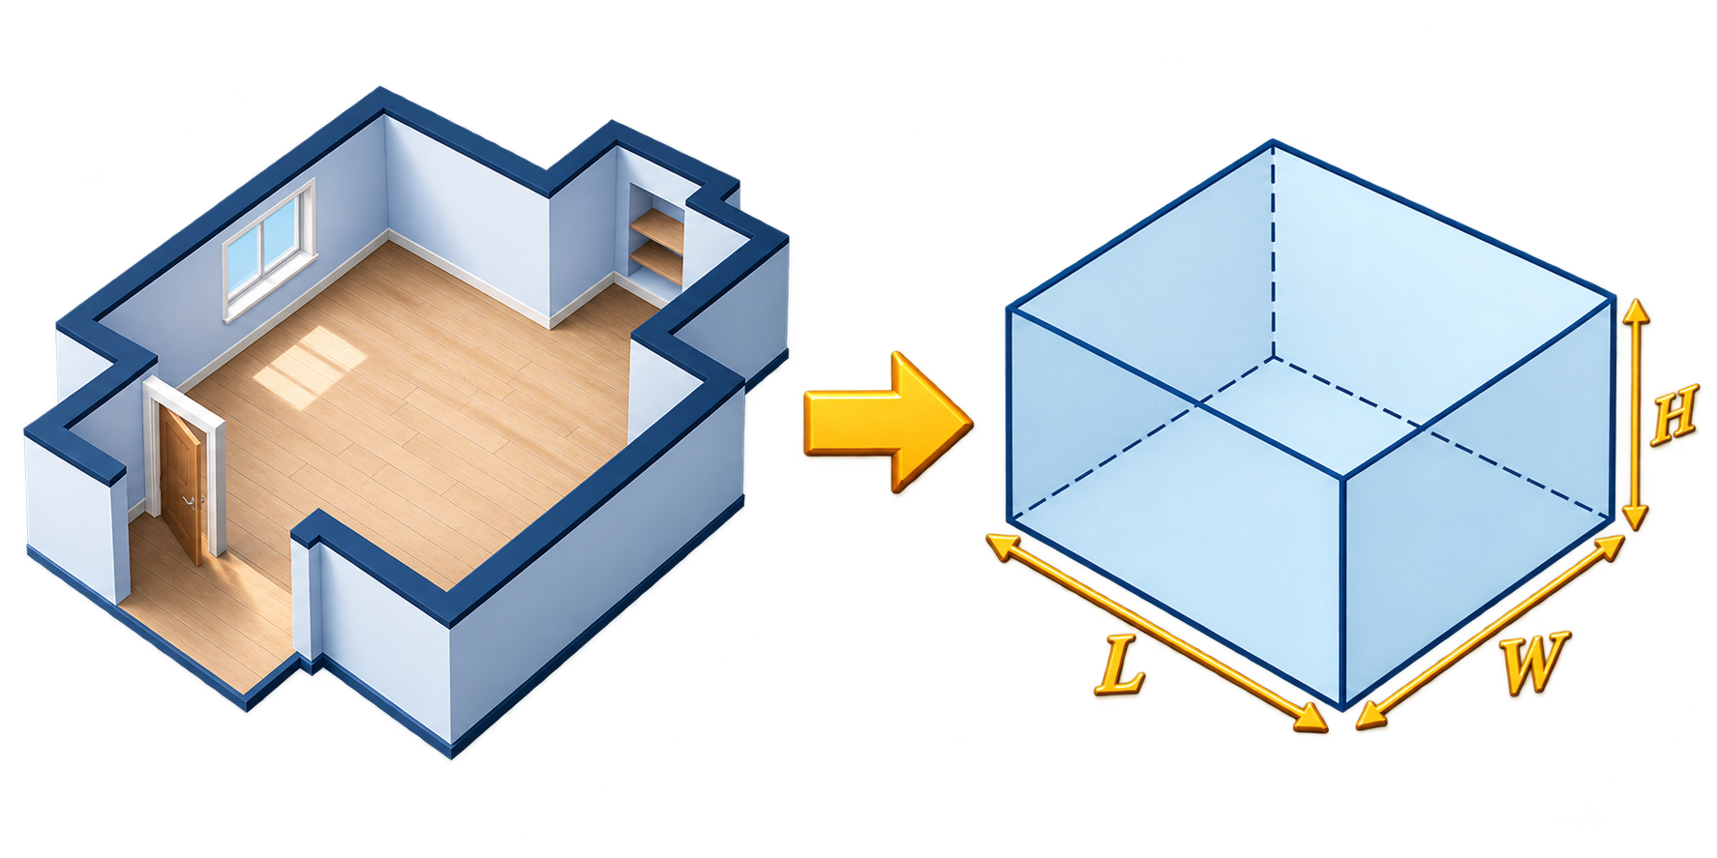
PHYS 2325 | University Physics I
Lecture 02 • Wed Aug 26 • Giancoli Chapters 1–2
Approximations preserve the essential physics
Exact information is often unavailable, so physics relies on reasonable approximations.
Example: treat a room as a rectangular box to estimate its volume.
A result cannot be more accurate than its data, assumptions, and approximations.
Report only the significant figures justified by those limitations.
Notes:
[Animation]
Reveal the bullets one at a time; then build the right-side sketch from its main object to labels and final result.
[/Animation]
[Sources]
- Giancoli, Physics: Principles with Applications, Chapter 1, Sections 1-3 and 1-4 (user-provided screenshots).
[/Sources]

Slide 42
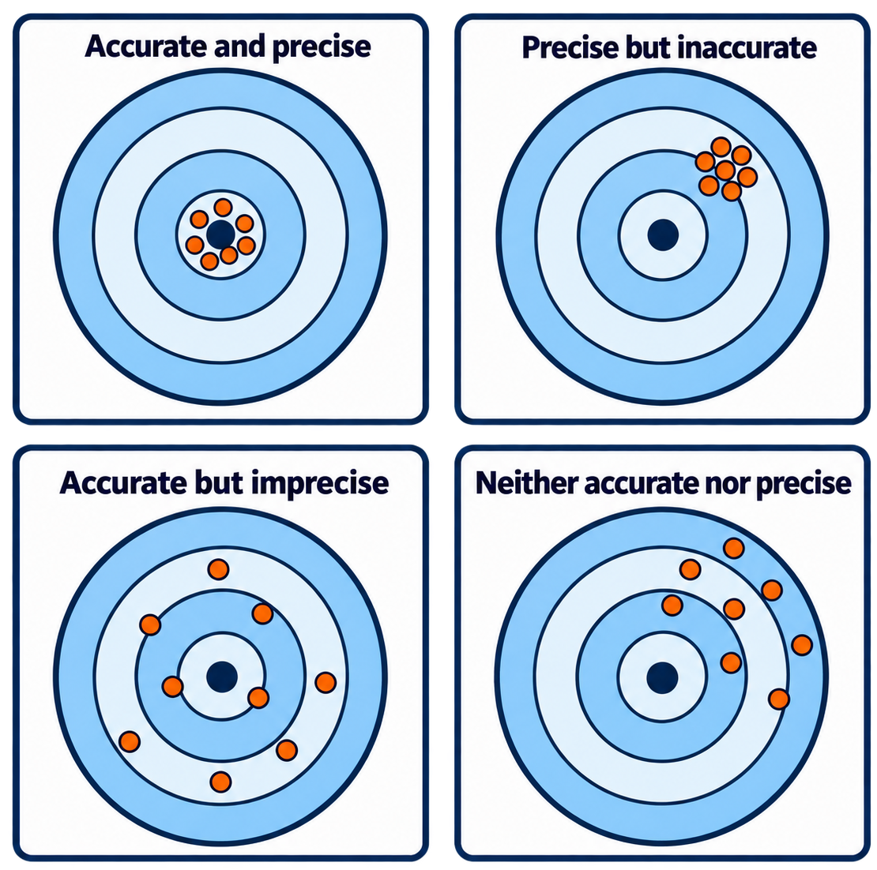
PHYS 2325 | University Physics I
Lecture 02 • Wed Aug 26 • Giancoli Chapters 1–2
Accuracy and precision answer different questions
Precision describes repeatability using the same method or instrument.
Accuracy describes closeness to the true or accepted value.
Measurements may be precise but inaccurate because of systematic error.
For 8.6, 8.7, and 8.8 cm, the repeatability is about ±0.1 cm.
Uncertainty estimates should consider both precision and accuracy.
Notes:
[Animation]
Reveal the bullets one at a time; then build the right-side sketch from its main object to labels and final result.
[/Animation]
[Sources]
- Giancoli, Physics: Principles with Applications, Chapter 1, Sections 1-3 and 1-4 (user-provided screenshots).
[/Sources]

Slide 43
PHYS 2325 | University Physics I
Lecture 02 • Wed Aug 26 • Giancoli Chapters 1–2
Every measured quantity needs a unit
A measurement is stated relative to an agreed unit or standard.
A number alone is usually meaningless: a length of ‘18.6’ is incomplete.
18.6 m, 18.6 cm, and 18.6 in represent very different lengths.
Standards define units precisely and allow results to be reproduced worldwide.
18.6
m
cm
in
number + unit
Notes:
[Animation]
Reveal the bullets one at a time; then build the right-side sketch from its main object to labels and final result.
[/Animation]
[Sources]
- Giancoli, Physics: Principles with Applications, Chapter 1, Sections 1-3 and 1-4 (user-provided screenshots).
[/Sources]

Slide 44
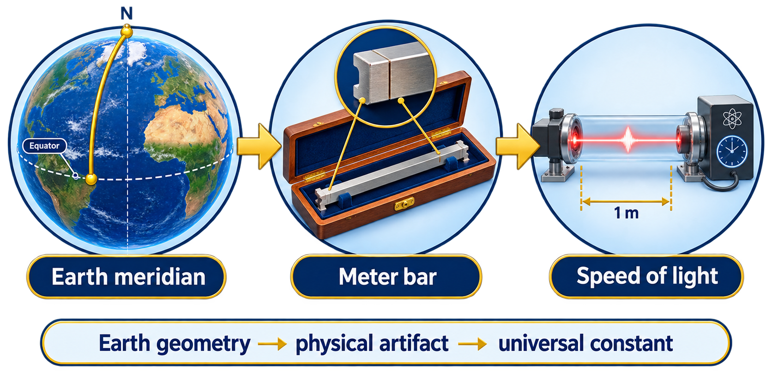
PHYS 2325 | University Physics I
Lecture 02 • Wed Aug 26 • Giancoli Chapters 1–2
The meter is defined using the speed of light
The meter (m) is the SI base unit of length.
Earlier standards used Earth, a platinum–iridium bar, and krypton-86 light.
The modern definition fixes c = 299,792,458 m/s exactly.
One meter is the distance light travels in vacuum in 1/299,792,458 s.
A constant-based standard is precise and reproducible anywhere.
Notes:
[Animation]
Reveal the bullets one at a time; then build the right-side sketch from its main object to labels and final result.
[/Animation]
[Sources]
- Giancoli, Physics: Principles with Applications, Chapter 1, Sections 1-3 and 1-4 (user-provided screenshots).
[/Sources]

Slide 45
PHYS 2325 | University Physics I
Lecture 02 • Wed Aug 26 • Giancoli Chapters 1–2
The second is defined by cesium-133
Earth’s rotation was once used to define time, but its rotation is not perfectly constant (vary in ms).
A cesium-133 atom has two closely spaced internal energy states.
Low-power microwaves can make the atom change from one state to the other.
The strongest response occurs at a precise frequency: 9,192,631,770 Hz
One hertz (Hz) means one cycle per second. Therefore, this microwave signal completes exactly 9,192,631,770 cycles in one second.
An atomic clock finds this cesium resonance and counts the microwave cycles.
One second is defined as the time required for exactly 9,192,631,770 cycles.
Atom provides the reference → Clock counts the cycles → One second
Notes:
[Animation]
Reveal the bullets one at a time; then build the right-side sketch from its main object to labels and final result.
[/Animation]
[Sources]
- Giancoli, Physics: Principles with Applications, Chapter 1, Sections 1-3 and 1-4 (user-provided screenshots).
[/Sources]

Slide 46
PHYS 2325 | University Physics I
Lecture 02 • Wed Aug 26 • Giancoli Chapters 1–2
The kilogram is tied to Planck’s constant
The kilogram (kg) is the SI base unit of mass.
Before 2019, one kilogram was defined as the mass of a particular platinum–iridium cylinder stored near Paris.
A physical object can gain or lose tiny amounts of material, so its mass is not a perfectly stable standard.
Planck’s constant, h, is a fundamental constant of nature. Its value is now fixed exactly: h = 6.62607015 × 10⁻³⁴ kg·m²/s
kg appears in the unit of h. Because the meter and second are already defined, fixing h also fixes the kilogram.
Before 2019
Physical cylinder → could change slightly → kilogram
Since 2019
Exact Planck constant → Kibble balance → kilogram
Notes:
[Animation]
Reveal the bullets one at a time; then build the right-side sketch from its main object to labels and final result.
[/Animation]
[Sources]
- Giancoli, Physics: Principles with Applications, Chapter 1, Sections 1-3 and 1-4 (user-provided screenshots).
[/Sources]

Slide 47
PHYS 2325 | University Physics I
Lecture 02 • Wed Aug 26 • Giancoli Chapters 1–2
Metric prefixes encode powers of ten
Large prefixes: giga G = 10⁹, mega M = 10⁶, kilo k = 10³.
Small prefixes: centi c = 10⁻², milli m = 10⁻³, micro μ = 10⁻⁶.
Nano n = 10⁻⁹ and pico p = 10⁻¹².
Examples: 1 km = 10³ m; 1 mm = 10⁻³ m; 1 μm = 10⁻⁶ m.
Capitalization matters: M and m are not interchangeable.
k 10³
m 10⁻³
μ 10⁻⁶
one shared measurement language
Notes:
[Animation]
Reveal the bullets one at a time; then build the right-side sketch from its main object to labels and final result.
[/Animation]
[Sources]
- Giancoli, Physics: Principles with Applications, Chapter 1, Sections 1-3 and 1-4 (user-provided screenshots).
[/Sources]

Slide 48
PHYS 2325 | University Physics I
Lecture 02 • Wed Aug 26 • Giancoli Chapters 1–2
Use one consistent system of units
SI uses meter, kilogram, and second as fundamental mechanical units.
The cgs system uses centimeter, gram, and second.
British engineering units commonly use foot, pound, and second.
Always include units and convert before combining incompatible systems.
A calculation is meaningful only when its units are consistent.
SI
cgs
British
one shared measurement language
Notes:
[Animation]
Reveal the bullets one at a time; then build the right-side sketch from its main object to labels and final result.
[/Animation]
[Sources]
- Giancoli, Physics: Principles with Applications, Chapter 1, Sections 1-3 and 1-4 (user-provided screenshots).
[/Sources]

Slide 49
PHYS 2325 | University Physics I
Lecture 02 • Wed Aug 26 • Giancoli Chapters 1–2
Seven base quantities generate all SI units
Length—meter (m); time—second (s); mass—kilogram (kg).
Electric current—ampere (A); temperature—kelvin (K).
Amount of substance—mole (mol); luminous intensity—candela (cd).
All other SI units are derived from these seven bases.
Example: 1 newton = 1 kg·m/s².
m
kg
s
kg·m/s² = N
Notes:
[Animation]
Reveal the bullets one at a time; then build the right-side sketch from its main object to labels and final result.
[/Animation]
[Sources]
- Giancoli, Physics: Principles with Applications, Chapter 1, Sections 1-3 and 1-4 (user-provided screenshots).
[/Sources]

Slide 50
PHYS 2325 | University Physics I
Lecture 02 • Wed Aug 26 • Giancoli Chapters 1–2
Modern SI standards use universal constants
Modern SI definitions fix exact fundamental constants.
Examples include c, Planck’s constant h, elementary charge e, and cesium frequency.
Constant-based standards are stable, precise, and reproducible worldwide.
Traditional unit sizes did not change—only their definitions and realization changed.
Universal constants provide a shared measurement language for science.
c
h
e
one shared measurement language
Notes:
[Animation]
Reveal the bullets one at a time; then build the right-side sketch from its main object to labels and final result.
[/Animation]
[Sources]
- Giancoli, Physics: Principles with Applications, Chapter 1, Sections 1-3 and 1-4 (user-provided screenshots).
[/Sources]

Slide 51
LECTURE 03
Estimation, Unit Conversions, and Motion Preview
Fri Aug 28 • Giancoli Chapters 1–2
Muhammad Nauman • PHYS 2325 • Fall 2026
Notes:
50-minute plan: 5 min opening/retrieval; 30 min concept development and examples; 10 min guided practice; 5 min exit check.
[Sources]
- Kevin Storr, University Physics I syllabus, Spring 2026.
- Giancoli, Physics for Scientists and Engineers, 5th ed., Chapters 1–2.
[/Sources]

Slide 52
PHYS 2325 | University Physics I
Lecture 03 • Fri Aug 28 • Giancoli Chapters 1–2
Learning Outcomes
• Convert quantities between unit systems using conversion factors
• Make and evaluate order-of-magnitude estimates
• Recognize position, displacement, time, speed, and velocity
Notes:
Use these objectives to frame the lecture and revisit them during the closing check.
[Sources]
- Kevin Storr, University Physics I syllabus, Spring 2026.
- Giancoli, Physics for Scientists and Engineers, 5th ed., Chapters 1–2.
[/Sources]

Slide 53
PHYS 2325 | University Physics I
Lecture 03 • Fri Aug 28 • Giancoli Chapters 1–2
Unit conversion multiplies by one
A physical quantity contains a number and a unit.
Choose a conversion factor equal to 1, such as 1 in = 2.54 cm.
Arrange the factor so the unwanted unit cancels.
Example: 21.5 in × (2.54 cm/1 in) = 54.6 cm.
21.5 in
2.54 cm / in
54.6 cm
in cancels
Notes:
[Animation]
Reveal the setup first, then the conversion or estimate, and finally the checked result. Build the right-side sketch in the same order.
[/Animation]
[Sources]
- Giancoli, Physics: Principles with Applications, Chapter 1, Sections 1-5 through 1-7 (user-provided screenshots).
[/Sources]

Slide 54
PHYS 2325 | University Physics I
Lecture 03 • Fri Aug 28 • Giancoli Chapters 1–2
Units cancel like algebraic factors
Write units explicitly in every calculation.
The numerator and denominator of a conversion factor represent the same quantity.
Several conversion factors may be chained in one line.
A correct final unit is an important check on the setup.
21.5 in
2.54 cm / in
54.6 cm
in cancels
Notes:
[Animation]
Reveal the setup first, then the conversion or estimate, and finally the checked result. Build the right-side sketch in the same order.
[/Animation]
[Sources]
- Giancoli, Physics: Principles with Applications, Chapter 1, Sections 1-5 through 1-7 (user-provided screenshots).
[/Sources]

Slide 55
PHYS 2325 | University Physics I
Lecture 03 • Fri Aug 28 • Giancoli Chapters 1–2
Convert an 8000-m peak to feet
Use 1 m = 3.28084 ft.
8000 m × (3.28084 ft/1 m) = 26,247 ft.
The meter units cancel, leaving feet.
The world's fourteen 8000-m peaks are all in the Himalaya region.
8000 m
26,247 ft
Notes:
[Animation]
Reveal the setup first, then the conversion or estimate, and finally the checked result. Build the right-side sketch in the same order.
[/Animation]
[Sources]
- Giancoli, Physics: Principles with Applications, Chapter 1, Sections 1-5 through 1-7 (user-provided screenshots).
[/Sources]

Slide 56
PHYS 2325 | University Physics I
Lecture 03 • Fri Aug 28 • Giancoli Chapters 1–2
Area conversions require squared factors
An area contains two length dimensions.
1 ft² = (12 in)² = 144 in², not 12 in².
For 880 ft²: 880 ft² × (0.0929 m²/1 ft²) ≈ 82 m².
Rule of thumb: divide square feet by about 10 to estimate square meters.
factor²
Notes:
[Animation]
Reveal the setup first, then the conversion or estimate, and finally the checked result. Build the right-side sketch in the same order.
[/Animation]
[Sources]
- Giancoli, Physics: Principles with Applications, Chapter 1, Sections 1-5 through 1-7 (user-provided screenshots).
[/Sources]

Slide 57
PHYS 2325 | University Physics I
Lecture 03 • Fri Aug 28 • Giancoli Chapters 1–2
Convert 55 mi/h into SI units
Use 1 mi = 5280 ft, 1 ft = 12 in, and 1 in = 2.54 cm.
Also use 1 h = 3600 s and 100 cm = 1 m.
55 mi/h ≈ 25 m/s.
Using 1 mi ≈ 1.609 km also gives about 88 km/h.
55 mi/h
25 m/s
Notes:
[Animation]
Reveal the setup first, then the conversion or estimate, and finally the checked result. Build the right-side sketch in the same order.
[/Animation]
[Sources]
- Giancoli, Physics: Principles with Applications, Chapter 1, Sections 1-5 through 1-7 (user-provided screenshots).
[/Sources]

Slide 58
PHYS 2325 | University Physics I
Lecture 03 • Fri Aug 28 • Giancoli Chapters 1–2
Unit cancellation catches conversion errors
Include units at every step and cancel them explicitly.
A conversion factor must be oriented correctly.
If centimeters do not cancel when converting cm to m, the factor is inverted.
An unexpected final unit signals an incorrect setup.
cm × m/cm ✓
cm × cm/m ✗
Units must cancel
Notes:
[Animation]
Reveal the setup first, then the conversion or estimate, and finally the checked result. Build the right-side sketch in the same order.
[/Animation]
[Sources]
- Giancoli, Physics: Principles with Applications, Chapter 1, Sections 1-5 through 1-7 (user-provided screenshots).
[/Sources]

Slide 59
PHYS 2325 | University Physics I
Lecture 03 • Fri Aug 28 • Giancoli Chapters 1–2
Order of magnitude gives a rapid scale
A rough estimate often needs only the correct power of ten.
Round quantities to one significant figure before calculating.
After calculation, keep only the relevant power of ten.
Estimates check calculator results and reveal unreasonable answers.
36,900
3.69 × 10⁴
coefficient × scale
Notes:
[Animation]
Reveal the setup first, then the conversion or estimate, and finally the checked result. Build the right-side sketch in the same order.
[/Animation]
[Sources]
- Giancoli, Physics: Principles with Applications, Chapter 1, Sections 1-5 through 1-7 (user-provided screenshots).
[/Sources]

Slide 60
PHYS 2325 | University Physics I
Lecture 03 • Fri Aug 28 • Giancoli Chapters 1–2
Estimate a lake as a cylinder
Approximate the lake as a cylinder with radius r ≈ 500 m and depth h ≈ 10 m.
V = πr²h ≈ 3 × (5 × 10² m)² × 10 m.
V ≈ 8 × 10⁶ m³, of order 10⁷ m³.
Since 1 m³ ≈ 10³ L, the lake contains about 8 × 10⁹ L.
r ≈ 500 m
h ≈ 10 m
Notes:
[Animation]
Reveal the setup first, then the conversion or estimate, and finally the checked result. Build the right-side sketch in the same order.
[/Animation]
[Sources]
- Giancoli, Physics: Principles with Applications, Chapter 1, Sections 1-5 through 1-7 (user-provided screenshots).
[/Sources]

Slide 61
PHYS 2325 | University Physics I
Lecture 03 • Fri Aug 28 • Giancoli Chapters 1–2
Estimate paper thickness from a stack
A single sheet is too thin for an ordinary ruler.
Measure 500 pages, corresponding to 250 sheets.
If the stack is 1.5 cm thick: 1.5 cm/250 ≈ 6 × 10⁻³ cm.
One sheet is therefore about 6 × 10⁻² mm—less than 0.1 mm.
thickness
500 pages
Notes:
[Animation]
Reveal the setup first, then the conversion or estimate, and finally the checked result. Build the right-side sketch in the same order.
[/Animation]
[Sources]
- Giancoli, Physics: Principles with Applications, Chapter 1, Sections 1-5 through 1-7 (user-provided screenshots).
[/Sources]

Slide 62
PHYS 2325 | University Physics I
Lecture 03 • Fri Aug 28 • Giancoli Chapters 1–2
Estimate a lifetime of heartbeats
Start with two reasonable estimates:
Average heart rate ≈ 80 beats per minute
Lifetime ≈ 70 years
  Convert 70 years into minutes:70 yr × 365 days/yr × 24 h/day × 60 min/h≈ 3.7 × 10⁷ min
Now use:
Total heartbeats = heart rate × total time
  N = (80 beats/min)(3.7 × 10⁷ min)≈ 2.9 × 10⁹ beats
Therefore, a heart beats approximately:≈ 3 × 10⁹ times
about three billion times in 70 years.
♥
80/min × 70 yr
≈ 3 × 10⁹ beats
Notes:
[Animation]
Reveal the setup first, then the conversion or estimate, and finally the checked result. Build the right-side sketch in the same order.
[/Animation]
[Sources]
- Giancoli, Physics: Principles with Applications, Chapter 1, Sections 1-5 through 1-7 (user-provided screenshots).
[/Sources]

Slide 63
PHYS 2325 | University Physics I
Lecture 03 • Fri Aug 28 • Giancoli Chapters 1–2
Estimate Earth’s radius from a lake
At height h = 3.0 m, measure the horizon distance d ≈ 6.1 km.
The line of sight is tangent, forming a right triangle.
R² + d² = (R + h)², so R ≈ (d² − h²)/(2h).
The rough result is R ≈ 6200 km; precise measurements give 6380 km.
d
R
Notes:
[Animation]
Reveal the setup first, then the conversion or estimate, and finally the checked result. Build the right-side sketch in the same order.
[/Animation]
[Sources]
- Giancoli, Physics: Principles with Applications, Chapter 1, Sections 1-5 through 1-7 (user-provided screenshots).
[/Sources]

Slide 64
PHYS 2325 | University Physics I
Lecture 03 • Fri Aug 28 • Giancoli Chapters 1–2
Fermi estimates build answers from simple assumptions
Estimate an unknown quantity by multiplying several reasonable factors.
Example: piano tuners in San Francisco depend on population, piano ownership, tuning frequency, and jobs per tuner.
Each assumption may be rough, yet errors often partly cancel.
The objective is a credible order of magnitude, not an exact count.
people
pianos
tunings
tuners
multiply reasonable factors
Notes:
[Animation]
Reveal the setup first, then the conversion or estimate, and finally the checked result. Build the right-side sketch in the same order.
[/Animation]
[Sources]
- Giancoli, Physics: Principles with Applications, Chapter 1, Sections 1-5 through 1-7 (user-provided screenshots).
[/Sources]

Slide 65
PHYS 2325 | University Physics I
Lecture 03 • Fri Aug 28 • Giancoli Chapters 1–2
Dimensions identify the type of quantity
Base dimensions include length [L], time [T], and mass [M].
Area has [L²]; volume has [L³]; speed has [L/T].
Dimensions are independent of the chosen units.
Dimensional analysis checks whether an equation can represent a physical relation.
[L]
[T]
[M]
[v] = [L/T]
Notes:
[Animation]
Reveal the setup first, then the conversion or estimate, and finally the checked result. Build the right-side sketch in the same order.
[/Animation]
[Sources]
- Giancoli, Physics: Principles with Applications, Chapter 1, Sections 1-5 through 1-7 (user-provided screenshots).
[/Sources]

Slide 66
PHYS 2325 | University Physics I
Lecture 03 • Fri Aug 28 • Giancoli Chapters 1–2
Both sides of an equation need the same dimensions
Only quantities with identical dimensions can be added or equated.
For v = v₀ + at: [L/T] = [L/T] + [L/T²][T].
Each term reduces to [L/T], so the equation is dimensionally consistent.
A mismatch proves that an equation is wrong.
[L/T]
[L/T]
BALANCED
Notes:
[Animation]
Reveal the setup first, then the conversion or estimate, and finally the checked result. Build the right-side sketch in the same order.
[/Animation]
[Sources]
- Giancoli, Physics: Principles with Applications, Chapter 1, Sections 1-5 through 1-7 (user-provided screenshots).
[/Sources]

Slide 67
PHYS 2325 | University Physics I
Lecture 03 • Fri Aug 28 • Giancoli Chapters 1–2
Dimensional analysis detects—but cannot prove—correctness
The proposed v = v₀ + at² fails because at² has dimension [L].
Dimensional consistency is necessary, but not sufficient.
A dimensionless numerical factor such as 2π cannot be checked this way.
A consistent equation may still contain the wrong coefficient or functional form.
[L/T]
[L]
MISMATCH
Notes:
[Animation]
Reveal the setup first, then the conversion or estimate, and finally the checked result. Build the right-side sketch in the same order.
[/Animation]
[Sources]
- Giancoli, Physics: Principles with Applications, Chapter 1, Sections 1-5 through 1-7 (user-provided screenshots).
[/Sources]

Slide 68
PHYS 2325 | University Physics I
Lecture 03 • Fri Aug 28 • Giancoli Chapters 1–2
Planck length combines fundamental constants
Step 1: Start with three fundamental constants
[G] = m³/(kg·s²), [ℏ] = kg·m²/s, [c] = m/s
Step 2: Multiply G and ℏ
[ℏG] = (kg·m²/s)(m³/(kg·s²))
The kilograms cancel:
[ℏG] = m⁵/s³
Step 3: Divide by c³ → [c³] = (m/s)³ = m³/s³
Therefore: [ℏG/c³] = (m⁵/s³)/(m³/s³) = m²
Step 4: Take the square root
The square root of m² is m:
[√(ℏG/c³)] = m
Therefore, the combination has the dimensions of length:
ℓₚ = √(ℏG/c³)
ℓₚ = √(Gh/c³)
≈ 10⁻³⁵ m
Notes:
[Animation]
Reveal the setup first, then the conversion or estimate, and finally the checked result. Build the right-side sketch in the same order.
[/Animation]
[Sources]
- Giancoli, Physics: Principles with Applications, Chapter 1, Sections 1-5 through 1-7 (user-provided screenshots).
[/Sources]

Slide 69
PHYS 2325 | University Physics I
Lecture 03 • Fri Aug 28 • Giancoli Chapters 1–2
Lecture 03 connects units, estimates, and dimensions
Conversion factors change units without changing the quantity.
Order-of-magnitude reasoning tests whether an answer is plausible.
Dimensions reveal the structure required of a physical equation.
Always carry units, state assumptions, and check the final scale.
UNITS → ESTIMATE → CHECK
PLAUSIBLE PHYSICS
Notes:
[Animation]
Reveal the setup first, then the conversion or estimate, and finally the checked result. Build the right-side sketch in the same order.
[/Animation]
[Sources]
- Giancoli, Physics: Principles with Applications, Chapter 1, Sections 1-5 through 1-7 (user-provided screenshots).
[/Sources]

