Slide 1
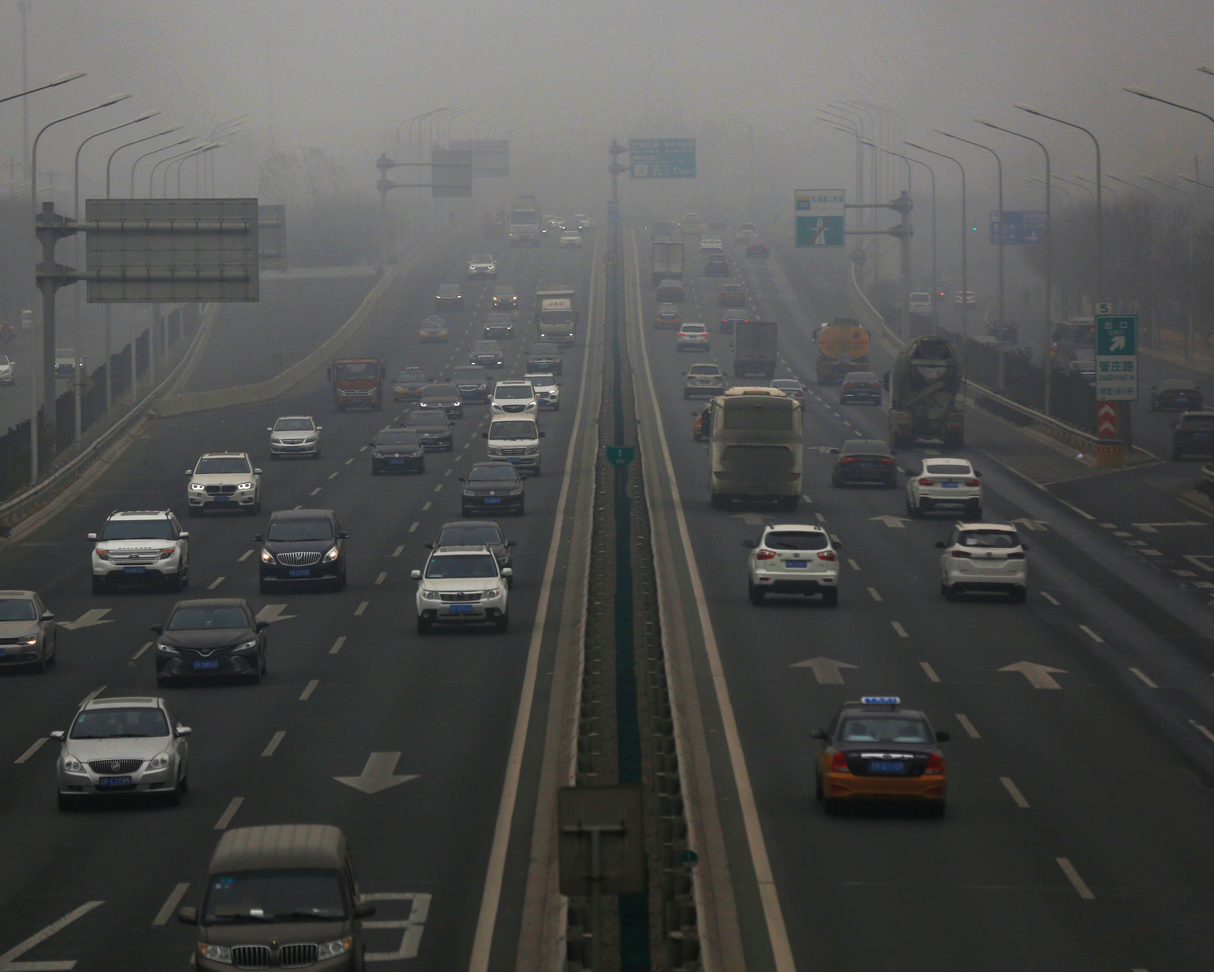
Capstone 1: Greenhouse gases
How do Greenhouse Gases Effect Temperature,
Sea Level, and Natural Disasters?
Presented by: James Hagerman
06/09/2022

Slide 2

Statistics Questions for Analysis
For Testing Correlation
Is there a relationship between sea level and natural disasters?
Is there a relationship between sea level and greenhouse gases?
Is there a relationship between natural disasters and greenhouse gases?

Slide 3
The Data
Links to All Data Provided at the End of PowerPoint
EMDAT (2020): International Disaster Database Natural Disaster data
https://ourworldindata.org/grapher/number-of-natural-disaster-events
OECD (2022): "Air and climate: Greenhouse gas emissions by source", OECD Environment Statistics Greenhouse Emissions by Year and Country data
https://www.oecd-ilibrary.org/environment/data/oecd-environment-statistics/greenhouse-gas-emissions_data-00594-en
UHSLC (2020): Estimate of Data for the Changes in Sea-Level Sea-Level data
https://datahub.io/ismail.shahzad/rise-in-sea-level
NASA (2021): Global Climate Change Vital Signs of the Planet Temperature Data
https://data.giss.nasa.gov/gistemp/graphs/graph_data/Global_Mean_Estimates_based_on_Land_and_Ocean_Data/graph.txt

Slide 4
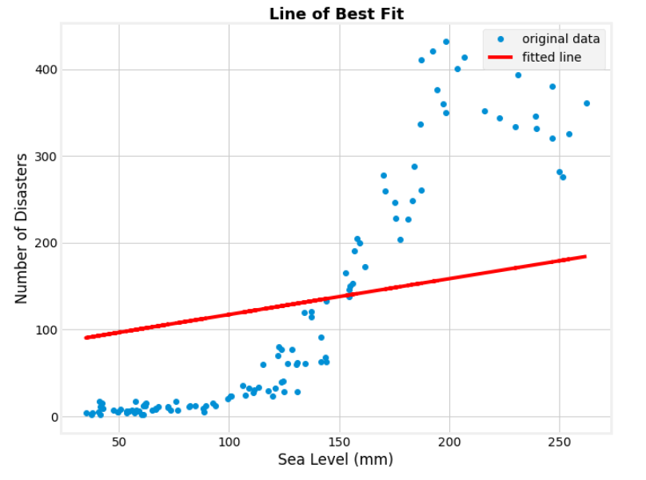
Claiming Credit
Implementing Python Script in PowerBI Dashboard
Implemented a visualization of a Linear Regression on the Number of disasters and Sea level

Slide 5
Results of the Analysis
Correlation Testing
We can reject the null hypothesis in every test at a 95% confidence interval
Sea Level and Natural Disasters P-value of 1.76e-45 and R-value of .90
Sea Level and Greenhouse Gases P-value of .049 and R-value of .31
Natural Disasters and Greenhouse Gases P-value of .012 and R-value of .41

Slide 6
Let's Take a Look at The Analysis & Dashboard

