Slide 1
DNDC guide — New version
Yihe Tang 16 Aug 2024

Slide 2
1. Input and output files
1. input file
Point simulation: JSON file (JavaScript Object Notation) is a lightweight data exchange format. It has a wide range of uses and has become an ECMA standard. It can be used in multiple programming languages ​​for data transmission, storage and exchange between the front and back ends. It can be said to be "less coding, higher processing speed".
Regional simulation: shapefile and JSON files.
2. output file
csv format table.

Slide 3


2. Site simulation - Get and adjust JSON
Unzip the Windows_DNDC compressed package to the C drive and open the Windows PowerShell software (which comes with the Windows system)
2. Switch the current directory to the DNDC model folder [convenient to directly call the compiled DNDC command]
3. Check the help document to understand the simulation type

Slide 4
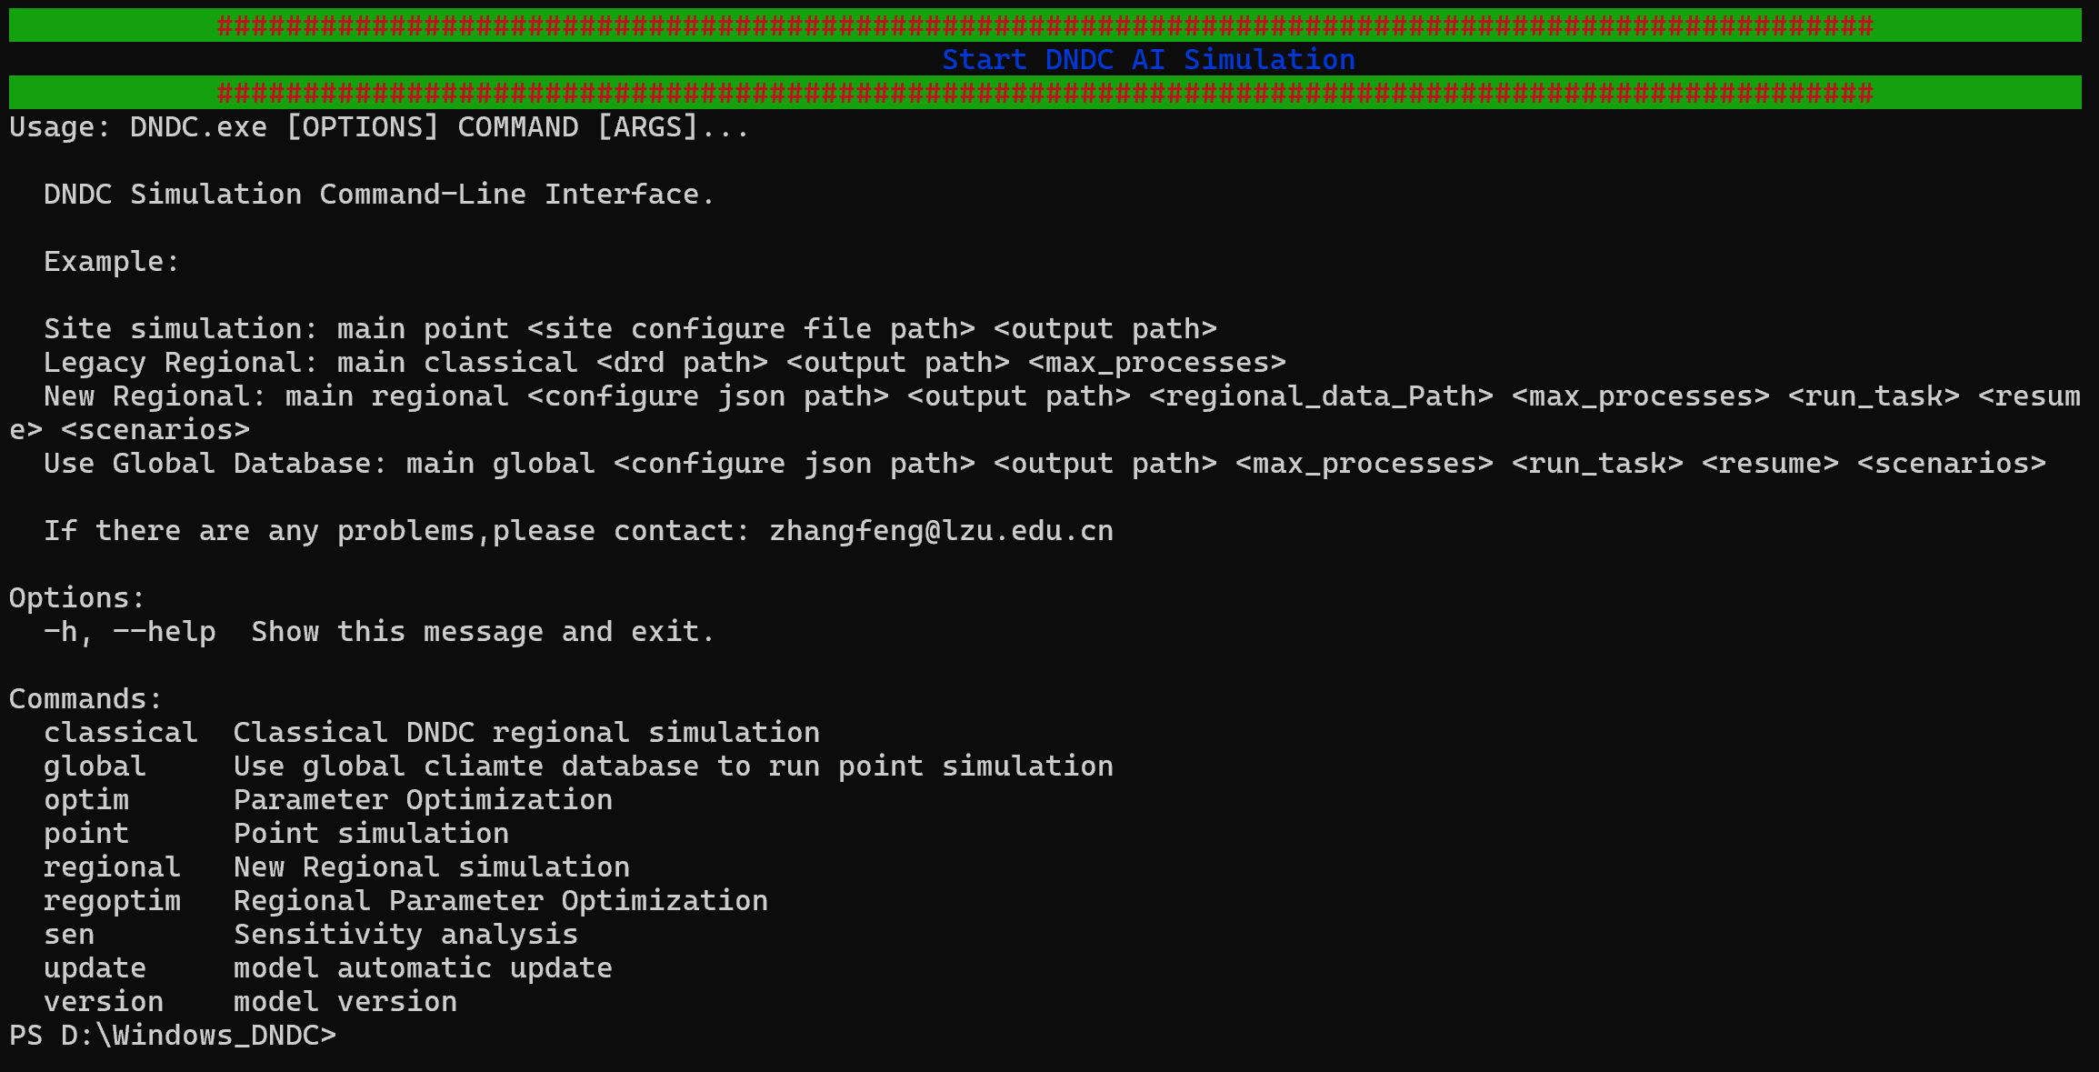

2. Site simulation - Get and adjust JSON
3. Global and point are commonly used point simulation modes
4.Regional is a new version of the regional simulation that can run in parallel

Slide 5
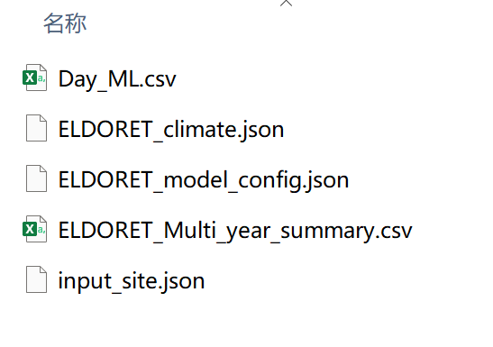
2. Site simulation - Get and adjust JSON
1. Enter the command and press Enter
./DNDC.exe global D:\result\grass\118 ELDORET 2004 3 35.3 0.48 -crp="/11_8000_2500_200_1_365_0.05" -man="/1_0_25" -pre="5" -day="0"
2. Error-free operation interface
3. Model output results

Slide 6
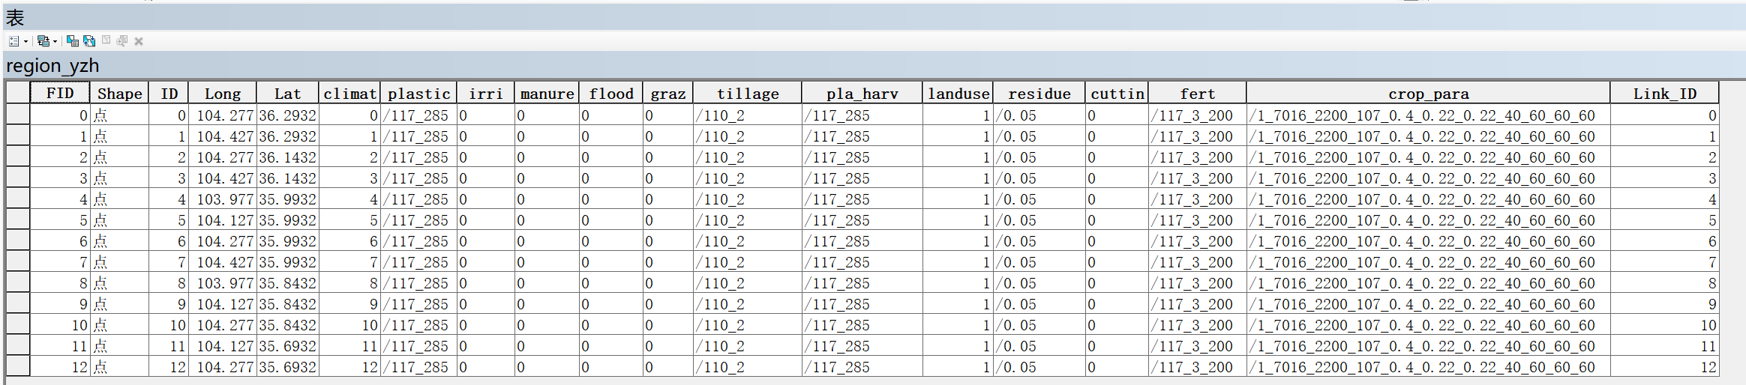
2. Regional simulation
Regional simulation is the parallel operation of site simulation.
Input file format:
1. shape file (Contains site parameter information)

Slide 7
2. Regional simulation
2. During regional simulation, the daily maximum temperature, daily minimum temperature, daily precipitation, and soil data of each point need to be placed in the prepared folder:
Create a folder and name it by yourself. The folder name will be used later. Don't make it too long. Assume the file name is [regional]
Create a shapefile folder in the regional folder and put the shapefile file of the simulation point made in the previous step
Create a climate folder in the regional folder and put three nc files of maximum temperature, daily minimum temperature and daily precipitation
Create a DEM folder in the regional folder and put the tif files of height (unit meter) and slope
Create a Soil folder in the regional folder and put the nc file of soil properties. Soil properties include N-Sed (nitrogen deposition, unit ppm, non-essential file), soil bulk density, soil pH, surface soil SOC, soil clay content, soil field holding capacity (value [0,1]), wilting point (value [0,1]), porosity (value [0,1]) and hydraulic conductivity (unit m/hr)

Slide 8
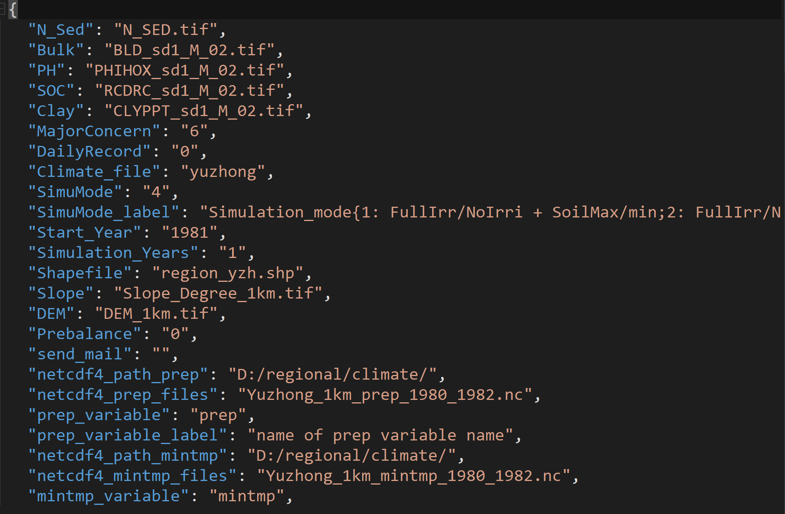

2. Regional simulation
3. JSON file

Slide 9
2. Regional simulation
4. regional simulation code

Slide 10
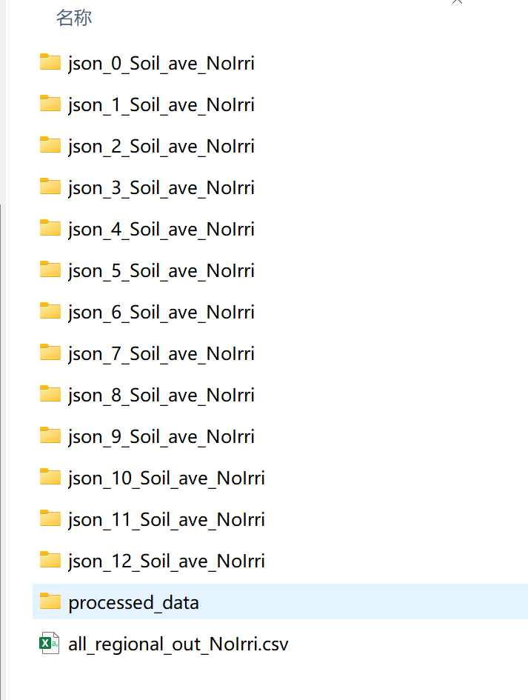
2. Regional simulation
5. Results

