Slide 1
WELCOME TO GAMEPROXY
A place to play, share and talk about games.
LEARN MORE

Slide 2
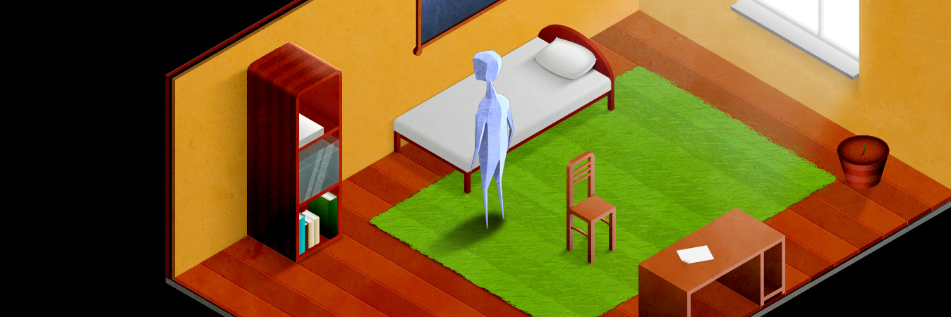
GameProxy Choice
THE
HOUSE
Can you find the exit? Is there any?
Wander around the house looking for hints to complete the game.
PLAY
Developed by ArturKot
NOT a Paid Promotion

Slide 3
WE HAVE MERCH!
We deliver to every country in the world excluding Iran, Cuba, Sudan, North Korea, Syria and Crimea and we have really low prices. This is a great way to support GameProxy. We have stickers, clothing, cases and much more (even a duvet if you really want!)
It is hosted on Redbubble and we get 15% of the sale.
GO TO OUR MERCH STORE

Slide 4
IN DEVELOPMENT!
We'll be creating a vast library of games very soon! We hope to see you when we've finished our website. In the meantime, stick around to see what we're doing!
You can also visit our GitHub repository if you’re bored.
VIEW ON GITHUB

Slide 5
WARNING!
If a game doesn't have a verified symbol, it may contain
extreme violence, offensive material or inappropriate material.
Found a bad game? Report it!
REPORT A GAME

Slide 6
KNOW YOUR STAFF
Here’s our staff members (1/2):
Seb
GameProxy uses coloured names for staff users. With games, if the creator has a coloured name, it means it was officially uploaded by a staff member of GameProxy.
James
Herbie
For those who are wondering, we are currently not accepting any new staff members over the internet. You must be able to contact a staff member in person to apply to be a staff member for GameProxy.
Caspar
Arlo
Ender

Slide 7
KNOW YOUR STAFF
Here’s our staff members (2/2):
Alex
GameProxy uses coloured names for staff users. With games, if the creator has a coloured name, it means it was officially uploaded by a staff member of GameProxy.
James W
Daniel
For those who are wondering, we are currently not accepting any new staff members over the internet. You must be able to contact a staff member in person to apply to be a staff member for GameProxy.

