Slide 1
Taiwanese Q&A using Large Language Models
314581029 盧楷勛

Slide 2
Platform
13th Gen Intel(R) Core(TM) i7-13700
NVIDIA GeForce RTX 4070 SUPER (12GB VRAM)
NVIDIA GeForce RTX 4090 SUPER (24GB VRAM) * 2
Intel Xeon Platinum 8580 (60 core)
NVIDIA H200 (140GB VRAM) * 2

Slide 3
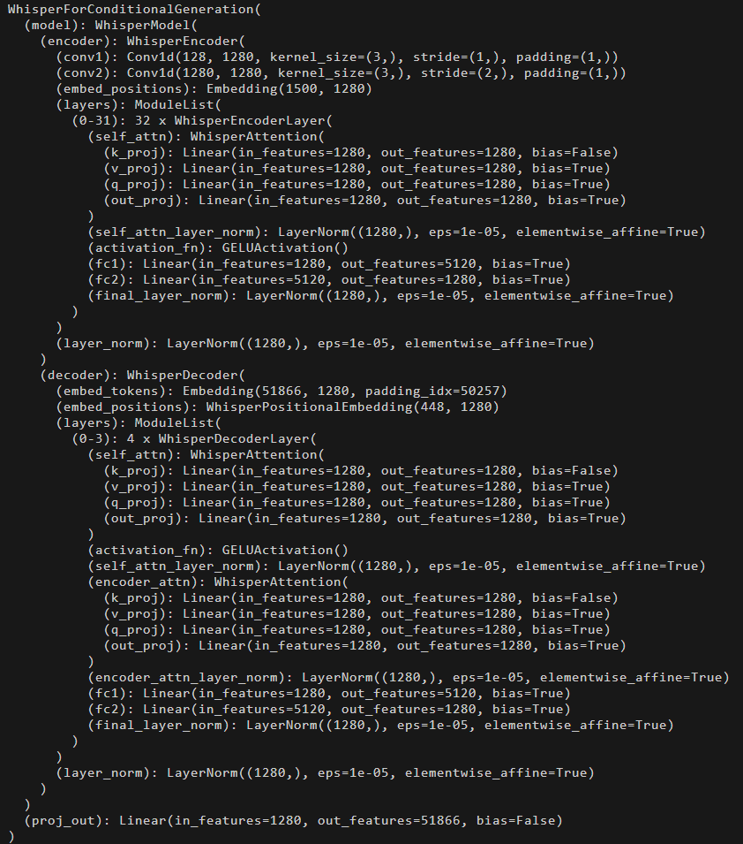
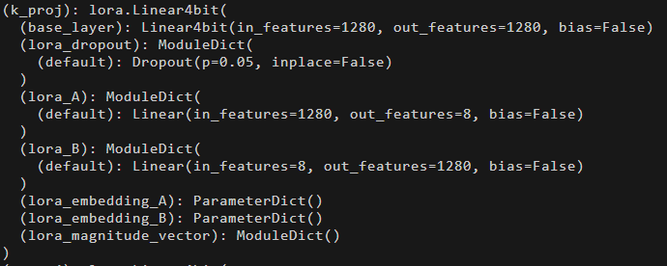
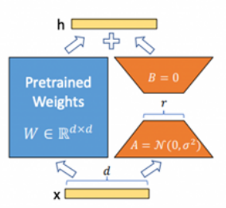


Recap: Attempt #9
Load larger model with LoRA and quantization
Layer | Parameters
Full 1280×1280 | 1,638,400
LoRA (rank 8) | 1280×8 + 8×1280 = 20,480
h = W · x (FP16)
h = (W_4bit + BA) · x (NF4)
Where A has shape (1280,8)
And B has shape (8, 1280)

Slide 4
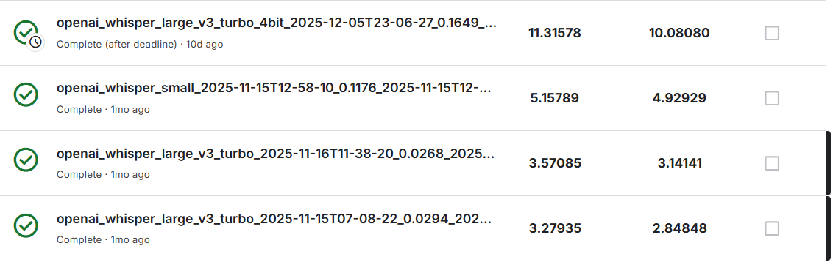

Training experiment
https://huggingface.co/Location0717/Whisper-large-v3-turbo-QLoRA-4bit-Taiwanese
https://huggingface.co/Location0717/Whisper-small-Taiwanese

Slide 5
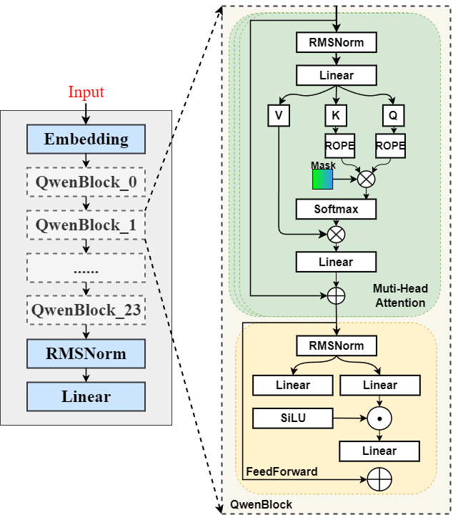
Model info
Qwen2.5-1.5B-Instruct
Qwen2.5-7B-Instruct
Qwen2.5-14B-Instruct
Qwen2.5-32B-Instruct
Qwen2.5-72B-Instruct
sentence-transformers
  paraphrase-multilingual-MiniLM-L12-v2
QLoRA 4-bit

Slide 6
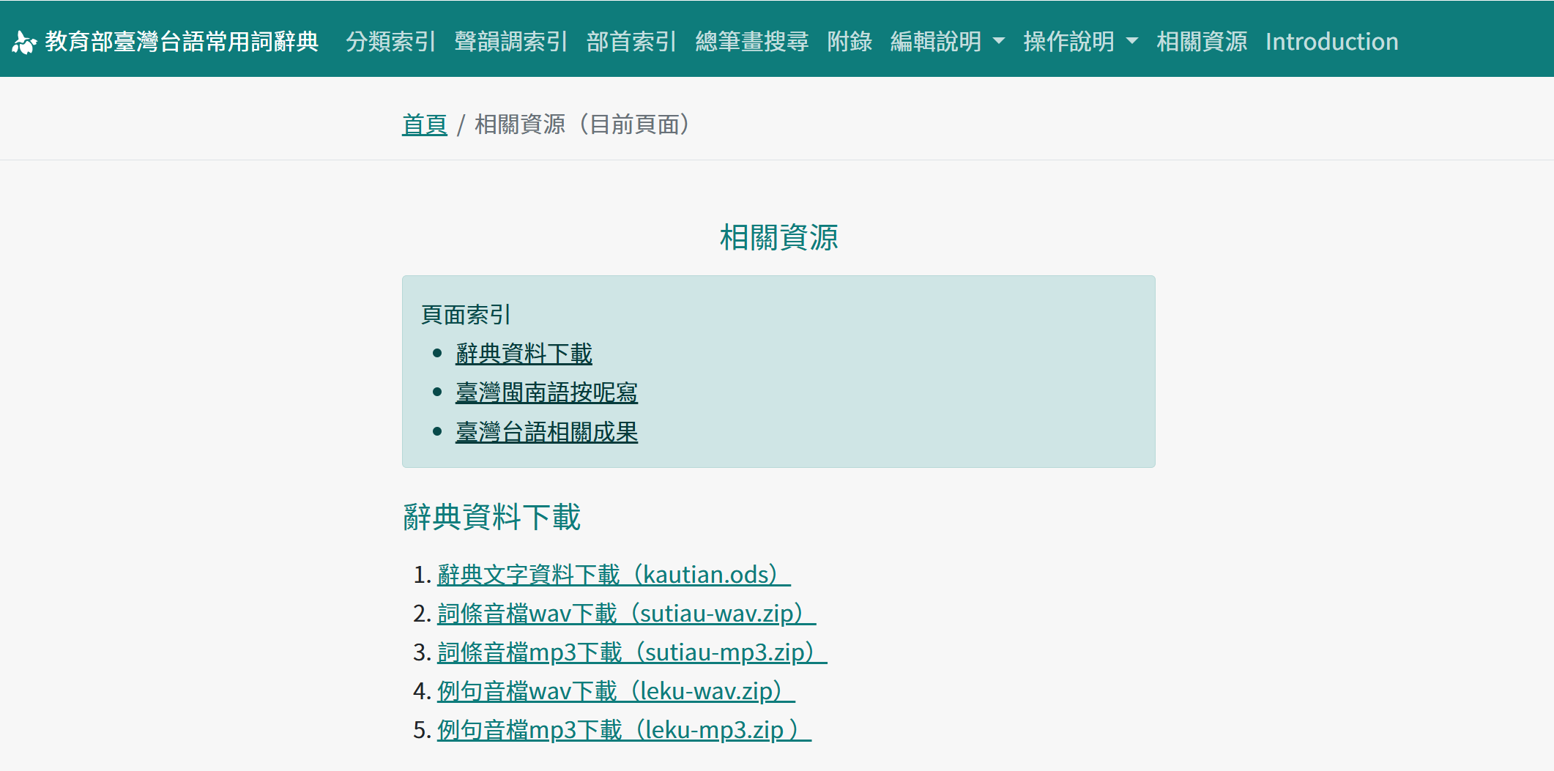
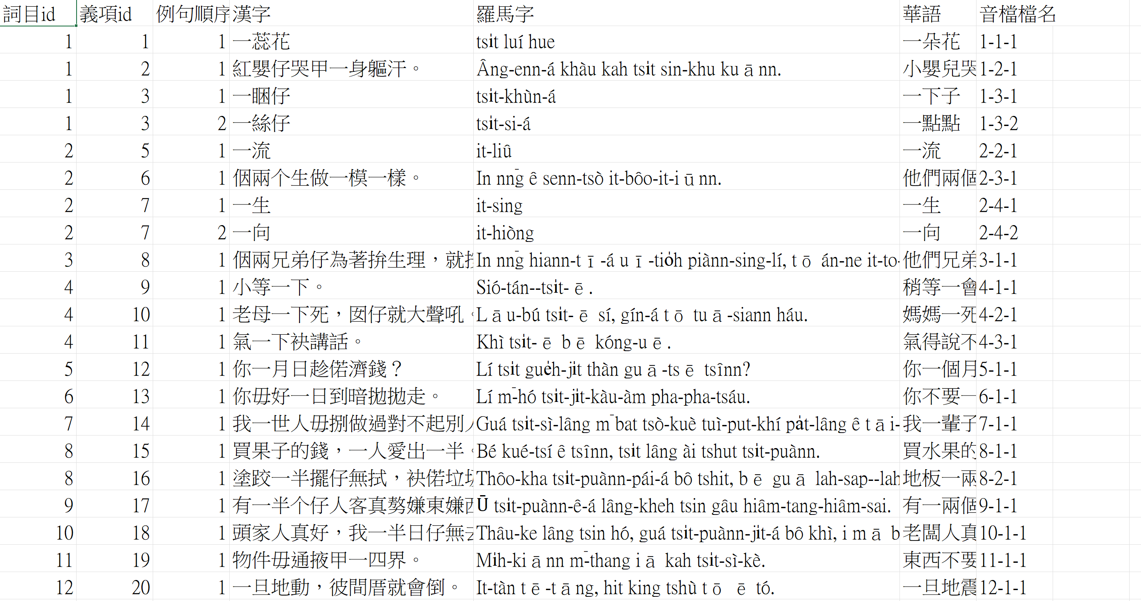
Data source
https://sutian.moe.edu.tw/zh-hant/siongkuantsuguan/
Dictionary-word (x21788)
Dictionary-sentence (x17697)

Slide 7
Data preprocessing
CPT & SFT data
Continual Pre-Training
{"text": "我聽著花開的聲：台語散文集 廖張皭 台語是阮佮故鄉的連結，台語予阮揣著轉去厝的路， 寫台文是我對故鄉的 siàu 念，嘛是咧走揣家己，中年書寫 閣 khah 是 ua̍t 頭 1 看家己的人生，反省 1 tsuā 行來的 ta̍p- ta̍p 滴滴。阮佇雲林二崙濁水溪邊的小庄頭出世，老爸掀《 彙音 寶鑑 》2 kā 阮號名。讀小學的時，就真佮意文學。國立成 功大學中文系畢業，bat 佇私立中學教冊，了後，佇國民學 校做老師。"}
Supervised Fine-Tuning
{"id": "381", "instruction": "", "input": "文章：\n桃園市龜山分局大埔派出所警員涂修理…..的警政署長陳國恩除了拜託院方全力搶救外，嘛重申執行酒駕勤務無止------\n\n問題：請問內政部長提議是按怎預防酒駕？\n\n選項：\n1. 綿爛執行酒駕勤務\n2. 籲請全民共同為陳明慧集氣，嘛重申酒駕零容忍的決心。\n3. 加強酒駕者的道安講習\n4. 全民前去病院探視\n\n答案：", "response": "3"}

Slide 8
Training Attempts

Slide 9
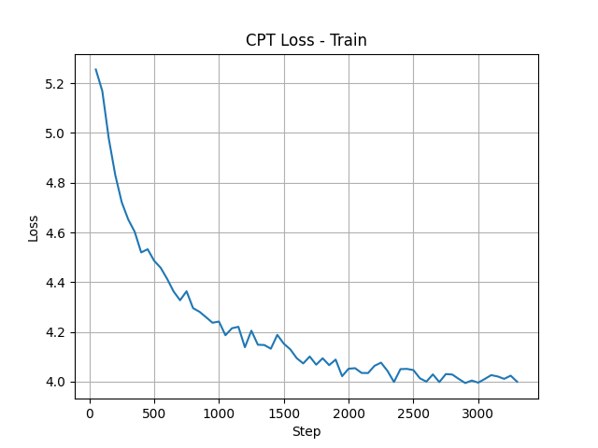
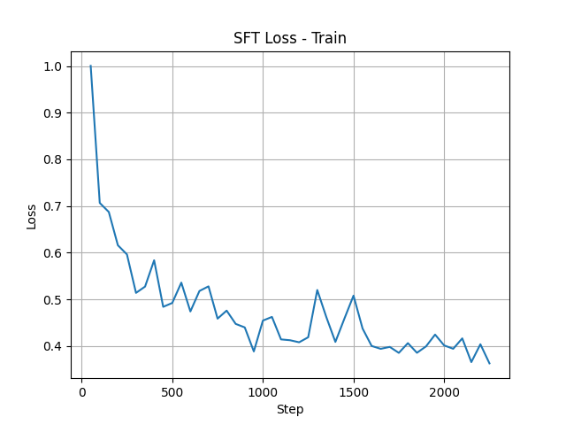
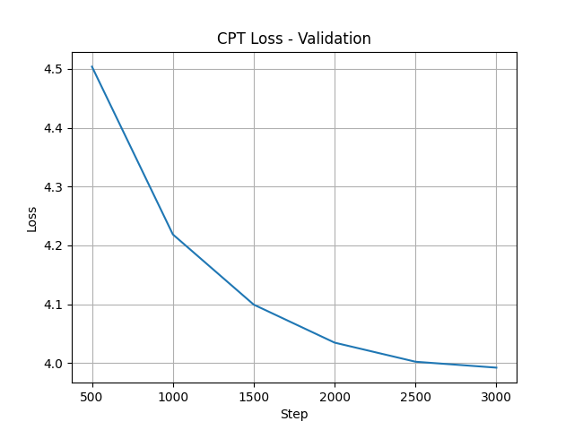
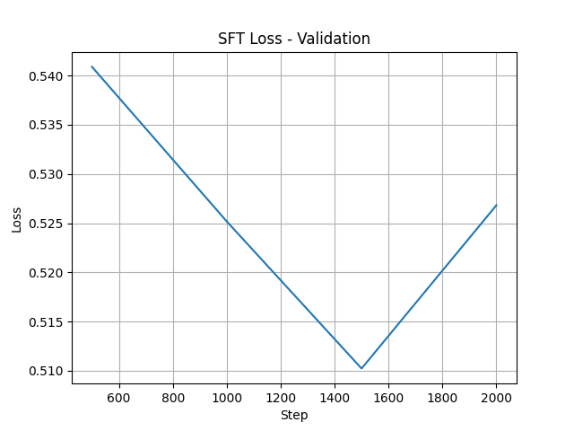

Attempt #1
Qwen2.5-1.5B-Instruct-QLoRA-4bit -> CPT stage -> SFT stage

Slide 10

Attempt #2
How about just don’t tune it?
Perform inference with larger model instead of training a small, quantized, less precision model

Slide 11
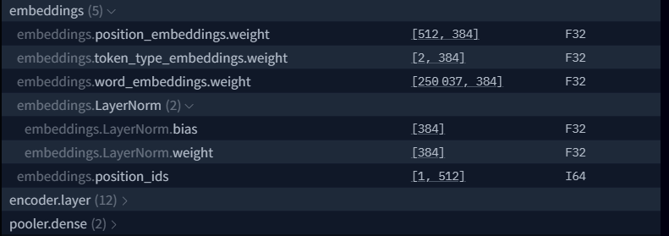
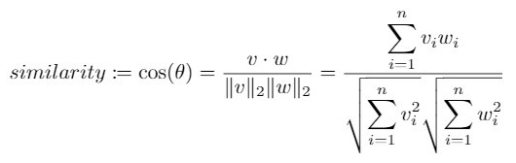
Attempt #3 using SFT data as few shot data
sentence-transformers
paraphrase-multilingual-MiniLM-L12-v2
(Bidirectional Encoder Representations from Transformers, aka BERT)
Mean pooling
Dim: 384
N*Dim
Question
Many SFT data

Slide 12
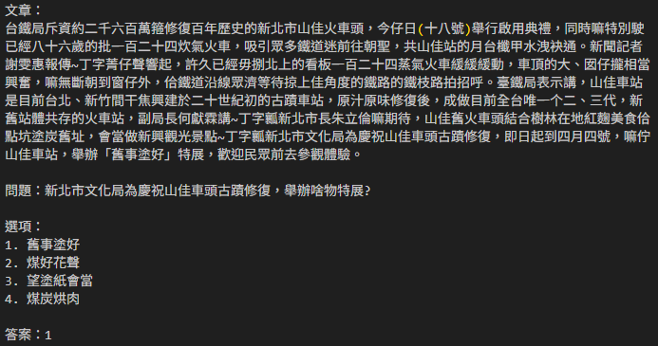
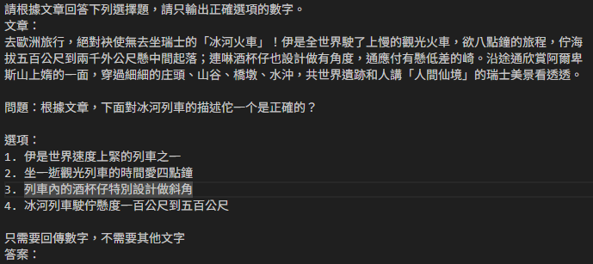
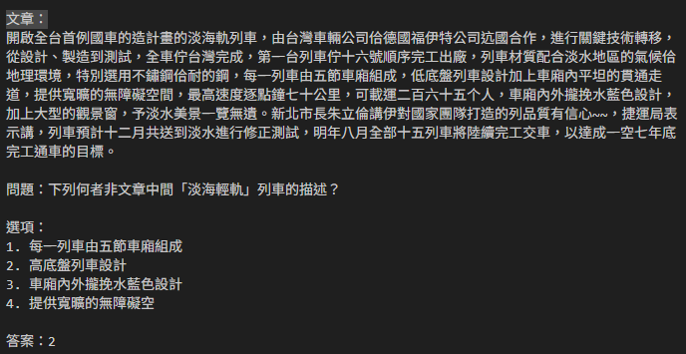
Attempt #3 using SFT data as few shot data

Slide 13
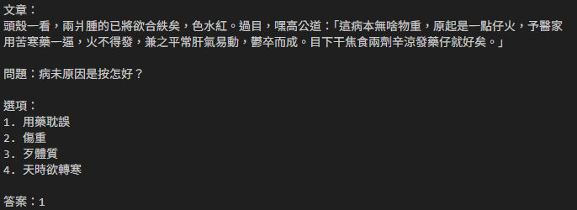
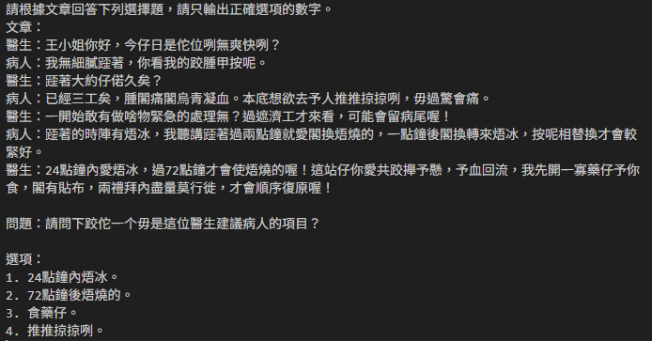
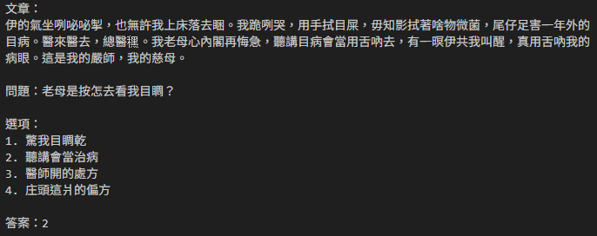
Attempt #3 using SFT data as few shot data

Slide 14
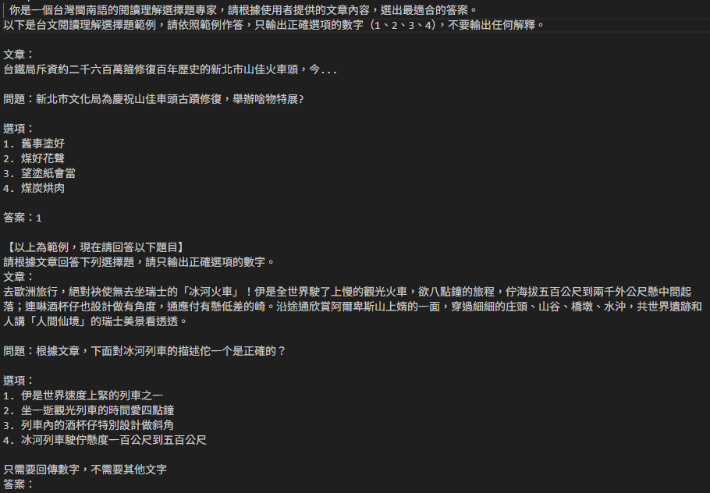
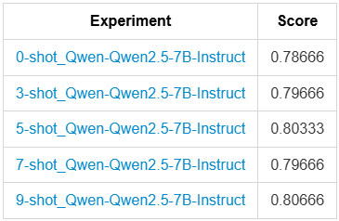
Attempt #3 using SFT data as few shot data

Slide 15
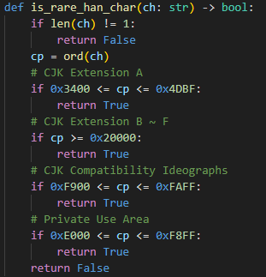
Attempt #4
RAG (Retrieval-Augmented Generation) with dictionary
Dictionary lookup
Exact match:
Look for explanation
char by char
Question
Sentence contains it:
Get sentence with explanation
Moving window size 2
Window size 3
Window size 4
…
Found nothing :(

Slide 16
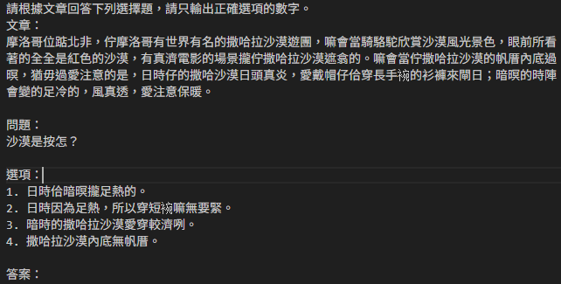
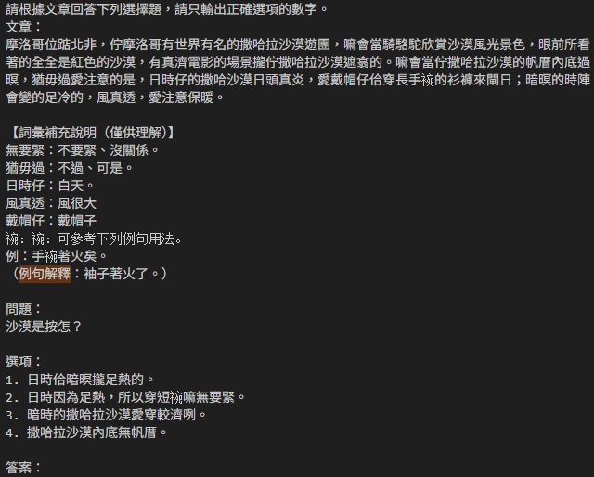
Attempt #4
RAG (Retrieval-Augmented Generation) with dictionary

Slide 17
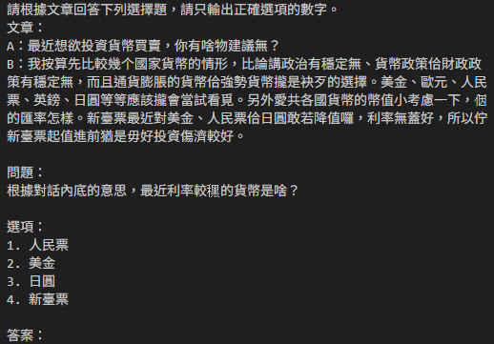
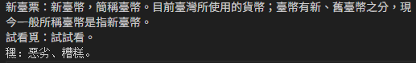
Attempt #4
RAG (Retrieval-Augmented Generation) with dictionary

Slide 18
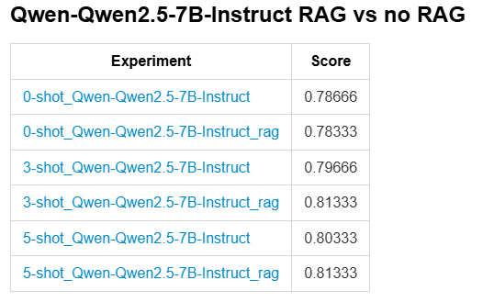
Attempt #4
RAG (Retrieval-Augmented Generation) with dictionary

Slide 19
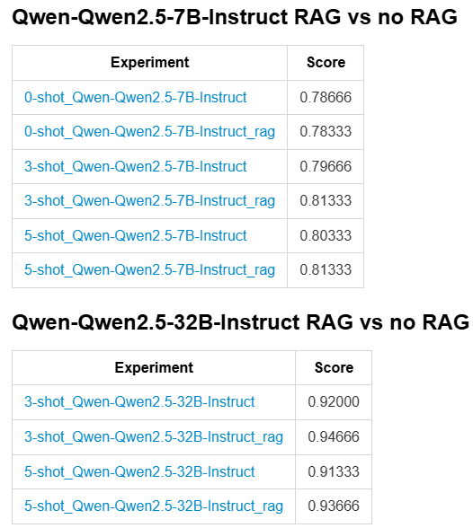
Attempt #4
Larger model: Qwen2.5-32B-Instruct
Special thanks to my friend again
for lending me 4090

Slide 20
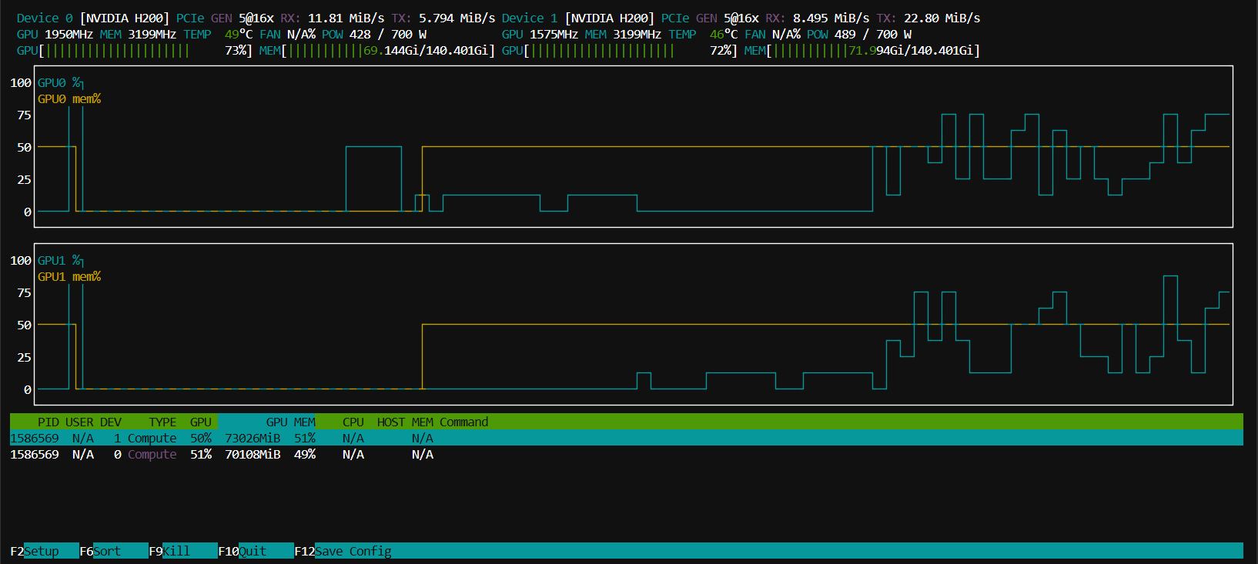
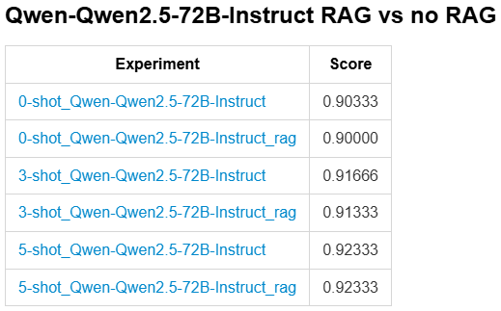
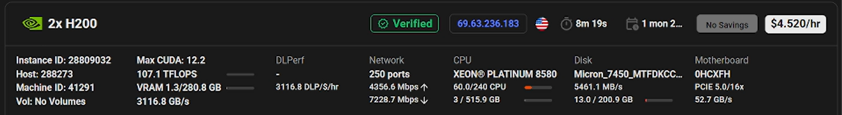
Attempt #5
Even larger model: Qwen2.5-72B-Instruct

Slide 21
Attempt #Future
Investigate why 32B out performs 72B (analyze reasoning / model Confidence)
In RAG (Retrieval-Augmented Generation) with dictionary, instead of explicit matching, we can ask LLM to do it.
Ask LLM to think before answering, or using COT
More aggressive augmentation in prompt in few shot
Feedback-driven RAG (Answer -> critique -> refine)
Generate 3~5 times with higher temperature and vote
…

Slide 22
Thank you

