Slide 1

SLS SF ZnNi Line Development Program

Slide 2
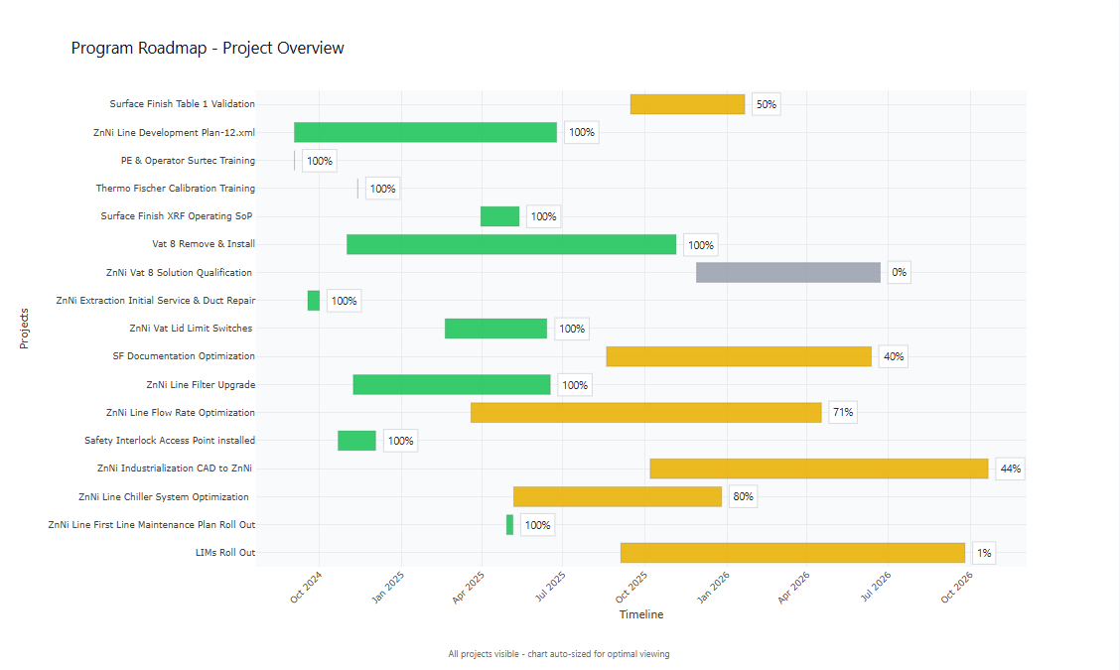
SLS SF ZnNi Line Development Program Roadmap

Slide 3
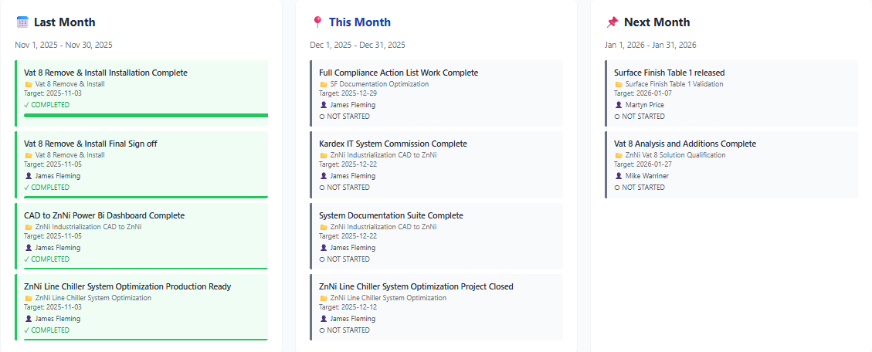
SLS SF – ZnNi Line Development Project Milestones Nov 25 Focus

Slide 4
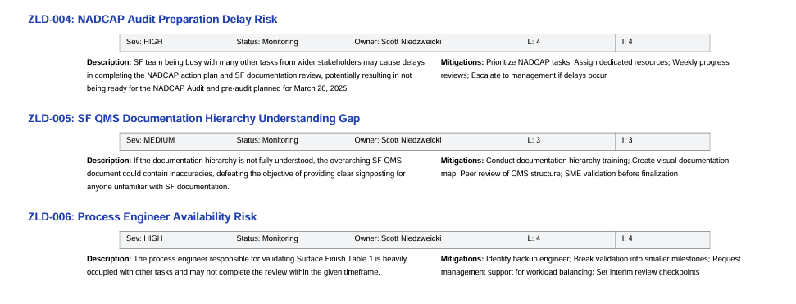
SLS SF ZnNi Line Development Program Project Risks

Slide 5
SLS SF ZnNi Line Development Project Milestone Changes

Slide 6
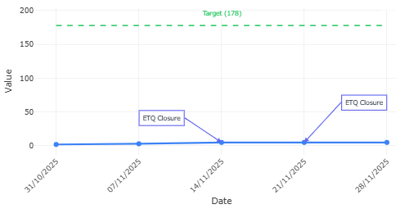
SLS SF – Documentation Progress

Slide 7
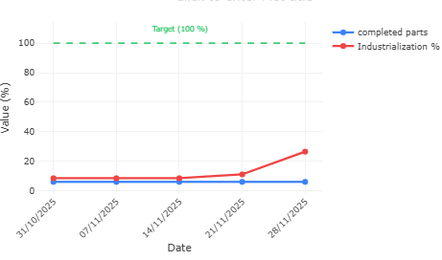
SLS SF CAD to ZnNi Industrialization Progress

Slide 8
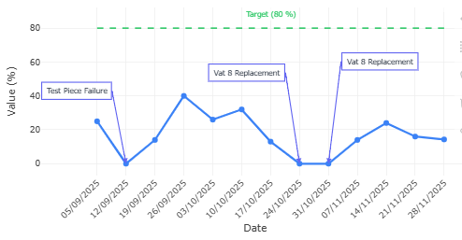
SLS SF ZnNi Line OEE Progress

Slide 9
SLS ZnNi Line Statistical Process Control

Slide 10
SLS ZnNi Line Content Control Chart
Vat 9 Zinc Content
TANK 9. Zinc

Slide 11
SLS ZnNi Line Content Control Chart
Vat 9 Nickel Content

Slide 12
SLS ZnNi Line Content Control Chart
Vat 9 Sodium Hydroxide NaOH

Slide 13
SLS ZnNi Line Content Control Chart
Vat 9 Sodium Carbonate Na2CO3

Slide 14
SLS ZnNi Line Content Control Chart
Vat 9 Iron Content

Slide 15
SLS ZnNi Line Content Control Chart
Vat 9 Chromium Content

Slide 16
SLS ZnNi Line Content Control Chart
Vat 9 Aluminium Content

Slide 17
SLS ZnNi Line Content Control Chart
Vat 9 Titanium Content

Slide 18
SLS ZnNi Line Content Control Chart
Vat 9 Lead Content

Slide 19
SLS ZnNi Line Content Control Chart
Vat 9 Copper Content

