Slide 1
Robotics Lab-02
James Meyers
Given 2 Reach Emlid boards with 2 GPS antennas+aluminum mounting plates, an RTK GPS network was established using an iPad as a hotspot for a Base and a Rover. Using ROS nodes and python drivers, data was collected as rosbags for four separate scenarios to analyze the improved GPS capabilities of filtering out error by using a Base and a Rover.
Data was collected for
1. Closed Area Stationary (10 mins)
2. Closed Area Walking
3. Open Area Stationary (10 mins)
4. Open Area Walking

Slide 2
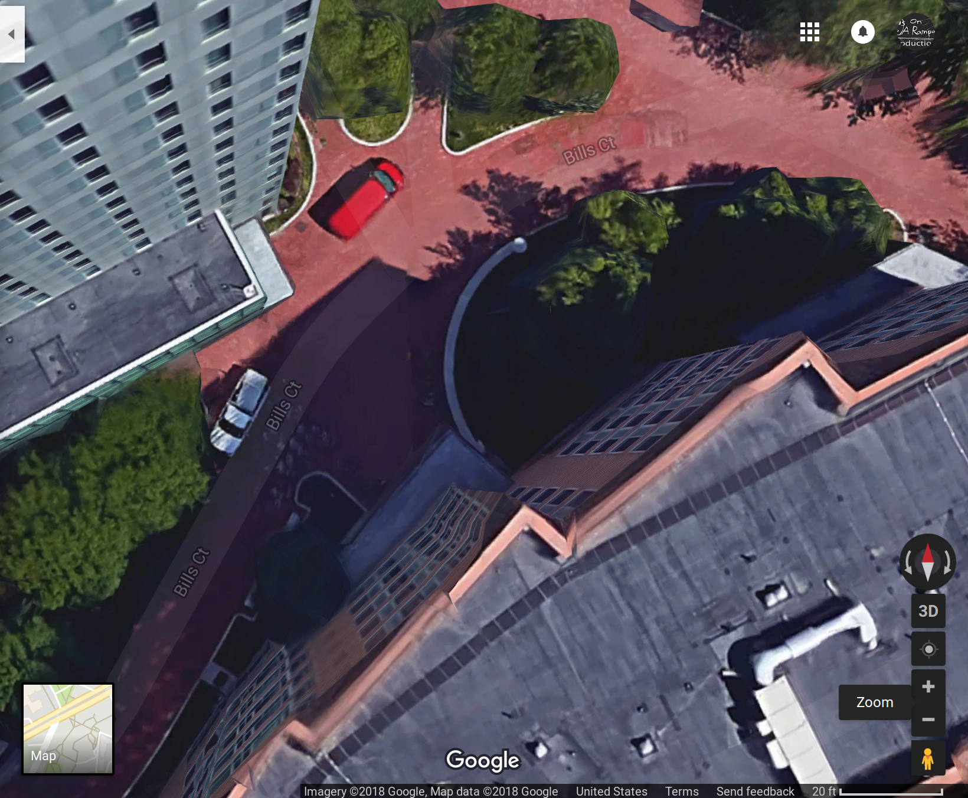
Closed Area Data
Collected for ~10 mins stationary, xx data points walking outside West Vilalge G

Slide 3
Closed Area Data (cont.)
While the UTM_y data may have a nearly Gaussian distribution, the UTM_x data appears more random and not easily approximated. Some other distibutions were tested (kernel, poisson, inverse normal, etc), but none seemed to fit the curves of the data collected, so normal was assumed. Below are the mean and standard deviations for both the utm_x and utm_y data.
pdx =
Normal distribution
mu = 666755 [666755, 666755]
sigma = 0.518826 [0.493575, 0.546821]
pdy =
Normal distribution
mu = 4.66699e+06 [4.66699e+06, 4.66699e+06]
Sigma = 0.224619 [0.213687, 0.236739]
The standard deviation of the UTM_y data is significantly smaller than UTM_x and the normal Gaussian distribution far better fits the data. This discrepancy could be due to a large number of factors including nearby building interference, low number of data points (734 in this case), or sensor inaccuracies.
Despite some of these possibilities, the data still shows that the standard deviation of UTM_x and UTM_y position is approximately 0.52 meters and 0.22 meters respectively. While this is based on what is seen to be a poor assumption of distribution for UTM_x in particular, it shows that we can be relatively certain we’re within a few meters of our location given by the GPS receiver.
Through greater statistical analysis, this certainty can be greatly improved as shown by an interesting article from GPSworld.com
http://gpsworld.com/gps-accuracy-lies-damn-lies-and-statistics/

Slide 4
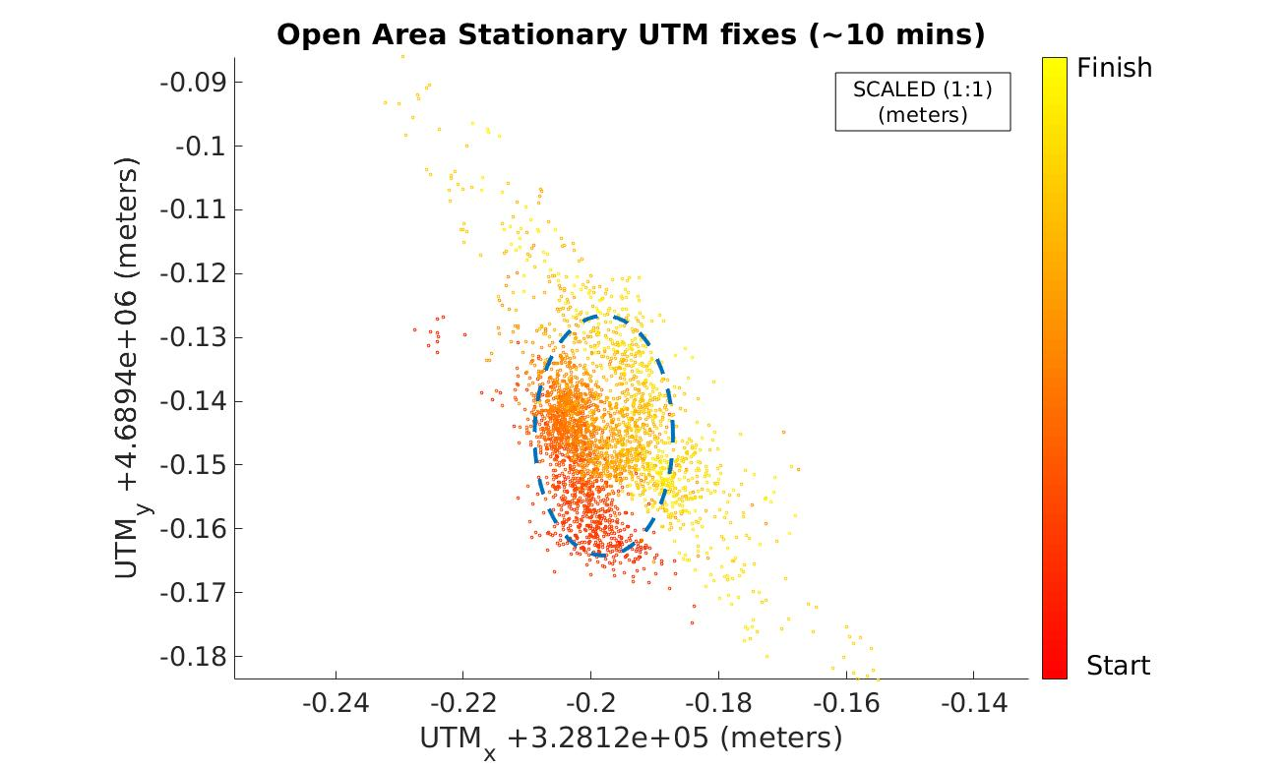
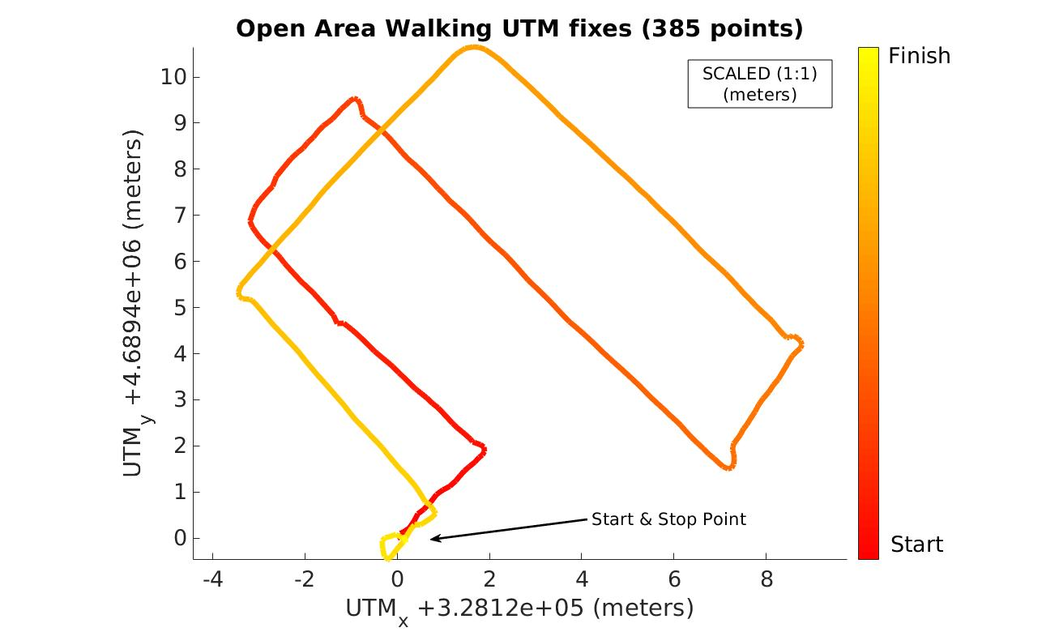
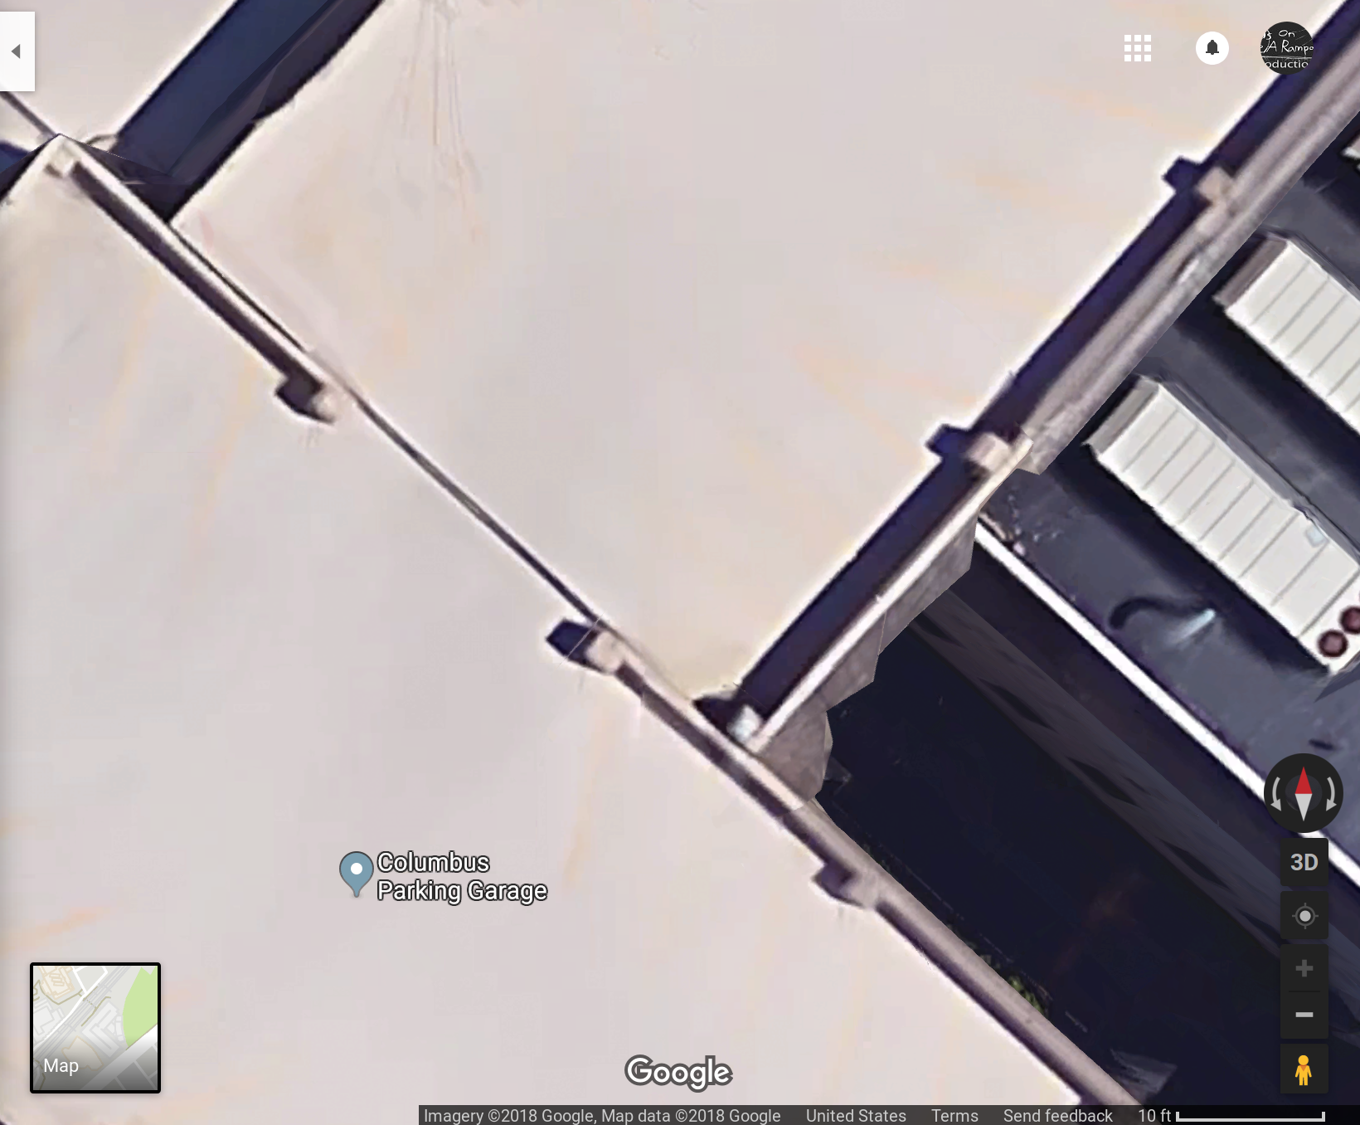
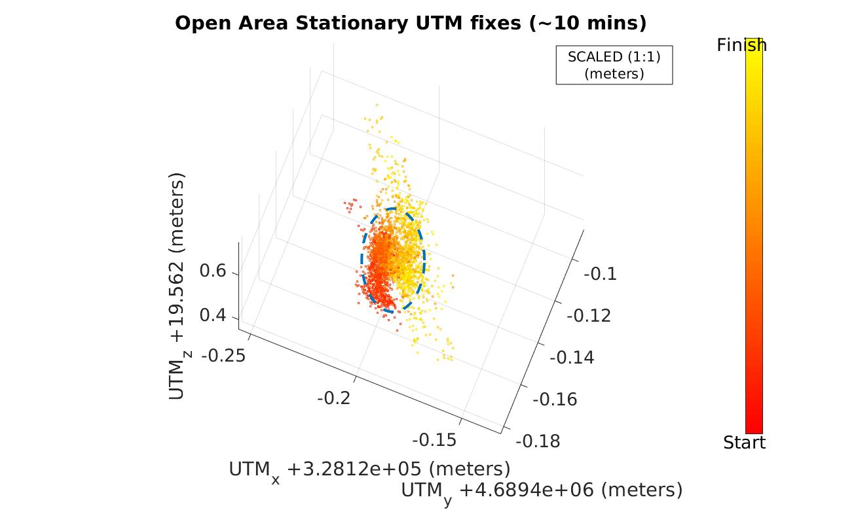
Open Area Data
Collected for ~10 min stationary, xx data points walking on top of Columbus Parking Garage

Slide 5
Open Area Data (cont.)
Data was collected while walking in a straight line for approximately 1 minute in Quincy, MA. The data was saved as an lcm log and imported into Matlab for futher analysis. The top left plot above shows the plot of UTM_x and UTM_y position as well as a linear and quadratic fitted curve. The residuals between the plotted UTM_x and UTM_y positions and the estimated curves are shown in the plot below.
The top right plot above is a 1:1 ratio of UTM_x and UTM_y compared to a google maps image of the walking path next to it. Its quite evident that even with some slight human error introduced by not walking an exactly straight line, the GPS is not providing accurate estimations of position. The GPS output very roughly demonstrates the point the walking started, ended, and the direction taken to get there, but has up to 3 meters of error. This is all assuming that the linear and quadratic fits are the actual path taken which is a generally poor assumption.
Overall, one can assume based on these findings that the GPS receiver provided gives very rough estimates of location, but has errors on the order of approximately +/- 3 meters without any additional statistics or math to increase accuracy or certainty of position.

