Slide 1
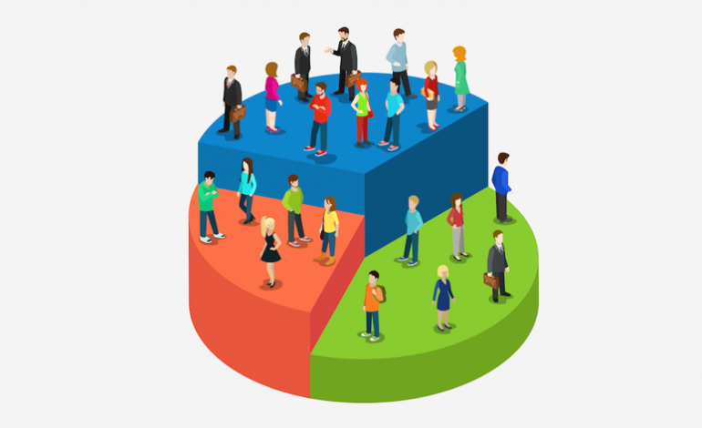
Customer Segmentation – Banking Sector

Slide 2
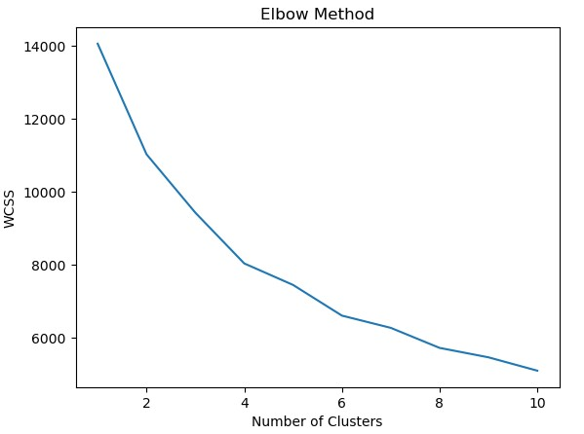
Application of the Elbow Method in customer segmentation
This graph illustrates the application of the Elbow Method in customer segmentation, a pivotal strategy in understanding customer behavior. The optimal number of customer groups is determined by the point where the decrease in Within-Cluster Sum of Squares (WCSS) slows down, which is 4 in this case. This data-driven approach allows businesses to tailor their services to distinct customer groups, enhancing satisfaction and business success.
<visualization>

Slide 3
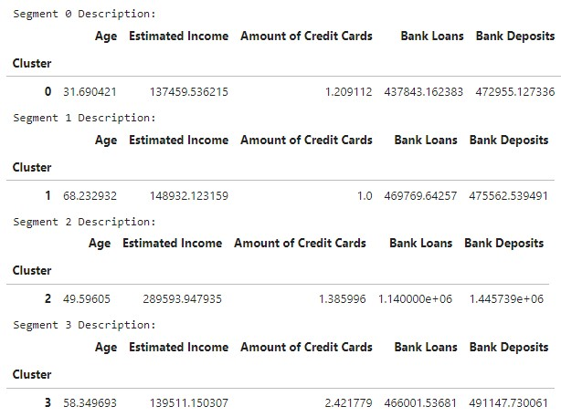
Results of k-means clustering based on banking and financial data
This table illustrates the results of k-means clustering. The clusters, numbered from 0 to 4, represent distinct customer groups. Each group is characterized by the mean values of features such as Age, Estimated Income, Amount of Credit Cards, Bank Loans, and Bank Deposits. For instance, customers in cluster 0 are around 31.69 years old on average, with an estimated income of approximately 137,459.53, holding 1.29 credit cards on average, and having average bank loans and deposits of around 473,784.2 and 729,551 respectively..
<visualization>

Slide 4
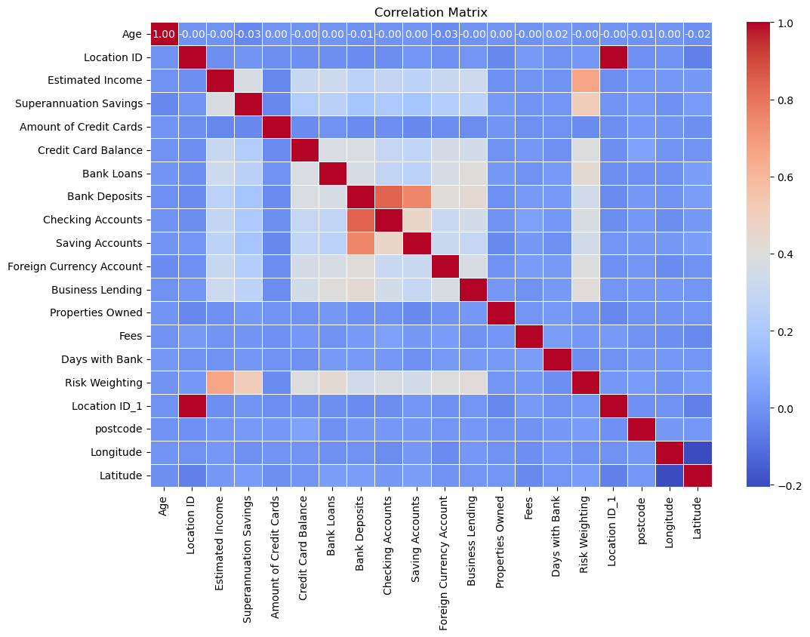
Correlation Matrix Heatmap
The heatmap represents the correlation between different financial variables such as “Age,” “Estimated Income,” “Credit Card Balance,” etc. Each cell within the matrix represents the correlation between two variables, with colors ranging from blue (negative correlation), white (no correlation), to red (positive correlation). This visualization aids businesses in understanding the relationships between different customer attributes, thereby enhancing their ability to tailor services to distinct customer groups
<visualization>

Slide 5
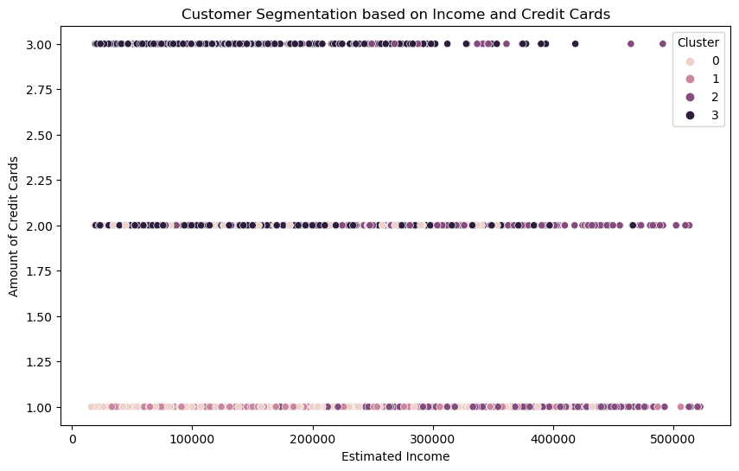
Customer Segmentation based on Income and Credit Cards
The graph shows customer segmentation based on income and credit cards. It has four clusters, each representing a distinct customer group. As income increases, there’s a slight increase in the number of credit cards held. This helps businesses tailor services to distinct customer groups. This is useful for understanding the relationship between a customer’s income and the number of credit cards they hold. This can help businesses tailor their services to distinct customer groups, enhancing satisfaction and business success
<visualization>

Slide 6
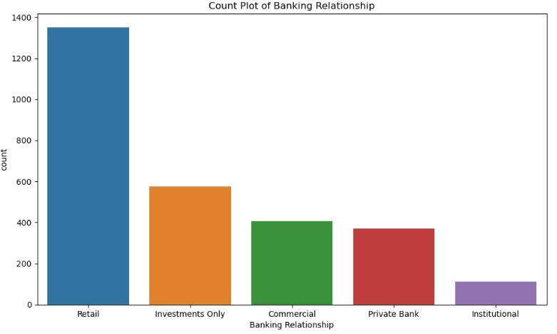
Count Plot of Banking Relationship
The chart shows the distribution of banking relationships. The majority of customers fall into the ‘Retail’ category. ‘Investments Only’ and ‘Commercial Banking Relationship’ have fewer customers, while ‘Private Bank’ and ‘Institutional’ categories have the least number of customers. This suggests most customers prefer retail banking services.

Slide 7



Key Takeaways
Personalized Marketing and Services: The project enables businesses to understand their customers better and tailor their services accordingly. This leads to personalized marketing strategies, optimized product offerings, and enhanced customer satisfaction.
Insightful Customer Distribution: The project provides insights into the socioeconomic diversity of customers, their banking types, demographics within different banking relationships, geographical distribution, and relationship duration. These insights can guide targeted marketing, tailored product offerings, and personalized service.
Understanding Financial Behaviors: The project helps in understanding financial behaviors across different banking relationships, which can guide product development and pricing strategies.

Slide 8
Next Steps
Strategy Implementation: Evaluate the effectiveness of the segmentation and implement strategies personalized for each segment. This could involve creating targeted marketing campaigns or developing new products/services tailored to each segment’s unique characteristics and behaviors
Continuous Improvement: Continually monitor and assess the performance of the segmentation strategy. Use feedback and results to refine the segmentation criteria, improve the clustering algorithms, and enhance the overall effectiveness of the customer segmentation project. This will ensure that the segmentation remains relevant and effective as the customer base and market conditions evolve

Slide 9



https://github.com/James-Muguro/CustomerSegmentation

