Slide 1

The Data-Driven Future of Loan Eligibility at Dream Housing Finance

Slide 2

Context and Data Audit
Data specifics: The dataset shows loan applications for individuals, with columns for loan ID, gender, age, marital status, dependents, county, education, self-employment status, applicant income, co-applicant income, loan amount, application date, loan term, credit history, property area and loan status.
The study's generalizability is constrained by a dataset covering only four of Kenya's 47 counties, limiting the applicability of findings to those regions. Dynamics observed in loan approval, demographics, and socioeconomic factors may not represent the entire country.
The dataset's geographic bias and focus on select variables like gender and education may overlook variations in loan processes and borrower characteristics in other counties. Conclusions drawn should be applied cautiously, recognizing potential limitations in representing diverse regions and demographics across Kenya.

Slide 3
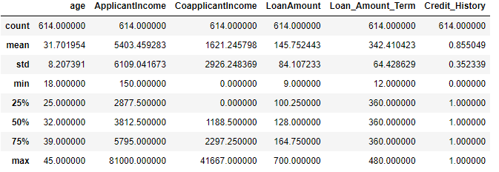
Summary statistics

Slide 4
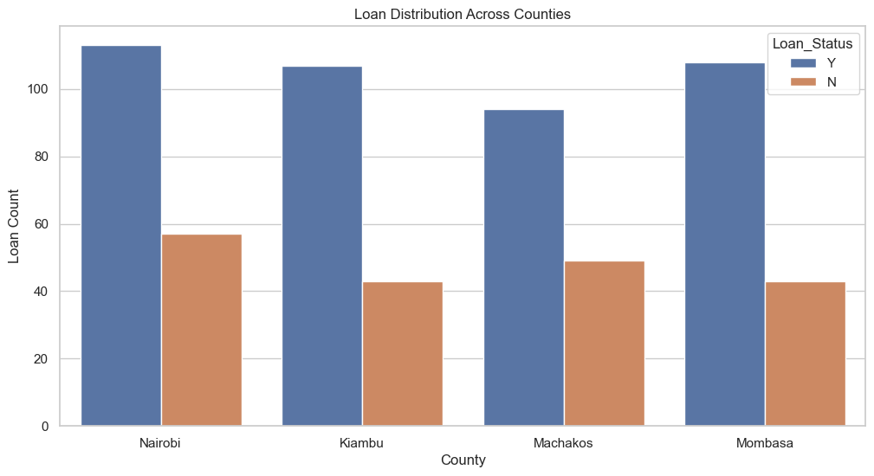
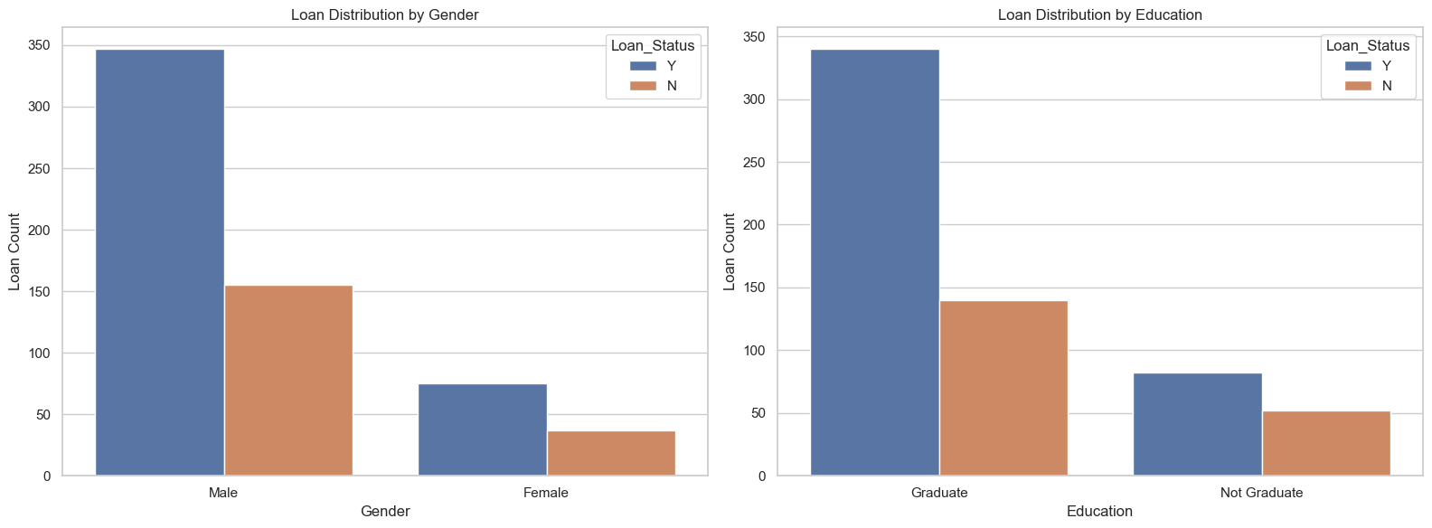
How are the loans distributed across counties and user demographics?
The loan distribution across counties reveals distinct patterns, with Nairobi having the highest loan count, followed by Mombasa and Kiambu, while Machakos exhibits the lowest loan count. This distribution implies varying borrowing behaviors among regions.
Nairobi's prominence may be attributed to factors such as a larger population, higher incomes, or a more developed financial sector. Kiambu and Mombasa's high loan numbers suggest economic growth and borrowing demand. Conversely, Machakos' lower loan count may result from specific economic conditions or lending criteria misaligned with local borrowing preferences.
The analysis highlights significant disparities in loan counts by gender and education. Men have notably more loans, potentially due to women's preference for collective borrowing methods. "Graduate" individuals demonstrate higher loan counts, suggesting formal employment advantages. Non-graduates, often in the informal sector, may face hurdles in loan approval. The findings underscore gender and education-related discrepancies in borrowing patterns.

Slide 5
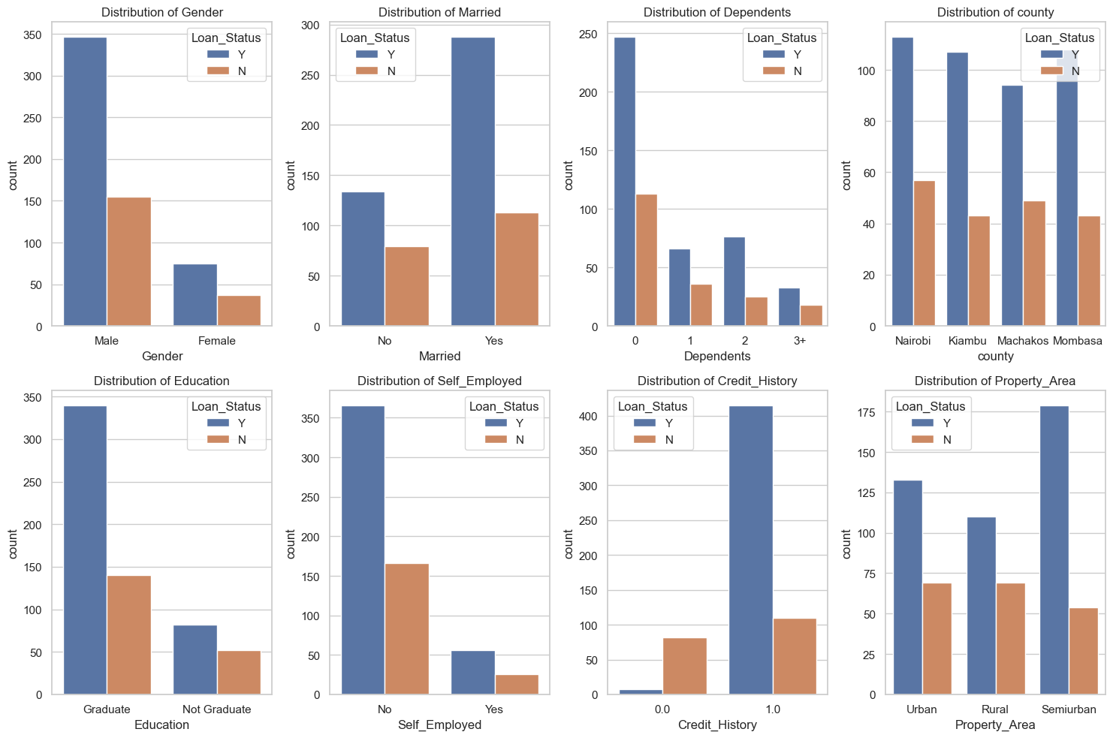
Do the Kenyan borrowers appear to be nationally representative?
To assess if Kenyan borrowers appear to be nationally representative, we will analyze the distribution of key categorical variables like "Gender," "Married," "Dependents," "county," "Education," "Self_Employed," "Credit_History," and "Property_Area.
The charts show that Kenyan borrowers exhibit some level of national representation, indicating that people from different economic sectors can obtain loans, though to differing extents.
However, it is imperative to address discrepancies found in specific demographic groups – that is, self-employed individuals, women, non-graduates, and those with three or more dependents – as they demonstrate significantly lower loan application and approval rates

Slide 6
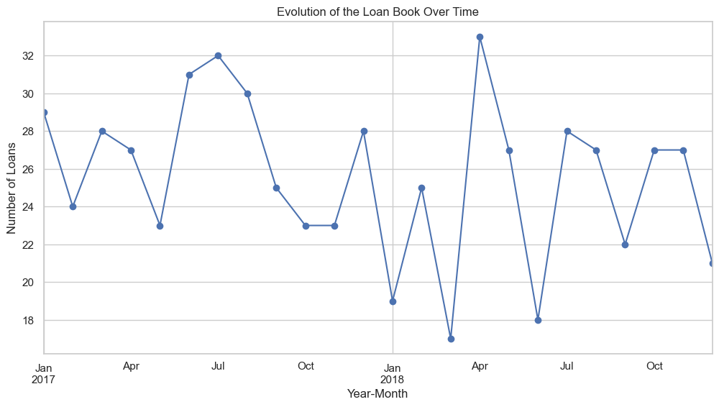
How has the loan book evolved over time?
From January 2017 to October 2018, the loan book shows a typically rising trend, suggesting an increase in the quantity of loans granted over this time
This increasing trend points to an increasing demand for loans, which may be driven by the expansion of the economy, more consumer knowledge of loan products, or changes in lending regulations
Though the overall trend is positive, there are instances of seasonality shown in the line chart, with significant declines in loan issuance in January 2018, March 2018, and June.

Slide 7
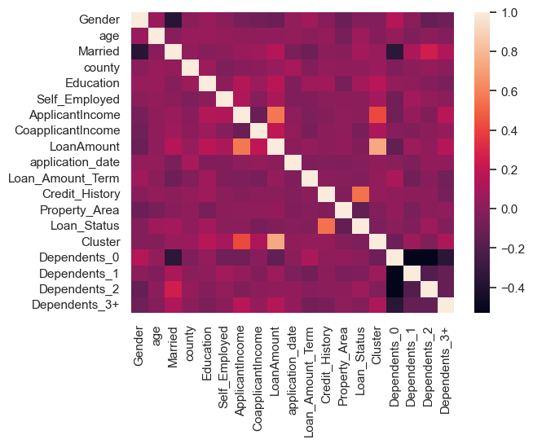
Can we identify distinct groups of borrowers?
The well-represented groups include males, graduates, high-income earners, individuals with a positive credit history, non-self-employed individuals, married individuals, and those with few dependants
Conversely, the underrepresented segments comprise females, non-graduates, low-income earners, individuals with a negative credit history, the self-employed, unmarried individuals, and those with more than three dependants
These findings shed light on the disparities in loan applications and approvals across various demographic and socioeconomic factors, highlighting the need for targeted strategies to address the unique challenges and opportunities within each group

Slide 8

Which factors predict who gets funded?
The analysis employed a logistic regression model with carefully assigned class weights to discern the factors impacting loan approvals, particularly prioritizing the under-represented class to mitigate potential bias.
With an achieved F1 score of 0.693, the model exhibits moderate accuracy in predicting loan outcomes, effectively identifying both approved and declined cases. The confusion matrix unveils 25 correct predictions of loan approval and 28 false positives.
Credit history, gender, location, education level, employment status, income level, number of dependents, and marital status are the pivotal determinants influencing the funding approval process
These factors collectively shape the outcome of loan approvals, highlighting their significance in the lending decision-making process

Slide 9
What data can we collect to improve monitoring and learning from loans?
To improve monitoring and extract meaningful insights from loans, a multimodal strategy for data collecting across multiple categories is necessary
Pre-loan data includes behavioral information like online browsing history and financial app usage, together with important application metrics like age, income, work history, education, dependents, credit history, and debt-to-income ratio
Analyzing loan performance data entails evaluating loan characteristics, service relationships, and payback measures

Slide 10

New Measures Constructed

Slide 11
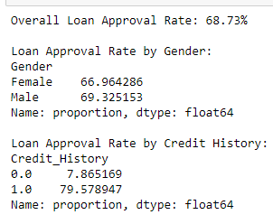
Loan approval rate
This provides valuable insights into the distribution of loan approvals by gender and credit history as well as overall
Although there is an overall favorable approval rate of 68.73%, a subtle gender gap has been identified, indicating the need for a more thorough investigation to determine the underlying causes and maintain fair lending standards
Notably, and in line with expectations, credit history turns out to be a crucial factor in loan approval. This emphasizes how important it is to keep up a good credit history and how much of an impact it has on being eligible for loans.

Slide 12
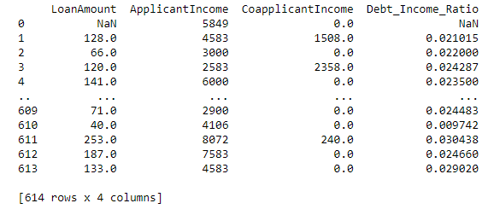
Debt-to-income ratio
This provides a thorough summary of important financial metrics, including the distribution of loan amounts, the applicant and co-applicant earnings, and the dataset's computed debt-to-income ratios
This comprehensive picture helps to shed light on the financial environment that the data captures, offering a sophisticated understanding of the financial issues associated with loan applications
Analyzing these important metrics further improves the dataset's overall understanding by providing useful information for evaluating loan applicants' financial standing and ability to handle debt

Slide 13

Credit history
The table presents a detailed overview of important statistics that shed light on several different aspects
Credit history classifications fall into two categories: "Bad" and "Good." By examining 'Loan_Amount_Term,' the average loan term variations for 'Bad' and 'Good' credit histories may be seen, as indicated by the little discrepancies between the mean values.
When looking at applicant ages, mean and median values are shown; applicants with "bad" credit histories have a mean age of 31.08, which is marginally lower than applicants with "good" credit histories, who have a mean age of 32.
The variable 'Loan_Status' displays distinct outcomes for the credit history categories labelled as 'Bad' (7.87) and 'Good' (79.58).

Slide 14
Segmentation and Groups of Interest

Slide 15

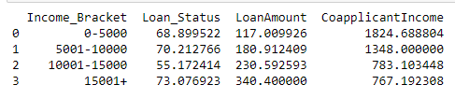
Income groups
Segments the data by income brackets and compares loan approval rates, loan amounts, and other variables across these groups.

Slide 16


Age groups
Segment the data by age brackets and compare loan status, loan amounts, and marital status across these groups

Slide 17

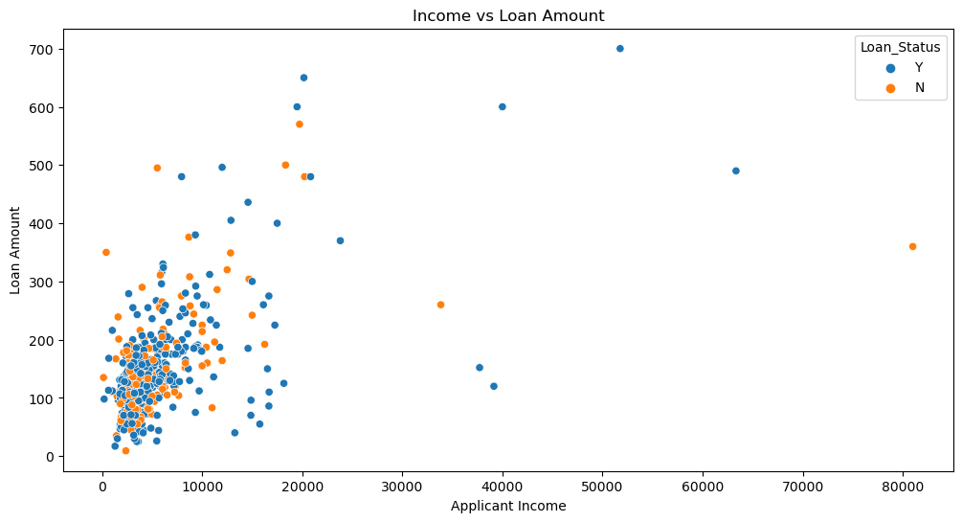
Potential Behavioral Insights
Overconfidence bias: Explores if applicants with higher incomes tend to underestimate the risk of taking on large loans.

Slide 18
Areas for Further Analysis
Predictive modeling: With additional time and resources, a machine learning model could be constructed to forecast loan approval or potential delinquency
Market Research and Competitor Analysis: With further dedicated resources, market research and competitor analysis can be done

Slide 19
Proposed New Measures
Loan purpose: including the purpose of the loan could provide valuable context for analyzing loan characteristics and repayment behavior
Employment history: information about job stability and duration could be relevant for assessing loan risk
Credit score: including credit scores would provide a more nuanced measure of creditworthiness than simply categorizing credit history

