Slide 1

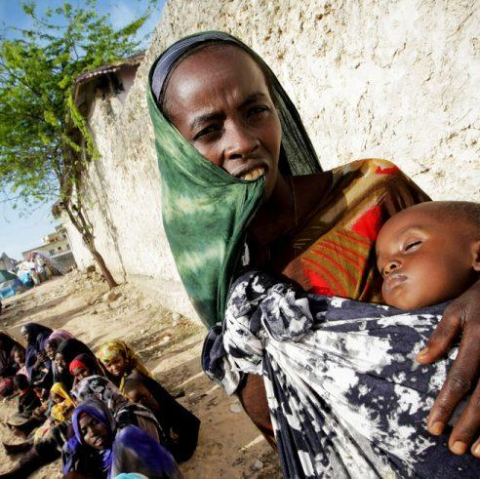
Unemployment Trends and Predictions in East African Countries

Slide 2
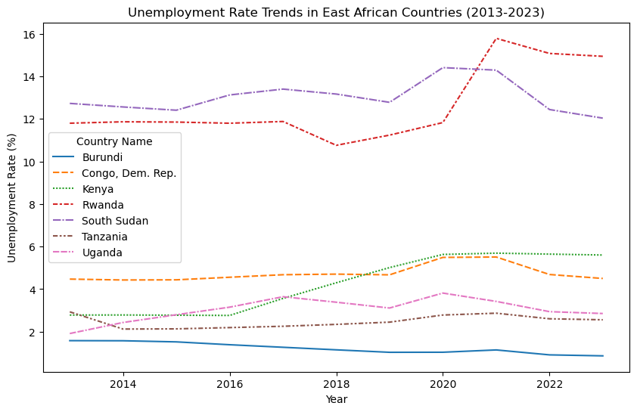
Unemployment Rate Trends in East African Countries (2013-2023)
This line graph illustrates the fluctuating unemployment rates across various East African nations. Burundi demonstrates a gradual decline in unemployment, while Congo DRC. experiences a notable increase post-2018. Kenya's rate remains stable, Rwanda's increases until approximately 2020 before declining, South Sudan sees a steady decrease, Tanzania maintains relative stability with minor fluctuations, and Uganda experiences a slight decrease.
<visualization>

Slide 3
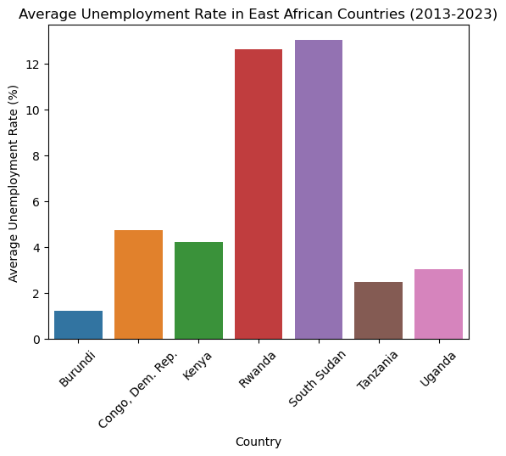
Average Unemployment Rate in East African Countries (2013-2023)
The bar graph illustrates the average unemployment rates in various East African countries from 2013 to 2023 Rwanda and South Sudan exhibit the highest average unemployment rates, nearly reaching 12%, while Burundi maintains the lowest average rate, below 2%. Congo Dem. Rep., Kenya, Tanzania, and Uganda fall between these extremes. This comparative data offers insights into the average unemployment rates over the decade, influenced by each country's economic policies, stability, and growth trajectory.
<visualization>

Slide 4
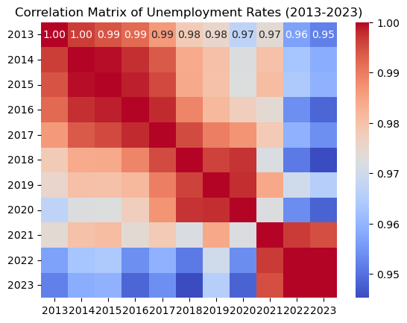
Correlation Matrix of Unemployment Rates (2013-2023
The heatmap displays a correlation matrix of unemployment rates from 2013 to 2023. Each cell shows the correlation coefficient between two years, ranging from 0.95 to 1.00. Red indicates higher correlation (closer to 1), blue lower (closer to 0.95). The diagonal line exhibits perfect correlations of 1.00, showing each year's relationship with itself. This matrix offers insights into how unemployment rates across different years correlate, with higher coefficients suggesting similar patterns and lower ones indicating differences.
<visualization>

Slide 5
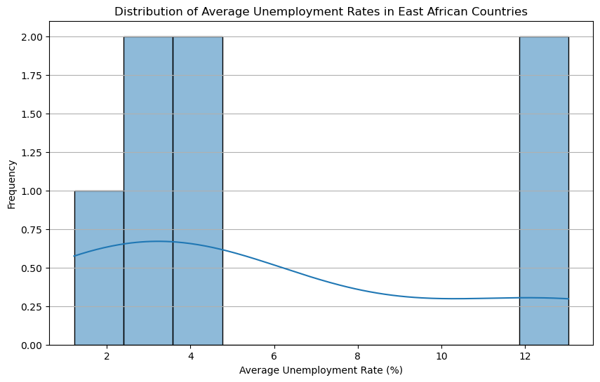
Distribution of Average Unemployment Rates
This graph shows the distribution of the average unemployment rates. The peak of the distribution curve at around the 4% unemployment rate suggests that most of the countries had an average unemployment rate close to 4%. The width of the distribution gives an idea of the variability of the unemployment rates, with a wider distribution indicating greater variability.
<visualization>

Slide 6
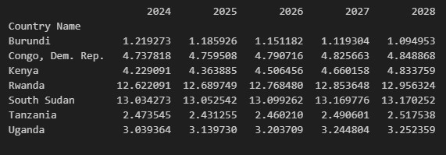
Predicted Unemployment Rates (2024-2028)
The image outlines predicted unemployment rates for the next five years across various East African countries. While Burundi expects a decline from 1.219273 in 2024 to 1.094953 in 2028, other nations such as Congo, Dem. Rep., Kenya, Rwanda, South Sudan, Tanzania, and Uganda anticipate increases. However, it's crucial to note that these are projections, and actual rates may diverge due to numerous influencing factors.
<visualization>

Slide 7



Key Takeaways
Historical Trends: Unemployment rates varied significantly among East African countries from 2013 to 2023. Some countries experienced an increase in unemployment rates, while others saw a decrease.
Predictions for 2024-2028: Our model predicts that all countries, except Burundi, will see an increase in unemployment rates over the next few years. Burundi is predicted to see a decrease in unemployment rates.
Implications: These trends and predictions provide valuable insights for policymakers, businesses, and individuals in these countries. They highlight the need for targeted interventions to address unemployment and its underlying causes.

Slide 8

Next Steps
Policy Recommendations: Based on these findings, we recommend that each country develop tailored strategies to address their unique unemployment challenges
Further Research: More research is needed to understand the specific factors driving these unemployment trends and to refine our predictions

