Slide 1
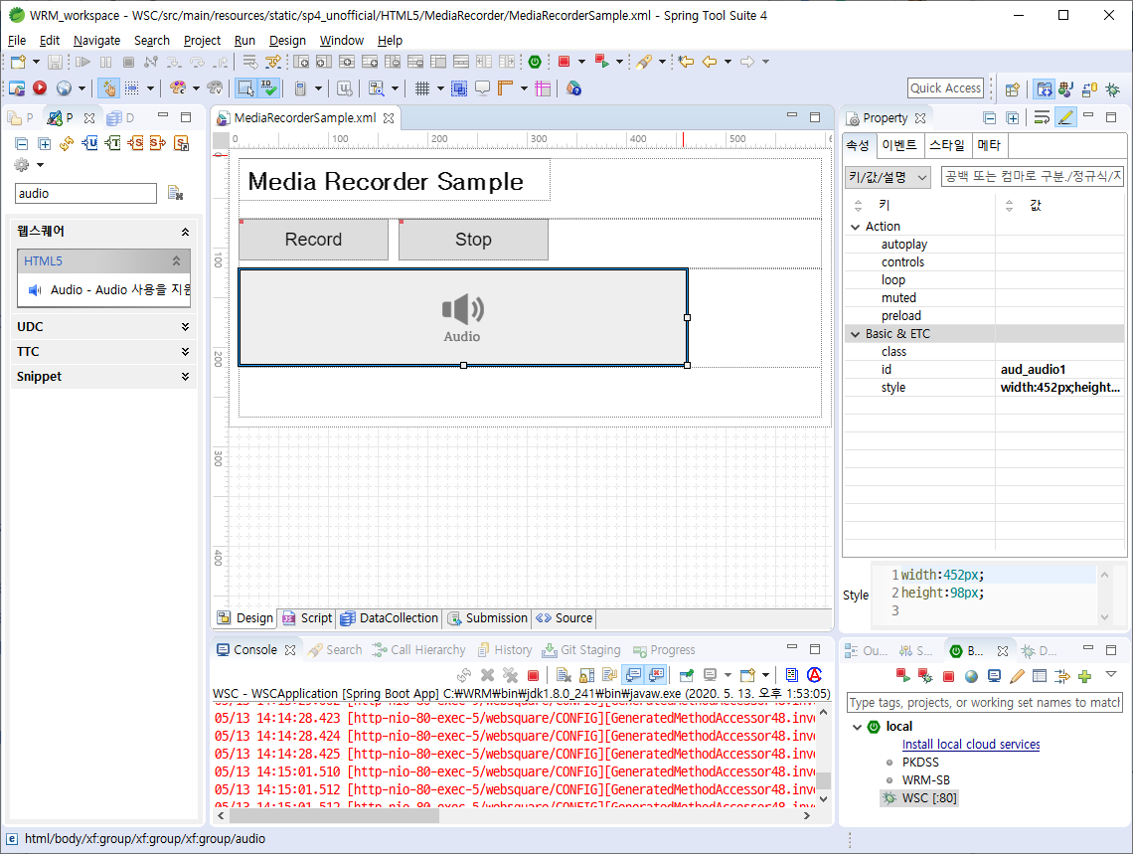
textbox
trigger(id: btn_record)
trigger(id : btn_stop)
audio(id: aud_audio1)

