Slide 1
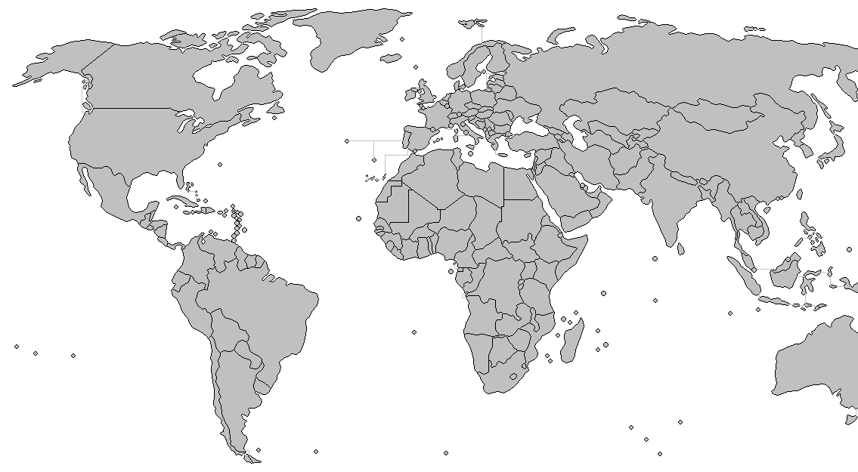

Slide 2
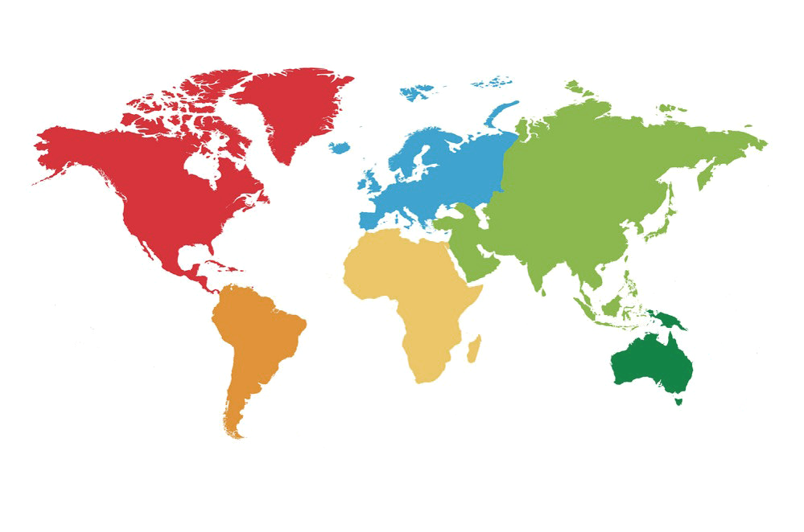

Client
L2
...
L1
L1
...
L0
L0
(a) Geographically Top View
of HGFRR Topology
(b) Hierarchical View of HGFRR Structure

Slide 7
Adapter
Consensus
PoX
... ...
Blockchain Layer
Facade
Structure
Maintainer
Disseminator
Peer Locator
Overlay Network
Layer
Wire Protocol
Socket
OS Layer

Slide 8
1
0
0
2
9
3
1
2
4
8
4
3
5
9
6
8
5
7
7
6
(a)
(b)

Slide 11
Adapter
Consensus
PoX
... ...
Blockchain Layer
Facade
Structure
Maintainer
Disseminator
Peer Locator
Overlay Network
Layer
Wire Protocol
Socket
OS Layer

