Slide 1
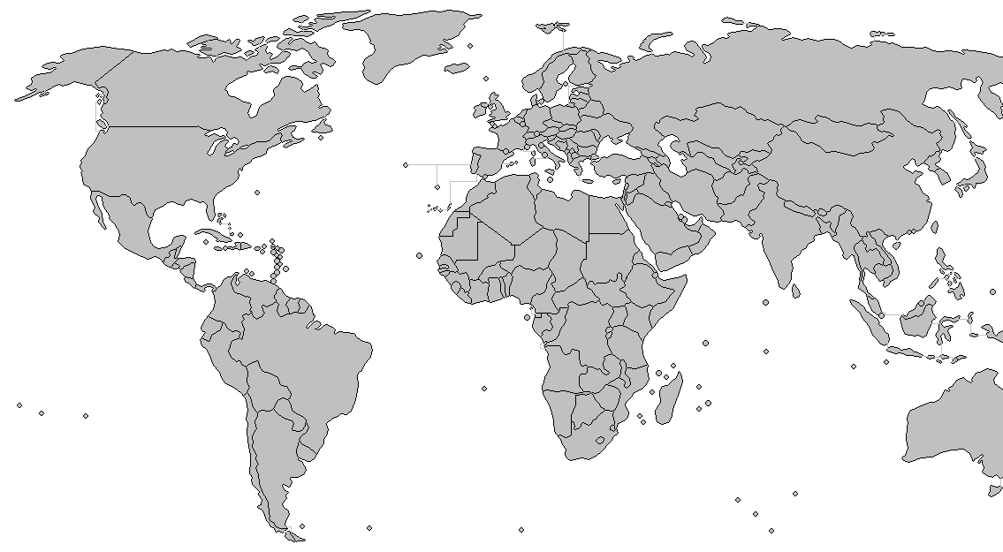

Slide 5
Adapter
Consensus
PoX
... ...
Blockchain Layer
Facade
Structure
Maintainer
Disseminator
Peer Locator
Overlay Network
Layer
Wire Protocol
Socket
OS Layer

Slide 6
1
0
0
2
9
3
1
2
4
8
4
3
5
9
6
8
5
7
7
6
(a)
(b)

Slide 10
Adapter
Consensus
PoX
... ...
Blockchain Layer
Facade
Structure
Maintainer
Disseminator
Peer Locator
Overlay Network
Layer
Wire Protocol
Socket
OS Layer

