Slide 1
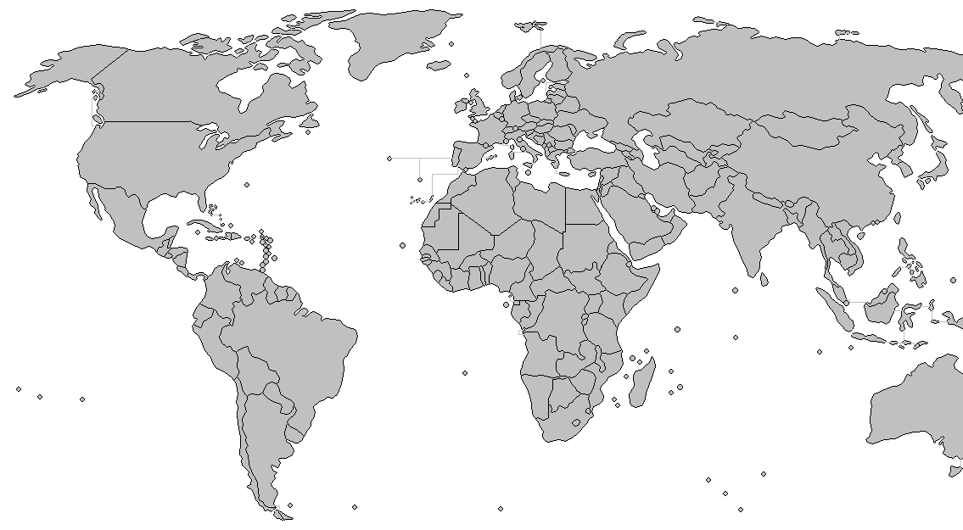

Slide 2

Client
L2
...
L1
L1
...
L0
L0
(a) Geographically Top View
of HGFRR Topology
(b) Hierarchical View of HGFRR Structure

Slide 3
...

Slide 4
Ln+1 Contact Nodes & Ln+2 Normal Nodes
Ln Normal Nodes
Ln Contact Nodes & Ln+1 Normal Nodes
Ln+1 Contact Nodes & Ln+2 Normal Nodes
9
8
7
1
6
Ln+1
2
5
3
4
1
5
8
2
4
7
Ln
3
6
9

Slide 5
Ln Normal Nodes
Ln Contact Nodes & Ln+1 Normal Nodes
Ln+1 Contact Nodes & Ln+2 Normal Nodes
Ln+2 Contact Nodes

Slide 6
Ln Normal Nodes
Ln Contact Nodes & Ln+1 Normal Nodes
Ln+1 Contact Nodes & Ln+2 Normal Nodes
Ln+2 Contact Nodes
③
②
①

Slide 7
Ln Normal Nodes
Ln Contact Nodes & Ln+1 Normal Nodes
Ln+1 Contact Nodes & Ln+2 Normal Nodes
Ln+2 Contact Nodes
①
③
②

Slide 8
Ln Normal Nodes
Ln Contact Nodes & Ln+1 Normal Nodes
Ln+1 Contact Nodes & Ln+2 Normal Nodes
Ln+2 Contact Nodes
①
③
①
①
③
③
②
②
②

Slide 9
Ln Normal Nodes
Ln Contact Nodes & Ln+1 Normal Nodes
Ln+1 Contact Nodes & Ln+2 Normal Nodes
Ln+2 Contact Nodes

Slide 10
L0 Normal Nodes
L0 Contact Nodes/L1 Normal Nodes
L1 Contact Nodes/L2 Normal Nodes

Slide 11
L0 Normal Nodes
L0 Contact Nodes/L1 Normal Nodes
L1 Contact Nodes/L2 Normal Nodes

Slide 12
Normal Nodes
Level 0 Contact Nodes
Level 1 Contact Nodes
Level 2 Contact Nodes

Slide 15
Normal Nodes
Level 1 Contact Nodes
Level 0 Contact Nodes
Level 2 Contact Nodes

Slide 21
Adapter
Consensus
PoX
... ...
Blockchain Layer
Facade
Structure
Maintainer
Disseminator
Peer Locator
Overlay Network
Layer
Wire Protocol
Socket
OS Layer

Slide 22
1
0
0
2
9
3
1
2
4
8
4
3
5
9
6
8
5
7
7
6
(a)
(b)

Slide 25
Adapter
Consensus
PoX
... ...
Blockchain Layer
Facade
Structure
Maintainer
Disseminator
Peer Locator
Overlay Network
Layer
Wire Protocol
Socket
OS Layer

