Slide 1

Responsive Storage: Home Automation for Research Data Management
Ryan Chard, Kyle Chard, Jason Alt, Dilworth Y. Parkinson, Steve Tuecke, and Ian Foster
Argonne National Lab, University of Chicago, and Lawrence Berkeley National Lab

Slide 2

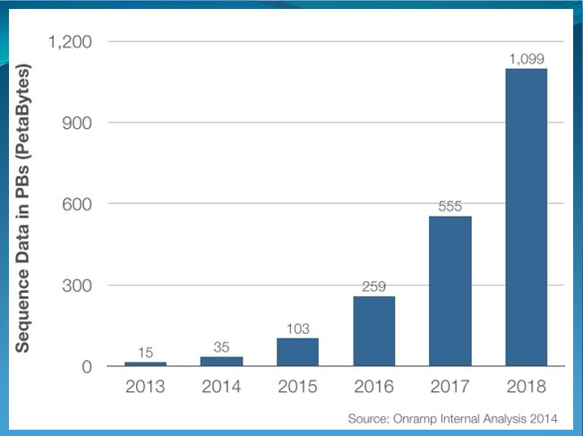

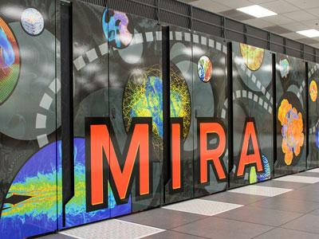
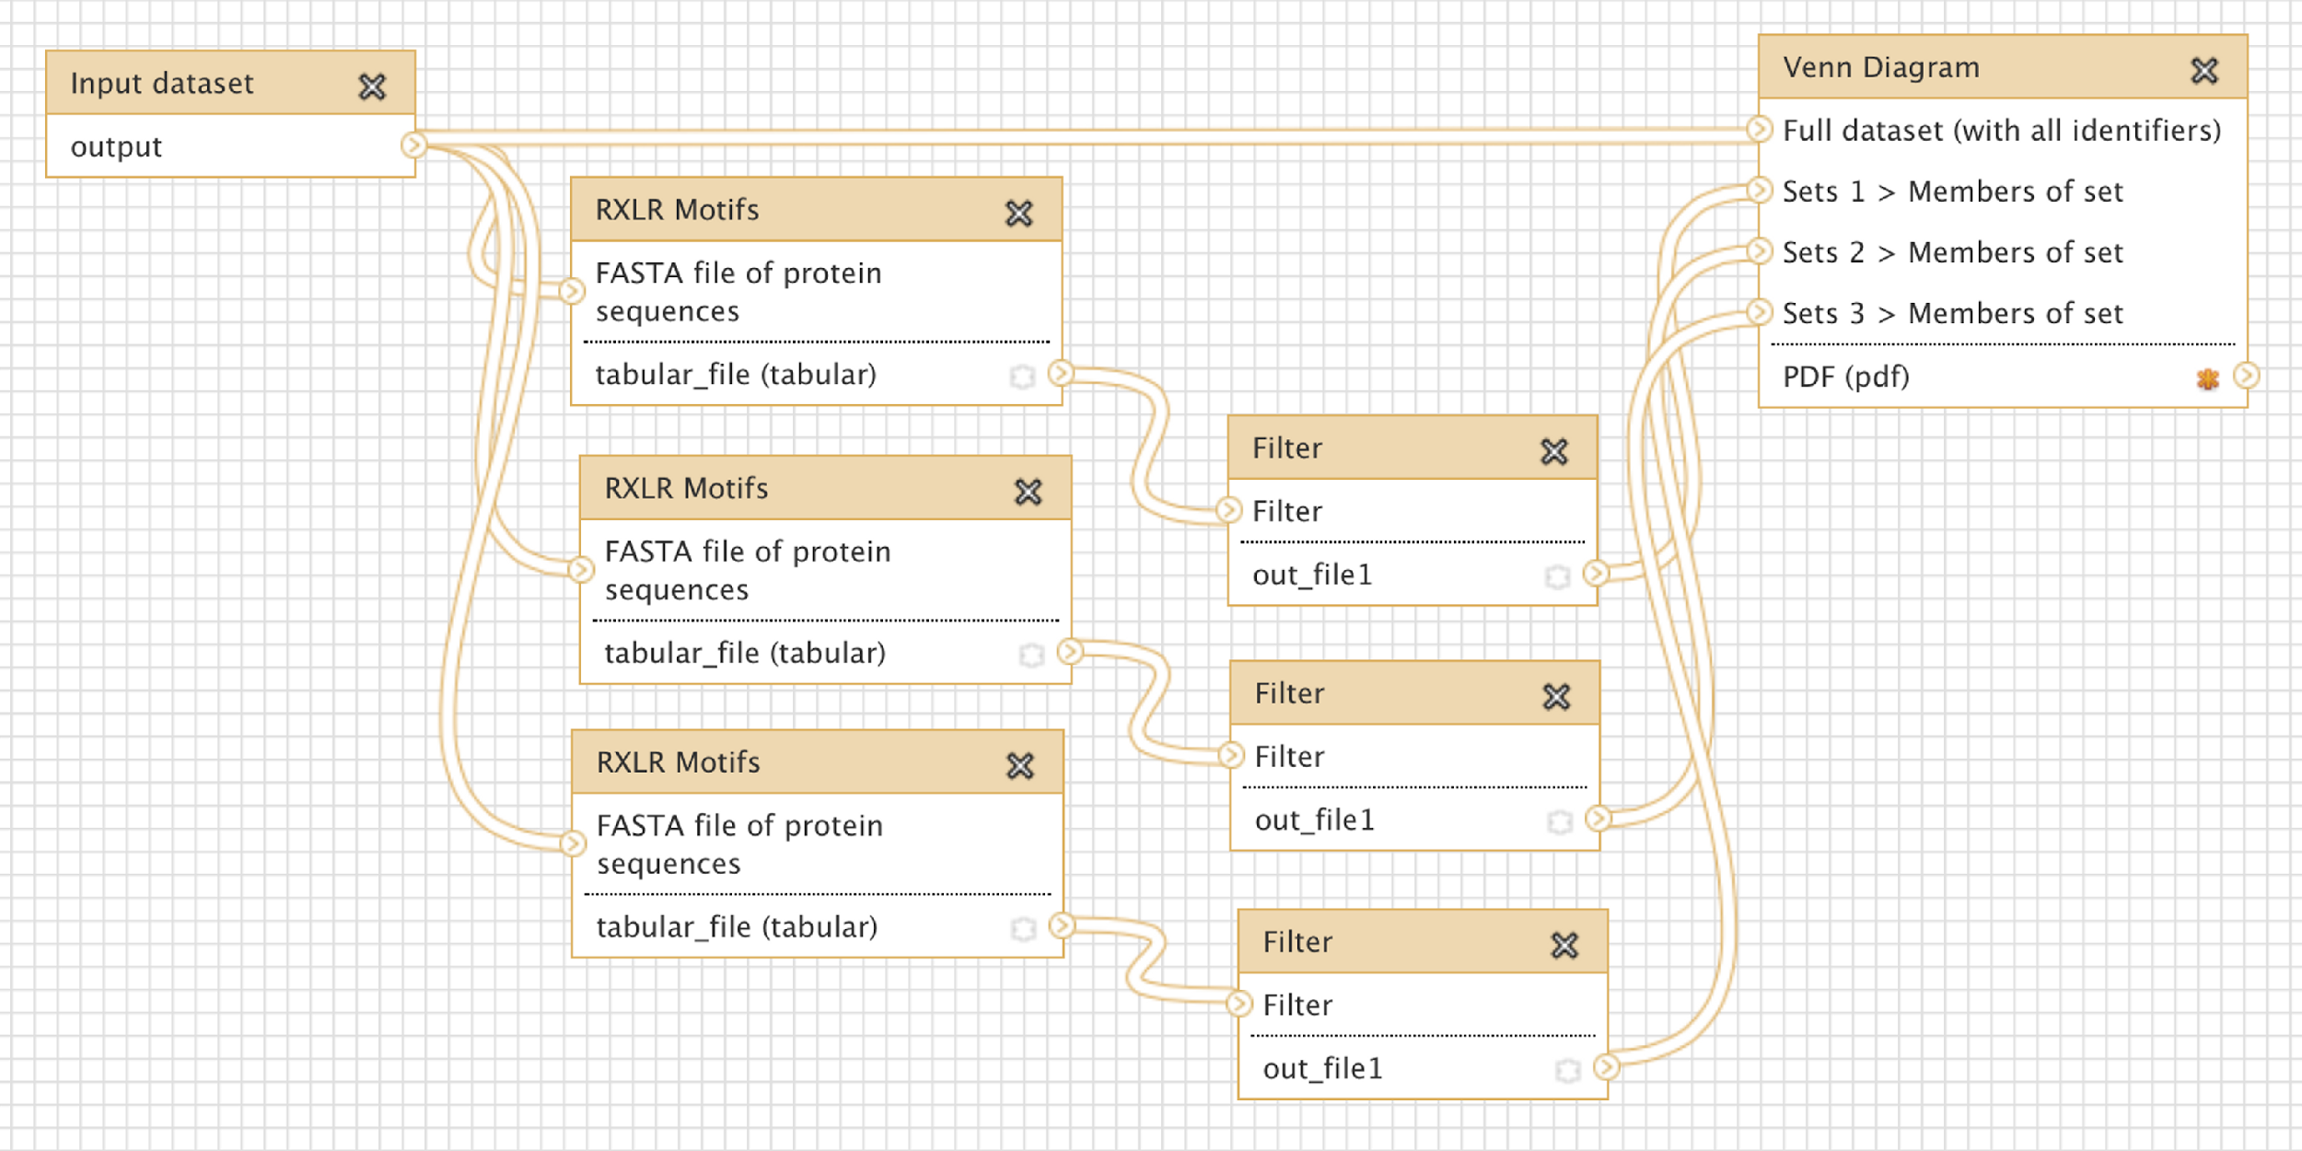

The Problem
Data generation rates are exploding
Complex analytics processes
The data lifecycle often involves multiple organisations, machines, and people
This creates a significant strain on researchers
Best management practices (cataloguing, sharing, purging, etc.) can be overlooked
Useful data may be lost, siloed, or forgotten
Notes:
Due to the size of datasets, analytics require hpc modalities MapReduce, MPI, etc. which are complicated
Also requires workflow systems, and HPC resources
Data management can be the missing peice

Slide 3
RIPPLE: A prototype responsive storage solution
Transform static data graveyards into active, responsive storage devices
Automate data management processes and enforce best practices
Reliable event-driven execution
Users focused: simple if-trigger-then-action rules
Accessible to all end users, not just admins and expert users
Users can set data management policies and then forget about them
Combine rules into flows to control end-to-end data transformations
Passively waits for filesystem events (very little overhead)
Filesystem agnostic – works on both edge and leadership platforms
Notes:
Ripple: our prototype
Give control back to users – make a note of the simplicity being targeted at non-technical users
Event based: every action happens in response to some triggering event. Create/delete/transfer/rule completion

Slide 4


RIPPLE Architecture (updated)
Service:
Serverless architecture
Lambda functions process events
Orchestrates execution of actions
Records and manages execution of flows
Agent:
Sits locally on the machine
Detects & filters filesystem events
Facilitates execution of actions
Can receive new recipes
Lambda Functions
Ripple Agent
Ripple
Runner
SQLite
Monitor
Process
Docker,
PBS,
SLURM,
…
Observers
SQS Queue of events
Filesystem
Ripple Cloud API
Notes:
Two main parts: an agent on a device monitoring for events, and a cloud service processing them
There is also a job runner, which is “coupled” with the agent, but can be run indepently

Slide 5
RIPPLE Agent
Ripple Agent
SQLite
Monitor
Process
Responsible for detecting and reporting events of interest
Filesystem agnostic – uses an appropriate monitor for the FS
Leverages Python Watchdog observers
inotify, polling, kqueue, etc.
Globus Transfer API detects globus events (transfer, create, delete)
Rules are retrieved from the cloud service and stored in an SQLite database
Hybrid filtering model:
Local monitor checks events against active rules
If they match, they are reported to the cloud for processing
Observers
Filesystem

Slide 6
RIPPLE Runner
Abstracts execution environments and allows job submission/status checks via API
Has a UUID and polls for actions – rules can invoke actions on any runner
Can be deployed almost anywhere:
Locally initiate Docker containers, singularity exec commands, and subprocesses to act on local files (metadata extraction, dispatch jobs, etc.)
Cloud runner (backed by Lambda functions) performs cloud functions: Globus transfers, create shared endpoints, send emails, invoke other Lambda functions etc. This functions an API gateway exposing the runner API and proxying requests through to Lambdas
HPC systems employ a runner for exposed batch submission (currently just SLURM)
Ripple
Runner
Docker,
PBS,
SLURM,
…

Slide 7
RIPPLE Cloud Service
Lambda Functions
Gateway API exposes Ripple service
Get rules
Report events
Update event status
API either proxies Lambda functions (get rules) or inserts payload into SQS queue.
Once an event reaches the SQS, it should not be lost
SQS queue reports to SNS topic, triggering Lambda functions to pull from the queue
Dead letter queue after 3 processing failures
CloudWatch timer triggers “cleanup” and “checkup” functions to process events still on the queue and outstanding jobs
SQS Queue of events
Ripple Cloud API

Slide 8

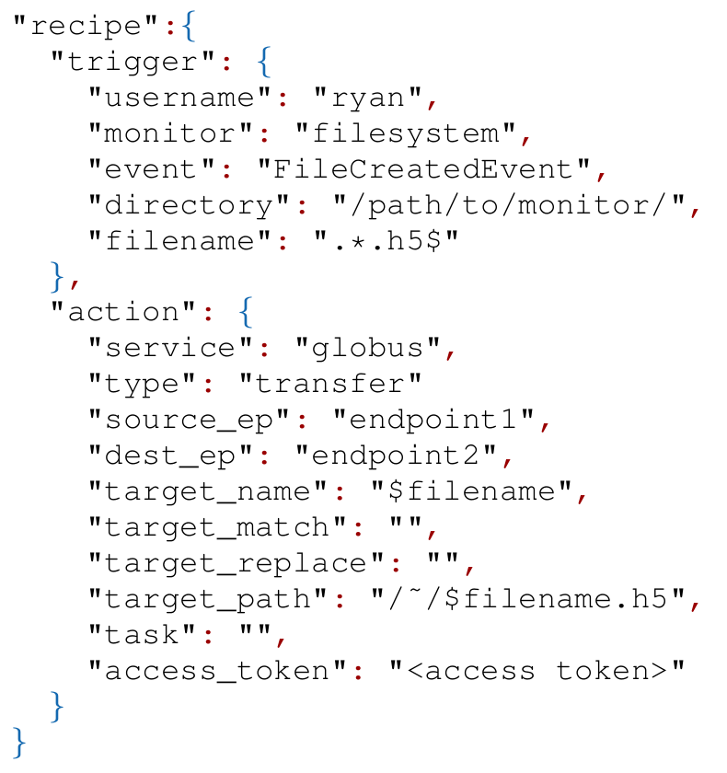
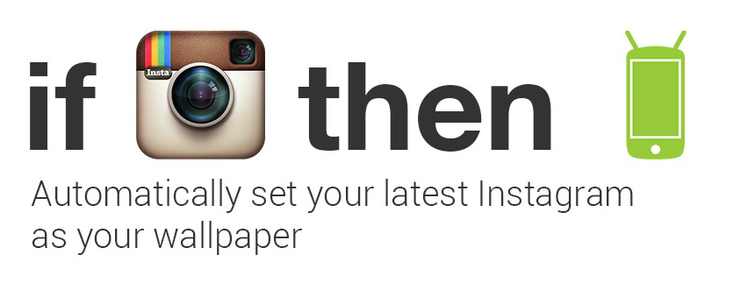
RIPPLE Rules
IFTTT-inspired programming model:
Triggers describe where the event is coming from (filesystem create events) and the conditions to match (/path/to/monitor/.*.h5)
Actions describe what service to use (e.g., globus transfer) and arguments for processing (source/dest endpoints).
Notes:
Targets allow you to act on another file – uses regex to match new expression
$filename etc. is just string templating and are resolved by the runner

Slide 9
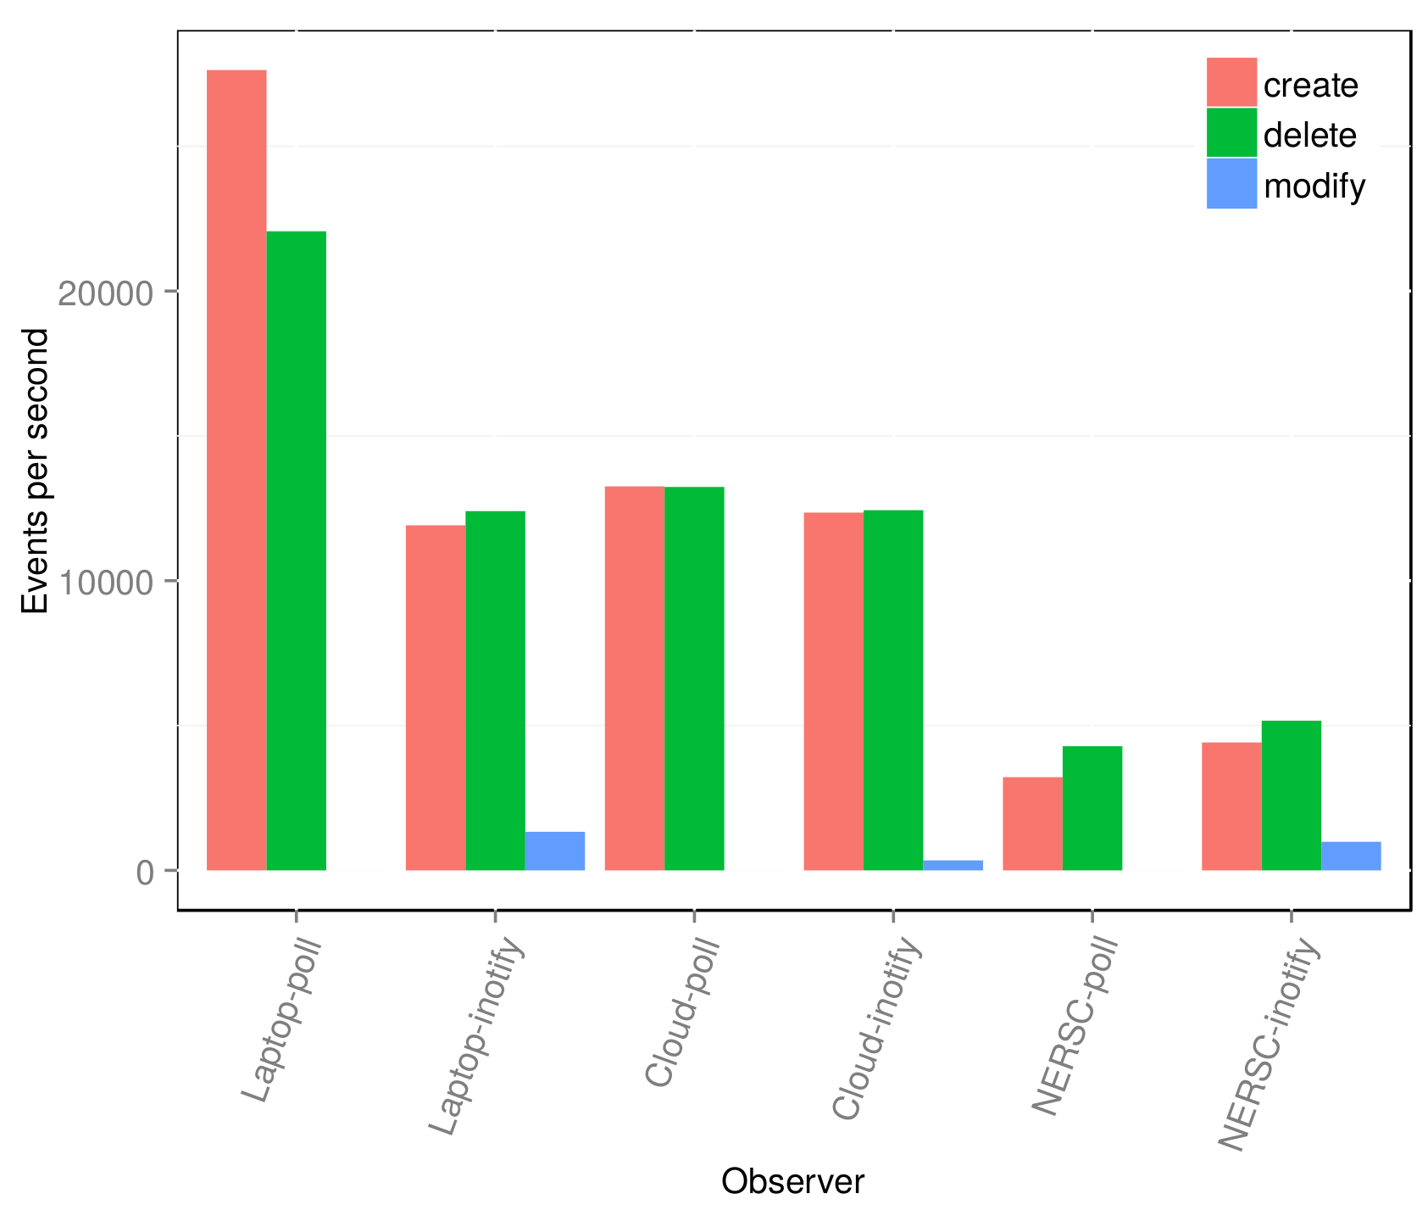
Event Detection
Goal: be able to monitor HPC storage workload (>3 mil events/day)
Inotify vs polling
Create/touch/delete 10,000 files and record event reporting duration (20k total)
Machines:
Laptop
c4.xlarge instance
Edison login node (gpfs)
Notes:
Surveyed NERSC 7.1PB store: has approx this. (~40 events per second)
10,000 file touches creates 20k events.
modifications are performed on a single file (this may not be ideal looking back at it. Touching many files gave a much greater number)
Problem is inotify can’t be deployed on it and polling would take a long time

Slide 10
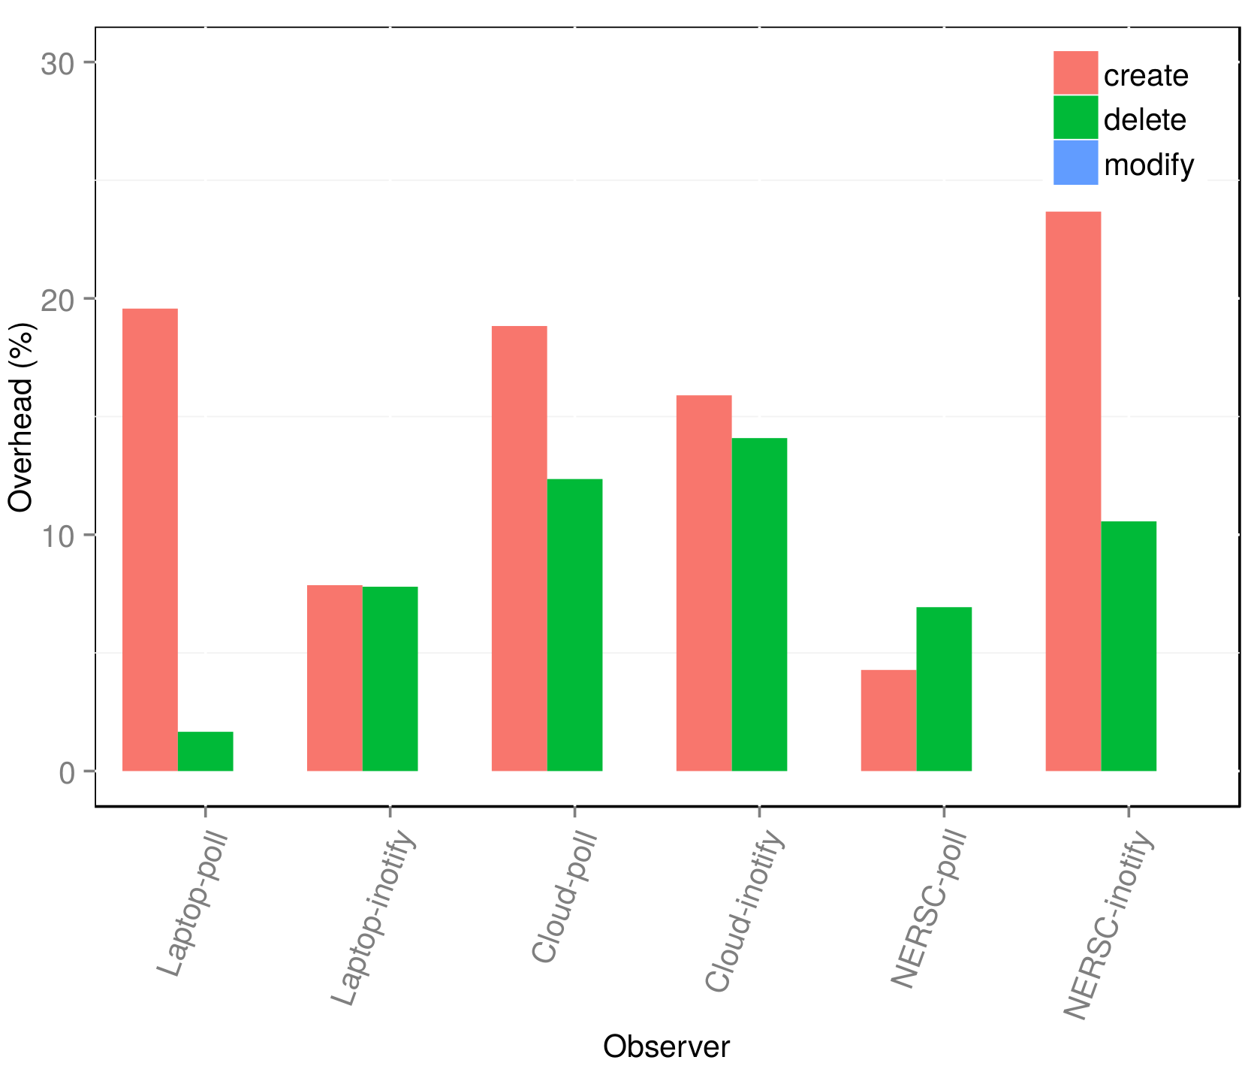
Filtering overhead
Goal: Determine overhead caused by filtering events locally
Measure differences in event/second detection
Filtering requires matching directory path and file extension
Polling is odd as it only polls once every second
Notes:
polling results are difficult as it only polls once every second
At most a 25% overhead, so still > 10,000 events per second.
Not too sure how to handle backlog if that starts happening. Would need to distribute monitors and filteringover multiple nodes.

Slide 11
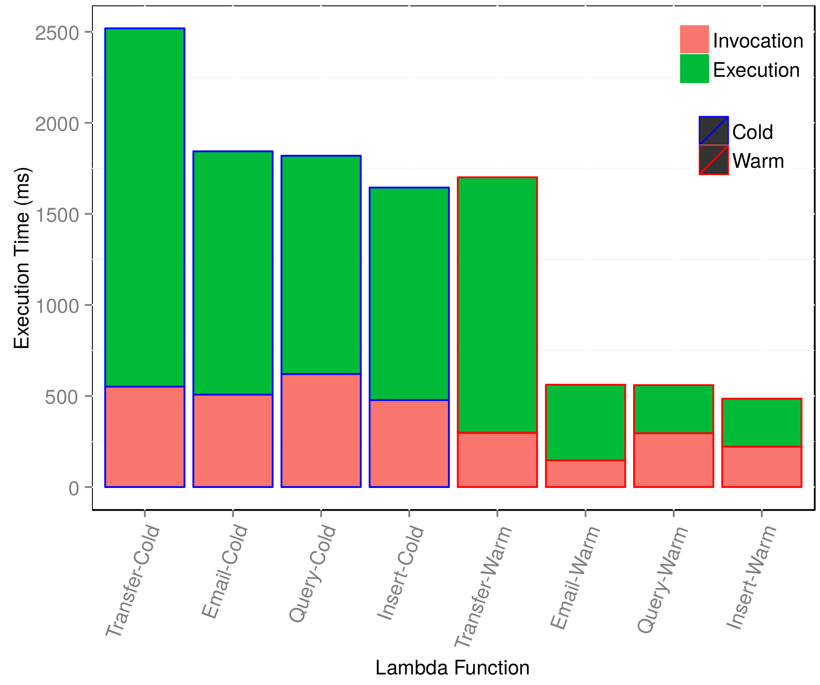
Lambda Performance
Goal: Understand lambda performance for different tasks
Cold vs Warmed functions
Actions:
Globus transfer
SMS email
DynamoDB insert/query
Transfers require a handshake with the Globus service, which also communicates with the endpoints

Slide 12
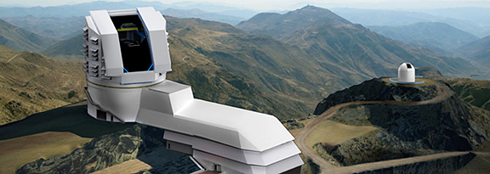


Use Case: Large Synoptic Survey Telescope
Developed a representative testbed of the LSST storage requirements
Automatically propagate data between storage tiers and facilities
Invoke Docker containers to extract metadata and maintain a file catalog
Compress and archive files
Recover deleted/corrupted files when delete and modification events occur
1.
Archiver
Custodial Store (Chile)
Custodial Store (NCSA)
Forwarder
2.
Landing
6.
Landing
3.
4.
Magnetic
Magnetic
7.
File Catalog
metadata
minid
gzip
catalog
....
Archive
File Catalog
Archive: ANL’s Sparrow
Notes:
Background: LSST intends to have two “custodial stores” – full replicas. Anything in 1 should be in the other. Files created in 1 must appear in the other within X hours.
Docker containers create a minid for a file (UUID)

Slide 13



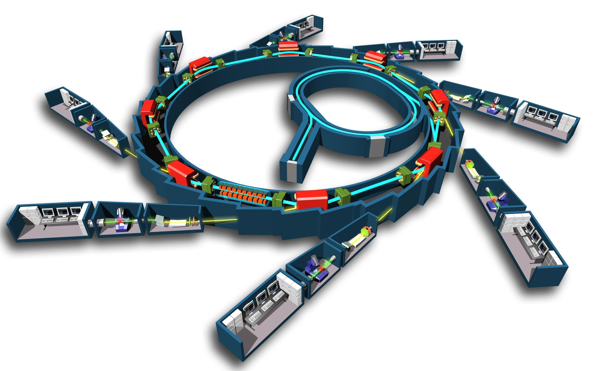
Use Case: Advanced Light Source
Deployed Ripple on an ALS and NERSC machine to automate data analysis
At ALS: Detect new heartbeat beamline data and initiate transfer to NERSC
At NERSC: Extract metadata, create sbatch file, dispatch analysis job to Edison queue, detect result and transfer back to ALS
At ALS: create a shared endpoint, notify collaborators of result via email

Slide 14
New Use Cases
Automated metadata extraction and ingestion into Globus Search
Uses singularity and Apache Tika to extract metadata
Metadata is wrapped into gmeta (json) documents and ingested into search
Offline feedback mechanism for workflows
Researchers want a human quality control component
Have Ripple send subsets of data to researchers via email to check it
Trigger actions based on content of reply messages

Slide 15
Summary
Event-driven automation of data management practices
User focused
Monitoring agent agnostic to underlying filesystem
Serverless event processing and action orchestration

Slide 16
Future Work
More use cases!
More runners
Scalable & high performance event monitors for leadership resources
Programming model for event-based data management
Integration with Globus

