Slide 1





Improving Application Migration to Serverless Computing Platforms: Latency Mitigation with Keep-Alive Workloads
Minh Vu#, Baojia Zhang#, Olaf David, George Leavesley, Wes Lloyd¹
December 20, 2018
School of Engineering and Technology, University of Washington, Tacoma, Washington USA
WOSC 2018: 4th IEEE Workshop on Serverless Computing (UCC 2018)

Slide 2
Outline
Background
Research Questions
Experimental Workloads
Experiments/Evaluation
Conclusions

Slide 3
Serverless Computing
Pay only for CPU/memory utilization
High Availability
Fault Tolerance
Infrastructure Elasticity
No Setup
Function-as-a-Service (FAAS)

Slide 4
Serverless Computing
Why Serverless Computing?
Many features of distributed systems, that are challenging to deliver, are provided automatically
…they are built into the platform

Slide 5
Serverless Platforms
AWS Lambda
Azure Functions
Commercial
IBM Cloud Functions
Google Cloud Functions
Apache OpenWhisk
Open Source
Fn (Oracle)

Slide 6
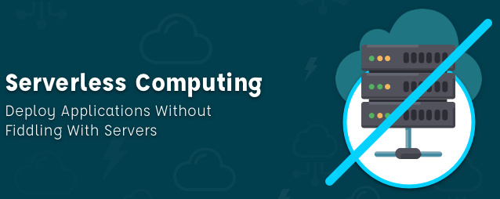
Serverless Computing
Research Challenges
Image from: https://mobisoftinfotech.com/resources/blog/serverless-computing-deploy-applications-without-fiddling-with-servers/

Slide 7
Serverless Computing Research Challenges
Memory reservation
Infrastructure freeze/thaw cycle
Vendor architectural lock-in
Pricing obfuscation
Service composition

Slide 8

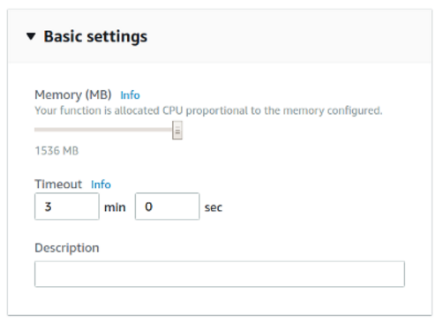

Memory Reservation Question…
Lambda memory reserved for functions
UI provides “slider bar” to set function’s memory allocation
Resource capacity (CPU, disk, network) coupled to slider bar: “every doubling of memory, doubles CPU…”
But how much memory do model services require?
Performance

Slide 9
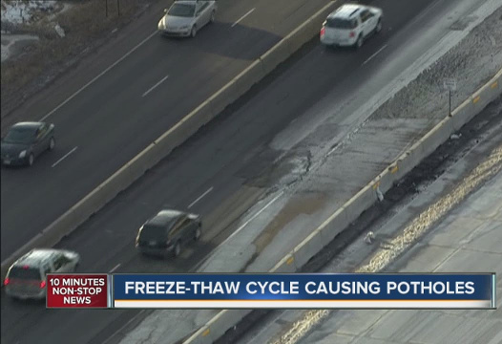
Infrastructure Freeze/Thaw Cycle
Unused infrastructure is deprecated
But after how long?
AWS Lambda: Bare-metal hosts, firecracker micro-VMs
Infrastructure states:
Provider-COLD / Host-COLD
Function package built/transferred to Hosts
Container-COLD (firecracker micro-VM)
Image cached on Host
Container-WARM (firecracker micro-VM)
“Container” running on Host
Performance
https://firecracker-microvm.github.io/
Image from: Denver7 – The Denver Channel News

Slide 10
Outline
Background
Research Questions
Experimental Workloads
Experiments/Evaluation
Conclusions

Slide 11
Research Questions
RQ1:
RQ2:
PERFORMANCE: What are the performance implications for application migration? How does memory reservation size impact performance when coupled to CPU power?
SCALABILITY: For application migration what performance implications result from scaling the number of concurrent clients? How is scaling affected when infrastructure is allowed to go cold?

Slide 12
Research Questions - 2
RQ3:
RQ4:
COST: For hosting large parallel service workloads, how does memory reservation size, impact hosting costs when coupled to CPU power?
PERSISTING INFRSASTRUCTURE: How effective are automatic triggers at retaining serverless infrastructure to reduce performance latency from the serverless freeze/thaw cycle?

Slide 13
Outline
Background
Research Questions
Experimental Workloads
Experiments/Evaluation
Conclusions

Slide 14
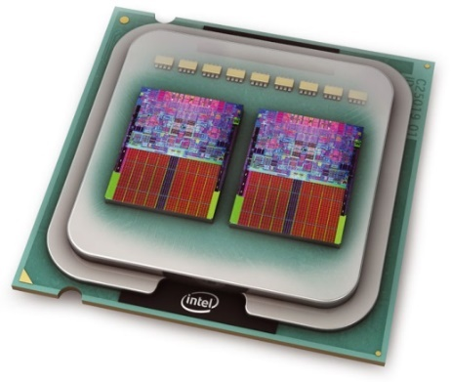

AWS Lambda PRMS Modeling Service
PRMS: deterministic, distributed-parameter model
Evaluate impact of combinations of precipitation, climate, and land use on stream flow and general basin hydrology (Leavesley et al., 1983)
Java based PRMS, Object Modelling System (OMS) 3.0
Approximately ~11,000 lines of code
Model service is 18.35 MB compressed as a Java JAR file
Data files hosted using Amazon S3 (object storage)
Goal: quantify performance and cost implications of memory reservation size and scaling for model service deployment to AWS Lambda

Slide 15

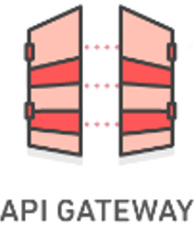


PRMS Lambda Testing
REST/JSON
Images credit: aws.amazon.com
Client: c4.2xlarge or c4.8xlarge (8 core) (36 core)
PRMS service
BASH: GNU Parallel
Multi-thread client script “partest”
Max service duration: < 30 seconds
Fixed-availability zone:
EC2 client / Lambda server
us-east-1e
Up to 100 concurrent
synchronous requests
Memory: 256 to 3008MB
Results of each thread traced individually

Slide 16
PRMS Lambda Testing - 2
REST/JSON
Images credit: aws.amazon.com
Client: c4.2xlarge or c4.8xlarge (8 core) (36 core)
PRMS service
Automatic Metrics Collection⁽¹⁾:
New vs. Recycled Containers/VMs
Container Identification UUID → /tmp file
# of requests per container/VM
Avg. performance per container/VM
VM Identification btime → /proc/stat
⁽¹⁾ Lloyd, W., Ramesh, S., Chinthalapati, S., Ly, L., & Pallickara, S. (April 2018). Serverless computing: An investigation of factors influencing microservice performance. In Cloud Engineering (IC2E), 2018 IEEE International Conference on (pp. 159-169). IEEE.
Avg. performance workload
Standard deviation of requests per container/VM
Linux CPU metrics

Slide 17
Outline
Background
Research Questions
Experimental Workloads
Experiments/Evaluation
Conclusions

Slide 18
RQ-1: Performance
Infrastructure What are the performance implications of memory reservation size ?

Slide 19
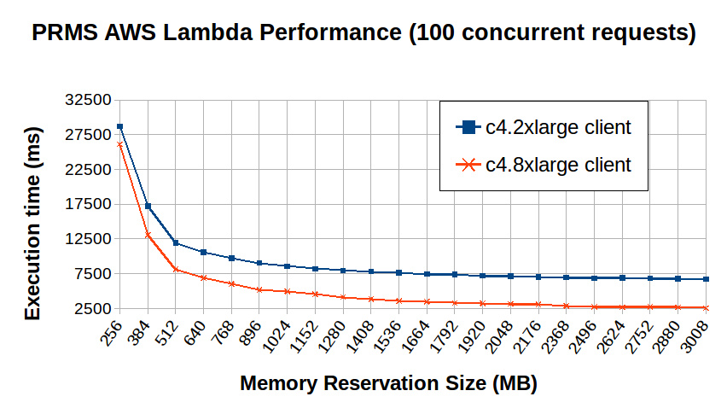
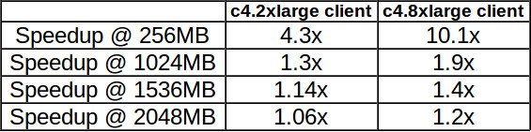
RQ-1: AWS Lambda Memory Reservation Size
Memory Speedup (256 → 3008 MB):
4.3 X 8-vCPU client 10.1 X 36-vCPU client
c4.2xlarge – average of 8 runs

Slide 20
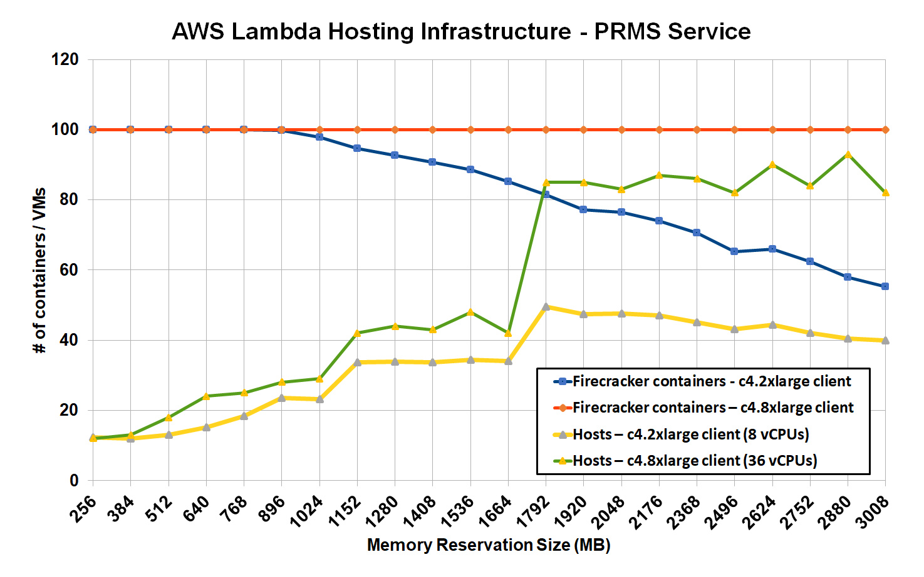
RQ-1: AWS Lambda Memory Reservation Size - Infrastructure
Many more Hosts leveraged when memory > 1536 MB
8 vCPU client struggles to generate 100 concurrent requests >= 1024MB
c4.2xlarge – average of 8 runs

Slide 21
RQ-2: Scalability
How does performance change when increasing the number of concurrent users ? (scaling-up, totally cold, and warm)

Slide 22
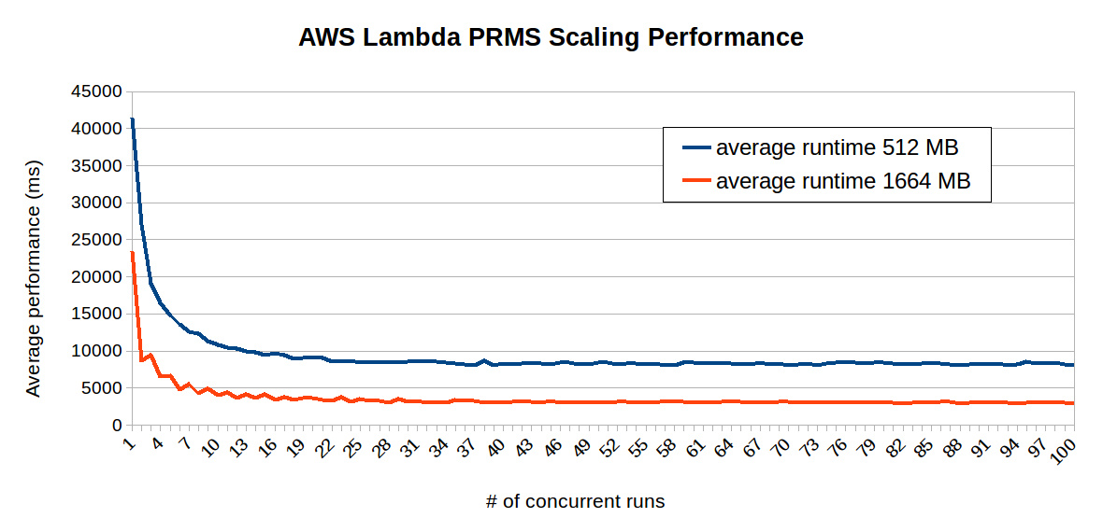
RQ-2: AWS Lambda PRMS Scaling Performance
W When slowly increasing the number of clients, performance stabilizes after ~15-20 concurrent clients.
C4.8xlarge 36 vCPU client

Slide 23
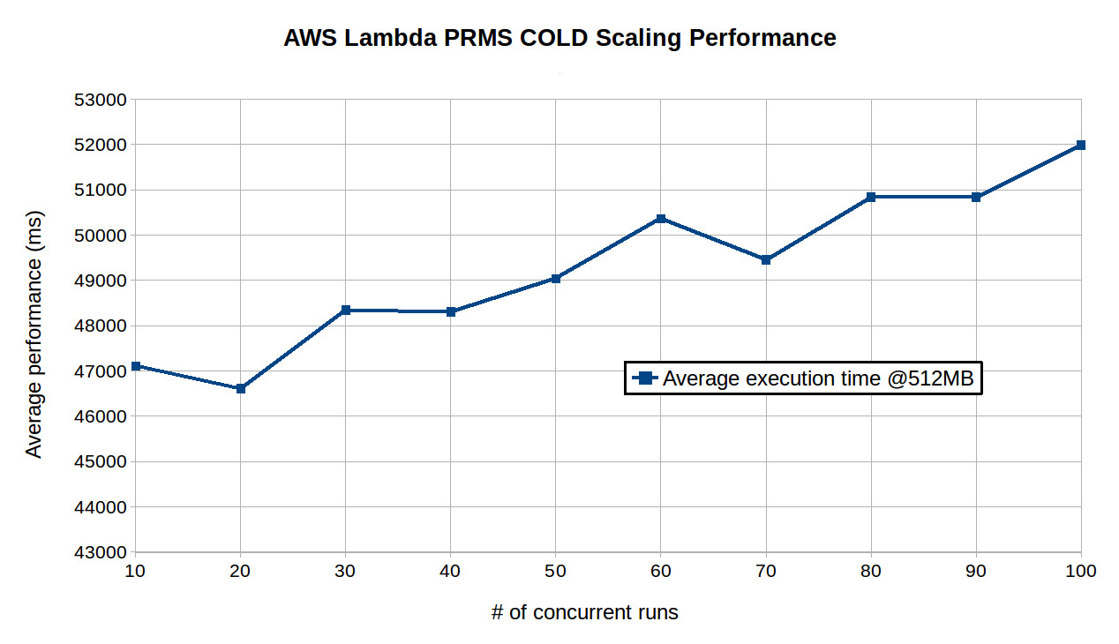
RQ-2: AWS Lambda Cold Scaling Performance
To Do:
@1664MB Cold Scaling Test
@3008MB Cold Scaling Test (estimate ~16sec initialization) @3008MB model execution is 3.1x faster than @512MB, is initialization ??

Slide 24
RQ-3: Cost
What are the costs of hosting PRMS using a FaaS platform in comparison to IaaS?

Slide 25
RQ-3: IaaS (EC2) Hosting Cost 1,000,000 PRMS runs
Using a 2 vCPU c4.large EC2 VM
2 concurrent client calls, no scale-up
Estimated time: 347.2 hours, 14.46 days
Assume average exe time of 2.5 sec/run
Hosting cost @ 10¢/hour = $34.72

Slide 26
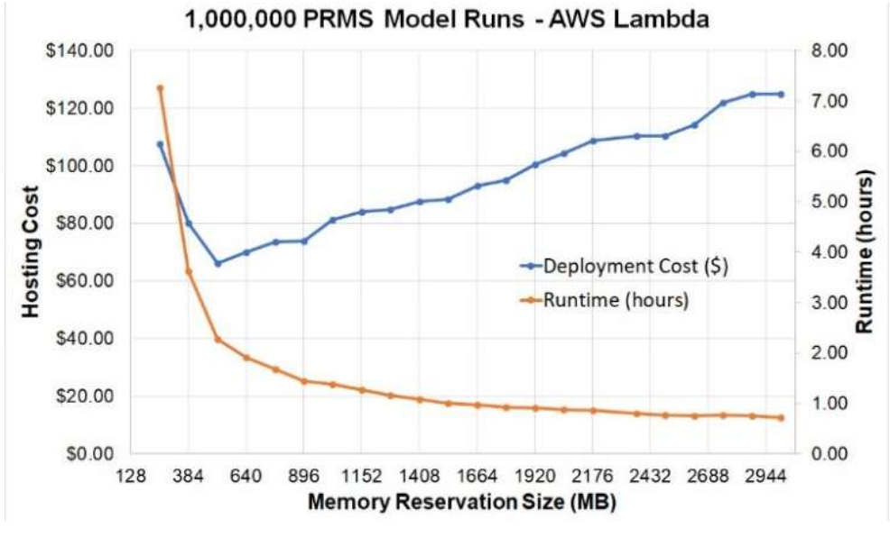
RQ-3: FaaS Hosting Cost 1,000,000 PRMS runs
AWS Lambda @ 512MB
Enables execution of 1,000,000 PRMS model runs in 2.26 hours @ 1,000 runs/cycle - for $66.20
With no setup (creation of VMs)

Slide 27
RQ-4: Persisting Infrastructure
How effective are automatic triggers at retaining serverless infrastructure to reduce performance latency from the serverless
freeze/thaw cycle?

Slide 28
RQ-4: Persisting Infrastructure
Goal: preserve 100 firecracker containers for 24hrs
Mitigate cold start latency
Memory: 192, 256, 384, 512 MB
All initial host infrastructure replaced between ~4.75 – 7.75 hrs
Replacement cycle (start→finish): ~2 hrs
Infrastructure generations performance variance observed from: -14.7% to 19.4% (Δ 34%)
Average performance variance larger for lower memory sizes: 9% (192MB), 3.6% (512MB)

Slide 29
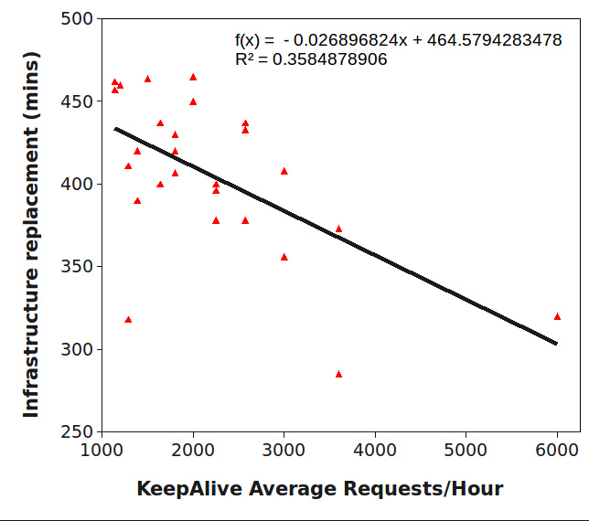
RQ-4: Persisting Infrastructure AWS Lambda: time to infrastructure replacement vs. memory reservation size
With more service requests per hour, Lambda initiated replacement of infrastructure sooner (p=.001)
Memory sizes tested: 192, 256, 384, 512 MB

Slide 30
RQ-4: Persisting Infrastructure Keep-Alive Infrastructure Preservation
PRMS Service: parameterize for “ping”
Perform sleep (idle CPU) – do not run model
Provides delay to overlap (n=100) parallel requests to preserve infrastructure
Ping intervals: tested 3, 4, and 5-minutes
VM Keep-Alive client: c4.8xlarge 36 vCPU instance: ~4.5s sleep
CloudWatch Keep-Alive client: 100 rules x 5 targets: 5-s sleep

Slide 31
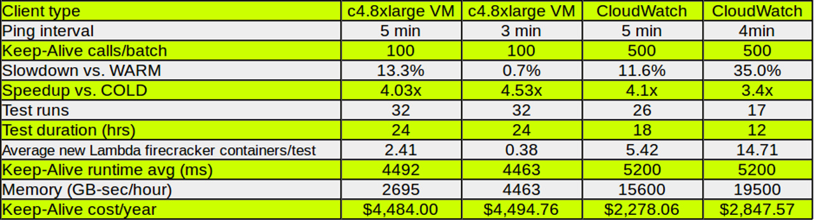
RQ-4: Keep-Alive Client Summary
Keep-Alive clients can support trading off cost for performance for preserving FaaS infrastructure to mitigate cold start latency

Slide 32
Outline
Background
Research Questions
Experimental Workloads
Experiments/Evaluation
Conclusions

Slide 33
Conclusions
RQ-1 Memory Reservation Size:
MAX memory: 10x speedup, 7x more hosts
RQ-2 Scaling Performance:
1+ scale-up near warm, COLD scale-up is slow
RQ-3 Cost
m4.large $35 (14d), Lambda $66 (2.3 hr), $125 (42 min)
RQ-4 Persisting Infrastructure (Keep-Alive)
c4.8xlarge VM $4,484/yr (13.3% slowdown vs warm, 4x ↑), CloudWatch $2,278/yr (11.6% slowdown vs warm, 4.1x ↑)

Slide 34
Questions

Slide 35
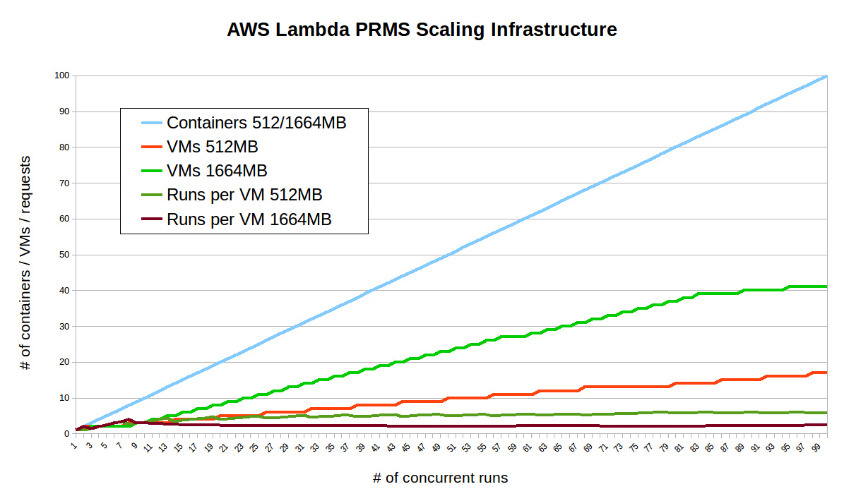
RQ-2: AWS Lambda Infrastructure for Scaling
Load Balancing:
@512MB: 5/6 requests per VMs
@1664MB (<82): 2 requests per VM
@1664MB (>82): 6 requests per VM
C4.8xlarge 36 vCPU client

Slide 36
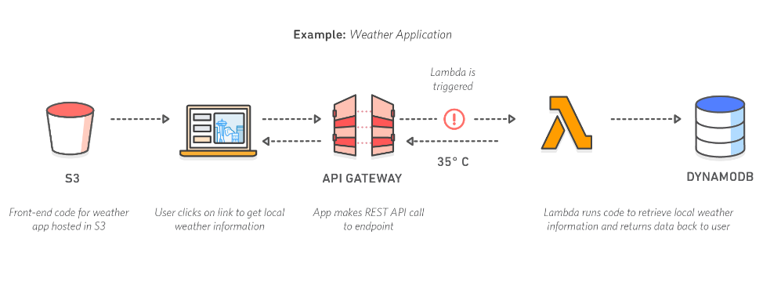

Vendor architectural lock-in
Serverless software architecture requires external services/components
Increased dependencies → increased hosting costs
Client
Images credit: aws.amazon.com

Slide 37
Pricing Obfuscation
IaaS pricing: hourly rental pricing, billed to nearest second intuitive pricing model…
Serverless Computing: Example: AWS Lambda Pricing FREE TIER: first 1,000,000 function calls/month → FREE first 400 GB-sec/month → FREE
Afterwards: $0.0000002 per request
$0.000000208 to rent 128MB / 100-ms

Slide 38
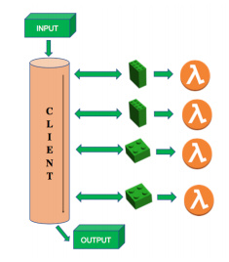

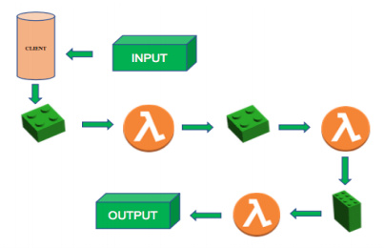
Service Composition
How should model code be composed for deployment to serverless computing platforms?
Recommended practice: Decompose into many microservices
Platform limits: code + libraries ~250MB
How does composition impact the number of function invocations, and memory utilization?
Client flow control, 4 functions
Server flow control, 3 functions
Monolithic Deployment
Performance

Slide 39
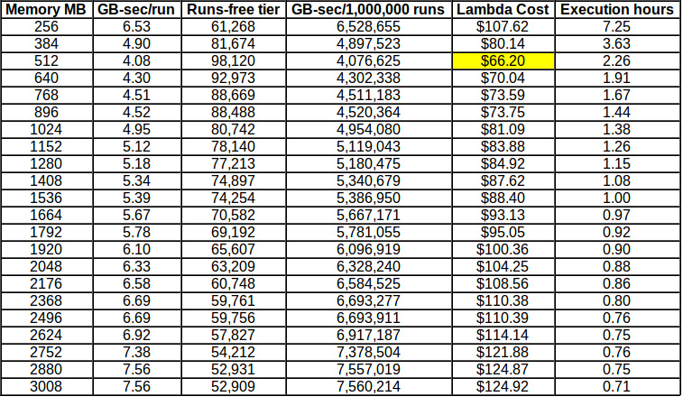
RQ-3: AWS Lambda Hosting 1,000,000 PRMS runs

Slide 40
RQ-3: AWS Lambda Hosting 1,000,000 PRMS runs
AWS Lambda @ 512MB
Enables execution of 1,000,000 PRMS model runs in 2.26 hours @ 1,000 runs/cycle - for $66.20
With no setup (creation of VMs)

Slide 41
Webservice hosting example
Each service call: 100% of 1 CPU-core 100% of 4GB of memory
Workload: 2 continuous client threads
Duration: 1 month (30 days)
VM: Amazon EC2 m4.large 2-vCPU VM
Hosting cost: $72/month m4.large: 10¢/hour, 24 hrs/day x 30 days
How much would hosting this workload cost on AWS Lambda?

Slide 42
Pricing Obfuscation
Workload: 20,736,000 GB-sec
FREE: - 400 GB-sec
Charge: 20,735,600 GB-sec
Memory: $345.04
Invocations: 5,184,000 calls
FREE: - 1,000,000 calls
Charge: 4,184,000 calls
Calls: $.84
Total: $345.88
Worst-case scenario = ~4.8x !
AWS EC2: $72.00
AWS Lambda: $345.88

Slide 43
Performance Implications of Serverless Computing Platforms
Infrastructure elasticity
Load balancing
Provisioning variation
Infrastructure retention: COLD vs. WARM
Memory reservation

Slide 44
Azure Functions Testing
COLD and WARM performance testing
App service instance lifetime > 12 hours
Restarting app, changing code, did not reassign infrastructure
To force COLD runs, had to create new function app
Concurrency test
From 1 to 200 concurrent client tests

Slide 45
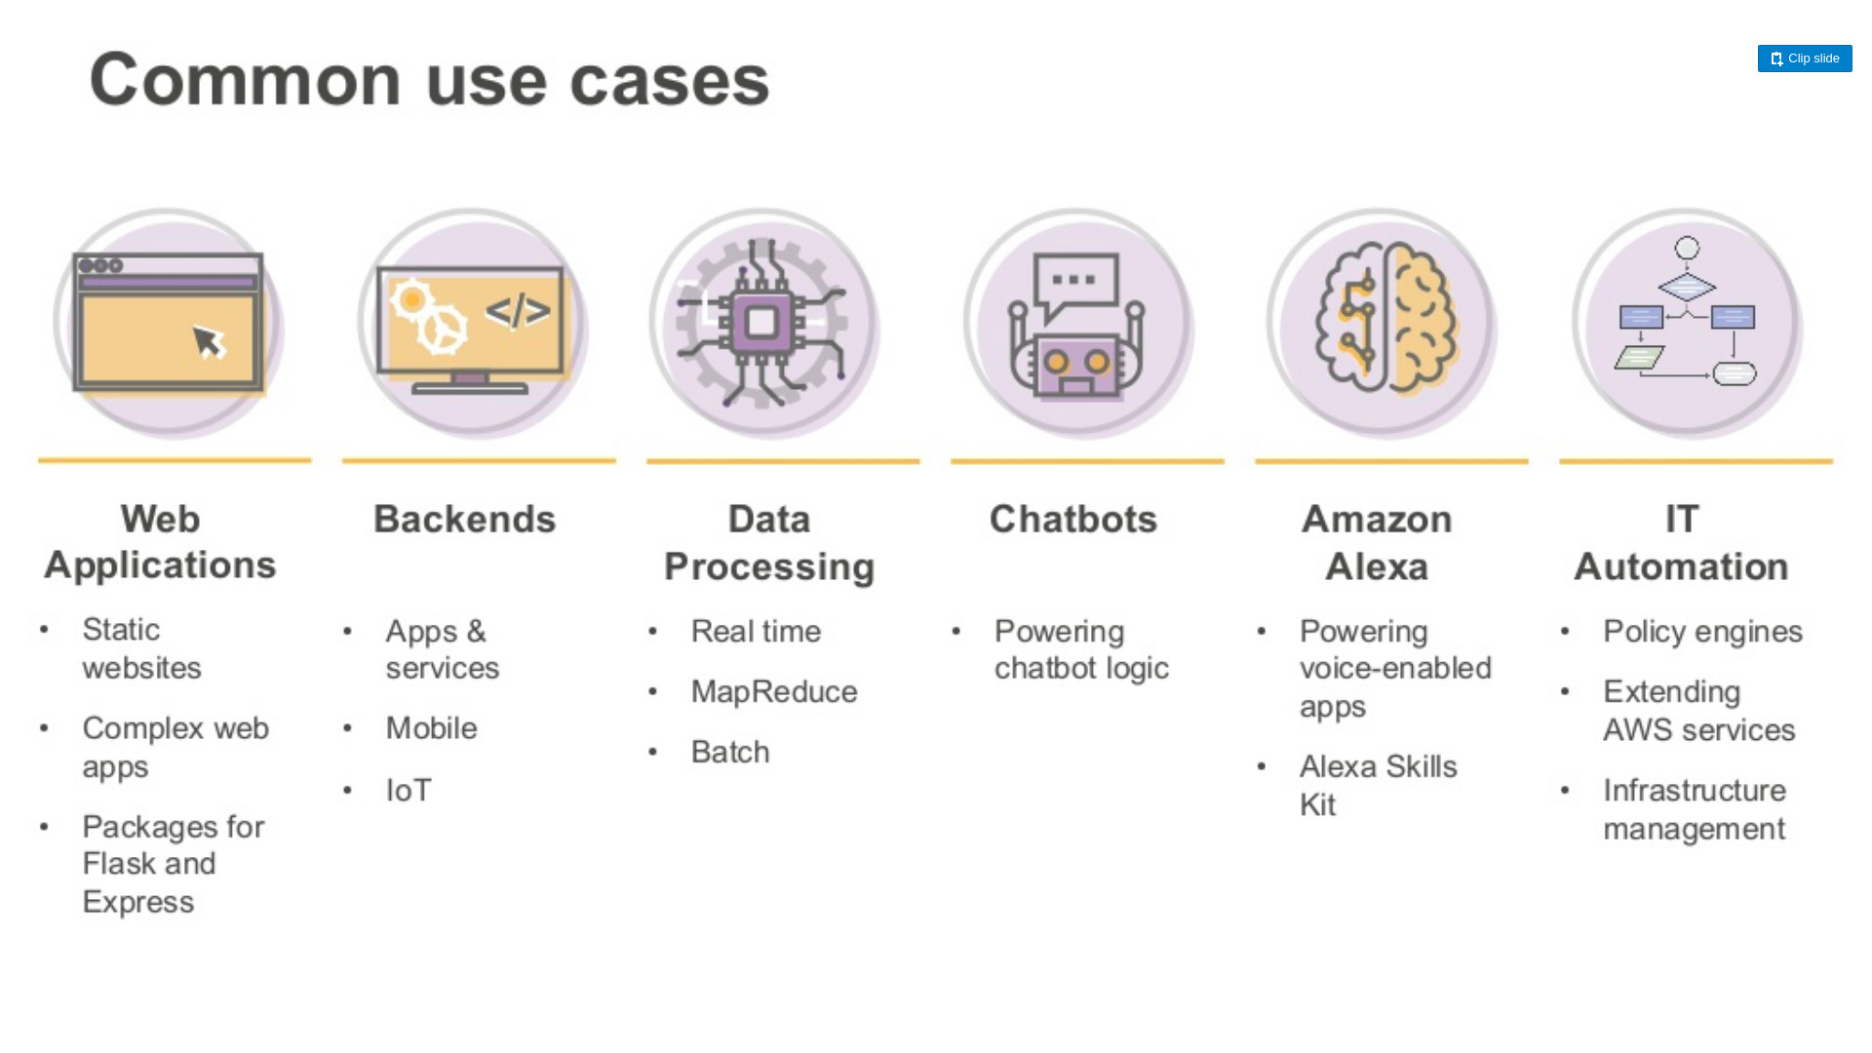
Aws Lambda - 4

Slide 46
Model service hosting example
Continuous service execution for one month: Each service call: 100% of 1 CPU-core Use of 3GB of memory/call
Workload: 2 continuous client threads
Duration: 1 month (30 days)
VM: Amazon EC2 m4.large 2-vCPU VM
Hosting cost: $72/month m4.large: 10¢/hour, 24 hrs/day x 30 days
How much would hosting this modeling workload cost on AWS Lambda?

Slide 47
Pricing Obfuscation
Workload: 15,552,000 GB-sec
FREE: - 400,000 GB-sec
Charge: 15,152,000 GB-sec
Memory: $252.13
Invocations: 5,184,000 calls
FREE: - 1,000,000 calls
Charge: 4,184,000 calls
Calls: $.84
Total: $252.97
Worst-case scenario = ~3.5x !
AWS EC2: $72.00
AWS Lambda: $252.97
3

Slide 48

RQ-1: AWS Lambda Memory Reservation Size
AWS Lambda Memory coupled to CPU power
Each Lamba “container” has access to 2 vCPUs
AWS claims: “Doubling memory, doubles CPU power”
Lambda CPUs: Intel Xeon E5-2666v3 CPU – 2.9 GHz
Is execution time halved for every doubling of memory?

Slide 49
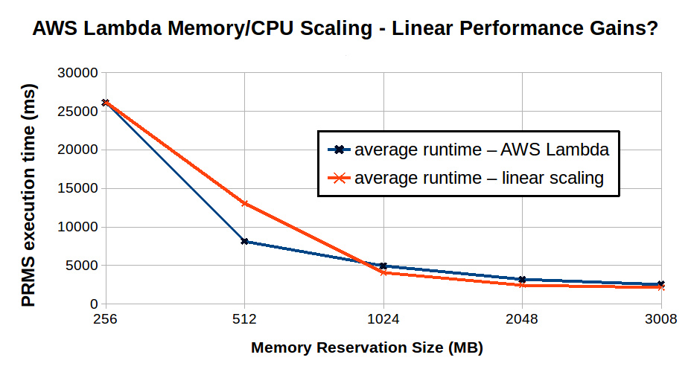
RQ-1: AWS Lambda Memory Reservation Size/Performance

Slide 50

Serverless Computing

Slide 51
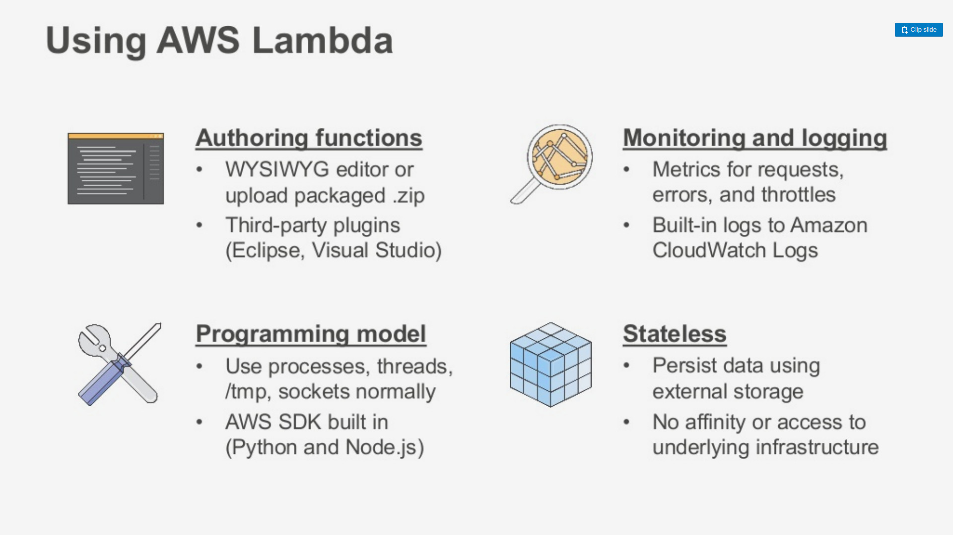
Aws Lambda - 2
Images credit: aws.amazon.com

Slide 52
AWS Lambda
Serverless Computing Platform
Image from: https://mobisoftinfotech.com/resources/blog/serverless-computing-deploy-applications-without-fiddling-with-servers/

Slide 53
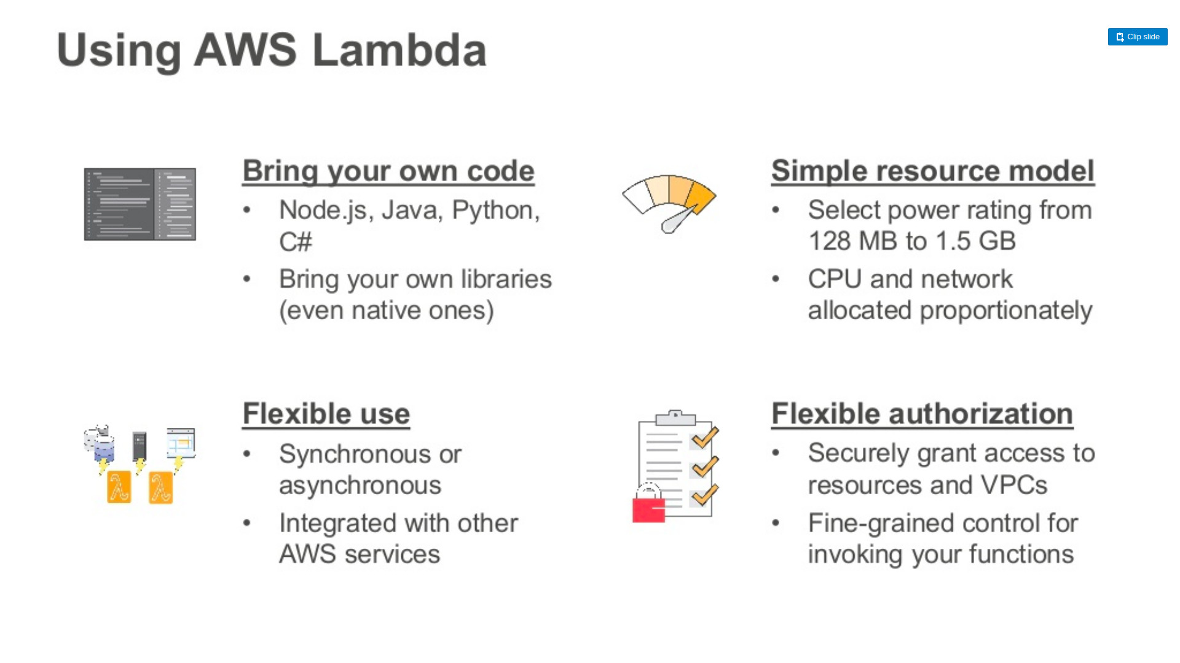
Aws Lambda
3
Images credit: aws.amazon.com

Slide 54
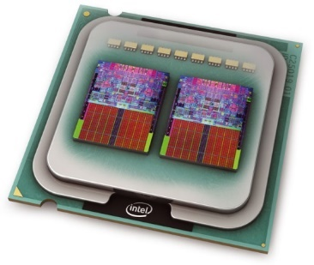
Smith Waterman Example
Applies dynamic programming to find best local sequencing alignment of two DNA/RNA samples
Embarrassingly parallel, each task can run in isolation
Use case for GPU acceleration
Example: Compare 20,336 protein sequences
Python client, C execution engine
Intel i5-7200U 2.5 GHz laptop client (2-core, 4-HT): 8.7 hrs
AWS Lambda, same laptop as client: 2.2 minutes
Partitions 20,336 sequences into 41 sets
Execution cost: ~ 82¢ (237x speed-up)

Slide 55
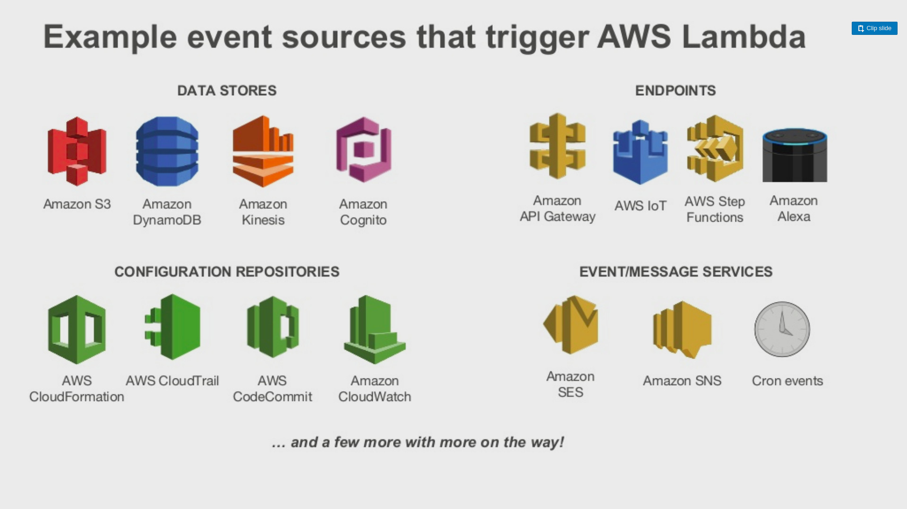
Aws Lambda - 3
Images credit: aws.amazon.com

Slide 56
Conclusions
RQ-1 Memory Reservation Size:
Increasing to 3GB provided a 10x speedup
~7x more VMs leveraged at high memory
RQ-2 Scaling Performance:
Slow scale up: stable performance stabilizes after ~15-20 concurrent clients.
COLD performance slow at low memory settings

Slide 57
Conclusions - 2
RQ-3 Cost: 1,000,000 PRMS model runs
Traditional 2-core VM: 14.5 days, $35
AWS Lambda 512MB: ~2.3 hours, $66
AWS Lambda 3008MB: 42 minutes, $125
No VM/docker configuration/setup

