Slide 1
Experience and Lessons from Building and Teaching a Serverless Solution
Second International Workshop on Serverless Computing (WoSC) 2017, ACM/IFIP/USENIX Middleware 2017
Donald F. Ferguson
Adjunct Professor, Dept. of Computer Science, Columbia University
Co-founder and CTO, Sparq TV
dff@cs.columbia.edu, donald.ferguson@seeka.tv

Slide 2
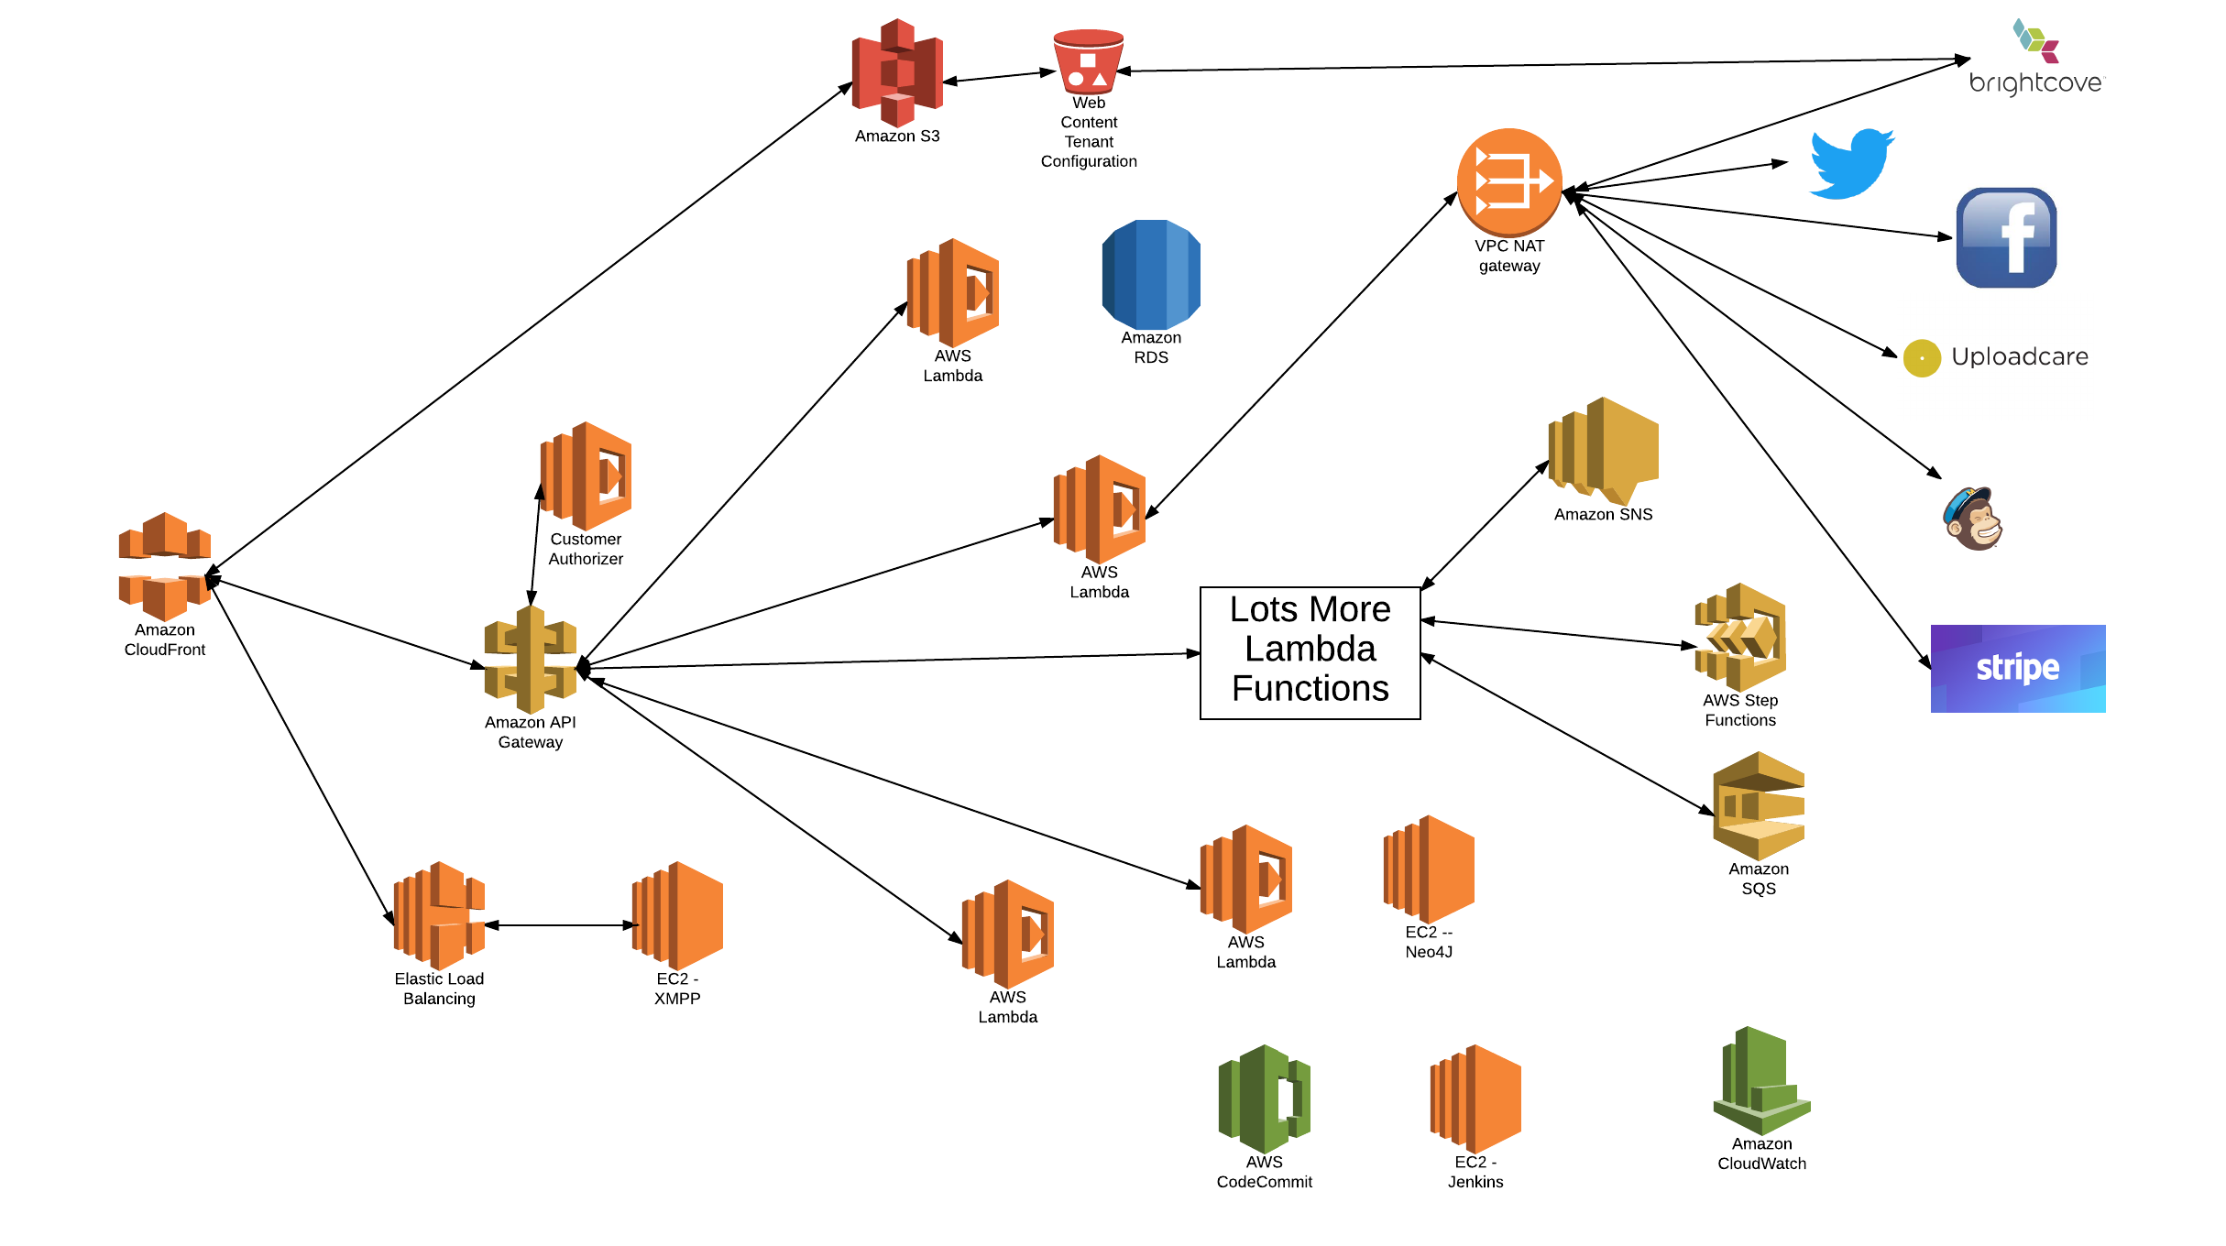
Seeka TV Architecture
Note
Not all connections shown
Probably forgot stuff
We have a couple of servers
XMPP
Neo4J (Graphene)
RDS

Slide 3
Seeka TV Architecture
Lambda implementing microservices for
Registration, authentication
User and profile management
Catalog and digital asset management
Watch parties
Commenting, tagging, …
Social media integration
Placement (business videos)
Tipping, crowd funding
Multi-tenant management
Other stuff I forgot
Note
Not all connections shown
Probably forgot stuff
We have a couple of servers
XMPP
Neo4J (Graphene)
RDS

Slide 4
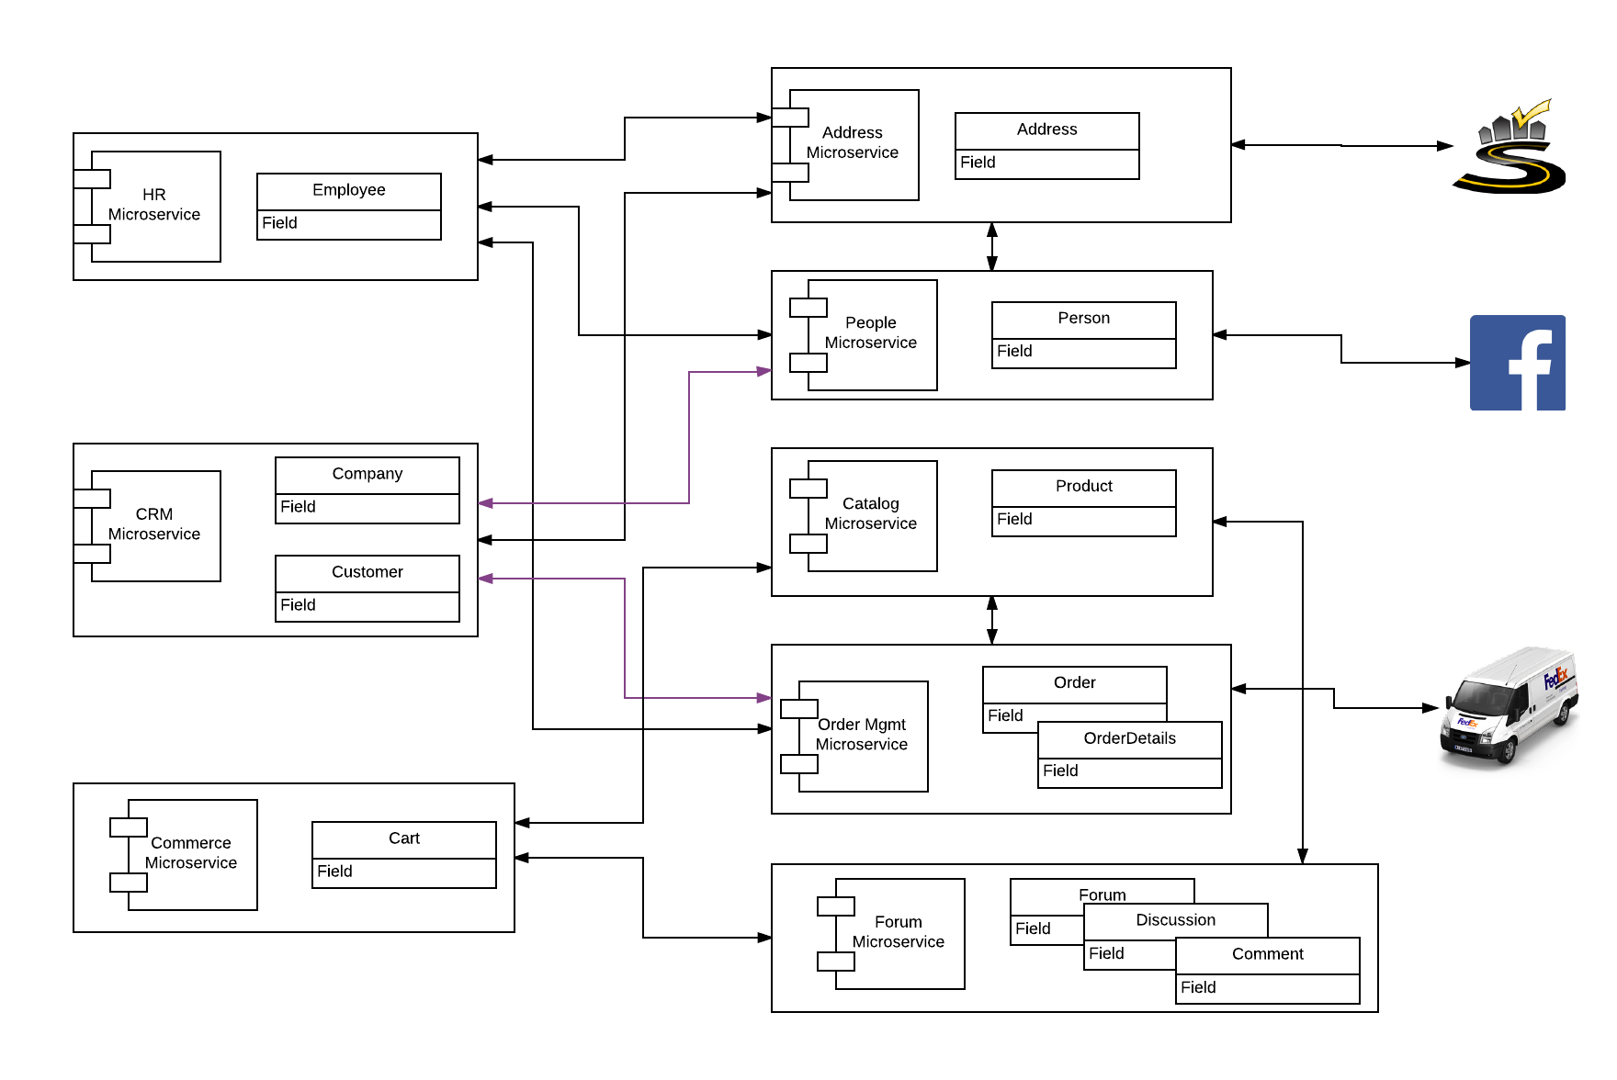
E6998 – Microservice and Cloud Applications Microservices Model
We only accomplished a fraction
Address
Person
OAuth2
Some composite microservice functions

Slide 5
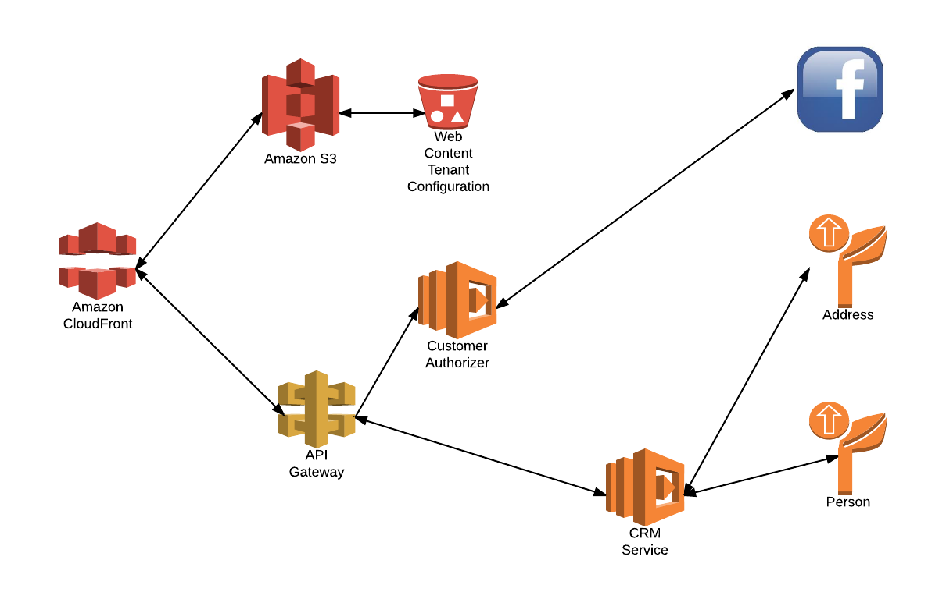
E6998 – Microservice and Cloud Applications Component Model

Slide 6
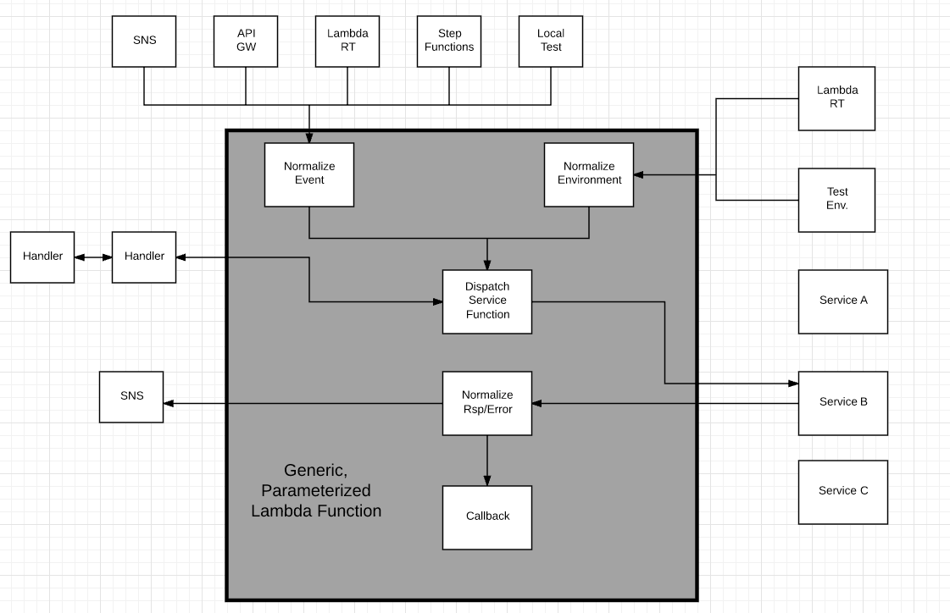
Design Pattern – Generic Lambda Function
Options
In zip file
Separate Lambda
Config info
Added to Lambda
Env Variable
From S3

Slide 7
Lessons Learned and Research Directions
Lessons learned
Serverless is much more than Lambda functions/function.
Think of the environment the way I drew it. A bunch of icons.
If you can configure and program with a web browser, and you do not manage hardware, SW, upgrade, etc. → It is serverless.
The environment is like a massive programmable wiki of /URLs
Productivity
There is significant productivity, especially initially, by eliminating all HW and SW server configuration and management.
The stateless model becomes incredibly productive but requires evolving from a more traditional microservice/service/application model to a event-function-event model.
There are a lot of subtle configuration settings and interactions between elements, and this is within a single environment. Azure-IBM-Google-AWS-… terrifies me.
Research opportunities
Service composition, even with SWF and Step Functions, is too tedious.
Application dependency mapping and end-to-end unit of work monitoring.
Declarative quality of service and middleware injection

