Slide 1
Sanity: The Less Server Architecture for Cloud functions
IBM T J Watson Research Center
Shripad J Nadgowda, Nilton Bila, Canturk Isci
IBM T J Watson Research Center

Slide 2
Agenda
IBM T J Watson Research Center
Background (check)
Motivation (for Change)
Sanity Architecture (What, Why and How ?)
(Validation by) Evaluation
(Take away) Conclusion
(Open for) Discussion

Slide 3





Getting on the same page
IBM T J Watson Research Center
Data Read/Write
Function trigger
Event/Data Sources
Compute Platform
D1
Data Store
$$f$$
$$f$$
D2
R1
R2

Slide 4
Getting on the same page
IBM T J Watson Research Center
Data Read/Write
Function trigger
Event/Data Sources
Compute Platform
D1’
Data Store
$$f$$
$$f$$
D2’
R1’
R2’
D1 ~ D1’
D2 ~ D2’

Slide 5

Eureka Moment!
IBM T J Watson Research Center
What if
Data from the input set are Equivalent And
associated functions Deterministic (or idempotent)
Then,
can we Avoid execution of functions, and still
De-duplicate the output results ?

Slide 6
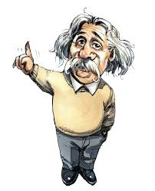
Sincere tribute
IBM T J Watson Research Center
Insanity:
Doing same thing over and over again, and
expecting different results
Sanity:
De-duplicate execution of cloud functions for
equivalent data events

Slide 7
Validation: Equivalent data
IBM T J Watson Research Center
Common data sources for Cloud functions:
IoT/Sensor data (e.g. weather), social media (e.g. tweets), user-activity (e.g. click stream), system monitor data (e.g. Prometheus)
Bounded range of values
E.g. temperature data to be (-20C to 50C)
Temporal duplication
E.g. data from a fixed sensors, system monitors
Spatial duplication
E.g. data from geo-distributed sensors
Semantically equivalent data

Slide 8
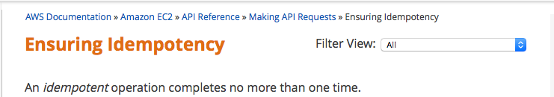


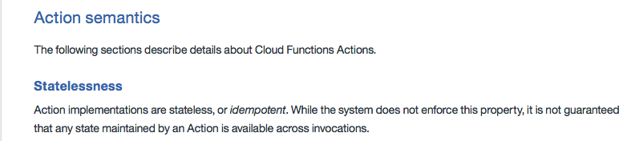

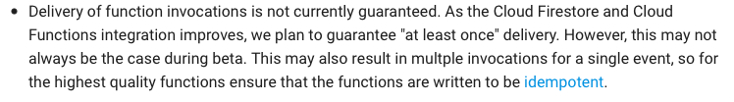
Validation: Deterministic functions
IBM T J Watson Research Center

Slide 9
Sanity: Less-server Architecture
IBM T J Watson Research Center
Sanity Deduplication
Data Read/Write
Function trigger
Event/Data Sources
Compute Platform
D1’
Data Store
D2’
R2’
D1 ~ D1’
D2 ~ D2’
R1’

Slide 10



Sanity: Less-server Architecture
IBM T J Watson Research Center
Sanity Deduplication
Data Read/Write
Function trigger
R1’
R1”
$$f1$$
$$f2$$
$$f3$$
e1
R1
e2
R1’
Data Store
D1
D1’
Extending Sanity to Sequence of Cloud functions

Slide 11


Sanity Use case: Vulnerability Analysis
IBM T J Watson Research Center
fvulnerability_check
6
fnotify
email
Container
Container
Container
Container
Container
Container
App
Container
App
Container
App
Container
3
App
App
App
2
App
App
App
1
Data Store
4
5
Cloud Compute
Cloud Compute
Cloud Compute Host
Container Data
metadata {namespace…}
file “/etc” {atime,mtime, …}
file “/var” {atime,mtime, …}
os “linux” {…}
config “/etc/groups” {…} ……..

Slide 12

Sanity: Mind the Gap...
IBM T J Watson Research Center
Considering ONLY storage-closed loop functions
reads data from storage
writes result back to the storage
External stimuli are avoided
stimulate external events like sending email, slack, SMS etc.

Slide 13

Sanity Use case:Architecture
IBM T J Watson Research Center
Sanity Controller
Data curation
Short-circuiting
Indexing
Filtering
PoV Annotation
Checksum
Serverless controller
$$f$$
New data event
Storage
System
D

Slide 14
Sanity Use case: PoV based de-duplication
IBM T J Watson Research Center
Sanity Controller
Data curation
Short-circuiting
Indexing
Filtering
PoV Annotation
Checksum
Serverless controller
$$f$$
New data event
Storage
System
D

Slide 15
Sanity Use case: PoV based de-duplication
IBM T J Watson Research Center
namespace: dev/mysql
crawl-time: 2017-03-11T17:04:42
{
metadata:{
namespace: "dev/mysql",
crawl-time: "2017-03-11T17:04:42”
...
},
file:{
name: "/etc/hosts",
atime: "1459243509",
mtime: "1459243509",...
}
packages:{
name: "coreutils",
version: "0.5.8-2.1ubuntu2",...
}...
}
{
metadata:{
namespace: "dev/mysql",
crawl-time: "2017-03-11T17:04:42”
...
},
packages:{
name: "coreutils",
version: "0.5.8-2.1ubuntu2",...
}...
}
{
metadata:{
namespace: ”$name$",
crawl-time: ”$crawl-time$”
...
},
packages:{
name: "coreutils",
version: "0.5.8-2.1ubuntu2",...
}...
}
MD5SUM
Original Data
Filtered Data
PoV annotated Data

Slide 16
Sanity Use case: Controller
IBM T J Watson Research Center
Sanity Controller
Data curation
Short-circuiting
Indexing
Filtering
PoV Annotation
Checksum
Serverless controller
$$f$$
New data event
Storage
System
D

Slide 17

Sanity Use case: Controller
IBM T J Watson Research Center
Function dupMap
I/P checksum | O/P Reference
sha1_data1 | out_ref1
sha1_data2 | out_ref2
… | …
Function Rule Map
Function-ID | Sanity Ref
f1 | ref1
f2 | ref2
… | …
Sanity Controller
I/P checksum | O/P Reference
sha1_data1 | out_ref1
sha1_data2 | out_ref2
… | …
Short-circuiting
Indexing
Serverless controller
$$f$$
Storage
System
2 GB Memory for 40K unique data entries

Slide 18
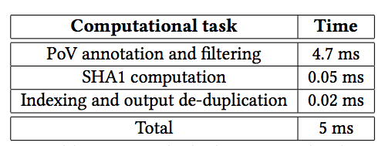
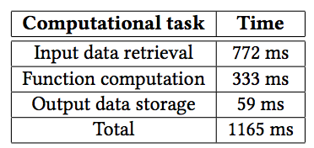
Sanity Use case: Evaluation
IBM T J Watson Research Center
Sanity Deduplication Overhead
Function execution stats

Slide 19


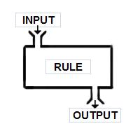
Conclusion
IBM T J Watson Research Center
Disaggregation with Cloud functions
Data and Compute are managed independently
Data events are largely semantically equilavent
Presenting an opportunity to de-duplicate data
Cloud functions are commonly deterministic
Presenting an opportunity to de-duplicate data
Cloud functions can be efficiently de-duplicated avoiding their redundant execution
Scale serverless platform by requiring less-server

Slide 20
IBM T J Watson Research Center
Thank You
Contact : nadgowda@us.ibm.com

