Slide 1


Understanding Open Source Serverless Platforms:
Design Considerations and Performance
Junfeng Li, Sameer G. Kulkarni,
K. K. Ramakrishnan, Dan Li
Notes:
understand the open source serverless platforms through measurement.
learn about the design considerations and performance.

Slide 2








Open Source Serverless Platforms

Slide 3
Motivation and Goals
To develop an understanding on the open source serverless platforms:
Do measurements to understand the impact of key configuration parameters of different components (platform, gateway, controller and function)
Evaluate and compare the performance of open source serverless platforms:
Different workloads
Different auto-scaling modes
Notes:
[Stress on the two points]
1. We use open source serverless platforms as vehicle to understand the serverless platforms.

Slide 4
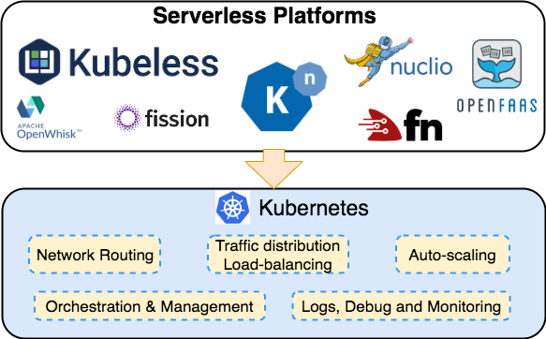
Dependence on Kubernetes
Notes:
These serverless platforms leverage kubernetes to do the network routing, …..
However, some platforms do their own auto-scaling (OpenFaaS) or ...

Slide 5
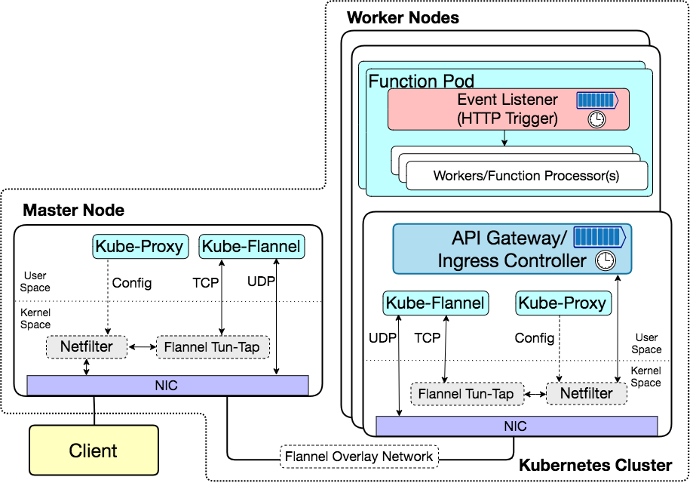
Service Exporting and Routing
Configure mapping rules for exporting service (Netfilter NAT rules)
Get events and push to a worker
Execute functions
Encapsulate
Route &
Load balance
Public NodePort
⇕
Internal
Pod_IP
Decapsulate
Notes:
[Say about queues, timer and other components in the figure, not just list them.]
For Container network interface (CNI), there are lots of options. For simplicity, we choose to use flannel because of its easy deployment.

Slide 6
Motivation and Goals
To develop an understanding on the open source serverless platforms:
Do measurements to understand the impact of key configuration parameters of different components (gateway, controller and function)
Evaluate and compare the performance of open source serverless platforms:
Different workloads
Different auto-scaling modes
v1.1.16
Gateway: v0.17.0
Faas-netes: v0.8.6
Faas-cli: v0.9.2
v0.8
v1.0.4

Slide 7
Experiment Setup
Topology: Kubernetes cluster (1 master, 2 workers) on CloudLab¹
Hardware: Intel Xeon E5-2640 v4 @ 20 Hyperthread cores.
Operating System: Ubuntu 16.04.1 LTS
Kubernetes v1.16.1, Docker v18.09.2
Functions and Workload:
Python ‘Hello-world’ function
Python ‘HTTP’ function
Workload Generator: wrk
[1] Duplyakin, Dmitry, et al. "The design and operation of CloudLab." 2019 USENIX Annual Technical Conference (USENIX ATC 19). 2019.

Slide 8
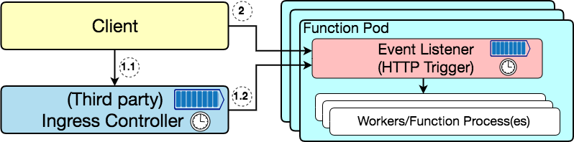
Nuclio
Direct call to func pod
(NodePort)
Working model
Invoke through IG
Multiple Workers
(Processes)
Notes:
[?] Nuclio is best for stateful functions (while showing multiple workers within same pod.)

Slide 9
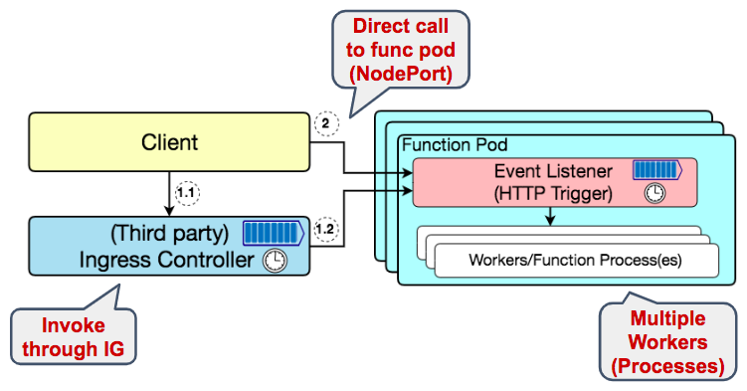
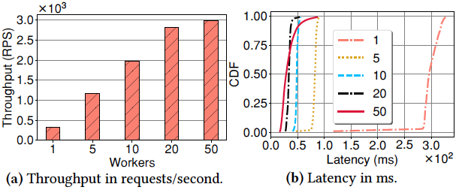
Nuclio
Salient parameter: the number of workers within one pod
Performance increases as the number of workers increases.
Notes:
Multiple workers can occupy multiple cores. And there are 20 cores on one server, so that the performance increases from 1 worker to 20 workers and increases slowly after 20 cores. Number of workers is set during the deployment time.
[?] Nuclio is best for stateful functions (while showing multiple workers within same pod.)

Slide 10
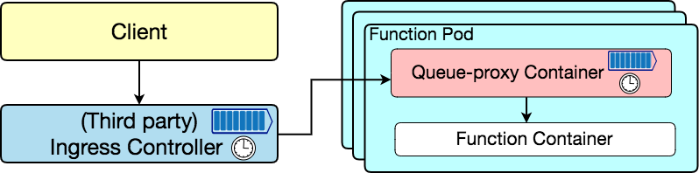
Knative
Working model
Multiple Workers (Threads)
Notes:
The working model of Knative is similar to that of Nuclio. The difference is that the client can only invoke the function through the ingress controller. There also could be multiple workers within one function pod. The number of workers is set during the deployment time.

Slide 11
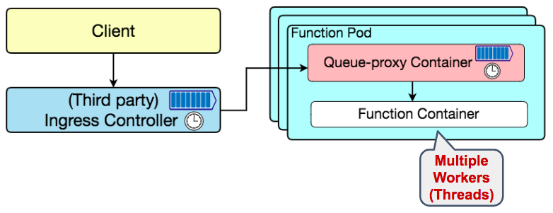
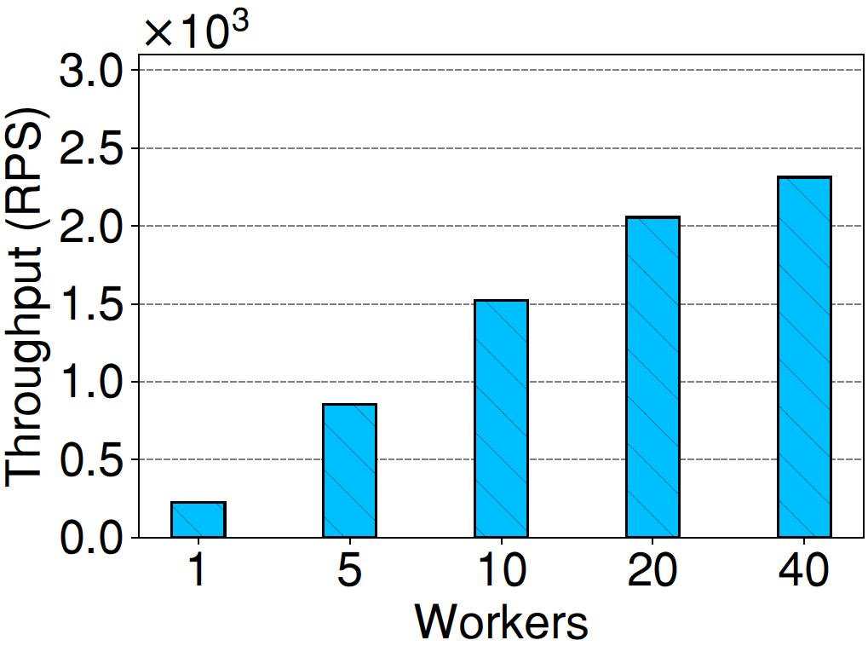
Knative
Salient parameter: the number of workers within one pod
Performance improves, but relatively lower than Nuclio.
Fig. Throughput of Knative.
Fig. Throughput of Nuclio.

Slide 12
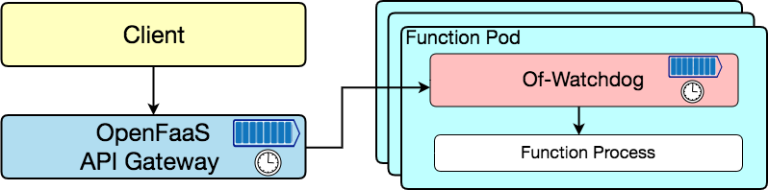
OpenFaaS
Working model
Get events and invoke function
Multiple Modes for Of-Watchdog:
(1) Fork-per-request:
Cold start for every request;
(2) Pre-fork:
Start the function once and keep warm.
One Worker
Notes:
Multiple modes for of-watchdog to invoke the function:
(1) Fork-per-request:
When the of-watchdog receives one request, it will setup one new function process and invoke the function. After the function execution, it will recycle the function process. In other words, that is cold start for every request;
(2) Pre-fork:
In the beginning, the of-watchdog sets up function process once and keep warm. When the of-watchdog receives one request, it will invoke the function directly.
(1) Serializing fork: This mode is designed to replicate the behaviour of the original watchdog for backwards compatibility. Stdout pipe is read into memory and then serialized or modified if necessary before being written back to the HTTP response.
(2) Streaming fork: Forks a process per request and can deal with a request body larger than memory capacity - i.e. 512mb VM can process multiple GB of video. Input is sent back to client as soon as it's printed to stdout by the executing process.

Slide 13
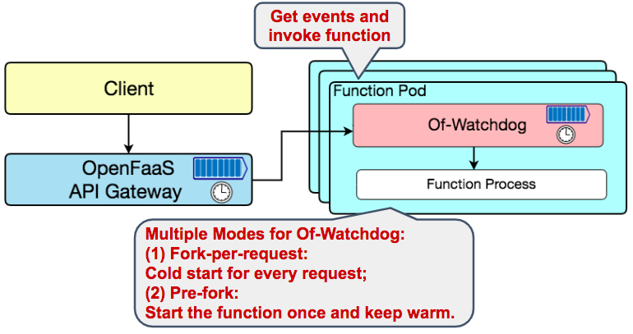
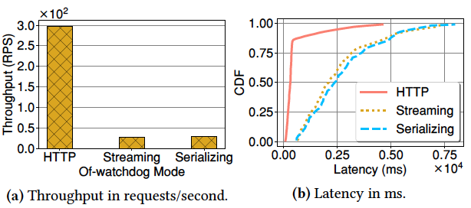
OpenFaaS
“Pre-fork” mode has much better performance than “Fork-per-request”.
Salient parameter: of-watchdog modes
Fork-per-request
Pre-fork
(Warm worker)
Notes:
Multiple modes for of-watchdog to invoke the function:
(1) Fork-per-request:
When the of-watchdog receives one request, it will setup one new function process and invoke the function. After the function execution, it will recycle the function process. In other words, that is cold start for every request;
(2) Pre-fork:
In the beginning, the of-watchdog sets up function process once and keep warm. When the of-watchdog receives one request, it will invoke the function directly.
(1) Serializing fork: This mode is designed to replicate the behaviour of the original watchdog for backwards compatibility. Stdout pipe is read into memory and then serialized or modified if necessary before being written back to the HTTP response.
(2) Streaming fork: Forks a process per request and can deal with a request body larger than memory capacity - i.e. 512mb VM can process multiple GB of video. Input is sent back to client as soon as it's printed to stdout by the executing process.

Slide 14
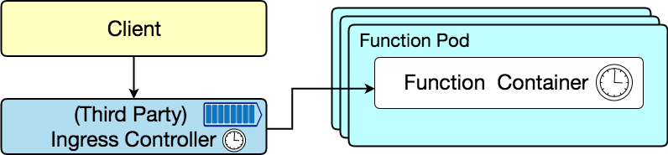
Kubeless
Working model
Kubeless only supports “Fork-per-request” mode.
Fork-per-request
One Worker
Notes:
Because there is only one function container within the function pod, the performance of different concurrency is almost the same.
In CDF figure, if the concurrency is bigger than one, there is a long tail because of the queuing latency.

Slide 15
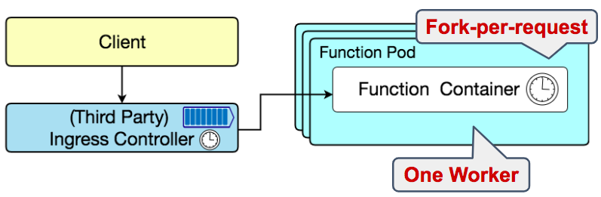
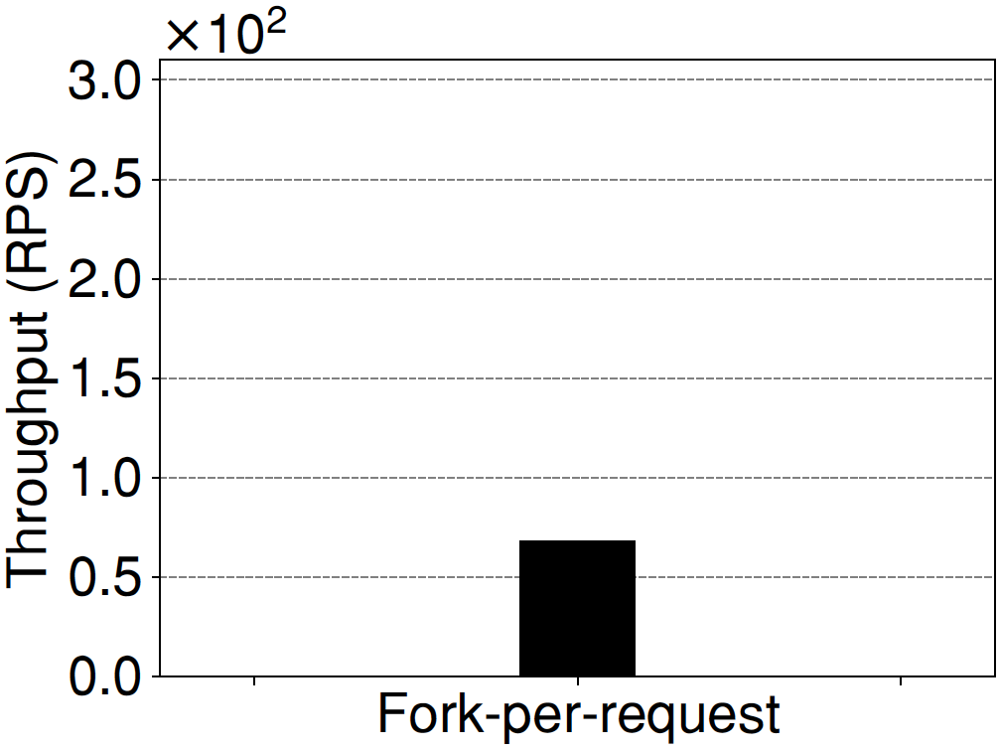
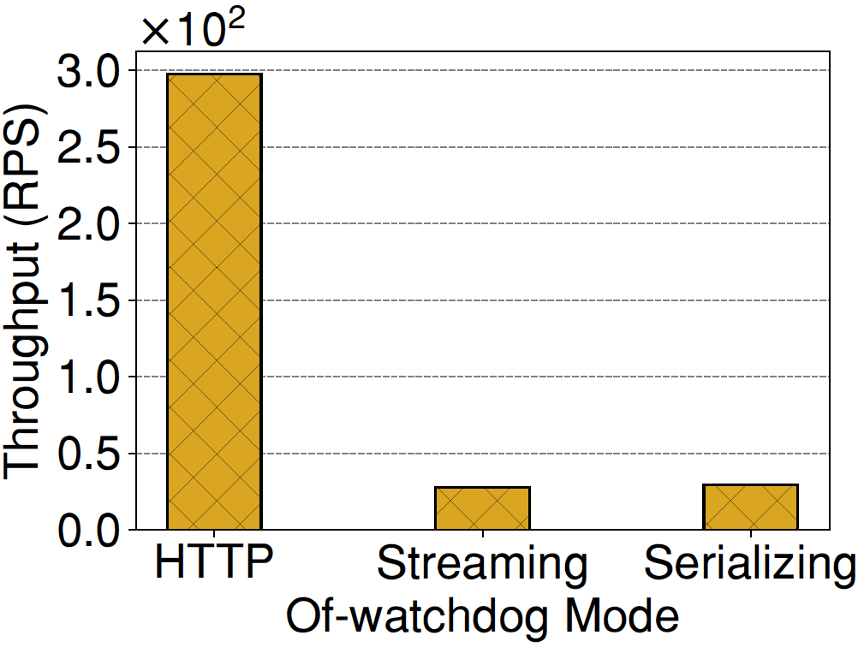
Kubeless
The performance of Kubeless is similar to that of OpenFaaS in “Fork-per-request” mode.
Fork-per-request
Fig. Throughput of Kubeless.
Fig. Throughput of OpenFaaS.
Notes:
Because there is only one function container within the function pod, the performance of different concurrency is almost the same.
In CDF figure, if the concurrency is bigger than one, there is a long tail because of the queuing latency.

Slide 16
Motivation and Goals
To develop an understanding on the open source serverless platforms:
Describe how different components work
Do measurements to understand the impact of key configuration parameters of different components (platform, gateway, controller and function)
Evaluate and compare the performance of open source serverless platforms:
Different workloads
Different auto-scaling modes

Slide 17
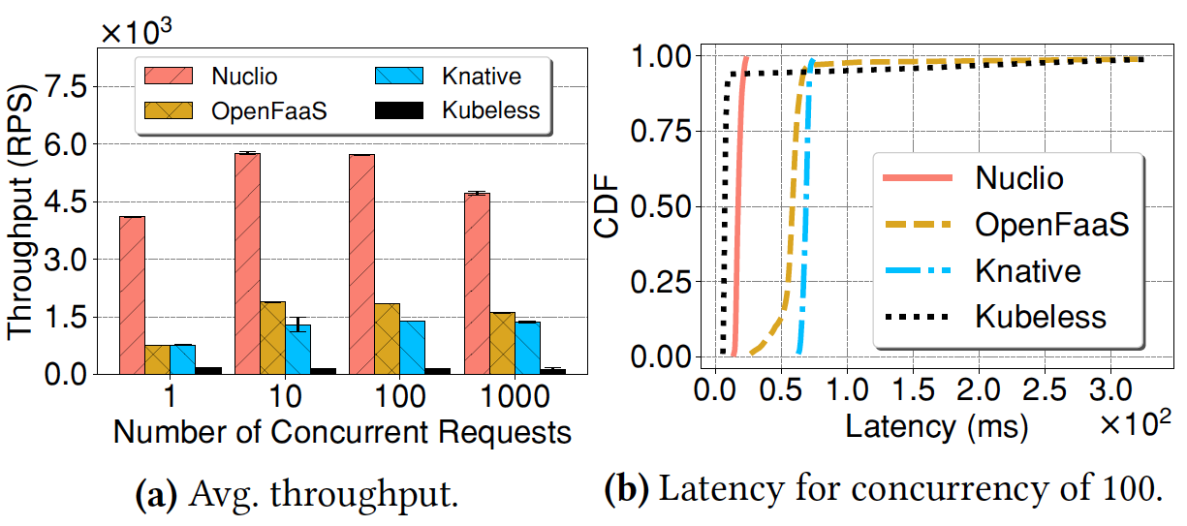
Performance
Baseline: helloworld function (Return “hello”)
Queuing Up ⇒ Long tail
Nuclio:
No ingress controller
⇒ Bypass the queue of ingress controller
⇒ Highest throughput
Kubeless:
Fork-per-request
⇒ Lowest throughput

Slide 18
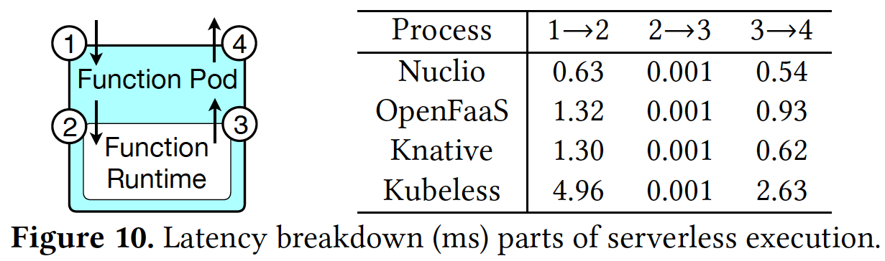
Performance
Same Python Runtime
⇒ Same execution time
Latency breakdown of helloworld function:
Platform Specific
Platform Specific
Fork-Per-Request
(Cold Start All the Time)
Notes:
In this slide, we show the latency breakdown within the function pod. We record the four timestamp in the four points: (1) the time when the function pod receives the request; (2) the function execution starts; (3) the time when the function execution finishes; (4) the time the function pod encapsulates the result and sends back the response.

Slide 19
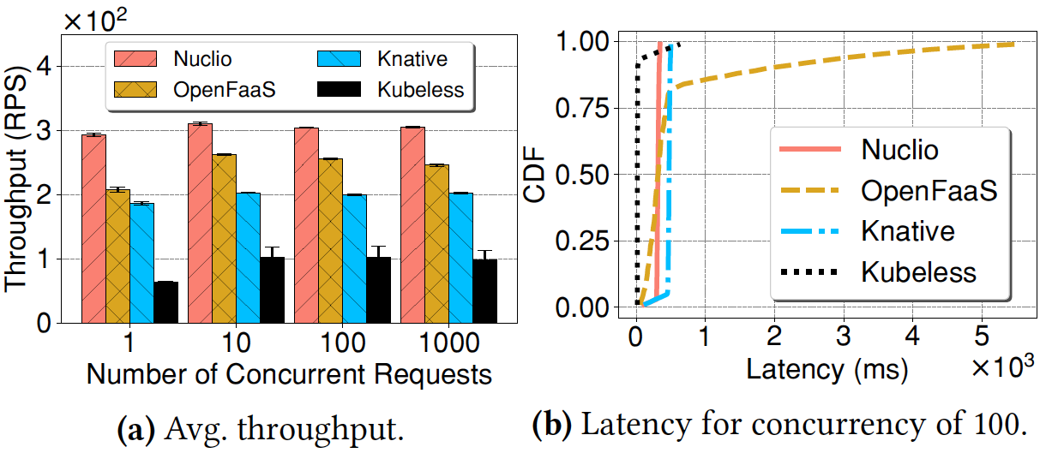
Performance
HTTP Workload: fetch a web page (5 Byte) from a local server
Nuclio:
No ingress controller
⇒ Bypass the queue of ingress controller
⇒ Highest throughput
Notes:
The function complexity increases and function execution takes more time. (The performance is normalized.)

Slide 20
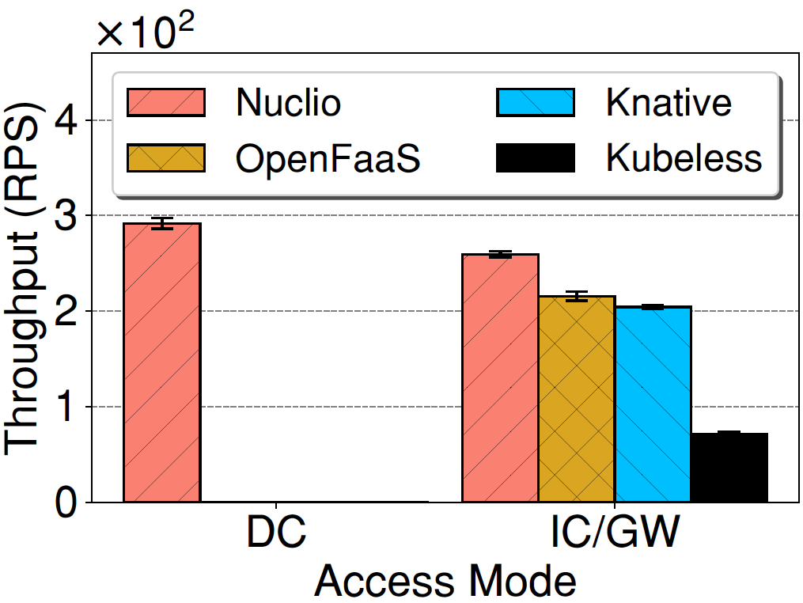
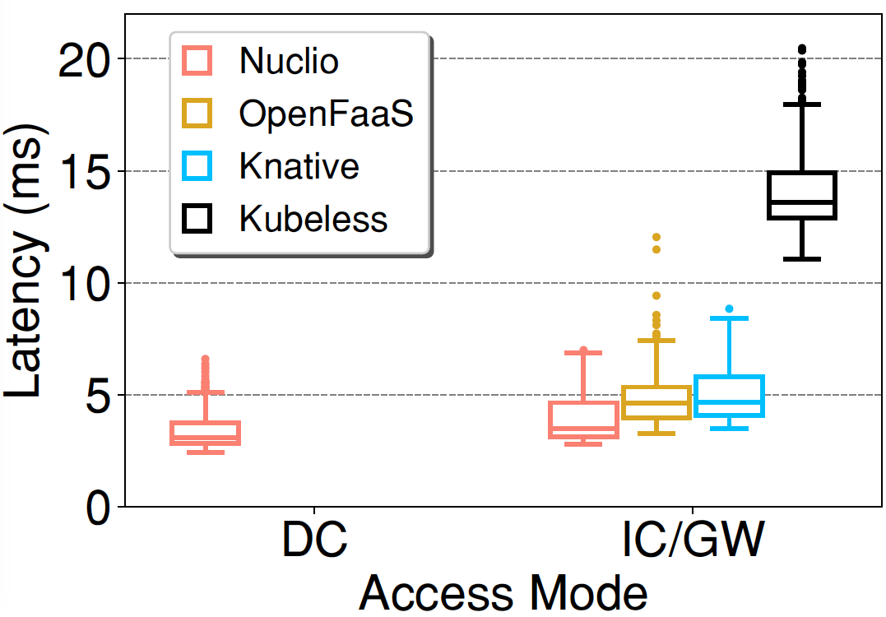
Performance
IC/GW: Overhead of Ingress Controller/API Gateway.
Different modes of exporting services:
Direct call to func pod
(NodePort)
Invoke through IC/GW
Notes:
HTTP Workload
add a diagram for three modes.
Local call: the client is on the same server where the function pod runs and it use the pod ip to invoke the function. This is not the typical way to invoke the function, but we do this just for the measurement.

Slide 21
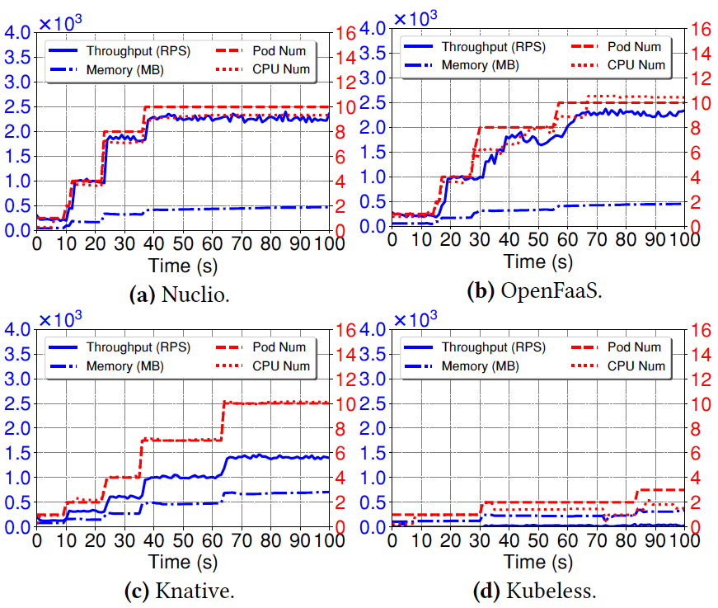
Performance: Auto-scaling
Resource-based auto-scaling:
Resource-based auto-scaling depends on Kubernetes HPA (Horizontal Pod Autoscaler)
In spite of the same function and HPA, platform characteristics govern auto-scaling.
(Different performance
⇒ Different resource utilization
⇒ Different auto-scaling rate)
Notes:
Different platforms => different performance => different resource utilization => different scaling rate (auto-scaling favors the platform that consumes more resources)

Slide 22
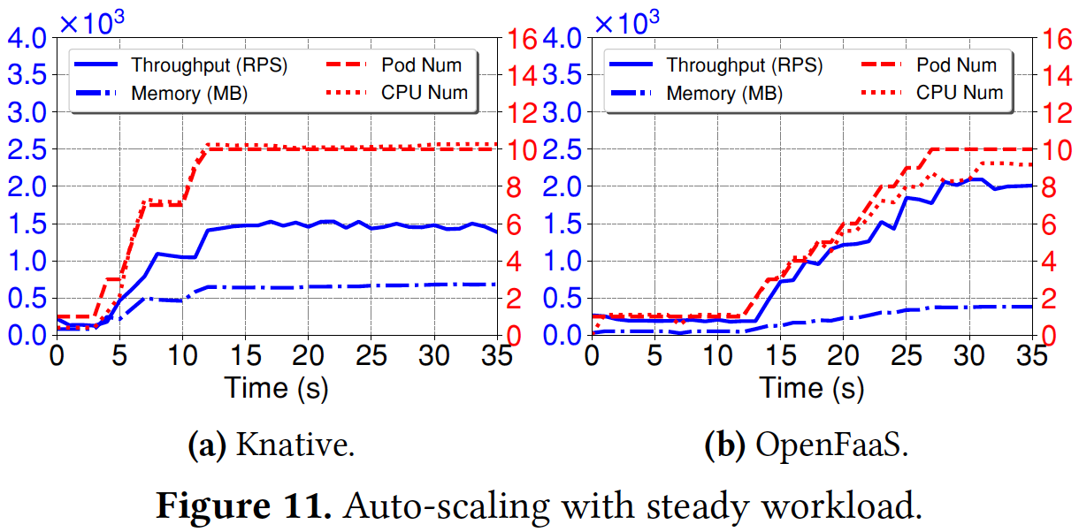
Performance: Auto-scaling
Prometheus reacts slowly
⇒ Slow scaling
Workload-based auto-scaling:
Concurrency-based
RPS-based
Notes:
We tried to make sure that parameter for scaling is same;
Not a good result because there are multiple variables. We should use knative for RPS-based and Conc-based auto-scaling.

Slide 23
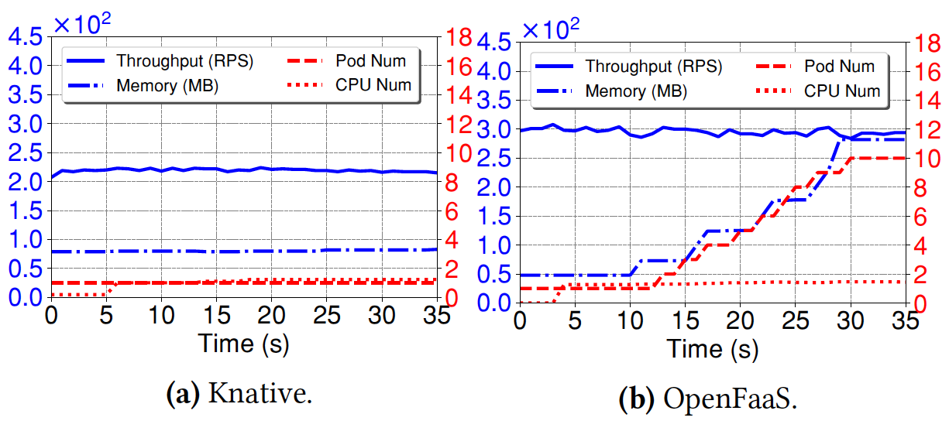
Performance: Auto-scaling
Issues about load balancing for OpenFaaS:
Behavior: Auto-scaling happens but NO performance improvement!
Load-balancing Issue!
If client enables keep-alive, OpenFaaS does not set up connections with newly created function pods, which hinders performance improvement.
No improvement
Auto-scale
Fig. RPS-based auto-scaling
in OpenFaaS
Notes:
Because wrk enables keep-alive by default and reuses connections to send out requests.

Slide 24
Performance: Auto-scaling
Issues about Concurrent-based auto-scaling:
Traffic: Conc=9, RPS=400
Configuration: Conc_Threshold=10
Behavior: No Auto-scaling!
No able to scale to 400 RPS (Actual RPS=~220)
No improvement
No Auto-scale
Misconfiguration inhibits auto-scaling.
(Conc. does not exceed threshold.
⇒ No auto-scaling with workload of low concurrency but high RPS.)
Fig. Conc-based auto-scaling in Knative
Notes:
The client sets up 9 connections and want to maintain traffic of 400 RPS. For the configuration of concurrent-based auto-scaling, the concurrent threshold is 10, that means ten concurrent requests will trigger the auto-scaling.
But there is no auto-scaling and the function pod can not process so many requests per second, so that the actual RPS is just around 220. The reason is that the auto-scaling configuration is set by the developer, which could not be suitable for the actual traffic. This misconfiguration may inhibit auto-scaling. The concurrency does not exceed the threshold, auto-scaling does not happen although there is a high RPS.

Slide 25
Key Observations
Function processing:
Multiple workers within one function pod contribute to performance improvement.
Pre-fork mode (warm worker) increases the throughput and reduces the latency.
Load balancing:
Plays an important role in the performance and scalability.
Coupling routing with load balancing can adversely affect the performance -- Needs greater attention!
Notes:
Load balancing:
(1) As what we see in the last slides about the issue of load balancing on OpenFaaS, load balancing plays an important role in the performance and scalability.
(2) Now, the serverless platforms leverage kubernetes routing mechanism to do the load balancing, which can adversely affect the performance.
So we need to pay greater attention on that.

Slide 26
Key Observations
Autoscaling:
For resource-based auto-scaling, in spite of the same function and HPA, platform characteristics govern auto-scaling.
Misconfiguration of auto-scaling rules can severely degrade the performance and system utilization.
Current Auto-scaling approaches are based only on the total processed requests, while the dropped requests are missed out. -- Incoming request rate needs to be accounted for.
Notes:
Simple leveraging kubernetes is not a good choice.

Slide 27
Backup Slides

Slide 28
Serverless 2020 and Beyond
Load balancing:
Improper load balancing results in poor performance improvement -- Needs greater attention!
Autoscaling:
Misconfiguration of auto-scaling rules can severely degrade the performance and system utilization.
Current Auto-scaling approaches are based only on the total processed requests, while the dropped requests are missed out. -- Incoming request rate needs to be accounted for.

Slide 29
Motivation
To understand how the serverless platforms work?
What is the impact of configuration parameters?
What is the performance of serverless platforms?
What is the behavior of auto-scaling?

Slide 30
Thank you!

Slide 31
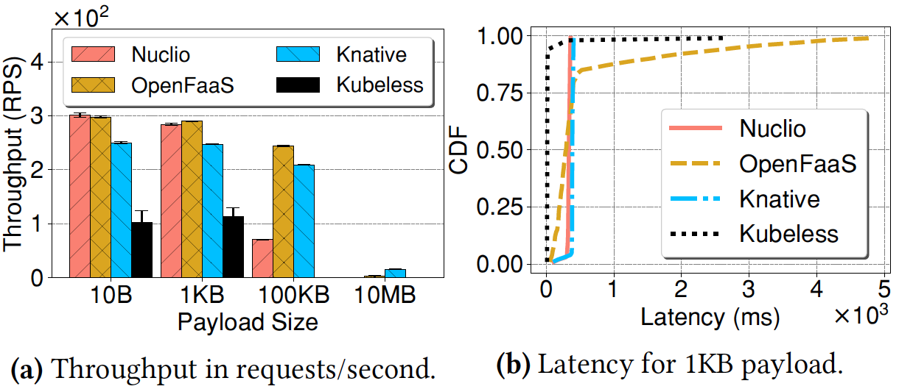
Performance
HTTP Workload: fetch a web page of different sizes

Slide 32
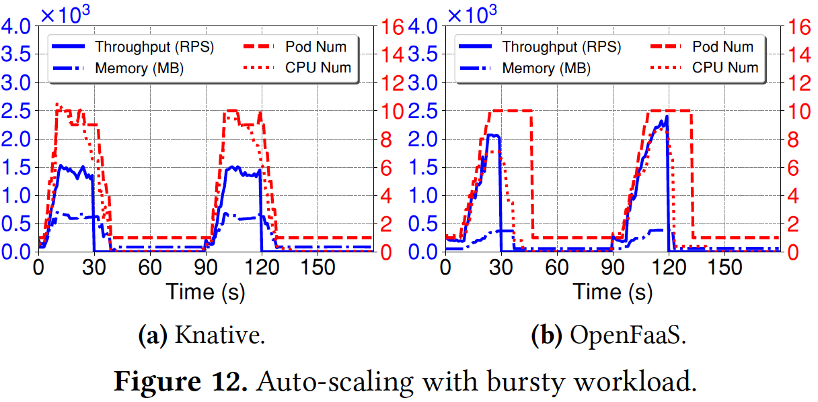
Performance: Auto-scaling
Prometheus ⇒ React slowly
Workload-based auto-scaling: bursty workload
Concurrency-based
RPS-based

Slide 33
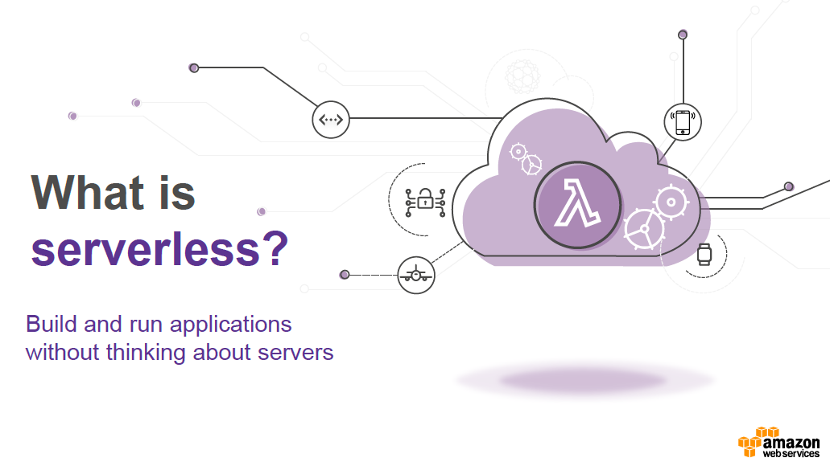

Slide 34
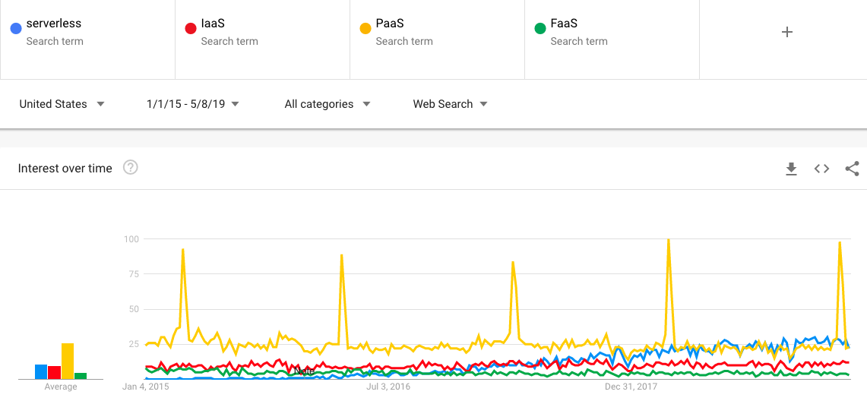
Serverless Computing: The New Hotness
https://trends.google.com/trends/explore?date=2015-01-01%202019-05-08&geo=US&q=serverless,IaaS,PaaS,FaaS

