Slide 1
FnSched: An Efficient Scheduler for Serverless Functions
Amoghavarsha Suresh, Anshul Gandhi
PACE Lab, Stony Brook University

Slide 2




Motivation
Serverless computing is becoming popular
Features:
Providers responsible for resource management
Pay-for-what-you-use (runtime)
Benefits:
Easy deployment: Write your code and ship it!
Increases programmer productivity
Seemingly infinite scalability
Notes:
I think we can keep going with motivation before coming to outline slide. Note, our main motivation is driven by the fact that serverless will eventually become popular enough that resource requirements of the serverless platform will skyrocket, necessitating smarter resource mgmt and scheduling. After we make this clear, then we can say our goal is to design a smart serverless scheduler, and then you can go to outline slide.

Slide 3
Motivation
Interest from different domains
Edge-Triggered applications: e.g. Web apps, backends, data preprocessing
Massively Parallel applications: e.g. MapReduce, Stream Processing
Serverless offers cost benefits: 20₵ per 1M lambda requests
Ex-Camera [NSDI’17] serverless video encoding is 60x faster and 6x cheaper than VM based (serverful) solution.
Interest in serverless computing will rise. For a viable service:
Efficient resource usage @ scale is important for the provider
Reasonable performance is important for the user
Smart scheduling and resource management is critical
Notes:
Note, our main motivation is driven by the fact that serverless will eventually become popular enough that resource requirements of the serverless platform will skyrocket, necessitating smarter resource mgmt and scheduling. After we make this clear, then we can say our goal is to design a smart serverless scheduler, and then you can go to outline slide.
At scale, the underlying infra needed to support the increasing serverless traffic can become a huge expense
Smart scheduling and resource management is critical!

Slide 4
Outline
Motivation
Scheduling Challenges
FnSched Design
Evaluation
Conclusion & Future work
Notes:
I think we should combine both single node and multi node into one parent bullet called “FnSched Design”, and these two can be subbullets.

Slide 5
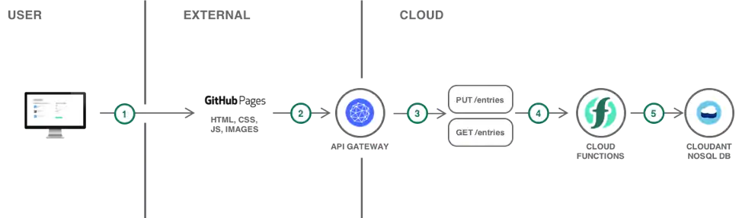
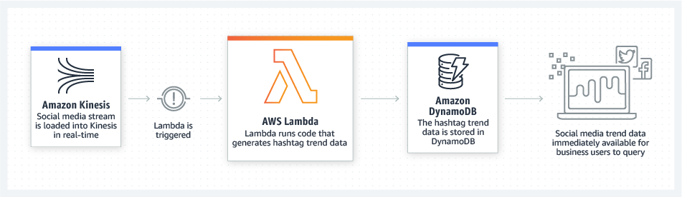
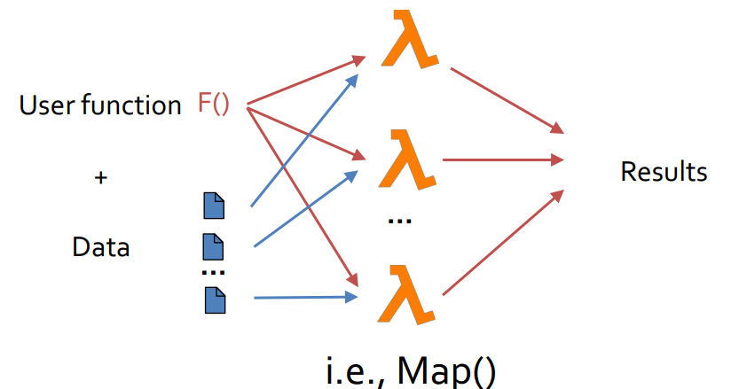
Scheduling challenge 1/3: Application Diversity
Increased Interest -> Application diversity
Edge-Triggered applications:
Short-lived, lightweight
e.g. Web apps, backends, data preprocessing
Massively Parallel applications:
Long running, computationally intensive
E.g. MapReduce, Stream Processing
Notes:
Provider + Users.

Slide 6
Scheduling challenge 2/3: Containers
Serverless applications are hosted on containers
Absence of running container results in Cold Start
Cold-Start:
Application execution is delayed, e.g. ~3s in our setup
Should minimize the number of cold-starts
Application Execution
App Specific Initialization
Runtime Initialization
Container Creation
Notes:
Provider + Users.

Slide 7


Scheduling challenge 3/3: Allocation & Placement
Strawman: Allocate a core for each application
However, provider cost will escalate!!
Solution: Effective packing
Where to place a container?
Whether to colocate a container?
How long should the container be alive?
Whether to add new nodes?
Notes:
Keep a warm container for each application

Slide 8
FnSched Approach
Goal: Target a maximum degradation latency and minimize the number of servers/invokers used.
FnSched Approach
Colocation
Packing, Proactive Spawning
Notes:
Provider + Users.
FnSched approach: Within the node + Across the nodes

Slide 9
FnSched: Resource Management
Popular Serverless platforms tie CPU allocation to memory requirement
CPU requirement is dependent on the class of applications
ET
C3
C4
C1
C2
MP
Short running ET apps are severely impacted compared to MP apps
We need to decouple memory and CPU requirement for effective colocation
Notes:
CPU requirement is dependent on the class of applications

Slide 10
FnSched: CPU Shares Algorithm
CPU Shares: Soft limit, decides proportion of CPU during contention
ET
C3
C4
C1
C2
MP
Allocate more of CPU time to short running ET during contention!

Slide 11
FnSched: CPU Shares Algorithm
CPU Shares: Soft limit, decides proportion of CPU during contention
ET
C3
C4
C1
C2
MP
When to increase the cpushares?
How much to increase?
How to balance the cpu shares?

Slide 12
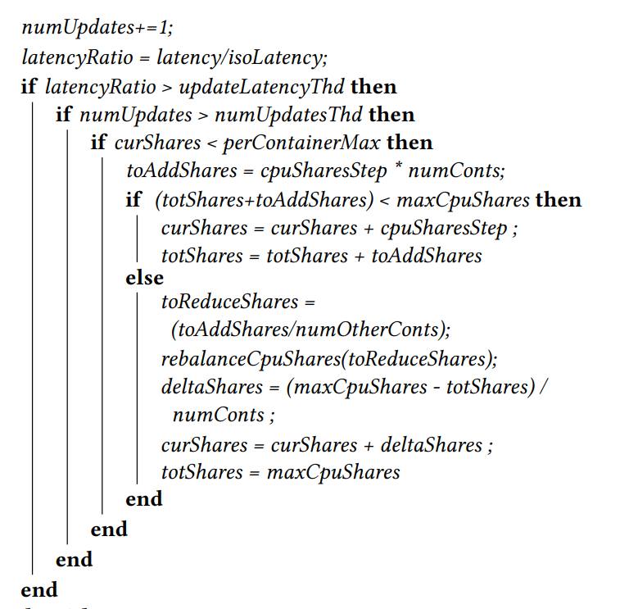
FnSched: CPU Shares Algorithm
numUpdatesThd → When to increase the cpushares?
cpuSharesStep → How much to increase?
maxCpuShares → How to balance the cpu shares?

Slide 13
Multi Node Placement: Packing
Packaging: Greedy algorithm based on data center power management policy.
I-1
I-2
I-N
Allocate request in the smallest index invoker
Helps to packing requests in as few invokers as possible
With effective packing, higher index invokers can be turned off
Notes:
Cold Starts: Send heartbeat requests to keep proactive containers alive
How to do it on multiple nodes?

Slide 14
Multi Node Placement: Proactive Spawning
Packaging: Greedy algorithm based on data center power management policy.
I-1
I-2
I-N
Cold Starts: Scheduling on invoker k is followed by proactively spawning an application container on invoker k+1
Notes:
Cold Starts: Send heartbeat requests to keep proactive containers alive
How to do it on multiple nodes?

Slide 15
Outline
Motivation
Scheduling Challenges
FnSched Design
Evaluation
Conclusion & Future work
Notes:
I think we should combine both single node and multi node into one parent bullet called “FnSched Design”, and these two can be subbullets.

Slide 16
Experimental Setup
OpenWhisk Cluster: 10 VMs
Front-end + control plane: 2 VMs
Invokers: 8 VMs
Distributed services: Storage: CephFS, Database: Redis, Stream Processing: Apache Kafka
Applications:
Edge-Triggered:
Image Resizing (IR),
Streaming Analytics (SA)
Massively Parallel:
Nearest Neighbors (NN)
Computational Fluid Dynamic (CFD) solver
latencyThd: 1.15 i.e. maximum of 15% performance degradation
HTTP Frontend
Controller
Invoker-1
Invoker-8
Distributed Services
Ceph FS
Redis
DB
Apache Kafka

Slide 17
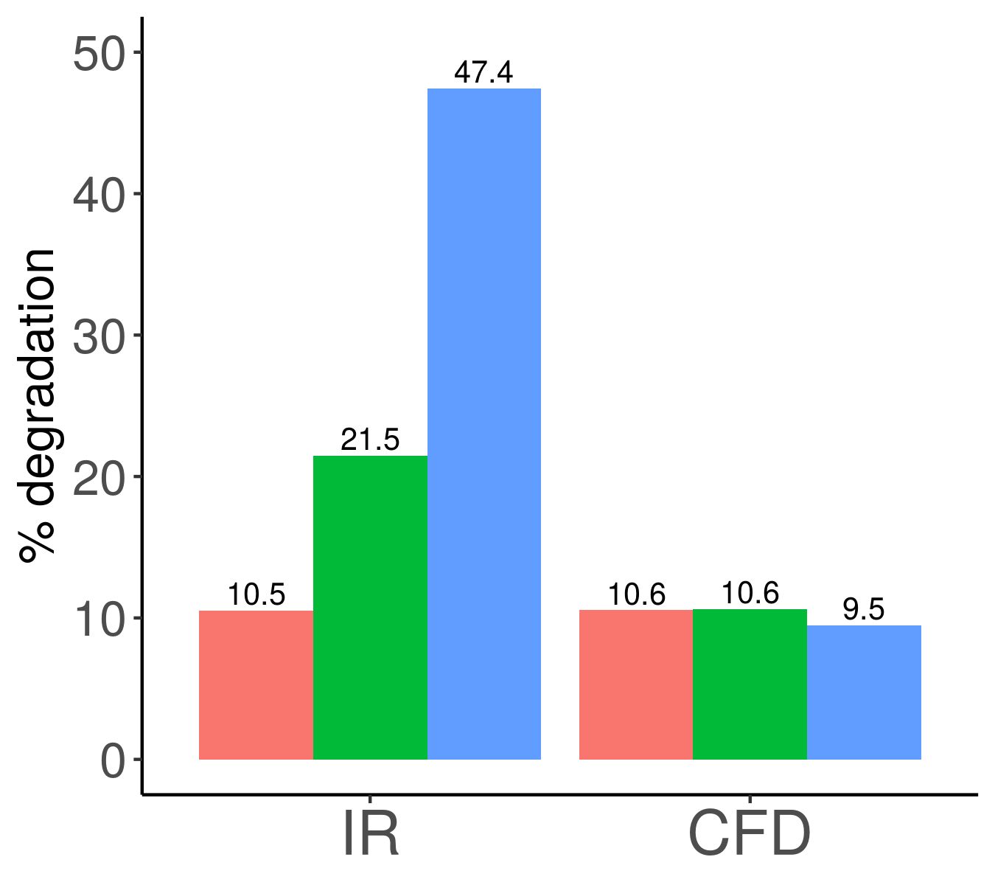
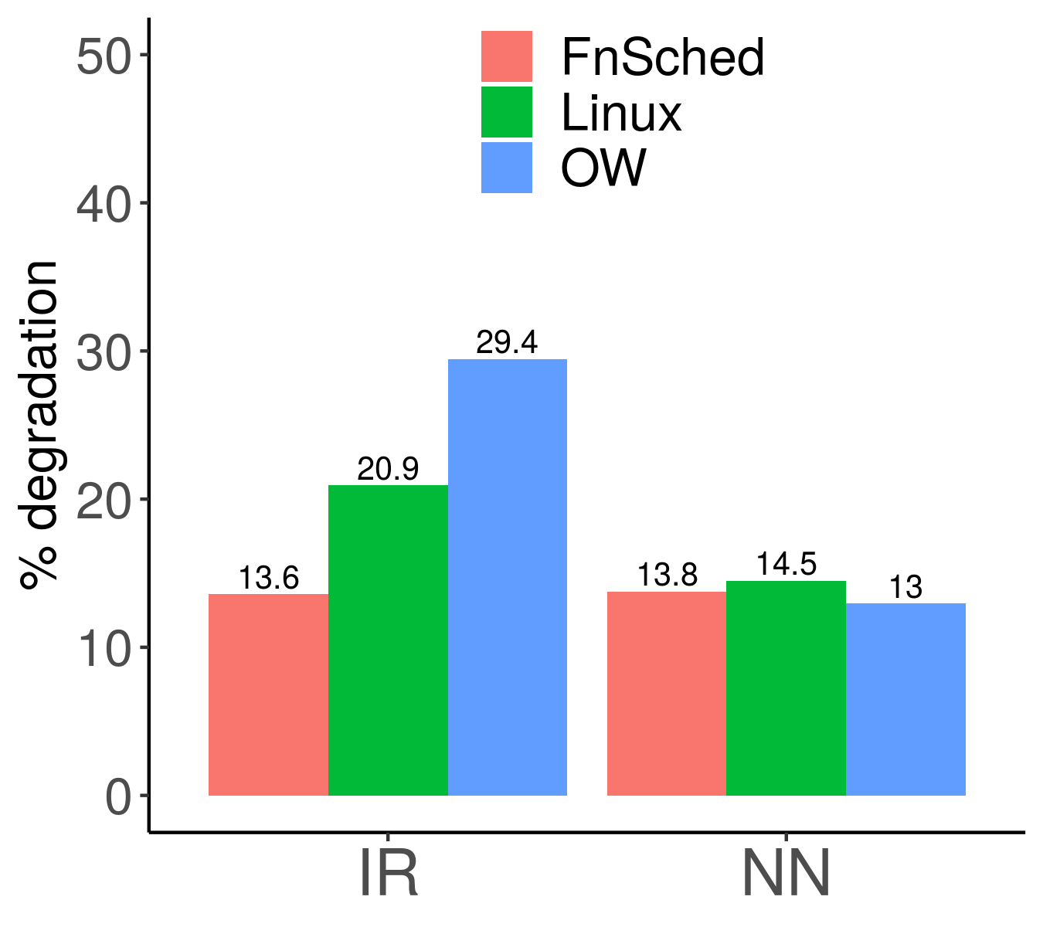
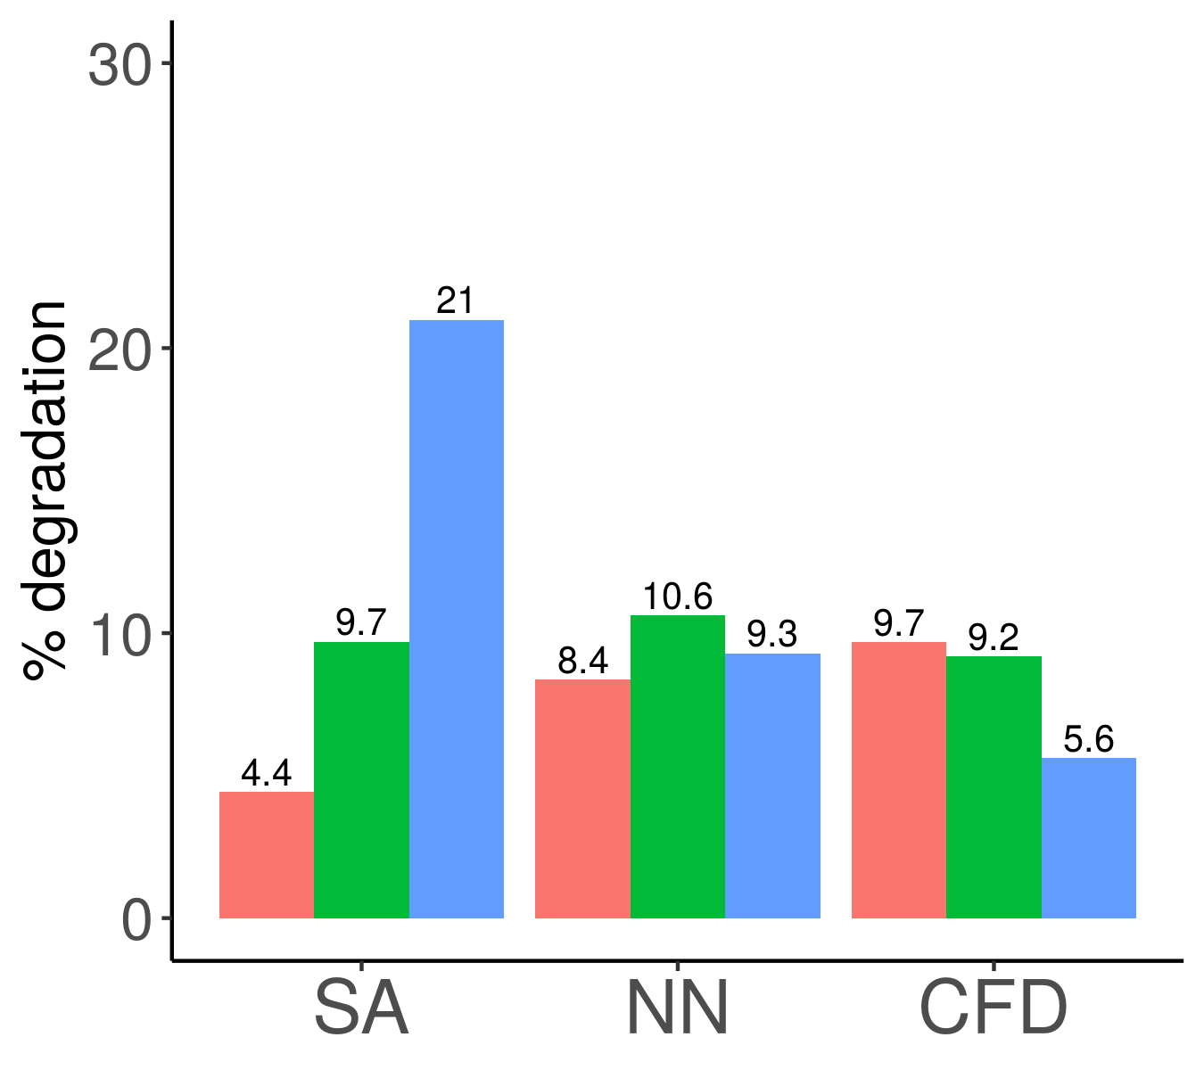
Single Node Evaluation
FnSched: Single node resource allocation
Linux: CPU shares 1024
OpenWhisk: CPU shares proportional to memory
Can safely co-locate
Notes:
Slides 13-15 are good, plan to spend 5mins on them combined as this is the main set of results.
Add line at 15%

Slide 18
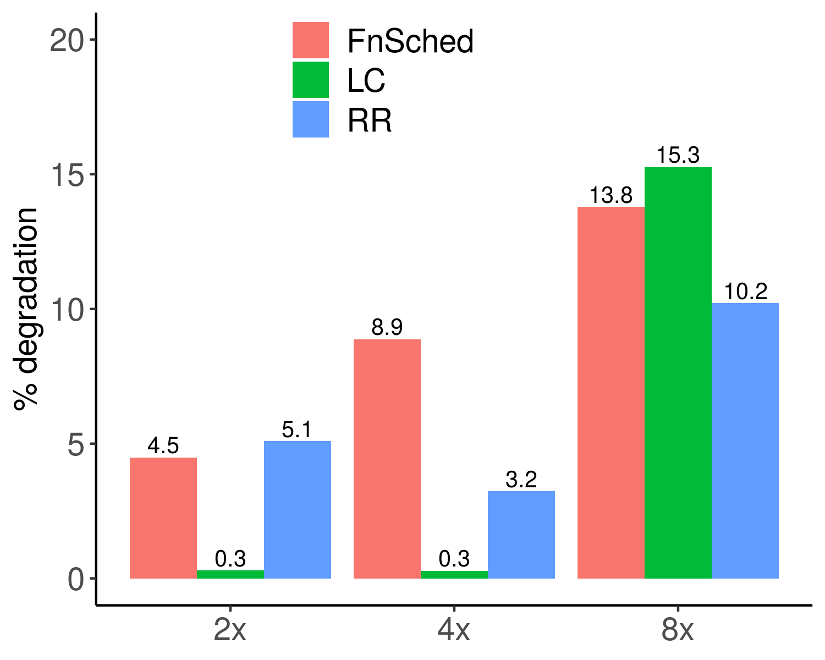
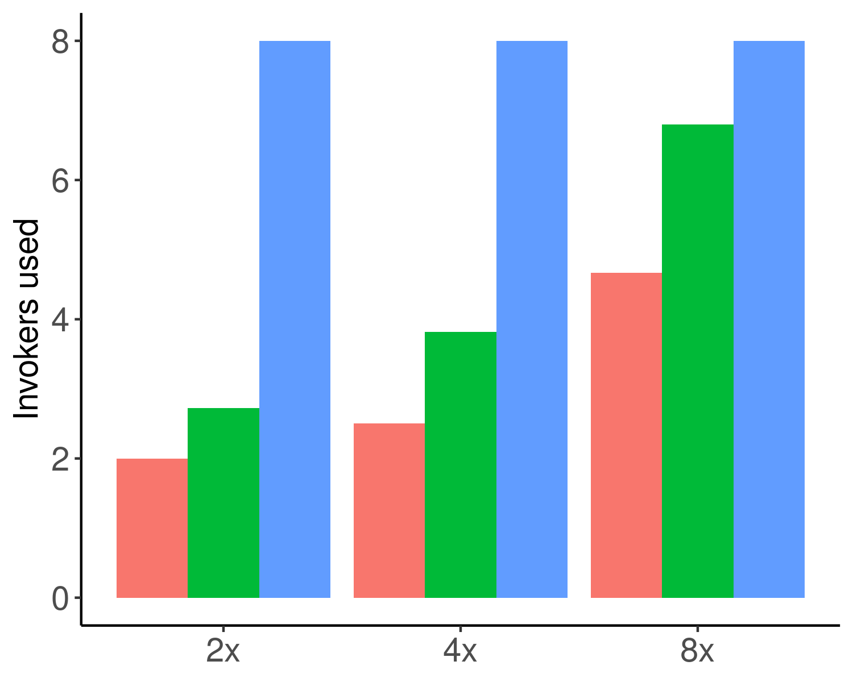
Multinode Evaluation: Scaling
FnSched: Single node resource allocation
LeastConnections (LC): Choose the invoker with least outstanding requests
RoundRobin (RR): Send successive requests to different invokers in a cyclic manner
Packing can scale and
maintain performance
FnSched uses 31% fewer invokers compared to LC, and 62% compared to RR
Notes:
Metric: 15% degradation + fewer nodes

Slide 19
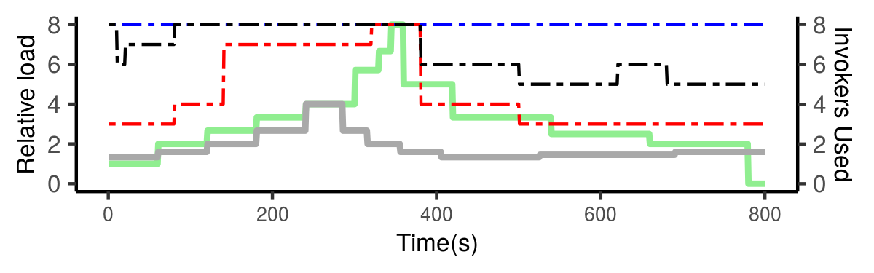
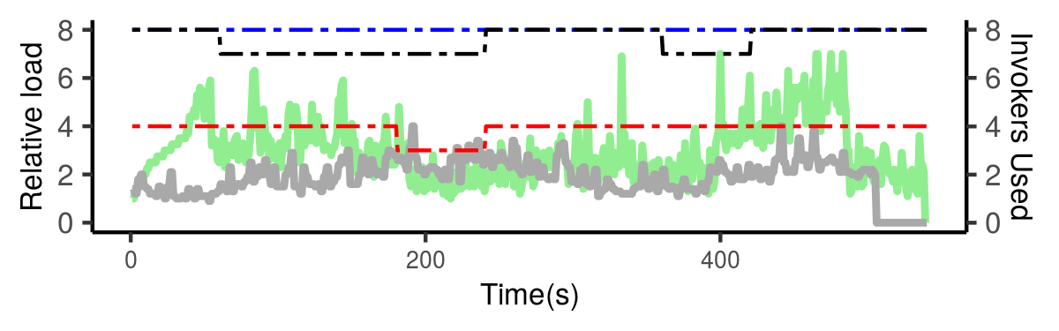
Multi Node Evaluation: Traces
Load:
IR
NN
Scheduling:
FnSched
LeastConnections
RoundRobin
Traces:
Synthetic (top)
WITS (bottom)
FnSched uses 36% fewer invokers compared to LC, and 55% compared to RR
Notes:
FnSched uses 36% fewer invokers compared to LC, and 55% compared to RR

Slide 20
Conclusion
Presented a work-in-progress serverless scheduling algorithm based on colocation + packing
CPU Shares algorithm: Reduces degradation compared to SoA
Packing + Proactive Spawning: Maintains acceptable performance,
While reducing invoker usage by 36% compared to LC, 55% compared to RR
Notes:
Maybe since this is workshop we can have a future work slide too, maybe we can even try to bounce off our icdcs paper ideas to see how they like it.

Slide 21
Q&A

Slide 22
Backup Slides

Slide 23
Future Work
Proactive Spawning : Figure out ~exact number of containers required
Evaluation: Scenarios where colocation opportunities are fewer
Multiple ET applications
ET:MP ratio is > 1
Compare against Knative

Slide 24
FnSched Approach
Goal: Target a maximum degradation latency and minimize the number of servers/invokers used.
Challenges | FnSched Approach
Application Diversity/ Resource management | Application class based colocation, resource management
Cold-Start | Proactive Spawning
Allocation & Placement | Packing based on data center power management policy
Notes:
Provider + Users.
FnSched approach: Within the node + Across the nodes

Slide 25
Sensitivity Analysis
Choose parameters for single node resource allocation algorithm. Parameters vary for application class
numUpdatesThd: Minimum iterations required before updating cpu-shares
maxCpuShares: Ceiling of the cpu-shares per container, maximum of 1024
cpuSharesStep: Per iteration increment of cpu-shares
updateLatencyThd: Minimum degradation before updating cpu-shares 1.10
Appln Class | numUpdatesThd | maxCpuShares | cpuSharesStep
ET | 5 | 768 | 128
MP | 3 | 256 | 64

Slide 26
Multi Node Placement: Latency monitoring
Packaging: Greedy algorithm based on data center power management policy.
I-1
I-2
I-N
Monitor average latency
Based on threshold latency, mark invoker to be in safe, warning, unsafe zone
Capacity of invoker varies by the zone
Notes:
Cold Starts: Send heartbeat requests to keep proactive containers alive
How to do it on multiple nodes?

