Slide 1
Serverless? are there any Cons?
Ali Kanso, PhD
Senior Cloud SW Engineer
IBM Research
T.j. Waston, NY
USA

Slide 2



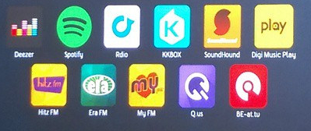
The New Paradigm
Netflix: 125 million streaming hours a day
Millennials spend 25 hours a week streaming music
From Passive Delivery, to Active Delivery
Event-based

Slide 3
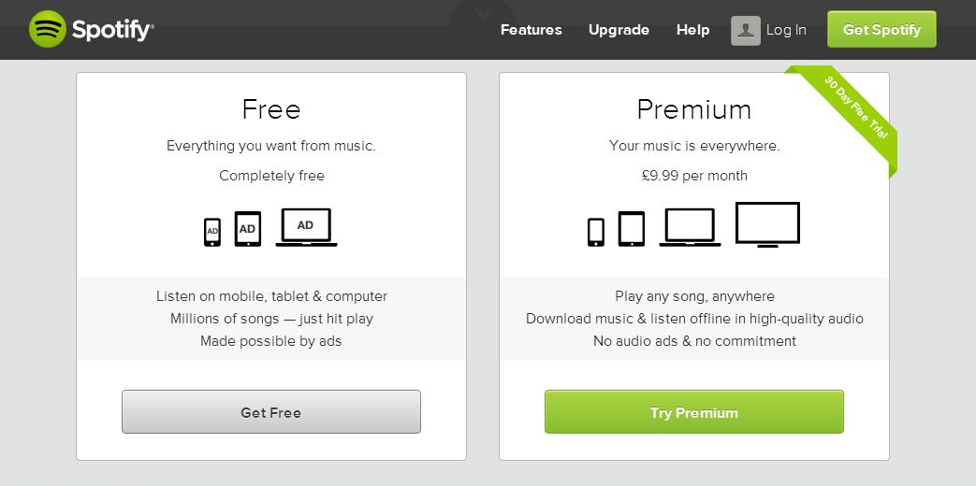
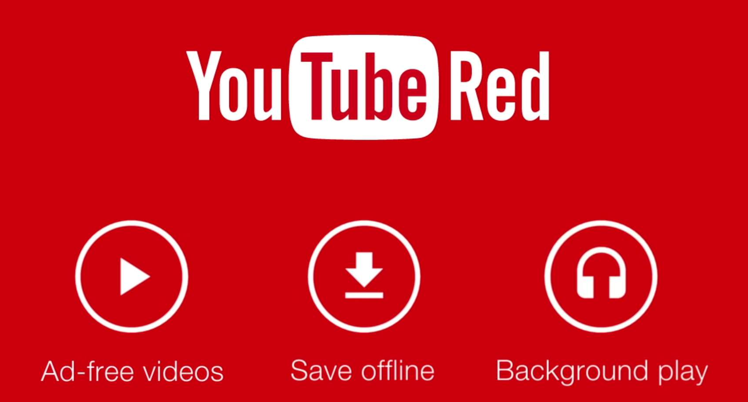
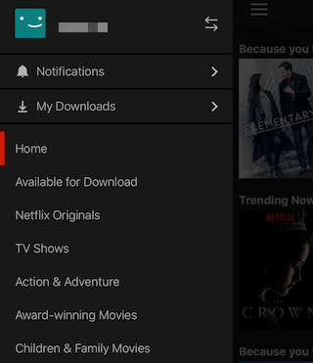
From Streaming to File Transfer
Subscription pays more than adds!
Streaming is costly!
Solution: File Transfer with Smart-Client
Transfer from long-lived event, to short lived event!

Slide 4
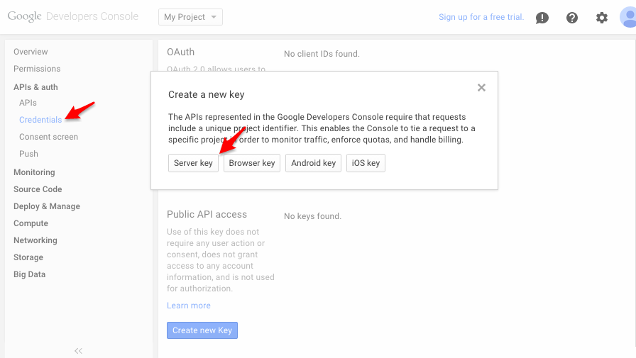
Why not simply PaaS?
Manage min # of instances
With microservice this can grow
Manage the workflow
Scaling is reactive, not deterministic

Slide 5
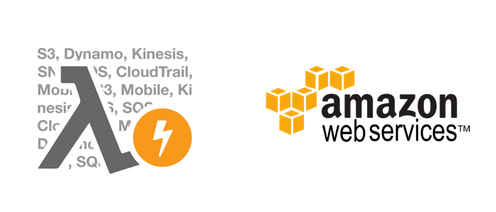

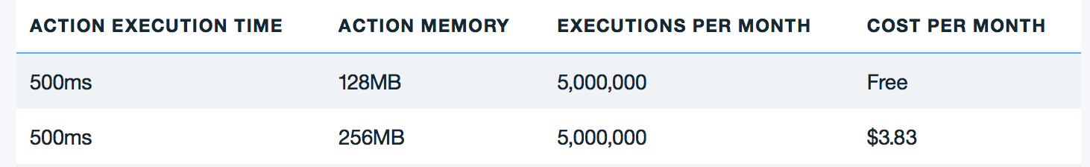
Pricing is a trap!
A function created with 1 GB of memory will cost $0.000001667 per 100ms of execution time
Amazon provides a perpetual free tier with 1 million free requests and 400,000 GB-seconds of compute time per month
5M requests, 100GB data moving, 10M GB-seconds = $62.307 per month

Slide 6
Making Sense Of Pricing
Cloud Providers know that:
serverless cannot work independently
You will need a backends that the cloud provider is offering (less latency), otherwise you pay for egress
As well as other services, and notifications …
The model allows Cloud Providers to fill unused resources in small portions

Slide 7
Any Cons?
When Public:
It may not be suitable for privacy-sensitive apps
Government, healthcare, Banking, …
It may not be suitable for latency-sensitive applications
You cannot customize your infrastructure to better suit your needs (e.g. lighter OS)
Vendor lock-in with the APIs and ther services eco-system
When Private:
You have to manage and maintain the serverless framework
Typically it is a multicomponent system (nginx, kafka, CouchDB, …)
Deployment, Availability, scaling, …

Slide 8
Any Cons?
You need to consider building thicker smarter front ends
E.g. make Third Party Calls and embed them in the request action
Smarter front-ends can help reducing the number of invocations, and making sense of the results

Slide 9

Remaining Question
Is it still worth it??

