Slide 1

Function-as-a-Service Application Service Composition: Implications for a Natural Language Processing Application
Mohammadbagher Fotouhi, Derek Chen Wes Lloyd¹
December 9, 2019
School of Engineering and Technology, University of Washington, Tacoma, Washington USA
WOSC 2019: 5th IEEE Workshop on Serverless Computing

Slide 2
Outline
Background
Research Questions
Experimental Implementation
Experiments/Evaluation
Conclusions

Slide 3

Natural Language Processing
How can computers be used to understand speech?
Image from: https://aliz.ai/natural-language-processing-a-short-introduction-to-get-you-started//

Slide 4
NLP Dialogue modeling components
Intent Tracking
Determines what the user wants
Policy Management
Choose the agent action
Text Generation
Generate the actual text

Slide 5
NLP Dialogue modeling components
Considering a scenario where a user asks : “What is Milad’s phone number ?”
Intent tracker -> Question
Policy Management -> To answer
Text generator -> “The number is 123-456-7890”
These phases include an initialization and inference step

Slide 6

Serverless Computing
Image from: https://mobisoftinfotech.com/resources/blog/serverless-computing-deploy-applications-without-fiddling-with-servers/

Slide 7
Serverless Computing
Function-as-a-Service (FaaS) platforms
New cloud computing delivery model that provides a compelling approach for hosting applications
Bring us closer to the idea of instantaneous scalability
Our goals- research implications of:
Memory reservation
Service composition
Adjustment of neural network weights
In the context of NLP application deployment

Slide 8
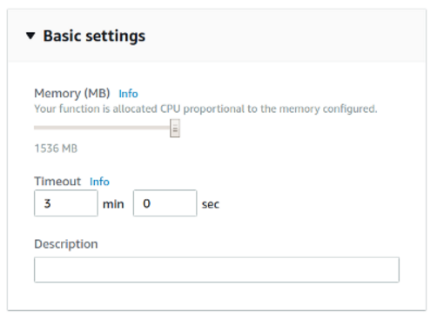

Memory Reservation
Lambda memory reserved for functions
UI provides “slider bar” to set function’s memory allocation
Resource capacity (CPU, disk, network) coupled to slider bar: “every doubling of memory, doubles CPU…”
How does memory allocation affect performance?
Performance

Slide 9

Infrastructure Freeze/Thaw Cycle
Unused infrastructure is deprecated
But after how long?
AWS Lambda: Bare-metal hosts, firecracker micro-VMs
Three infrastructure states:
Fully COLD (Cloud Provider/Host)
Function package transferred to hosts
Runtime environment COLD
Function package cached on Host
No function instance or micro-VM
WARM (firecracker micro-VM)
Function instances/micro-VMs ready
Performance
Image from: Denver7 – The Denver Channel News

Slide 10
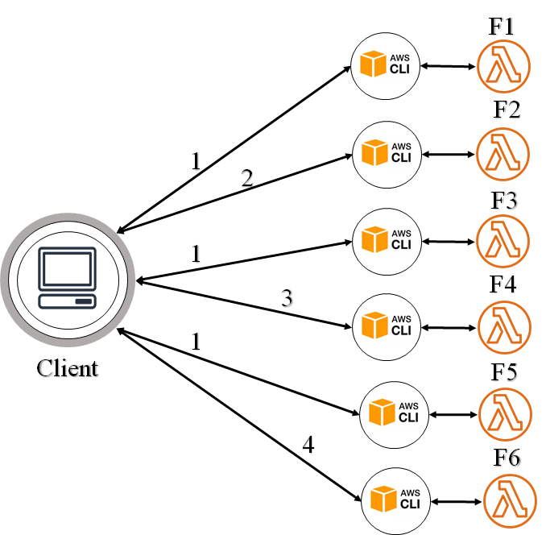
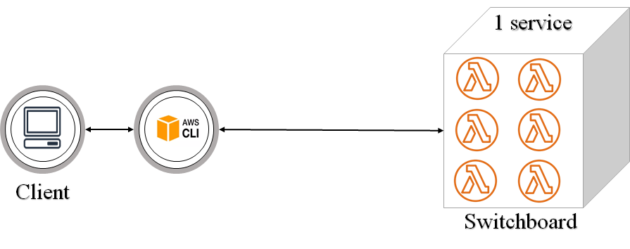
Service Composition
How should applications be composed for deployment to serverless computing platforms?
Fully aggregated (Switchboard) and fully disaggregated (Service isolation) composition
Platform limits: code + libraries ~250MB
How does service composition affect freeze/thaw cycle and impact performance?
Switchboard / Asynchronous
Service isolation
Performance

Slide 11
Outline
Background
Research Questions
Experimental Workloads
Experiments/Evaluation
Conclusions

Slide 12
Research Questions
RQ1:
RQ2:
MEMORY: How does the FaaS function memory reservation size impact application performance?
COMPOSITION: How does service composition of microservices impact the application performance?

Slide 13
Research Questions - 2
RQ3:
RQ4:
NN-WEIGHTS: How does varying the neural network weights impact the performance of the NLP application?
FREEZ THAW LIFE CYCLE: How does the service composition of our NLP application impact the freeze-thaw life cycle?

Slide 14
Outline
Background
Research Questions
Implementation
Experiments/Evaluation
Conclusions

Slide 15
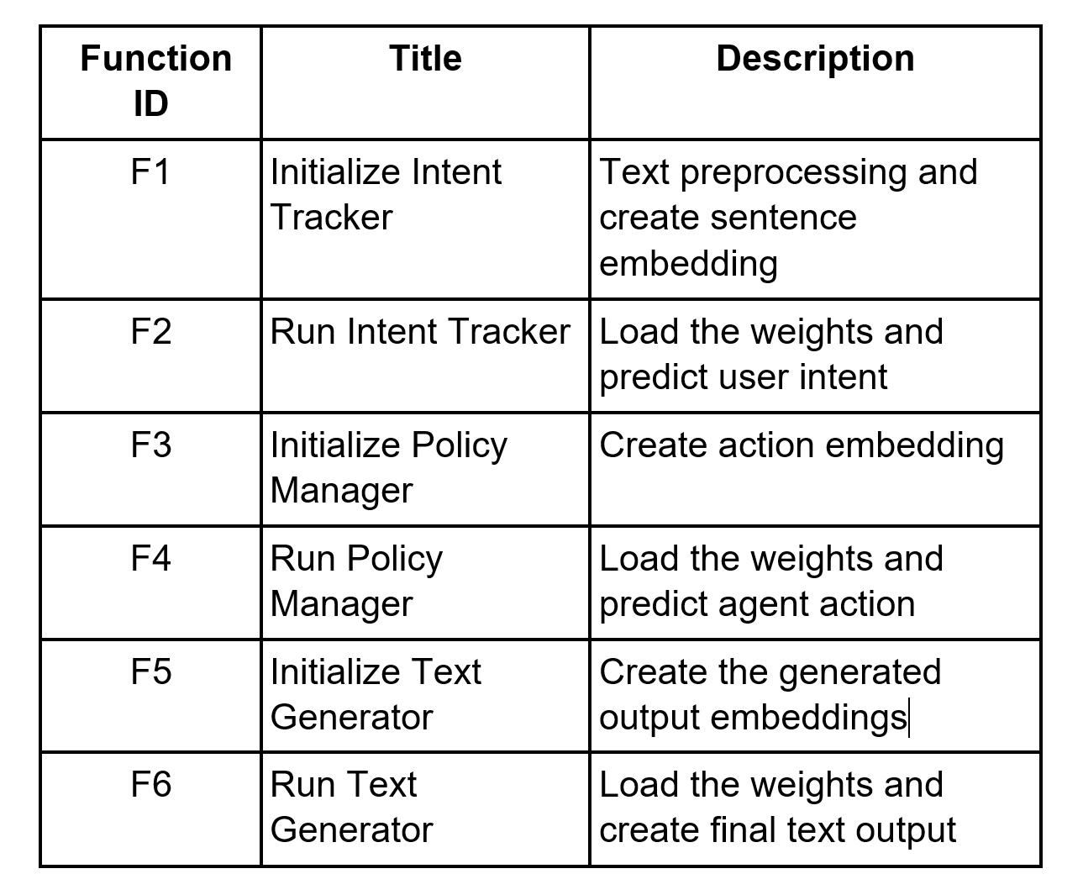
Aws lambda Inference functions

Slide 16
Switchboard architecture
Aggregated all 6 microservices in one package
Client initiates pipeline
Switchboard routine accepts calls and routes internally

Slide 17
Full service isolation architecture
Fully decomposed functions as independent microservices
Cloud provider provisions separate runtime containers

Slide 18
Application Implementation
Disseminate neural network models with AWS S3
AWS CLI based client for submitting requests
Leveraged AWS EC2’s Python Cloud9 IDE to identify and compose dependencies
Packaged dependencies as ZIP for inclusion in Lambda FaaS function deployment
Conformed to package size limitations (<250MB)

Slide 19
Outline
Background
Research Questions
Experimental Workloads
Experiments/Evaluation
Conclusions

Slide 20
NN-Weights
How does varying the neural network weights impact the performance of the NLP application?

Slide 21
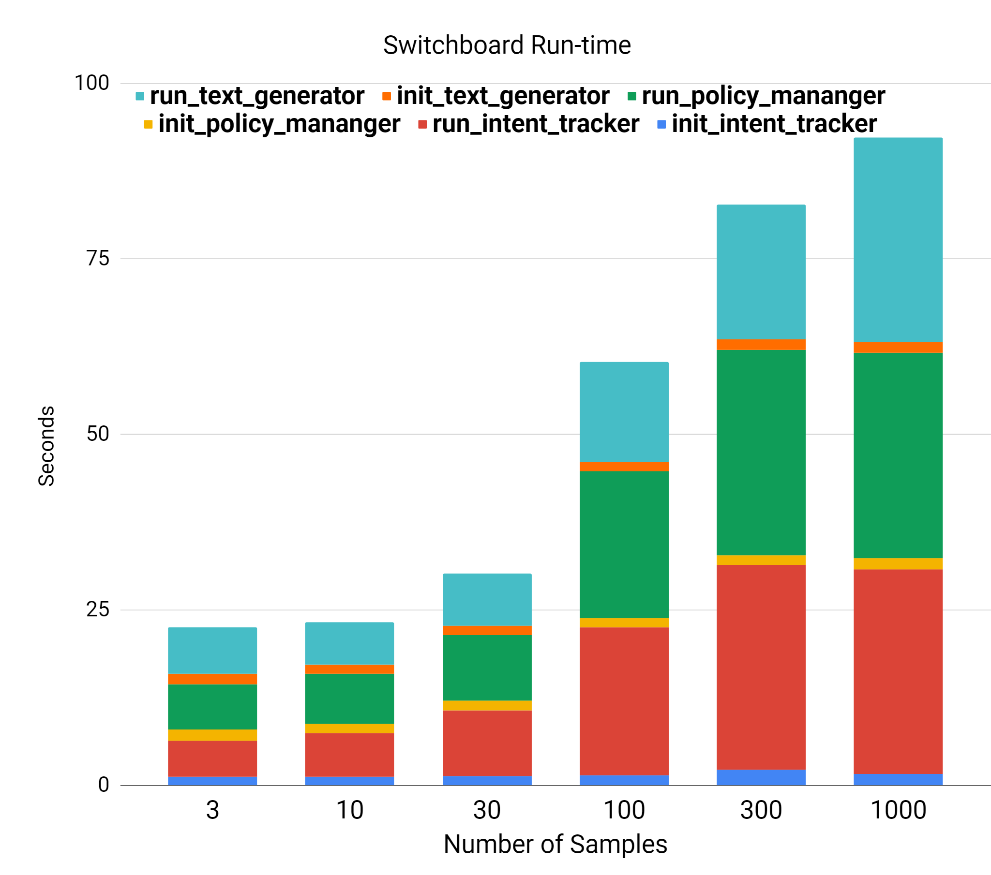
Runtime performance Switchboard
Running the inferences is the performance and memory bottleneck.
Increasing the number of samples increases the runtime.
The Intent tracker initialization is slower than the other initialization phases.
Performance range: 22.46 sec for 3 samples , 92.31 sec for 1,000 samples - throughput (samples/second) increased ~81x.
Coefficient of variation (CV) ~ 6.3%.
c4.2xlarge – average of 8 runs

Slide 22
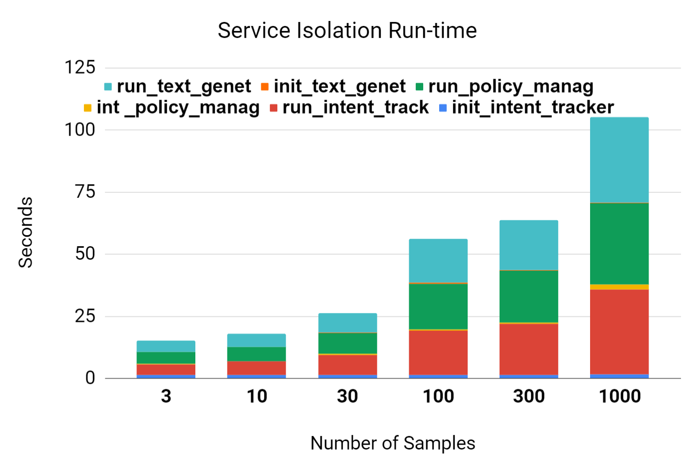
Runtime performance Service Isolation
Initialization phases, all have the same performance.
In all cases, the performance bottleneck is running the network.
Runtime increases with larger input data sizes.
Performance range: 14.19 sec for 3 samples, 108.29 sec for 1,000 samples - throughput (samples/second) increased ~43x.
Coefficient of variation (CV) averaged 12.6%
c4.2xlarge – average of 8 runs

Slide 23
Memory
How does the FaaS function memory reservation size impact application performance?

Slide 24
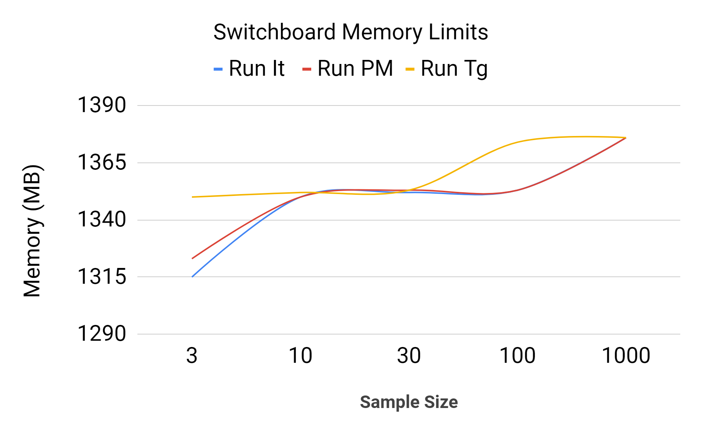
Memory Utilization Switchboard
Max Memory used (MB)
C4.8xlarge 36 vCPU client

Slide 25
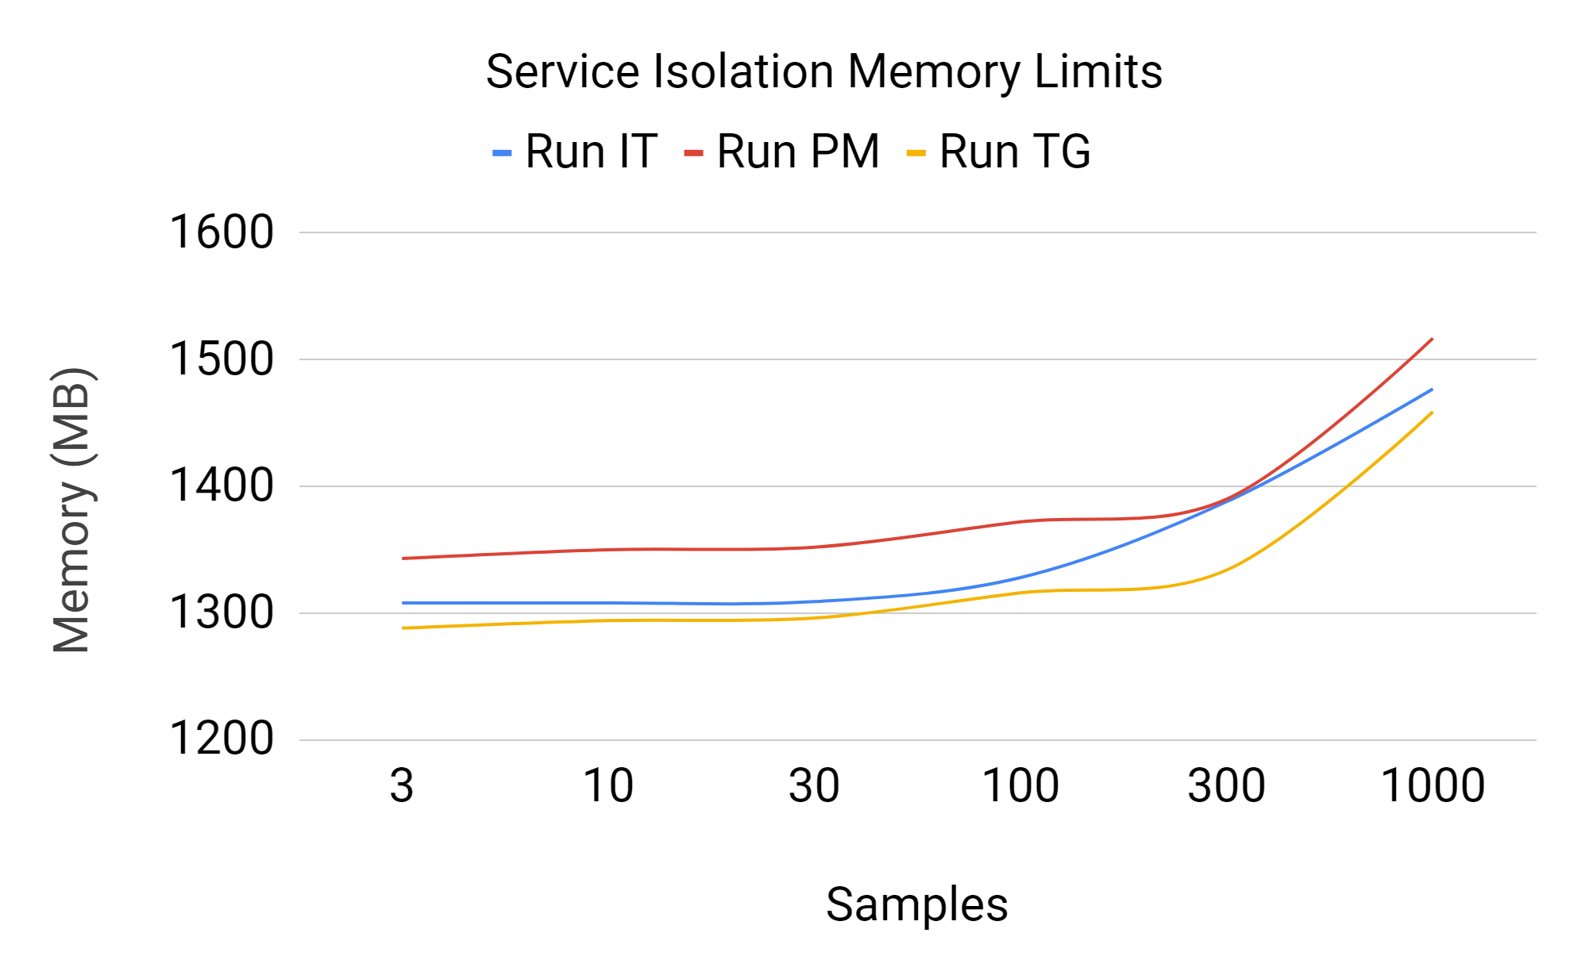
Memory Utilization Service isolation
Max Memory used (MB)

Slide 26
Composition
How does service composition of microservices impact the application performance?

Slide 27
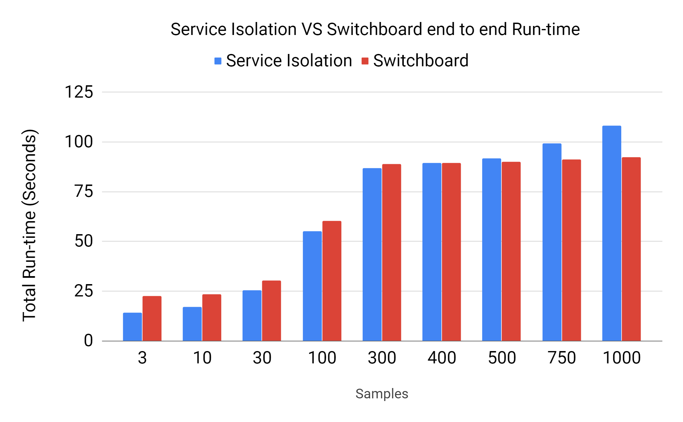
Performance Comparison
Switchboard performed more efficiently over larger input dataset sizes.
As the input data size grows, the switchboard outperforms the service isolation.
The service isolation architecture runtime performance normalized to switchboard :
63.2% : 3 samples- 73% : 10 samples- 84% : 30 samples- 91.5% : 100 samples- 94.6% : 300 samples- 117.3%: 1000 samples
Memory sizes tested: 192, 256, 384, 512 MB

Slide 28
Outline
Background
Research Questions
Experimental Workloads
Experiments/Evaluation
Conclusions

Slide 29
Conclusions
Switchboard architecture minimized cold starts
Switchboard performed more efficiently over larger input dataset sizes vs. service isolation
14.75 % faster for 1,000 samples
17.3% increase in throughput
When inferencing just 3 samples, the service isolation architecture was faster
36.96% faster for 3 samples
58% increase in throughput
→ full service isolation not always optimal

Slide 30
Questions

