Slide 1
Serverless Panel Middleware 2019
Ali Kanso, Ph.D.
Sr. SW Engineer

Slide 2
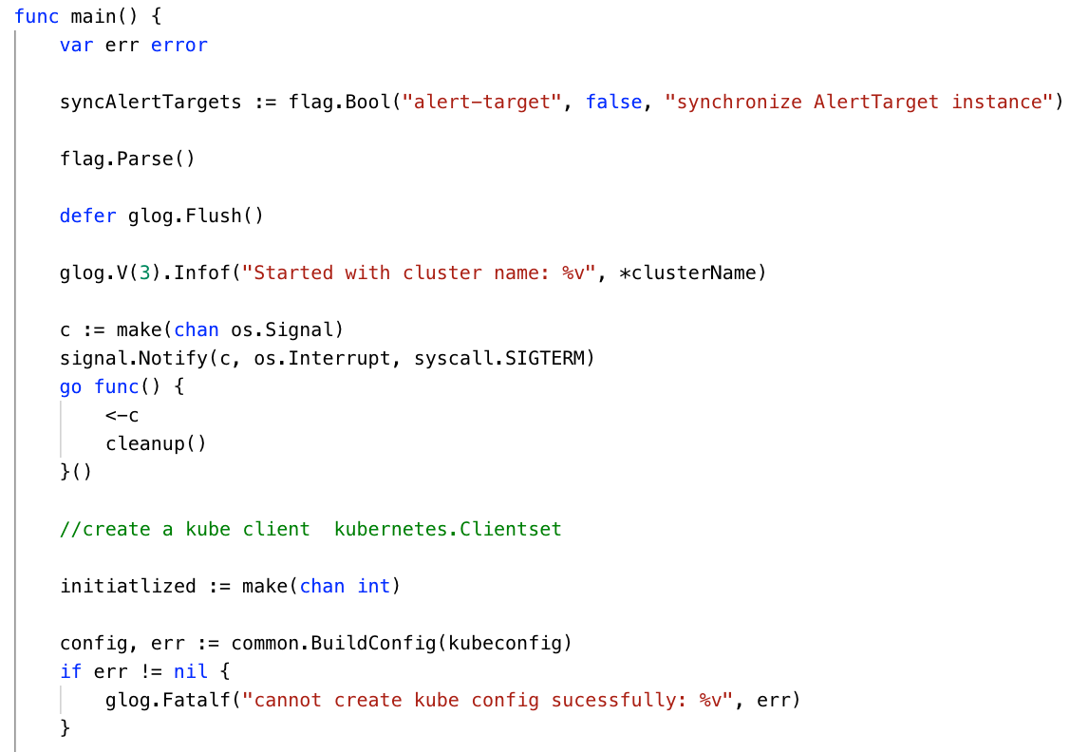
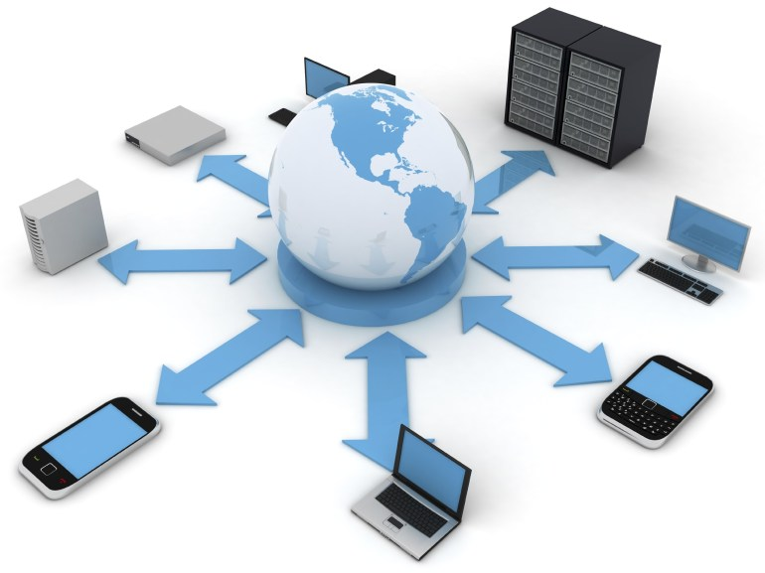

Do we know how to write Functions as a service?
Can Serverless be Pervasive?
Is serverless computing a game changer?

