Slide 1
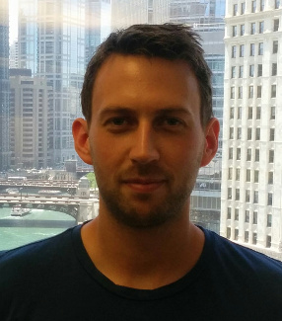
FaaS: The future of computing?
Ryan Chard
Postdoc, Argonne National Laboratory
A powerful abstraction of computing resources
Rapidly being adopted for event-based systems
Proven beneficial for scalable websites/IoT use cases
Facilitates reproducibility and sharing of codes
Significant for scientific use cases
Predictions:
It will be applied to general purpose computing applications
5 min exec/memory limitations etc. are arbitrary and will be expanded as demand grows
Edge-based FaaS adoption will grow: OpenWhisk/AWS GreenGrass
Leadership devices will expose FaaS platforms
Serverless computing will supplant VM provisioning (EC2 etc.)
The way all scalable programming will eventually be performed

Slide 2
Research Topics
Apply to parallel programming (e.g., Jonas et al. proposed PyWren)
PyWren uses Lambdas to perform Map functions
The Lambda loads a pickled applications and executes it
Batch submission system that dynamically wrap codes into lambdas, or uses cloud pickle like PyWren
Streamlining the creation of functions
Enable a “cloud button” for notebooks etc. that deploys them as functions
Analysis portals backed completely by FaaS execution

