Slide 2
(a)
Drift scenario 1
(b)
Drift scenario 2
Urban
K = 10
Rural
K = 1000
Urban
K = 1000
Colonization
Rural
K = 1000
Gene flow
(3)
(c)
Colonization
(1)
p_{B} (e.g. Li)
(2)
p’_{B} (e.g. Li)
(4)
Growth
Selection
Colonization
q_{B} (e.g. li)
q’_{B} (e.g. li)
Within-population dynamics

Slide 3
Urban
Selection against HCN
Rural
Selection for HCN
Maximum s
Strength of
selection (s)
Distance from
urban-most population
0
20
40
–Maximum s

Slide 4
(a)
(b)
HCN
CYP79D15
Li
Mean Slope
(c)
(d)
Proportion of significant slopes
Strong
drift gradient
Minimum urban
population size
No
drift gradient
Level of gene flow (m)

Slide 5
(a)
No gene flow (m = 0)
Low gene flow (m = 0.01)
High gene flow (m = 0.05)
Mean Slope
(b)
Proportion of significant slopes
Strong
drift
Proportion of founding alleles
Weak
drift

Slide 6
Strong founder effect (prop. = 0.01)
β = 0.003; P = 0.002; R² = 0.22
Intermediate founder effect (prop. = 0.2)
β = 0.007; P < 0.001; R² = 0.93
No founder effect (prop. = 1.0)
β = 0.0009; P < 0.001; R² = 0.99
(a)
Colonization
(b)
Proportion of simulations
in which HCN is lost
Mean frequency of HCN
Urban
Distance from urban-most
population
Rural
Urban
Distance from urban-most
population
Rural

Slide 7
(a)
(b)
No gene flow (m = 0)
No gene flow (m = 0)
Low gene flow (m = 0.01)
Low gene flow (m = 0.01)
High gene flow (m = 0.05)
High gene flow (m = 0.05)
Mean Slope
(c)
(d)
Proportion of significant slopes
Selection coefficient (s)
Selection coefficient (s)

Slide 8
(a)
No gene flow (m = 0)
Low gene flow (m = 0.01)
High gene flow (m = 0.05)
Mean Slope
(b)
Cline direction
Positive
Negative
Proportion of significant slopes
Initial allele frequency (CYP – Li)

Slide 9
(a)
No founder effect
(prop. = 1.0)
(b)
Intermediate founder effect
(prop. = 0.2)
(c)
Strong founder effect
(prop. = 0.01)
Mean slope
(d)
(e)
(f)
Proportion of significant slopes
Selection coefficient (s)
Selection coefficient (s)
Selection coefficient (s)

Slide 10
(a)
No founder effect
(prop. = 1.0)
(b)
Intermediate founder effect
(prop. = 0.2)
(c)
Strong founder effect
(prop. = 0.01)
Mean slope
(d)
(e)
(f)
Proportion of significant slopes
Initial allele frequency (CYP – Li)
Initial allele frequency (CYP – Li)
Initial allele frequency (CYP – Li)

Slide 11
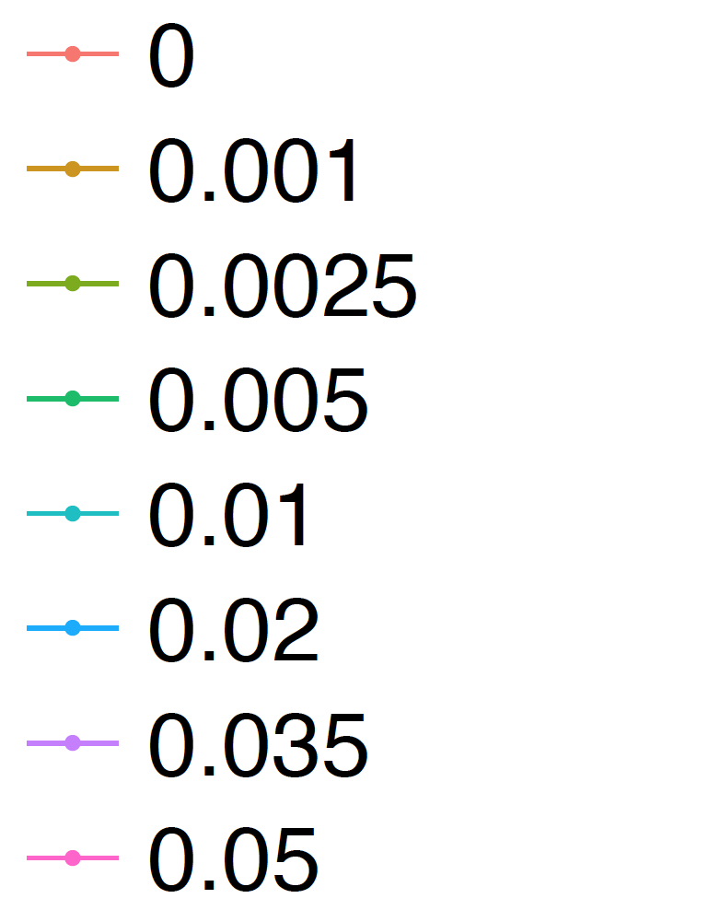
(a)
Mean Slope
Level of
gene flow
(b)
Proportion of sig. positive slopes
Generation

Slide 12
(a)
Strong drift gradient (min N = 10)
No gene flow (m = 0)
(b)
Intermediate drift gradient (min N = 100)
No gene flow (m = 0)
Count
(c)
Strong drift gradient (min N = 10)
High gene flow (m = 0.05)
(d)
Intermediate drift gradient (min N = 100)
High gene flow (m = 0.05)
Count
(e)
Slope
Observed slopes
Not significant
Significant
Count
Slope

Slide 13
(a)
CYP79D15
(b)
Li
Not significant
Not significant
Significant
Significant
Count
Slope
Slope

Slide 14
(a)
Mean number of generations
to filling of landscape
(b)
Mean number of generations
to carrying capacity
Strong
drift
Proportion of founding alleles
Weak
drift

Slide 15
Drift scenario 1
Drift scenario 2
Count
Slope

