Slide 1
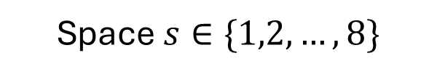
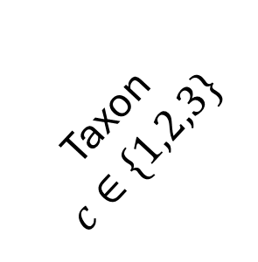

Resource-consumer-predator biomass
T$ime t∈\{1,2,…,5\}$
Taxon
$$c∈\{1,2,3\}$$
Space $s∈\{1,2,…,8\}$

Slide 2
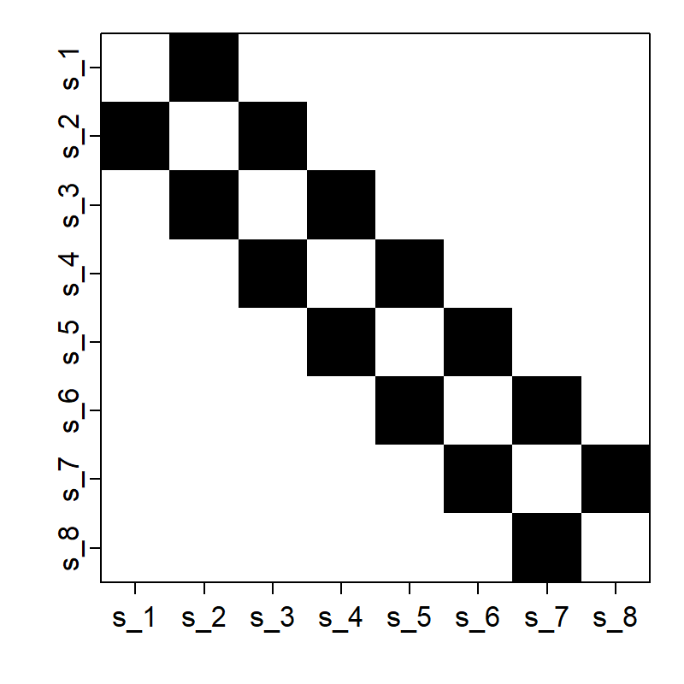
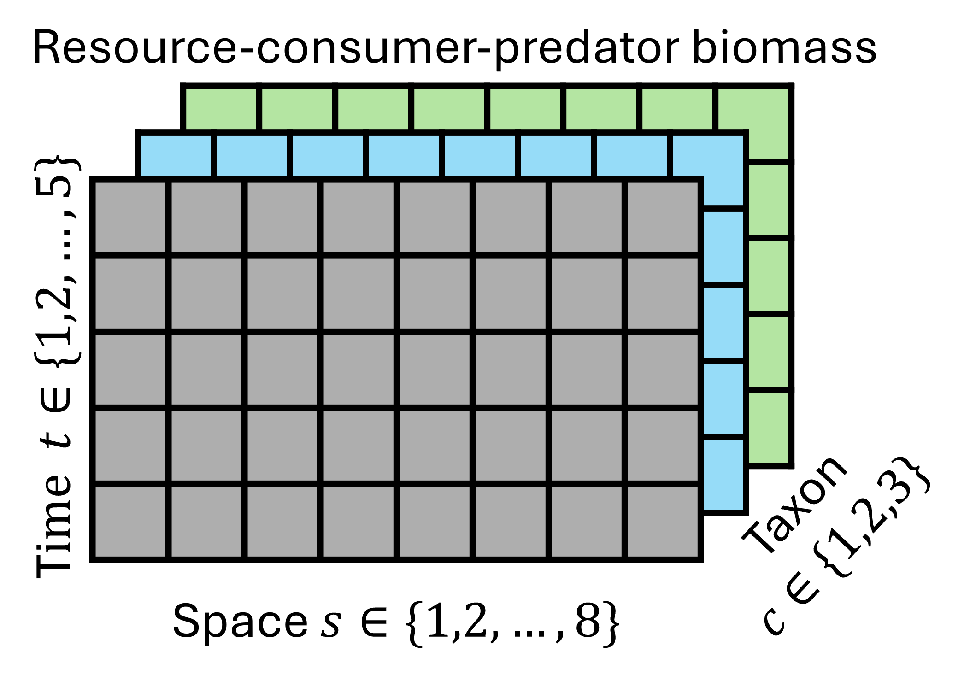
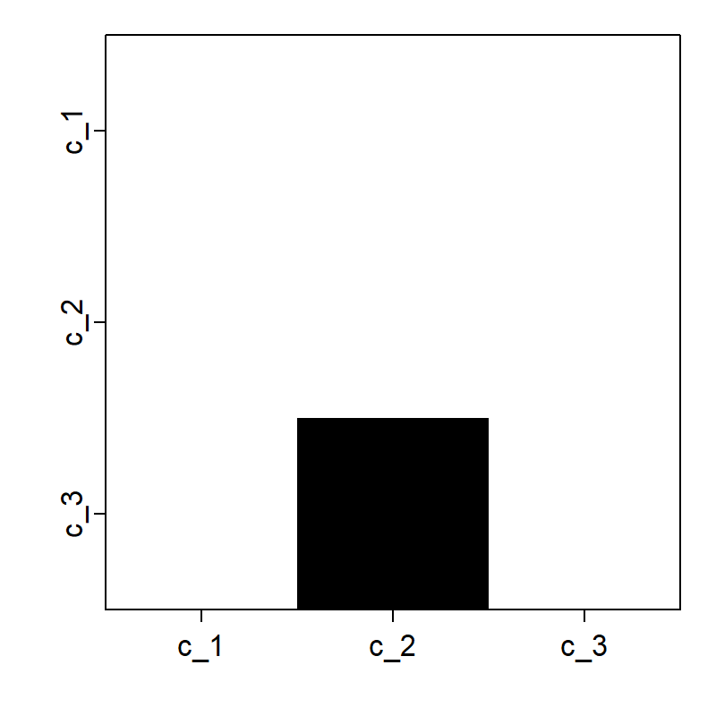
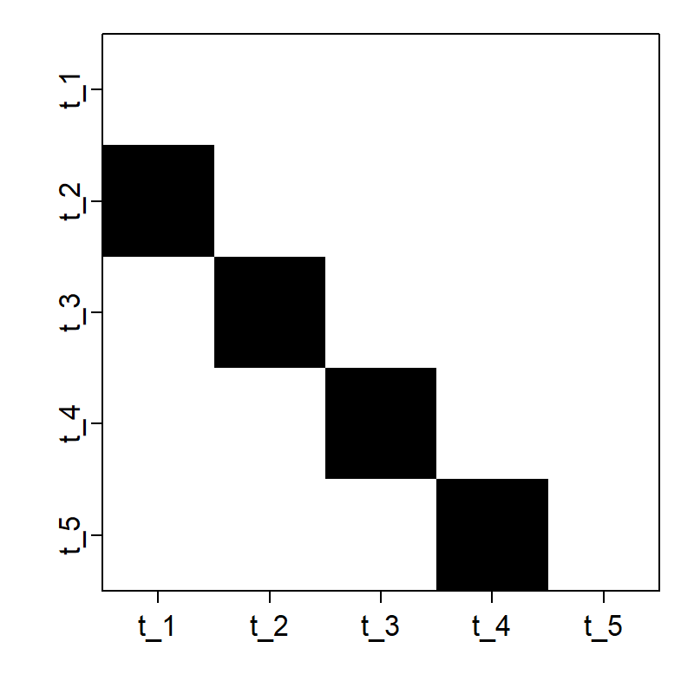
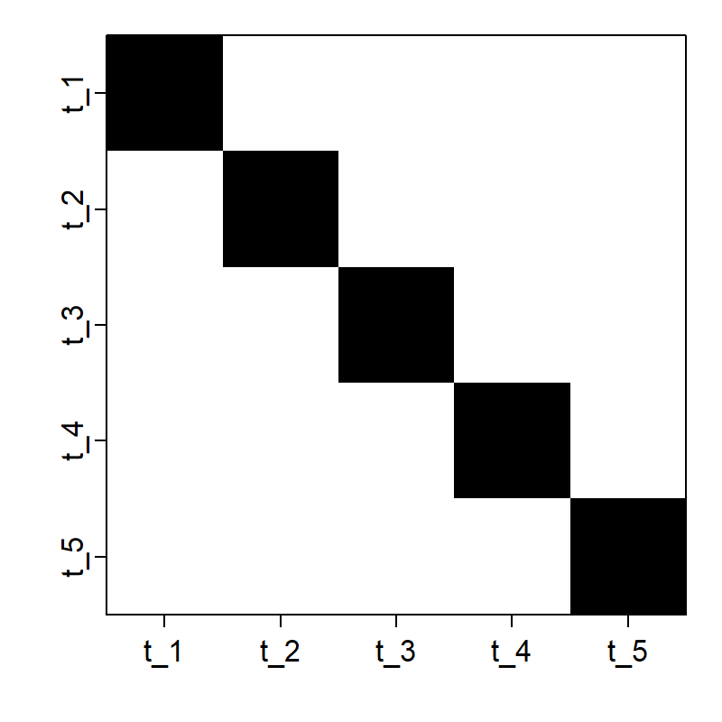
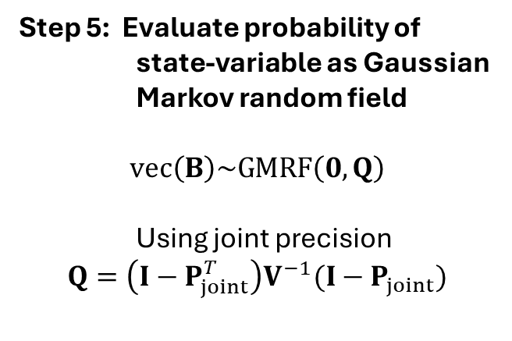

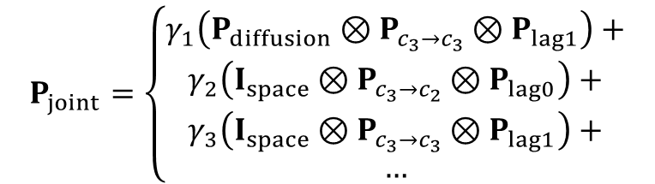




Step 1: Define dimensions for
state-variable $B$
Step 3: Construct elementary
paths matrices
Step 4: Assemble joint path matrix
$$P_{joint}=\left\{\begin{aligned}γ_{1}\left(P_{diffusion}⊗P_{c_{3}→c_{3}}⊗P_{lag1}\right)+ \\ γ_{2}\left(I_{space}⊗P_{c_{3}→c_{2}}⊗P_{lag0}\right)+ \\ γ_{3}\left(I_{space}⊗P_{c_{3}→c_{3}}⊗P_{lag1}\right)+ \\ …\end{aligned}\right.$$
$$P_{diffusion}=$$
$$P_{c_{3}→c_{2}}=$$
Step 5: Evaluate probability of
state-variable as Gaussian Markov random field
$$vec\left(B\right)\sim GMRF\left(0,Q\right)$$
Using joint precision
$$Q=\left(I−P_{joint}^{T}\right)V^{−1}(I−P_{joint})$$
Step 2: Hypothesize mechanisms
Dynamics
≈
Predator diffusion over time +
Predator consumption of consumer +
Predator density dependence +
…
$$P_{lag1}=$$
$$P_{lag0}=$$

