Slide 1
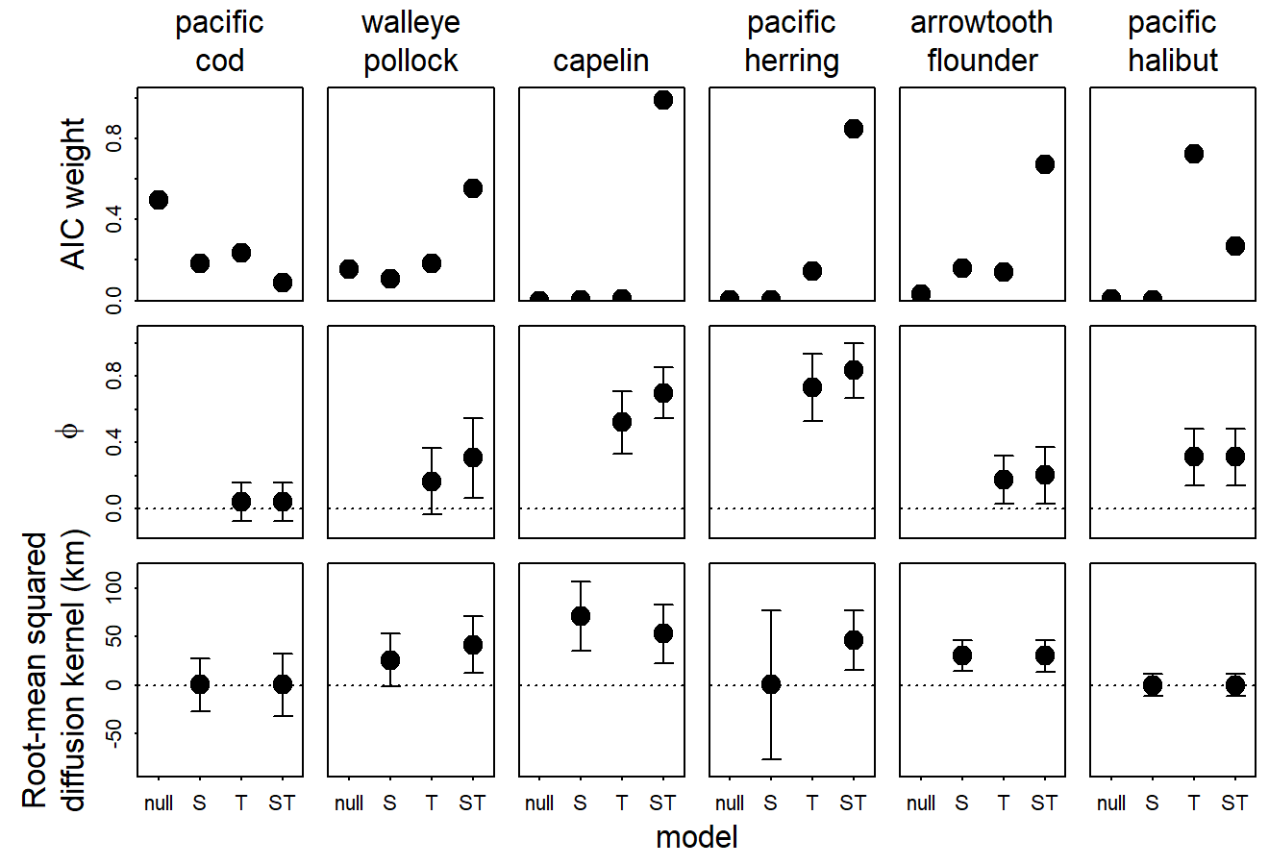
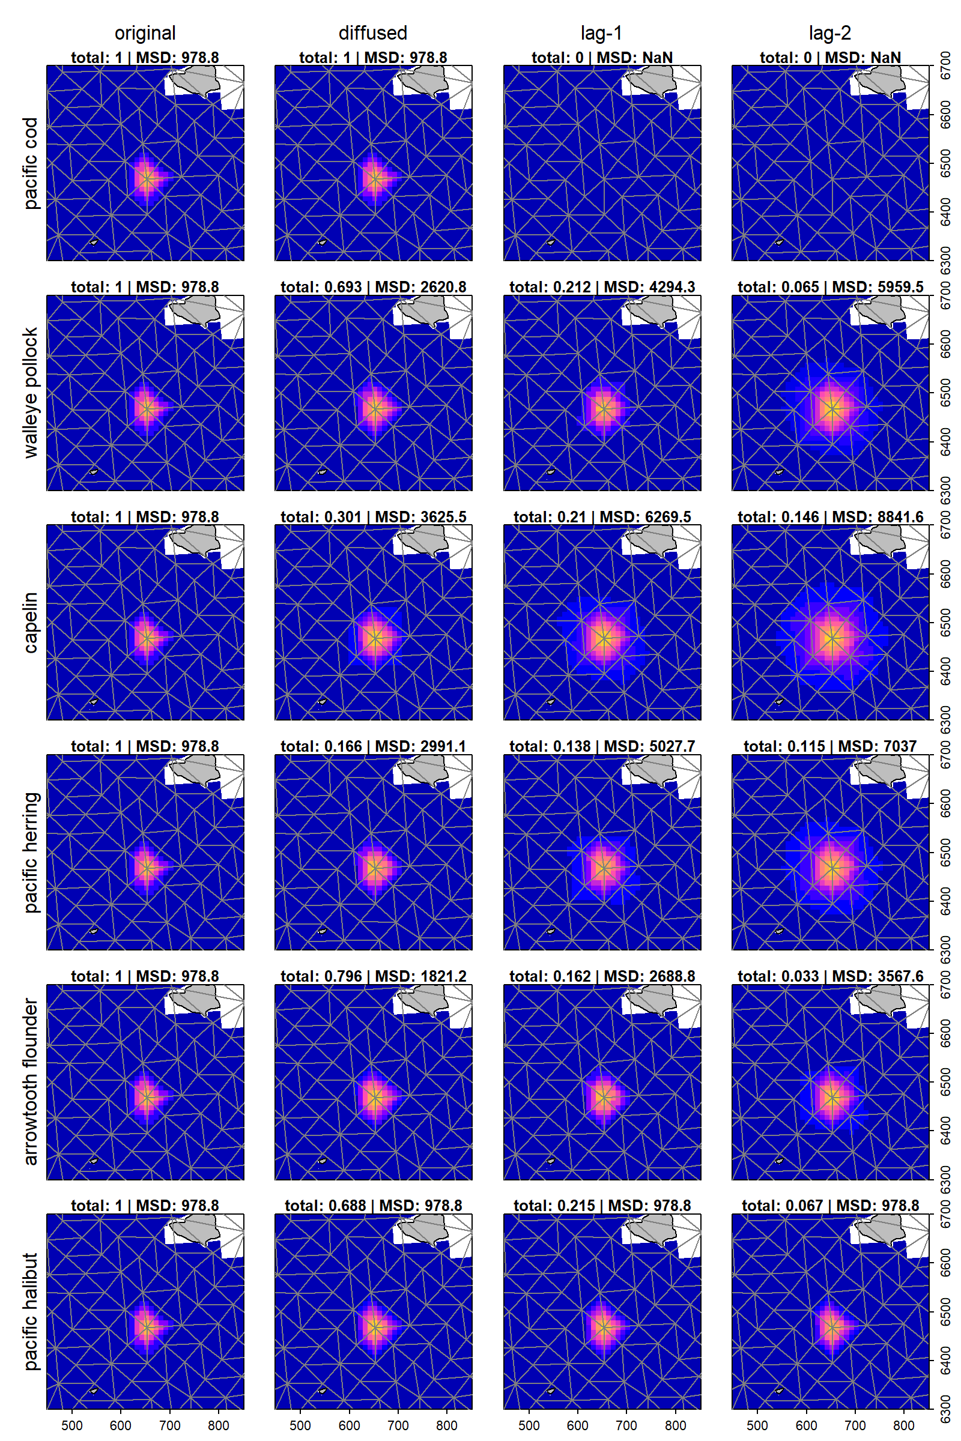
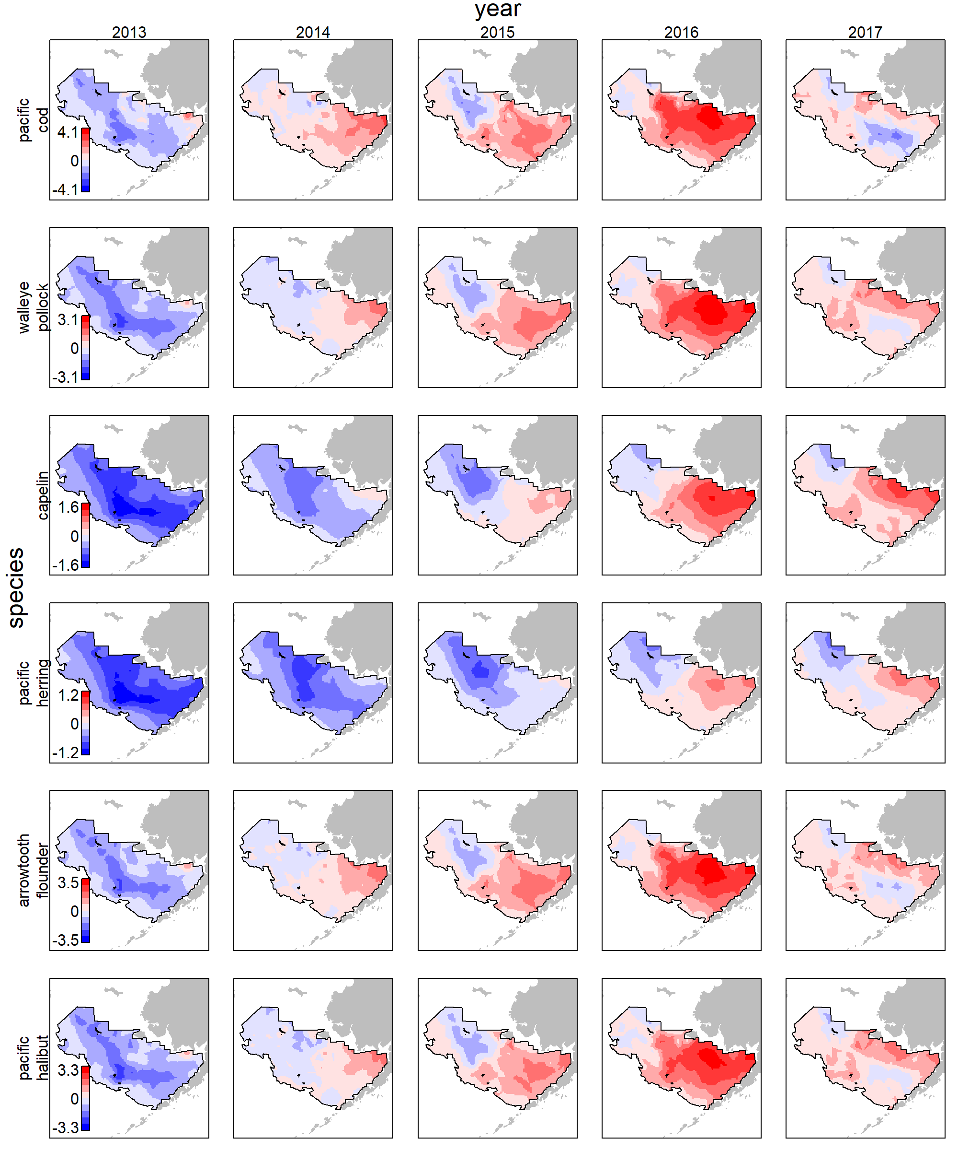

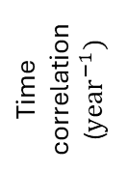
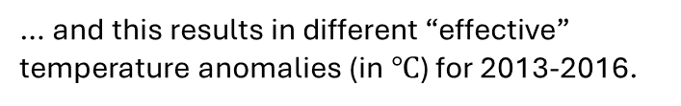
Spatio-temporal distributed lags (STDL) estimate covariate impacts on population density in nearby habitats over time-lagged responses.
STDL is not significant for Pacific cod …
AIC weight
… and is significant for capelin.
Time correlation ($year^{−1})$
… and this results in different “effective” temperature anomalies (in $℃$) for 2013-2016.
Spatial diffusion (km)

