Slide 1
42001: Competitive Strategy
Copyright 2020
Thomas Wollmann
Associate Professor, Microeconomics
thomas.wollmann@chicagobooth.edu

Slide 2
Logistics

Slide 3
TAs, Office Hours
TAs
Jena Manilla (jmanilla@chicagobooth.edu)
Frank Montana (fmontana@chicagobooth.edu)
Best bet for administrative issues
Excellent resource for substantive questions—they know the material exceptionally well
I’m around all autumn quarter—and afterwards
Pandemic: email me anytime and we’ll talk via Zoom
Post-apocolypse: just drop by Office 306

Slide 4
Readings and Website
REQUIRED
All material—including the syllabus—distributed via Canvas
Everyone get announcements? Any issues with Canvas?
OPTIONAL
Luís Cabral’s Introduction to Industrial Organization
Very careful but nearly algebra free
Recommended if you have not seen any IO / keeping up with lecture / have trouble unpacking cases
Redacted slides
Lists of key terms

Slide 5
Weekly assignment
Download the reading guide / study questions
Distributed ~ Thursday for the following week
Read the papers / notes / cases
Write a two page or less response to study questions
Submit via Canvas prior to class
Study groups of ≤ 3 students OK with me
You should do your own write-up
All members participate in discussion
Mostly graded for completeness and some coherence
Prepare to discuss in class (more on this in a few slides)

Slide 6
Midterm and Final
Short answer questions, e.g. one to four sentence responses
Case distributed one week in advance
Should roughly mirror mini-cases and/or full cases you would receive in a consulting interview (if I do a good job writing)
Students should take exam during “scheduled time”
Midterm held in/around week 5
Final held post-Thanksgiving
Update on exam administration forthcoming…
Please exhaust options before asking for exceptions…
If we spoke about alternate test date, remind me several times

Slide 7
Grading
Class participation 30%
Reading guide responses 5%
Midterm 25%
Final exam 40%
All may vary up to +/- 2% based on how class plays out
Maybe midterm is down-weighted and memos up-weighted (?)

Slide 8
Participation [1/3]
Some background on the approach
Classroom ~ boardroom
Concise answers
Backed up by evidence
Quantity and quality matter
Too slow for some, too fast for others
Probably a feature rather than a bug of the course
Endlessly hard subject, littered with subtleties and ample opportunities to impress the room
Yet, a lot of ways to prepare and improve

Slide 9
Participation [2/3]
University of Chicago decorum—or lack thereof
Interrupt me if I am unclear
Challenge me if you disagree
Challenge others (but politely)
Aside: for stuff that has an airplane mode… try to restrict to case materials, slides, and notes
No problem if you come late / leave early / et cetera, or even have to take a call during class (but probably leave the room…)

Slide 10
Participation [3/3]
In-person attendees, remember your name card!
I’m pretty good with names but ~200 take a few weeks
No outside sources (except for personal experiences)
I will randomly try to cold call after first week
If you absolutely do not want to participate for the day, let me know a head of time

Slide 11
Virtual attendance notes
Hopefully it approximates in-person experience
In-person guidelines apply
Examples
Rely mostly on Zoom’s “Raise Hand” feature
If you have lecture material question, you’re hands up, and I move on, unmute/interrupt me
Come/go as you please
No need for a name card, though
Keep video on and audio muted but ready if you’re “present”
Limit chat to serious logistics issues (e.g., accidental muting)

Slide 12
Honor code
As a reminder…
Do not solicit or receive materials from past students
Do not discuss exam cases with anyone
Do not do anything else that is obviously dishonest / duplicitous

Slide 13
Questions?

Slide 14
Some introductions…

Slide 15
Topics and methods

Slide 16
Agenda
What is competitive strategy?
Why use an economic approach?
What topics do we cover?
Competitive strategy as constrained optimization
Dire consequences of equilibrium
What to do about it
-Break-
Case – Moneyball

Slide 17
Re: Industrial organization
IO = microeconomics of firm behavior (see, e.g., Cabral [2000])
Competitive strategy = IO turned upside down
Regulation, antitrust = suppressing profits (e.g. re: price effects)
This course = figuring out how to juice them
Note: I reserve right to tell regulators how to outsmart you
Most/all topics are not business-specific—the basic issues should be broadly applicable, e.g. investment, competition, cooperation, positioning (more on this, too, in a few slides)

Slide 18
The economic way of thinking (1/3)
Trivia
The faculty of what university have most
contributed to the field of economics
(and its tremendous subsequent success)?

Slide 19
The economic way of thinking (2/3)
If no one told you, modern economics was born here
Economics is a method—not a subject
Three building blocks
Individuals exhibit maximizing behavior
(weaker condition: they respond to incentives)
Preferences are stable
Markets that tend towards equilibrium exist
These parsimonious and clear assumptions create a powerful, cohesive framework for understanding human behavior
We will apply these unflinchingly and unapologetically

Slide 20
The economic way of thinking (3/3)
I am biased—but it has probably been objectively, disproportionally successful among disciplines
Basic exercise: describe → predict → prescribe
Assumptions strongly hold in practice, e.g. market efficiency
Example: Walmart’s supply chain
Example: Soviet shortages

Slide 21
Course material split
A price theoretic view of managerial decision-making
Take others’ actions as fixed to simplify
A game theoretic view of managerial decision-making
Others’ payoffs *explicitly* depend on my actions
To fix ideas, read these over, figure out which is which (?)
Suppose its 1980. How should GM reposition its offerings in response to nascent Japanese competition?
Suppose its 2012. Should Uber enter Ft. Myers especially early, since doing so might forestall or delay Lyft’s entry?

Slide 22
Course layout (1/2)
Price theory for managers (weeks 1-4)
Profits in equilibrium (1)
Across-industry analysis, “Five Forces” (2)
Within-industry analysis, “Competitive advantage” (3)
Vertical integration and firm boundaries (4)
Game theory for managers (weeks 5-9)
Midterm; Tuna Game; Nash* (5)
Dynamic pricing (6)
Entry/exit deterrence (7)
Network effects* (8)
Platform competition (9)

Slide 23
Course layout (2/2)
Why are some industries and/or firms so profitable?
How do strategic decisions fit together?
When should the firm “buy or build”, e.g. fast “last mile” delivery?
How do we deter entrants? Not disturb large incumbents?
How do we cooperate with rivals and avoid jail, e.g. fare codes?
Why are so many recent “unicorn” startups exploiting network effects? How can we solve the chicken-and-egg problem?

Slide 24
Course style
Intuition, not algebra
Note that this does not make it any easier
Layman’s terms—not jargon
Explain it to a boss
Argue with a colleague
Sell it to a client
Boil the material down to directional effects and key tradeoffs
Material is simple but not easy
Each case is a puzzle—solving them out should be fun

Slide 25
Constrained optimization

Slide 26
Constraints
$
These are the benefits to buyers,
i.e. demand for the industry’s good/services
Potential
Industry
Earnings
This reflects what else you could do with the resources, i.e. the marginal cost
Quantity Produced by the Industry

Slide 27
Shifts
$
Mostly f(marketing)
Potential
Industry
Earnings
Mostly f(operations)
Quantity Produced by the Industry

Slide 28
Objective function
What should we maximize?

Slide 29
Objective function
What should we maximize?
Well-being of our workforce
Health of the planet
Happiness of chickens, e.g. cage-free eggs

Slide 30
Objective function
What should we maximize?
Well-being of our workforce
Health of the planet
Happiness of chickens, e.g. cage-free eggs
Profits, i.e. discounted net cash flows, are the firm’s obj.
Others are, in most cases, a means to an end
Example: remove advertising for cage-free eggs
Regulation and competition constraint our options
You absolutely can question this presumption!

Slide 31
Shadow prices, opportunity costs
Profits = revenues – costs
Economic costs incorporate forgone opportunities, too¹
AC of using a machine you already own?
EC of using a machine you already own?
EC of studying when you already own the materials?
Examples of what might change this?
¹ This used to lead into an elaborate “there’s always money in the banana stand” joke. Sadly, few Booth MBAs seem to have watched Arrested Development, so it fell flat. Thus, I removed it. To those of you who would have appreciated it, I am sorry. Your colleagues ruined it for you. Womp womp.

Slide 32
In-class Example: Economic Costs

Slide 33
Accounting Cost of Full-Time MBA
2015-16 Estimated Cost of Attendance 3 Quarters (9 months)
Tuition | $63,980 (10 courses)
Student Life Fee | $1,089
Lifetime Credentials Fee | $60 (one time fee in fall of first year)
Health Insurance | $3,636
Books | $1,200
Rent and Utilities | $14,520 ($1,613 per month)
Food | $5,400 ($600 per month)
Personal | $3,000
Transportation | $1,500
Computer Allowance | $1,200 (first year only)
Total | $98,085

Slide 34
Question
Are these costs all economic costs?

Slide 35
Accounting Cost of Full-Time MBA
2015-16 Estimated Cost of Attendance 3 Quarters (9 months)
Tuition | $63,980 (10 courses)
Student Life Fee | $1,089
Lifetime Credentials Fee | $60 (one time fee in fall of first year)
Health Insurance | $3,636
Books | $1,200
Rent and Utilities | $14,520 ($1,613 per month)
Food | $5,400 ($600 per month)
Personal | $3,000
Transportation | $1,500
Computer Allowance | $1,200 (first year only)
Total | $98,085

Slide 36
Question
Are these all the economic costs?

Slide 37
Accounting Cost of Full-Time MBA
2015-16 Estimated Cost of Attendance 3 Quarters (9 months)
Tuition | $63,980 (10 courses)
Student Life Fee | $1,089
Lifetime Credentials Fee | $60 (one time fee in fall of first year)
Health Insurance | $3,636
Books | $1,200
Rent and Utilities | $14,520 ($1,613 per month)
Food | $5,400 ($600 per month)
Personal | $3,000
Transportation | $1,500
Computer Allowance | $1,200 (first year only)
Total | $98,085

Slide 38
Predictions
Hypothesis:
Prospective MBA students consider economic rather than accounting costs in their enrollment decision
Q: How should we test this?
Q: What would we look for in data?

Slide 39
MBA Applications & the Business Cycle

Slide 40
More Predictions
Last year I got a question about 1997/1998 drop
Q: What might have happened? What prices changed?

Slide 41
MBA Applications & the Business Cycle

Slide 42
MBA Applications & the Business Cycle
1992: format change to
GMAT, spike in exam-takers

Slide 43
MBA Applications & the Business Cycle
1997: five years
post-format change
1992: format change to
GMAT, spike in exam-takers

Slide 44
Economic Profits in Equilibrium

Slide 45
Competition, arbitrage (1/2)
Well-defined objective, i.e. make decisions to:
Max { dollar revenues – economic costs }
s.t. consumer preferences, production technology
Note: accounting profits can (clearly) be greater than zero
e.g., you can inherent a machine, produce and sell output
Less clear how economic profits systematically vary

Slide 46
Competition, arbitrage (2/2)
Example
Cost of funds ~ 7%
Machine perpetually generates net π of $575,000
As a potential buyer, what qualifies as economic profit?
What does this require of the seller? What else?

Slide 47
Equilibrium (1/2)
A “rest point” or “steady state” of a system
Suppose we observe that cheetahs consume only gazelles and that the population ratio is roughly 1:1

Slide 48
Equilibrium (1/2)
A “rest point” or “steady state” of a system
Suppose we observe that cheetahs consume only gazelles and that the population ratio is roughly 1:1
Now suppose a virus eliminates half the gazelle stock
What happens to the ratio?

Slide 49
Equilibrium (1/2)
A “rest point” or “steady state” of a system
Idea extends beyond economics to biology, chemistry, etc.
Suppose we observe that cheetahs consume only gazelles and that the population ratio is roughly 1:1
Suppose a virus eliminates half the gazelle stock
What happens to the ratio?
Suppose a cheetah can choose a gazelle-rich area/not
How important is careful selection?

Slide 50
Equilibrium (2/2)
Environmental changes create threats / opportunities
→ Drive entry / exit of market participants
→ → Competition pushes the market back into equilibrium
Endless “real world” examples…

Slide 51
In-Class Example: Commercial vehicles

Slide 52
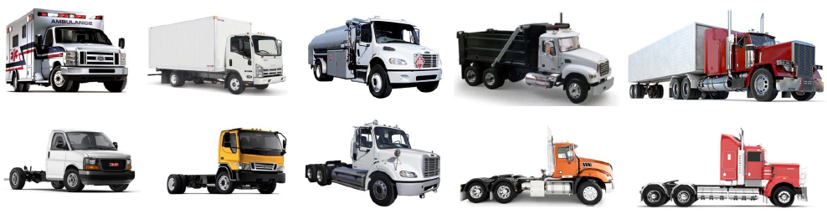
The market for big trucks
Entry and exit among commercial vehicles

Slide 53
The market for big trucks
Entry and exit among commercial vehicles
Highlighted vehicles appeal to construction buyers

Slide 54
The market for big trucks
Entry and exit among commercial vehicles
Highlighted vehicles appeal to construction buyers
Q: What happens to π during construction boom/busts…
holding products fixed? Allowing them to adjust?

Slide 55
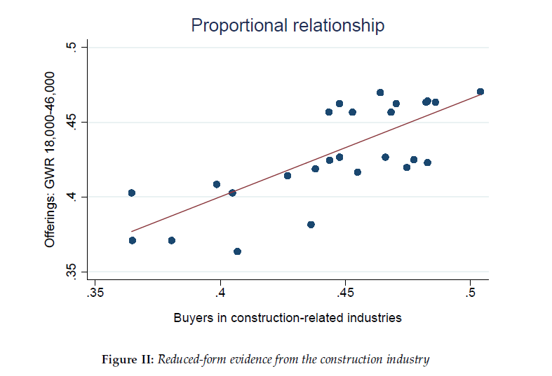
“Equilibrium” product offerings

Slide 56
Trucks without bailouts
Suppose some commercial vehicle sellers need a “bailout” in 2009, and suppose they do not get one
Q: What does this mean for profits of rival firms?
Q: How large, on avg., are equilibrium economic profits?*

Slide 57
In-Class Example: Taxi Medallions

Slide 58
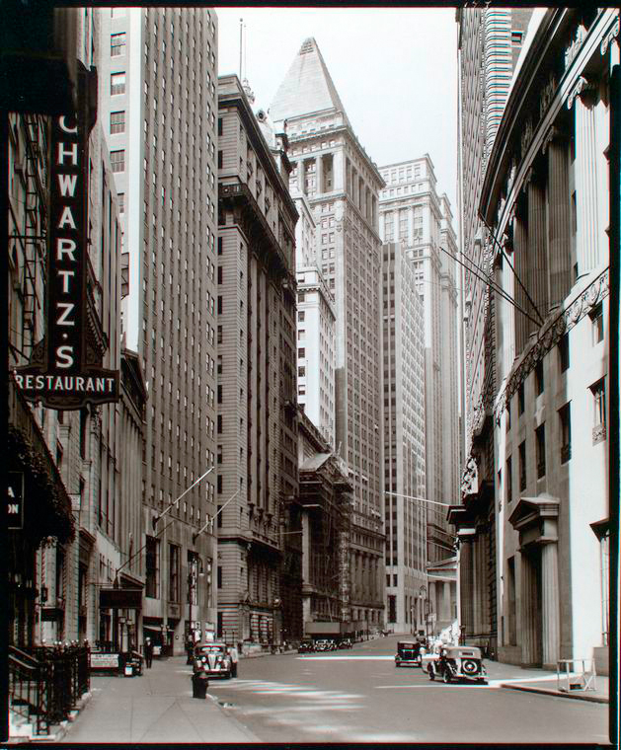
Background
NYC strictly limits the number of operating taxis
License to operate is called a “medallion”
Must be displayed on hood
11,787 taxi medallions in 1969
How many medallions today?

Slide 59
Trends in Income and Medallion Supply

Slide 60
Background
NYC strictly limits the number of operating taxis
License to operate is called a “medallion”
Must be displayed on hood
11,787 taxi medallions in 1969
13,605 today—but why?

Slide 61
Background
NYC strictly limits the number of operating taxis
License to operate is called a “medallion”
Must be displayed on hood
11,787 taxi medallions in 1969
13,605 today
16,763 taxis in 1932!?

Slide 62
Medallions in equilibrium
As a result, what happened to medallion prices… until about 2010?

Slide 63
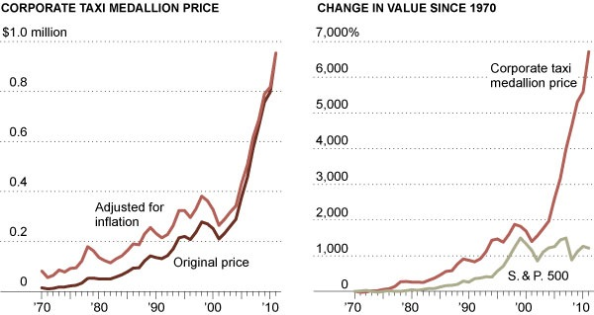
Trends in Medallion Prices

Slide 64
Trends in Medallion Prices
-- 2011: medallion sells @ $1MM --

Slide 65
Trends in Medallion Prices
Did this last forever?
Was U/L opp. around forever?

Slide 66
Trends in Medallion Prices
-- 2020: medallion rumored @ ~ $65,000 --
Did this last forever?
Was U/L opp. around forever?

Slide 67
Economic profits in Course 42001

Slide 68
Recap
Well-defined problem = constrained optimization of profits
Market attributes fixed
Environmental change
Opportunities, threats
Recognize, formulate response
Need a framework, turn to economics
Yet, profits invite entry, rivalry, imitation

Slide 69
The challenge for this course
This creates tension: If all markets are in equilibrium, then what is the point of CS?
All markets are not in equilibrium—they are only driving towards it, adjusting after changes in the environment
The market forces—the “drivers”—are entrepreneurs, managers, etc., i.e. students enrolled in this course
This course is not about picking dollar bills off the ground
This course is about exploiting opportunities that arise from unexpected changes in the market environment

Slide 70
One final point
Great question from 2019:
Do I really need economics today?
What about “big data,” machine learning, etc.?
Can’t I “A/B” test my way through these problems?

Slide 71
Questions?

Slide 72


