Slide 1
MONEYBALL
Copyright 2019
WEEK 1 CASE

Slide 2


Buying a team…

Slide 3

The business of baseball
“Revenues – costs”?
“Excess profits”?

Slide 4
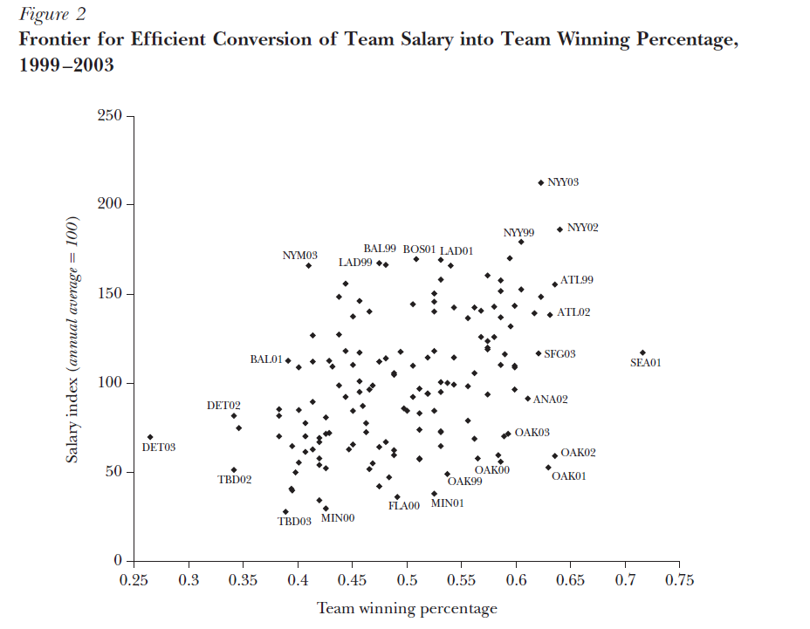
Cheap wins

Slide 5
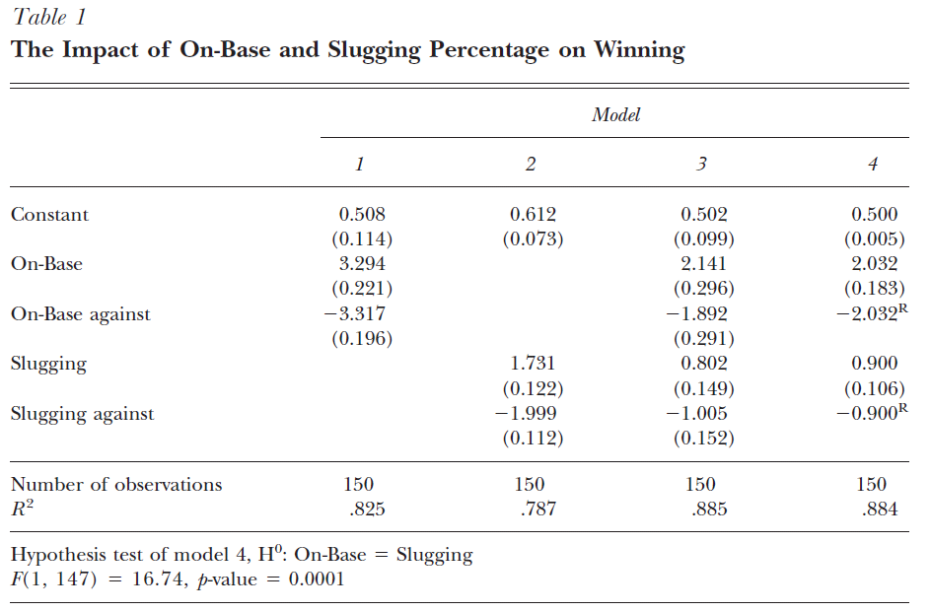
Production function

Slide 6
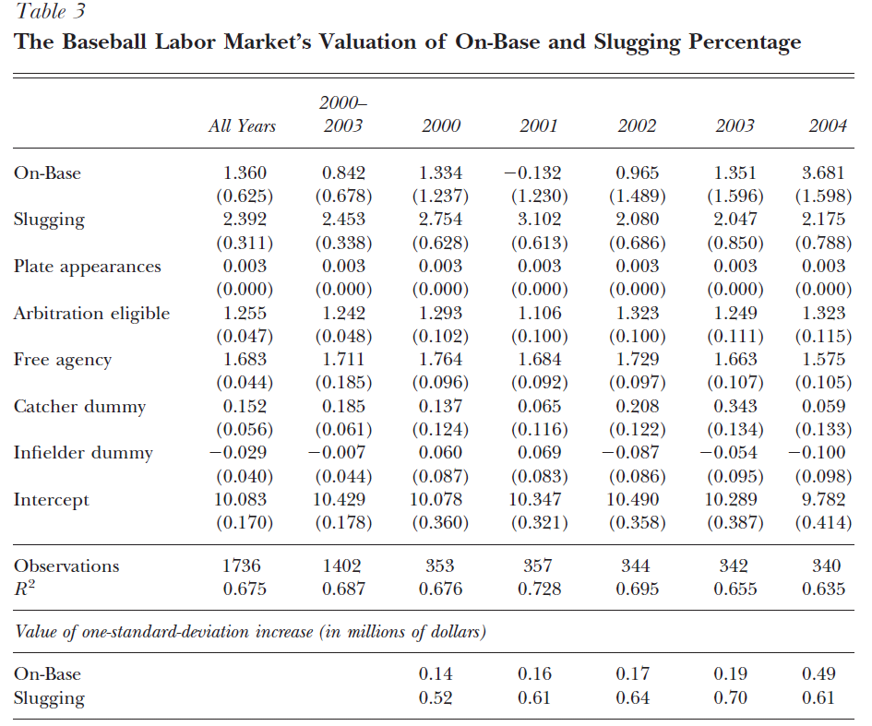
Cost curve

Slide 7
Broader issues
What determines player price?
https://www.youtube.com/watch?v=pWgyy_rlmag
Forget about the specific fact… what broad strat. outperforms?
https://www.youtube.com/watch?v=TpBcwGOvO80

Slide 8
Broader issues
What determines player price?
https://www.youtube.com/watch?v=pWgyy_rlmag
Forget about the specific fact… what broad strat. outperforms?
https://www.youtube.com/watch?v=TpBcwGOvO80

Slide 9
Equilibrium
What does it look like?
Do we get there?

Slide 10
Markets equilibrate

Slide 11
Factor market: equilibrium
Factor | Cost per win (2000) | Cost per win (2004)
On-base percentage | $0.17 m | $1.36 m
Slugging percentage | $1.41 m | $0.68 m
In 2000, it was much cheaper to get wins from on-base percentage than from slugging percentage
By 2004, this was no longer true—much closer, maybe inverted
Note: if you’re minting $$, don’t talk to reporters (esp. M. Lewis)

Slide 12
“Zero economic profits”
How long have excess profits persisted?

Slide 13
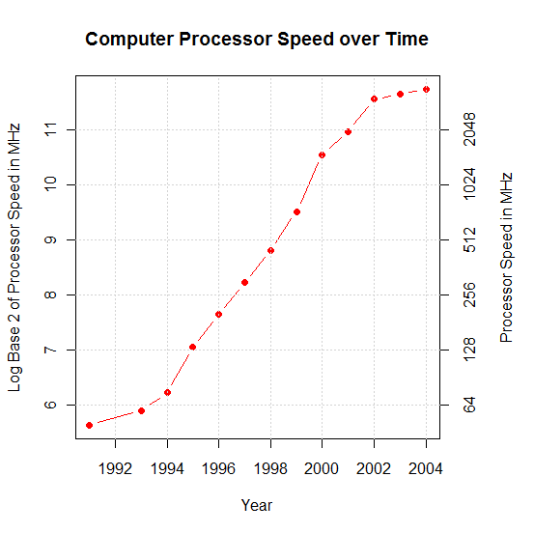
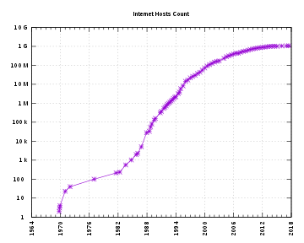
Data storage, sharing, and computational power…
https://www.youtube.com/watch?v=yGf6LNWY9AI&t=2s

Slide 14
Questions
Assuming markets are wrong is a bit of a dicey business…
Any reservations w/r/t the Hakes-Sauer [2006] argument?

Slide 15
Takeaways
Markets are tending to equilibrium—still, vast sums of money
Key = taking advantage of structural, environmental shifts
Next week
Framework for assessing these opportunities
Cola Wars case

