Slide 1
Week 2 Case: The Cola Wars
Copyright 2018
Thomas Wollmann
thomas.wollmann@chicagobooth.edu

Slide 2
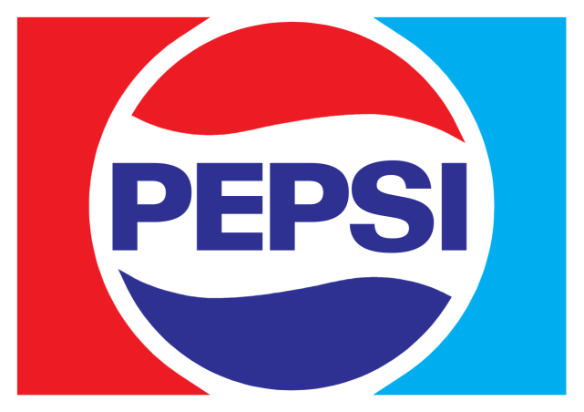
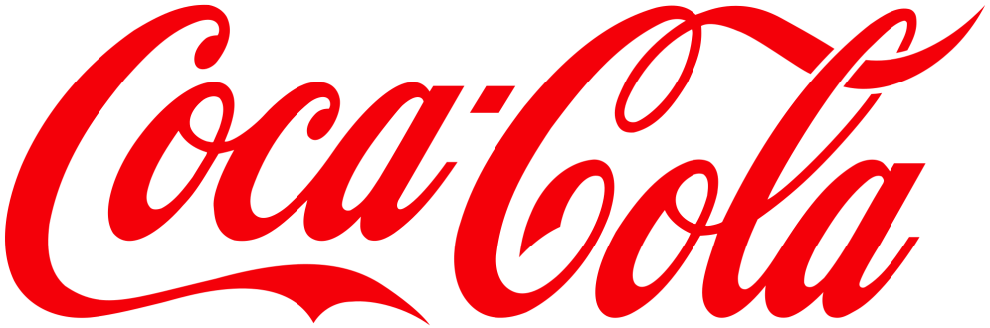
The Cola Wars: a Five Forces approach

Slide 3
Structural/environmental changes [1/2]
February 2014: Albertson’s (#2 US grocer) acquires Safeway (#4/5 US grocer)
December 2014: US FTC, which shares antitrust enforcement responsibility with US DOJ, requires 146 locations are divested
November 1998: Exxon and Mobil—the top two US oil companies, respectively—merge
November 1999: US FTC requires 2,431 gas stations are div’d

Slide 4
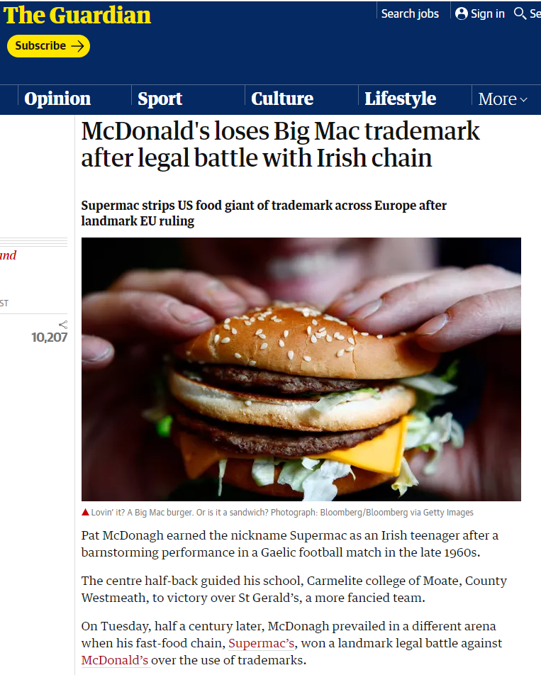
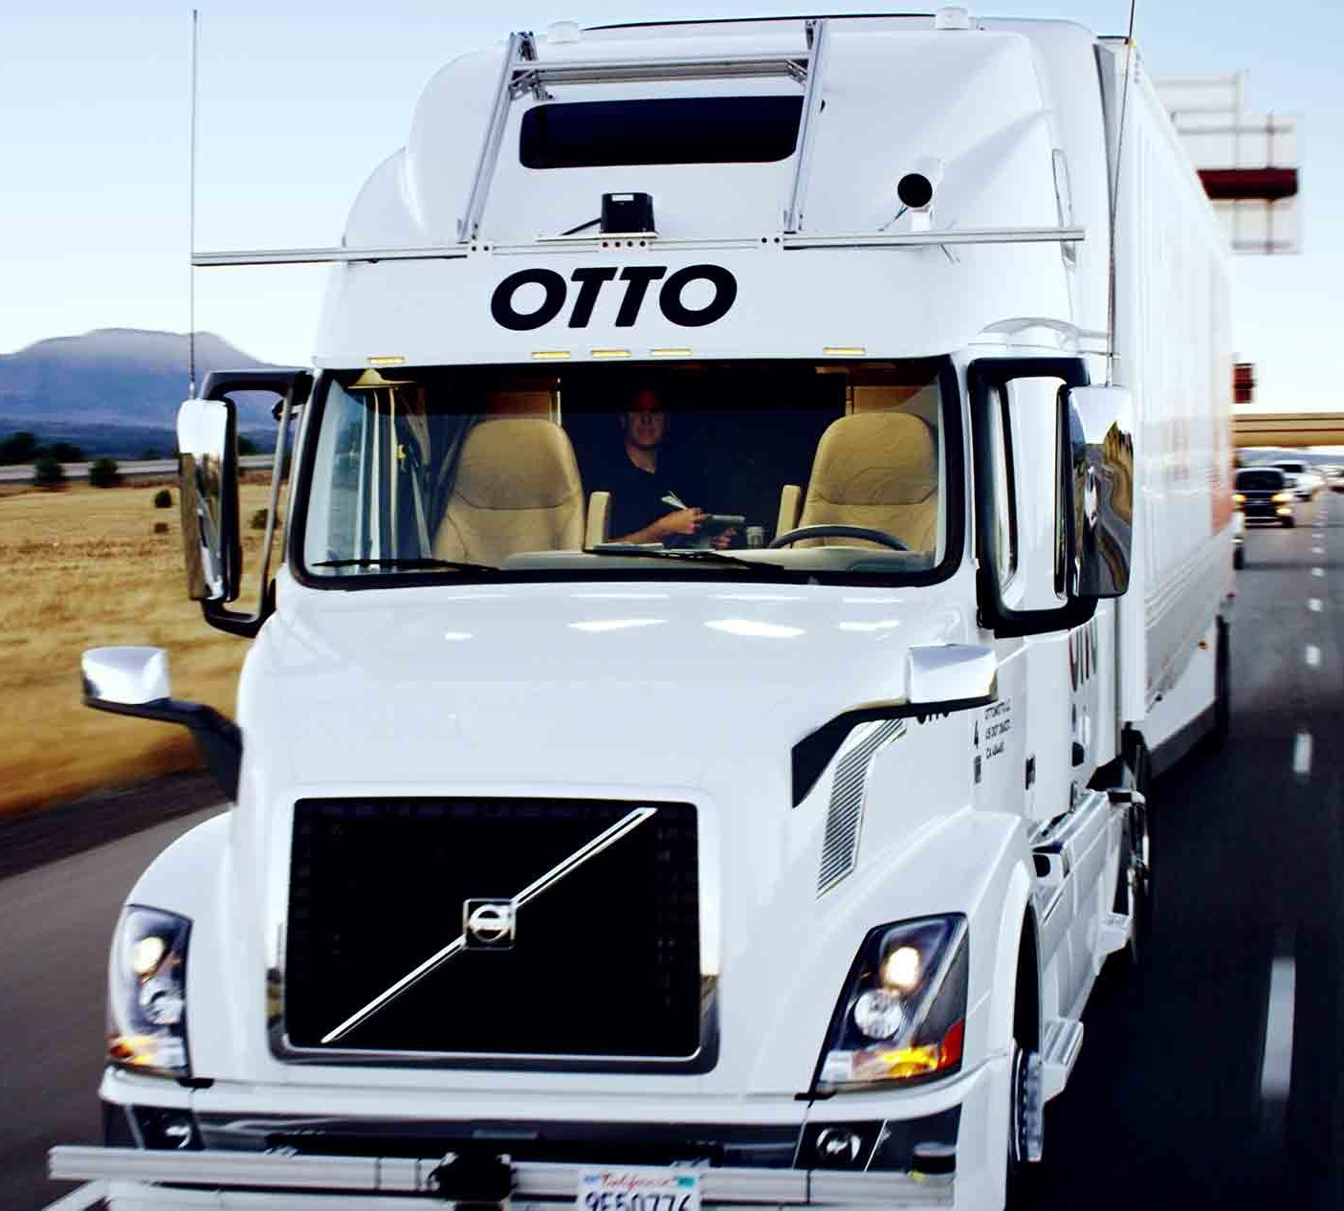
Structural/environmental changes [2/2]
US legislature weakens intellectual property laws
Self-driving trucks dominate freight industry

Slide 5
Structural/environmental changes [2/2]
US legislature weakens intellectual property laws
Self-driving trucks dominate freight industry

Slide 6
The “War”
“The most intense battles…”

Slide 7
Differentiation [1/2]
Product differences typically obvious even with a blindfold on
e.g. Acceleration in a Porsche
e.g. Functionality of a Mac v. PC
e.g. Convenience of a bank near v. far from your house

Slide 8
Differentiation [2/2]
…so Coke and Pepsi must be very different products

Slide 9
Pepsi Challenge [1/2]
Coca-Cola v. Pepsi
Massive ad campaign circa 1975
What we should expect to see?
“More than 50%!”
https://www.youtube.com/watch?v=v7lw_vhxtNc
“They taste so differently…”
https://www.youtube.com/watch?v=triyBZ4iVVI
By show of hands, who thinks they can tell?

Slide 10
- The Pepsi Challenge -

Slide 11
Pepsi Challenge: Results 2015-2019 [1/2]
Pr.(Correct random guess)=1/3
Note that 2019 I substituted Whole Foods 365 Cola for RC Cola
However, 2019 also presented this gem…

Slide 12
Pepsi Challenge: Results 2015-2019 [2/2]
Abraham (Evening section, 2019)
[A] “I grew up arnd. Atlanta…I like Coke—won’t drink Pepsi.”
[T] “…If you’re offered Pepsi at a restaurant?”
[A] “then I’ll drink water. I can definitely taste the difference.”

Slide 13
Pepsi Challenge: Results 2015-2019 [2/2]
Abraham (Evening section, 2019)
[A] “I grew up arnd. Atlanta…I like Coke—won’t drink Pepsi.”
[T] “…If you’re offered Pepsi at a restaurant?”
[A] “then I’ll drink water. I can definitely taste the difference.”
0 / 3 CORRECT!
But then a puzzle—how are they differentiated?

Slide 14
CSD Competition
Coke and Pepsi compete on brand via marketing/advertising
Evidence from their financial statements?

Slide 15
CSD Competition
Coke and Pepsi compete on brand via marketing/advertising
Evidence from their financial statements?
…in the real world?
Bears!
https://www.youtube.com/watch?v=KV0sTeofBWE
This gem from the 1970s—may contain highest number of emotional triggers per minute in human history!
https://youtu.be/X7l3FxHiqyQ?t=2m1s

Slide 16
CSD Competition
You know you’re competing hard on brand identity when…
You resort to using, in a single TV spot, …
Grandfathers spending time with grandkids
Dad sailing with young daughter
Family visits to grandmother’s house

Slide 17
CSD Competition
You know you’re competing hard on brand identity when…
You resort to using, in a single TV spot, …
Grandfathers spending time with grandkids
Dad sailing with young daughter
Family visits to grandmother’s house
Who apparently runs a puppy farm!?

Slide 18
CSD Competition
You know you’re competing hard on brand identity when…
You resort to using, in a single TV spot, …
Grandfathers spending time with grandkids
Dad sailing with young daughter
Family visits to grandmother’s house
Who apparently runs a puppy farm!?
Another adorable bleached-blond three-year-old appears?

Slide 19
CSD Competition
You know you’re competing hard on brand identity when…
You resort to using, in a single TV spot, …
Grandfathers spending time with grandkids
Dad sailing with young daughter
Family visits to grandmother’s house
Who apparently runs a puppy farm!?
Another adorable bleached-blond three-year-old appears… who is then snuggled (and/or eaten!?) by the puppies

Slide 20
Still a puzzle?
How large on “net” profits?
So who is going to start a CSD brand?

Slide 21
Wrap-up
What Five Forces is definitely informative about…
Suppose you are pharmacist Asa Candler
Suppose you live in Atlanta, Georgia in 1888
Do you invest $2,300 to buy the rights, and another $2,500 to further develop and commercialize brown, fizzy syrup?
Next week: within-industry analysis

Slide 22


