Slide 1
INDUSTRY ANALYSIS
Copyright 2019
Thomas Wollmann
thomas.wollmann@chicagobooth.edu

Slide 2
Agenda
Week 1 review
Economics → IO → firm strategy
Takeaways from Moneyball
Across-industry analysis
Summarizing returns
Mike Porter’s Five Forces Framework
A more “Chicago” approach
Case – Cola Wars

Slide 3
Week 1 Recap

Slide 4
An economic approach to firm decision-making
Economics = a toolbox, not a set of topics
IO = application to firms, in particular competition in markets
Careful use w/r/t “business policy” at a bit of a zenith right now
Objective: max. profits | conditional on preferences, production
Equilibrium forces present general challenge
Goal of this course—perhaps MBA generally—is building intuition around exploiting/preserving profitable opportunities
Notes:
Quickly; aggressively.

Slide 5
Case: Moneyball
Ex post evidence of success, some disagreement
Moneyball controversy quibbling about slugging/OBP
Real arc of the story is archaic scouting/pricing
Changes in computational power, digitized statistics
Cost of identifying talent falls ~ 1994-1999
Oakland A’s capitalize on it
Ultimately secret gets out—π didn’t last long
To what extent? Widespread SABR use today

Slide 6
Motivation: Variation in performance across industries

Slide 7
Which industries are particularly profitable?
For the sake of example, measure
Performance α return on equity – cost of capital
Plot cumulative value from, e.g., 1994-2012
Result is considerable persistent dispersion across industries

Slide 8
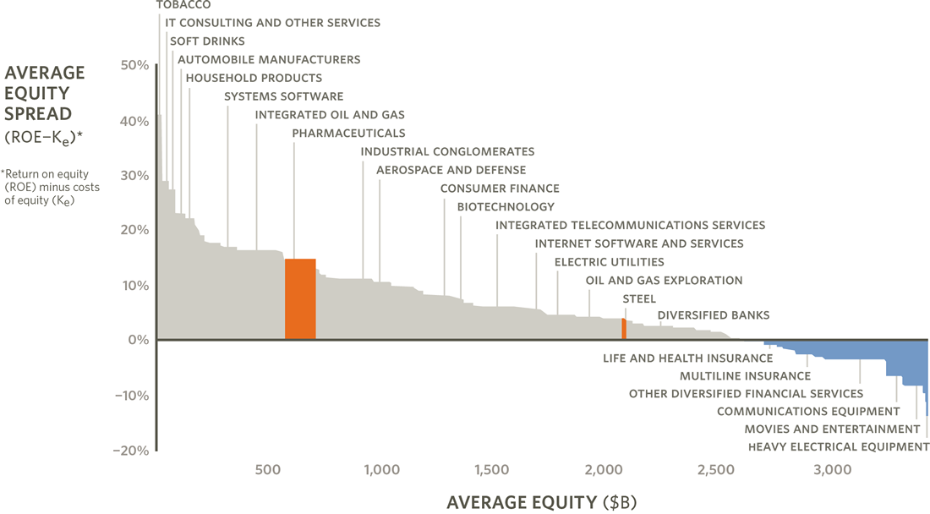
From Ghemawat & Rivkin (2014)

Slide 9
Across-industry analysis [1/3]
Take a cross-sectional approach and ask today, “Why are some industries more profitable than others?”
Two goals
Exploit variation to build general intuition re: what shifts profits
Provide a framework for “as if” entry opportunities
Porter’s Five Forces Framework maps “paleo-IO” to the question

Slide 10
Across-industry analysis [2/3]
Caveats
Observations from the 1970s, written circa 1980
Pre-game theory foundations yield some log. inconsistencies
Proof, i.e. causal evidence, comes much later
Even so, it required some ad hoc revisions
Assumes that firms within industries ~ homogenous
Notes:
Mike gets a lot of credit in turning IO upside down, so to speak, but the framework requires a few caveats.

Slide 11
Across-industry analysis [2/3]
Caveats
Observations from the 1970s, written circa 1980
Pre-game theory foundations yield some log. inconsistencies
Proof, i.e. causal evidence, comes much later
Even so, it required some ad hoc revisions
Assumes that firms within industries ~ homogenous → we’ll relax this assumption next week

Slide 12
Across-industry analysis [2/3]
Caveats
Observations from the 1970s, written circa 1980
Pre-game theory foundations yield some log. inconsistencies
Proof, i.e. causal evidence, comes much later
Even so, it required some ad hoc revisions
Assumes that firms within industries ~ homogenous → we’ll relax this assumption next week
At worst, a good start for organizing ideas
Influential and jargon-free, or at least in the business lexicon…

Slide 13
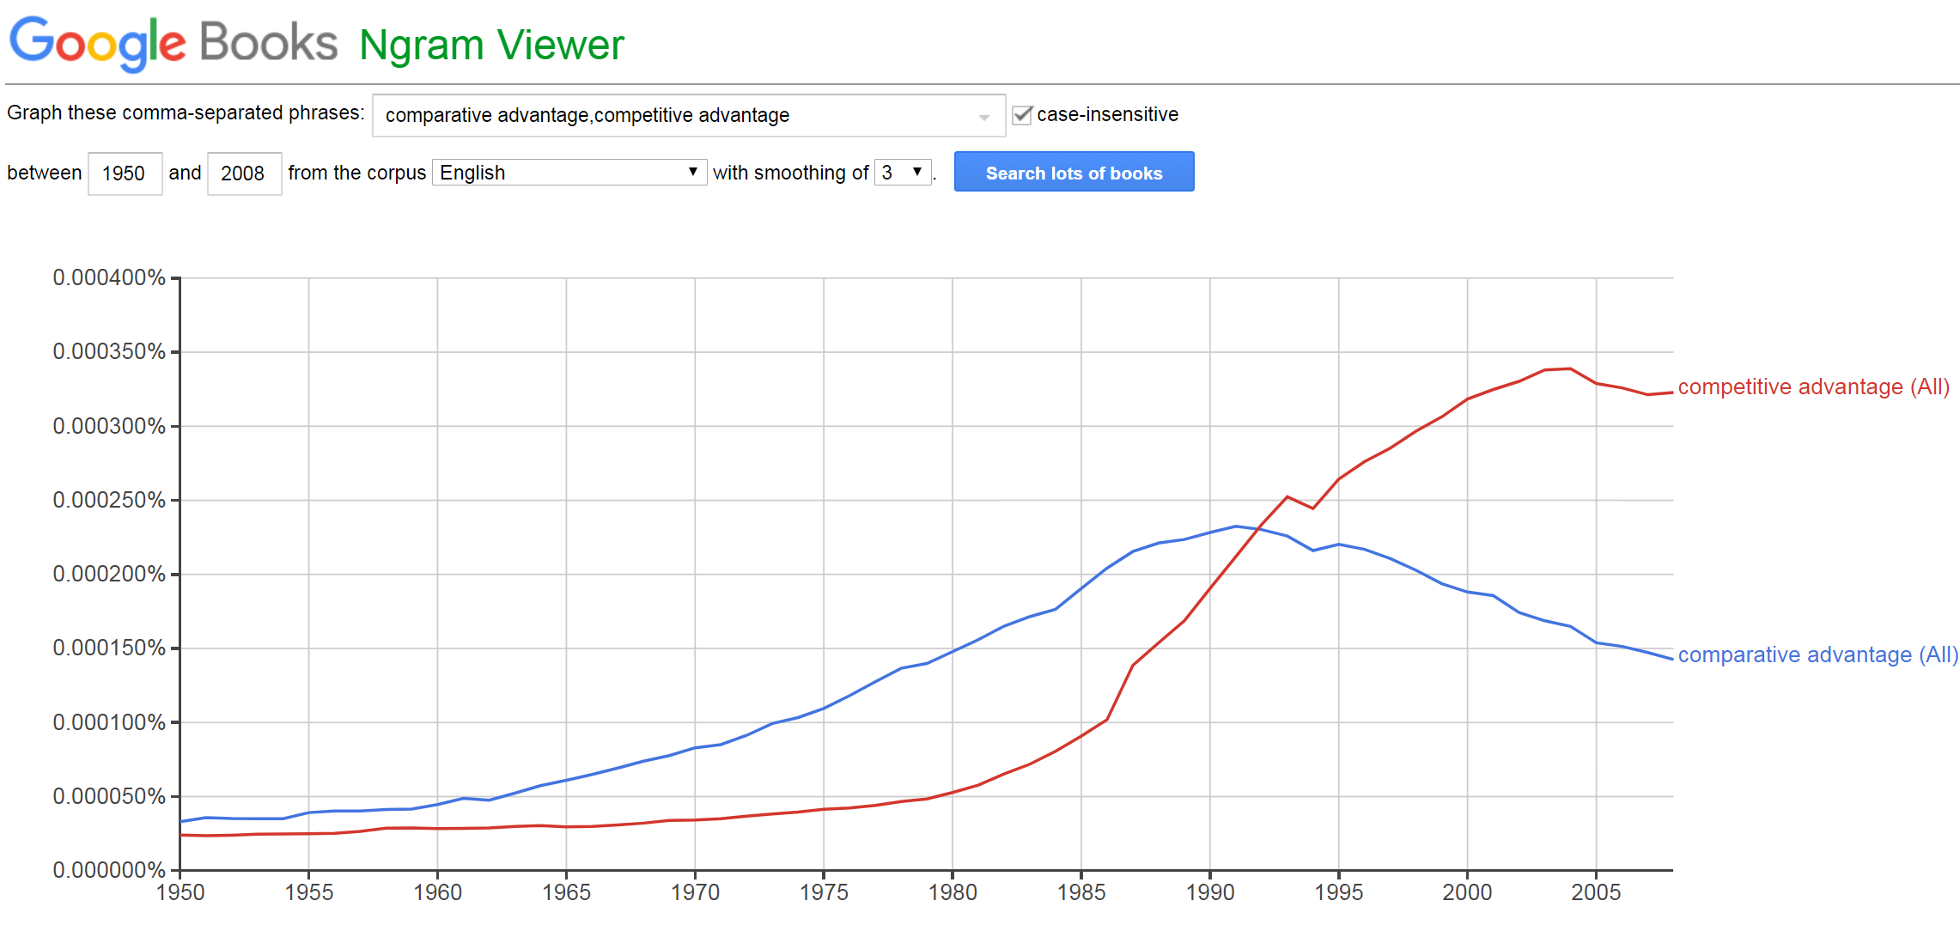
Across-industry analysis [3/3]
Some “data”

Slide 14
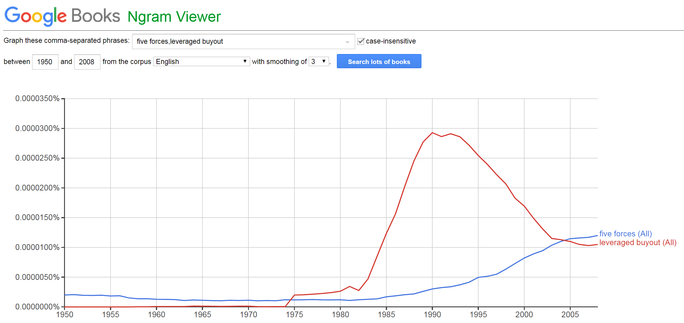
Across-industry analysis [3/3]
Some “data”

Slide 15
Across-industry analysis [3/3]
You can do a lot with Ngrams—I got carried away…

Slide 16
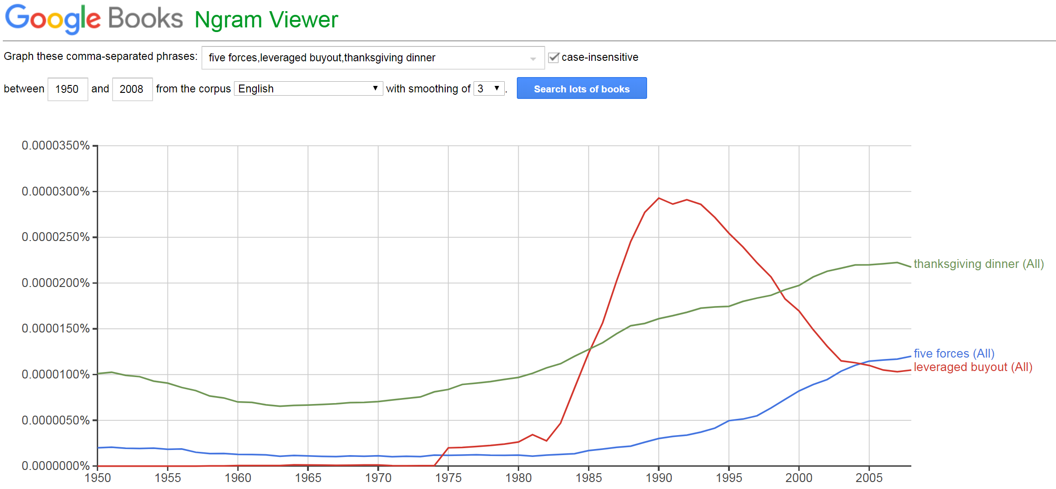
Across-industry analysis [3/3]
For example…

Slide 17
Five Forces Framework

Slide 18
Porter’s Five Forces

Slide 19
Porter’s Five Forces
Supplier power
Substitutes
Rivalry
Threat of entry
Buyer power

Slide 20
Force 1
Would you rather have 1000 customers with single unit demand or 2 customers with 500-unit demand?
When your customers are few in number and large in size, you are the one who whose alternatives are poor
How much can you push on price at the margin?
Note: with only two buyers (e.g., Walgreens and CVS), push a bit too hard and you lose half your sales…

Slide 21

Buyer power – high or low?

Slide 22


Buyer power – high or low?

Slide 23

Who’s the buyer?

Slide 24
Buyer power – high or low?

Slide 25
Buyer power – clearly high

Slide 26
Buyer power considerations
Number and size
We agree that π(1000 buyers,▪)>π(2 buyers,▪)
3 equal-size buyers v. 3 with 80%,15%,5% shares?

Slide 27
Buyer power considerations
Number and size
We agree that π(1000 buyers,▪)>π(2 buyers,▪)
3 equal-size buyers v. 3 with 80%,15%,5% shares?
⇒ “Concentration,” e.g. HHI = Σ_{f} s_{f}²
Three buyers at 33% mkt. share = 33² * 3 = 3,267
Three at 80%,15%,and 5% = 80² +15² + 5² = 7,475
Note: this is a widely used measure, not buyer-spec.
Other practical considerations to which we’ll return

Slide 28
Force 2
Supplier power = same concept as buyer power
If supplier is irreplaceable in your production process, they have power in negotiations

Slide 29


More quick examples: supplier power – high/low?

Slide 30
Force 3
Within an industry, how “hard” do rivals compete?
Note that “rivalry,” “competition” are interchangeable
Haven’t yet said how firms compete…
Delta v. United?
Intel v. AMD?
Aramark, i.e. Kovler cafeteria, v. Medici?
Bain v. BCG?
UPS v. Fedex?

Slide 31
Force 3
Within an industry, how “hard” do rivals compete?
Note that “rivalry,” “competition” are interchangeable
Leaving aside price, how do these firms compete?
Delta v. United?
Intel v. AMD?
Aramark, i.e. Kovler cafeteria, v. Medici?
Bain v. BCG?
UPS v. Fedex?

Slide 32
Force 3
Within an industry, how “hard” do rivals compete?
Note that “rivalry,” “competition” are interchangeable
Leaving aside price, how do these firms compete?
Delta v. United?
Intel v. AMD?
Aramark, i.e. Kovler cafeteria, v. Medici?
Bain v. BCG?
UPS v. Fedex?
A comprehensive analysis follows next week

Slide 33
Rivalry measures
Intensity of competition varies market to market
Monopoly is exceedingly rare
Perfect competition equally uncommon
Mere observations suggests that most markets characterized by oligopoly—competition exists, but firms do not compete to p=mc
In oligopoly, what prevents the latter from happening? In other words, what feature(s) of the product(s) “soften” rivalry?
Clear measure of this from FFF?*

Slide 34
Rivalry measures
Intensity of competition varies market to market
Monopoly is exceedingly rare
Perfect competition equally uncommon
Mere observations suggests that most markets characterized by oligopoly—competition exists, but firms do not compete to p=mc
In oligopoly, what prevents the latter from happening? In other words, what feature(s) of the product(s) “soften” rivalry?
Degree of differentiation unclear—so we’ll be precise later on

Slide 35
Force 4
Suppose, e.g., we raise prices
We lose market share to rival firms
To what can we also lose sales?

Slide 36
Force 4
How easily can consumers sub. outside the industry?
One Porter example is electronic security systems
Prior examples
Aramark v. Medici?
Delta v. United?
Bain v. BCG?
Porter: “subtle” distinctions from rivalry?*

Slide 37
Force 4
How easily can consumers sub. outside the industry?
One Porter example is electronic security systems
Prior examples
Aramark v. Medici?
Delta v. United?
Bain v. BCG?
Rivalry v. sub. is (again) unclear—but we’ll resolve the ambiguity

Slide 38
Defining and measuring competition

Slide 39
A Booth approach¹
FFF leaves open first order questions
Measure internal rivalry?
Draw the line between “rivals” and “extended rivals”?
Measure “extended rivalry”?
How far to extend?
¹ More precisely, this is a “differentiated product demand system” approach where the underlying form of utility I am describing is random coefficient logit (with demographics). It’s a “(Chicago) Booth” approach in the sense that I am at least sure no one is teaching this at some “other” highly ranked MBA programs.

Slide 40
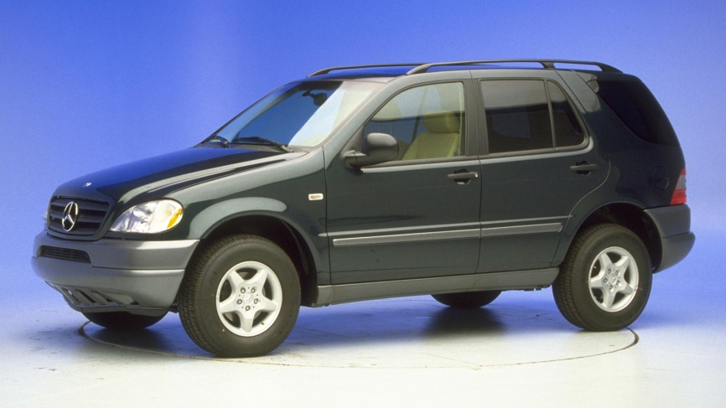
A Booth approach¹
FFF leaves open first order questions
Measure internal rivalry?
Draw the line between “rivals” and “extended rivals”?
Measure “extended rivalry”?
How far to extend?
Canonical case: ’97 M-Class
Who are the rivals?
¹ More precisely, this is a “differentiated product demand system” approach where the underlying form of utility I am describing is random coefficient logit (with demographics). It’s a “(Chicago) Booth” approach in the sense that I am at least sure they have no one teaching this at HBS.

Slide 41
A Booth approach¹
FFF leaves open first order questions
Measure internal rivalry?
Draw the line between “rivals” and “extended rivals”?
Measure “extended rivalry”?
How far to extend?
Canonical case: ’97 M-Class
Luxury car v. SUV?
Need a comp. measure
¹ More precisely, this is a “differentiated product demand system” approach where the underlying form of utility I am describing is random coefficient logit (with demographics). It’s a “(Chicago) Booth” approach in the sense that I am at least sure they have no one teaching this at HBS.

Slide 42
Intuition [1/2]
Consider two otherwise identical markets, each with two firms
In each, firms start @ an arbitrarily high price, e.g. ~ monopoly
In each, one firm lowers price a certain amount
In Market A, they considerable market share
In Market B, they gain very little
Notes:
To build intuition…

Slide 43
Intuition [1/2]
Consider two otherwise identical markets, each with two firms
In each, firms start @ an arbitrarily high price, e.g. ~ monopoly
In each, one firm lowers price a certain amount
In Market A, they considerable market share
In Market B, they gain very little
How do prices and profits compare?
In percentage terms, what parameter governs?
Where is competition intense?

Slide 44
Intuition [2/2]
This logic doesn’t just hold at an arbitrarily high price.
[Some algebra]

Slide 45
Example: some consumer products
Consider a 10% price increase
Ask…
How much share is lost—”a lot” or “a little”?
To whom is it lost?
Examples
Apple iPhone
Samsung television
Plavix, on patent
Bumble Bee tuna
So where do we see low / high prices?

Slide 46
Substitution to “outside” alternative
Define an outside good to summarize alternatives beyond direct competitors
Reason = we cannot keep track of infinite alternatives
This can be first order important
Examples
Luxury cars compete with other cars—mostly luxury class
Small/compact cars compete with public transport, etc.

Slide 47
Missing piece

Slide 48
…Force 5
Now, suppose industry has
Many potential suppliers
Many prospective buyers
Weak substitutes
Few or differentiated products

Slide 49
…Force 5
Now, suppose industry has
Many potential suppliers
Many prospective buyers
Weak substitutes
Few or differentiated products
What does Porter suggest about π?
Or, at least, what do you think people perceive here?

Slide 50
…Force 5
Now, suppose industry has
Many potential suppliers
Many prospective buyers
Weak substitutes
Few or differentiated products
What does Porter suggest about π?
Or, at least, what do you think people perceive here?
What doesn’t square with the first week’s material?

Slide 51
Equilibrium

Slide 52
Entry and exit
Equilibrating force in markets that comes “before” price
Clearly Porter points to cases of persistent excess profits
What do we need for profits not to be arbitraged away?

Slide 53
Entry barriers
Limit competition
Main ones you will encounter are enumerated on the subsequent slides
Often these work in concert to limit competition

Slide 54
I. Economies of scale
Firms’ Average Costs
Average Cost Curve
Minimum Efficient Scale (MES)
Firms’ Output

Slide 55
Fixed costs and market structure
Firms’ Average Costs
Incumbent AC Curve
Potential Entrant AC Curve
maximum scale rents
P′
scale rents
P
= P″
D′
D″
D
Incumbent Capacity
Firms’ Output

Slide 56
Example: commercial aircraft manuf.
Only 2 wide-body jet manufs., ~ 2 new designs in decades
Boeing 787: $32 billion to design
Airbus A350: €11-14 billion to design
Economies of scale are not a mere theoretical constructs: A350 cost several times the combined profits of the next two biggest firms (Embraer and Bombardier) over the last 3 years
Barrier to entry: large fixed and/or sunk costs

Slide 57
II. Learning-by-doing
Costs fall with accumulated production
Usually thought of as mechanical, manufacturing relationship
Much broader, more nuanced (e.g. re: online search)

Slide 58
Example: search engines
Search engine market shares in October 2015
Google: 64%
Bing: 34%
Bing launched in 2009, not profitable until October 2015
Losses of $1 billion/quarter in 2011!
More market share = more searches = better results in future
Barrier to entry: LBD, i.e. accumulated “know-how”
How is this different from scale economies?

Slide 59
III. Branding
Value (of product) rises with accumulated marketing efforts
Less mechanical and more cognitive/psychological than LBD
Certainly no less important

Slide 60
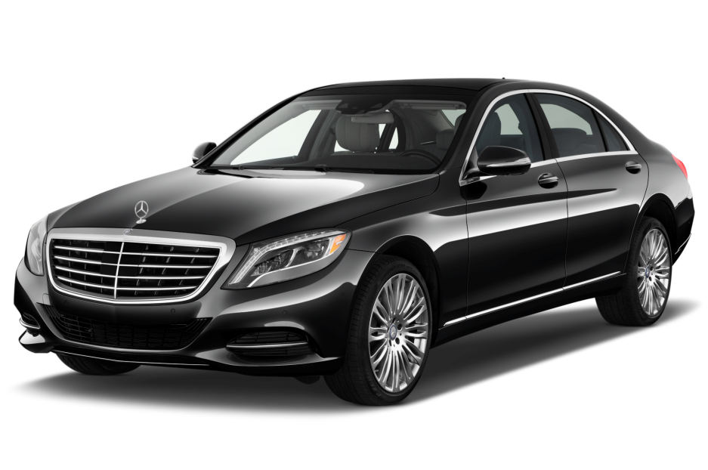
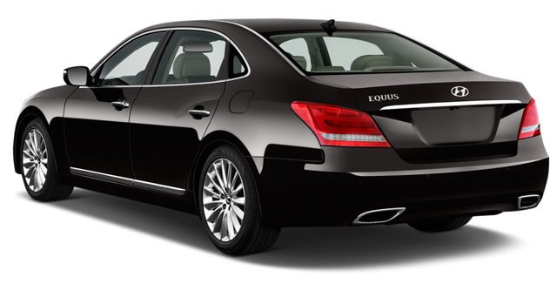
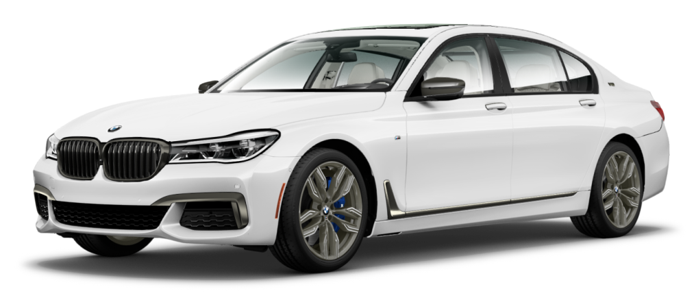
Example: luxury sedans
How hard has entry been? What is segment dQ/dP?
Notes:
106,150;62,69

Slide 61
Exclusive rights to make/use/sell
Intellectual property conveys certain rights to individuals
Types of IP
Patents exclude others from profiting from an invention
Trademark ~ recognizable sign, expression
Copyright ~ creative works
Many other property rights exist
Mostly formal (e.g., real property rights, permits, licenses)
Occasionally, informal

Slide 62
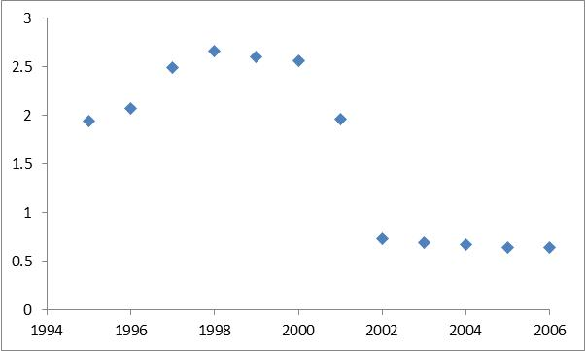
Example: Prozac gross profits
Approx. π in billions
Eli Lilly & Co.: 35 million Rx Prozac per year as of 2000
What happened @ t=2000?

Slide 63
Example: Prozac gross profits
Approx. π in billions
Eli Lilly & Co.: 35 million Rx Prozac per year as of 2000
Barr Pharma. successfully challenges patent
How much should managers care…?

Slide 64
Example: Prozac gross profits
Approx. π in billions
Eli Lilly & Co.: 35 million Rx Prozac per year as of 2000
Barr Pharma. successfully challenges patent
LLY stock drops $34 billion on the day court invalidates

Slide 65
General constraints on entry
There are others, so as a general categorization…

Slide 66
General constraints on entry
Real constraints: laws of nature
Scale economies
Learning-by-doing
Brand equity
Relationships
Network effects
Artificial constraints: imposed by society
Real property rights, e.g. mines
Production/use rights, e.g. e.g. patents
Licensing: liquor, taxi medallions, CPAs
Contractual, e.g. exclusive and/or existing long-term

Slide 67
Wrap-up

Slide 68
Inter-industry analysis
Large variation in returns “across” (see, e.g. G-R [2014])
π = f(buyer power, supplier power, substitution patterns, ▪)
All of this assumes barriers to entry/exit so that “excess” profits are not arbitraged away

Slide 69
Next steps…
We now have a sense of across-industry π differences—but almost no mention of within-industry differences so far
Next week
Even larger impact of π differences
Define “position”, isolate tradeoffs
Very widely applicable, e.g. politics, etc.
Next: Cola Wars

Slide 70


