Slide 1
WEEK 3 CASE: AIRBORNE EXPRESS
Copyright 2020
Thomas Wollmann
thomas.wollmann@chicagobooth.edu

Slide 2

Competitive advantage?

Slide 3
Airborne Express
UPDATE

Slide 4
Purple makes moves
Re-brands, builds, and/or acquires range of services
Examples
FedEx Express
FedEx Ground
FedEx Freight
FedEx Custom Critical
FedEx Services

Slide 5
Brown makes moves
Addresses the strike
https://youtu.be/RxgH5QNuGAA?t=43s
Known as “slow”…
Goes beyond “overnight”—uses fleet to guarantee early
Massive advertising campaign ~18 mos. post-case
https://www.youtube.com/watch?v=Tv7YTGdC0_8
Known as “simple”…
Like Fedex, it expands to supply chain management
“Consultants,” part of another big campaign https://www.youtube.com/watch?v=P7M7A34b6Rw

Slide 6
Airborne performance
ABF net income grew from $27M in 1996 to $137M in 1998
Enters Fortune 500
Yet, 2000+ saw dramatic worsening of situation
FedEx and UPS cherry-picked ABF short haul business through distance-based pricing (ouch!)
ABF net income: $92MM in 1999, $28M in 2000, -$20M in 2001

Slide 7
Subsequent events.
Did they take our advice?

Slide 8
Subsequent events.
Partly merged into DHL in 2003
Launched full suite of products

Slide 9
Subsequent events.
How did this turn out?

Slide 10
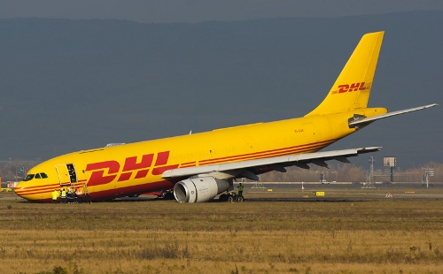
Womp womp.

Slide 11
“Failure to deliver.”
Combined entity lost > $10B over ten years!
Nov. 2008—DHL announces it’s leaving domestic U.S. market

Slide 12
“Failure to deliver.”
Combined entity lost > $10B over ten years!
Nov. 2008—DHL announces it’s leaving domestic U.S. market
Why’d they buy? Overconfidence after European experience?

Slide 13
“Failure to deliver.”
Combined entity lost > $10B over ten years!
Nov. 2008—DHL announces it’s leaving domestic U.S. market
Why’d they buy? Overconfidence after European experience?
Update to update: re-enters US Aug. 2016 re: e-commerce…?

Slide 14
WEEK 4 CASE: ENTERPRISE RENT-A-CAR
Thomas Wollmann
thomas.wollmann@chicagobooth.edu

Slide 15

Key positioning decision

Slide 16
Barriers?
Is Enterprise’s competitive advantage “sustainable”?

Slide 17
Enterprise
UPDATE

Slide 18
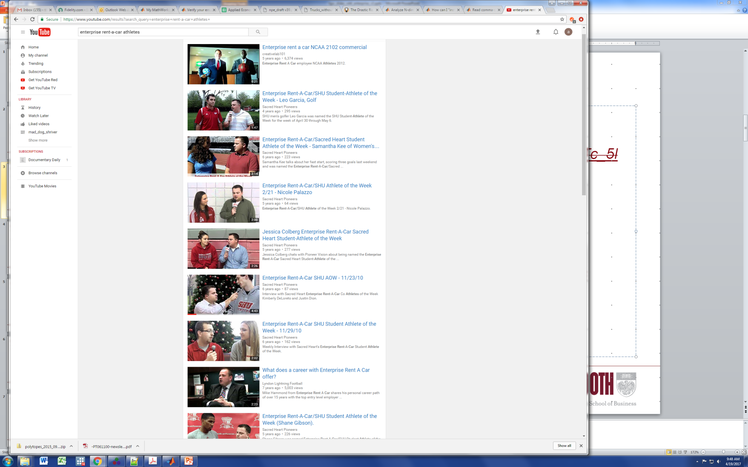
Example
Targets of ads?

Slide 19
What happened?
Competitors enter “locally”
Hertz “Local Edition” started in 1996, now 2300 offices
Avis/Budget will pick you up at the repair shop
Yet, Enterprise maintained advantage
Rivals found it hard to duplicate business model
Consistently named one of best companies to launch a career with by BusinessWeek
Highest in J.D. Power customer satisfaction for airport rentals in 9 of 11 years from 2003 to 2014
Grew to $5.6B in FY 2000, $19B in FY 2015
Note: All as of 2016 (i.e., ignores ridesharing complications)

Slide 20
Takeaways
Avoiding competition can trump locating near demand (e.g., Enterprise enters where most customers aren’t)
Firms should choose operational decisions that complement/reinforce main strategic position (e.g., Airborne doesn’t advertise, have retail loc’s)
Enhance profitability today
Future?
Downside: they naturally make the business less agile
Upside: they make the position tougher to imitate
Next week: the boundaries of the firm

Slide 21


Slide 22
Complementary operational decisions [2/2]
Relationships with service managers and customers “Boyfriend.” https://www.youtube.com/watch?v=G1v_UHTc_5I Updated for digital! https://youtu.be/QJVCNNCf7Q0
Empowerment = https://youtu.be/Q1jSrPvD1S8?t=1m55s

