Slide 1
BOUNDARIES OF THE FIRM
Copyright 2020
WEEK 4

Slide 2
Week 3
Within-industry π differences ↔ Positioning
Airborne
Positioned for high and predictable packages/stop
Very profitable @ 1997, but UPS strike ends “single-sourcing”
DHL loses order of mag. more $ than ABE earned ’95-’20
Enterprise
Positioned very simply—in city center, not at airport
# in profits, not # in sales
Odd operational decisions make it tough to challenge (consider, e.g., Hertz agents making inroads into body shops)
Important aux. lesson: agility not necessarily good (i.e., complementary decisions may deter future competition)

Slide 3
Weeks 1-3 recap
Competitive strategy = life or death
Issues
Economic profits
Equilibrium; entry and exit
Factors driving profit differences within/across industries
Density and elasticity of consumers
Pricing and positioning of products
This week = firm boundary and contracting issues
Note: might notice material speeds up at this point

Slide 4
Midterm
Structure / material
90 minutes
Short answer—phrases or paragraphs
No reason to memorize cases beyond very broad takeaways
Roughly 40% is based on case (“Zara”), which is posted
Will include today’s material
Open case and open notes
Administered first half of week 5 class
Manage time carefully. Make sure you attempt every question!
It is supposed to be fun.

Slide 5
Agenda
Main topic: a theory of the firm
Interchangeable phrases
“Make v. buy”
“Vertical integration” v. “arm’s length” transactions
“In-house v. outsource”
Example: Amazon’s last mile problem?
If markets work, we should isolate our competency and focus
…but it turns out there are problems with this approach
…and you will face them when you leave the classroom

Slide 6
Review: Asymmetric information

Slide 7
Brief rehash of the principal-agent (PA) problem
PA introduces some issues that arise in the boundary problem
Not a boundary issue per se
Canonical situation:
Principal owns asset
Agent works on and/or with the asset
Value of output increases in agent’s effort and/or ability
Principal keeps the output
Agent receives a wage

Slide 8
Example: Mgmt. consulting
Firm owns brand, you work for the firm
Quality of their advice depends on number of your insights
Insightful analysis requires effort
They keep revenue, and you receive a wage
Classified Advertisement
“McKinsey & Co.
$150,000 flat salary + benefits
No interview! No monitoring!”
How well does this work and why?

Slide 9
Two problems
Consulting firm does not know…
“Type” of worker
Brilliant and boneheaded people both apply
Brains of employee hidden from employer
In jargon, “adverse selection”
“Actions” of worker
Regardless of type, everyone shirks
Effort of employee hidden from employer
In jargon, “moral hazard”

Slide 10
Short case: Safelite Group, Inc.

Slide 11


Lazear [2000]

Slide 12
Problems and solutions
Flat salary → piece-rate
Selects on ambition and/or skill (i.e., “type”)
Also induces effort from workers
Requires some care in implementation (e.g. w.r.t. quality)
Result: 44% improvement in productivity
½ from adverse selection
½ from moral hazard
Clearly shows benefit of the worker “owning” his/her operation

Slide 13
Boundaries of the firm: An introduction

Slide 14
Starting point: Complete contracts [1/2]
Two people, only one car
Jeff wants to drive ~ 6 days/week, Jess 1 day/week
Basic question arises as to who should own the car
What did Ronald Coase realize?

Slide 15
Starting point: Complete contracts [1/2]
Two people, only one car
Jeff wants to drive ~ 6 days/week, Jess 1 day/week
Basic question arises as to who should own the car
U of C economist Ronald Coase wins Nobel Prize for realizing:
When all efforts and actions are contractible, then production is organized in the most efficient possible way, regardless of who owns what.
That is, with perfect property rights—no transactions costs, etc.—ownership is irrelevant for efficiency.
Note: doesn’t matter for efficiency—does matter for distribution!

Slide 16
Starting point: Complete contracts [2/2]
What do contracts look like in a “perfect property rights” world?
Complete contracts require…
Different actions for every state of the world
Everything verified easily—costlessly—in court
Impossible for a host of reasons (e.g., bounded rationality, ongoing disagreements about the world, unverifiability, etc.)
Contracts are not complete, so ownership matters

Slide 17
Introduction
Extend PA problem to the vertical integration decision
Ask, “In a vertical chain of buyers and suppliers, what should firms contract for and what should they do themselves?”
e.g. Should Coke own sugar plantations? The distributors?
e.g. Should Airborne own its airports? Employ the deliverers?

Slide 18
Introduction
Extend PA problem to the vertical integration decision
Ask, “In a vertical chain of buyers and suppliers, what should firms contract for and what should they do themselves?”
e.g. Should Coke own sugar plantations? The distributors?
e.g. Should Airborne own its airports? Employ the deliverers?
Often hear “Own things with high margins, high returns,” e.g. “Stick with concentrate, not bottling. It’s a good business.”

Slide 19
Introduction
Extend PA problem to the vertical integration decision
Ask, “In a vertical chain of buyers and suppliers, what should firms contract for and what should they do themselves?”
e.g. Should Coke own sugar plantations? The distributors?
e.g. Should Airborne own its airports? Employ the deliverers?
Often hear “Own things with high margins, high returns,” e.g. “Stick with concentrate, not bottling. It’s a good business.”
Ask, “What really determines optimal boundaries of the firm?”
Note that this gets very complicated—it’s the only point in the course where I “cut corners,” technically speaking

Slide 20
Example: No-name CSDs
Generic cola = sales company
Critical input = bottling / packaging operations
Classified Advertisement
“Be a supplier to Wildwood Cola
$1MM per year flat compensation
Simple task: Just make bottles for us”
What goes wrong with this contract?

Slide 21
Example: No-name CSDs
Generic cola = sales company
Critical input = bottling / packaging operations
Classified Advertisement
“Be a supplier to Wildwood Cola
$1MM per year flat compensation
Simple task: Just make bottles for us”
Supplier will shirk—low productivity, poor quality, et cetera
Alternative is clearly monitoring, but it’s costly to increase the span of control (e.g., create divisions, add presidents, VPs)

Slide 22
Benefits of the market
Agents (a.k.a. subsidiary companies) will shirk
Let them take responsibility for their actions
In other words, let them take ownership over production
Safelite intuition all over again!
Agent effort is important ⇒ use the market
We could “look over their shoulder” (i.e., monitor them)
Layers of management usually expensive and inefficient
Span of control costly ⇒ use the market
Why not always use the market?

Slide 23
Three problems with dis-integration
Transaction costs
Hold-up problems
Double marginalization

Slide 24
Boundary determinant I: Transaction costs

Slide 25
Description
Example: employment vs. independent contractor
You work in investment banking
New tasks come up day-to-day
Option 1: Every time your boss asks you do something, you negotiate a price
Option 2…?

Slide 26
Description
Example: employment vs. independent contractor
You work in investment banking
New tasks come up day-to-day
Option 1: Every time your boss asks you do something, you negotiate a price
Option 2: As an employee, you are expected to do X activities between the hours of Y and Z
Negotiation can be very costly to both parties
Worse yet, parties often have to “find” one another first

Slide 27
Benefits to authority (i.e., vertical integration)
Hassle of discovering a party ≡ transaction costs (search)
Hassle of discovering a price ≡ transaction costs (haggling)
Alternative : “Employ” your supplier and “instruct” him or her to do X where X falls within some agreed upon set of activities
Transaction costs are high ⇒ vertically integrate
Compare to an input for which prices are posted
Compare to an input for which sellers meet in one place

Slide 28
Boundary determinant II: The “hold-up” problem

Slide 29
Canonical situation
You have a relationship-specific asset (i.e., an asset that is much more valuable within the relationship)
Asset requires costly up-front investment
Investment increases the total value of the relationship
Asset has less value if the relationship breaks down

Slide 30
Example: Coal-mines
Suppose we consider isolated coal mines
Coal is expensive to ship but electricity is cheap
You want to build a new $200MM power plant
Where is most efficient place to put it?
Who owns electric plants (in the “data”)?

Slide 31
Ownership decision
The real problem is not the hold up!
The real problem is that if you expect to be held up, you will under-invest in relationship-specific assets
Threat of ex-post hold up is high ⇒ ex ante investment is low
Not a problem if the person who is invests and the person who can hold up are the same person (i.e., principal=agent)
Assets are relationship-specific ⇒ vertically integrate
Threat of opportunism is high ⇒ vertically integrate
Alternate solutions to problem?

Slide 32
Next steps
- Break -
Mini-case: Baker-Hubbard [2004]
Other considerations
Case: Birds Eye Frozen Foods

Slide 33
Short case: US Trucking

Slide 34

Baker and Hubbard [2004]
Optimal boundaries for freight transport firms?

Slide 35

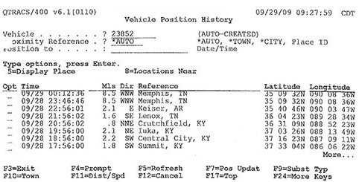
Technological changes and vertical integration
What is this? How does it impact ownership structure?

Slide 36
Boundary determinant III: Double marginalization

Slide 37
Description
Canonical situation
Industry with vertical relationships, e.g. manuf./retailer
Both upstream and downstream have some market power
Example: “upstream” and “downstream” parts of industry
Upstream cost is c_{u} and downstream demand is Q(p)
Note: upstream wholesale price is part of downstream cost
Maximize total profits solving: max { (p - c_{u} - c_{d}) x D(p) }
Result: Prices are higher than under vertical integration —in a way that reduces total profit throughout the vertical chain

Slide 38
Proof of inefficiency?
[Algebra]
[Graph]

Slide 39
Solution
Obvious alternative: upstream and downstream firms merge
Market power upstream/downstream ⇒ vertically integrate
Other solutions?
Example = two-part tariffs
Gets complicated quickly—especially in the real world
At least one Booth course devoted to this problem alone
I will probably follow up with an email about this

Slide 40
Boundary determinants: Summary and alternatives

Slide 41
Summary
Information asymmetries smaller when agent “owns” the asset
Could monitor—but managerial layers (very) costly
Why, then, would we ever integrate?
Transaction costs: repeated searching and haggling required
RSIs are important ⇒ hold-up risk ⇒ no/low ex ante invest
Market power upstream and downstream = inefficiently higher prices and lower profits
Can mitigate with multi-sourcing, trust, two-part tariffs, etc.
Also, there are compromise options (e.g. franchises)

Slide 42
Next step
Case: Birds Eye Frozen Foods

Slide 43
WEEK 5 CASE: BIRDS EYE FROZEN FOODS
Thomas Wollmann
thomas.wollmann@chicagobooth.edu

Slide 44
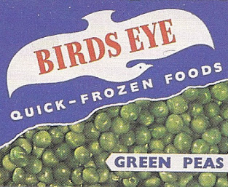
Frozen peas
Remarkably boring case—if you don’t care about $$$!

Slide 45
Frozen foods
I will spare you the melodramatic Monty Python video
“A small group of men would launch an operation which, if successful, would change the face of the edible pea market… These desperate men…met at the headquarters…to plan the elimination of all erstwhile competitors…”

Slide 46
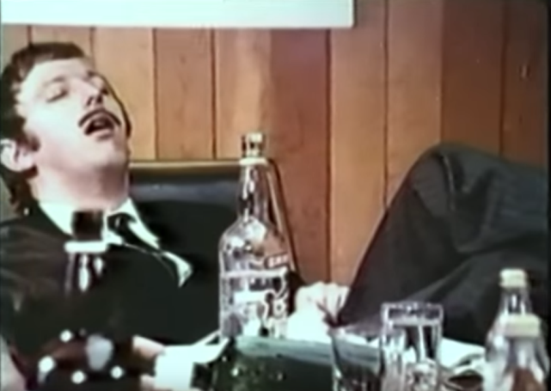
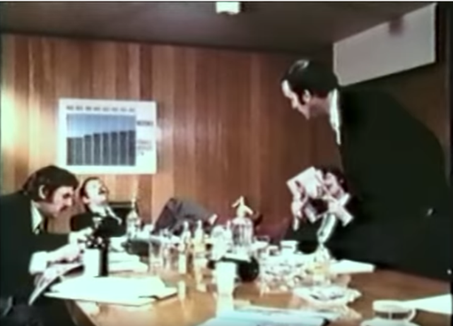
Frozen foods
I will spare you the melodramatic Monty Python video
“A small group of men would launch an operation which, if successful, would change the face of the edible pea market… These desperate men…met at the headquarters…to plan the elimination of all erstwhile competitors…”

Slide 47
Market changes: late 1960s / early 1970s
What happened?
Is this a “top line” (revenue) or “bottom line” (cost) problem?
What should Birds Eye do?

Slide 48
Birds Eye Frozen Foods
UPDATE

Slide 49
What happened?
1980: too many factories and too much overhead
1980-1982…?

Slide 50
What happened?
1980: too many factories and too much overhead
1980-1982: company-wide restructuring
Shed assets, increased R&D, increased product lines
Cut costs, then heavy advertising
https://www.youtube.com/watch?v=bFBtFaU0Gbg
https://www.youtube.com/watch?v=3stS1y4V7_o
 | 1972 | 1977 | 1980 | 1981 | 1982 | 1983 | 1984
Sales
Profit
Capital Employed

Slide 51
What happened?
1980: too many factories and too much overhead
1980-1982: company-wide restructuring
Shed assets, increased R&D, increased product lines
Cut costs, then heavy advertising
https://www.youtube.com/watch?v=bFBtFaU0Gbg
https://www.youtube.com/watch?v=3stS1y4V7_o
 | 1972 | 1977 | 1980 | 1981 | 1982 | 1983 | 1984
Sales | 91.8 | 212.3 | 298.1 | 384.7 | 404.8 | 420.6 | 452.1
Profit | 2.1 | 2.4 | 13.0 | 5.9 | 4.0 | 8.2 | 16.9
Capital Employed | 33.9 | 100.0 | 141.2 | 224.5 | 240.0 | 227.6 | 228.2

Slide 52


Slide 53
Changing span of control costs?
Stylized very recent facts
Kaldor Facts → labor share falling
Capital share falling → profit share rising
Investment low, in spite of high Tobin’s Q
Decreasing economic dynamism
Also, rising inequality
Consolidation, scale economies, sunk costs, span of control?
[Not on exam, very helpful to understand, though]

