Slide 1
THE TUNA GAME and GAME THEORY INTRODUCTION
Copyright 2020
WEEK 5

Slide 2
Week 5 (Post-midterm)
Brains usually “fried” post-midterm
Thus, usually follow with Tuna Game (~45 minutes) and informal introduction to game theory (~25 minutes)
TG is entertaining (it nearly caused a divorce!?) but illustrative, reflecting almost every major issue arising in weeks 6+
I think I more than made up for not being able to play TG 2020: I compiled all prior data so we can talk through the rounds and then study the distribution of choices/outcomes

Slide 3
The Tuna Game

Slide 4
Setup [1/3]
Note: for a host of reasons, I probably won’t post any unredacted Tuna Game slides (but specifics are not on final)
Worlds/firms
Break up class into 6 different “worlds” called 1,2, …,6
Each world has 3 different “firms” called A, B, C
Hence, students split evenly across 18 firms
Hence, class of 65 ≈ 3.5 students in each firm
“A” firms seated in left third of room, “B” in center, “C” in right
Example: in World 1 there are three firms: 1A, 1B, and 1C, with 1A huddled together at left, 1B at center, 1C at right

Slide 5
Setup [2/3]
Each team receives stack of index cards and XL Sharpie marker
In each round, I will cycle through the worlds (i.e, 1,2,…,6)
I will start by calling out “World 1”
Simultaneously, 1A, 1B, and 1C will hold up their cards
Cards indicate your firm’s choice.
Firms choose quantity (i.e., this is repeated Cournot)
Example: firm 1B chooses Q_{B}
[Details on next slide.]

Slide 6
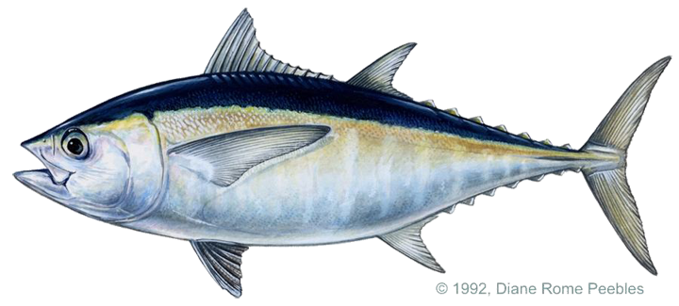
Profits = (Price – Marginal Cost) * Quantity
Price(Q_{A},Q_{B},Q_{C}) = max{ 45 – 0.2 * (Q_{A +} Q_{B +} Q_{C}), 0 }
Marginal cost = $5
Your boat chooses quantity—choices are simultaneous!!!

Slide 7
Setup [3/3]
Final instructions
“You have 5 minutes to decide on first quantity.”
“There will be many, many rounds.”
No other information given about length of game.
“You’ll have time after the first round to think about how you want to adjust your quantity.”
I emphasize that while your profits are determined only by the decisions of firms in your world, your goal is to maximize profits overall (not relative to the other two teams in your world)

Slide 8
Group exercise
What would you choose in the first round?
[Proceed to breakout rooms for 5 minutes.]

Slide 9
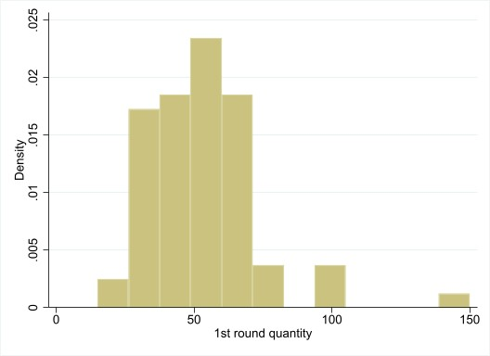
Results: Round 1 choices

Slide 10
Group exercise
Any questions?
I allow rival firms to meet for ~3 minutes after round 7.
What quantity do you think is played in round 8?
The game lasts 18 rounds.
What quantity do you think is played in round 18?
[Proceed to breakout rooms for 5 minutes.]

Slide 11
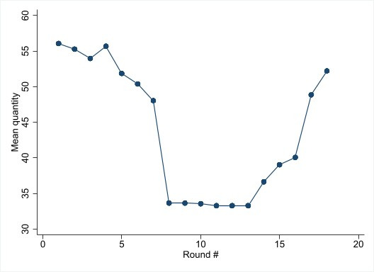
Result: Average quantity by round

Slide 12
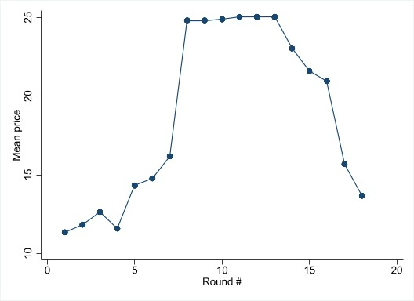
Result: Average price by round

Slide 13
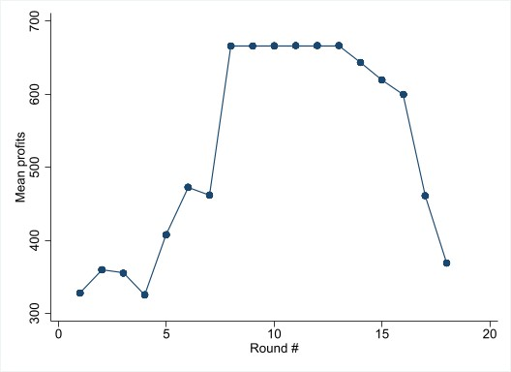
Result: Average profits by round

Slide 14
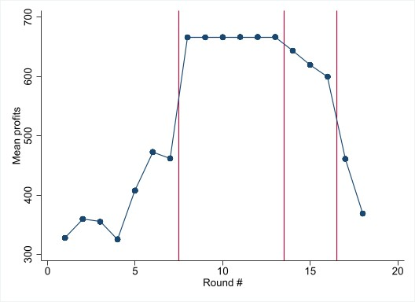
Breakdown at vert. lines 2 and 3?

Slide 15
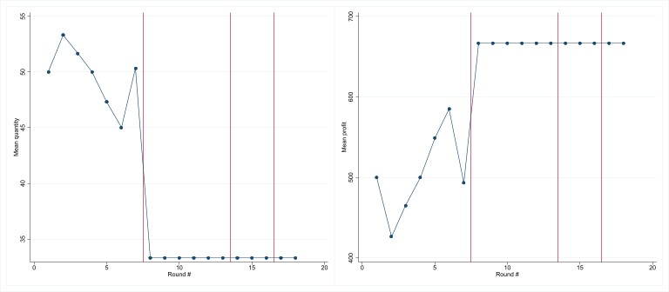
One of many interesting cases
In one world in F’19, collusion didn’t break down
Very frustrating for me but profitable for firms (ranked 1,2,4)
Will return to this and many other cases next week…

Slide 16
Game Theory Introduction

Slide 17
Game Theory
Until this point in the course, rivals’ actions have been fixed
Going forward, they condition their actions on your actions
Can lead to radically different—sometimes strange—solutions (e.g., the chicken game)
Allows us to understand phenomena not suited for classical micro (i.e., a price theory approach)
e.g. “Real world” positioning
e.g. Value of commitment
e.g. Dynamics of cooperation
e.g. Network effects and multi-sided platforms

Slide 18
Defining a game
Players
Action space—what choices players take
Payoffs—typically profits for our purposes
Timing
Sequential, e.g., tic-tac-toe, price setting with leader
Simultaneous move, e.g., rock-paper-scissors, auctions
Information issues—beyond the scope of this course
Private information, e.g., I don’t know your marginal costs when I set my prices
Complete information = everything observable

Slide 19
Equilibrium [1/2]
What is an equilibrium of the game?
i.e. What will people play?
i.e. What is the expected outcome?
Early reasoning: “I think that you think that I think that…”
Example: Poisoned chalice in the Princess Bride https://www.youtube.com/watch?v=E2y40U2LvKY
Series of self-referential loops
Creates total impasse in game theoretic work
Is there any way out of this?
Hint: Math Dept., Princeton Univ., 1953

Slide 20
Equilibrium [2/2]
Enter John Nash, who posits that eq’l defined by each player doing the best he or she can given what everyone else is doing (i.e., there are no profitable unilateral deviations)
Natural—but clever—concept for which he won the Nobel
Upside: at least one almost always exists
Downside: possible multiplicity (i.e., many equilibrium)
Related: doesn’t state how we get to an equilibrium, though certainly bounds what is possible (often, tightly)
Example from A Beautiful Mind—but is it Nash!? https://youtu.be/CemLiSI5ox8

Slide 21
Example: The Tuna Game
You choose Q_{i} and rivals choose Q_{j} and Q_{k}
Price determined by Q_{i} + Q_{j} + Q_{k}
Profit = (45 – 5 - 0.2(Q_{i} + Q_{j} + Q_{k})) * Q_{i}
∂Profit / ∂Price = 40 – 0.4 Q_{i} – 0.2 (Q_{j} + Q_{k})
You maximize profit by setting marginal profit to zero
Your optimal quantity depends on what your rivals choose
That is, you cannot make your decisions independent of rivals
Note: this is Nash’s point in the movie, albeit wrongly stated!

Slide 22
Game setup for sequential moves

Slide 23
Sequential Move Game Trees (1/3)
Reminder: key feature of sequential move games=order matters
For discrete decisions, use game trees to map moves to payoffs
Offer clear graphical representation of sequential reasoning
Not crucial to do formally
Yet, games can get very complicated very quickly, so often very smart people use them (e.g., war games)
Note: henceforth we’ll specify payoffs in parentheses: (Payoff to Player 1, Payoff to Player 2, …)

Slide 24
Sequential Move Game Trees (2/3)
Player 1
Player 2
(π₁,π₂)
(π₁,π₂)
Player 2
(π₁,π₂)
(π₁,π₂)

Slide 25
Sequential Move Game Trees (3/3)
Solve via backwards induction
This means players “look ahead but reason backwards”
Yields Nash eql. in that strategies are optimal, conditional on forecasting that people will play Nash strategies “later on”

Slide 26


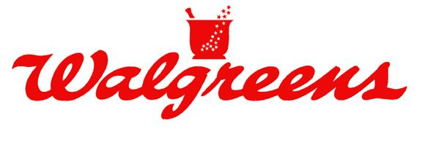
Example: Store entry/pricing
Say CVS already has a store on a street corner
Walgreens considering entering across the street
If Walgreens enters, then CVS decides on whether they will engage with a price war or not

Slide 27
Example: Store entry/pricing
Walgreens moves first
Two actions: Enter or Not Enter
If W does Not Enter:
Payoff = (W, C) = ($0, $300K)
If W Enters, C chooses Fight or Not Fight
If C Fights, payoff = (-$100K, -$100K)
If C does Not Fight, payoff = ($100K, $100K)
How do we graph it?

Slide 28
Example: Store entry/pricing
Player 1
Player 2
(π₁,π₂)
(π₁,π₂)
Player 2
(π₁,π₂)
(π₁,π₂)

Slide 29
Example: Store entry/pricing
W
0, 300
100,100
-100,-100
C
Not Enter
Enter
Not Fight
Fight

Slide 30
Example: CVS and Walgreens—in reverse
For now, let’s merely reverse order of play
Take a second and write down the game
What is the Nash equilibrium?

Slide 31
Example: CVS and Walgreens—in reverse
C
W
0, 300
-100,-100
W
0, 300
100, 100
Not Fight
Fight
Not Enter
Enter
Not Enter
Enter

Slide 32
Example: CVS and Walgreens—in reverse
Equilibrium
C plays Fight
W plays Not Enter
Payoffs are 0 for Walgreens and 300 for CVS
CVS prefers this outcome
Thus, it would rather the order be reversed
How can CVS ensure this outcome is realized?

Slide 33
Commitment for CVS
For sequential move games, committing is analogous to changing the order of moves
CVS would like to commit to Fight no matter what
It dislikes this decision if Walgreens players Enter
But knowing CVS will fight—due to CVS’s commitment—Walgreens never plays Enter
Thus, CVS never dislikes this decision in equilibrium! (sorry for the double negative)
In essence, the firm is tying its hands to improve its outcome

Slide 34
Commitment in The Tuna Game [1/2]
Commitment provides an advantage in The Tuna Game
You want to commit to q = 33.3333
In the collusion rounds…
You met
You probably promised q ≈ 33
You split up again… and almost all broke their promise
You couldn’t commit, and you all earned less than optimal
Example: commitment mechanism
Suppose you could bring the janitor in and write a contract: you will either choose q=33 or you owe him $50,000
This ties your hands (i.e. restricts your ability to choose)
All players in your world would place 1st for sure

Slide 35
Commitment in The Tuna Game [2/2]
One criticism:
Fine in theory but… no one would actually do this in practice…

Slide 36
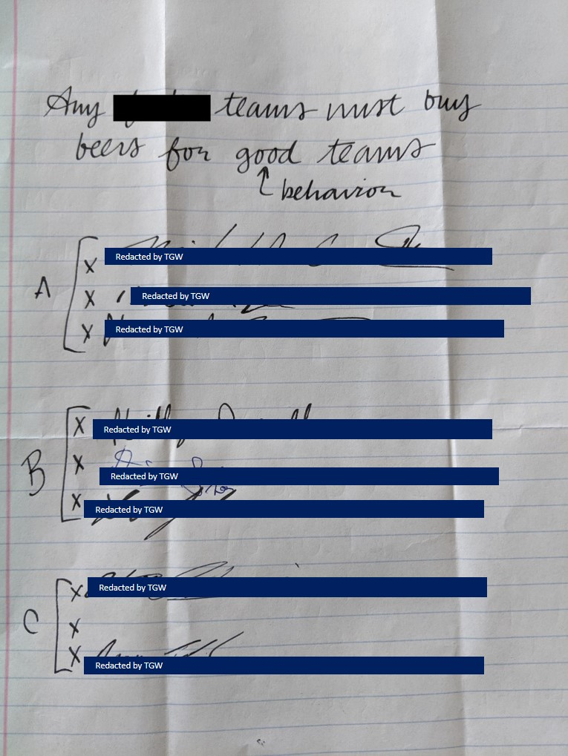
Commitment in The Tuna Game [2/2]
One criticism:
Fine in theory but… no one would actually do this in practice…
(Credit: Friday section, Fall 2020!)

Slide 37
Commitment in The Tuna Game [2/2]
One criticism:
Fine in theory but… no one would actually do this in practice…
Opposite criticism:
This is obvious…
(Credit: Friday section, Fall 2020!)

Slide 38
Commitment in The Tuna Game [2/2]
One criticism:
Fine in theory but… no one would actually do this in practice…
Opposite criticism:
This is obvious…
but note that it took 5 years for anyone to think fast enough to execute this.
(Credit: Friday section, Fall 2020!)

Slide 39
Cautionary tale
Another recent example (Credit: Thursday section, Winter 2018!)
Keep one 33.3 card
Throw the markers back at the professor
What happened? (Note: foreshadows airline case!)

Slide 40
Cautionary tale
Another recent example (Credit: Thursday section, Winter 2018!)
Keep one 33.3 card
Throw the markers back at the professor
What happened? (Note: foreshadows airline case!)
Rival tuna boat held up laptop with 67 on it!! Chaos!!

Slide 41
Commitment
We will return to commitment later on

Slide 42
Game setup for simultaneous moves

Slide 43
Simultaneous moves: Setup
Key feature: everyone moves together
For discrete decisions, use tables to map actions to payoffs
Easy to extend to multiple actions (many players is complicated)
Player 2
 | Left | Right
Up | ($π₁, $π₂) | ($π₁, $π₂)
Down | ($π₁, $π₂) | ($π₁, $π₂)
Player 1

Slide 44
Simultaneous moves: Setup
Player 2
 | Left | Right
Up | ($π₁, $π₂) | ($π₁, $π₂)
Middle | ($π₁, $π₂) | ($π₁, $π₂)
Down | ($π₁, $π₂) | ($π₁, $π₂)
Player 1

Slide 45
Simultaneous moves: Setup
(If you’re interested in 3 players…)
Player 2
 | Left | Right
Up | ($π₁, $π₂,$π₃) | ($π₁, $π₂,$π₃)
Down | ($π₁, $π₂,$π₃) | ($π₁, $π₂,$π₃)
Top
Player 1
Player 3
Player 2
 | Left | Right
Up | ($π₁, $π₂,$π₃) | ($π₁, $π₂,$π₃)
Down | ($π₁, $π₂,$π₃) | ($π₁, $π₂,$π₃)
Bottom
Player 1

Slide 46
Three main ways to find simultaneous move eql.
Iteratively eliminate strategies to find a “dominant” one
Search for other “pure strategy” equilibria
Consider “mixed strategy” equilibria

Slide 47
Types of simultaneous move equilibrium (1/3)
Call a strategy s_{i’} a “dominated strategy” if alternative strategy s_{i} yields higher payoffs no matter what your rivals play
Formally, u_{i}(s₁,...,s_{i},...,s_{N}) < u_{i}(s₁,...,s_{i’},...,s_{N}) for all s₁,…,s_{N}
Steps
Eliminate all dominated strategies for all players
Iterate this procedure
If only one remains, choose it—it’s the “dominant strategy”

Slide 48
Prisoners’ dilemma
Facts: Ratting on your partner is privately beneficial. Yet, if you both confess, your prison time is much longer than if you both remain silent.
Prisoner 2
 | Silence | Confess
Silence | (1 yrs, 1 yrs) | (10 yrs, 0 yrs)
Confess | (0 yrs, 10 yrs) | (5 yrs, 5 yrs)
Prisoner 1

Slide 49
A variant of the dilemma: US-Soviet Arms Race
Facts: You never expect to use nuclear weapons and doing so is quite costly. Yet, if your rival has them and you don’t, they gain almost complete control over you.
USSR
 | Build | Don’t
Build | (-$1T,-$1T) | ($1T, -$100T)
Don’t | (-$100T, $1T) | ($0, $0)
USA

Slide 50
Types of simultaneous move equilibrium (2/3)
Suppose iteration does not yield a dominant strategy
Then, consider other pure strategy equilibria
Example: Sushi restaurants in Chicago

Slide 51
Geographic positioning (with multiplicity)
Facts: Generally WL>WP. Yet, both want to avoid locating next to one another.
Arami
 | West Loop | Wicker Park
West Loop | (-$1M, -$1.5M) | ($1M, $2.5M)
Wicker Park | ($3M, $2M) | (-$2M, -$2M)
Momotaro

Slide 52
Types of simultaneous-move equilibrium (3/3)
Suppose iteration does not yield any pure strategy equilibrium
Consider mixed strategy eql.
Example: Poisoned cups
In the interests of time, I will save the solution concept/explanation for an email announcement
Note: many interesting real world examples (e.g., penalty kicks)

Slide 53
Poisoned cups (with mixed strategies)
Facts. Player 1 pours the drinks. Player 2 selects which to drink from. Both players wish to avoid the poison.
Player B
 | Drink near cup | Drink far cup
Place it near B | (0, -1) | (-1, 0)
Place it far | (-1, 0) | (0, -1)
Player A
What is the Nash equilibrium?

Slide 54
Takeaways

Slide 55
Game theory (re-)introduction
Sequential move = timing matters → backward induction
Simultaneous move games
Might have dominant strategy equilibrium
Often have multiple equilibria
Mostly beyond the scope of 42001
“Mixed strategy” equilibria—randomly varying actions
Choosing among equilbria
Many other considerations…

Slide 56
“DYNAMIC PRICING”
Copyright 2020
WEEK 6

Slide 57
Game Theory
Prior lecture: static (i.e., “one-shot” games)
We play and then we are done
Examples: Prisoners’ dilemma, entry decisions, arm’s race
In markets, frequent opportunities for repeated play, e.g. Coke/Pepsi, Fedex/UPS, Hertz/Avis
This matters because profits are typically higher if you’re smart about repeated play
In the Tuna Game, which rounds score best (i.e., early rounds, middle rounds, or late rounds)? Why?

Slide 58
Ways to weaken rivalry

Slide 59
Motivation
Firms do not internalize negative effect of actions on others
A monopolist, for example, internalizes the externality
Tuna Game
You did not internalize the fact that raising quantity lowers the price that *all other* boats receive
That is, max’ing your π means means not max’ing total π
If you could make joint decisions, you choose q=33, not q=50
Firms would love to “soften” rivalry up and play more like monopolists (i.e., internalize each others’ payoffs)
Merger is an option but will be subject to §7 (Clayton Act)
How else might firms accomplish this?

Slide 60
Methods
Cartel / explicit agreement to restrain competition= set p or q
Can be open, as in OPEC/DeBeers, or secret, as in lysine case (next slide) or mid-stage Tuna Game

Slide 61
Methods
Cartel / explicit agreement to restrain competition= set p or q
Can be open, as in OPEC/DeBeers, or secret, as in lysine case (next slide) or mid-stage Tuna Game
What’s the problem with explicit collusive agreements?

Slide 62
Methods
Cartel / explicit agreement to restrain competition= set p or q
Can be open, as in OPEC/DeBeers, or secret, as in lysine case (next slide) or mid-stage Tuna Game
§ 1 (Sherman Act) makes “contract, combination, or conspiracy in restraint of trade” illegal
Do not ever make explicit agreements in this country
You will go directly to jail
You will not pass “Go”
You will not collect $200
See, e.g., The Informant w/ M. Damon

Slide 63
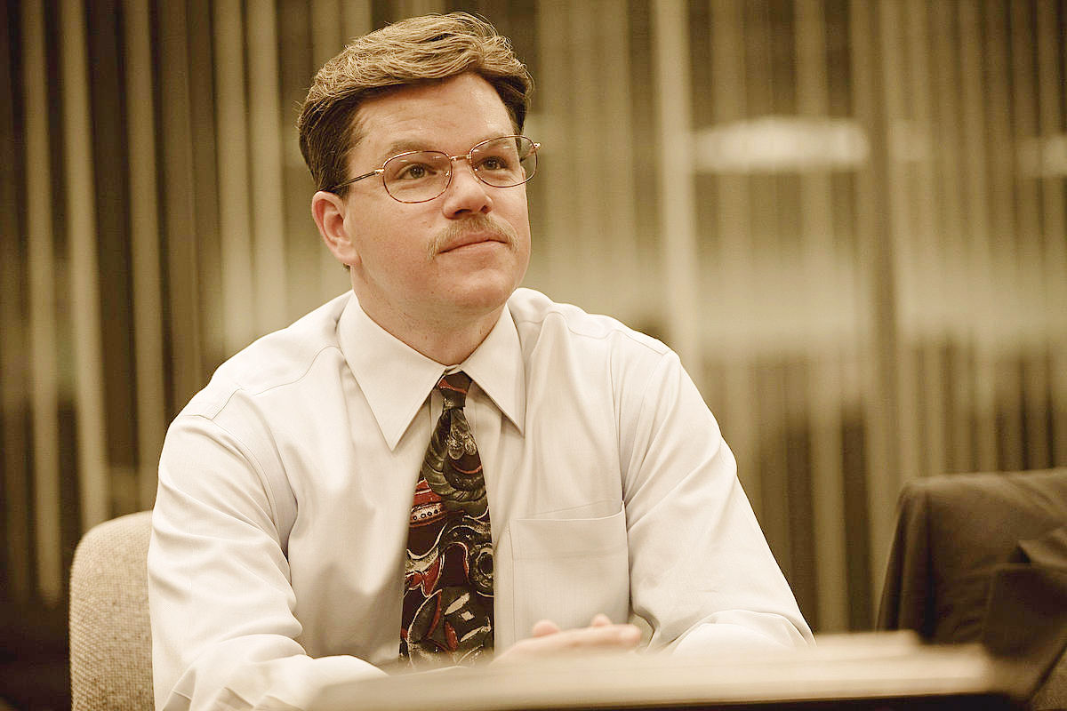
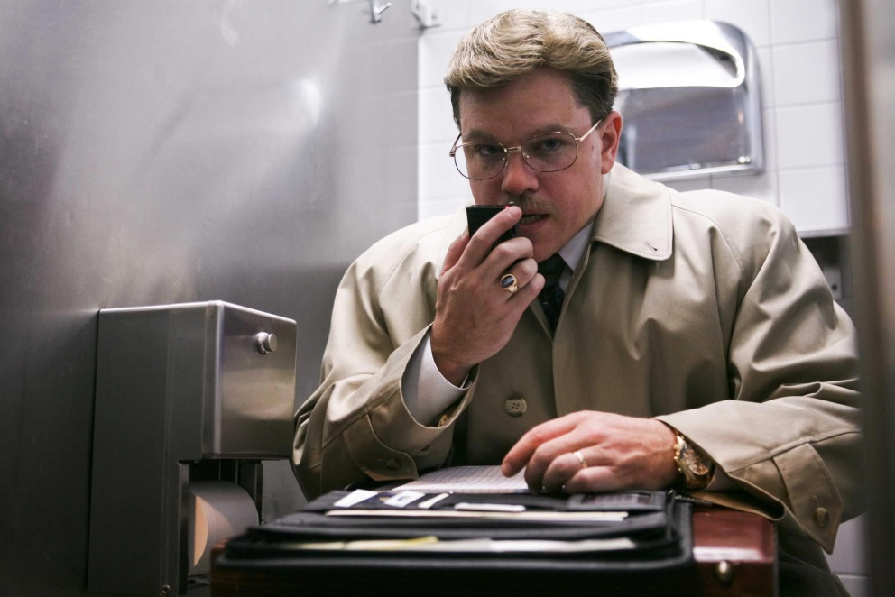
Also, do not do stupid $&#@ for your boss or your firm after you leave here.
If you do, get your own attorney!

Slide 64
Two methods
Cartel / explicit agreement to restrain competition= set p or q
Can be open, as in OPEC/DeBeers, or secret, as in lysine case or mid-stage Tuna Game
§ 1 (Sherman Act) makes “contract, combination, or conspiracy in restraint of trade” illegal
Do not ever make explicit agreements in this country
You will go directly to jail
You will not pass “Go”
You will not collect $200
See, e.g., The Informant w/ M. Damon
What is the other way?

Slide 65
Two methods
Cartel / explicit agreement to restrain competition= set p or q
Can be open, as in OPEC/DeBeers, or secret, as in lysine case or mid-stage Tuna Game
§ 1 (Sherman Act) makes “contract, combination, or conspiracy in restraint of trade” illegal
Do not ever make explicit agreements in this country
You will go directly to jail
You will not pass “Go”
You will not collect $200
See, e.g., The Informant w/ M. Damon
Tacit collusion—an industry “norm”

Slide 66
Tacit collusion: Introduction
In most markets, firms don’t explicitly collude
In some markets, firms do tacitly collude—or at least try to
In the data, markets vary in intensity of rivalry, and tacit collusion might account for part of this
Often described as norms that dictate “soft competition” (high prices) or “price wars” (low prices)
Grey area of legality, mostly not criminal—still consult a lawyer

Slide 67
Softening up rivalry: Managerial considerations

Slide 68
Tacit collusion: Main issues
When are firms most incentivized to tacitly collude?
When can firms actually come to an unspoken agreement?
When can it be sustained? Or, what causes it to break down?

Slide 69
Issue I: How motivated are agents to collude? [1/2]
Establishing an agreement is costly
When are benefits likely to outweigh costs?
Compare π_{Collusive} – π_{Nash} to costs of coordinating
π under collusion (cooperation)
Bounded by industry demand curve and marginal costs
Equivalent to maximum profit of a monopolist
π under competition (i.e., non-cooperation)
Bounded by residual demand curve and marginal costs
Determined by Nash prices and/or quantities
In many cases, tens of billions of dollars difference

Slide 70
Issue I: How motivated are agents to collude? [2/2]
Consider changing the Tuna Game parameters
Fact: P = 45 - 0.20 × Q_{rivals’ sum} - 0.20 × Q_{yours}
Fact: π = (P-5) × Q_{f}
Suppose: P = 45 – 0.01 × Q_{rivals’ sum} - 0.20 × Q_{yours}
Suppose: π = (P - 40) × Q_{f}
(If you’re interested, for the Tuna Game, π_{Collusive}–π_{Nash} α (a-c)²/b where P = a-b×Q and MC=c.)

Slide 71
What gains from collusion depend on
Size of potential industry earnings?
Incentives to collude high if market elasticities are low.
Commodity vs. diff’d products?
Incentives to collude high if cross-price elasticities are high (i.e., low differentiation).
Suppose it works… collusion ⇒ high profits, but high profits ⇒ entry
Collusive benefits require entry barriers.

Slide 72
Likelihood of tacit collusion
Incentives to coordinate | Implementation aids | Sustainability of collusion
Low market elasticity | … | …
Low differentiation
High barriers to entry
[Note: don’t rush to copy these down; I’ll leave the full
table up over the break.]

Slide 73
Issue II: When can it be implemented? [1/2]
Suppose you’d like to implicitly agree on p, q, x,…
When can you actually reach an unspoken agreement?
Face two main challenges
Communication without verbalization
Firms must to coalesce around specific tacit price/quantity
Cannot speak directly about it
Non-members do best
Small players can free-ride
Thus, one cannot depend on fringe players to collude

Slide 74
Issue II: When can it be implemented? [2/2]
Fewer firms communicate easier
Secret deals hurt ability to verify prices/quantities/profits
Private information about costs draws out bargaining
Easy to illustrate using the Tuna Game
Also, free-riders are small, few—do not impact major players

Slide 75
What implementation depends on
Small number of firms
Transparency of rivals’ prices
Common knowledges of rivals’ costs
Free-riders are small and few—do not impact major players

Slide 76
Likelihood of tacit collusion
Incentives to coordinate | Implementation aids | Sustainability of collusion
Low market elasticity | Few major firms | …
Low differentiation | Few/small free-riders
High barriers to entry | Common knowledge of rivals’ costs
 | Transparency of rivals’ prices (i.e., no secret deals)

Slide 77
Issue III: When can it be sustained?
Once it is setup, what do we worry about?
How do we keep that from happening?

Slide 78
Issue III: When can it be sustained?
Once it is setup, what do we worry about?
How do firms keep that from happening?

Slide 79
Issue III: When can it be sustained?
Tradeoffs b/c cheating now changes rivals’ behavior in future
Incentive to do it = higher profits today
Incentive not to do it = lost profits tomorrow
Sustainability ≡ feasible punishment
Example: Collusive strategy that is Nash
We all play q* until someone deviates
If someone deviates, all others gang up on them
Punish deviant sufficiently long to dis-incentivize deviating
Go back to q* after punishment period
Note that economists worked out the math for most games

Slide 80
What sustainable collusion depends on
Future matters
Patience
Many periods left to go
Low bankruptcy threat
Rationality: need firms who will not deviate even when short-run incentives are high (otherwise, the whole thing unravels)
Multi-market contact: punishment easier when multiple opportunities exist in the future periods

Slide 81
Likelihood of tacit collusion
Incentives to coordinate | Implementation aids | Sustainability of collusion
Low market elasticity | Few major firms | Patience
Low differentiation | Few/small free-riders | Repeated play
High barriers to entry | Common knowledge of rivals’ costs | Rationality
 | Transparency of rivals’ prices (i.e., no secret deals) | Low bankruptcy threat
 |  | Multi-market contact

Slide 82
Takeaways

Slide 83
Takeaways
No need to wrap-up—American Airlines CEO does it for us!
- Break -
Case: The US Airline Industry in 1995
Case: New “disciplined” fare system
[Reminder: put “likelihood” table on projector for a few minutes.]

Slide 84
Likelihood of tacit collusion
Incentives to coordinate | Implementation aids | Sustainability of collusion
Low market elasticity | Few major firms | Patience
Low differentiation | Few/small free-riders | Repeated play
High barriers to entry | Common knowledge of rivals’ costs | Rationality
 | Transparency of rivals’ prices (i.e., no secret deals) | Low bankruptcy threat
 |  | Multi-market contact

Slide 86
WEEK 7 CASE: AIRLINES AND AIRFARES
Copyright 2019
Thomas Wollmann
thomas.wollmann@chicagobooth.edu

Slide 87
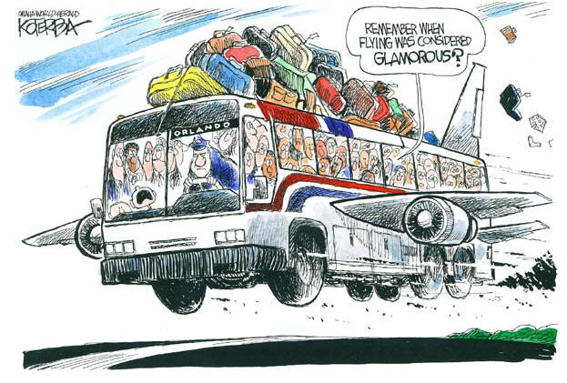
Air travel today

Slide 88
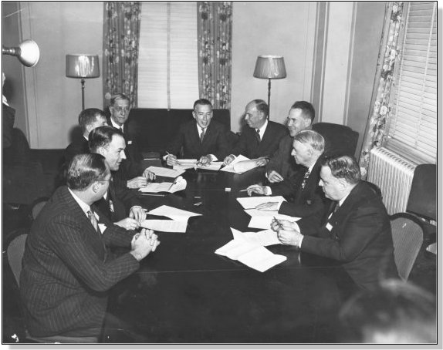
A managerial assessment of regulation
Civil Aeronautics Board, 1944

Slide 89
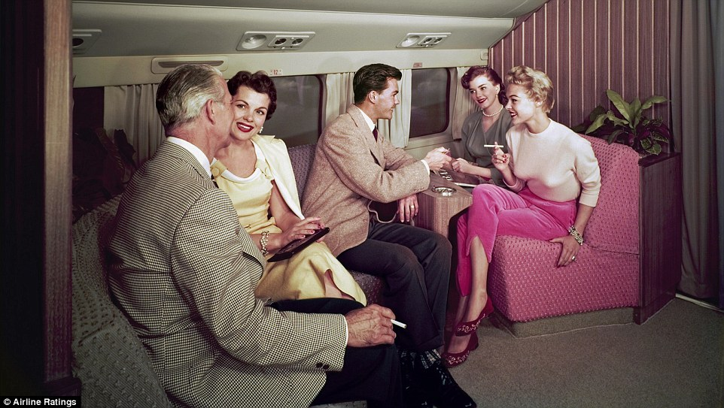
The Golden Age

Slide 90
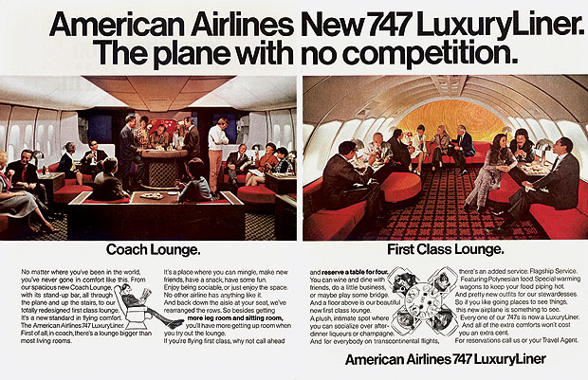
Air travel in the Golden Age

Slide 91
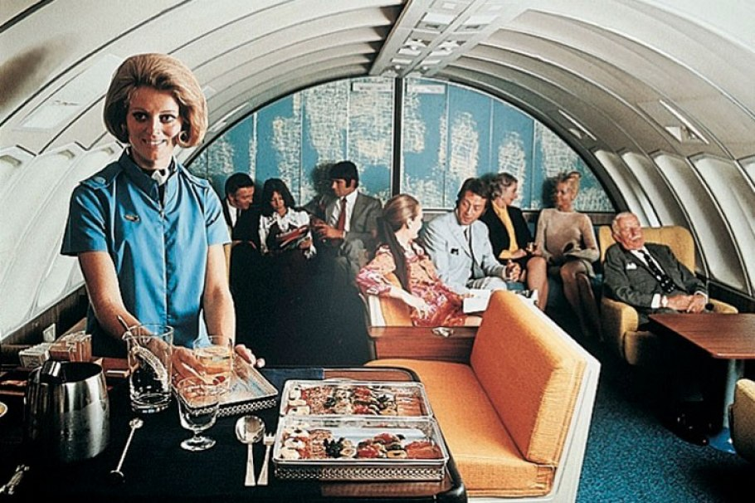
The Golden Age

Slide 92
The Golden Age

Slide 93
Too rich to care!

Slide 94
Developments…
1970s?
Managerial innovations?
Does this lead to profitability?
Maybe a glimmer of hope in Texas…

Slide 95

Looks promising.

Slide 96
Looks promising.

Slide 97
Looks promising.

Slide 98
Looks promising.

Slide 99
Looks promising.

Slide 100
Or not.
Explicit collusion nearly sends Crandall to prison (fortunately he was rich and had important friends)
With that, let’s fast forward twelve years…

Slide 101
New fare schedules: April 1992
Thomas Wollmann
thomas.wollmann@chicagobooth.edu

Slide 102
New system
What does Crandall propose?

Slide 103
Outcomes
{ United, Southwest, Delta, Continental, TWA, NWA }
Who do you think most likely plays along?
Who do you think doesn’t?
What do you think happens?

Slide 104
Airlines
OUTCOMES

Slide 105
Who plays ball?
United, Continental, Delta—all match
Southwest
“We’d have to raise fares to get those prices…”
Doesn’t go along—does it matter?
TWA
“Stands to lose [our] niche [we] had carved out for by pricing its full coach fare below the majors… TWA still studying American’s move late yesterday...” - WSJ
American does not retaliate

Slide 106
Northwest response
May 1992: NWA announces “adults fly free”
Adult and child together fly for price of one ticket
Why does this make sense?
Uh oh. What’s going on?
How should American respond?
Run their own program
Across-the-board discount
Ignore
What is worst—most spiteful—decision? (Bear in mind, he almost went to jail twelve years earlier…)

Slide 107
American responds
Late-May 1992
“NWA aimed a water pistol at American. American responded with water hose.” – WSJ
American lowers across-the-board
Others immediately match!
Entire industry fare structure unravels!
A million fare categories!!
Summer 1992: as unprofitable as ever!

Slide 108
American responds
Late-May 1992
“NWA aimed a water pistol at American. American responded with water hose.” – WSJ
American lowers across-the-board
Others immediately match!
Entire industry fare structure unravels!
A million fare categories!!
Summer 1992: as unprofitable as ever!

Slide 109
American responds
Late-May 1992
“NWA aimed a water pistol at American. American responded with water hose.” – WSJ
American lowers across-the-board
Others immediately match!
Entire industry fare structure unravels!
A million fare categories!!
Summer 1992: as unprofitable as ever!

Slide 110
Back to price wars
WSJ (paraphrased):
“Mr. Crandall, do you have a comment? What happened to your commitment to simple fares?”
Crandall:
“**** it.”
“We’re going to file every cockamamie fare anybody else wants to file…”
“We tried price leadership, but it didn’t work, so we are into death by a thousand cuts!”

Slide 111
Back to price wars
WSJ (paraphrased):
“Mr. Crandall, do you have a comment? What happened to your commitment to simple fares?”
Crandall:
“**** it.”
“We’re going to file every cockamamie fare anybody else wants to file…”
“We tried price leadership, but it didn’t work, so we are into death by a thousand cuts!!”

